Slide 1
The heavy investment in naval warfare by both Germany and Britain from 1906 resulted in both sides having new state-of-the-art warships by 1914. The main theatres of war were the North Sea, the Baltic, the Mediterranean and the Black Sea. The war at sea in World War 1 began conventionally with squadrons of warships seeking each other out on the high seas and also attacking merchant shipping.
Sea warfare changed after the Battle of Jutland on 31 May to 1 June 1916. In many ways the battle was indecisive but it was the last major fleet action between opposing battleships in World War 1. After that Germany concentrated on unrestricted submarine warfare.
Germany now attempted to enforce a blockade on Britain, mostly through the effectiveness of its U-boats. Being an island, Britain was extremely vulnerable to attacks on its supply lines. Neutral powers, in particular the United States before it entered the war, continued to send merchant shipping to Britain, often smuggling military equipment too, which was not allowed by international law. German efforts to enforce the blockade of Britain by sinking merchant shipping, even neutral ships, ultimately triggered the entry of the United States into the war in 1917 (or at least provided President Woodrow Wilson with a reason for declaring war).
Germany too was vulnerable, depending on the importing of food, coal and non-ferrous metals. Britain enforced a naval blockade on German ports from mid-1916 onwards.

Slide 2
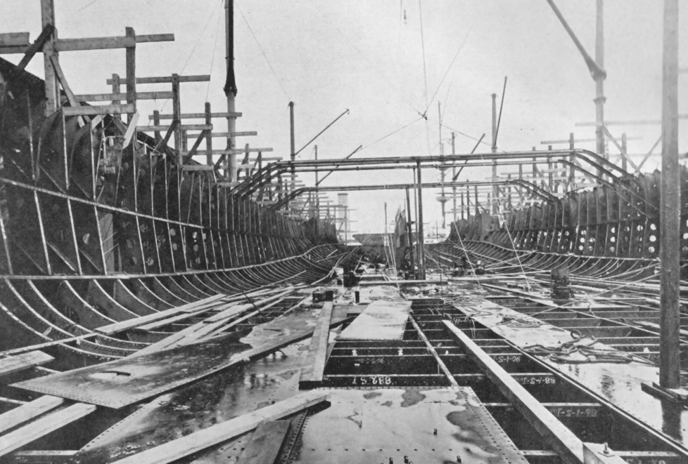
The Naval Arms Race
The beginning of the construction of HMS Dreadnought in 1905 at HM Portsmouth Dockyard.
(Public Domain)
History textbooks often focus on the Anglo-German naval arms race from 1898 to 1912. It is certainly the case that from 1898 onwards the Kaiser and his naval minister, Admiral Tirpitz, were aiming to create a battle fleet that could compete with Britain’s navy. The Kaiser saw this as essential if Germany was to be an important colonial power.
But the historian Christopher Clark has argued that “British policy makers were less obsessed with, and less alarmed by, German naval building than is often supposed.” He argues that Britain was equally concerned about the naval construction of all its potential rivals and not just Germany (The Sleepwalkers, London 2013, p.149).
In 1900 Britain had the largest navy but the next largest were the navies of France and Russia. Japan, with the help of British shipyards, was building a modern navy that in 1904-05 inflicted a major defeat on the Russian Pacific navy and the United States had started to modernize its navy before engaging in the Spanish-American War of 1898.
All the Great Powers that had a naval tradition were agreed that in the 20th century sea power was vital if they were to continue to be important international powers.

Slide 3
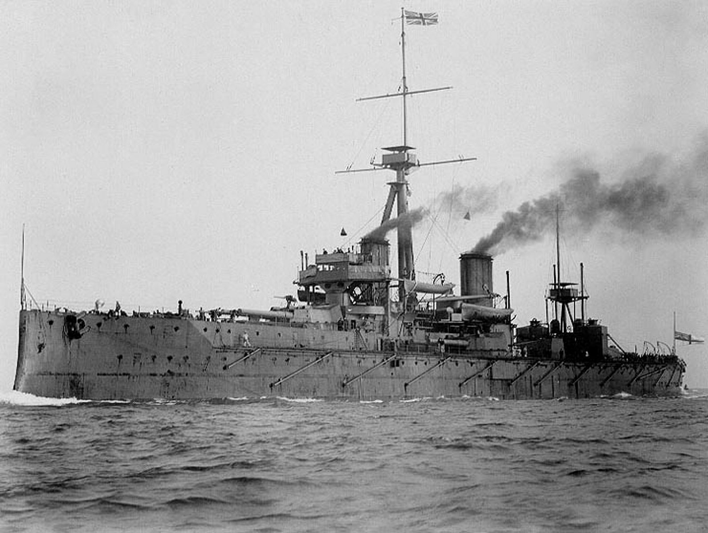
The HMS Dreadnought
HMS Dreadnought, commissioned for the British Royal Navy in December 1906 and taken out of service in 1919.
(Public Domain)
HMS Dreadnought was the first super-battleship to be built in the decade before the war and that is why it gave its name to the whole class, whether they were British, German, French, Russian, US or Japanese. She was the first major warship to be powered by steam turbine and had 10 long-range 305mm guns and 24 smaller 76mm guns for defending itself against enemy torpedo boats.

Slide 4
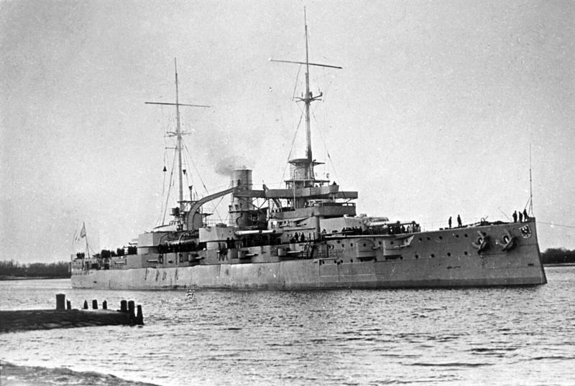
The SMS Rheinland
SMS Rheinland, commissioned for the German Imperial Navy.
(Public Domain)
The SMS Rheinland was one of the first Dreadnought-class battleships to be built for the German navy. It was commissioned in 1910. She saw active service in the North Atlantic and the Baltic and fought in the Battle of Jutland June 1916.

Slide 5
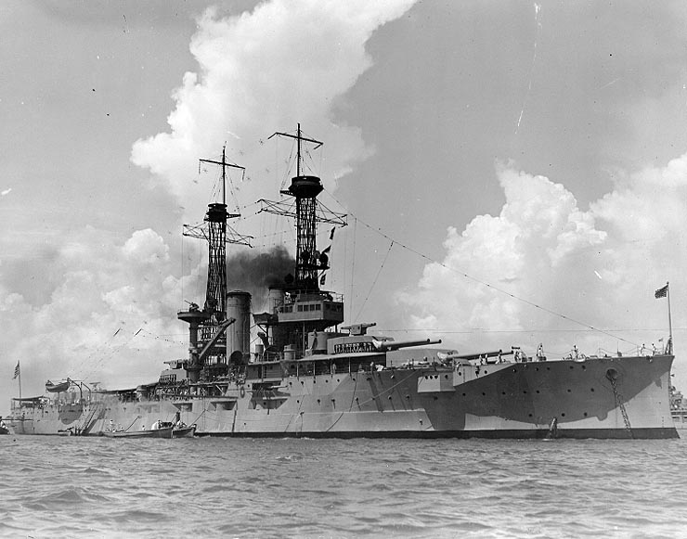
The USS Florida
USS Florida. A Dreadnought-class battleship commissioned in 1911.
(Public Domain)
The USS Florida was built in 1910 and commissioned in 1911. She had 10 large, long-range 305mm guns. After the United States entered the war she was sent to Europe and carried out patrols and convoy escort duties in the North Sea and North Atlantic. But the Florida never engaged with the German High Seas Fleet.

Slide 6
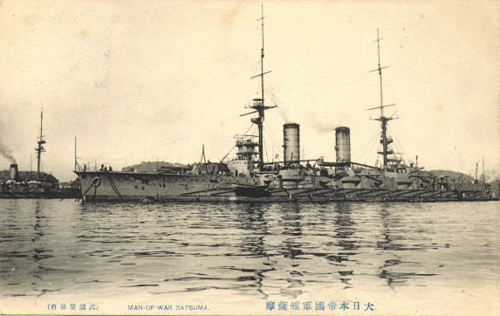
The IJN Satsuma
IJN Satsuma 1906.
(Public Domain)
In 1905 Japan began a programme of building new battleships armed with large guns. This is the Satsuma. It was launched one year before HMS Dreadnought. Japan was commissioning warships from the British at this time. But the Satsuma was built in Japan, although about 80 per cent of the materials were imported from Britain.

Slide 7
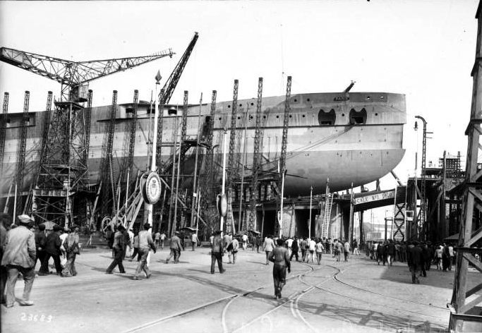
The Paris
Construction of Battleship Paris, 1912.
(Public Domain)
The Paris was one of four Dreadnought-class battleships built by France before the war. She was built in the shipyards of La Seyne-sur-mer on the Mediterranean coast near the city of Toulon. She was commissioned on 1 August 1914 and spent the war patrolling in the Mediterranean and the Adriatic.

Slide 8
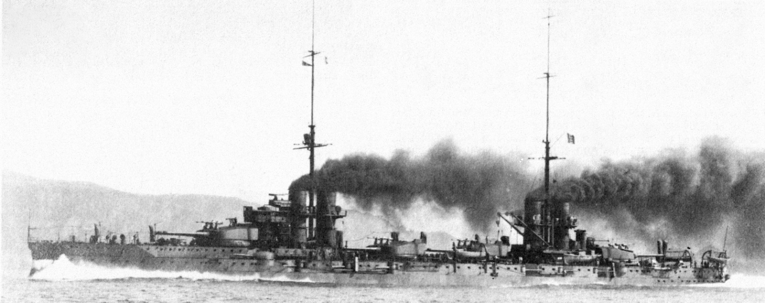
The Dante Alighieri
Italian battleship Dante Alighieri.
(Public Domain)
The Dante Alighieri was the first of four Dreadnought-class battleships built by Italy before the war. She was the flagship of the squadron based at Taranto at the south eastern end of the Italian Peninsula. She patrolled the Southern Adriatic and Ionian Sea and took part in the blockade of Austro-Hungarian ships based at Cattaro (now Kotor) in Montenegro.

Slide 9
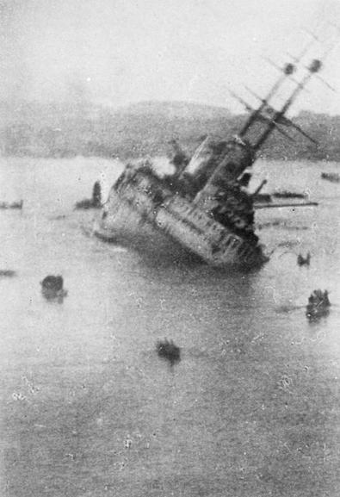
The SMS Viribus Unitis
SMS Viribus Unitis sinking on 1 November 1918.
(All Rights Reserved except for Fair Dealing exceptions otherwise permitted under the Copyright, Designs and Patents Act 1988, as amended and revised.)
The Austro-Hungarian SMS Viribus Unitis was the first of four Dreadnought-class battleships built for the Austro-Hungarian navy. She was commissioned in 1912. She took part in the bombardment of the Italian port of Ancona in 1915 and was sunk just a few days before the armistice on the Western Front by a limpet mine attached to her hull by Italian frogmen (divers).

Slide 10
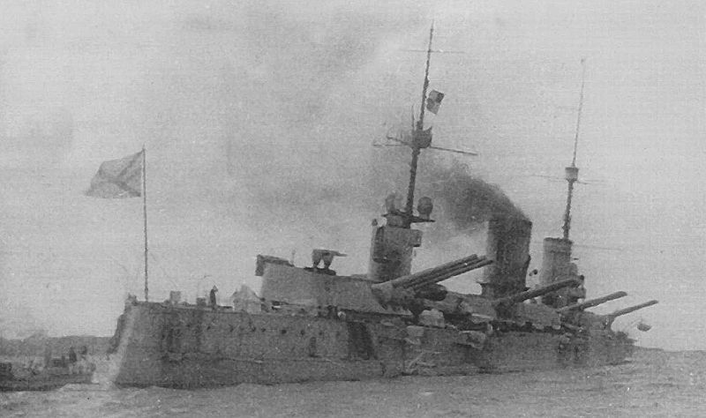
The Petropavlovsk
The Imperial Russian Battleship Petropavlovsk 1916.
(Public Domain)
The Russian battleship Petropavlovsk was the third of four dreadnought-class battleships to be built before the war. She was commissioned in 1915 and spent the war in the Gulf of Finland. Her crew joined the mutiny by the Russian Baltic fleet after the February Revolution in 1917.

Slide 11
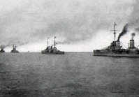
The German High Seas Fleet
A Battleship squadron of the German High Seas Fleet
(Public Domain)
By 1914 the German navy had three squadrons of Dreadnought-class battlecruisers, each comprising eight warships. The High Seas Fleet was under the command of Admiral von Ingenohl until after the Battle of Dogger Bank in January 1915, when he was replaced by Admiral von Pohl.

Slide 12
Naval battles on the High Seas
The Naval Arms Race from 1898 to 1914 was all about building a new generation of fast, heavily armed and heavily armoured warships to challenge for supremacy of the High Seas. Like all arms races there was an important element of deterrence in this. If a nation depended on merchant shipping for the importing of essential goods then it was vulnerable unless it had a powerful navy to protect its merchant ships from enemy attack.
But the focus on battleships also highlighted the fact that thinking about naval warfare in the first decade of the new century still reflected the prevailing naval strategy of the previous two centuries. Squadrons of battleships, destroyers and cruisers sailing the high seas to seek out enemy squadrons for set-piece battles.
The emergence of the submarine, and then airpower, significantly changed that strategy. But at the beginning of the war the navies of the Great Powers were still anticipating the kind of conventional naval warfare for which they had been trained.

Slide 13
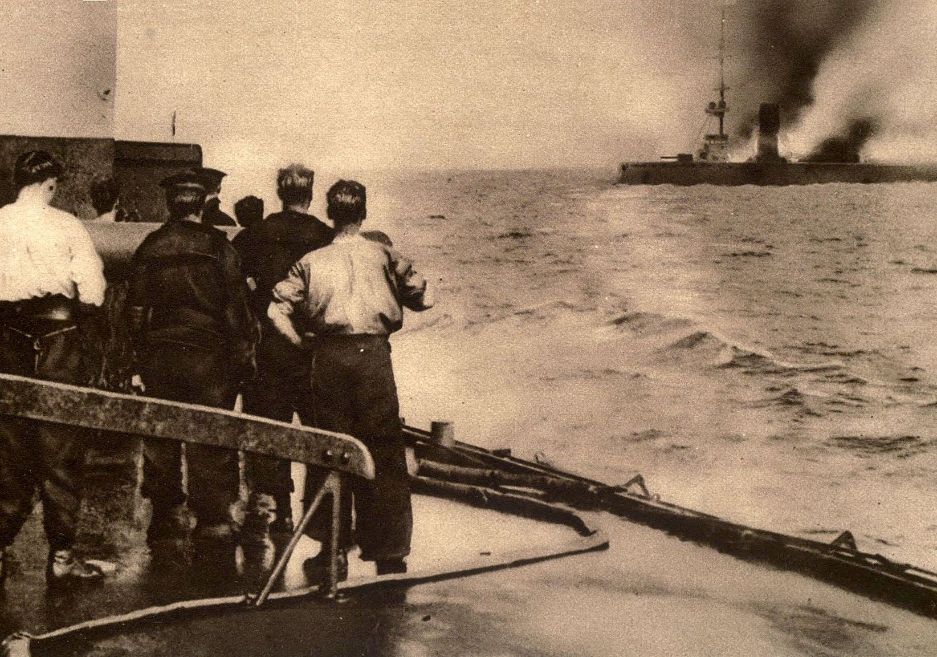
The Battle of Heligoland Bight
Sinking of the German Battlecruiser Mainz at the Battle of Heligoland Bight.
(Public Domain)
This was the first sea battle of World War 1, on 28 August 1914. Two British squadrons attacked German shipping near the German naval base of Heligoland. Having sunk two enemy torpedo boats a German squadron was sent to intercept them. Finding themselves outgunned the British squadron called for assistance from another squadron in the North Sea. The combined squadrons sunk three German cruisers, the Mainz, Köln and Ariadne and damaged others.

Slide 14
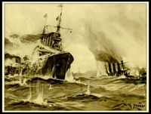
The battle of Coronel
The battle of Coronel, 01.11.1914.
(Europeana, Public Domain)
A German squadron commanded by Admiral Graf Maximilian von Spee had been attacking Allied merchant shipping in the South Pacific. Squadrons from the British and Japanese navies had orders to seek out and engage with the German squadron. The British West Indies fleet intercepted Spee’s fleet off the coast of Chile near the port of Coronel. The British were outnumbered and outgunned. Two British cruisers were sunk and a third was seriously damaged.

Slide 15
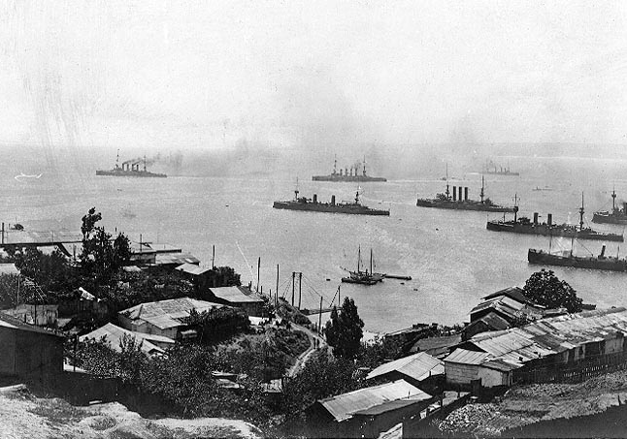
The Battle of Coronel
Admiral Graf von Spee’s squadron leaving Valparaiso, Chile after the Battle of Coronel and heading for the South Atlantic.
(Public Domain)
Admiral von Spee’s squadron now sailed into the South Atlantic unaware that a larger and better armed British squadron of battleships was re-fuelling at Port Stanley in the Falkland Islands in the South Atlantic. They intercepted the German squadron on 8 December sinking four cruisers, including Spee’s flagship, Scharnhorst. None of the British ships were damaged.

Slide 16
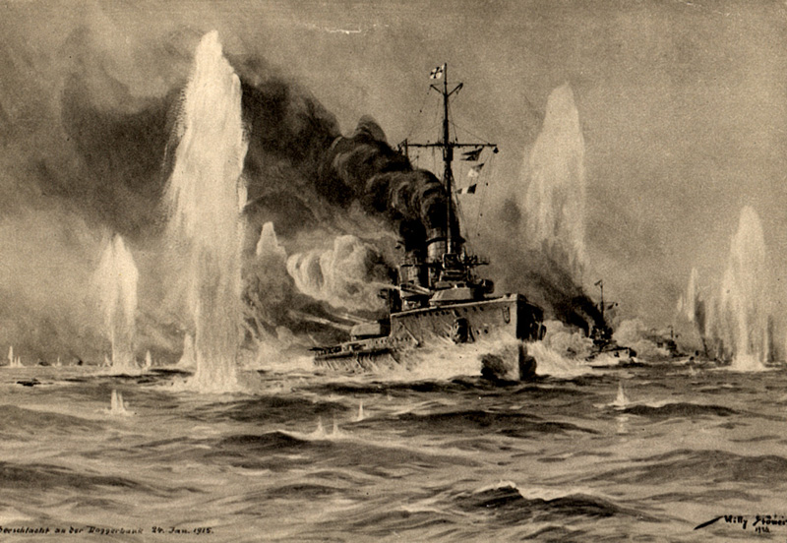
The Battle of Dogger Bank
German battlecruisers under attack during the Battle of Dogger Bank 24.01.1915.
(Postcard painted by Willi Stöwer, Public Domain)
By the end of 1914 the German navy was diverting most of its resources to submarine warfare but on 16 December 1914 a German naval squadron bombed three British coastal ports in the North East of England: Scarborough, Whitby and Hartlepool. The bombardment outraged public opinion in Britain. A month later the German High Seas Fleet decided to carry out another attack. This time they were intercepted by British warships in the North Sea off Dogger Bank on 24 January 1915. One battlecruiser was sunk and the German flagship Seydlitz was badly damaged

Slide 17
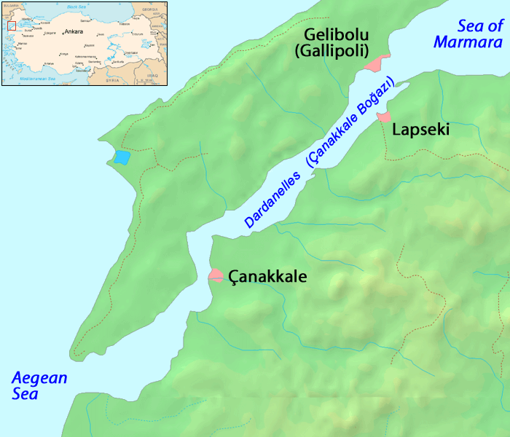
The Dardanelles
Map of the Dardanelles, 1915.
(Public domain)
When Germany declared war on the Entente Powers the Ottoman Empire was still neutral and under international law it was required to close the Dardanelles to warships from all sides. When it entered the war on the side of the Triple Alliance Ottoman warships bombarded Russian ports in the Black Sea. The Allies decided to launch a naval campaign against the Dardanelles to open the Straits for the Russian Black Sea fleet and force the Ottoman Empire to the negotiating table.

Slide 18
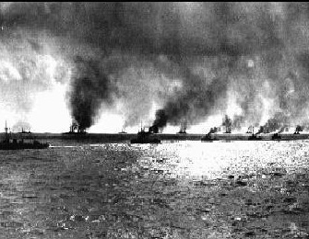
The Dardanelles
Allied fleet in the Dardanelles, 18.03.1915.
(Public Domain)
On 19 February 1915 Two Allied destroyers entered the Straits and exchanged fire with Ottoman forts guarding the entrance. Another sortie was made on 25 February when four Allied battleships attacked the forts. But the main Allied naval assault was delayed until 18 March. After the February assaults the Ottoman navy had noticed that the Allied ships fired a salvo and then turned to starboard (turned right) to withdraw as the next line of ships moved in to fire. So the Ottoman navy laid new mines on the Asian side of the Straits (on the starboard side of the enemy ships entering the straits). The Allies failed to notice the new mines with disastrous results.

Slide 19
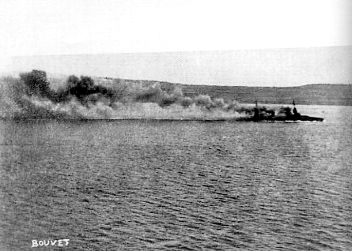
The Dardanelles
(Public Domain)
Unaware of the new minefields on the Asian side of the straits, the French Battleship Bouvet turned to starboard, hit a mine and sank within two minutes with all hands lost.

Slide 20
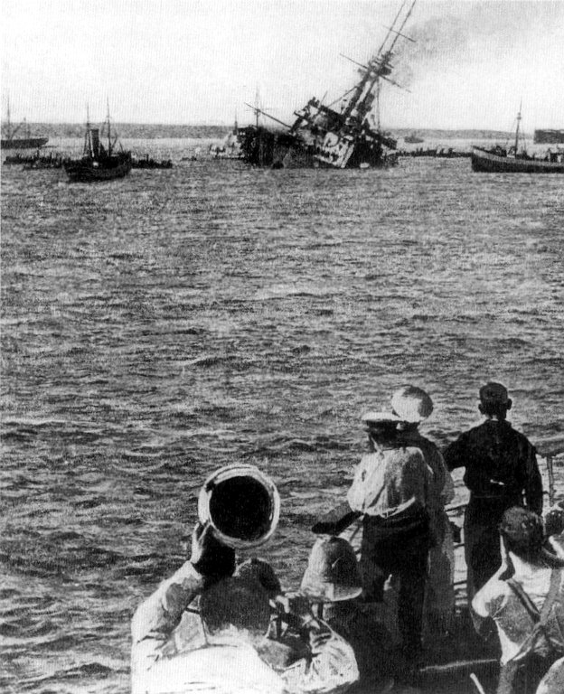
The Dardanelles
The sinking of HMS Majestic off the Dardanelles, 27 May 1915
"Two days later (27 May 1915) we discovered the Majestic near the coast. Looking through the periscope, I saw the men on board the ship enjoying their lunch. I hesitated a moment, thinking to give them time to finish their meal, but then I remembered I was here to do my duty. I gave orders to fire the deadly torpedo. I had to do it. We submerged again, and, coming to the surface after a while, we saw the ship bottom up.”
British Battleship HMS Majestic, hit by a torpedo fired by U-Boat 21 about to roll over and sink. Other Allied ships are moving in to rescue the crew.
(Public Domain)
Letter by Captain Otto Hersing of the U-21.
(War Letters 1914–1918, Vol. 2, dated September 1915.)

Slide 21
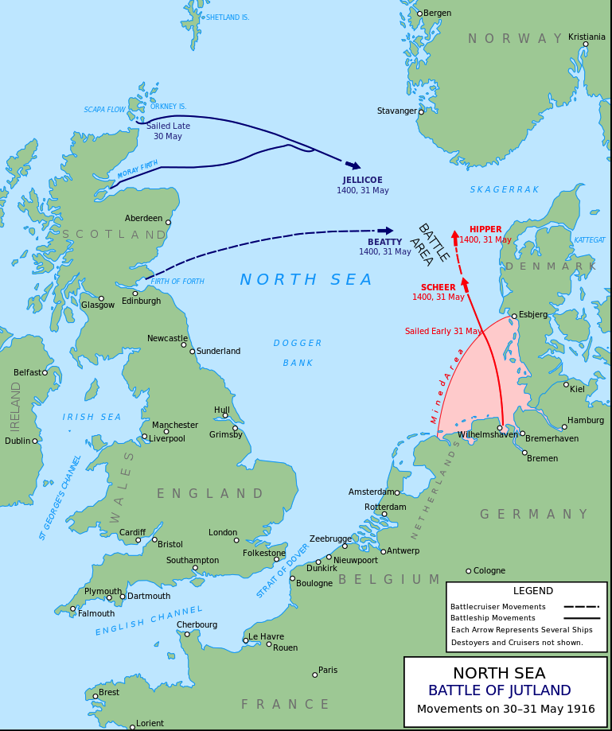
The Battle of Jutland
Battle of Jutland, 30-31 May 1916.
(Creator: Grandiose, CC Attribution-Share Alike 3.0)
This was the last and the biggest surface naval battle between the British and German navies of World War 1. The German High Seas Fleet left its port of Wilhelmshaven with the aim of bombing British coastal towns in the north east. Their wireless communications were intercepted and British fleets sailed from Scapa Flow in Orkney, Cromarty near Inverness and the Firth of Forth near Edinburgh. The fleets met off Jutland, the northern peninsula of Denmark.

Slide 22
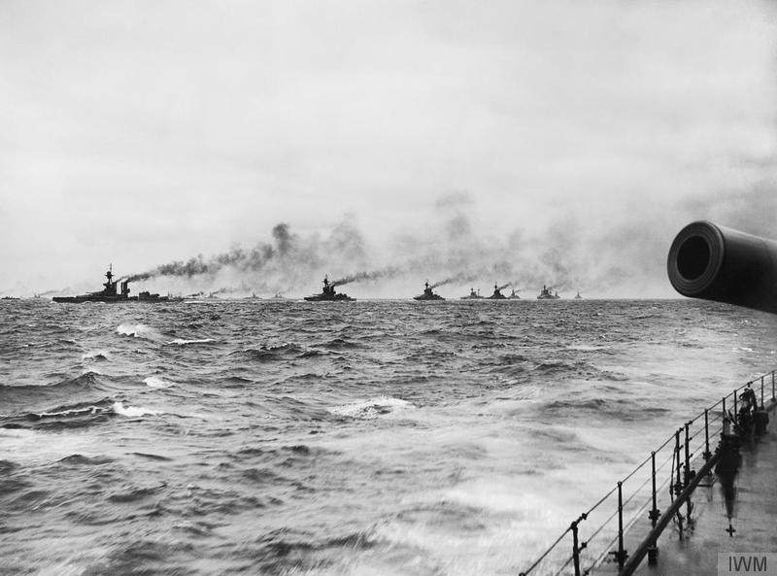
The Battle of Jutland
The British Grand Fleet in the North Sea, 1916.
(IWM, this item is available to share and reuse under the terms of the Imperial War Museum Non-Commercial Licence)
In the battle of Jutland on 31 May- 1 June, 1916, the German High Seas Fleet lost two battleships, four cruisers and five destroyers. The British Grand Fleet lost three battlecruisers: HMS Queen Mary, the Indefatigable and the Invincible, as well as several armoured cruisers and destroyers. The remaining British warships outgunned the remaining German ships and so the Germans retreated back towards Wilhelmshaven. Fearing an attack by German torpedo boats Admiral Jellicoe did not pursue and destroy. However, from that point the German High Seas Fleet remained blockaded in port.

Slide 23
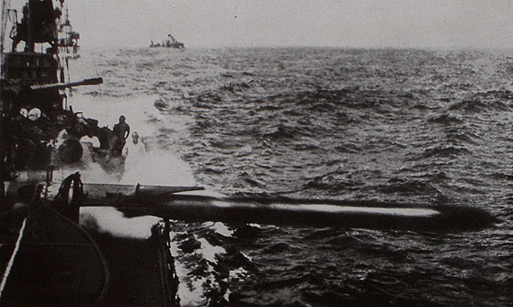
The Battle of Jutland
German torpedo boat firing a torpedo at the Battle of Jutland, 31.05.1916.
(Public Domain)

Slide 24
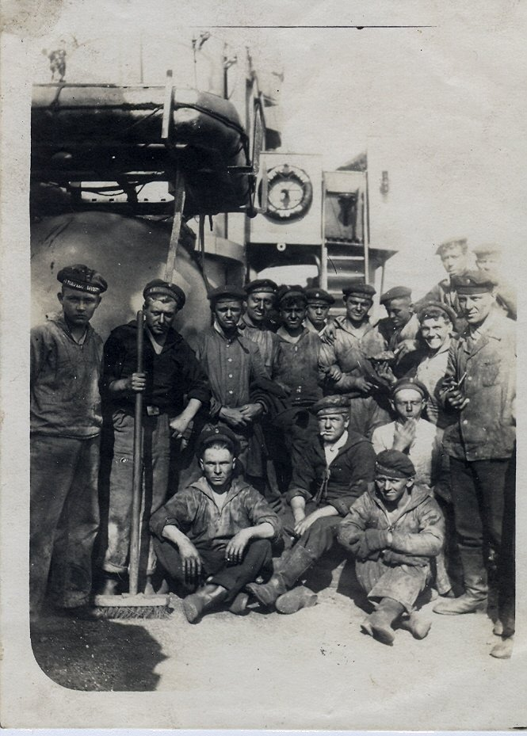
The Battle of Jutland
Members of the surviving crew of SMS Seydlitz returning to port. 01.06.1916.
(Public Domain)
The German battlecruiser SMS Seydlitz was hit 21 times by shells and torpedoes; 98 of her crew were killed and 55 wounded. The damaged ship with her surviving crew returned to the German port of Wilhelmshaven.

Slide 25
The Battle of Jutland
During the afternoon, between Skagerrak and Horn Reef, a heavy engagement developed, which was successful to us, and which continued during the whole night.
In this engagement, so far as known up to the present, there were destroyed by us the large battleship Warspite, the battle-cruisers Queen Mary and Indefatigable, two armoured cruisers, apparently of the Achilles type; one small cruiser, the new flagships of destroyer squadrons, the Turbulent, Nestor, and Alcaster, a large number of torpedo-boat destroyers, and one submarine….
On our side the small cruiser Wiesbaden, by hostile gunfire during the day engagement, and his Majesty's ship Pommern, during the night, as the result of a torpedo, were sunk.
The fate of his Majesty's ship Frauenlob, which is missing, and of some torpedo boats, which have not returned yet, is unknown.
Extract from the First Official German Statement on the Battle of Jutland, 31 May- 1 June, 1916
Berlin, June 1, 1916
(Records of the Great War, Vol. IV, edited by Charles F. Horne and Walter F. Austin, New York: National Alumni, 1923)

Slide 26
The Battle of Jutland
The battle-cruisers Queen Mary, Indefatigable, and Invincible, and the cruisers Defence and Black Prince were sunk.
The Warrior was disabled, and after being towed for some time had to be abandoned by her crew. It is also known that the destroyers Tipperary, Turbulent, Fortune, Sparrowhawk, and Ardent were lost, and six others are not yet accounted for. No British battleships or light cruisers were sunk.
The Commander-in-Chief also reports that it is now possible to form a closer estimate of the losses and the damage sustained by the enemy fleet.
One dreadnought battleship of the Kaiser class was blown up in an attack by British destroyers and another dreadnought battleship of the Kaiser class is believed to have been sunk by gunfire.
Of three German battle-cruisers, two of which are believed were the Derfflinger and the Luetzow, one was blown up, another was heavily engaged by our battle fleet and was seen to be disabled and stopping, and the third was observed to be seriously damaged.
One German light cruiser and six German destroyers were sunk, and at least two more German light cruisers were seen to be disabled. Further repeated hits were observed on three other German battleships that were engaged. Finally, a German submarine was rammed and sunk.
Extract from the First Official British Statement on the Battle of Jutland, 31 May- 1 June 1916
London, June 2, 1916
(Records of the Great War, Vol. IV, edited by Charles F. Horne and Walter F. Austin, New York: National Alumni 1923)

Slide 27
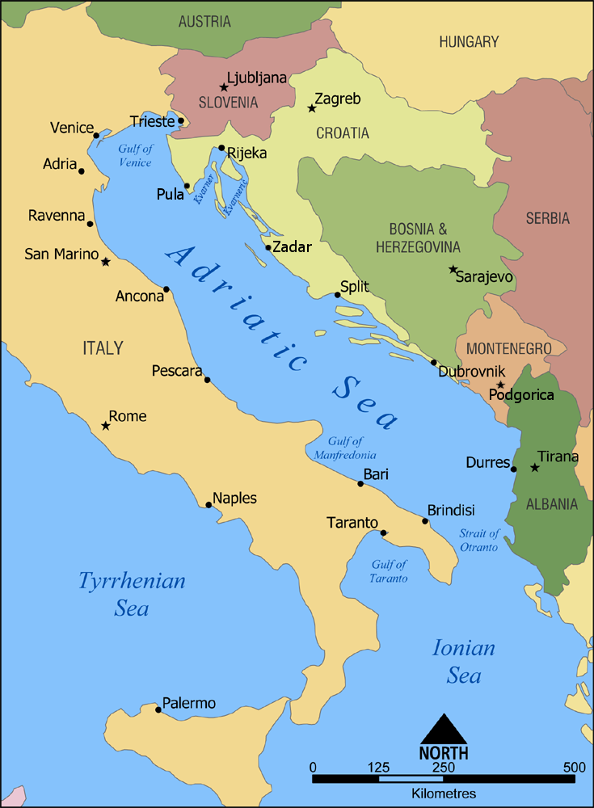
The Battle of the Strait of Otranto
As this map shows, the Strait of Otranto separates the Adriatic from the Ionian Sea and the Mediterranean. In 1915 the Allies had constructed a barrage across the narrow 72km-wide strait to prevent the Austro-Hungarian navy from accessing the Mediterranean. The barrage consisted of more than 50 small boats (like trawlers) known as ‘drifters’ because they were designed to use drift nets. The barrage stretched across the Strait with steel mesh nets to stop submarines. The ‘drifters’ were also armed with 15mm guns, mines and depth charges. They were supported by 35 destroyers.
Battle of the Strait of Otranto, 14-15 May 1917
(CC Attribute Share-Alike 3.0)

Slide 28
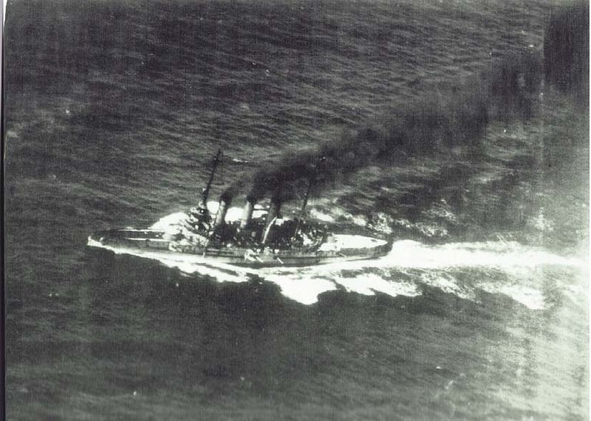
The Battle of the Strait of Otranto
Austro-Hungarian armoured cruiser, SMS Sankt Georg.
(Public Domain)
On 14-25 May 1917 the Allied Otranto barrage across the Strait was attacked by a force of Austro-Hungarian cruisers and destroyers, commanded by Captain Miklós Horthy. An Allied force of destroyers came to defend the barrage. Horthy’s squadron was then joined by more Austro-Hungarian warships and U-boats. Several ‘drifters’ and an Allied destroyer were sunk and others badly damaged. When more Austro-Hungarian cruisers and U-boats led by the armoured cruiser SMS Sankt Georg joined the battle the Allied ships withdrew and the Austro-Hungarian fleet returned to port.
Captain Horthy was subsequently promoted to Admiral and, in the inter-war years, became a dictatorial Regent of the Kingdom of Hungary and an ally of the National Socialist regime in Germany.

Slide 29
Submarine Warfare
By 1900 all the main sea-going powers were engaged in trials of under-water ships but the prototypes seemed too vulnerable to be effective in conventional naval warfare. At this time navies tended to be commanded by Admirals who had served their time on board battleships and believed that naval supremacy was achieved through large-scale set piece battles. To them, submarine warfare ignored the conventional rules of naval combat. When the international powers met in the Hague in 1899 and again in 1907 they discussed proposals to prohibit submarine warfare but could not agree on the steps to be taken.
By 1914 it was assumed that, if submarines were used at all, it would be against enemy warships rather than merchant shipping. But this situation changed in March 1913, when the British government announced that it would arm its merchant ships for defensive purposes. This changed their status. Historically, enemy merchant ships could be sunk if carrying weapons, munitions and contraband but not before all persons on board were taken to safety. But, now in time of war, they would no longer be unarmed non-combatant ships. This set a precedent that was later used by the German navy to justify unrestricted submarine warfare. In February 1915 Germany decided that it needed to use its U-boats (Unterseeboote) to stop the flow to Britain of weapons, ammunition and essential goods from its Empire and the United States. All enemy and neutral merchant ships entering waters around Britain would be sunk without warning. This began an eight-month campaign in which U-Boats sank many Allied and neutral merchant ships. The US threat to sever diplomatic relations with Germany in April 1916 led to a suspension of unrestricted submarine warfare but it started again in January 1917 when the German government believed that it could not win the war without unrestricted submarine warfare.

Slide 30
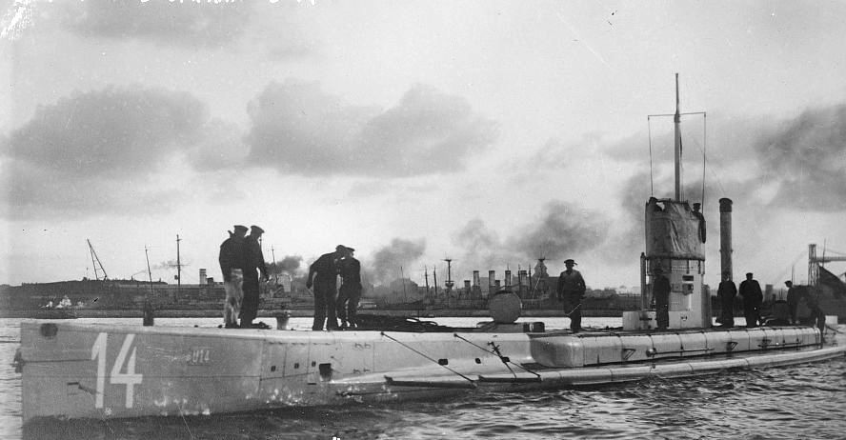
The U-Boat 14
U-Boat 14 launched in 1911 and commissioned by the German Navy in April 1912.
(Public Domain)
The U-Boat 14 saw action in the North Sea where it sunk two cargo ships heading for Britain: a Danish steamer, the Cyrus and a Swedish cargo boat, Lapland. U-14 was sunk off the north east coast of Scotland on 5 June 1915.

Slide 31
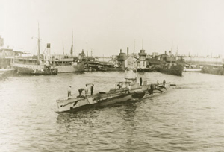
The E19
British submarine E19 in the port of Tallinn, Estonia.
(Public Domain)
The E19 was commissioned in 1914 and after a short period of patrolling in the North Sea was sent to join the British submarine flotilla in the Baltic. She sank several German freighters and SMS Urdine. Along with six other British submarines of the Baltic flotilla she was scuttled off Helsinki by her crew on 8 April 1918 to avoid capture by German forces.

Slide 32
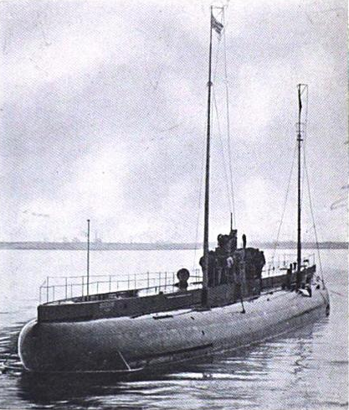
The Deutschland
German U-boat Deutschland (U-155).
(Public Domain)
Deutschland was just one of two U-boats that were privately commissioned in 1916 by German businessmen. It was an unarmed cargo submarine designed to break the Allied blockade of German ports by bringing in supplies beneath the blockading ships and minefields. On 19 February 1917 she was commissioned by the Imperial German Navy and became the U-155 armed with six torpedo tubes and a deck gun. In this role she was highly successful, sinking 43 Allied and neutral ships before surrendering on 24 November 1918.

Slide 33
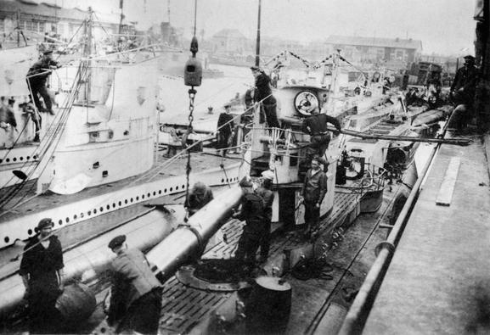
Torpedos
Loading torpedoes aboard a U-Boat of the German Flanders Flotilla at Zeebrugge, Belgium 1917.
(IWM, all Rights Reserved except for Fair Dealing exceptions otherwise permitted under the Copyright, Designs and Patents Act 1988, as amended and revised)
The main weapon of all the armed submarines on both sides in World War 1 was the torpedo. This was a self-propelled tube with an explosive warhead that could be launched above or below the surface. It detonated on contact with or near by its target.

Slide 34
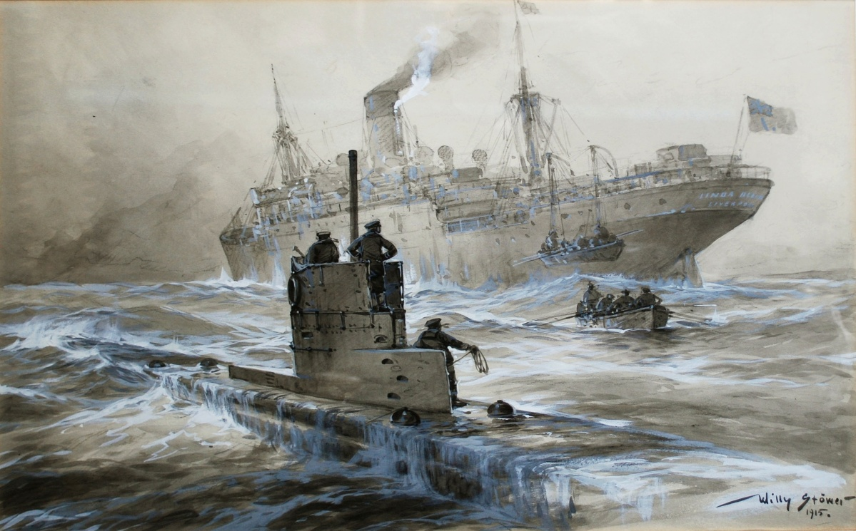
The sinking of SS Linda Blanche
The sinking of SS Linda Blanche by U-21 on 30 January 1915.
(Public Domain)
Here we see another postcard by the prolific German artist, Willi Stöwer. It depicts the sinking of a British cargo ship sailing out of Manchester and heading for Belfast. She was carrying general cargo rather than munitions. This was early in the first U-boat campaign. There were no casualties and, according to the artist, the U-boat helped to rescue the Linda Blanche’s crew.

Slide 35
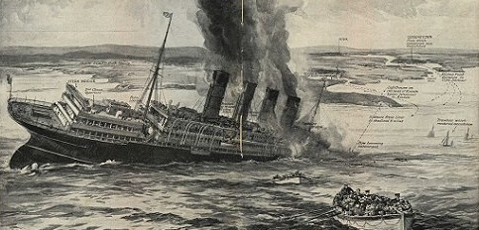
The sinking of RMS Lusitania
Illustration of the sinking of RMS Lusitania on 1 May 1915, reproduced in The Sphere, 15 May 1915.
(Public Domain)
By May 1915 the German Navy’s policy of unrestricted submarine warfare took a darker turn. On 1 May the British passenger liner was sunk by U-20 off the coast of Ireland. Over 1000 passengers and crew died including 128 Americans. This caused outrage on both sides of the Atlantic. The illustration shows Irish fishermen arriving on the scene to rescue survivors.

Slide 36
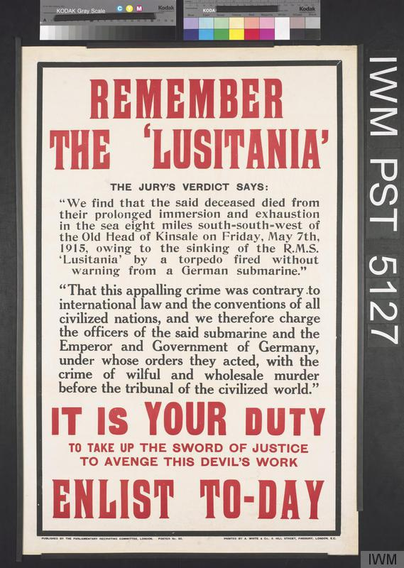
The sinking of RMS Lusitania
The sinking of RMS Lusitania with such loss of civilian life was presented as a war crime on both sides of the Atlantic, as this poster indicates. Germany defended itself by alleging that the Lusitania was carrying munitions to Britain. The USA threatened to sever diplomatic relations with Germany and in response the German government (temporarily) suspended unrestricted submarine warfare.
(IWM, this item is available to share and reuse under the terms of the Imperial War Museum Non-Commercial Licence)

Slide 37
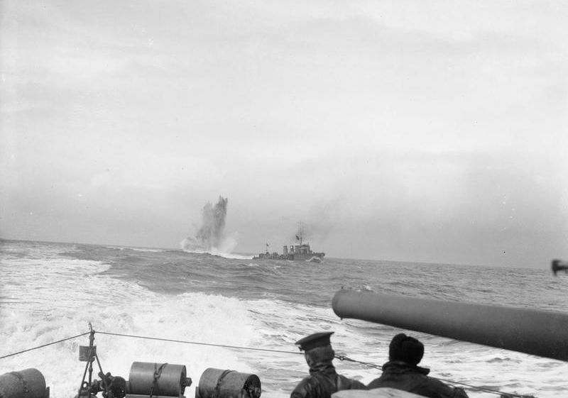
The HMS Tempest
British destroyer, HMS Tempest, dropping depth charges, 1918
(IWM, this item is available to share and reuse under the terms of the Imperial War Museum Non-Commercial Licence)
As submarine warfare developed so it became necessary to develop anti-submarine devices and tactics.
Steel mesh nets were used to create underwater barriers; minefields were laid, early hydrophones were used to detect submarines below the surface and some destroyers were equipped with depth charges (the drums that can be seen aft of the deck of HMS Tempest off the east coast of England.
The depth charges would explode under water near the submarine creating a massive shock that could disable the boat.

Slide 38
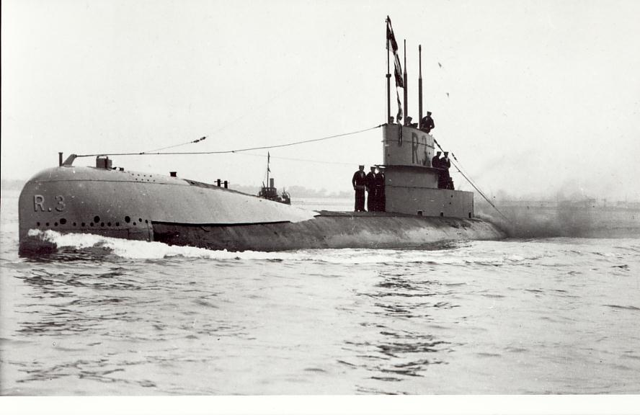
The R3
British Submarine R3: The emergence of the Hunter-Killer submarine.
(Public Domain)
For most of World War 1 the role of submarines was to seek out battleships, cruisers and destroyers and convoys of merchant shipping, surface and fire their torpedoes. They did not have the capacity to fight enemy submarines below the surface. However, towards the end of the war the British began to develop the R-Class. Highly streamlined, they were faster below the water than they were on the surface. They could fire their torpedoes when submerged and they were equipped with an early form of hydrophone to pick up acoustic echoes in the water. The hydrophone had been developed after the Titanic had hit an iceberg and they could detect icebergs up to 3km away. Now, in wartime they had an aggressive role as well. The R-class submarines were commissioned too late in the war to have much impact but became the prototype for the next generation of submarines.

Slide 39
Convoy duty
After the Battle of Jutland when the Imperial German Navy’s surface ships had returned to port and after the allies had constructed the Otranto Barrage to prevent Austro-Hungarian warships from leaving the Adriatic the purpose of the Allied surface ships inevitably changed. Some were used to enforce the blockading of German and Austrian naval and commercial ports and some became raiders on the high seas, seeking out and destroying enemy merchant shipping. But for most Allied battlecruisers and destroyers the main task for the rest of the war was convoy duty to protect allied and neutral merchant shipping from U-boat attacks.

Slide 40
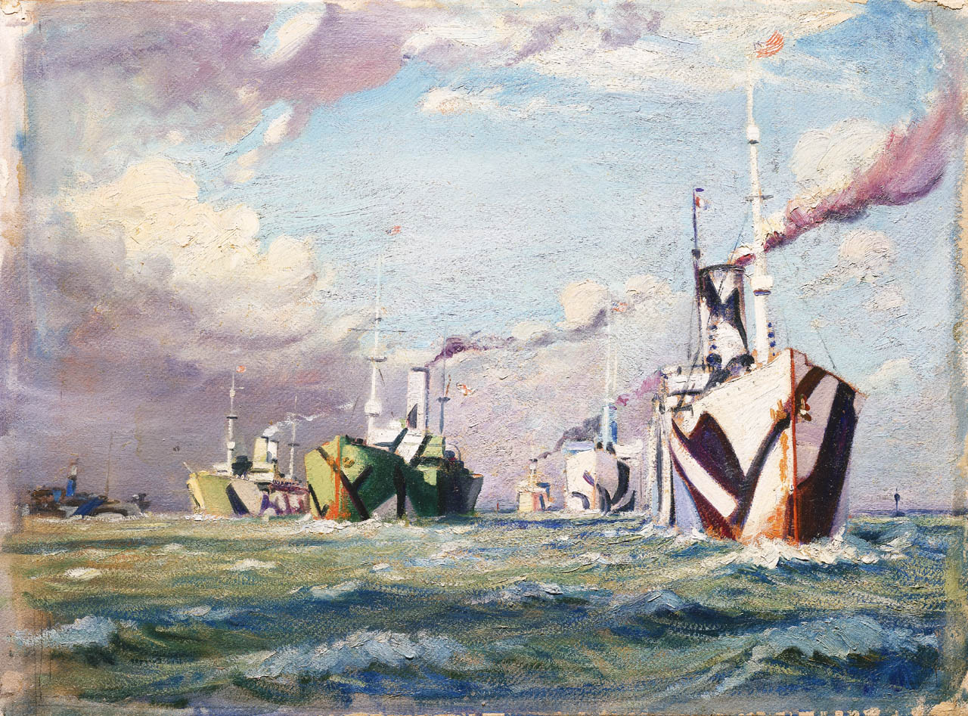
The dazzle camouflage
Painting of a convoy of ships crossing the Atlantic during World War 1.
(A Convoy, 1918. Everett, John. 1918. Repro ID: L8376. © National Maritime Museum Collections)
This painting by John Everett, created some time in 1918, shows the dazzle camouflage (called ‘razzle dazzle’ in the United States) that was designed to confuse the enemy. The intention was to make it difficult for enemy destroyers and U-boats to estimate the direction, range and speed of each target ship. The ship in the foreground is flying the flag of France and the American Stars and Stripes, which suggests that it was a troop carrier.

Slide 41
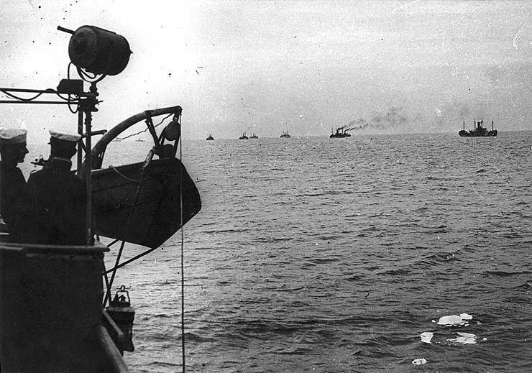
Transatlantic convoys
Transatlantic convoy approaching the French port of Brest, 1 November, 1918.
(Public Domain)
This photograph, taken from a convoy escort ship, USS Rambler, shows the typical distance maintained between the ships.

Slide 42
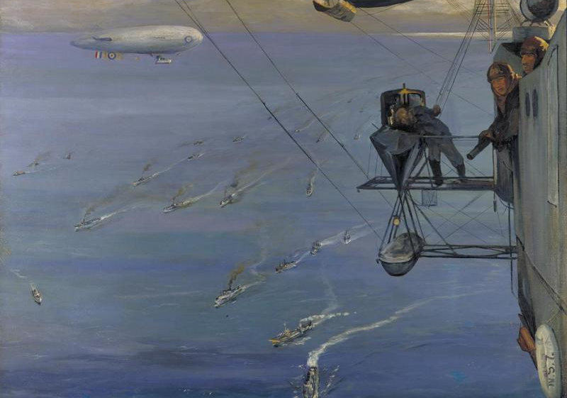
Convoys in the North Sea
Aerial view of a convoy in the North Sea off the coast of Norway, 1918.
(Sir John Lavery. IWM, this item is available to share and reuse under the terms of the IWM Non Commercial Licence)
Painting by John Lavery. The aerial view of the convoy is taken from an airship. Another airship can be seen in the background.

Slide 43
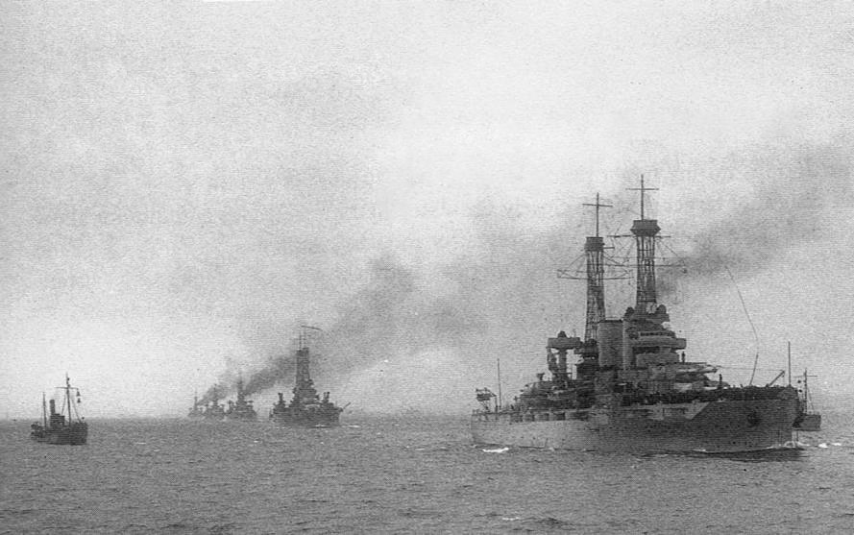
Convoys in the North Sea
United States Battleship Division Nine arriving at the port of Rosyth in Scotland, having crossed the Atlantic to carry out convoy duties in the North Sea.
(Public Domain)

Slide 44
Convoys in the North Sea
Whether ships’ crews were on convoy duty, seeking out enemy shipping, blockading an enemy port or submerged below the surface of the sea there could be long hours when very little seemed to be happening. Crews on duty always needed to be alert for enemy shipping, changing weather conditions and other hazards but off duty they needed to relax and forget the war for a few hours. And they needed to keep fit and healthy.

Slide 45
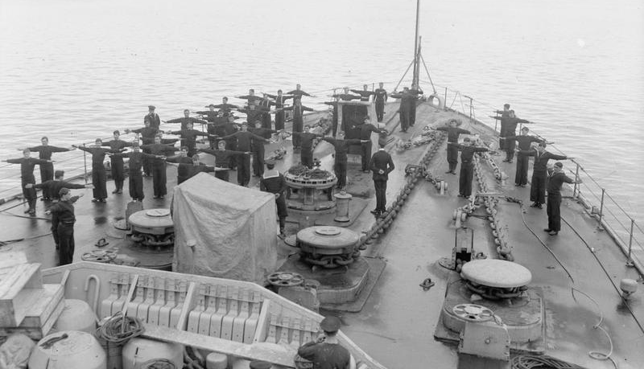
Physical exercise
Marines and naval ratings (ordinary seamen) getting physical exercise on the forecastle (front upper deck) of HMS Royal Oak during wartime.
(IWM, this item is available to share and reuse under the terms of the Imperial War Museum Non-Commercial Licence)

Slide 46
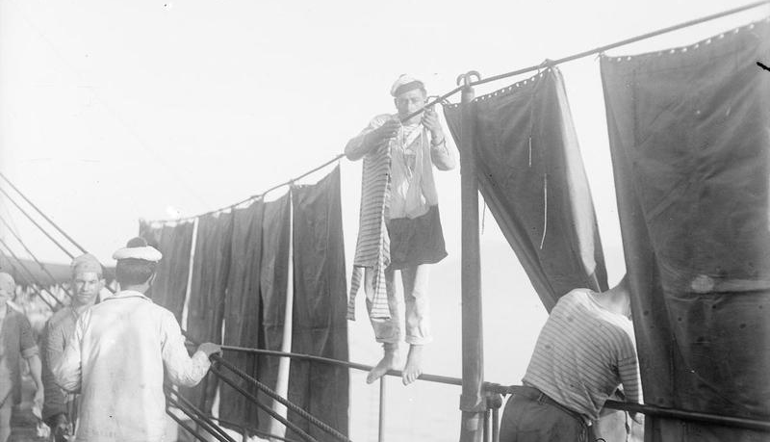
Washing clothes
French sailors washing clothes on deck.
(IWM, this item is available to share and reuse under the terms of the Imperial War Museum Non-Commercial Licence)

Slide 47
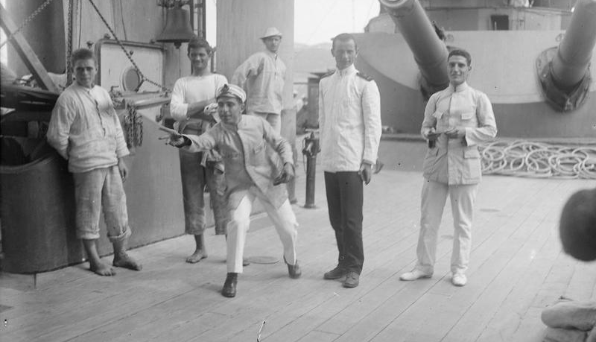
Leisure time
Italian crewmen playing quoits on deck during leisure time.
(IWM, this item is available to share and reuse under the terms of the Imperial War Museum Non-Commercial Licence)

Slide 48
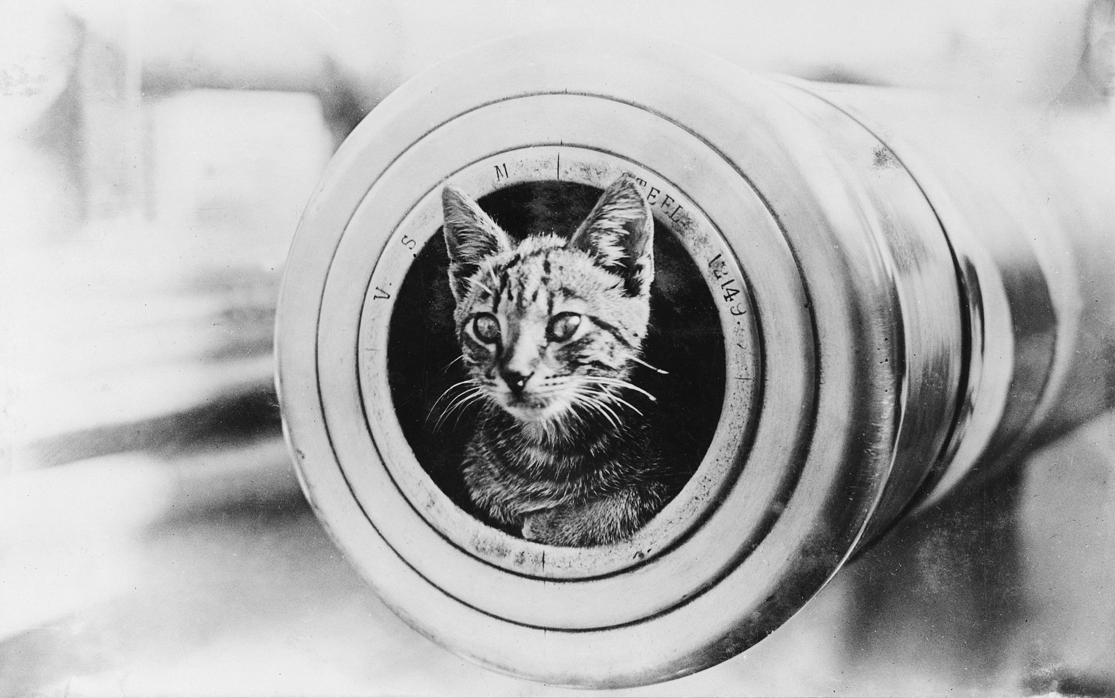
The ship’s cat
The ship’s cat of Australian warship HMAS Encounter watches life on board from the muzzle of a 150mm gun.
(Public Domain)

Slide 49
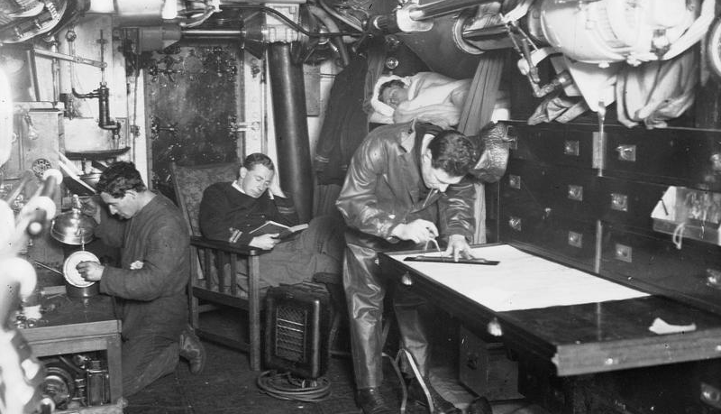
Leisure time
Lieutenant Palleyne reading in the wardroom of British submarine HMS E34, while another officer plots their course.
(IWM, this item is available to share and reuse under the terms of the Imperial War Museum Non-Commercial Licence)

Slide 50
The evolution of the aircraft carrier
Even in the 19th century some warships had been carrying a large balloon or kite which would be used as an observation post for the fleet. But the first main breakthrough was the invention of the seaplane that had floats instead of wheels. Not long afterwards navies began to experiment with the conversion of cargo ships to carry a number of seaplanes. Usually a hangar would be built on the deck with a crane that would winch the seaplane down to sea level and then back up again after a flight. The first successful conversion was the French ship Foudre. The main role of these planes was scouting for the enemy fleet or for enemy merchant ships and convoys.
The first flat deck carrier from which wheeled airplanes could take off was launched on 5 September 1914. At first these carriers still carried seaplanes as well as wheeled planes. The problem of wheeled airplanes returning to the ship and landing on the deck after a sortie had not yet been solved. Squadron Leader E.E. Dunning became the first pilot to land a conventional plane on the deck of a moving warship on 2 August 1917 when he successfully landed on HMS Furious. He was killed attempting a second landing 5 days later.
It was not until the inter-war years that purpose-built aircraft carriers with full length flight decks were designed and built and wheeled airplanes could regularly take off, return and land on deck. Only then did aircraft carriers begin to play a really significant role in the tactics of naval warfare.

Slide 51
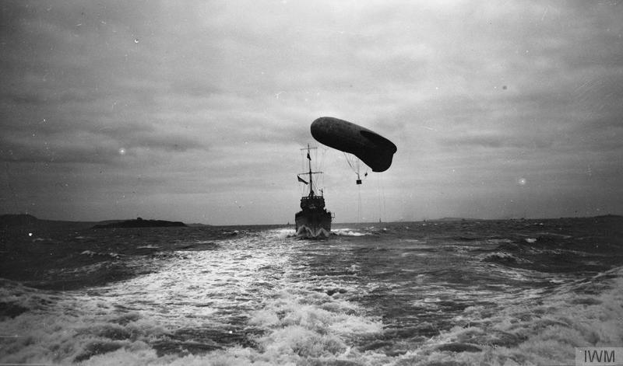
Observer kite balloons
British Destroyer, HMS Moresby towing an observer kite balloon, 1917.
(IWM, this item is available to share and reuse under the terms of the Imperial War Museum Non-Commercial Licence)

Slide 52
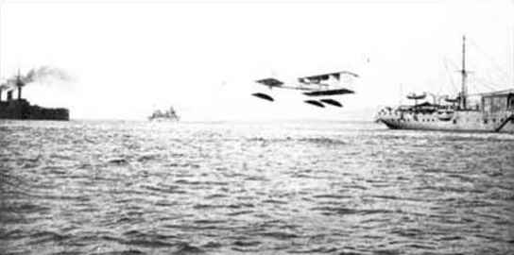
Seaplanes
A French Voisin-Canard Seaplane taking off from the carrier Foudre during a training exercise in June 1912.
(Public Domain)

Slide 53
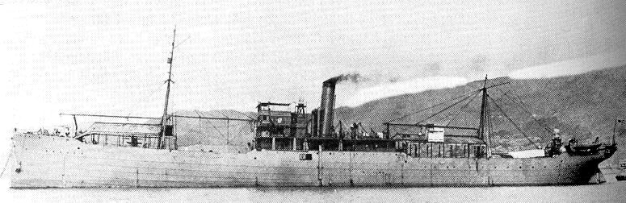
IJN Wakamiya
IJN Wakamiya, 1914 equipped with four French seaplanes.
(Public Domain)
The Japanese ship Wakamiya was a converted cargo ship commissioned on 1 August 1914. It carried out the first successful air raids launched from a warship when its seaplanes carried out two sorties in September 1914. The first was a bombing raid on the port of Tsingtao; the second was a bombing raid on German troops in the area outside the port.

Slide 54
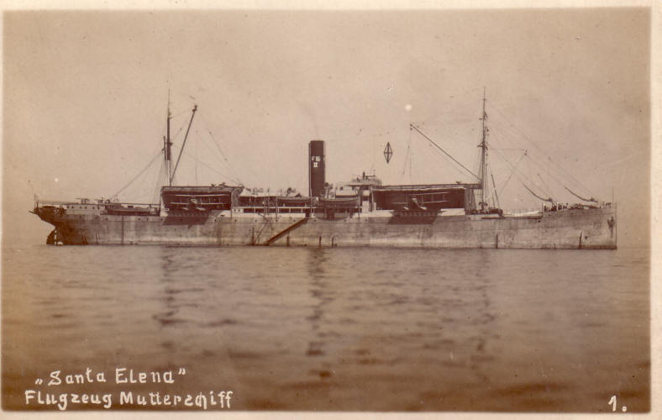
SMH Santa Helena
SMH Santa Helena, one of the first German cargo ships to be converted into a seaplane tender (or carrier).
(Public Domain)
The Santa Helena was converted into a seaplane tender in 1914 and commissioned on 1 July 1915. She operated mainly in the Baltic. There was a seaplane hangar and crane fore and aft and she could carry up to four seaplanes.

Slide 55
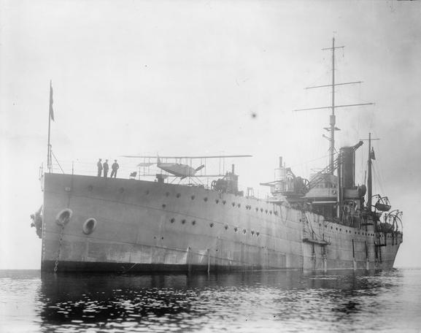
HMS Ark Royal
HMS Ark Royal was the first purpose-built seaplane carrier.
(All Rights Reserved except for Fair Dealing exceptions otherwise permitted under the Copyright, Designs and Patents Act 1988, as amended and revised)
The Ark Royal was commissioned on 10 December 1914 and took part in the Gallipoli Campaign in the following year where her seaplanes flew reconnaissance missions. She also operated in the Adriatic in 1916 to support Allied forces on the Macedonian Front.

Slide 56
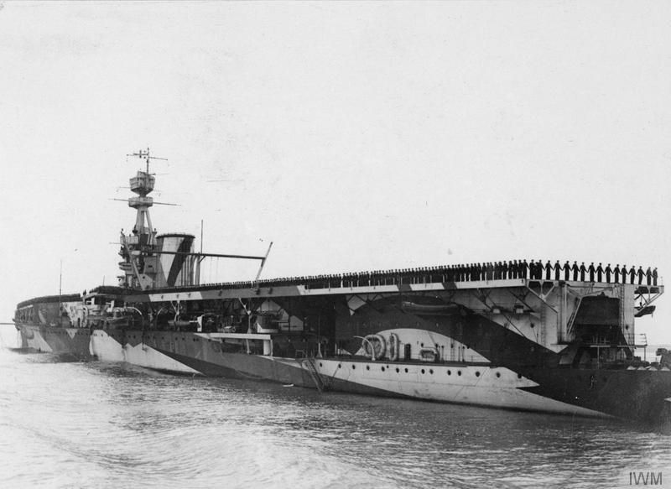
HMS Furious
HMS Furious, September 1918.
(IWM, this item is available to share and reuse under the terms of the Imperial War Museum Non-Commercial Licence)
HMS Furious was originally designed as a battlecruiser but was modified under construction to become the first aircraft carrier with a flight deck that would enable airplanes with wheels to take off from the forward deck. Later it was modified again and a rear flight deck was added to enable the planes to return and land. But this proved difficult because of turbulence and limited deck space so landing on deck was abandoned. The first true aircraft carrier with a long flight deck suitable for take off and landing was HMS Argus, which was not operational until October 1918.

Slide 57
The End of the War at Sea
The naval war ended for most of the German High Seas Fleet when they returned to their base in the Baltic after the Battle of Jutland. From that point on Germany’s war at sea was primarily fought by its U-boats.
The participation of the Russian Imperial Fleet came to an end after the signing of the Treaty of Brest-Litovsk in March 1918 with Germany.
The German High Seas Fleet surrendered ten days after the signing of the Armistice on the Western Front, 11 November 1918. On 21 November a total of more than 40 Allied battleships and battlecruisers and more than 150 destroyers and cruisers made a rendezvous in the North Sea to escort the German High Seas Fleet to internment at Scapa Flow off the Orkney Islands, Scotland.
Negotiations then began about the ultimate fate of the German fleet. Fearing that his ships would be divided up amongst the Allies Admiral von Reuter ordered the scuttling of the whole fleet in Scapa Flow on 21 June 1919. Although the British ships guarding the High Seas Fleet managed to beach 22 of the German ships the rest were sunk.

Slide 58
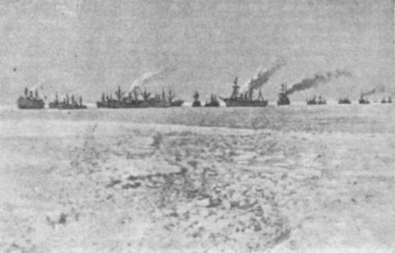
The Imperial Russian Baltic Fleet
The return of the Imperial Russian Baltic Fleet to its base at Kronstadt in March 1918.
(Public Domain)
After the signing of the Treaty of Brest-Litovsk on 3 March 1918 between Germany and the new Soviet government, Lenin ordered the Russian Baltic Fleet based at Tallinn and Helsinki to return to Kronstadt. Because of the bad weather conditions the fleet had to be escorted back by icebreakers.
The Russian Black Sea fleet remained in port and during the civil war evacuated the defeated White forces to Turkey. It then sailed to Tunisia where it was offered asylum by the French government.

Slide 59
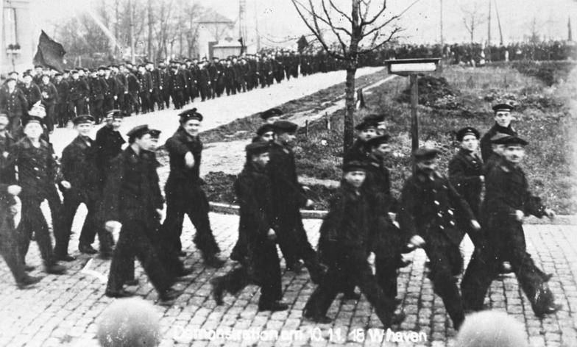
The Kiel Mutiny
Kiel Mutiny. German sailors marching in protest on 6 November 1918.
(Bundesarchiv, Bild 146-1976-067-10A, CC-BY-SA 3.0)
Just a week before the Armistice ended the war on the Western Front sailors from the German High Seas fleet based at Wilhelmshaven and Kiel mutinied. This triggered off a revolution in Germany, the abdication of the Kaiser and the proclamation of a republic.

Slide 60

Scapa Flow
German battlecruisers steaming to internment in Scapa Flow, 21 November 1918.
(Public Domain)
In the lead is SMS Seydlitz, followed by SMSs Moltke, Hindenburg, Derfflinger and Von der Tann. Photograph taken from one of the escort ships.

Slide 61

Scapa Flow
The scuttling of SMS Bayern, 21 June 1919, at Scapa Flow.
(All Rights Reserved except for Fair Dealing exceptions otherwise permitted under the Copyright, Designs and Patents Act 1988, as amended and revised)

Slide 62




World War One: War at Sea
This collection is made by Pieter Baetens with the support of Bob Stradling and Francesco Scatigna of the Historiana editing team.
‘The sinking of a hostile armed troop carrier by a German submarine in the Mediterranean Sea’. Painting by Willi Stöwer, 1917, subsequently used as a propaganda postcard. (Public Domain)

