Slide 1
The “war on land” was predominantly a mobile and a mechanised war. Both sides used tanks, infantry and mobile artillery. This source collection covers all three kinds of warfare, but also looks at other aspects of the war on land as well. The first section looks at what has come to be known as “blitzkrieg” (or “lightning warfare”) – a tactic based on speed and surprise involving the combined use of tanks, infantry and air support. The next section looks at the developing importance of the role of tank warfare during the war. The third section focuses on the role of the infantry. This truly was a global war and infantry soldiers found themselves fighting in all kinds of terrains and conditions, including extremes of cold and heat, for which they had not always been well-prepared. The fourth section focuses on different aspects of armed resistance. The final section looks at some aspects of the war on land that we might perhaps associate more with the First World War.

Slide 2
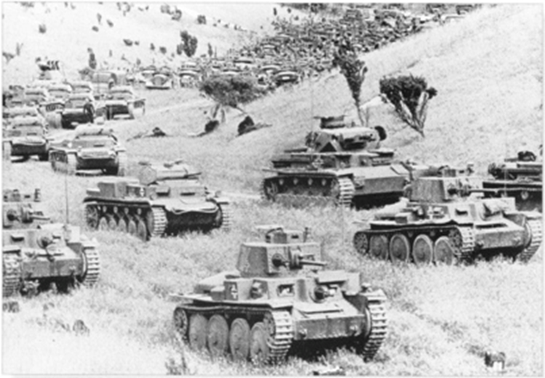
Blitzkrieg
An illustration of how the strategy of ‘blitzkrieg” involved a dense concentration of men, weapons and armoured vehicles.
(OmahaBeach44, CC BY-SA 4.0)
A dense concentration of tanks, other armoured vehicles, infantry and close air support using speed and surprise to break through the enemy’s lines, outflank and defeat them.
The term was first used by German journalists observing the strategy being adopted in the invasion of Poland. It was seldom, if ever, used by the High Command of the German Wehrmacht.
Military historians now see a direct link between the German army’s rapid advances in 1914 and again in the Spring offensive of 1918, and the use of this tactic in the Second World war, but adapted to the new military technologies.

Slide 3
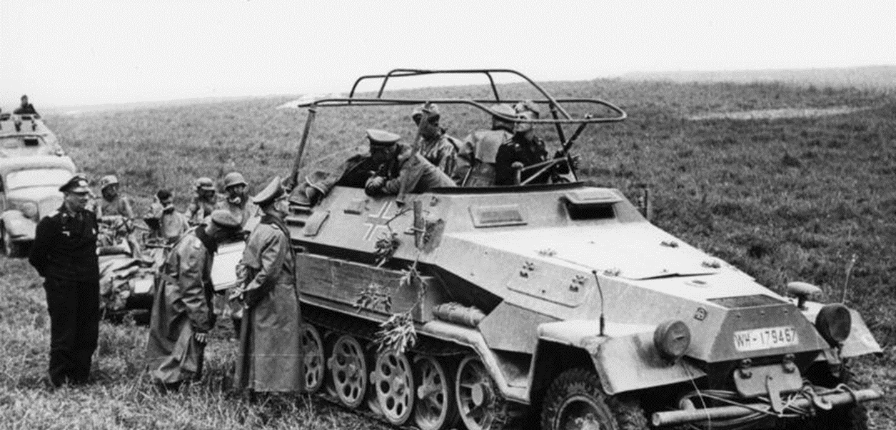
General Heinz Guderian
General Heinz Guderian is often associated with the development of the ‘Blitzkrieg’ strategy. He played an important role in the planning of the invasion of the low countries and France. In this image he stands in a military Pantzerwagen talking to another General, Adolf Kunzen.
France: May/June 1940.
(Bundesarchiv, Bild 101I-769-0229-02A, Borchert, Erich (Eric), CC-BY-SA 3.0)

Slide 4
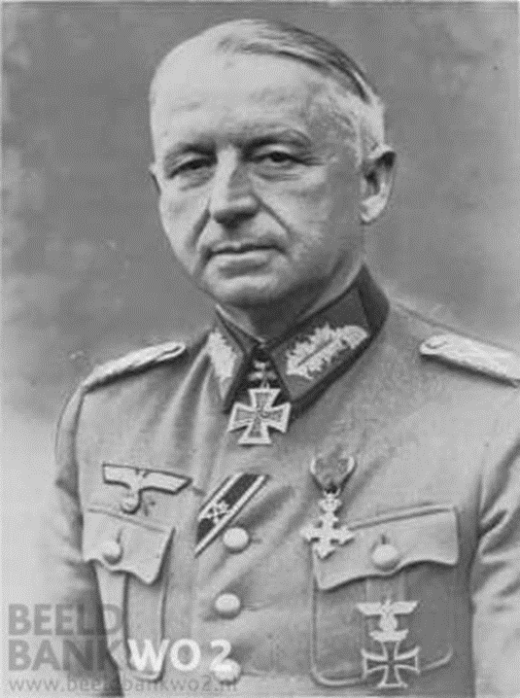
Erich von Manstein
Field Marshal Erich von Manstein (1887-1973) also contributed to the development of ‘Blitzkrieg’. He had already been involved in the German rearmament programme from 1936 onwards, where both he and Guderian separately formed Panzer divisions. Von Manstein’s strategy for ‘Blitzkrieg” formed the basis for much of the military success of the German army during the Battles in Belgium and Northern France.
(BeeldBank WO2, Public Domain)

Slide 5
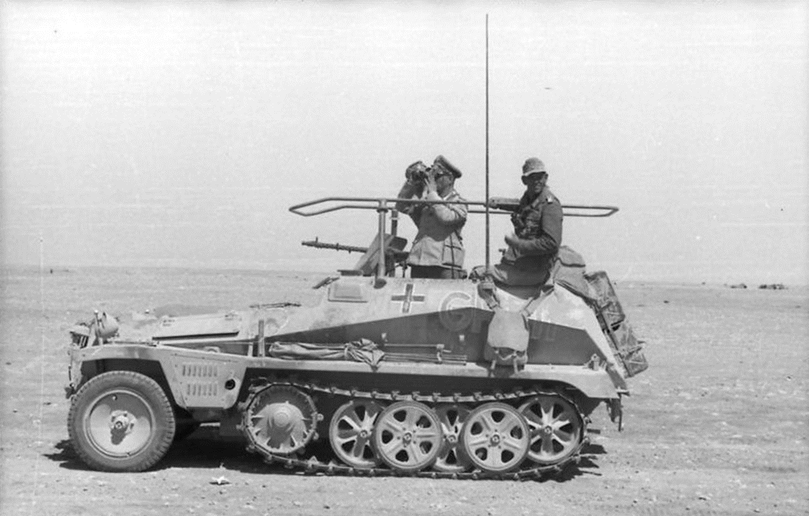
General Erwin Rommel
Libya: June 1942.
(Bundesarchiv, Bild 101I-443-1589-09, Zwilling, Ernst A., CC-BY-SA 3.0)
General, later Field Marshal, Erwin Rommel is also associated with the German ‘Blitzkrieg’ strategy. He is best known for his use of the strategy in desert warfare. But he had also commanded an armoured brigade in the invasion of Poland in 1939 and a panzer division in the invasion of Belgium and France in 1940.
In this image he is in a light-weight command panzerwagen together with General Fritz Bayerlein.

Slide 6
Testimony of General Erwin Rommel
"The tanks now rolled in a long column through the line of fortifications and on towards the first houses, which had been set alight by our fire. In the moonlight we could see the men of 7th Motorcycle Battalion moving forward on foot beside us. Occasionally an enemy machine-gun or anti-tank gun fired, but none of their shots came anywhere near us. Our artillery was dropping heavy harassing fire on villages and the road far ahead of the regiment. Gradually the speed increased. Before long we were 500, 1,000, 2,000, 3,000 yards into the fortified zone. Engines roared, tank tracks clanked and clattered. Whether or not the enemy was firing was impossible to tell in the ear-splitting noise. We crossed the railway line a mile or so southwest of Solre-le-Château, and then swung north to the main road which was soon reached. Then off along the road and past the first houses.”
This quote from General Rommel describes the use of combined forces in an attack to break through French defences in 1940.
(From “Blitzkrieg, 1940,” EyeWitness to History.com, 2002)

Slide 7
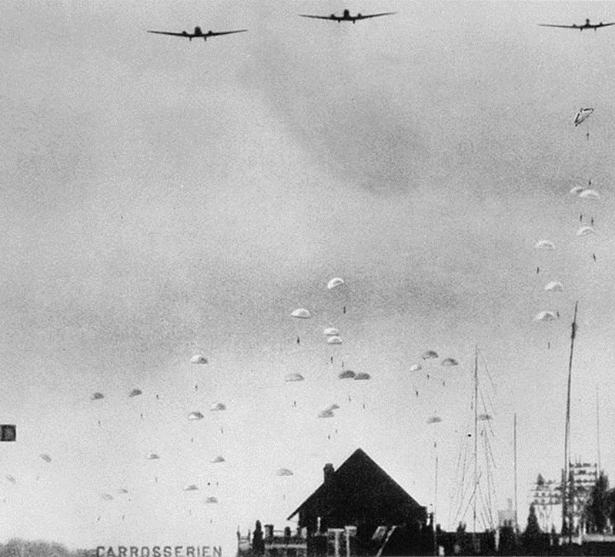
German paratroopers landing in the Netherlands
On 10 May 1940, the German invasion of the Netherlands took place. This photo shows German paratroopers landing in Tedingerbroek, near The Hague. Three Junker Ju-52 transport planes are visible, dropping a Fallschirmjäger Division (paratroopers). Their objective was to occupy strategic points such as airfields and to support the infantry on the ground.
(Dutch National Archives, Fotocollectie Algemeen Nederlands Persbureau 917-7045, CC BY-SA 3.0 NL)

Slide 8
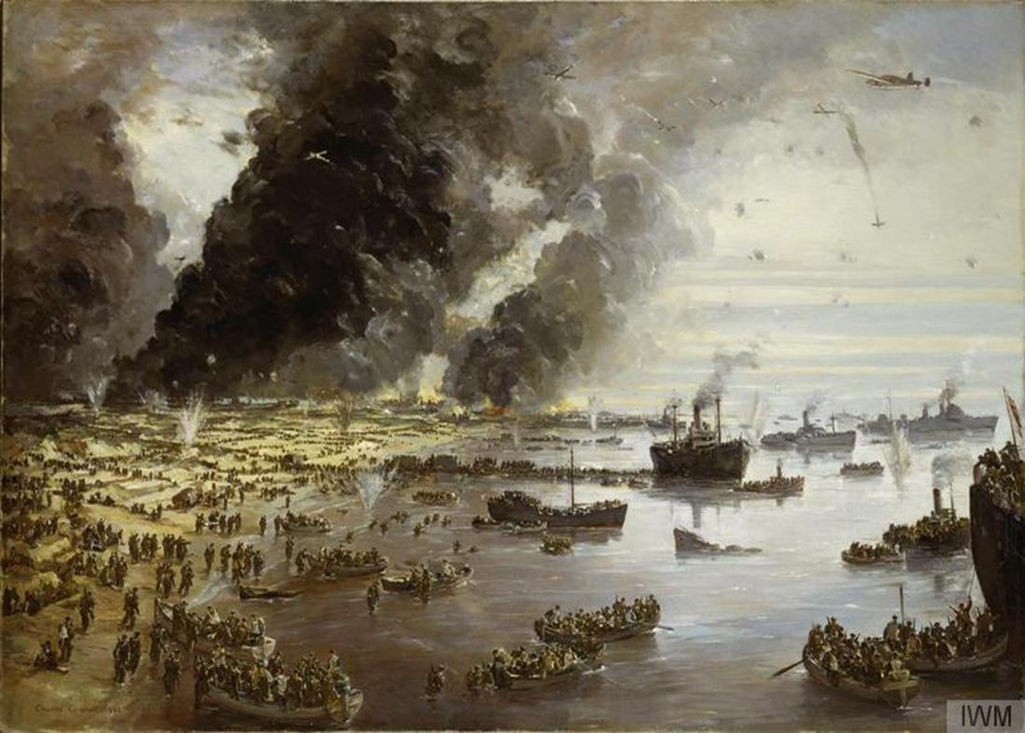
Dunkirk evacuations
(Imperial War Museums, © IWM Art.IWM ART LD 305 Non Commercial Licence)
After the occupation of the Netherlands and Belgium, the German tactics of ‘Blitzkrieg’ moved to France. Between the end of May and the beginning of June, 1940, French and British armed forces were able to hold off the German attacks just long enough for most of them to be evacuated, either to Britain or to the unoccupied south of France. The crowded boats and the large numbers of soldiers on the beach highlight the urgency of the mass evacuation at this time and the devastating impact of the rapid German advance through the Low Lands to France.

Slide 9
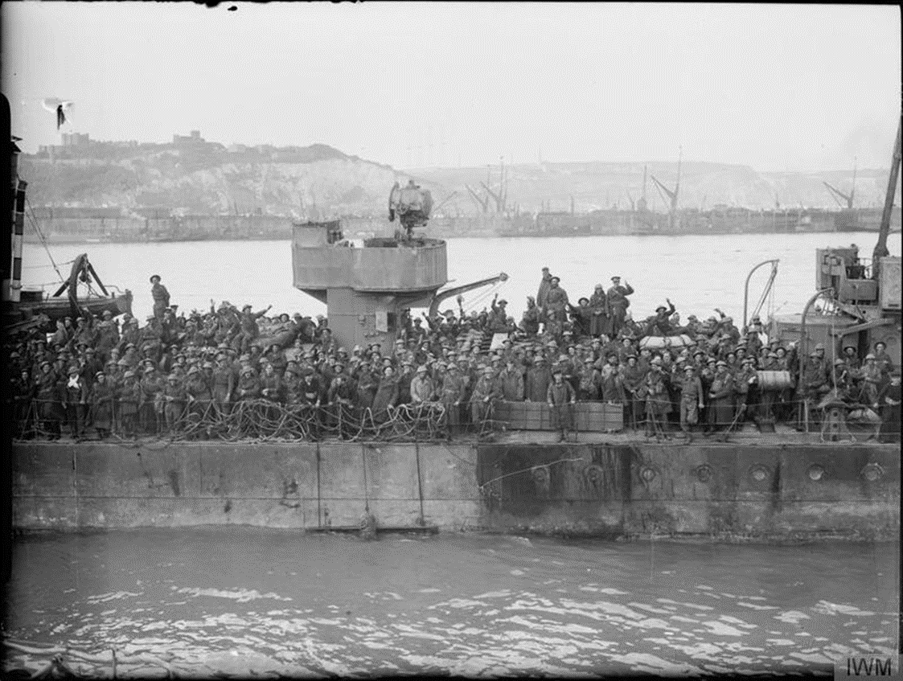
Evacuation of the British armed forces from France
Evacuated British soldiers return to the United Kingdom, 31 May 1940. The crowd occupies the deck of a Royal Navy destroyer at Dover.
(Imperial War Museums, © IWM HU 1662, Non Commercial Licence)

Slide 10
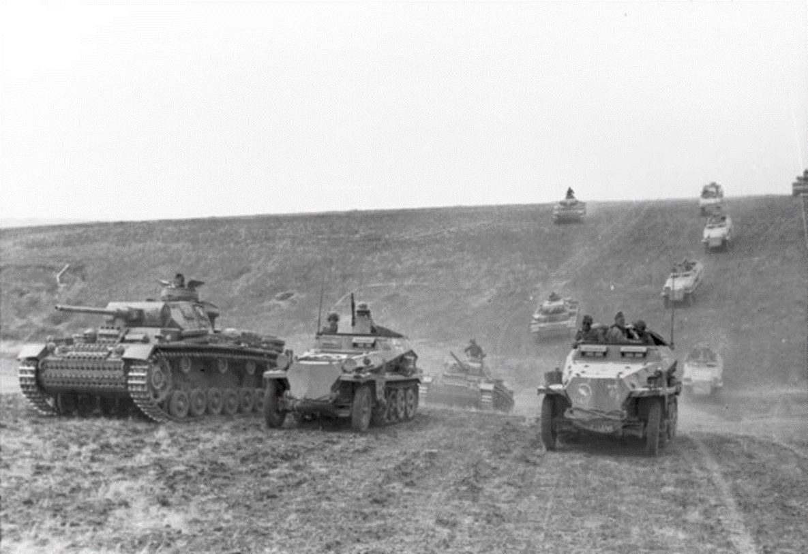
German artillery in the Soviet Union
(Bundesarchiv, Bild 101I-218-0504-36, Dieck, CC-BY-SA 3.0)
Light and medium armoured artillery of the 24th Panzer Division near Stalingrad in the Soviet Union (1942).
By this time in the war German commanders were putting into practice a lot of the strategic lessons they had learned from the invasions of Belgium, the Netherlands and northern France.
Here, crossing the East European plain of the Soviet Union we can see many different types of tanks and armoured vehicles, all advancing rapidly together and in large numbers.

Slide 11
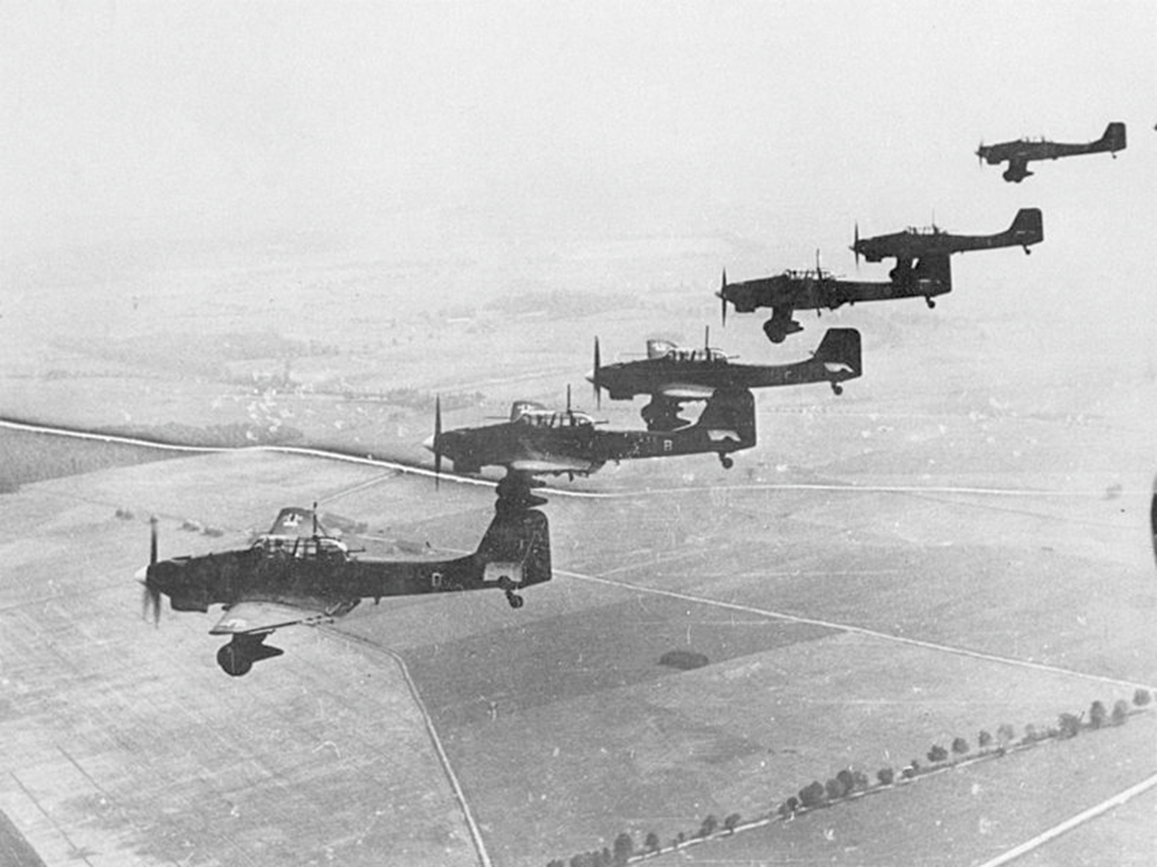
Stuka dive bombers
Stuka dive bombers (Junker 87s) flying over Poland in 1939 supporting the tanks and troops on the ground during the German occupation of Poland. The combined use of tanks, air support, motorized infantry and artillery is a typical feature of the German Blitzkrieg strategy.
(Bundesarchiv, Bild 183-1987-1210-502, Hoffmann, Heinrich, CC-BY-SA 3.0)

Slide 12
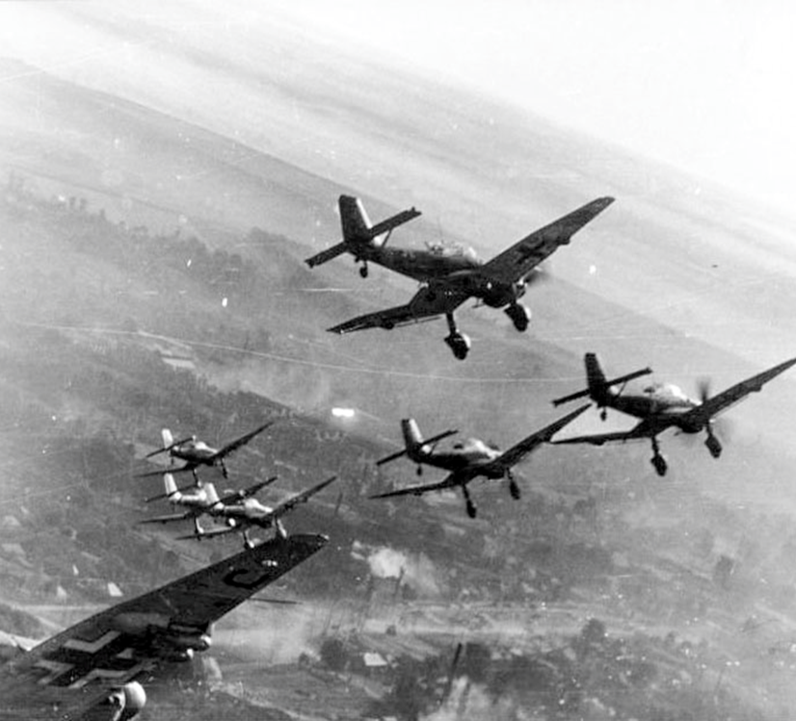
Stuka dive bombers Junker Ju 87
Here the Stuka dive bombers are flying over Russia, 22 December 1943. On the ground there are traces of many bombs being dropped on a city.
(Bundesarchiv, Bild 101I-646-5188-17, Opitz, CC-BY-SA 3.0)

Slide 13
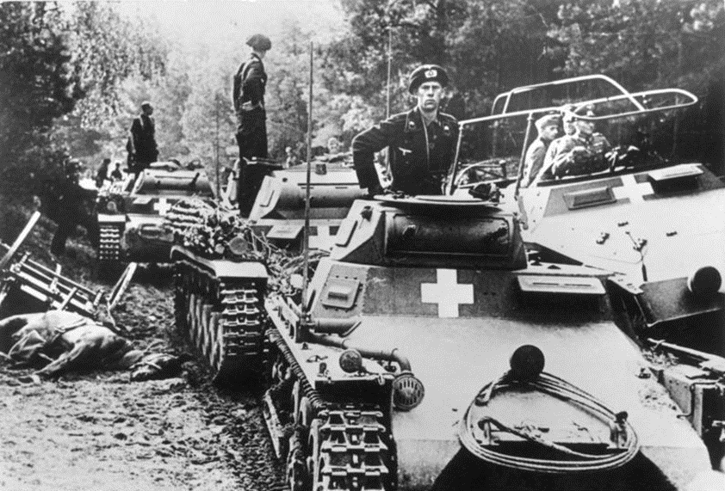
Tank Warfare
Panzer I and II tanks and a half track armoured vehicle near the River Brda in north-west Poland on 3 September, 1939.
(Bundesarchiv, Bild 146-1976-071-36, CC BY-SA 3.0 de)
In World War 1 the newly-developed tanks were intended to traverse “no man’s land” between their own and the enemy’s lines, destroy enemy trenches and create a break in the lines through which the infantry could advance. They were slow, unreliable, had poor mobility and were vulnerable to direct hits from heavy artillery.
As international tension built up in the 1930s all of the major powers invested in mechanised warfare, including tanks, armoured vehicles and large trucks to transport the infantry. The intention was that if there was another major war on the continent it would be a mobile war rather than a war of attrition based on lines of trenches.
New military tactics emerged to make full use of the mobility of tanks and other armoured vehicles.
During the war both sides moved into mass production of tanks and into developing new technologies to improve their firepower, speed, mobility and armoured protection.

Slide 14
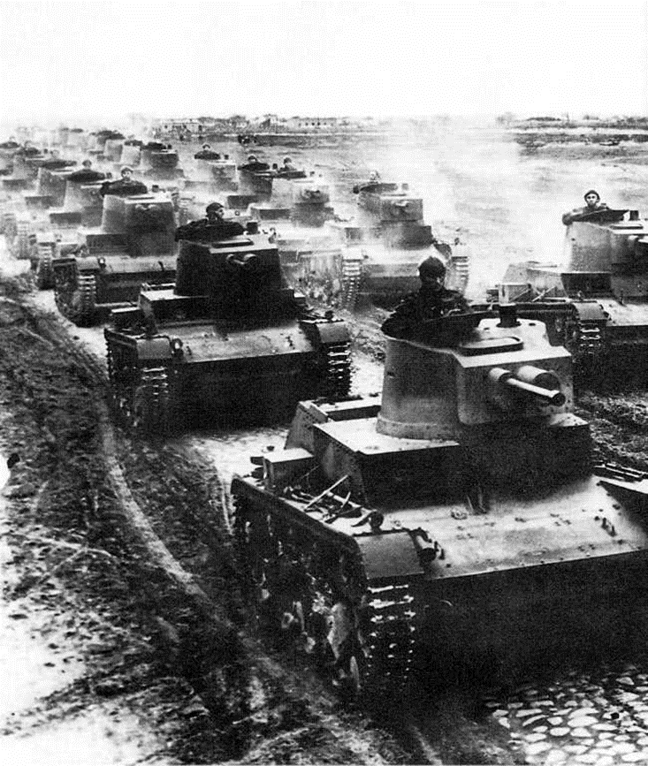
Light Polish tanks
A large number of light-weight Polish tanks (7TP) preparing to defend Poland against Germany (1939). This was the standard Polish tank during the German invasion. No more than 150 tanks were produced. It was better armed than the German Panzer I and II tanks but totally outnumbered compared with the panzer divisions that the Wehrmacht could put into the field against them.
(Komuda, Leszek, Public Domain)

Slide 15
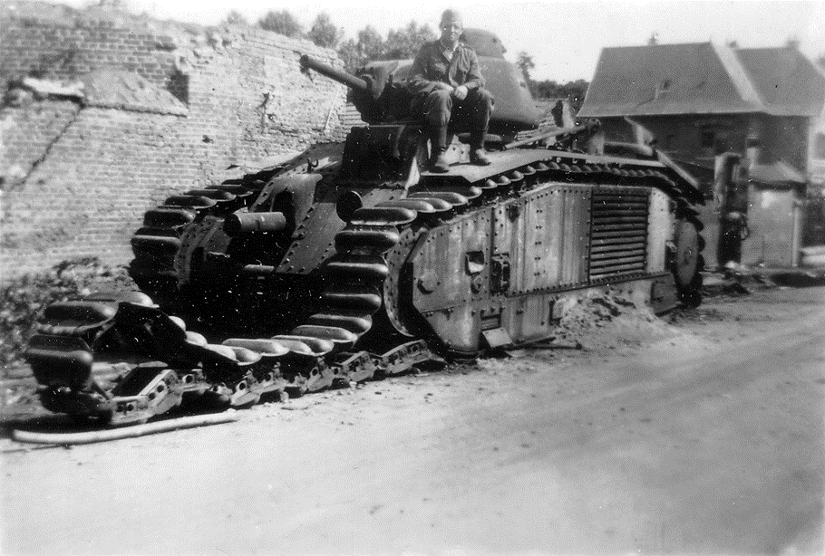
French Char B1 tank disabled in North France in 1940.
(Conseil Régional de Basse-Normandie, National Archives USA, Public Domain)
The Char B1 was a heavy tank designed specifically to support infantry to break through enemy lines by destroying fortifications, trenches, gun emplacements and other tanks. In many respects it was too slow to be suitable for a war of movement, such as the Battle of France in 1940. But it was more heavily armoured and it also outgunned the German tanks that were being used at the beginning of the War. For example, on 16 May 1940, during the Battle of France, one Char B1 destroyed 13 German tanks. After France had surrendered the Germans adapted the Char B1 for their own purposes and used them on the Eastern Front.

Slide 16
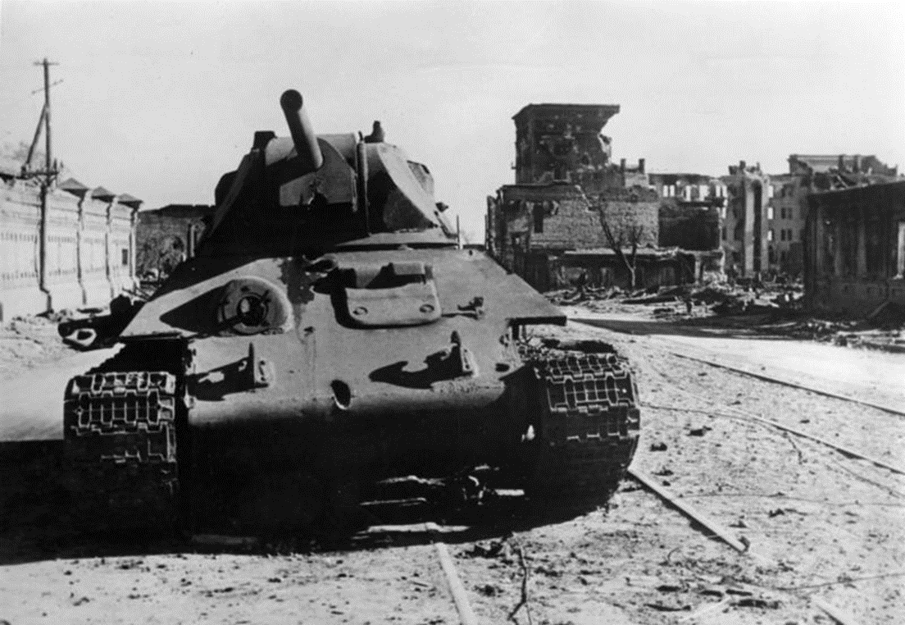
T-34 Soviet tank during the battle of Stalingrad
(Bundesarchiv, Bild 183-B22359, CC-BY-SA 3.0)
The T-34 was the most common Soviet tank and important in the eventual failure of the Wehrmacht’s Operation Barbarossa. In 1942 the T-34 had better firepower, armour and mobility than the tanks being used by the German army. General Paul von Kleist who commanded a panzer division in Operation Barbarossa describe the T-34 in 1942 as “the finest tank in the world”. It was unrivalled until the German Tiger tanks came into mass production. This tank is in Stalingrad, in what appears to be a deserted street, highlighting the street-to-street fighting that was typical of the Battle of Stalingrad. October 1942.

Slide 17
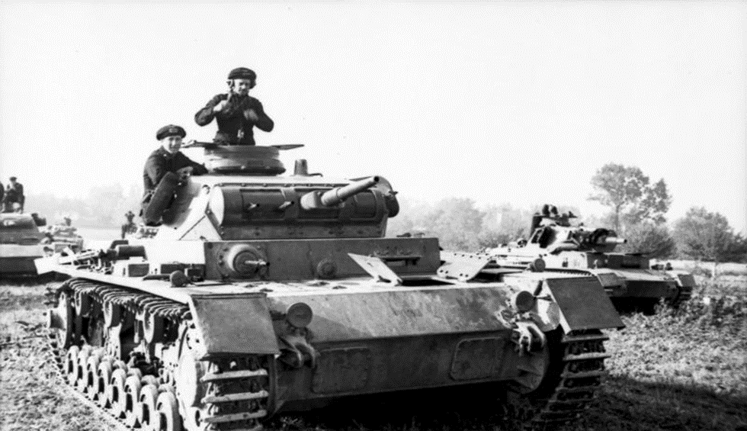
The German Panzer III tank was a key weapon in a mobile war.
(Bundesarchiv, Bild 101I-318-0083-30, Rascheit, CC BY-SA 3.0 DE)
Textbooks often refer to the superiority of the German Panther and Tiger tanks, compared with most of the tanks being deployed by the Allies. However, these were not introduced until late 1942. The tank used by German forces to make rapid advances in Poland, France, North Africa and the Soviet Union from 1939 to 1943 was the Panzer III and its successor, the Panzer IV. Fast, medium tanks suited to the blitzkrieg strategy. They were phased out after the Battle of Kursk in the summer of 1943 when the Russian T34 proved superior in armour and weaponry.

Slide 18
The threat of a burning tank
Extracts from Catherine Merridale, Ivan’s War: The Red Army 1939-45, London 2005.
“’Have you burned yet?’ was a common question for tank men to ask each other when they met for the first time. A dark joke from this stage of the war has a politruk [political officer] informing a young man that almost every tank man in his group had died that day. ‘I’m sorry,’ the young man replies, ‘I’ll make sure that I burn tomorrow.’”
“Of the 403.272 tank men [including a small number of tank women] who were trained by the Red Army in the war, 310.000 would die. Even the most optimistic soldiers knew what would happen when a tank was shelled. The white-hot flash of the explosion would almost certainly ignite the tank crew’s fuel and ammunition. At best, the crew – or those, at least, who had not been decapitated or dismembered by the shell itself – would have no more than ninety seconds to climb out of their cabin.”
(IVAN’S WAR, p. 188)
(IVAN’S WAR, p. 187)

Slide 19
T-34 eyewitness story
[IN 1942] “The revival of manufacturing seemed like a miracle. Tanks and aeroplanes soon came to symbolize the Soviet recovery, with Chelyabinsk, the new manufacturing centre in the Urals, earning the nickname Tankograd. Mass production accelerated everything. Manufacture of the world-beating T-34 medium tank, for instance, was adapted so that the turrets could be stamped, not cast. Troops still dubbed it the ‘matchbox’, partly because they expected it to cach fire as readily as its predecessors, which had been nicknamed zazhigalki, ‘lighters’, but also because T-34s poured off the production lines in such prolific numbers after 1942.”
An extract from Catherine Merridale’s Ivan’s War
(Catherine Merridale, Ivan’s War: The Red Army 1939-45, London 2005, p. 140.)

Slide 20
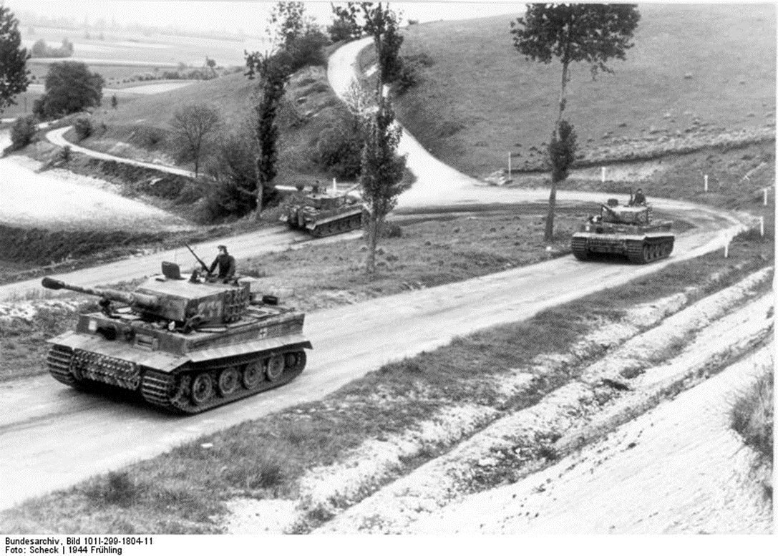
German “Tiger I” tanks in France
These tanks, known as “Tiger I” tanks were the the VI version of the series of Panzer tanks produced during the war. They were among the strongest tanks in the world at that time with advanced technology in terms of armour, fire power and mobility. In this image you see three Tiger tanks driving through Normandy towards the end of the war.
Date: 21 March 1944.
(Bundesarchiv, Bild 101I-299-1804-11, Scheck, CC-BY-SA 3.0)

Slide 21
Tiger eyewitness story
“The lieutenant’s tank was moving forward maintaining fire from every kind of gun. But an enemy shell fired at the machine. The firing from the burning tank did not cease. The mechanic, selecting the machine’s highest gear, contrivd to drive it at one of the enemy’s advancing tanks. The fire from Lt Gusev’s tank continued. They were firing so they must be still alive. Lt Gusev’s tank drove forward at full throttle straight towards the enemy tank. The Tiger [German tank] wanted to turn around and get out, but it succeeded only in turning sideways. Our burning tank rammed into the Tiger and both tanks exploded. The crew of heroes perished.”
An extract from Catherine Merridale’s Ivan’s War
(Catherine Merridale, Ivan’s War: The Red Army 1939-45, London 2005, p. 190)

Slide 22
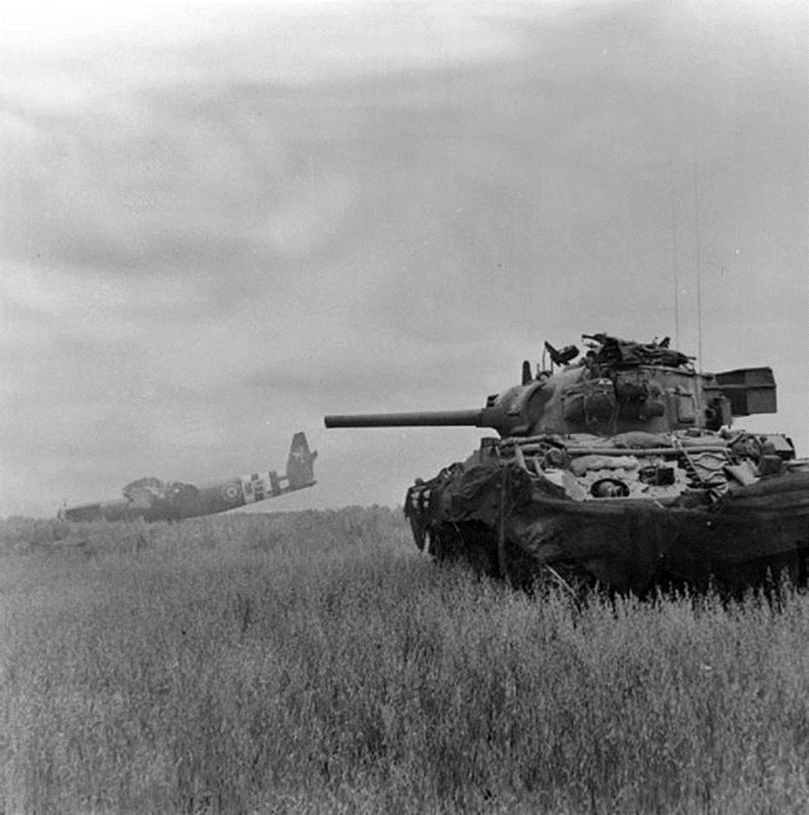
US M4 Sherman tank in Normandy
The US M4 Sherman tank proved very useful for the Allied Forces in the later years of the war. It was first used in 1942 in North Africa. Here the Sherman is providing cover for a British Horsa Airspeed glider that would have been transporting 30 British airborn soldiers to the battlefield during the Normandy landings (10 June 1944).
(Imperial War Museums, © IWM B 5348, Non Commercial Licence)

Slide 23
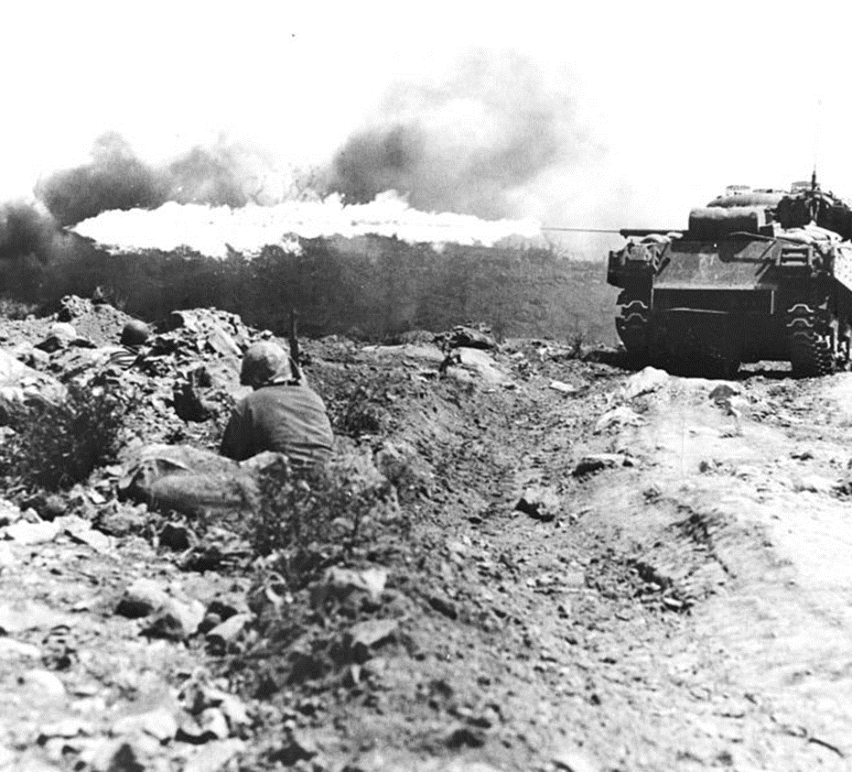
US Sherman tank at the battle of Iwo Jima in the Pacific March 1945
Tanks from the United States were not only used in Europe. This M4A3 Sherman tank was adapted with a Ronson flamethrower and was used during the battle of Iwo Jima against the Japanese army.
(Department of Defense Photo (USMC) 140758, Public Domain)

Slide 24
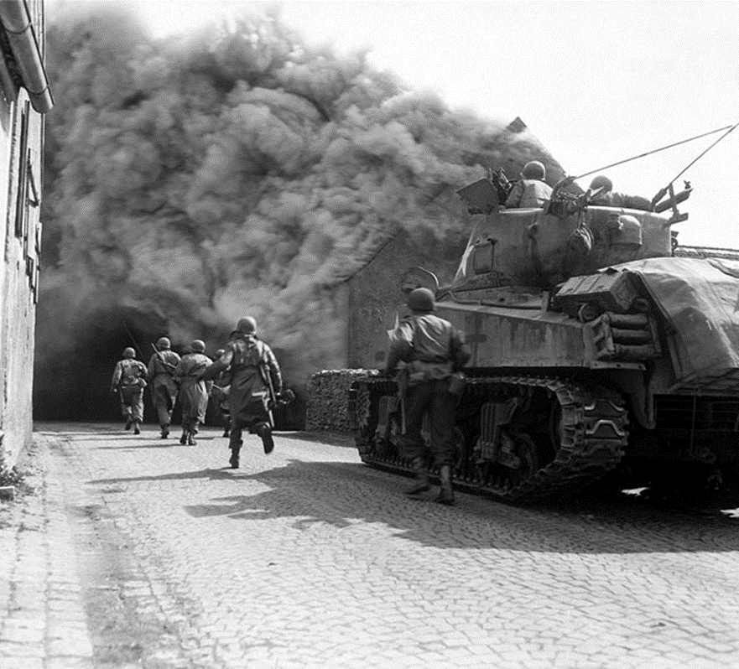
US Sherman M4 tank in Germany, 22 April 1945
In March 1945, the US army was advancing into Germany. By April they had reached Wernberg in South-East Germany, where this picture was taken.
Here we see an M4 Tank from the 11th Armoured Division providing support for infantrymen of the 55th Armed Battalion.
(National Archives and Records Administration, 531278, Public Domain)

Slide 25
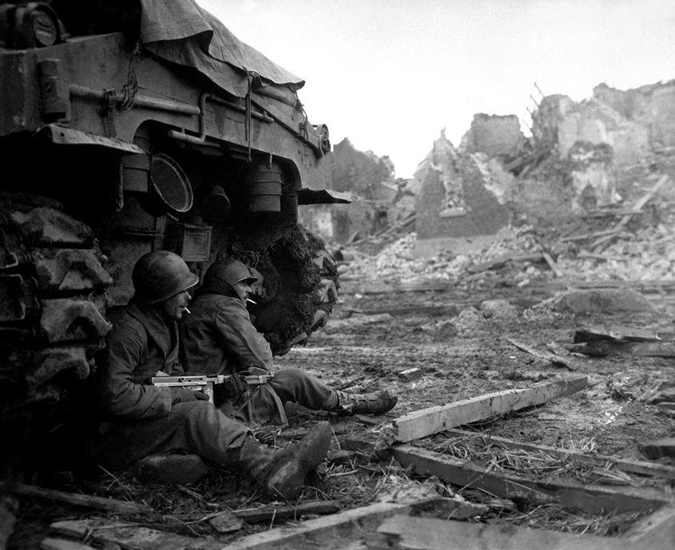
Infantry
American GIs from C Company 36th Armored Infantry Regiment sheltering by an M4 Sherman tank while attacking Gleich in North Rhine Westphalia on 11 December 1944.
(National Archives and Records Administration, 531225, Public Domain)
The Infantry are the foot soldiers who are trained to engage with the enemy at close range. Their greatest asset is that they can operate in terrain that may be inaccessible to field artillery, cavalry or, by World War 2, tanks and other armoured vehicles.
By 1939-40 infantry were far more mobile than the foot soldiers of previous continental wars. It is certainly the case that infantry in World War 1 were often transported to the front by troop transport ships and trains but in World War 2 they had amphibious landing boats, airborne troops, large trucks and armoured vehicles all of which could be used to get the infantry to where they were needed as rapidly as possible.
In addition to rifles and bayonets, they also had sub-machine guns, rocket launchers, flame throwers, hand grenades and portable mortars.

Slide 26
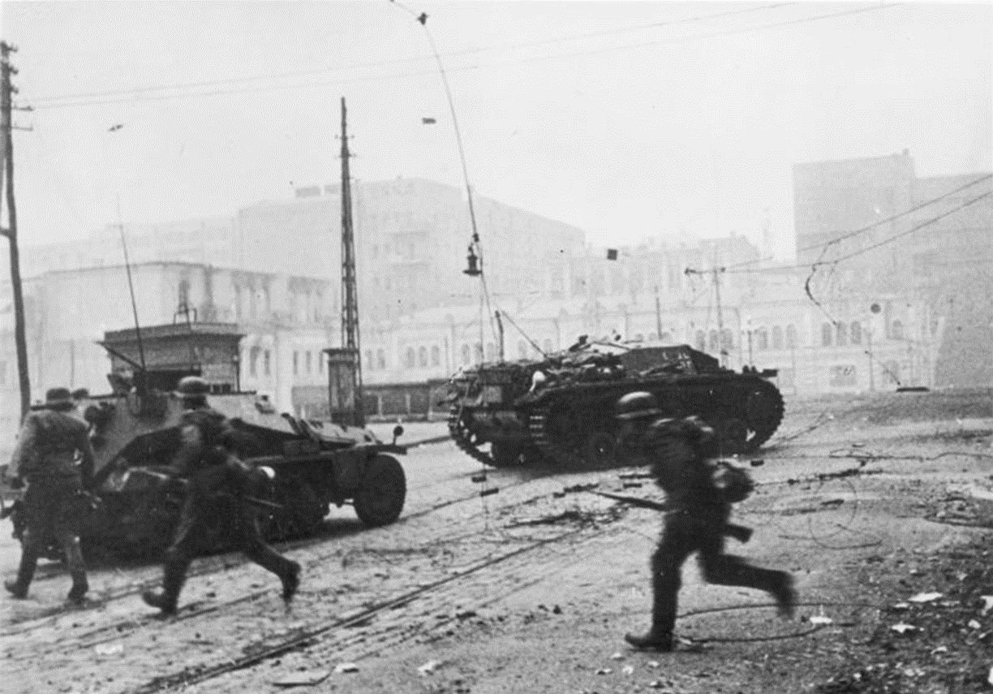
Fighting in cities: German forces seize Kharkov
On 25 October 1941, the German army invaded Kharkov, the capital city of Ukraine. Infantry soldiers with Panzerwagen and tanks are running through the deserted and demolished streets of the city.
(Bundesarchiv, Bild 183-L20582, Schmidt, CC-BY-SA 3.0)

Slide 27
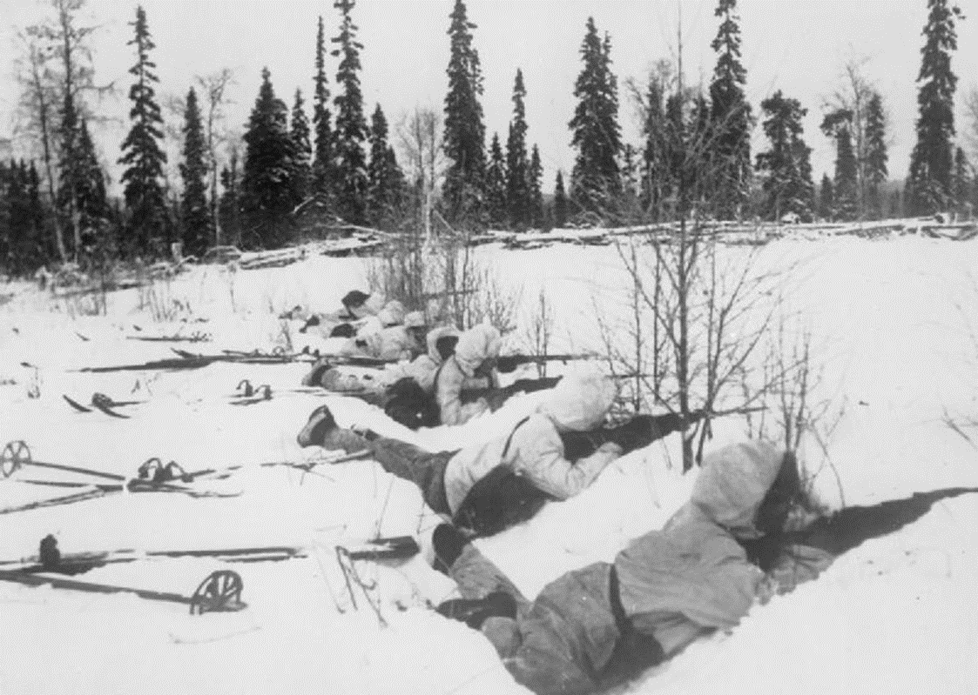
Fighting in the snow: Finnish ski troops
Finnish ski troops in Northern Finland on the alert for Russian troops during the Winter War between the Soviet Union and Finland. Rough terrain with forests and the lack of roads made the use of ski troops convenient and successful (12 January 1940).
(Imperial War Museums, © IWM HU 55566, Non Commercial Licence)

Slide 28
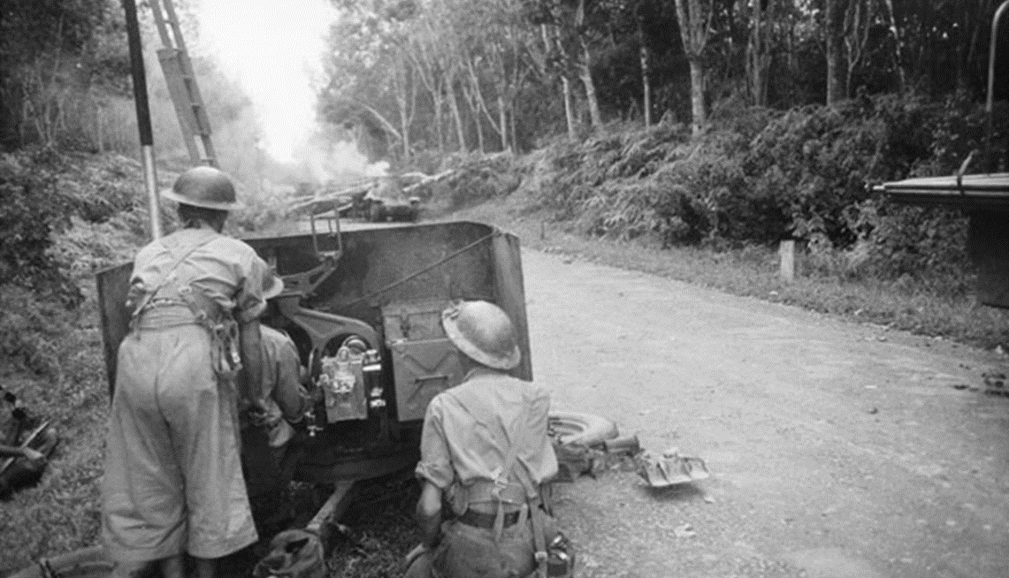
Fighting in the jungle: infantry in the Pacific
An Australian anti-tank regiment in action at a roadblock in Malaya fighting Japanese tanks (18 January 1942).
(Imperial War Museums, © IWM MH 30848, Non Commercial Licence)

Slide 29
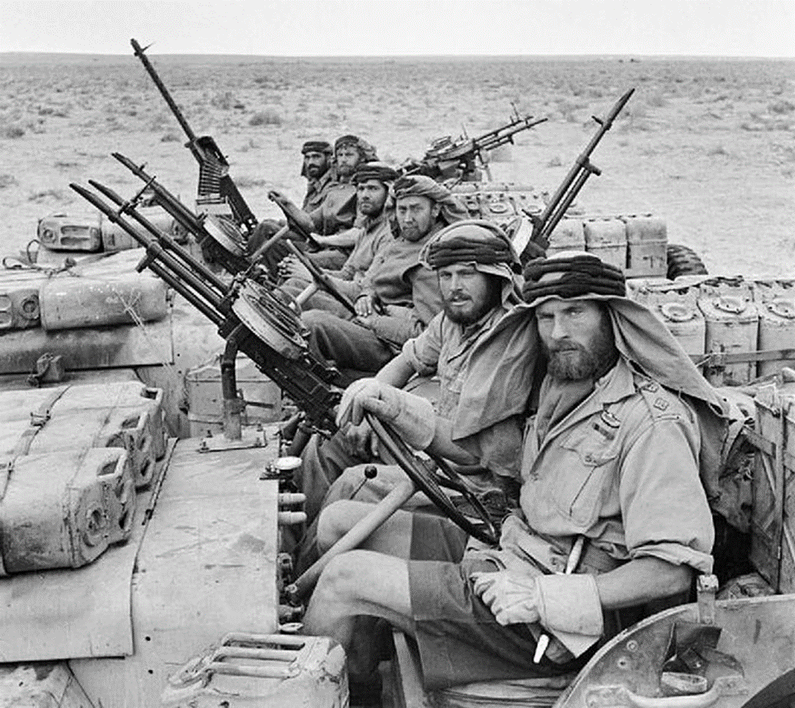
Fighting in the desert: The Special Air Service (SAS)
A heavily armed patrol of ‘L’ Detachment Special Air Service, a commando force set up to operate behind enemy lines in the North African campaign (18 January 1943).
(Imperial War Museums, © IWM E 21337, Non Commercial Licence)

Slide 30
British Lieutenant describes desert warfare
“It was a nightmare trip up to the Tunisian border. It took five days, travelling in filthy carriages, and all we had to eat was bully beef and hard tack biscuits. After the third day, at a place called Beni Maucour, we heard news of the battalion. At Beni Maucour, during one of the tedious halts, a hospital train pulled in. In it were some of our officers and men. They told us that the battalion had been in battle, the colonel had been killed with two other officers, and we had sustained considerable casualties. This was most grievous news, and you can guess how I felt at being left out of our first action. However, my time was to come.”
In this quote, Lt. Ambler describes his experience of fighting in North Africa with the circumstances they had to endure in addition to the fight itself.
(From Lt F.E.R. Ambler, Francis, Civic Centre, Bedford, “WW2 People’s War: Battle of Tunis”, BBC.co.uk, 2004)

Slide 31
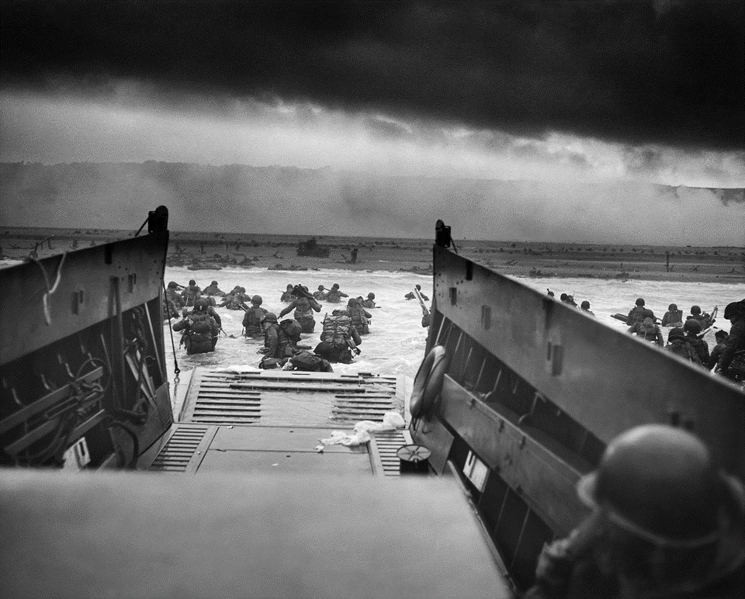
American GIs leaving an amphibious craft at Omaha Beach during the Normandy landings.
Troops of Company E, American 16th Infantry disembark from a landing craft at Omaha Beach on the Normandy Coast on 6 June 1944.
Two-thirds of the Company were killed or injured during the landing.
(National Archives and Records Administration, 195515, Public Domain)

Slide 32
Eyewitness from D-Day
Robert Edlin, a member of the 2nd Ranger Battalion from the United States, joined the first wave of attacks in Normandy.
“I began to run with my rifle in front of me. I went directly across the beach to try to get to the seaway. In front of me was part of the 116th Infantry, pinned down and lying behind beach obstacles. They hadn’t made it to the seaway. I kept screaming at them, ‘You have to get up and go! You gotta get up and go!’ But they didn’t. They were worn out and defeated completely. There wasn’t any time to help them.’’
“I continued across the beach. There were mines and obstacles all up and down the beach. The air corps had missed it entirely. There were no shell holes in which to take cover. The mines had not been detonated. Absolutely nothing that had been planned for that part of the beach had worked. I knew that Vierville-sur-Mer was going to be a hellhole, and it was.”
(From “Invasion of Normandy, June 6, 1944: On the Beach” EyeWitness to History.com (2010)).
(From “Invasion of Normandy, June 6, 1944: On the Beach” EyeWitness to History.com (2010)).

Slide 33
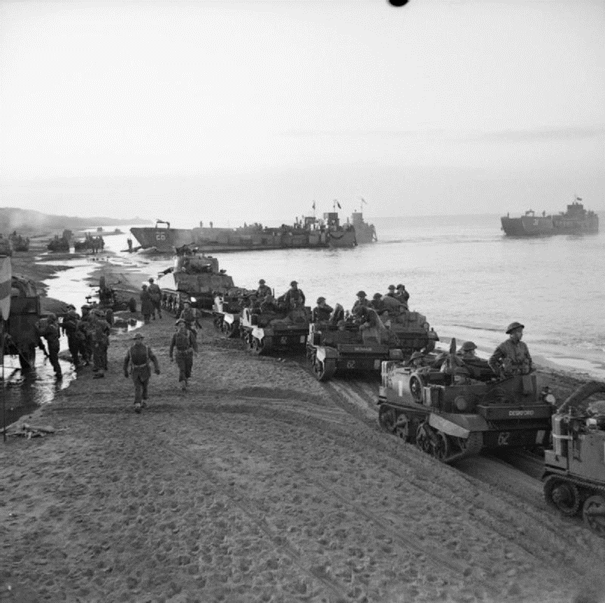
Fighting on the beach: Operation Shingle
In addition to the Normandy invasion, the Allied forces also started Operation Shingle on the Italian coastline in early spring 1944. It was an amphibious invasion by British and American forces, who encountered a lot of German resistance (22 January 1944).
(Imperial War Museums, © IWM NA 11041, Non Commercial Licence)

Slide 34
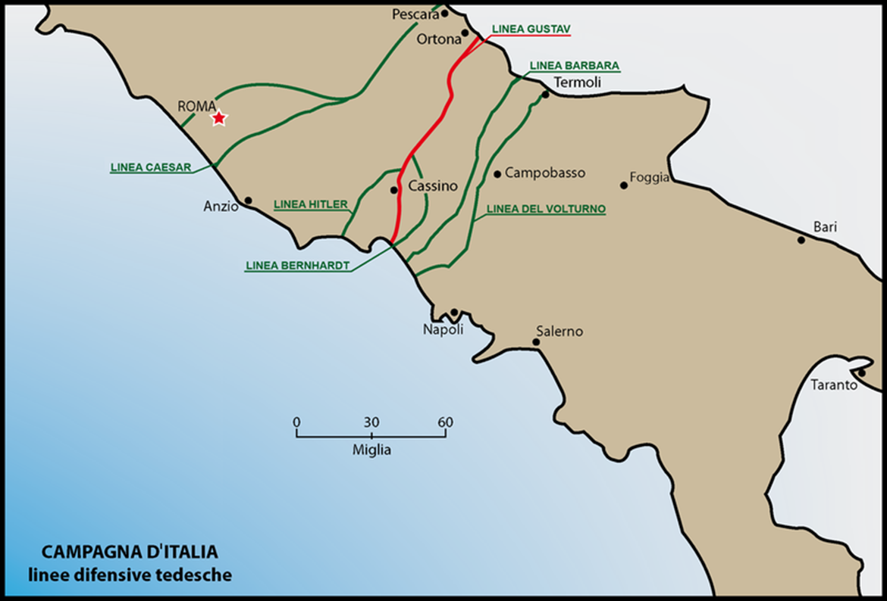
German defensive lines in Italy
Various lines of the German defences in Italy. The Allied amphibious forces arrived at Anzio on the West coast (Spring 1943).
[For more details see The War Becomes Global in this module.]
(Llorenzi, CC BY-SA 3.0)

Slide 35
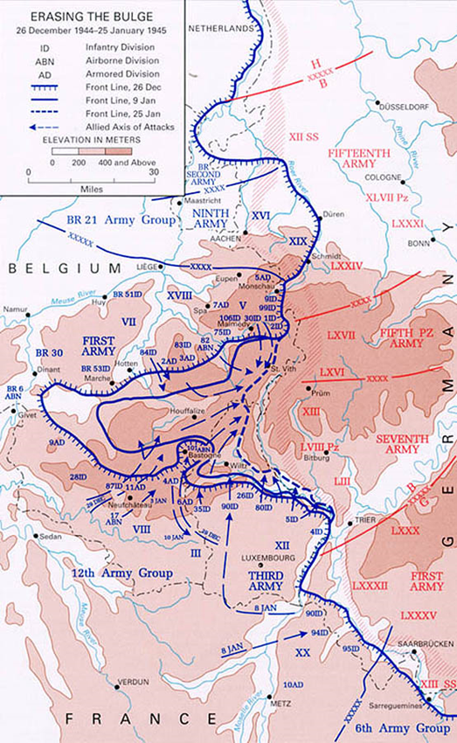
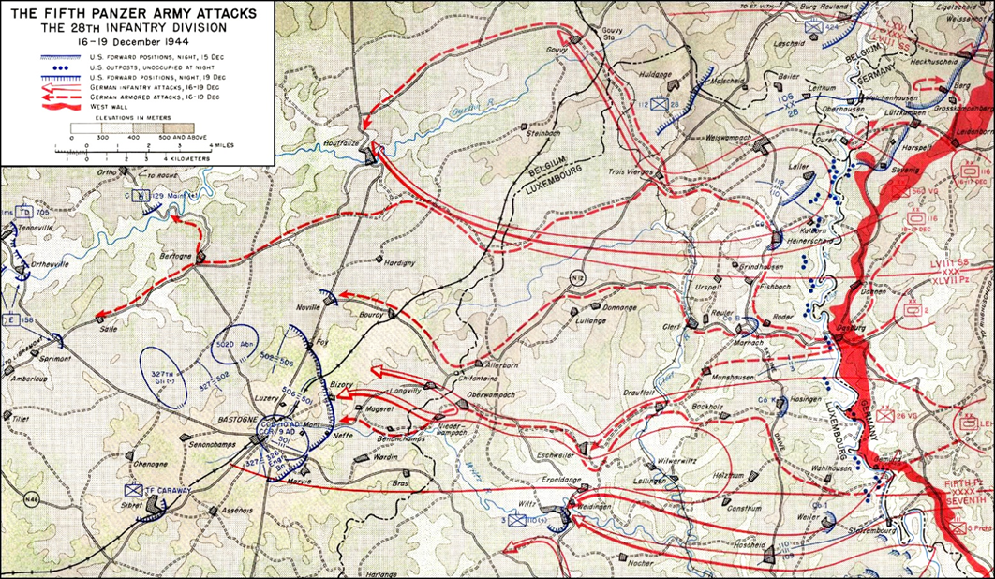
The German “Battle of the Bulge” offensive and the Allied counter-offensive
These maps show the German path of attack and the response by the Allies.
(US Government, Public Domain)
(US Government, Public Domain)

Slide 36
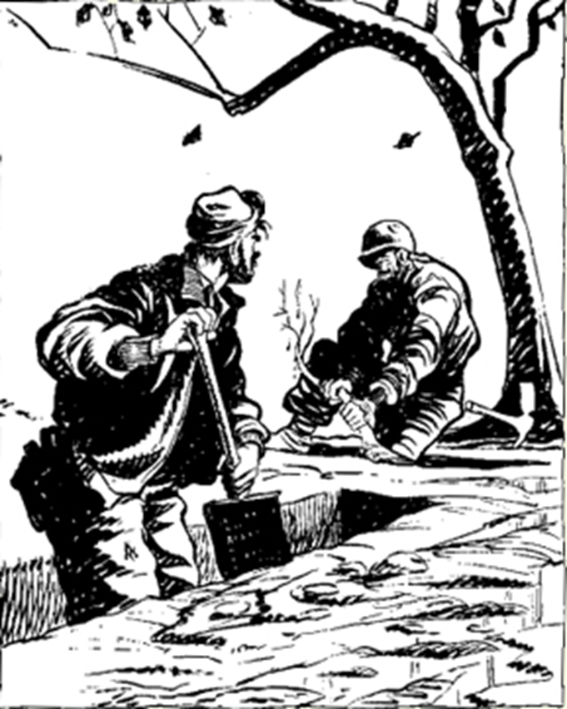
Willie and Joe cartoon
“Me future is settled, Willie. I’m gonna be a perfessor on types o’ European soil”
The original caption for this “Willie and Joe” cartoon. One from a series created by William Henry “Bill” Mauldin, an American soldier who served in the war. Willie and Joe were two infantrymen who endured the ordeals of the war in an apparently nonchalant way.
(US Government, Public Domain)

Slide 37
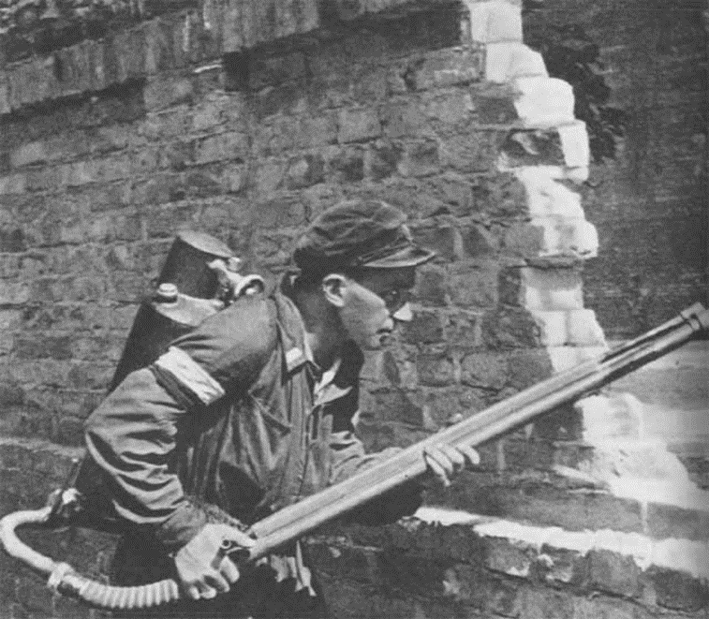
Organized Armed Resistance
Resistance fighter with a flame thrower in the Warsaw Uprising, autumn 1944.
(Jerzy Beeger, Public Domain)
Some kind of resistance by civilians or soldiers no longer on active service took place in every occupied country in World War 2. It could take many forms: non-cooperation with the enemy, disruption of normal services (e.g. main roads, trains, telephones); passing on information to the Allies; hiding allied pilots and soldiers and helping them to escape to neutral countries; engaging in armed conflict with occupying forces.
In this collection we have focused mostly on organized armed resistance. Other forms of resistance are looked at in the section on The Civilian War.

Slide 38
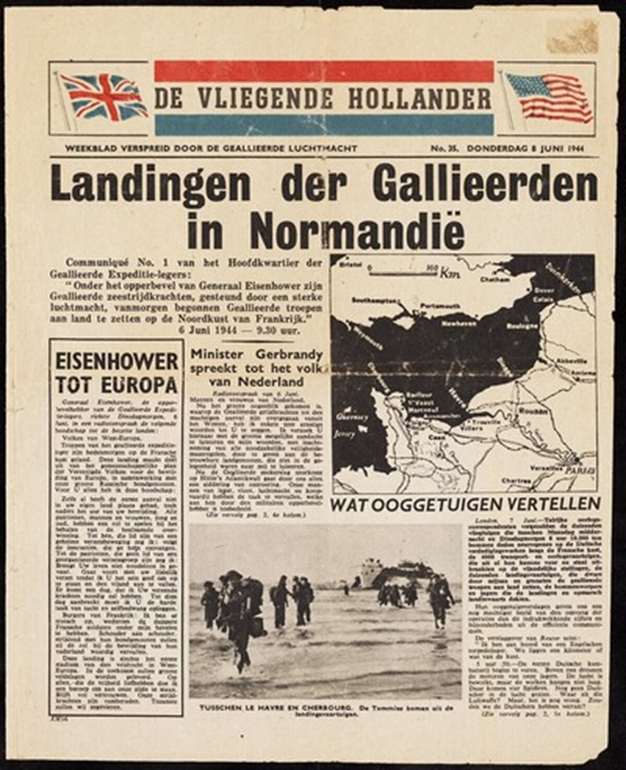
Dutch resistance pamphlet “The Flying Dutchman”
Dutch resistance paper announcing the “Landing of the Allied Forces in Normandy”. This pamphlet was a newsletter spread by the Dutch Forces, at that moment integrated with the British Army and Air Force.
Translation of the headlines:
“Communiqué No.1 of the Headquarters of the Allied Expedition-armies: Under the supreme command of General Eisenhower, the Allied Navy Seals, with strong air support, have started to drop off Allied Forces on the North coast of France.”; “Eisenhower to Europe”; “Minister Gerbrandy speaks to the people of the Netherlands”; “What eyewitnesses tell” (8 June 1944).
(Museon, 163593, Public Domain)

Slide 39
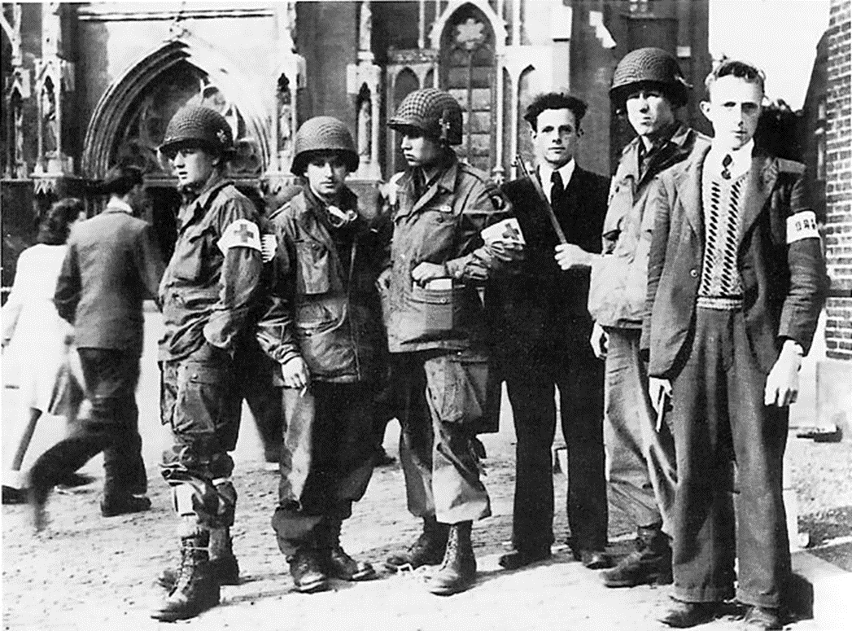
Dutch resistance fighters with US soldiers
Two members of the Eindhoven Resistance group with troops of the US 101st Airborne Division after Allied landings in the Netherlands in September 1944.
(CIA, Public Domain)

Slide 40
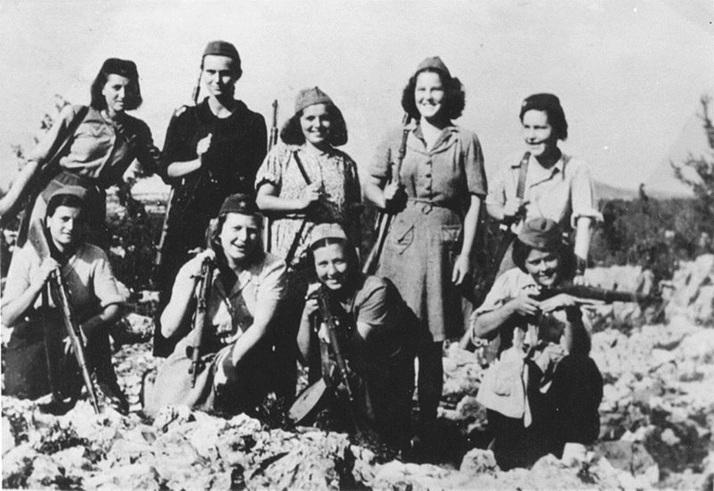
Female Yugoslav partisans in Mount Dinara
This is an all-female group of Yugoslav partisans. The partisans or Yugoslav National Army were large in number and mostly led by the communists. They were fighting the occupying forces of the Nazi Germans and the Fascist Italians. This picture is taken near the border of present-day Bosnia-Herzegovina and Croatia (July 1943).
(Archiv Znaci, 5054, Public Domain)

Slide 41
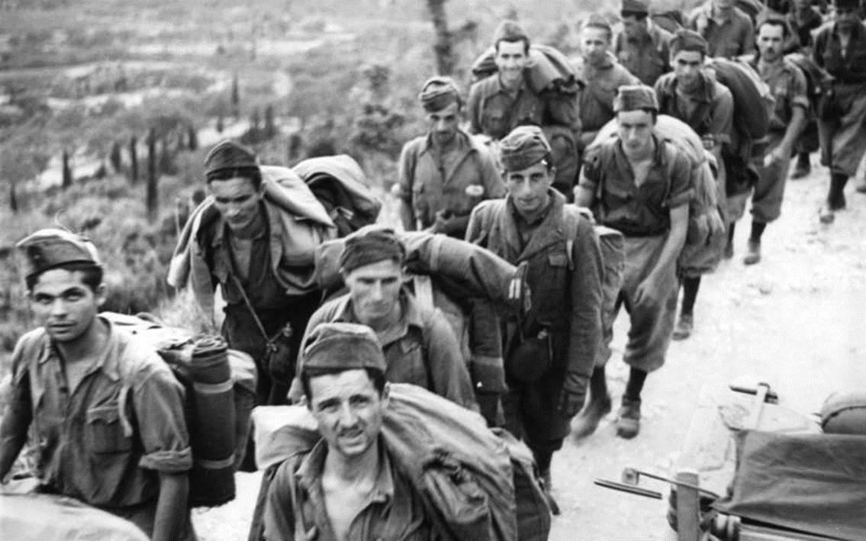
Italian partisan prisoners in Corfu
(Bundesarchiv, Bild 101I-177-1459-32, Cuno, CC-BY-SA 3.0)
After the Italian capitulation to the Allied Forces the northern half of the country came under the control of German forces. In response, the Italian resistance, the “partigiani” movement, started to expand and became very active in the north.
These are Italian partisans captured by German forces soon after the Italian capitulation in Corfu (September 1943).

Slide 42
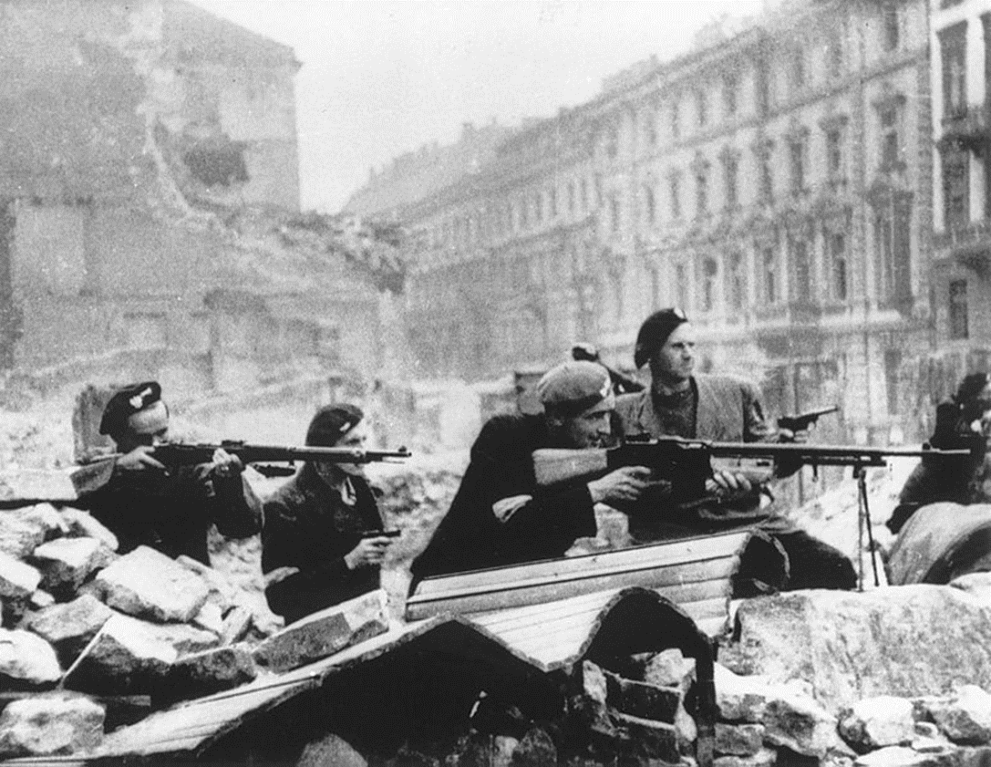
Polish Home Army
The Polish Home Army took part in the biggest resistance operation in the Second World War, namely the Warsaw Uprising.
This image shows soldiers from the Polish Home Army shooting from behind a barricade in the centre of Warsaw (August 1944).
(Jerzy Tomaszewski, Public Domain)

Slide 43
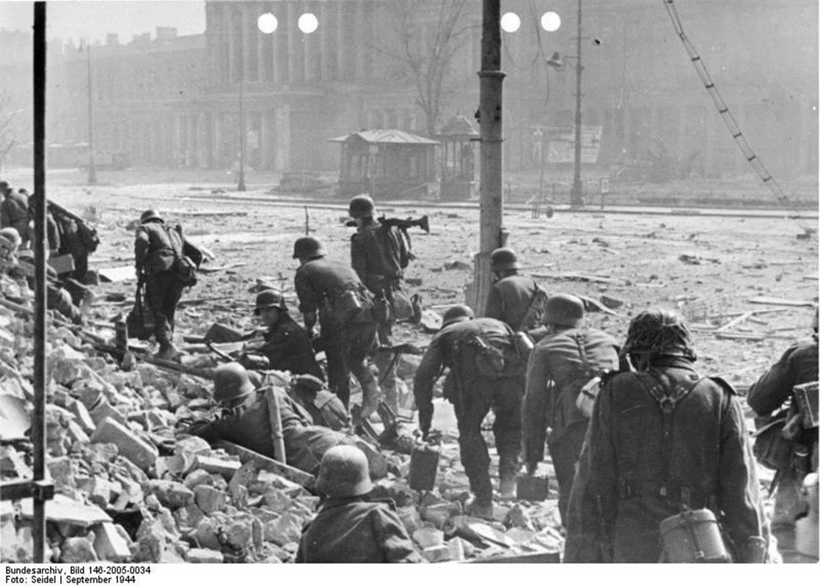
German soldiers during the Warsaw Uprising
German soldiers walk into Theatre Square in Warsaw during the Warsaw uprising, using the rubble caused by shelling as cover. In the background can be seen the National Theatre (11 September 1944).
(Bundesarchiv, Bild 146-2005-0034, Seidel, CC-BY-SA 3.0)

Slide 44
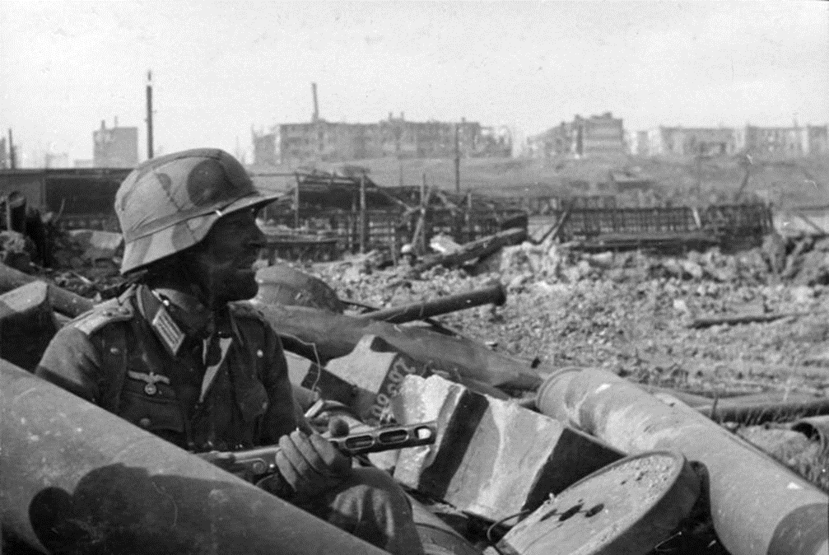
Trench warfare
German Oberleutnant at Stalingrad using a rough defensive barrier from the rubble, which serves as a temporary trench.
(Bundesarchiv, Bild 116-168-618, CC-BY-SA 3.0)

Slide 45
Trench warfare
“Their hair turned grey, their skin dried out, the lightness (and numbers of teeth) vanished from their smiles. And then there were the injuries, truncated limbs and scars.”
An extract from Catherine Merridale’s Ivan’s War
(Catherine Merridale, Ivan’s War: The Red Army 1939-45, London 2005, p. 209)

Slide 46
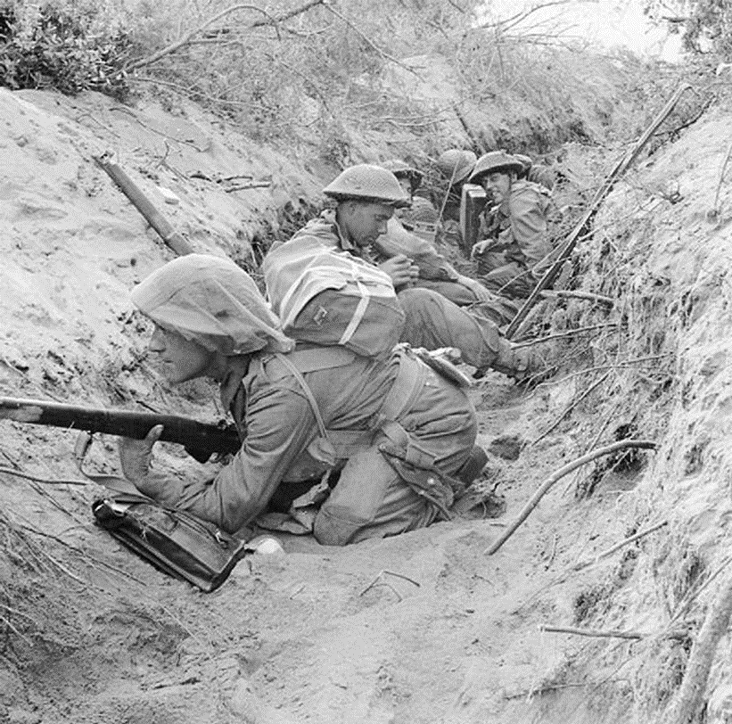
Fighting in trenches
Although the Second World War was much more of a mobile war than the First World War had been, trench warfare was still used in some circumstances. These are men of 'D' Company, 1st Battalion (‘The Green Howards’ in the British Army) occupying a captured German communications trench during the offensive at Anzio, Italy (22 May 1944).
(Imperial War Museums, © IWM NA 15297, Non Commercial Licence)

Slide 47
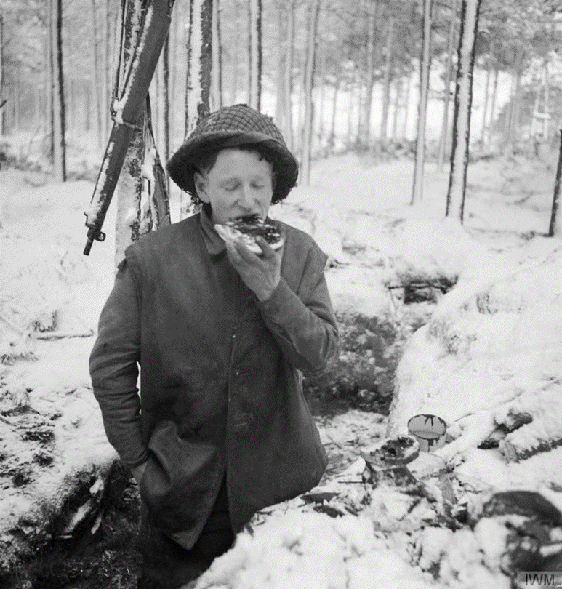
Trenches in The Netherlands
Private G. Carnally (British) eats his midday meal in a trench in the snow, while manning part of the front line along the river Maas in the Netherlands (8 January 1945).
(Imperial War Museums, © IWM BU 1598, Non Commercial Licence)

Slide 48
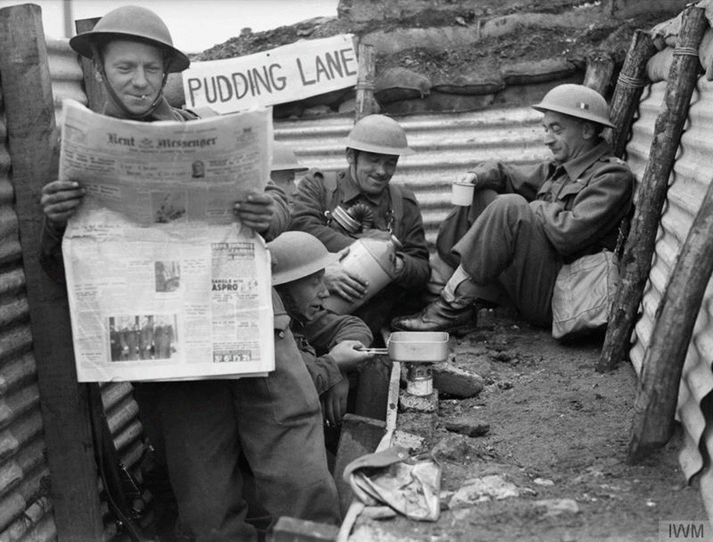
Trenches in France
Men of the British 1st Queen’s Own Royal West Kent Regiment enjoy a tot of rum and are cooking in a section of a trench called ‘Pudding Lane’, 4th division near Roubaix (3 April 1940).
(Imperial War Museums, © IWM F 3551, Non Commercial Licence)

Slide 49
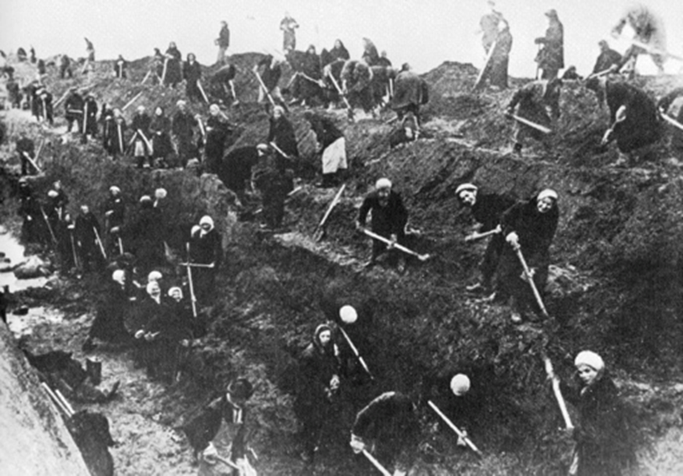
Women digging trenches on the outskirts of Moscow 1941
Russian women digging trenches to defend Moscow from attack by the 2nd, 3rd and 4th Panzer armies of the Wehrmacht during Operation Typhoon.
October 1941 – January 1942
(US Government, Public Domain)

Slide 50
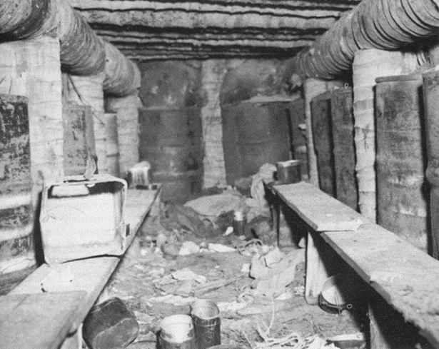
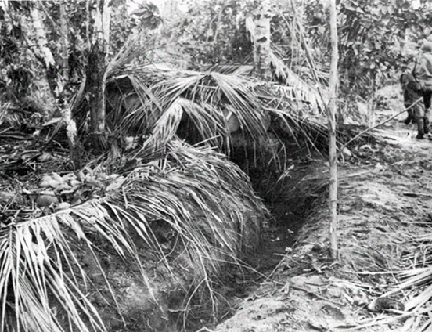
Japanese trenches in the Pacific War, Battle of Buna-Gona, New Guinea 1942-43
The Japanese had taken most of New Guinea earlier in 1942. Now they attempted to take the rest of the island, including Port Moresby, which was in Allied hands. They established beachheads at Buna, Gona and Sanananda to march overland. They encountered fierce opposition from Australian and American troops and built a series of trenches and bunkers in the jungle which were then carefully camouflaged. The top photograph shows one of these bunkers. The bottom photo shows a communication trench between the bunkers.
(United States Army Centre of Military History, Public Domain)
(United States Army Centre of Military History, Public Domain)

Slide 51
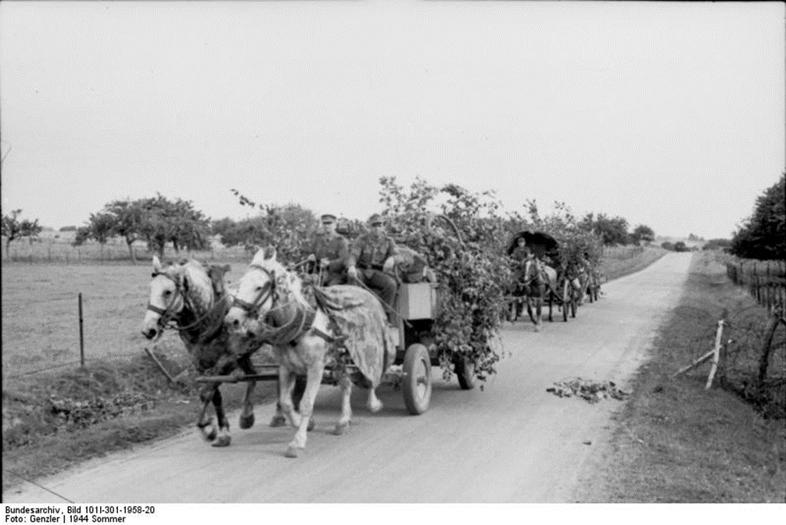
Horse Power in World War 2
A German horse-drawn supply train in Northern France in June 1944.
(Bundesarchiv, Bild 101I-301-1958-20, Genzler, CC-BY-SA 3.0)
We tend to think of World War 2 as a mechanized war. But, most of the belligerent countries in World War 2 continued to use horses throughout the war. Between them Germany and the USSR used over six million horses during the war. Because of shortages of oil and gas the Wehrmacht relied heavily on horses to transport infantry and on horse-drawn artillery, and the problem became worse as the war progressed. The Soviet Union also relied increasingly on horses to move their infantry and artillery as their mechanized vehicles were destroyed or captured during Operation Barbarossa. The Americans, though heavily mechanized, retained a mounted division in the Philippines and the Chinese and Japanese also retained cavalry regiments and horse-drawn artillery.

Slide 52
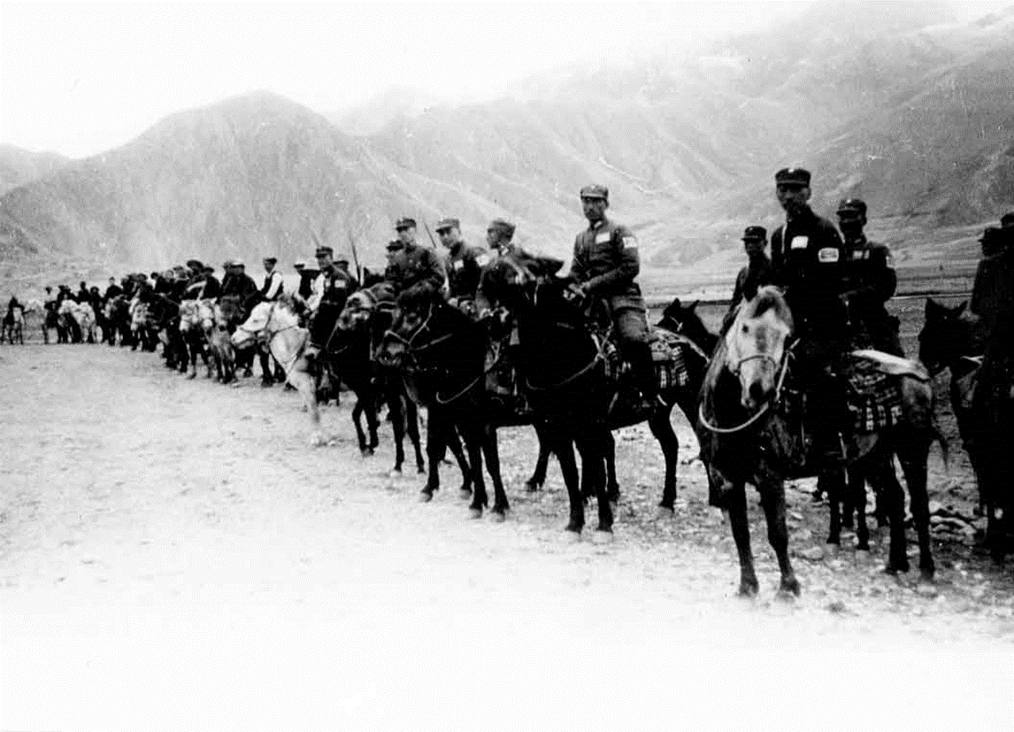
Cavalry in China
The Chinese National Revolutionary Army, fighting Japan in Asia between 1937 and 1945, made extensive use of cavalry divisions (1943).
(People’s Republic of China, Public Domain)

Slide 53
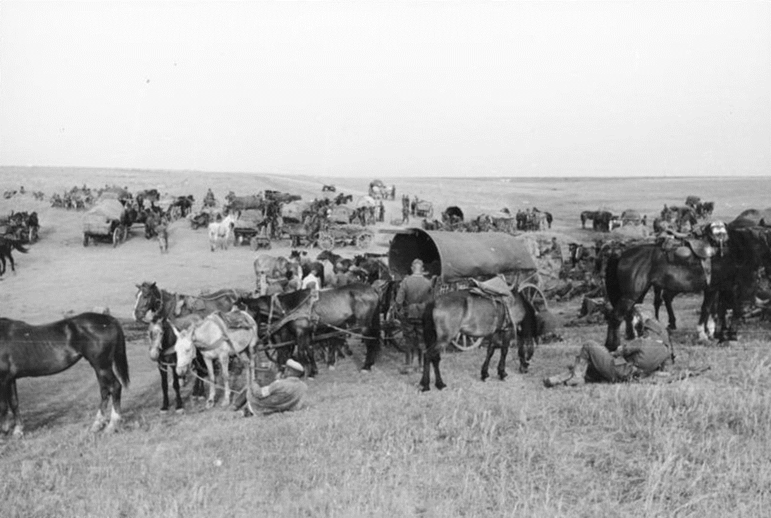
German horses in southern Soviet Union
In the Second World War horses were mainly used to carry materiel, personnel, weaponry and supplies. This regiment is using a large number of horses for this purpose in the South of the Soviet Union (August 1942 ).
(Bundesarchiv, Bild 101I-217-0476-20, CC BY-SA 3.0 DE)

Slide 54
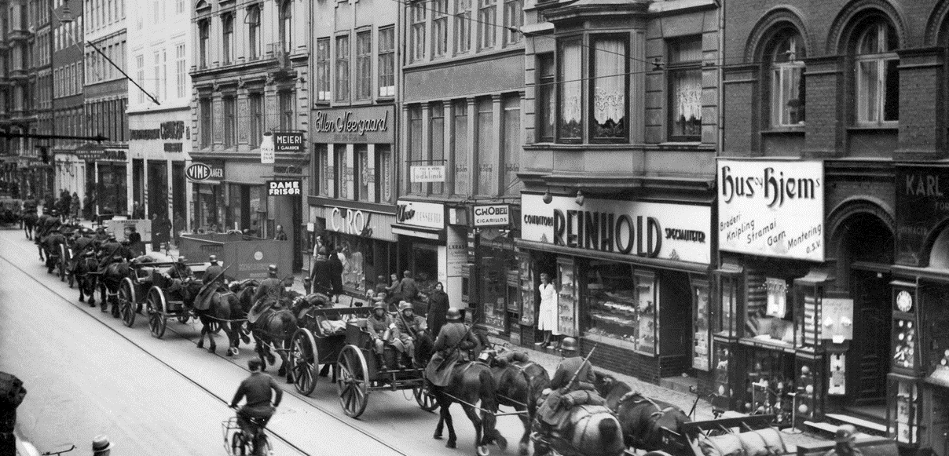
German horses in Copenhagen
Horses were also used by the German forces to parade through occupied cities to demoralise the local population. Here they are parading in Copenhagen.
(Nationalmuseet Denmark, CC BY-SA 2.0)

Slide 55
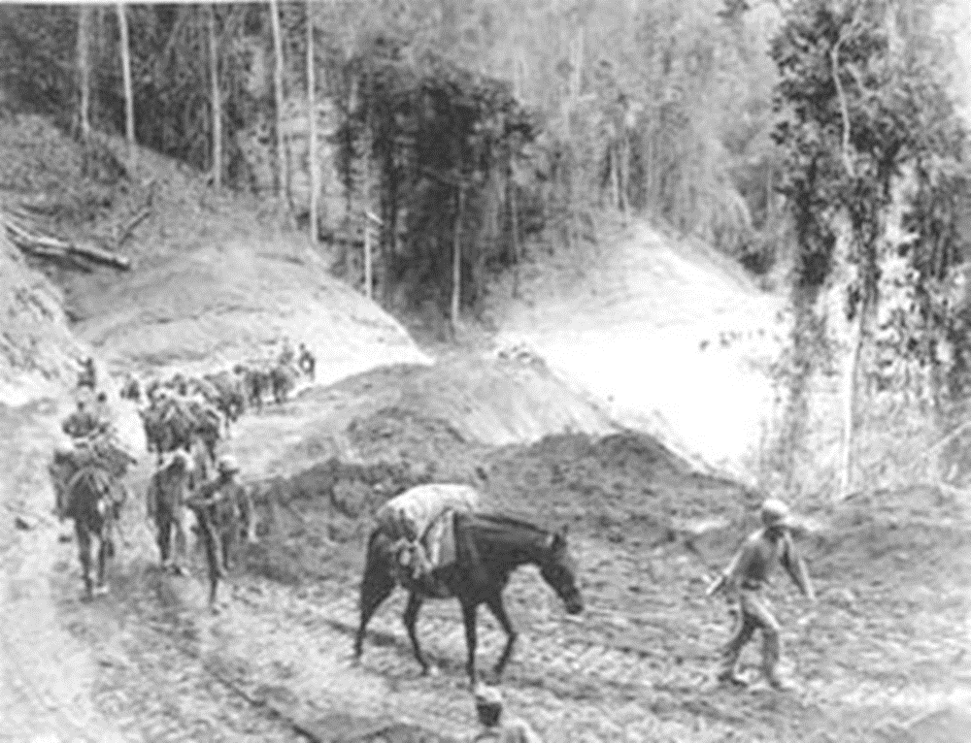
Pack horses and mules in Burma
Pack horses and mules were essential for American forces fighting in North-East Burma where the terrain was difficult for motor vehicles.
(US Department of Defense, Public Domain)

Slide 56
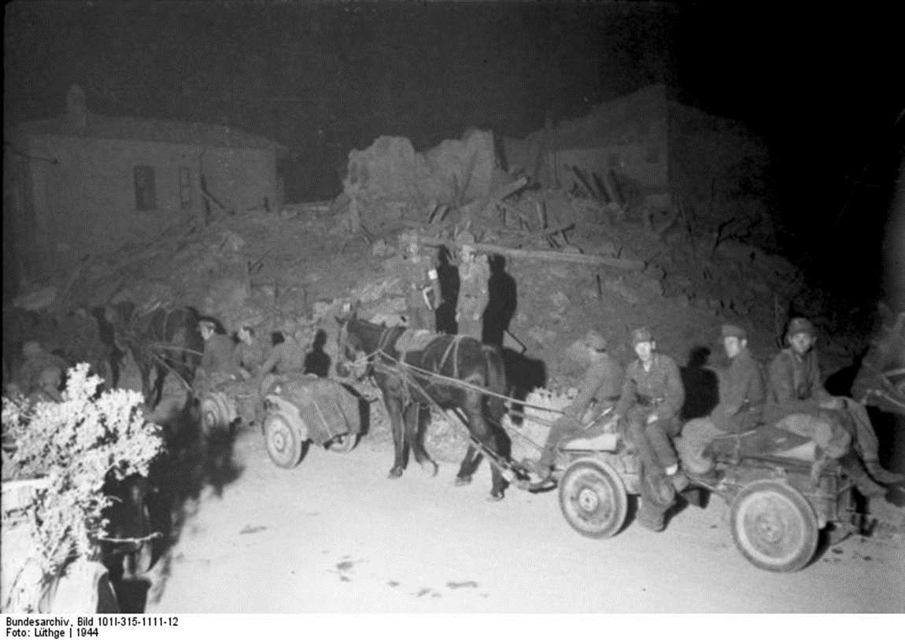
Horses in Rimini/Ancona, Italy (1944)
In 1944, Italy was divided in two parts: the Italian Social Republic in the North and the Kingdom of Italy in the South. The North was occupied by the German army. Rimini and Ancona were part of the occupied zone in the North. The German soldiers made extensive use of horses for transportation of personnel and materiel.
(Bundesarchiv, Bild 101I-315-1111-12, CC-BY-SA 3.0)

Slide 57




War on Land
This collection was made by Laura Steenbrink with the support of Bob Stradling of the Historiana editing team.
(Wikimedia Commons, Public Domain)

