Slide 1
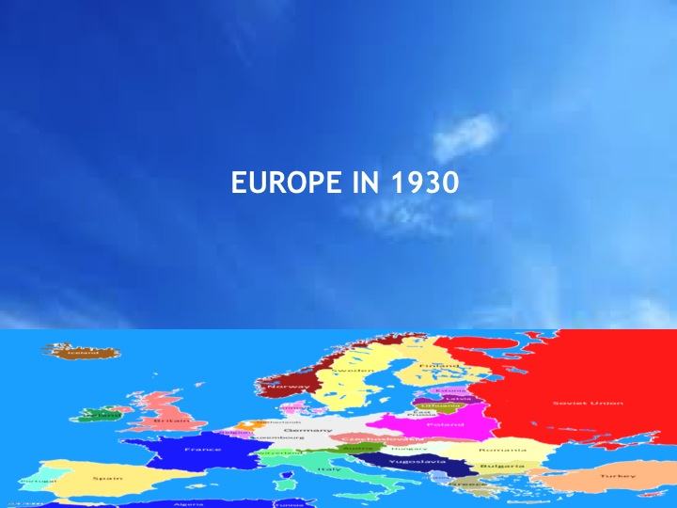
Europe in 1930
When the Treaty of Versailles was being signed on 28 June 1919 Marshal Foch, the Allied Commander in Chief, prophesied that “This is not a peace. It is an armistice for twenty years.” In the late 1920s Marshal Foch appeared to be wrong. In 1928 the Declaration of the Briand-Kellogg Pact to exclude war as an option of foreign policy, except in self defence, had been signed by 65 nations. But by the mid-1930s Japan, Italy and Germany had left the League of Nations and they were ignoring the attempts of Britain and France to maintain the post-war international order.

Slide 2
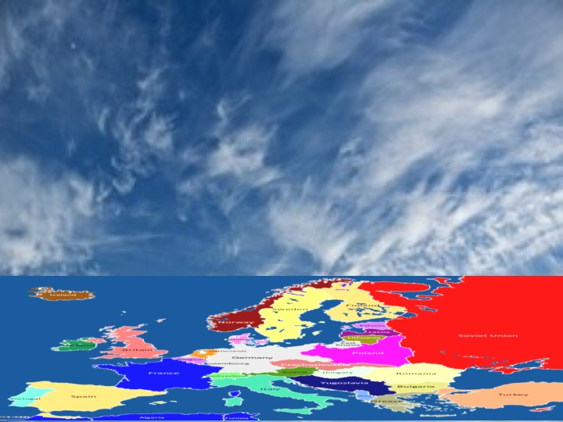
September 1931
Japan invades the Chinese province of Manchuria. This undermines collective security and the League of Nations. Member states trading with Japan are unwilling to risk their interests there by supporting economic sanctions against Japan.

Slide 3
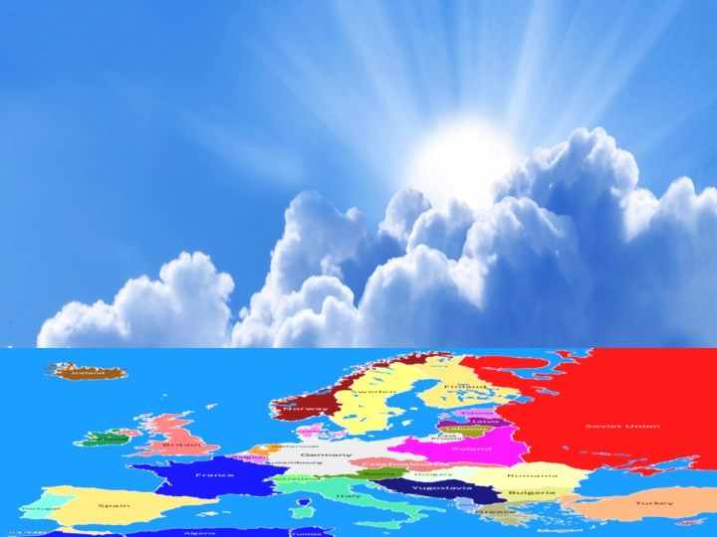
February 1932
Opening of World Disarmament Conference in Geneva.

Slide 4
October 1933
Hitler announces German withdrawal from the Geneva Disarmament talks and from the League of Nations.

Slide 5
April 1935
Announcement of the Stresa Front, an agreement between France, Britain and Mussolini’s Italy which offers hope of combined action to block future German aggression.

Slide 6
May 1935
Agreement of a Treaty of Mutual Assistance between France and the Soviet Union, offering hope of ending Soviet diplomatic isolation, and of protecting Czechoslovakia against future aggression.

Slide 7
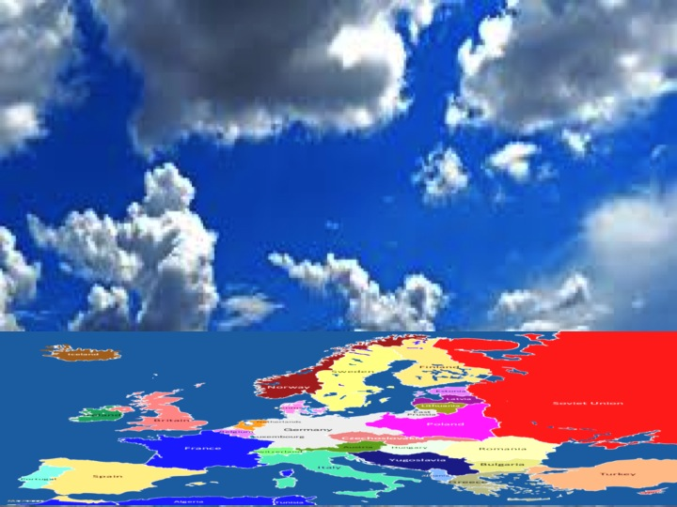
October 1935
Italian forces invade Abyssinia. This undermines hopes raised by the Stresa Front and challenges collective security and the authority of the League of Nations.

Slide 8
March 1936
German forces enter the Rhineland Demilitarised Zone. This unilateral action breaches the terms of the Treaty of Versailles and intensifies fears of German rearmament and future threats to territories bordering Germany.

Slide 9
July 1937
The 2nd Sino-Japanese War begins when Japan invades China. This also intensifies tensions between Japan and both the USSR and the United States.

Slide 10
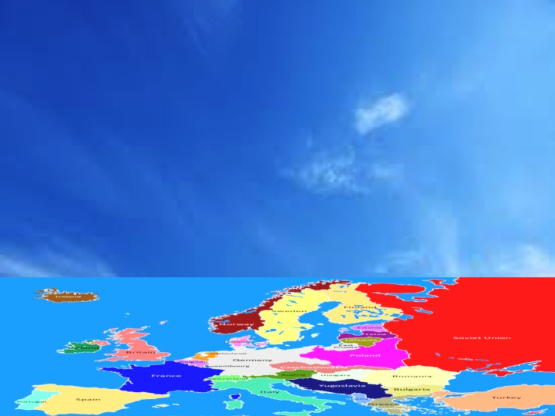
October 1937
US President Franklin Roosevelt makes his ‘Quarantine Speech’ in Chicago. He proposes to use economic sanctions against any aggressor nation. At first the international community sees this as a positive move away from isolationism by the USA. But, if anything American public opinion became even more isolationist after the speech.

Slide 11
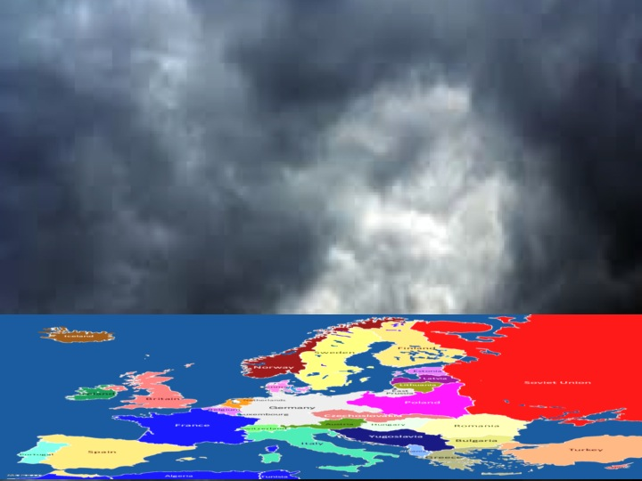
April 1938
German forces enter Austria to secure the Anschluss, the annexation of Austria by Nazi Germany. This does not lead to war but gravely weakens hopes for international peace and stability.

Slide 12
September 1938
Tensions are raised by a German threat to Czechoslovakia. A four-power peace conference in Munich secures an agreement to maintain the peace at the expense of German annexation of Czech western borderlands. At first public opinion in Western Europe believes that the Agreement will ensure peace. It soon comes to be seen as a failed act of appeasement by Britain and France.

Slide 13
October 1938
The fact that Czechoslovakia and the USSR are excluded from the Munich Conference undermines the possibility of future Soviet cooperation with the Western powers against German aggression.

Slide 14
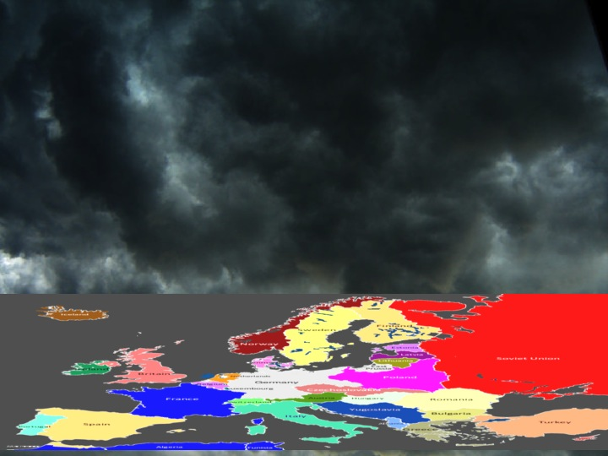
March 1939
The German occupation of Prague, Bohemia and Moravia destroys hopes that the Munich Agreement will ensure a lasting peace.

Slide 15
May 1939
A series of border disputes and military skirmishes had soured Soviet-Japanese relations. After Japan and Germany sign the Anti-Comintern Pact in November 1936 tension between Japan and the Soviet Union escalates until full-scale military conflict breaks out on the Mongolian-Manchurian border.

Slide 16
August 1939
An Anglo-French military delegation travels to Moscow to discuss military cooperation in the hope that this will block German aggression against Poland. BUT…..

Slide 17
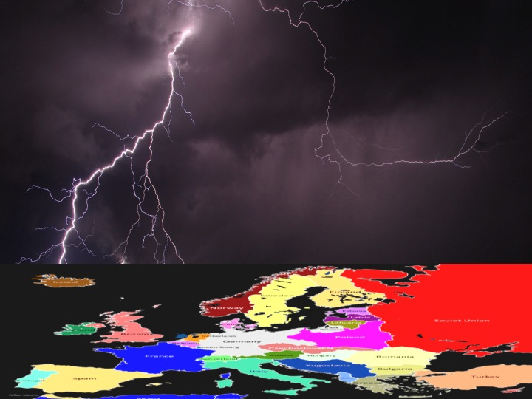
August 1939
Secret negotiations between Germany and the USSR culminated in the dramatic announcement of the German-Soviet Non-Agression Pact. This opened the way for Germany to invade Poland and made a general war in Europe imminent.

Slide 18
The war clouds gather
Text made by Chris Rowe, and graphics made by Bob Stradling of the Historiana Team.
(Wikimedia Commons, Carla Nunziata, CC BY-SA 3.0)

