Slide 1
The Second World War had destroyed the Continent – both spiritually and physically - yet the War had also created the conditions for applying the centuries-old ideal of a unified Europe to the circumstances which now confronted western Europe.
The sheer physical destruction and the horrors of war played a big role in fuelling a critical mass of intellectuals and politicians from many paths of life (Christian Democrats, Socialists, Social Democrats, Liberals) into joining those who had advocated the idea of a unified Europe.

Slide 2
The Advocates of a United Europe
After the Peace of Westphalia in 1648, which ended the Thirty Years War, the idea of national sovereignty began to dominate international relations. This was the idea that each state had sovereignty or exclusive power over its territory and no other state had the right to interfere in its domestic affairs. Of course, states still went to war with each other and sometimes the victor would occupy part of the territory of the loser but this was held to be a temporary state of affairs until a treaty was agreed and then the territorial integrity or sovereignty of the loser would be recognised again. Broadly speaking, this principle underpinned international relations for over 250 years. Nevertheless, in the 19th and 20th centuries there were idealists and visionaries who believed that the best way of preserving peace on the continent was not to try to maintain the balance of power between the most powerful nations through alliances but for each nation state to share some of its sovereignty with its neighbours in a federation or united states of Europe. Unlike empires, where the most powerful nation exercises authority over the less powerful nations within the borders it has imposed by force, this kind of ‘supranational’ organisation necessitated that each member state voluntarily gave up some of its authority to an agreed supranational body that would govern in the interests of all its members.

Slide 3
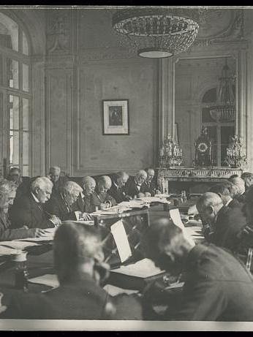
The Paris Peace Conference, 1919
After both the First and Second World Wars most people were clearly weary of war and appalled by the scale of the deaths and devastation. In the inter-war years there were some visionaries who believed that the only solution was a federation or united states of Europe, or, at least, some transnational institutions that would ensure greater political and economic cooperation between the nation states of Europe. At the Paris Peace Conference in 1919 the French industry minister, Etienne Clémental, proposed a new economic order where coordination would replace wasteful competition and the scarce resources needed for post-war reconstruction would be pooled. This idea was rejected by the USA and Britain. Clémental’s assistant was a young Jean Monnet who, after World War 2, played such an important role in establishing the European Community.
Meeting of a committee of allied nations to consider the terms of the Peace Treaty in one of the rooms at the Palace of Versailles in 1919.
(US Library of Congress, no known restrictions on use)
Notes:
https://www.loc.gov/pictures/item/2016652395/

Slide 4
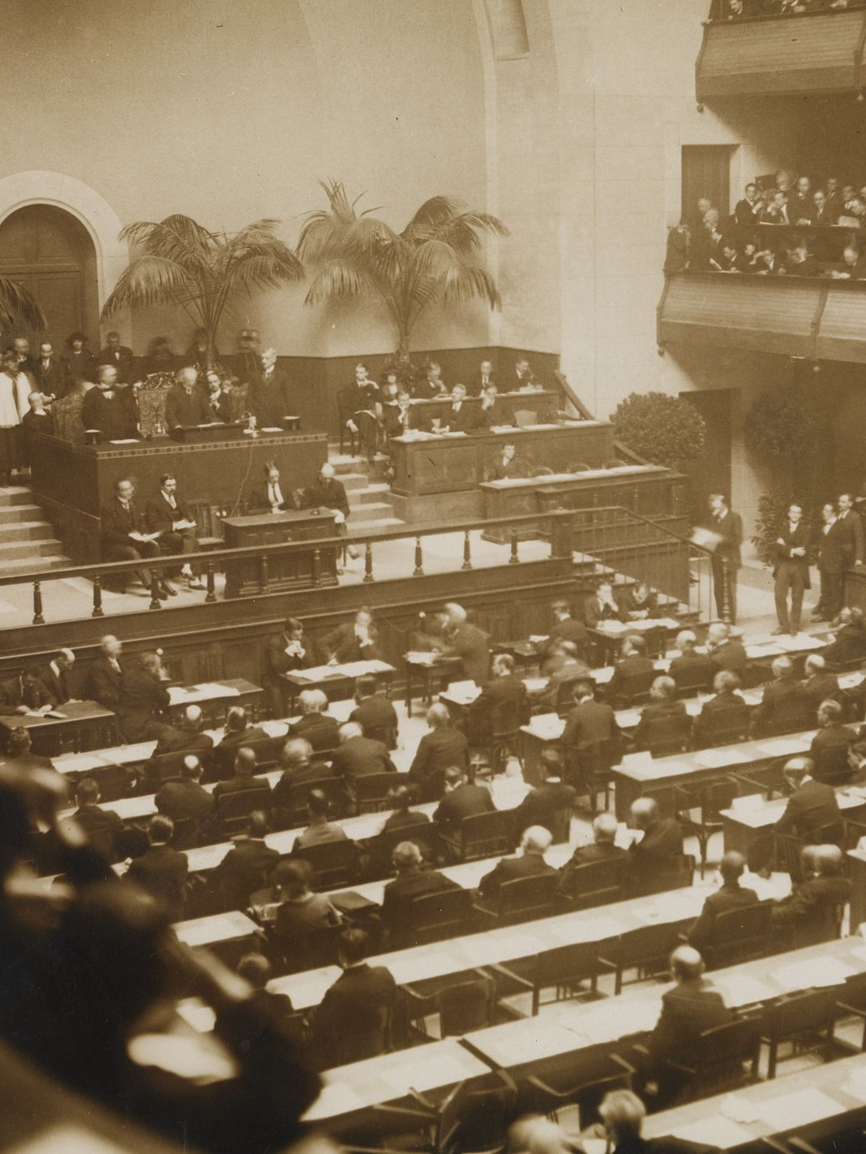
The idea of an international organisation with supranational powers
The League of Nations was an inter-governmental organisation which came into being in January 1920 as a result of the Paris Peace Conference. It had an Assembly of representatives of all the member states which met once a year, a Council which acted as the executive body and a Permanent Secretariat based in Geneva. Two senior officials in the secretariat were the Frenchman, Jean Monnet, deputy secretary general, and the British civil servant, Arthur Salter, who was head of the economic and financial section. Both were impressed by the way the secretariat put aside national interests and loyalties in pursuit of international goals. But they left the League in the 1920s, frustrated by the way that the decision-making process of the Council and Assembly was paralysed by national interests whenever an international crisis emerged. Both continued to be vocal advocates of a supranational rather than an inter-governmental body to maintain peace and promote economic and political cooperation.
Official opening of the League of Nations, 15 November 1920.
(National Library of Norway, Public Domain)

Slide 5
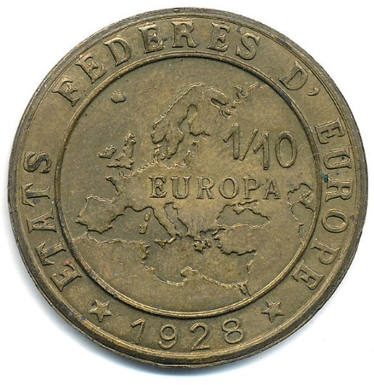
A federation of European States or an intergovernmental association?
(Wikimedia Commons, Defranoux, CC BY-SA 3.0)
In 1923 the Austrian, Count Richard von Coudenhove-Kalergi, founded the Pan-Europa Movement which was committed to a unified Europe. Its secretariat was based in Munich and it had members in most non-communist European nations. It had a particularly strong membership in France, including future presidents and premiers of France such as Léon Blum, Georges Pompidou, Charles de Gaulle and Aristide Briand. In 1929 Briand gave a speech at the League of Nations at which he proposed a federation of European nations based on economic and political cooperation.
Here we see a sample coin for the currency of a European Federation ‘Europa’. In the 1920s the French Government led by Aristide Briand was at the helm of the efforts towards the establishment of a European federation – but this attempt failed.

Slide 6
The origins of the Federal Union in Britain
“(...) national sovereignty is the root cause of the most crying evils of our time and of the steady march of humanity back to tragic disaster and barbarism.
(…) The only final remedy for this supreme and catastrophic evil of our time is a federal union of the peoples so that while every nation is completely self-governing in its own internal affairs all the people are united into a single commonwealth for their common affairs.”
In 1938 a small but influential group emerged in Britain committed to the idea of a federal Europe. They formed an organisation called Federal Union and during the war they established links with resistance movements in occupied Europe. Their literature particularly influenced anti-Fascists in Italy such as Altiero Spinelli. After the war the Federal Union campaigned for British membership of the European Coal & Steel Community and the European Economic Community. Although federalists across Europe had different ideas of what a unified Europe should look like they were agreed that it was essential that the competing and conflicting interests of nations should be translated into a shared political arena through common institutions with the cooperating nations being prepared to give up some degree of national sovereignty in order to achieve mutually beneficial goals.
Lord Lothian (1882-1940, British Ambassador to the USA between 1939 and 1940) wrote this pamphlet for the Federal Union when the Second World War had just begun.
(Lord Lothian, The Ending of Armageddon, Federal Union, Britain, 1939)

Slide 7
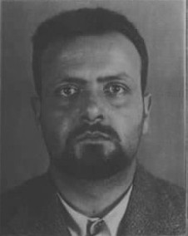
Altiero Spinelli
In the eyes of the longstanding advocates of the European project, World War 2 was a catastrophe that hid a precious opportunity.
The Italian, Altiero Spinelli, a progressive federalist who had been interned by the fascists on the island of Ventotene during the war, co-authored a Manifesto in 1941 that argued for a ‘Revolutionary Federalism’ which would unify Europe and, in the long-term, the world.
Here we see Altiero Spinelli (1907-1986) as a young man. This is the mug-shot taken and archived by the Italian Interior Ministry under the Fascist Regime, during Spinelli’s internment in Ventotene.
(Wikimedia Commons, Public Domain)

Slide 8
The Ventotene Manifesto
“The question which must first be resolved (…) is that of the abolition of the division of Europe into national, sovereign states. The collapse of the majority of the states of the continent under the German steamroller has already placed the destinies of the European populations on common ground: either all together they will submit to Hitler’s dominion, or all together they will enter a revolutionary crisis after his fall (…). The general spirit today is already far more disposed than it was in the past to a federal reorganization of Europe. The hard experience of the last decades has opened the eyes even of those who would not see, and has matured many circumstances favourable to our ideal. (…) A free and united Europe is the necessary premise to the strengthening of modern civilization, for which the totalitarian era represented a standstill. The end of this era will immediately revive in full the historical process of the struggle against social inequalities and privileges. All the old conservative structures which hindered this process will have collapsed or will be in a state of collapse. This crisis must be exploited with decisiveness and courage.”
The Manifesto, produced by Spinelli and Rossi, is written in a style of language that betrays its time and Spinelli’s brief experience as a Communist. But the manifesto did contain the nucleus of a radical political theory and practice aimed at transforming Europe after the war by replacing the old nation states with a new federal institutional structure for Europe.
Spinelli’s vision of a federation of European States did not come true. However, his lifelong battles at the European inter-governmental level (he served as a European Commissioner and then as a Member of the European Parliament in the 1980s) did help to shape the European Union as we now know it, and continues to fuel a vocal Federalist Movement in Europe.
A.Spinelli and E.Rossi, The Ventotene Manifesto, 1941.
(Translation by CVCE)

Slide 9
Revival of the European Project after World War Two
In spite of the failure of the League of Nations to maintain peace during the inter-war years, the major powers opted for setting up another international organisation to keep the peace after the Second World War, the United Nations. There were some key organisational differences. The UN was not founded to administer post-war peace treaties as well as maintain the peace; the USA, the USSR and all the major powers were founder members; it guaranteed the right of any nation state to respond to an armed attack but not to initiate one; and, although the decisions of the Security Council required unanimity, the decisions of the UN Assembly only required a majority vote. In 1949 ten West European states also founded the Council of Europe, another intergovernmental organisation, to uphold human rights, democracy and the rule of law in Europe. Four more states joined in 1950 and now it has 47 members.
However, in these years just after the war there was also a growing feeling amongst some European politicians that, for a number of reasons, more needed to be done to encourage greater political and economic cooperation in Europe rather than return to a situation where competing national interests dominated the inter-governmental decision-making process. The idea of a supra-national European organisation re-emerged and this time it was not just supported by a few idealists and visionaries; it had political backing from some European governments and from the United States.

Slide 10
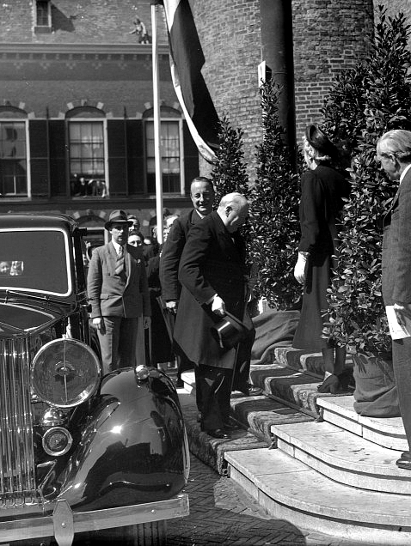
The idea of an international organisation with supranational powers
After the Second World War similar arguments emerged for a supranational organisation where the member states would give up some degree of national sovereignty in order to ensure collective security in Europe. Various organisations emerged with similar agendas, and they came together in Paris on 11 November 1947 to form the International Committee of the Movements for European Unity (ICMEU). This included the Union of European Federalists, the United Europe Movement founded by Winston Churchill, the European Parliamentary Union founded by Count Cougenhove-Kalergi, the French Council for a United Europe, the Independent League for European Cooperation founded by the former Belgian prime minister, Paul van Zeeland, and a number of other similar movements. The ICMEU was involved in organising the Hague Congress in 1948.
Winston Churchill arriving at the Hall of Knights in the Hague to address the Congress in 1948. He argued that the Congress should “resolve that in one form or another a European Assembly shall be constituted”.
(Netherlands National Archive, CC BY-SA 3.0 unported)

Slide 11
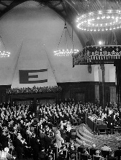
The Hague Congress meeting
The Hague Congress concluded that it was “the urgent duty of the nations of Europe to create an economic and political union in order to assure security and social progress” and that this could only come about by some merging of sovereignty in order to protect collective European democracy. The whole thrust of the deliberations at the Congress seemed to be towards a federation of Europe. This was in spite of the fact that the leading advocates of federalism for Europe, such as Spinelli, were mostly sidelined at the Congress by the heads of government that attended.
The Congress had proposed the founding of the Council of Europe to promote human rights, democracy, European culture and the rule of law in Europe. However, by the time the fine detail had been agreed it was clear that the Council would be an intergovernmental organisation rather than provide the institutional framework for a federation of Europe.
The Hague Congress meeting (7-11 May 1948).
(National Archief, CC BY-SA 3.0)

Slide 12
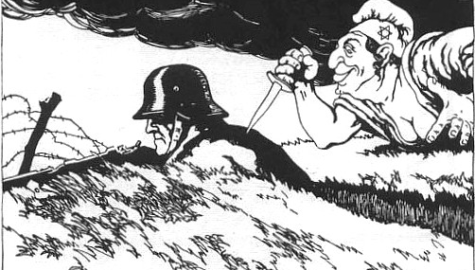
Why did the European Project get more political support after World War Two?
General Erich Ludendorf, German Chief-of-staff, first used the phrase “stabbed in the back” in a conversation with a British General in the autumn of 1919. He blamed the civilian government for surrendering when he believed that the army could have fought on to achieve a more honourable peace. The phrase caught on and soon it was extended to include the socialists and the communists. Also, as we can see in this Austrian cartoon dated 26 March 1919, with its Nazi-style caricature of a Jew, the accusations of treachery were soon extended to include the Jews.
(Wikimedia Commons, public domain (EU))
Why was there a much more concerted effort, with the support of most west European governments, to promote the idea of the European project after the Second World War, even if the emphasis tended to be more on intergovernmental cooperation rather than a supranational federation? There were four main differences between the early 1920s and the late 1940s which could help to account for this.
First, the Second World War ended in 1945 with the unconditional surrender of the Axis powers, whereas in 1918 there was still unfinished business. Fighting had continued in eastern Europe. The civilian German government rather than the German High Command, had signed the terms of surrender and this had allowed the army to perpetuate the myth of “the stab in the back” and to refuse to accept that Germany had lost the war. This was not the case in 1945.

Slide 13
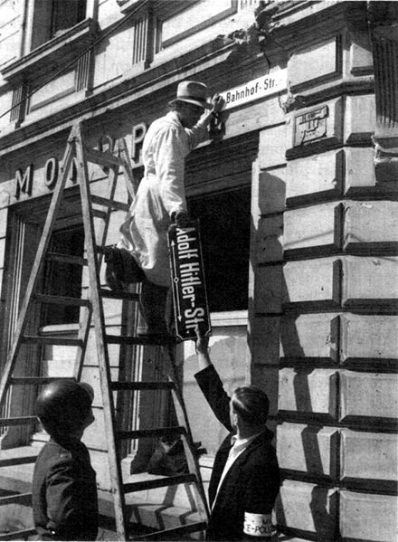
Why did the European Project get more political support after World War Two?
Second, the kind of authoritarian, fascist, or nationalist forces which had overthrown Europe’s democratic regimes in the inter-war years were in total disarray in 1945 in those countries that had fought the war. Those who had lived in occupied western Europe during the war were in no mood to allow home-grown authoritarian, fascist, or nationalist factions to gain power. In eastern Europe the communist parties were seeking power through the ballot box but not attracting sufficient support to form majority governments.
Here, a street in Trier, Germany, erases its old name “Adolf Hitler Strasse”, 12/05/1945, just a few days after the Führer’s death.
(Wikimedia Commons, Public Domain)

Slide 14
Why did the European Project get more political support after World War Two?
“the problem of evil will be the fundamental question of post-war intellectual life in Europe – as death became the fundamental problem after the last war.”
Hannah Arendt, Eichmann in Jerusalem: A Report on the Banality of Evil, New York 1963.
“While the courts were defining the monstrous crimes that had just been committed in Europe, Europeans themselves were doing their best to forget them…… The wartime occupation.. was a humiliating experience and postwar governments preferred to forget collaboration and other indignities and emphasize instead the heroic resistance movements, national uprisings, liberations, and martyrs.”
Third, the public mood in 1945 was different from 1919. After World War One the harsh terms in the Peace Treaties had fueled deep resentment in the nations that had lost the war or, like Italy, had expected more from victory. After World War 2 there was a desire to get on with reconstruction, but there was also a strong feeling of guilt about what had happened and what had been allowed to happen. These two quotes, from the political theorist Hannah Arendt and the historian Tony Judt, highlight the pervasiveness of this feeling. Arendt, reporting on the war crimes trial of Adolf Eichmann, referred to the “banality of evil” where ordinary people committed terrible atrocities without thinking about the consequences while in every other respect lived normal lives. The historian Tony Judt suggested that, until the 1960s, most people in Europe tried to forget what had happened, preferring to believe that the Nuremberg trials had addressed Arendt’s “problem”. However, both authors observed that after 1945 people were confronting the consequences of a war where more civilians than soldiers had died. There was a growing recognition that in future more radical solutions might be needed to limit the impact of competing national interests.
(Tony Judt, The ‘problem of evil’ in post-war Europe’ in New York Review of Books, 14 Feb, 2008)

Slide 15
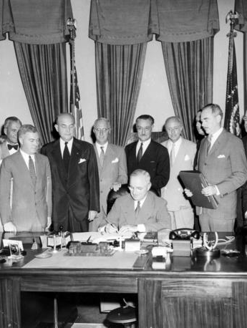
Why did the European Project get more political support after World War Two?
Finally, the geopolitical landscape in 1945-50 had greatly changed compared with the 1920s. After World War 1, the United States and the USSR disengaged from post-war international relations. The USSR was still a pariah state in Europe without diplomatic recognition and excluded from the League of Nations. The United States had returned to its pre-war isolationist position and Congress had rejected membership of the League. After World War 2, the geopolitical landscape was very different. Former Allies in the war now saw each other as a threat to their own security. The USSR was creating a buffer zone within central and eastern Europe to ensure that it could not be attacked from the west. The United States, believing that peaceful coexistence with the USSR was not possible, now formulated its policy of containment, using military and economic aid to resist further expansion of Soviet influence in Europe and around the world.
President Harry S. Truman (seated), in the presence of representatives of the other member nations, signs the proclamation which brought the 12-nation North Atlantic Pact into being. The White House, Washington, USA, 24 August 1949.
(Abbie Rowe, National Park Service. Harry S. Truman Library & Museum. Accession Number: 73-3193)

Slide 16
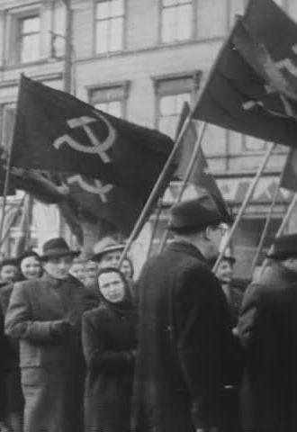
The growing divide between eastern and western Europe.
Political elections held between 1945 and 1950 confirmed a divide between Western and Eastern Europe. After the war the communist parties in most central and eastern European countries were small. The communist party only had a mass base in Czechoslovakia, Yugoslavia and Albania. The Kremlin’s strategy was the formation of Democratic or National Fronts involving coalitions between the communists, the socialists and the other anti-fascist parties. The communists in the coalition government would then gain control of the ministries of justice and the interior, the army and broadcasting. With the help of Soviet occupying forces they would usually establish a secret police force as well. A pattern emerged where anti-communist opponents would be politically undermined, arrested, murdered or “disappeared”. The communists had little success in the democratic elections in the East German zone and in Austria and therefore employed non-democratic means to gain power. In Poland the election in 1947 was rigged in favour of the Communists. In Czechoslovakia in the May 1946 election the communists won 38% of the vote and were the largest party. They formed a coalition government with non-communist parties but in 1948 they seized power through a coup.
Pro-communist demonstrators in Czechoslovakia in the winter of 1947 before the Communist Party staged a coup and ousted the other parties from the coalition government.
(US National Archives, Public Domain)

Slide 17
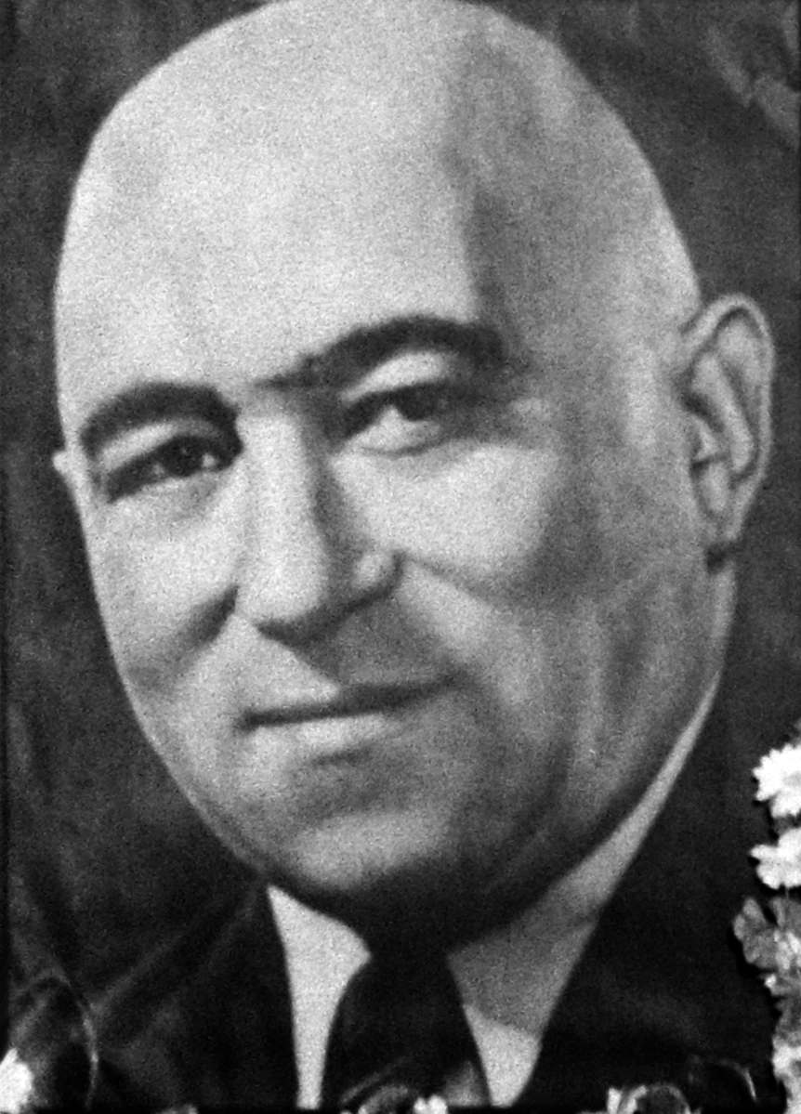
The growing divide between eastern and western Europe.
In April 1945 in Hungary, after the Axis forces had been driven out of the country by the Red Army, the Hungarian Communist Party (HCP), with the support of the Social Democrats and the trade unions, held a majority of seats in the Assembly and led the provisional government. However, when a free democratic election was held in November 1945 the communists only won 17% of the vote. The Independent Smallholders was the largest party and only three seats short of a majority. The communists formed a leftist bloc within the coalition government and gained control of key ministries. They used this influence to undermine the leadership of the Independent Smallholders, some of whom were arrested and charged with conspiracy and even espionage against the Red Army. In the 1947 election the communists only got 22% of the vote in spite of election fraud on a wide scale. They continued to use the secret police to undermine opposition. Mátyás Rákosi, leader of the HCP, described his approach to any opposition as “salami tactics” – cutting off the opposition parties “like slices of salami”. It worked. When the next election was held in 1949 the Communists received 95% of the vote.
Mátyás Rákosi, leader of the Hungarian Communist Party (HCP) from 1945-48 and then leader of the Hungarian Working People’s Party from 1948-56 which was the result of a forced merger between the HCP and the Social Democrats.
(Wikimedia Commons, CC BY-SA 3.0 unported)

Slide 18
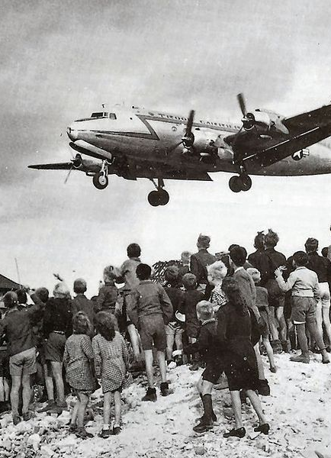
The growing divide between Western and Eastern Europe
Two other events in the late 1940s contributed to growing east-west division. First, the civil war in Greece (1946-49) between Greek communists, supported by the governments in Albania and Yugoslavia, and the army of the royalist government backed by the Western Allies. Second, the Berlin Blockade (June 1948 - May 1949) that isolated West Berlin from the rest of western Germany and led to the Berlin airlift in which US and British planes flew in essential supplies for West Berliners.
Berliners watch a US plane bringing much needed supplies, 1948. The airlift was organised by US and British Air Forces in response to the Soviet decision to blockade Berlin.
(Wikimeda Commons, US Air Force, Public Domain)
Notes:
The DC party is now defunct and Wikipedia have used this poster in a collage of three posters on the following grounds. The image is from:
Christian Democracy (Italy), a now defunct political party, and is used based on fair use of an image, specifically in reference to point 4 "Other promotional material: Posters, programs, billboards, ads. For critical commentary.”
We could make the same claim for its use by Historiana, so I think it is worth inclusion on that basis. The Praga 1938-1948 poster form thg 1948 Italian election does not seem to be in the public domain or Creative Commons so I have opted for this alternative.

Slide 19
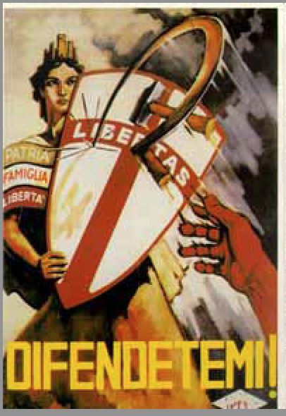
The growing divide between Western and Eastern Europe
These developments in Greece and Berlin influenced the first post-war elections in France and Italy. The communists had strong support in both countries because of their role in the wartime resistance. But in both elections the communists were presented as a threat to democracy and links were made to the Greek civil war, the Berlin airlift and the recent elections in eastern Europe. The French communists were partners in the coalition government in 1946 but excluded from government in May 1947 after a series of industrial strikes encouraged by Moscow. The Italian communists were strong in the industrial cities of northern Italy but never participated in coalition governments.
A poster produced by the Christian Democrat Party for the 1946 Italian election. It portrays Italia Turrita, the national personification of the nation, raising a shield to defend Italy against the communist hammer and sickle.
(Wikimedia Commons, fair use.)
Notes:
The DC party is now defunct and Wikipedia have used this poster in a collage of three posters on the following grounds. The image is from:
Christian Democracy (Italy), a now defunct political party, and is used based on fair use of an image, specifically in reference to point 4 "Other promotional material: Posters, programs, billboards, ads. For critical commentary.”
We could make the same claim for its use by Historiana, so I think it is worth inclusion on that basis. The Praga 1938-1948 poster form thg 1948 Italian election does not seem to be in the public domain or Creative Commons so I have opted for this alternative.

Slide 20
Inter-governmental cooperation or integration?
In 1945 the countries of western Europe, especially France, were mainly concerned about how to prevent Germany, or at least its western part, from rapidly becoming an economic power that could again threaten the peace of Europe. Part of their solution was greater economic and political cooperation between the countries on the western borders of Germany. In 1944 the governments in exile of Belgium, Luxembourg and the Netherlands had signed a treaty in London which established a customs union between the three countries. This became the Benelux union, an inter-governmental organisation in which ministers from the three countries would agree policies on economic, social and financial cooperation and then the three national parliaments would convert these policies into law. At the same time, France proposed to take control of the industrial heartland of the Ruhr and the Saar on Germany’s western borders. This was known at the time as the Monnet Plan after Jean Monnet, pre-war advocate of a united Europe and later to be recognised as one of the founders of the European Union.
However, it soon became apparent that it was the new geopolitical landscape and the United States’ concern with containing the Soviet threat rather than fear of a resurgent Germany that would determine the kind of cooperation and integration that would emerge in western Europe.

Slide 21
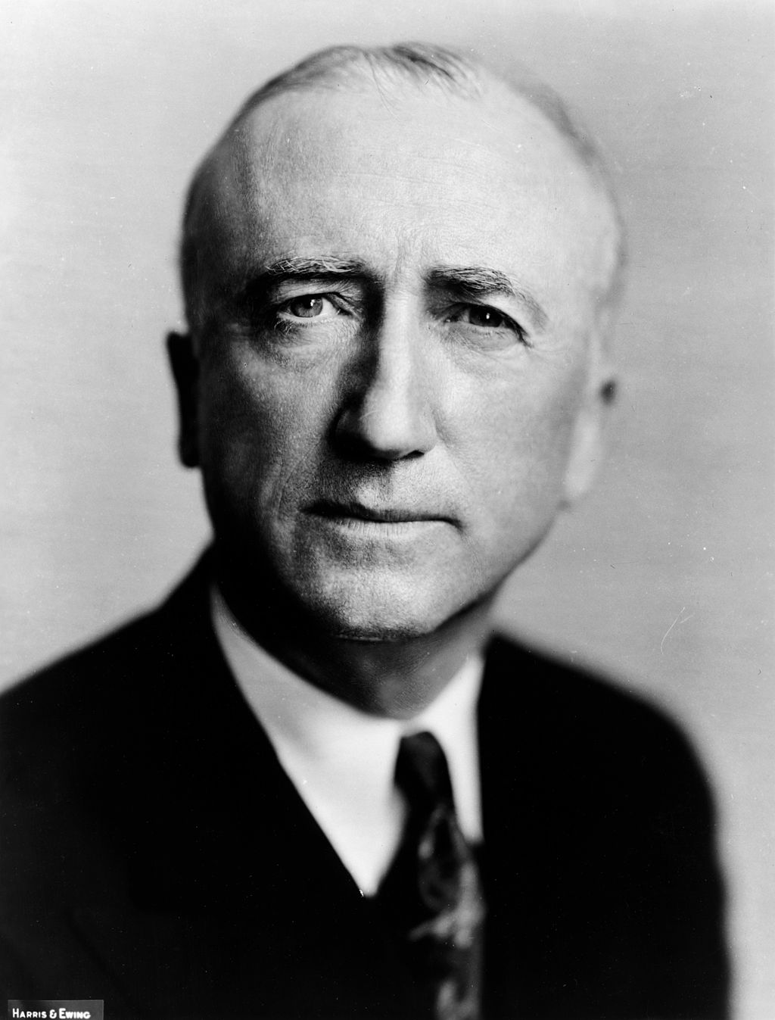
The Monnet Plan
In 1945 Jean Monnet was responsible for the economic reconstruction of post-war France. His plan (not to be confused with the Schuman Plan which Monnet later helped to draw up) proposed to keep Germany’s heavy industries weak and re-build French industry, particularly iron and steel production, using coal and steel from the Ruhr and Saar areas of western Germany. This necessitated French control over those areas. In many respects the Monnet Plan resurrected a policy that had been adopted after the First World War which had been deeply resented in Germany and fuelled support for National Socialism. The United States feared that this time a similar action would also lead to resentment and to increased support for communism in the western zones of Germany. James F. Byrne, US Secretary of State, in a speech in Stuttgart, 6 September 1946, known as the Restatement of Policy on Germany, made it clear that the United States would not support the Monnet Plan:
“The United States will not support any encroachment on territory which is indisputably German or any division of Germany which is not genuinely desired by the people concerned. So far as the United States is aware the people of the Ruhr area and the Rhineland desire to remain united with the rest of Germany. And the United States is not going to oppose their desire.”
James F. Byrnes, U.S. Secretary of State (1945-47).
(Library of Congress, Public Domain)

Slide 22
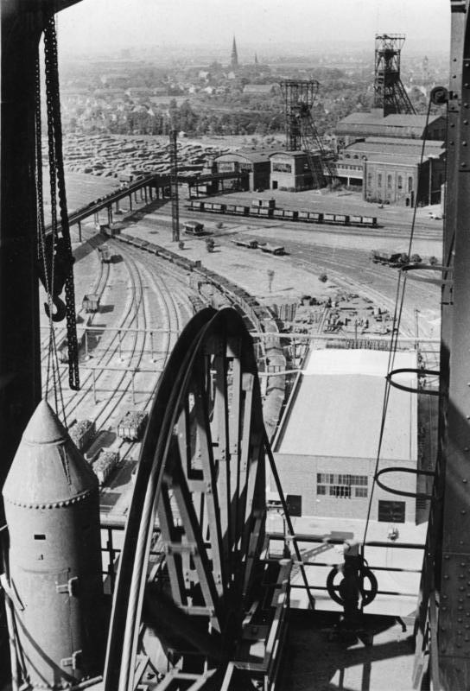
The International Authority for the Ruhr (IAR)
Instead of the Monnet Plan the United States, the Benelux countries, Britain and France signed the London Agreement, on 28 April 1949 which established the International Authority for the Ruhr (IAR). This was an inter-governmental body, with a secretariat in Düsseldorf, to control the coal and steel industries in the Ruhr. It was imposed on West Germany as a condition for allowing them to establish the Federal Republic of Germany.
Essentially the IAR now controlled the West German economy, at least in terms of industrial manufacturing, because it could determine just how much coal and steel from the Ruhr would be allocated to West Germany. On 27 May 1952 the IAR was replaced by the European Coal and Steel Community.
Heavy industry in the Ruhr valley in 1949 after it had come under the control of the International Authority for the Ruhr.
(Bundesarchiv, Bild 183-R80414 / CC-BY-SA 3.0)
Notes:
https://commons.wikimedia.org/wiki/File:Bundesarchiv_Bild_183-R80414,_Essen,_Zeche_%22Zollverein%22.jpg

Slide 23
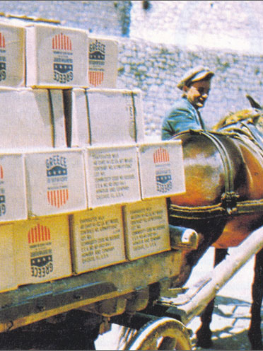
The Marshall Plan
On June 5 1947 US Secretary of State George C. Marshall, gave a speech at Harvard University in which he outlined the European Recovery Program (ERP), otherwise known as the Marshall Plan. It met with strong opposition in the US Congress and the amount of money made available was reduced from the proposed $17 billion to $12.4 billion. However, it became law on 3 April, 1948. The Marshall Plan was also offered to the Soviet government and its satellite States. However, Moscow refused to accept financial aid that would have established a form of US oversight over the Soviet economy and put pressure on the other countries of the Eastern Bloc to also reject participation in the plan.
Sixteen western European countries did participate in the ERP, including the defeated Axis powers, Austria, Italy and West Germany. Britain was the largest recipient of US aid, at around $3.3 billion, France received $2.3 billion, the Benelux countries nearly $2 billion, while Germany received just under $1.5 billion.
Donkey carrying U.S. supplies delivered to Greece as part of the aid provided under the Marshall Plan. 1952.
(Wikimedia Commons, Public Domain)

Slide 24
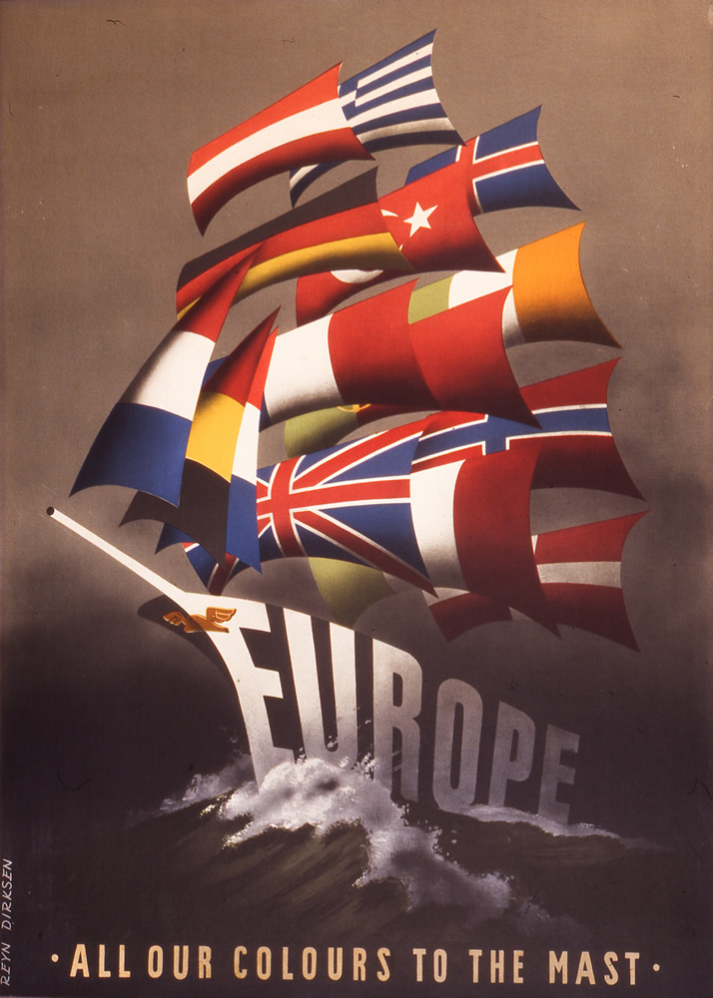
The Marshall Plan
The Marshall Plan had three broad aims: (1) to assist in the rebuilding of Europe’s war-torn communities and economies; (2) to expand levels of trade between US firms and European markets; and (3) to support the Truman Doctrine in reducing the spread of communism beyond the Eastern bloc.
It was clear, soon after the announcement of the Marshall Plan, that Washington wanted a unified response from the 16 European countries that were prepared to sign up to the plan. On 21 April, 1947 a committee convened by the US State Department reported that: “(The) cost and duration of the United States economic assistance are directly dependent upon the successful integration and coordination of the economic programs in the critical countries both with each other and with similar programs in countries not receiving special US aid.” To facilitate this process 16 European countries met in Paris to draw up, what Georges Bidault, the French Foreign Minister, called “a balance sheet of the assets and needs of Europe” to be sent to the U.S. Government.
Less than a year later the Organisation for European Economic Cooperation (OEEC) was formed to supervise the distribution of the aid provided under the European Recovery Program.
One of the posters created as part of an international competition to promote awareness of the ERP (Marshall Plan). The theme was the countries of Western Europe working together to re-build their economies and create stable democracies.
(Marshall Foundation, CC BY-NC-ND.2.0)
Notes:
http://marshallfoundation.org/library/posters/marshall-plan-poster-colours-mast/
The original source of the posters is the OECD. These posters are free to use provided the source is attributed and they are used for non-commercial purposes (NC) and are not derivatives, i.e. modified (ND)
Attribution: CC BY-NC-ND.2.0

Slide 25
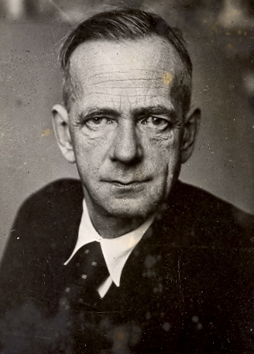
Responses to the idea of European integration
The requirement by Washington for some measure of integrated cooperation in Europe to administer the European Recovery Plan was not universally welcomed in western Europe. For some left-wing parties the idea of European integration was perceived as an American ‘Trojan Horse’.
Kurt Schumacher, leader of the German Social Democratic Party (SPD) thought that the European Project was a “conservative, clerical, capitalist, trust-driven [attempt] to create a Europe whose capitalist structure, poor democratic credentials and lack of social vitality would make it an easy target for an attack from the East.” But this position was challenged within the party by the elected SPD mayors of Berlin, Bremen and Hamburg and their supporters such as the rising politician, Willy Brandt, who later led the SPD and became Chancellor. They saw the potential economic and political benefits of integration.
Kurt Schumacher, Chairman of the German Social Democratic Party 1946-1952. He was a fierce opponent of both National Socialism and Communism, describing the East German and Soviet communists as “red Nazis”. During the Third Reich he spent 10 years in concentration camps and was a witness at the Nuremberg trials.
(Wikimedia Commons, Public Domain)
Notes:
Wikimedia Commons
Public Domain (USA)

Slide 26
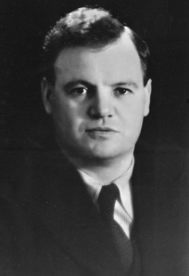
Responses to the idea of European integration
Although the French Socialist Party supported France’s participation in economic and political cooperation with other European countries in order to implement the Marshall Plan, the French Communists, as these two quotes demonstrate, were totally opposed:
“Western Europe [will] be reduced to being a semi-American colony and drawn into an aggressive war against the USSR.”
Maurice Thorez, [leader of the French Communist Party] quoted in the French Socialist newspaper, L’Action, 10 December 1947.
“After disorganizing the national economies of the countries which are under the American yoke, American leaders now intend conclusively to subjugate the economy of these countries to their own interests.”
L’Humanité, (Newspaper of the French Communist Party), 18 September 1944.
Maurice Thorez, leader of the French Communist Party from 1930 to 1964.
(Wikimedia Commons, Public Domain, France)
Notes:
https://commons.wikimedia.org/wiki/File:Thorez.jpg

Slide 27
Responses to the idea of European integration
The official British view on European integration was clearly stated by Sir Stafford Cripps, the Chancellor of the Exchequer (Finance Minister) of the Labour Government elected in 1945. It was a view that was to be re-stated again and again by British politicians throughout the second half of the 20th century and up to the point when the British electorate voted in a referendum (by 52% to 48%) to leave the European Union on 23 June 2016.
“It does not, however, seem to us – as at present advised – either necessary or appropriate to invest a supra-national authority of independent persons with powers for overriding Governmental and Parliamentary decisions in the participating countries…Certainly this Parliament has always exercised the greatest caution as to agreeing to any removal from its own democratic control of any important element of our economic power or policy.”
The British, as the recipient of the largest amount of US Aid were, not surprisingly, keen on cooperating with their neighbours to obtain an agreed proposal that could be sent to Washington. Indeed, the British, along with the French government were the prime movers in organising the Paris Conference of the 16 countries seeking Marshall Plan aid. They supported an inter-governmental initiative. Just as they had supported the mutual defence pact of the Treaty of Brussels in 1948 and then the setting up of NATO, they also supported the idea of the OEEC.
However, they were wary of any initiative that looked likely to lead to greater integration, shared sovereignty over certain economic policies or a federal Europe.
Speech given by Sir Stafford Cripps, Chancellor of the Exchequer to the British House of Commons, 26 June 1950.

Slide 28
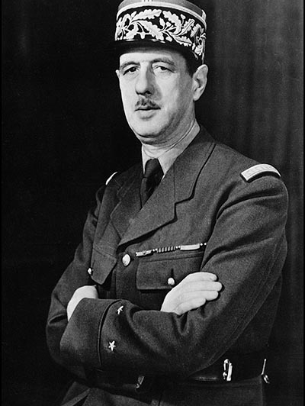
Responses to the idea of European integration
In France, leftist opposition to the European Project was matched by Conservative opposition. The war hero, General De Gaulle, had led the Provisional Government of France from 20 August 1944 to 20 January 1946. Elections to the Assembly were held in October 1945 but de Gaulle was unwilling to lead a coalition government which assigned any ministerial posts to the Communists. He resigned and formed his own political party, the Rassemblement du Peuple Français (RPF) which he hoped would gain enough popular support to return him as President with a mandate to give the presidency more executive powers. His supporters voted against ratification of the 1951 Treaty of Paris that established the European Coal and Steel Community (the immediate predecessor to the 1957 European Communities) out of concern over a possible loss of French sovereignty.
General Charles de Gaulle, circa 1942, when he was leader of the Free French forces.
(Library of Congress, LC-USZ62-96-46, right status not evaluated)

Slide 29
The Schuman Plan and the European Coal and Steel Community
On 9 May 1950, Robert Schuman, French Foreign Minister, declared that:
“Through the consolidation of basic production and the institution of a new High Authority, whose decisions will bind France, Germany and the other countries that join, this proposal represents a step towards a European federation, imperative for the preservation of the peace.”
Subsequently the Federal Republic of Germany, Belgium, Italy, Luxembourg and the Netherlands all agreed to join this initiative and thus the European Coal and Steel Community (ECSC) was created.
So, the impetus for some degree of European economic and political integration and for the consolidation of US influence in western Europe, came initially from the United States through the Marshall Plan and the Truman Doctrine. However, the kind of integration envisaged by Washington was a long way from the idea of a United States of Europe that the federalists, such as Altiero Spinelli and Jean Monnet, had envisaged during and after World War Two.
While the far left expressed concern about an American “trojan horse” the initiative which most aroused concern in the British government and amongst Gaullists in France centred on the Schuman Plan for a supra-authority to take control of coal and steel production in western Europe. Recognising that the Federal Republic of Germany wanted to be free of the restrictions of the International Authority for the Ruhr, Jean Monnet negotiated with Chancellor Adenauer and then presented the French Foreign Minister, Robert Schuman, with a proposal to place all French and German production of coal and steel under a High Authority which would also be open to other European states.
Extract from a speech given by Robert Schuman, in the famous Clock Room in the Ministry of Foreign Affairs, Quai d’Orsay, Paris on 9 May 1950.

Slide 30
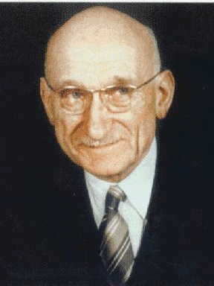
Formation of the European Coal and Steel Community
Schuman was proposing the first supranational European organisation, although he studiously avoided using the term in his Declaration. It was supranational in the sense that each of the six member states had to delegate to the High Authority some of its sovereign power and responsibility for coordinating the production and internal market for coal and steel. This was the executive body and is the forerunner of the European Commission. It was led by nine persons appointed by the member states, with Jean Monnet as its first president.
Robert Schuman, during his long political career he was twice Prime Minister of France, Minister of Finance and Foreign Minister and first President of the European Parliamentary Assembly.
(Wikimedia Commons, Public Domain)
Notes:
https://en.wikipedia.org/wiki/File:Robert_Schuman.jpg

Slide 31
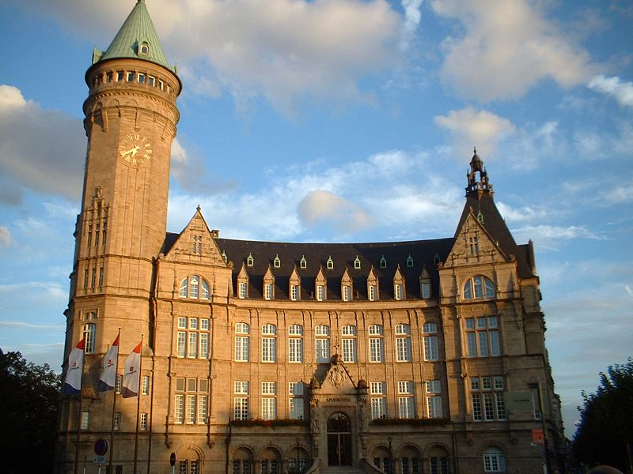
Treaty of Paris, 1951
The building in the city of Luxembourg that housed the first High Authority of the European Coal and Steel Community.
(Wikimedia Commons, Public Domain)
The Schuman declaration resulted in the 1951 Treaty of Paris, establishing the European Coal and Steel Community (ECSC). In addition to the High Authority, based in Luxembourg, there was also a Common Assembly of delegates from the six national parliaments to monitor the work of the High Authority and a Court of Justice to arbitrate whenever there were disputes.
However, the end result was not quite as Schuman and Monnet had envisaged. It was a compromise between supranationality and intergovernmentalism. The Dutch, with support from other member states, insisted that a fourth institution be set up, the Council of Ministers, to supervise the work of the High Authority (and to to ensure that national interests were protected).

Slide 32
A clash of interests over the defence of western Europe
Schumann: “Germany has no army and should not have one. It has no arms and will not have any. It is therefore unthinkable, for France and all her allies, that Germany would be allowed to adhere to the Atlantic pact as a nation capable of defending itself or aiding in the defence of other nations.”
Truman: “Without Germany the defense of Europe was a rearguard action on the shores of the Atlantic Ocean. With Germany, there would be a defense in depth, powerful enough to offer effective resistance to aggression from the east. The logic behind this is very plain. Any map will show it, and a little arithmetic will prove what the addition of German manpower means to the strength of the joint defense of Europe.”
The United States government saw economic and political integration within western Europe as a key element in its policy of containment of communism. At the same time it was facing growing concern in the US Congress about the cost of maintaining a substantial military force in Europe. It needed its European partners to contribute more in terms of finance, arms and armed forces within NATO, and to agree to the rearmament of West Germany. The American position was starkly and clearly stated by President Truman in his memoirs [See quote].
However, the allies of the United States in western Europe, whilst acknowledging Washington’s concerns, were more focused on European integration as the best way of restraining West Germany from becoming a major economic and military force. The main sticking point for them was German rearmament. The idea was not universally popular in the Federal Republic of Germany, the British thought it was too soon to rearm a former enemy, and Robert Schuman made it clear that France was prepared to exercise its veto over German membership of NATO.
(Robert Schuman, cited in Reiner Pommerin (ed) The American Impact on Postwar Germany, Oxford 1995, p.24)
(Harry S. Truman, Memoirs: Years of Trial and Hope, Garden City, 1956, p.253)

Slide 33
Plan for a supranational European Defence Community
“The establishment of a European Army cannot be the result of a mere aggregation of national military units (…). Common institutions are the only response to unequivocally common tasks.”
René Pleven, 1954.
“(In case of a ratification), how to conceive the diplomatic action of a sovereign national government, whose soldiers respond to an authority other than its own? (…) What is the URSS going to do, faced with the fait accompli of a German rearmament? (…) would they create an equivalent number of military divisions in East Germany? Is this going to result in a recrudescence of international tension?”
Le Monde, 1954.
It was Jean Monnet who found a compromise solution to this impasse over German rearmament and German forces in NATO. Again, his solution involved the setting up of a supranational organisation within western Europe – the European Defence Community (EDC). Monnet presented French Prime Minister, René Pleven, with a plan to establish a European army with a common budget, run by a Commissariat, with a Council of Ministers and an Assembly (similar to the ECSC). It would be placed under the command of NATO and while it would include German forces these would not be under German command. The UK opted out of the Plan, but the member states of the ECSC signed the Treaty establishing the EDC in Paris on 27 May 1952. However, the Treaty had to be ratified by each national parliament and it was rejected by the French Parliament mainly because of fears of loss of French sovereignty over her military. The EDC was not implemented and West Germany was admitted into NATO. Again, national interests had clashed with a proposal for a European supranational authority.
René Pleven, President of the Council, presents the project of a European Defence Community to the French Parliament (24/10/1954).
French newspaper Le Monde reports the words of Jules Moch, a Socialist MP and staunch opposer of the Defence Community. Le Monde, 12/02/1954.

Slide 34
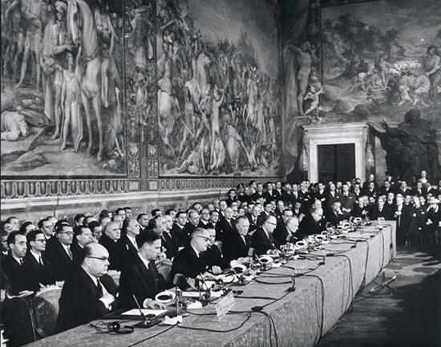
Treaty of Rome, 1957
After a majority in the French Assembly rejected the ratification of the Treaty to create the European Defence Community (EDC) it was clear that the idea to create a European Political Community which incorporated both the European Coal and Steel Community (ECSC) and the EDC had to be dropped. Thinking within the membership of the ECSC now moved on to the idea of a customs union or common market for all goods and not just coal and steel. The leaders of the six ECSC nations met in June 1955 in Messina, Italy mainly to appoint a new President of the ECSC High Authority to replace Jean Monnet, who had come to the end of his term of office. However, they also used the opportunity to discuss how best to relaunch the idea of European integration. The Belgian Prime Minister, Paul-Henri Spaak, was asked to convene an inter-governmental committee to draw up a step-by-step plan for creating a European Common Market. The subsequent report by the Spaak Committee led to an Intergovernmental Conference which, in turn, led to the Treaties of Rome in 1957 and the creation of the European Economic Community and Euratom in 1958.
The signing of the Treaties of Rome, 25 March 1957.
(European Commission Audiovisual Library)
Notes:
https://commons.wikimedia.org/wiki/File:Bundesarchiv_Bild_183-39998-0427,_Paul-Henri_Spaak.jpg

Slide 35
Conclusions
Academics have continued to debate about the extent to which the European Economic Community and its successor, the European Union, are supranational or intergovernmental organisations and whether or not the European Project can be fully implemented without political as well as economic integration.
The European Commission is a supranational authority and, as such, operates much as Jean Monnet envisaged that the High Authority of the ECSC would operate. However, many academics, and the federalists who still seek a United States of Europe, regard the Council of Ministers as an intergovernmental organisation which acts as a restraint on integration. Some have argued that close neighbours have more common ground and that this was apparent in the six member states of the ECSC but every enlargement of the European Community has reduced the areas of common ground. It has also been argued that major crises such as the financial crash of 2008 or the ongoing refugee crisis which escalated in 2015, tend to push some member states into acting unilaterally rather than agreeing to or abiding by a common policy.
But some academics, for example, Jan Beyers and Guido Dierickx, have observed that regular meetings of the Working Groups of the Council of Ministers have increased the scope for supranational and not just intergovernmental negotiations within the EU.

Slide 36



The European Project
This collection has been developed by Francesco Scatigna and Bob Stradling of the Historiana historical content team.
(European Commission Audiovisual Library)

