Slide 1
The Second World War was accompanied by the greatest mass migrations in history. By the beginning of 1945 more than 50 million people had been set in motion by the war.
As the war ended in 1945, these millions of displaced people were pushed into new mass migrations. Many were forced to move by the upheavals that accompanied the final defeat of the Axis powers. Millions were made homeless by the ever-greater destructiveness of mass bombing. 12 million people or more fled westwards as the Red Army marched along the road to Berlin. Millions were displaced by the imposition of new forms of political control in the vacuum that was caused by the collapse of defeated regimes.
The cessation of hostilities in 1945 did not bring an end to the mass migrations, if anything, they were accelerated. The tides of people on the move washed across Europe in many different directions. Many were simply trying to return home: demobilised soldiers, released prisoners of war, forced labourers trying to get home, refugees. Many who had escaped displacement during the war were now forced to move by its consequences: new borders, new political masters, new national identities that cut them off from their roots and compelled them to become migrants.

Slide 2
The winds of war: Population movements
From 1941 the war became a global conflict. Vast armies fought on far-flung battle fronts: Japanese armies fighting in Malaya, Indonesia, the Philippines and Burma, American armies fighting in North Africa, the Far East and Western Europe, 250 000 Italians fighting at Stalingrad. The men and women fighting this wider war, represented a mass military migration: peasants from Asiatic Russia, farm boys from America’s Middle West, Poles, Czechs, Australians and Canadians.
In addition to the millions of troops fighting far from home, millions of civilians were uprooted by the war. Children had been evacuated from towns and cities to places of safety, civilian refugees took to the roads to escape the destruction.
This was a total war. The scale and intensity of warfare brought major shifts of population: mass mobilisation of troops, many thousands of prisoners of war, huge numbers of workers conscripted to war industries, people rounded up in occupied territories to work as forced labourers or to be interned in camps. There was also the impact of ideology and totalitarianism. Both Nazi Germany and the Soviet Union had enforced mass deportations and ‘re-settlement’.

Slide 3
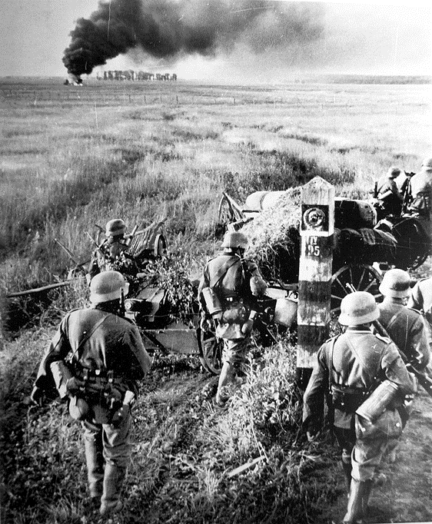
The mass movements of fighting troops
By 1945, the Second World War had caused mass movements of fighting troops, far from their homelands. For example, the widening of the war after the German invasion of the Soviet Union in June 1941 had involved the movement of armies on a vast scale. 3.1 million German troops had been supported by almost 1 million allies: Finns, Italians, Romanians and Hungarians, fighting against 5.5 million Soviet troops. Although vast numbers had been killed or captured in the first year of the war, by 1942-43, huge new armies had been assembled east of the Urals, ready to advance deep into central Europe in 1944-45.
German forces at the USSR border, June 1941
(Wikimedia Commons, Public Domain)

Slide 4
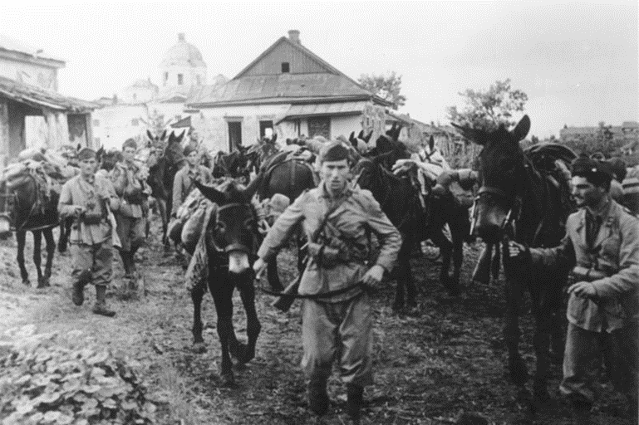
The movements of Germany’s allies
Italian troops serving on the Eastern Front, July 1942
(German Federal Archives, CC BY-SA 3.0)
Germany’s allies had been pushed into providing significant forces to fight on the Eastern Front. In the climactic battle at Stalingrad in 1942-43, 250000 Italian troops held a sector of the front, alongside 50000 Romanian troops.
Only a small proportion of these forces ever returned home.

Slide 5
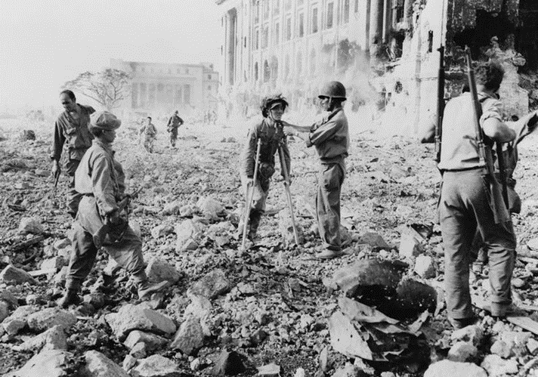
The Pacific War
Wounded Japanese troops surrendering to Allied forces in the Philippines.
(US Office of War Information, Public Domain)
There were also major theatres of war beyond Europe. From December 1941, six million Japanese troops had been involved in the Pacific War, invading Indochina, Malaya, Indonesia, Burma, the Philippines and the Pacific islands. The United States had mobilised huge armies in response. Throughout the war in the Pacific there were mass movements of soldiers, POWs and civilians across Asia.

Slide 6
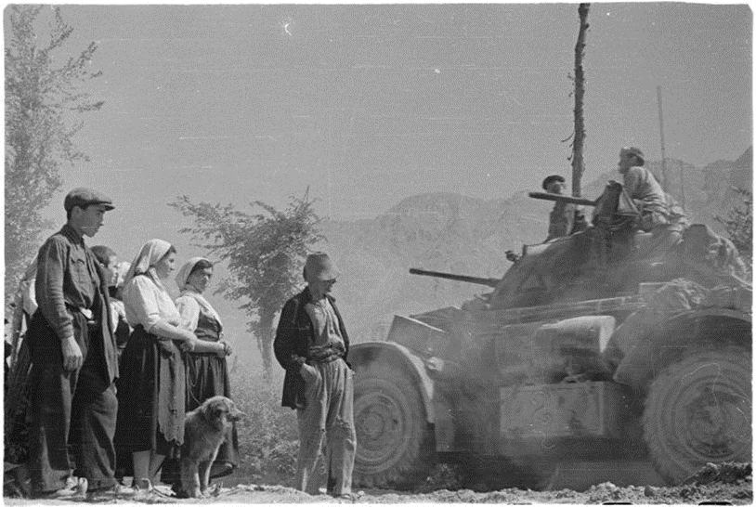
Refugees in Europe
Italian refugees passing a tank from a New Zealand squadron May 1944.
(New Zealand Government, Public Domain in New Zealand)
Europe was full of refugees. The ebb and flow of war had repeatedly endangered civilian populations caught up in war zones, forcing them to flee.
For some, it was possible to return home after the war moved on to other fronts, but many were still displaced when the war ended.

Slide 7
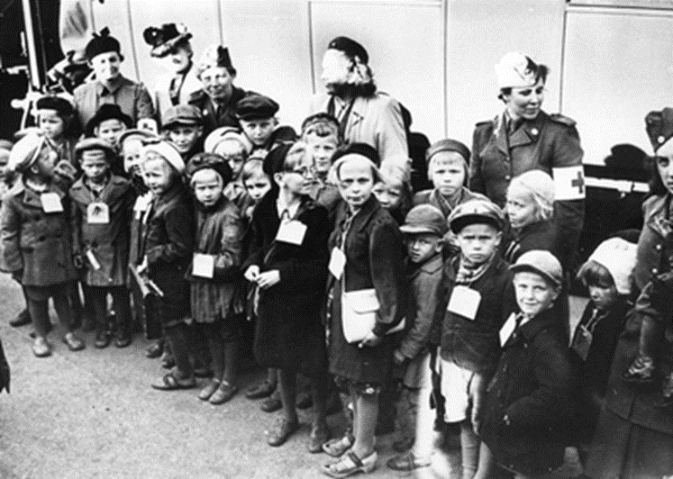
The evacuation of children
Finnish children evacuated to the safety of neutral Sweden during the Continuation War of 1941-1944. The return home of these children became a very controversial issue after the war ended.
(Historiana, Public Domain)
In many countries, children had been evacuated from their homes for their protection. Evacuations had been intended as a temporary measure, but many thousands of children were still separated from their families when the war ended.
Children also suffered greatly from the emotional and physical displacement caused by mass bombing, with the destruction of their homes and the break-up of family life.

Slide 8
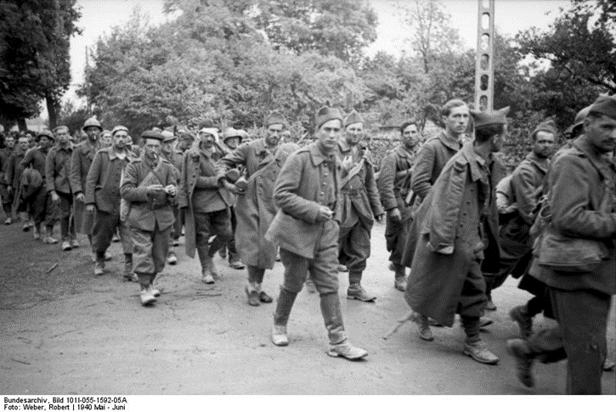
Prisoners of war
French prisoners of war being marched into captivity, May 1940.
(German Federal Archives, CC BY-SA 3.0)
Huge numbers of prisoners of war were in captivity. From 1940, Germany’s rapid military victories had resulted in many thousands of POWs being placed in a vast network of camps, mostly in eastern Germany. As the war continued, even greater numbers of POWs had been imprisoned in such camps on the Eastern Front, in Italy, the Balkans, and in the Far East.

Slide 9
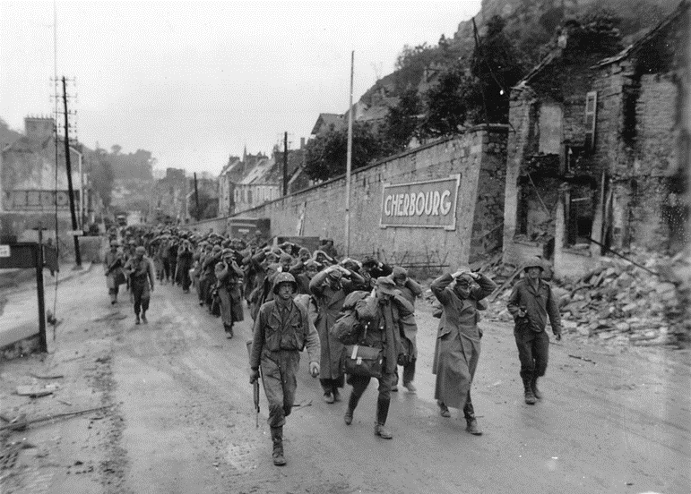
The Allied invasion of Europe
German POWs captured during the Allied invasion of western Europe in 1944 being escorted through Cherbourg by US forces.
(US Navy Archive, Public Domain )
Between December 1941 and 1945, the United States had committed huge armies and resources to the Second World War. In addition to its own Pacific war, the US had also taken the lead role in the Allied invasion of Western Europe. By the time the war in Europe ended in May 1945, 1.9 million US troops were fighting there. Demobilising these armies, and repatriating the huge numbers of POWs captured by American forces was a major post-war challenge.

Slide 10
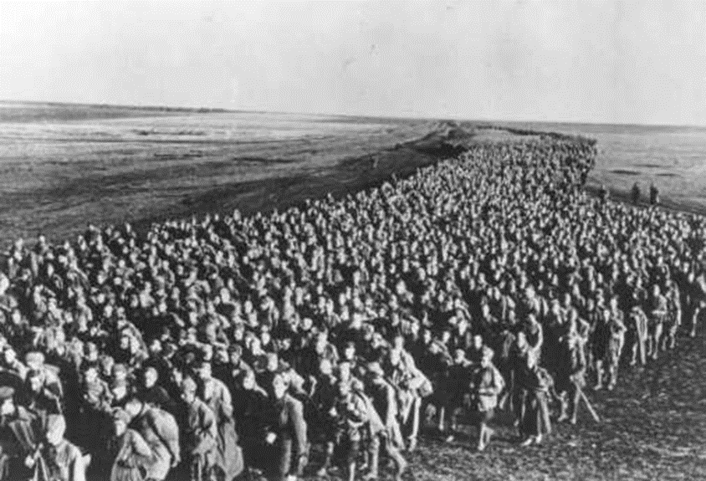
Soviet POWs
Soviet POWs captured at the Battle of Kharkhiv, June 1942
(US Holocaust Museum, available for re-use for educational and non-commercial purposes)
By 1945, 5.7 million Soviet troops had ben captured by the Germans on the Eastern Front. Of these, POWs, about 1 million were released to fight as auxiliary forces alongside the Germans. Approximately 3.3 million died in captivity, often in appalling conditions.
Around 500 000 survived until the end of the war.

Slide 11
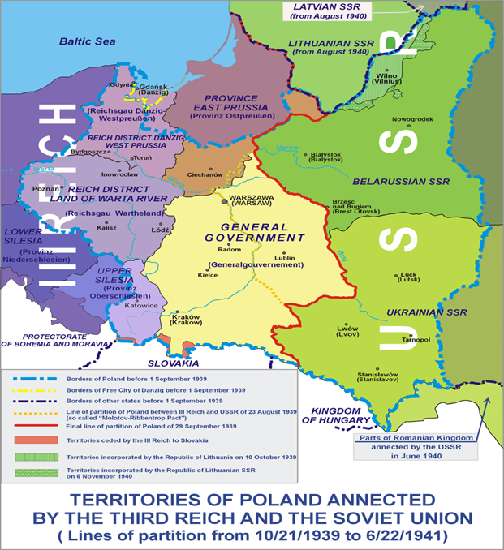
Mass deportations in Poland
Map showing the occupation of Poland in 1939 by both German and Soviet forces.
(Wikimedia Commons, Lonio17, CC BY-SA 4.0 International)
Millions of people had been uprooted by mass deportations. By the terms of the Nazi-Soviet Pact, Poland had been partitioned between the Third Reich and the USSR. Western Poland had been incorporated into the Reich, to be ‘Germanised’ by ethnic German settlers. Thousands of Poles had been forcibly removed to the east. In the region referred to as ‘General Government’, large numbers of Polish Jews had been forced into ghettos by the Nazis.
The USSR had also enforced deportations from Eastern Poland and the Baltic States.
By 1945, many of these people were dead. The few survivors faced huge difficulties in returning home.

Slide 12
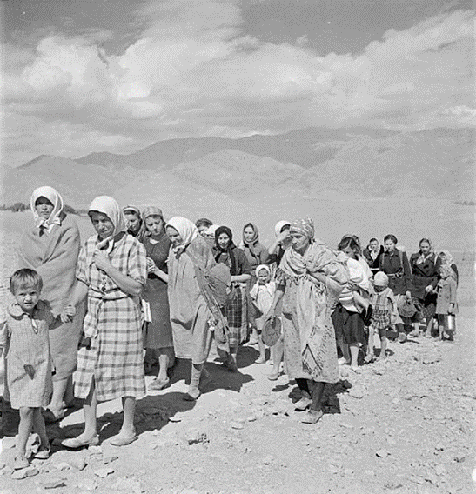
Deportations in the USSR
Hundreds of thousands of people from Poland and the Baltic States had been deported eastwards by the USSR in 1940-41 after the Nazi and Soviet occupations. These mass deportations had then been followed by further population movements after the Nazi invasion of the USSR. Many Poles had been released from internment camps to fight alongside the Red Army; 120 000 Poles were evacuated to Iran in 1942. Between 1942 and 1944, similar deportations had been enforced on ethnic minorities in the USSR, such as the Kalmyks, the Chechens, and the Crimean Tatars.
In 1944-45, after the tide of war had turned and Soviet armies began advancing westwards, many Polish, Estonian, Latvian, and Lithuanian deportees hoped they would be able to return to their former homes. But, instead, there was a further wave of deportations and ethnic cleansing as new borders were shaped by the victories of the USSR and the emergence of the Soviet Bloc.
Polish refugees crossing into Iran, November 1942.
(Wikimedia Commons, Terry Ashwood, Public Domain)

Slide 13
National purges in the USSR
As the Red Army moved forward after the victory at Stalingrad in early 1943, Stalin’s security chief Lavrenty Beria recommended the deportation of whole peoples accused of collaborating with the Germans. For the most part, these were the Muslim nations of the Caucasus and Crimea. As Soviet troops retook the Caucasus, Stalin and Beria put the machine into action. On a single day in November 1943, the Soviets deported the entire Karachai population to Kazakhstan and Kyrgyzstan. Over the course of two days, 28-29 December 1943, the Soviets dispatched 92 000 Kalmyks to Siberia. Beria went to Grozny personally to supervise the deportations of Chechens and Ingush peoples in February 1944. People who could not move were shot. Leading about 120 000 special forces, Beria rounded up and expelled 479 000 people in just over a week. In April 1944, right after the Red Army reached the Crimea, Beria proposed and Stalin agreed that the entire Crimean Tatar population be resettled. 180 000 people were deported, most of them to Uzbekistan. Later in 1944, Beria had the Meshketian Turks deported from Soviet Georgia.
Against this backdrop of essentially continuous national purges, Stalin’s decision to ethnically cleanse the Soviet-Polish border seems like an unsurprising development of policy. In September 1944, Stalin opted to move Poles (and Polish Jews), Ukrainians, and Belarussians back and forth across the state border in order to create ethnic homogeneity. The same logic was applied, on a far greater scale, to the ethnic Germans in Poland.
(Timothy Snyder BLOOD LANDS: EUROPE BETWEEN HITLER AND STALIN (2010), published by The Bodley Head, London UK, pp 330-331)

Slide 14
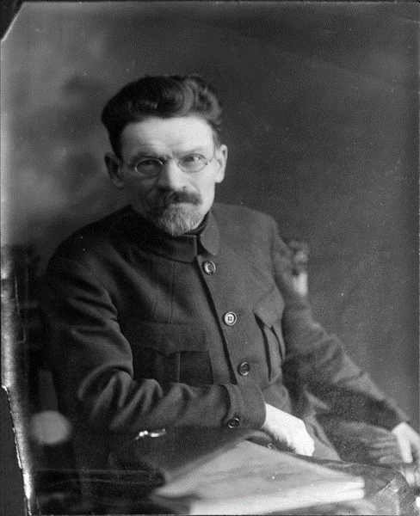
The liquidation of the Kalmyk people
By 1945, millions of people were living far from their homelands as a result of wartime deportations. One example of this was the Kamlyk people who had lived in the steppes, south of the Volga river and west of the Caspian Sea, since the days of the Mongol Empire.
After the Red Army liberated the region following the Battle of Stalingrad, Stalin and Beria had ordered the Kamlyks to be deported to Siberia as ‘political undesirables’. They were eventually allowed to return home in 1957, during the Khrushchev ‘Thaw’. Less than half of those who had been deported survived.
Mikhail Ivanovitch Kalinin who signed the Decree No. 115/144 on behalf of the Presidium of the Supreme Soviet of the USSR entitled “On the liquidation of the Kalmyk ASSR”.
(Wikimedia Commons, Public Domain)

Slide 15
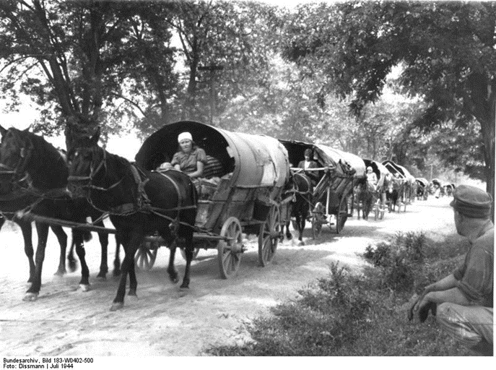
Ethnic German expellees
Expelled Black Sea Germans, passing through Hungary, July 1944.
(German Federal Archives, CC-BY-SA 3.0)
The Black Sea Germans had settled in southern Ukraine and the Crimea in the early 19th century, welcomed by the Tsars as useful citizens – hard-working and productive farmers and craftsmen. They had come under Nazi rule after the German conquest of western and southern Ukraine in 1941-42. When German forces began to retreat westwards after defeats at Stalingrad and Kursk in 1943, the Black Sea Germans were uprooted; 135 000 people were forced top flee o the West. They became part of the flood of 12 million ethnic German expellees in the mass migration of 1944-45.

Slide 16
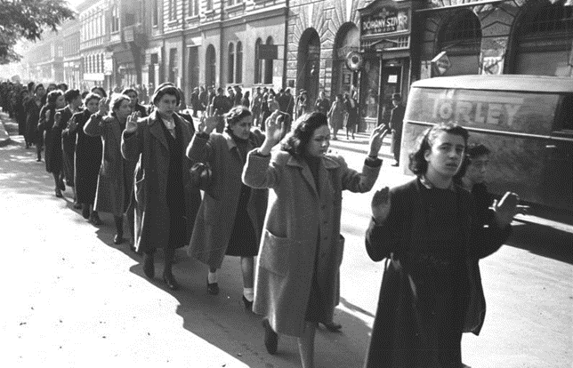
The repatriation of displaced persons
Hungarian Jewish women rounded up for deportation, October 1944. The deportation of 440 000 Jews from Hungary, begun in May 1944, was one of the last such mass deportations during the war.
(German Federal Archives, CC BY-SA 3.0)
Throughout the years of the Nazi Empire in Europe, massive numbers of Jews, Roma and other ‘racial enemies of the Reich’ had been rounded up to be deported to the camps. Millions of these deportees perished in the death camps.
In 1945 the minority who survived were among the millions of displaced persons waiting to be repatriated, and facing a very uncertain future.

Slide 17
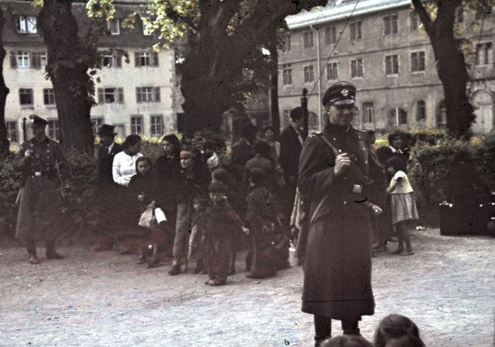
The deportation of the Romani people
Romani people rounded up for deportation at Asperg, near Stuttgart in southern Germany in 1940.
(German Federal Archives, CC BY-SA 3.0)
As with the Jews, Sinti and Roma people had been victims of Nazi racial policies. Thousands had been registered, rounded up and ‘re-settled’ in camps in the East.
Later in the war, most had been exterminated in the death camps. The few survivors faced enormous problems in returning to their former life.

Slide 18
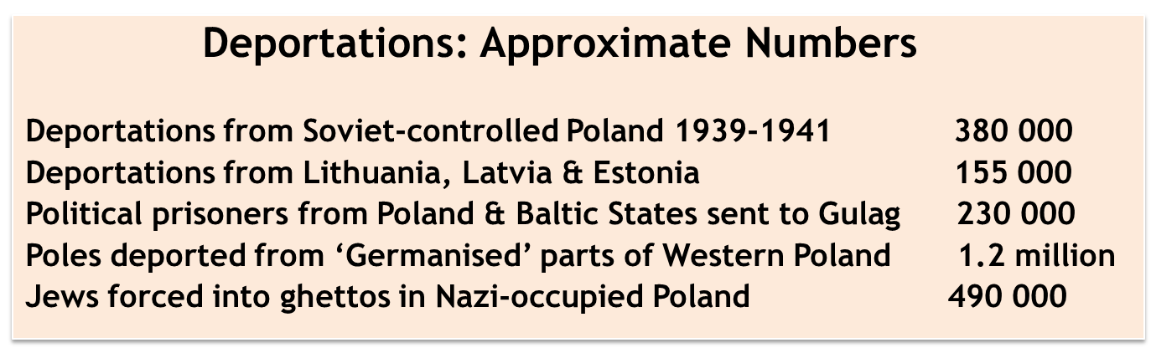
Deportations in approximate numbers
(Figures collated by Chris Rowe from various sources)

Slide 19
The end: victory & defeat, 1945-1946
The Second World War did not end neatly. The war comprised many interlocking conflicts, which did not all end at the same time. On the Eastern Front, many countries were liberated from German occupation long before the final climactic battle for Berlin and VE Day. In the Far East, conflict continued for months after the surrender of Nazi Germany. As the war entered its final months, the mass movement of people intensified as they desperately sought to return home: vast numbers of prisoners of war, refugees fleeing war zones, those made homeless by ‘scorched earth’ tactics and mass bombing. Equally, many people were desperate not to return home, because their homeland was now controlled by a menacing foreign power.
The cessation of military hostilities was only the beginning of the end of the shifts of population caused by the war. Millions of soldiers had to be demobilised and find their way home; so did as many as 12 million forced labourers. Millions of refugees and homeless people remained ‘displaced persons’. And new borders and new political regimes led to a fresh wave of forced expulsions.

Slide 20
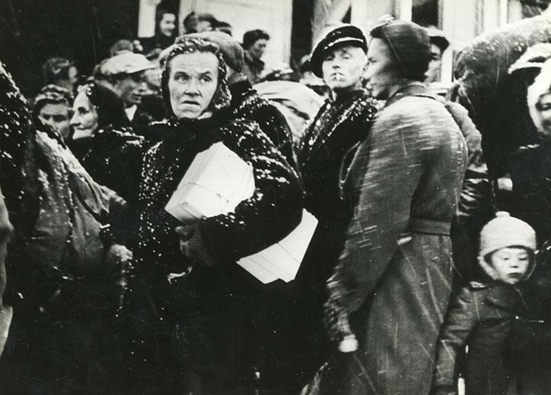
The ‘death marches’
Norwegian woman queuing for food in Kiruna, the northernmost town in Sweden, during the forced migration from Norway to Sweden late in 1944.
(National Archives of Norway, CCO 1.0 Universal Public Domain Dedication)
From the time the war had turned against Germany in 1944-45, many people were pulled or pushed into migration. Sometimes this was a voluntary decision, but in many cases it was compelled by necessity, or by the direct orders of the German occupiers.
Thousands of inmates of the concentration camps were sent on ‘death marches’ to camps further west. In Norway, thousands of civilian refugees were forced into an arduous winter journey to northern Sweden.

Slide 21
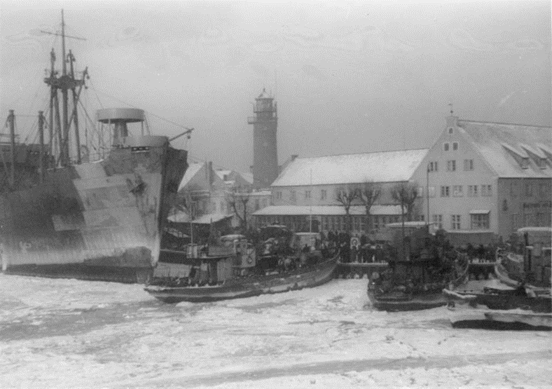
The displacement of ethnic Germans
German refugees hoping to escape by sea from Pillau in East Prussia in 1945, just before Soviet forces reached the port.
(German Federal Archives, CC BY-SA 3.0)
From 1944 Germans in the eastern parts of the Reich were displaced by the advancing Red Army. During 1944-45 approximately 12 million ethnic Germans fled westwards. The defeat of Nazi Germany meant that these Volksdeutsche were uprooted from territories that had been German for centuries, such as East Prussia.

Slide 22
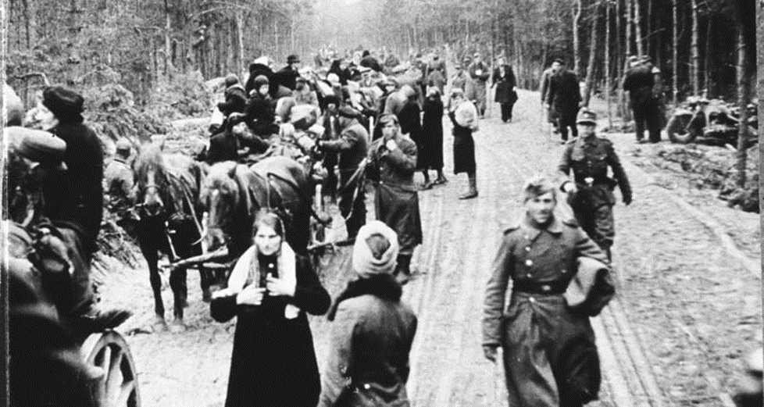
The advance of the Red Army
The advance of the Red Army through Poland and East Prussia caused a flood of ethnic German refugees to flee westwards.
(German Federal Archives, CC BY-SA 3.0)

Slide 23
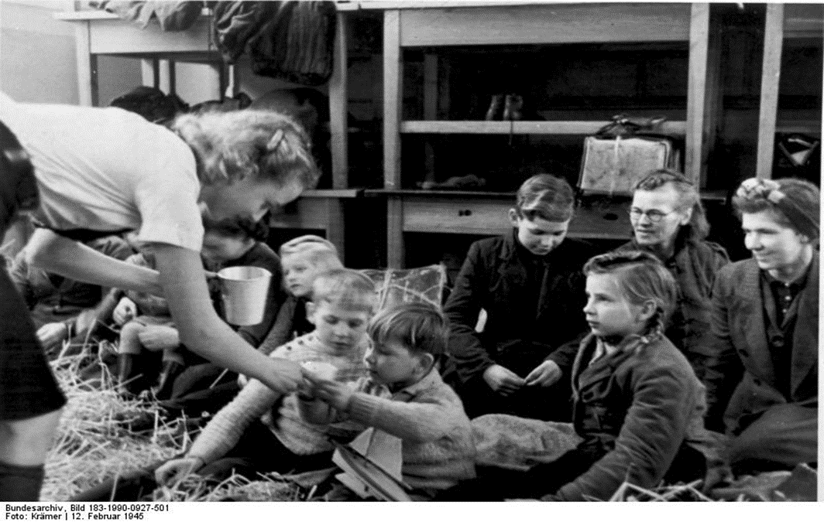
German refugee children in Denmark
German refugee children at a reception centre in Denmark, February 1945.
(German Federal Archives, CC BY-SA 3.0)

Slide 24
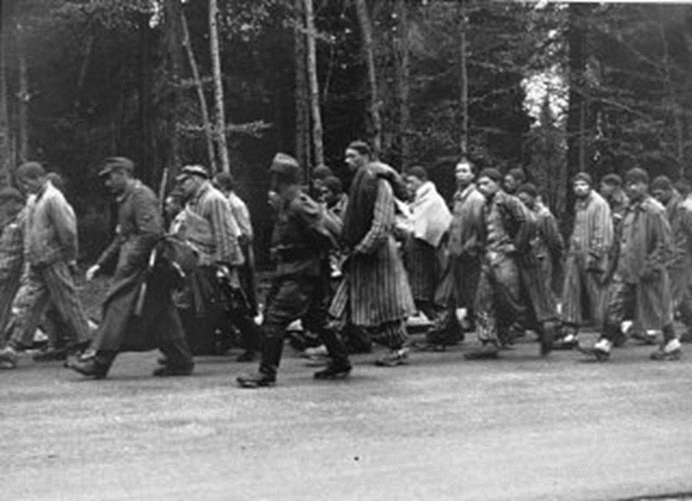
The evacuation of concentration camps
Inmates of KZ Flossenburg on a ‘Death March’ through Bavaria, April 1945.
(US Holocaust Museum, available for re-use for educational and non-commercial purposes)
As Soviet forces advanced westwards, the Nazi authorities began to evacuate inmates from the camps and sent them on forced marches to camps further west. These death marches were on a huge scale and caused appalling casualties due to mistreatment, harsh weather conditions and sheer exhaustion. Even after liberation many prisoners died through diseases such as typhus and dysentery.

Slide 25
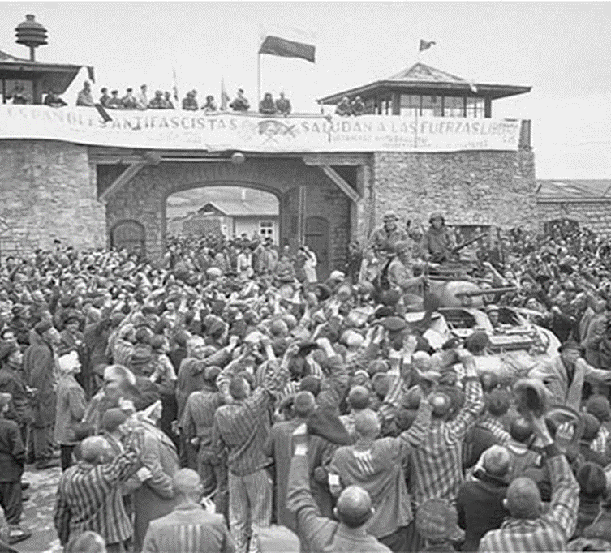
The liberation of concentration camps
Surviving prisoners at KZ Mauthausen near Linz cheering US troops at the liberation, April 1945.
(US Holocaust Museum, available for re-use for educational and non-commercial purposes)

Slide 26
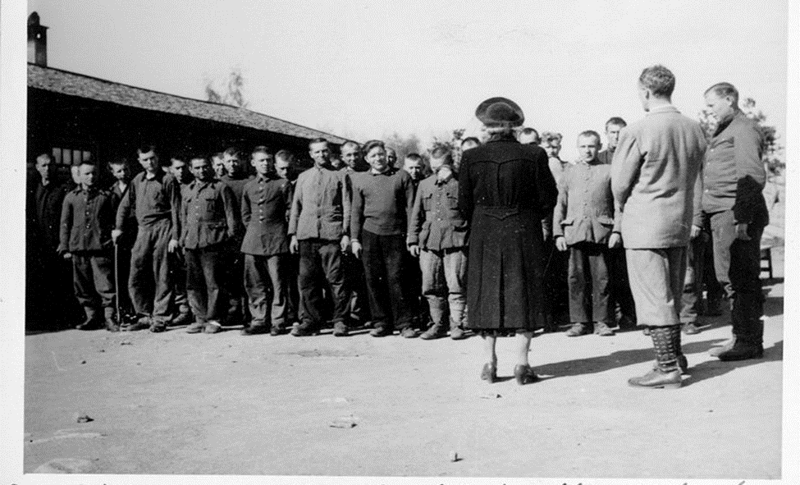
The liberation of Soviet POWs
Soviet POWs at Hamar, Norway being addressed by the local Norwegian chief of police after their liberation, May 1945
(Wikimedia Commons, CC BY-SA 2.0 generic)

Slide 27
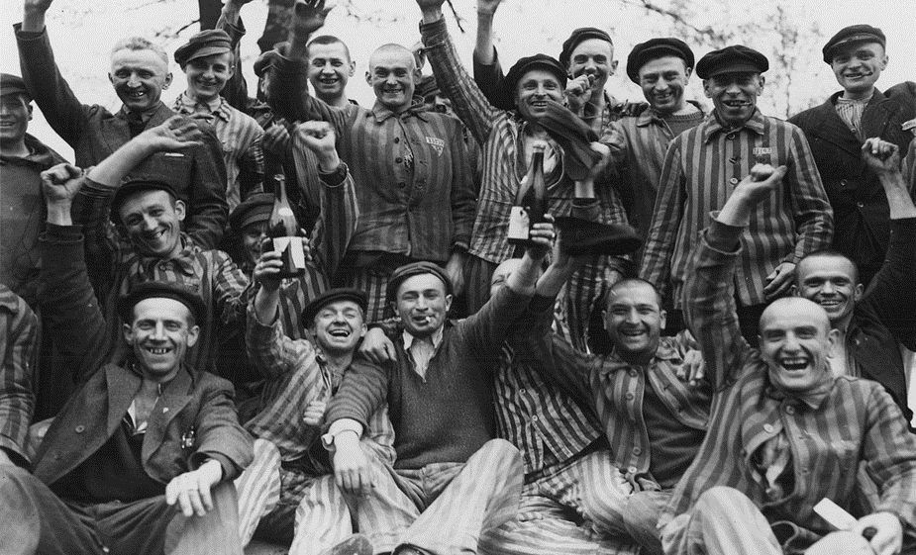
The liberation of Dachau
Polish prisoners celebrating their liberation from the Dachau concentration camp in Bavaria, May 1945.
(US National Archive, Public Domain in the US)

Slide 28
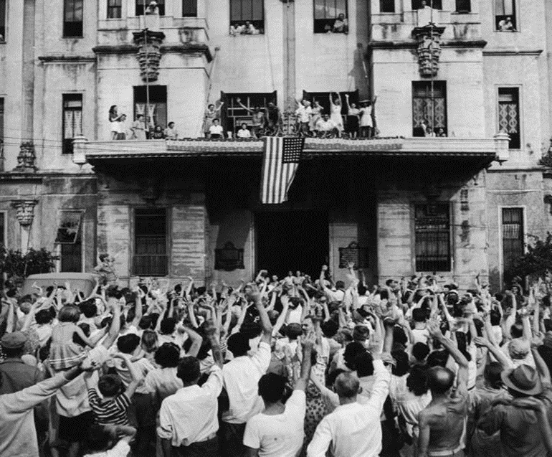
Liberation in the Pacific
All across the lands conquered by the Japanese during the Second World War, prisoners held in captivity dreamed of the moment when they would be freed and able to return home.
Inmates celebrating their release from the Santo Tomas University internment camp in the Philippines, February 1945.
(Wikimedia Commons, Public Domain in the Philippines)

Slide 29
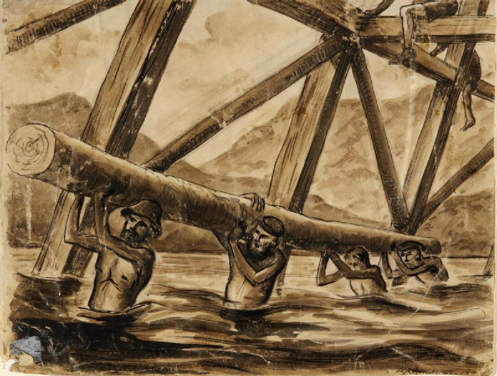
Population Movements at the end of the war
A drawing by Leo Rawlings, 1943, showing British POWs working as forced labourers on the Bridge over the River Kwai, part of the construction of the Burma Railway,
(Imperial War Museum, re-usable for non-commercial purposes)
Between 1942 and 1945, many thousands of Allied prisoners of war - British, Australian and American - had been held in Japanese POW camps. They were often subjected to harsh conditions and forced labour.
At the end of the war, there were major logistical problems in getting the surviving POWs home.

Slide 30
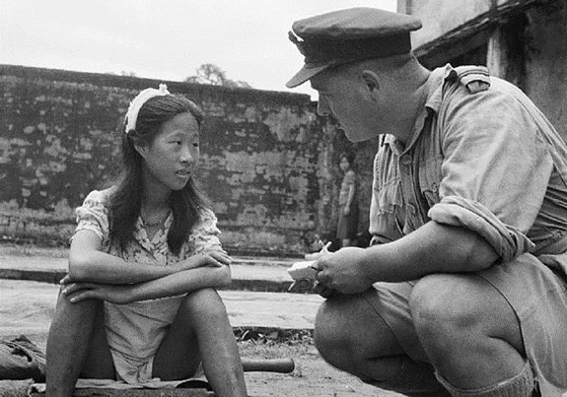
The Japanese ‘comfort battalions’
A young Chinese woman who had been enslaved in a Japanese ‘comfort battalion’ being interviewed by a British officer in Burma after she was freed.
(Wikimedia Commons courtesy of Sanok History Museum, Public Domain)
Many women had been forced to move by the dynamics of total war. One example was the conscription by the Nazis of hundreds of thousands of Ukrainian women and girls for work in Germany. Another was the conscription of Korean, Malayan, Tamil and Chinese women and girls into ‘comfort battalions’ - in order to provide sexual services for Japanese forces. In 1945, they faced huge difficulties in returning home.

Slide 31
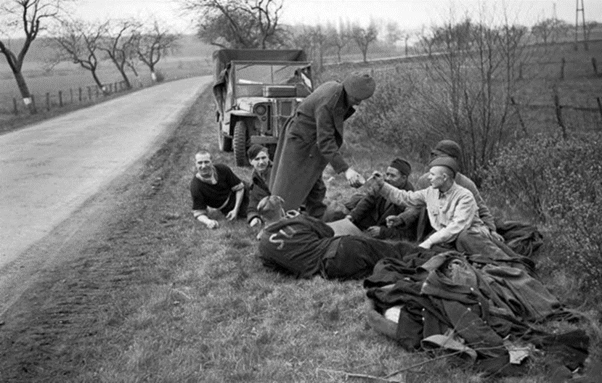
The long way home
Freed Russian forced labourers being given cigarettes by British troops, somewhere in Germany, April 1945.
(Imperial War Museum, Public Domain)
At the end of the war, millions of forced labourers joined the other millions of freed prisoners, and displaced persons in the desperate search for a way to return home. For many, this meant a long journey across a ruined continent. They also faced the prospect that their homes might have been destroyed; or made unreachable by new regimes and new borders.

Slide 32
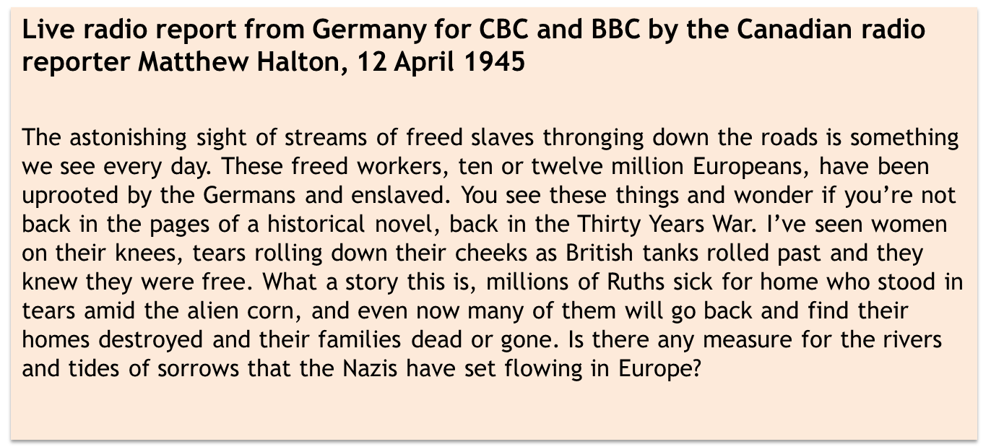
The long way home
Extract from War Report: D Day to VE Day (edited BBC live broadcasts 1944-45).
(Copyright CBC/Radio-Canada)

Slide 33
Out of place in the Post-war world
When the war ended in 1945, new political forces were unleashed. In addition to the millions of people displaced by the war who sought to return home, millions more faced new forms of displacement. Many were driven into exile as new borders were drawn, creating new national identities. Millions of Poles were pushed westwards by the incorporation of eastern Poland into Soviet Ukraine; millions of Germans were forced out when Silesia was incorporated into Poland. There were also mass movements caused by revenge attacks. Three million ethnic Germans were expelled from Czechoslovakia, and this was only a part of the mass movement of German expellees and refugees – the total was almost certainly higher than 12 million.
At the same time, millions of other stateless ‘displaced persons’ were moving in search of places of security. The United Nations established a High Commission for Refugees to deal with this problem. One indirect consequence of the war was the migration of Jewish people to Palestine and the new state of Israel; another related development was mass population shifts caused by upheavals in India after Britain ended colonial rule in 1947.

Slide 34
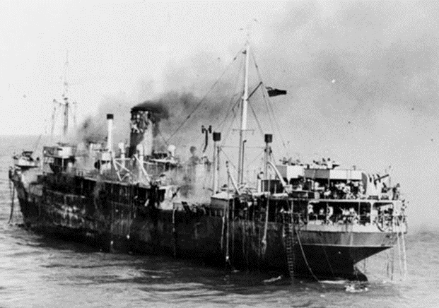
Civilian refugees in the Middle East
SS Empire Patrol caught fire while carrying 500 Greeks home from Port Said in 1945, after three years of exile in the Middle East.
(Imperial War Museum (A 30736), re-usable for non-commercial purposes)
After Italian and German forces occupied Greece, thousands of civilian refugees fled across the Mediterranean to temporary refugee camps in the Middle East. Most returned home in 1945, though it was a difficult and dangerous journey.

Slide 35
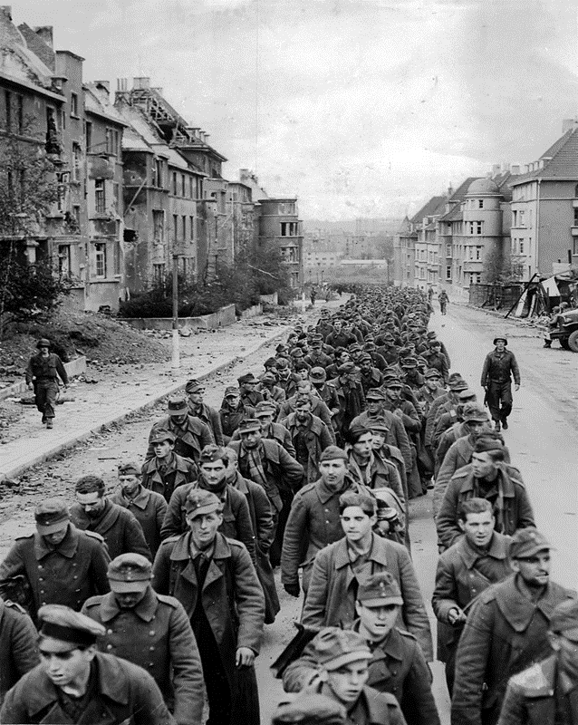
German POWs
German soldiers taken prisoner near Aachen.
(US National Archives & Records Administration, Public Domain)

Slide 36
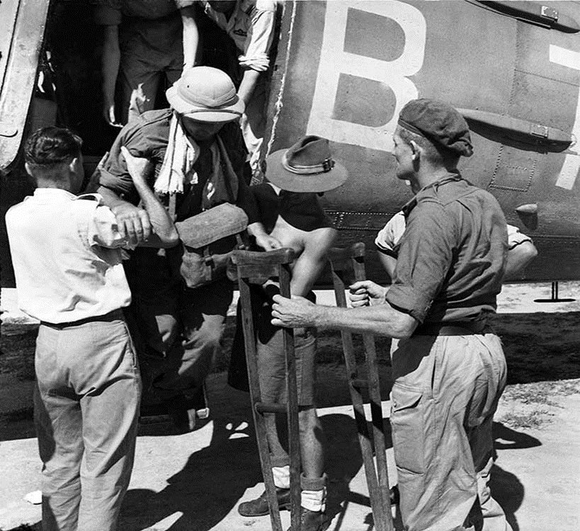
Australian POWs
Australian prisoners of war arriving in Singapore in September 1945, after being released from captivity after the surrender of Japan.
(Australian War Museum (AWM 119705), Public Domain)

Slide 37
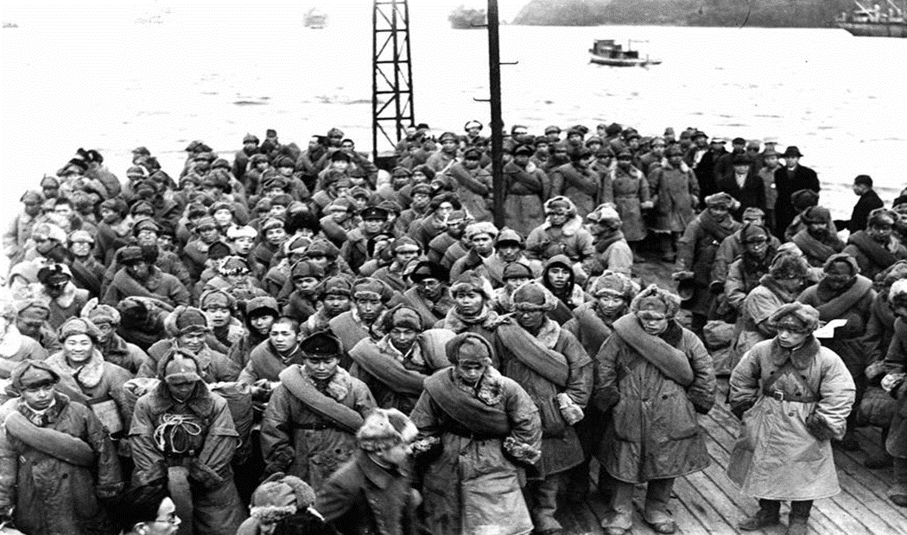
Japanese POWs
Japanese POWs returning home from Siberia 1946
(Japan Times, Public Domain)

Slide 38
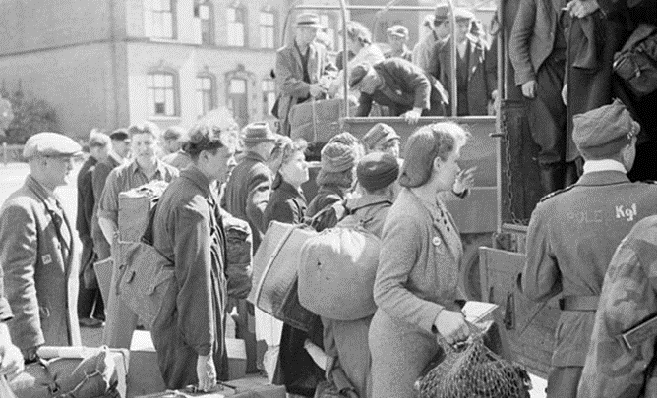
Displaced Persons in Hamburg 1945
Displaced Persons in Hamburg 1945.
(Imperial War Museum, Public Domain)

Slide 39
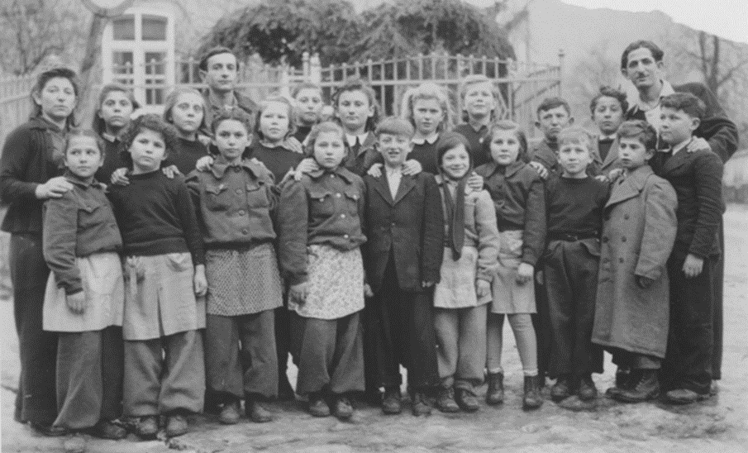
Displaced Persons camps
School children at a Displaced Persons camp, Schauenstein 1946.
(US Government, Public Domain)

Slide 40
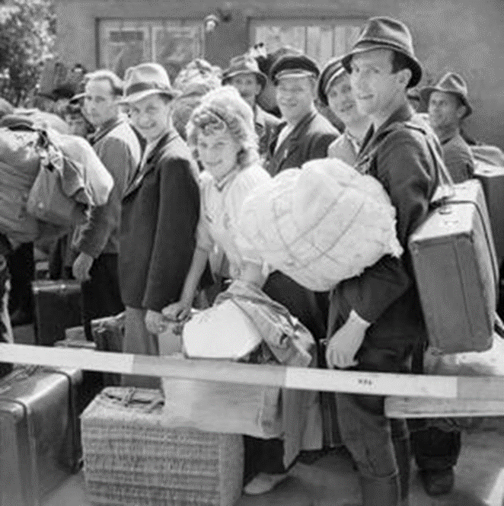
Displaced Persons Assembly Centres
Polish nationals waiting for army lorries to take them from the No. 17 Displaced Persons Assembly Centre in Hamburg to a Polish repatriation camp.
(Imperial War Museum, IWM Non-commercial licence)

Slide 41
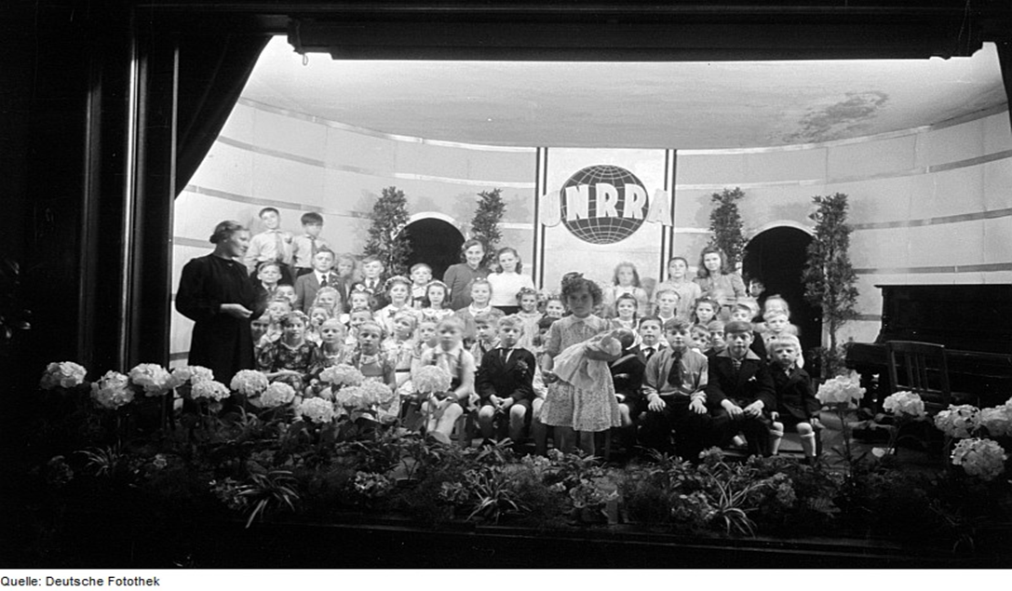
United Nations Relief and Rehabilitation Administration
Mother’s Day at a United Nations Relief and Rehabilitation Administration camp for Displaced Persons in Germany
(Deutsche Fotothek, CC BY-SA 3.0 de)

Slide 42
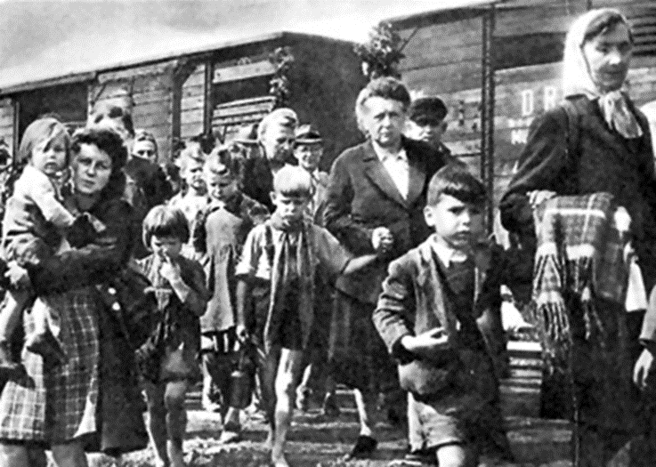
Ethnic German expellees
Ethnic Germans expelled from Czechoslovakia after the end of the war in 1945.
(Wikimedia Commons courtesy of Sudetendeutsche Stiftung, CC BY-SA 1.0 generic)
The liberation of Czechoslovakia opened the way for revenge attacks against the ethnic German population of the Sudetenland, many of whom had welcomed the Nazi takeover of the country in 1938-39.
There were ‘wild expulsions’ as local populations resorted to uncontrolled violence; and official decrees by the restored democratic government under Edward Benes. Nearly three million Germans were expelled.
Similar expulsions drove ethnic Germans out of liberated Poland

Slide 43
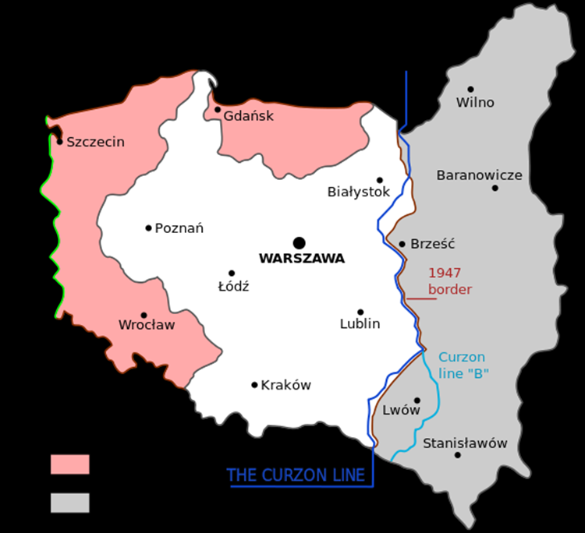
The territorial changes affecting Poland and Ukraine
Map of territorial changes affecting Poland, Germany and the Soviet Socialist Republic of Ukraine, 1945-47.
(Wikimedia Commons, Radek, CC BY-SA 3.0 unported)
Stalin’s exploitation of the victories of the Red Army led to fundamental change in the geographical borders of Poland.
Extensive parts of eastern Poland were transferred to Ukraine (once again part of the USSR). To compensate Poland for this loss of territory, Silesia and parts of East Prussia were annexed from Germany and incorporated into Poland. These changes resulted in massive displacement of civilian populations.

Slide 44
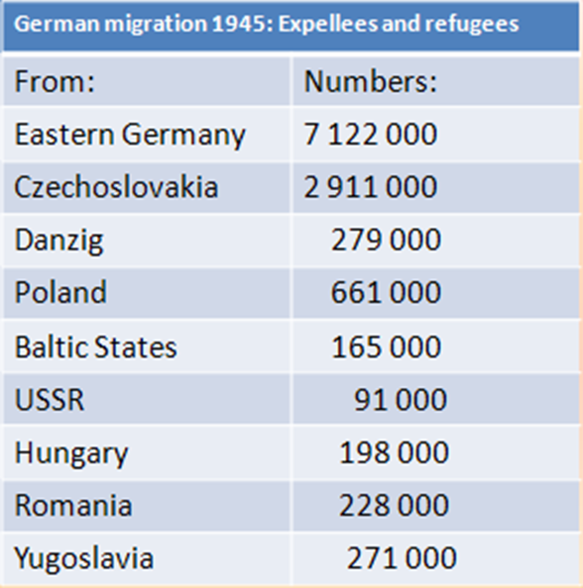
Mass Migration of Ethnic Germans, 1944-45
(Historiana)
The flight of the ethnic German population from Czechoslovakia was only one part of a mass movement. The statistical records can only be approximate but the total number of expellees and refugees was almost certainly higher than 12 million. At the same time, millions of other displaced persons were criss-crossing post-war Europe – refugees from various battle fronts, released prisoners of war, demobilised soldiers from disbanded armies. All in all, the migrations of 1944-46 represented one of the biggest population upheavals in the history of the world.

Slide 45
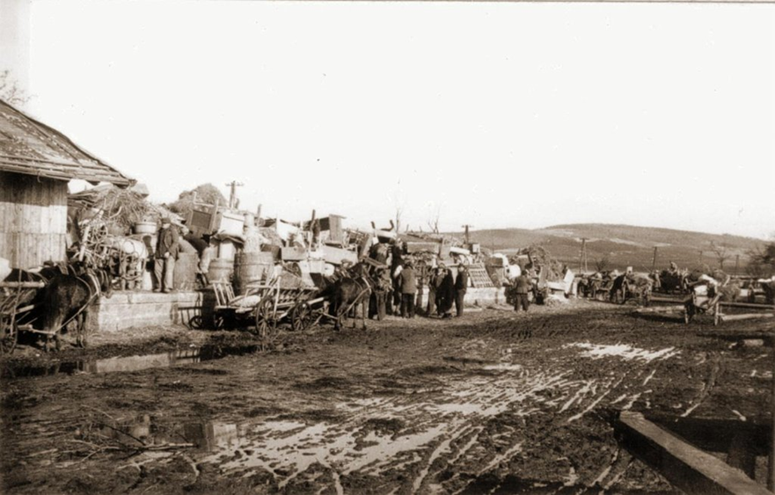
The population exchanges
Ukrainians ‘re-settled’ to the USSR in March 1946.
(Wikimedia Commons courtesy of Sanok History Museum, Public Domain)
The USSR and the PKWN (the pro-Communist Provisional Government of National Liberation) agreed to a massive population exchange in September 1944, to be implemented after the war. The exchange involved almost 500 000 Ukrainians and more than one million Poles and Polish Jews.

Slide 46
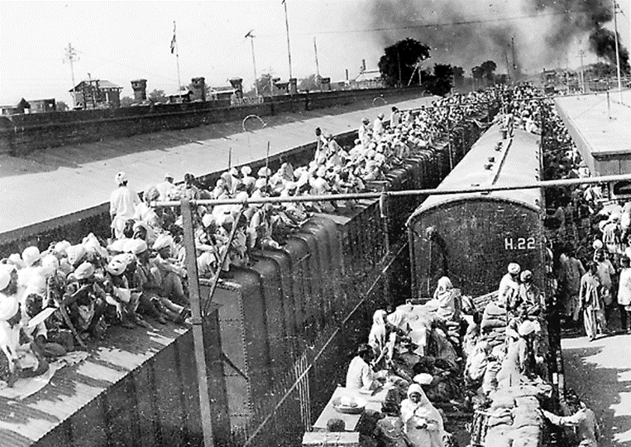
The partition of India
Refugees crowding emergency trains during the inter-ethnic violence following the end of British rule in India in 1947
(Wikimedia Commons, Public Domain in India)
An indirect consequence of the Second World war was that it strengthened nationalist and anti-colonial feeling in the British and French empires.
In 1947, Britain took the decision to withdraw from India. This led to serious inter-communal violence between Hindus and Muslims and ultimately to the Partition of India. The violence, and the drawing of new borders, led to shifts of population involving millions of people.

Slide 47
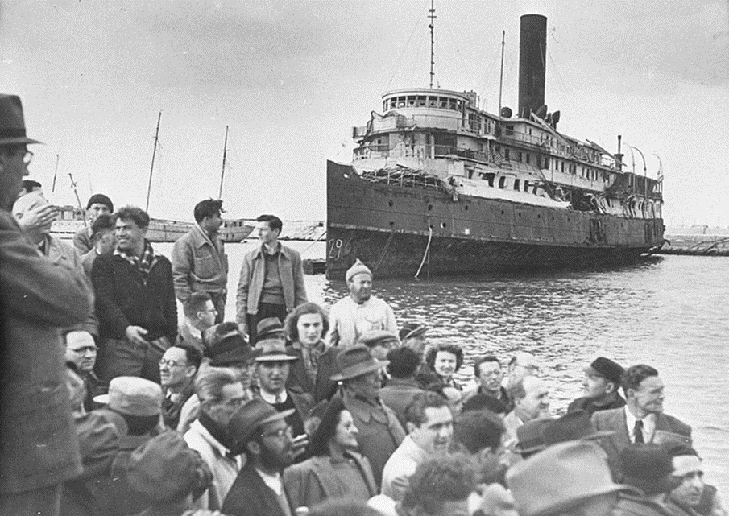
The Jewish exodus
Jewish migrants landing at Haifa in Palestine, July 1947.
(Wikimedia Commons courtesy of The Palmach Archive, Public Domain)
The shock of the Holocaust left a deep impression upon those European Jews who survived. The idea of Zionism, of Palestine as a national homeland for the Jews, was greatly strengthened. Despite obstruction from the authorities in British-controlled Palestine, many Jews joined the exodus.

Slide 48
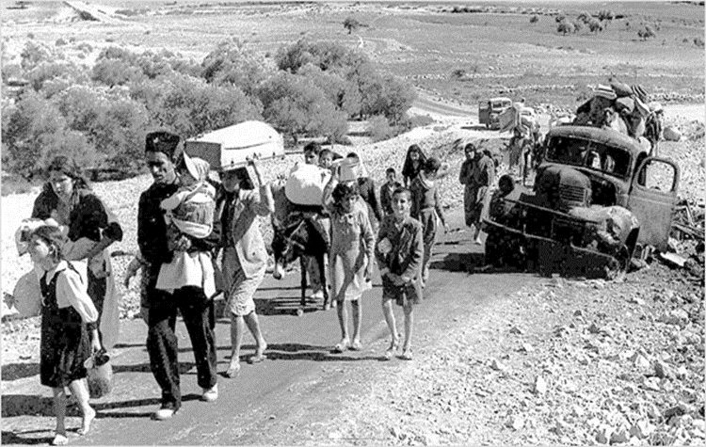
Israel and the displacement of Arab Palestinians
Palestinian refugees displaced from Galilee by the Arab-Israeli War of 1948
(Wikimedia Commons, Public Domain)
Mass movements of people often caused other mass movements. The birth of the state of Israel in 1948, emerged from the influx of Jewish refugees from Europe, and a fiercely-fought Arab-Israeli War. The war caused a massive displacement of 700 000 Arab Palestinians. Most of these refugees lost their ancestral homes. They were housed in ‘temporary’ refugee camps in neighbouring Arab states.
Hopes of returning home withered away in the years that followed. The displacement of Palestinian refugees became known as the Al Nakbah, or ‘Cataclysm’.

Slide 49




People on the move
This collection has been developed by Chris Rowe of the Historiana editing team.
(German Federal Archives, CC BY-SA 3.0)

