Slide 1
The term ‘Home Front’ was first used in World War 1. It refers to the civilian population’s involvement in supporting the war effort when their armed forces are fighting on foreign territory. In Belgium, France, the Balkan States and much of Central and Eastern Europe large sectors of the civilian population were living under occupation. In Britain, Germany and the United States, after they entered the war, the civilian populations were sold directly experiencing the war. and Germany (for most of the duration of the war) they might not have been directly under attack but they were still directly involved in the war. As in the First World War, women, young people and older men worked in factories, on the land and in essential public services, doing work that had previously been done by the men who were now conscripted into the armed forces. But, in addition, the aerial bombing of towns and cities and the blockading of ports meant that far more civilians in 1939-1945 directly experienced the conflict. Their homes were bombed, they spent long times in air raid shelters and their children and the infirm were evacuated to safer rural areas.
Their everyday lives were highly regulated: their newspapers were censored, they needed work permits and identity cards. Food, fuel and clothing were scarce so to prevent the civilian population from being starved into submission these essentials were distributed to people in a controlled way through rationing.
And yet, in spite of much hardship, people still tried to live as normal a life as possible. They got married, raised children, got an education, went to the theatre, the cinema and the dance halls, listened to the radio and wrote letters to their loved ones who were away in the armed forces.

Slide 2
Shortages and rationing
None of the main combatant countries in World War 2 were self sufficient in foodstuffs or in the raw materials that were essential for waging a mechanized war. More than 60% of the food consumed by the British was imported from the British Empire as well as imports of sugar, oil, rubber, textiles, ferrous and non-ferrous metals and chemicals. Germany imported coal, oil, grain, textiles, rubber, iron ore, pig iron, lead and phosphates. The German U-boat blockade of Britain and the counter-blockade of German ports by the British navy meant that both countries experienced severe shortages of these essential goods and raw materials. Furthermore in the 1930s Germany was dependent on the Soviet Union for imports of grain, oil and other raw materials, while the Soviet Union was importing weapons, technology and manufacturing machinery from Germany.
Italy was dependent on imports of oil, coal, rubber, tin, copper, iron ore and scrap iron. Japan, faced by a rapidly growing population, needed to import food, oil and raw materials, mostly from the United States.
As the League of Nations observed in a report in 1942: “The control of consumption is a necessary condition…..[for] the effective mobilization of resources for war purposes.” Rationing of scarce commodities was introduced to ensure their fair distribution amongst the population. And major public campaigns called on the civilian population to restrict their consumption and help with recycling essential materials.

Slide 3
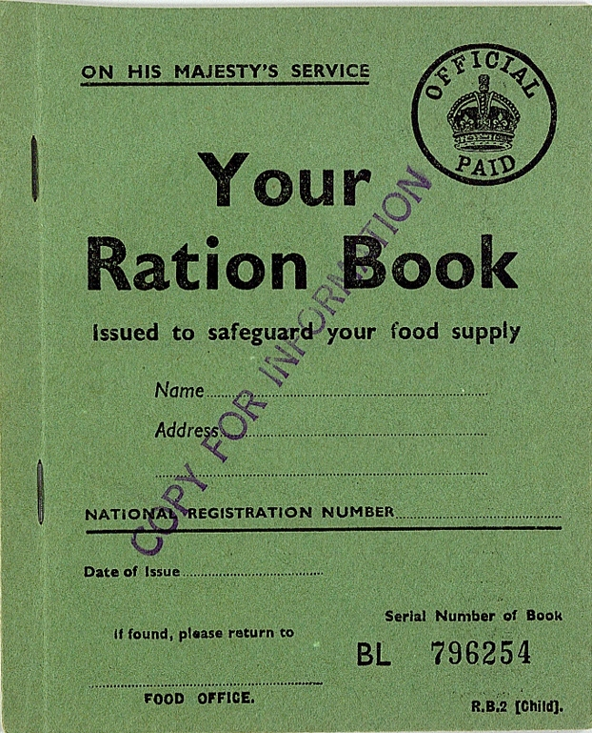
A child’s ration book
War was declared on 3 September 1939 and Britain introduced ration coupons for petrol on 8 September. This was because Britain was totally dependent on imports of petrol. Rationing of bacon, butter and sugar began in January 1940. Rationing of meat, tea, cereals and other dairy produce soon followed. However, food in restaurants was not rationed until May 1942 and this caused public resentment since it discriminated in favour of those who could afford to eat out regularly. By August 1942 almost all food except vegetables and bread was rationed.
Front cover of a child’s ration book
(British National Archive, Public Domain)

Slide 4
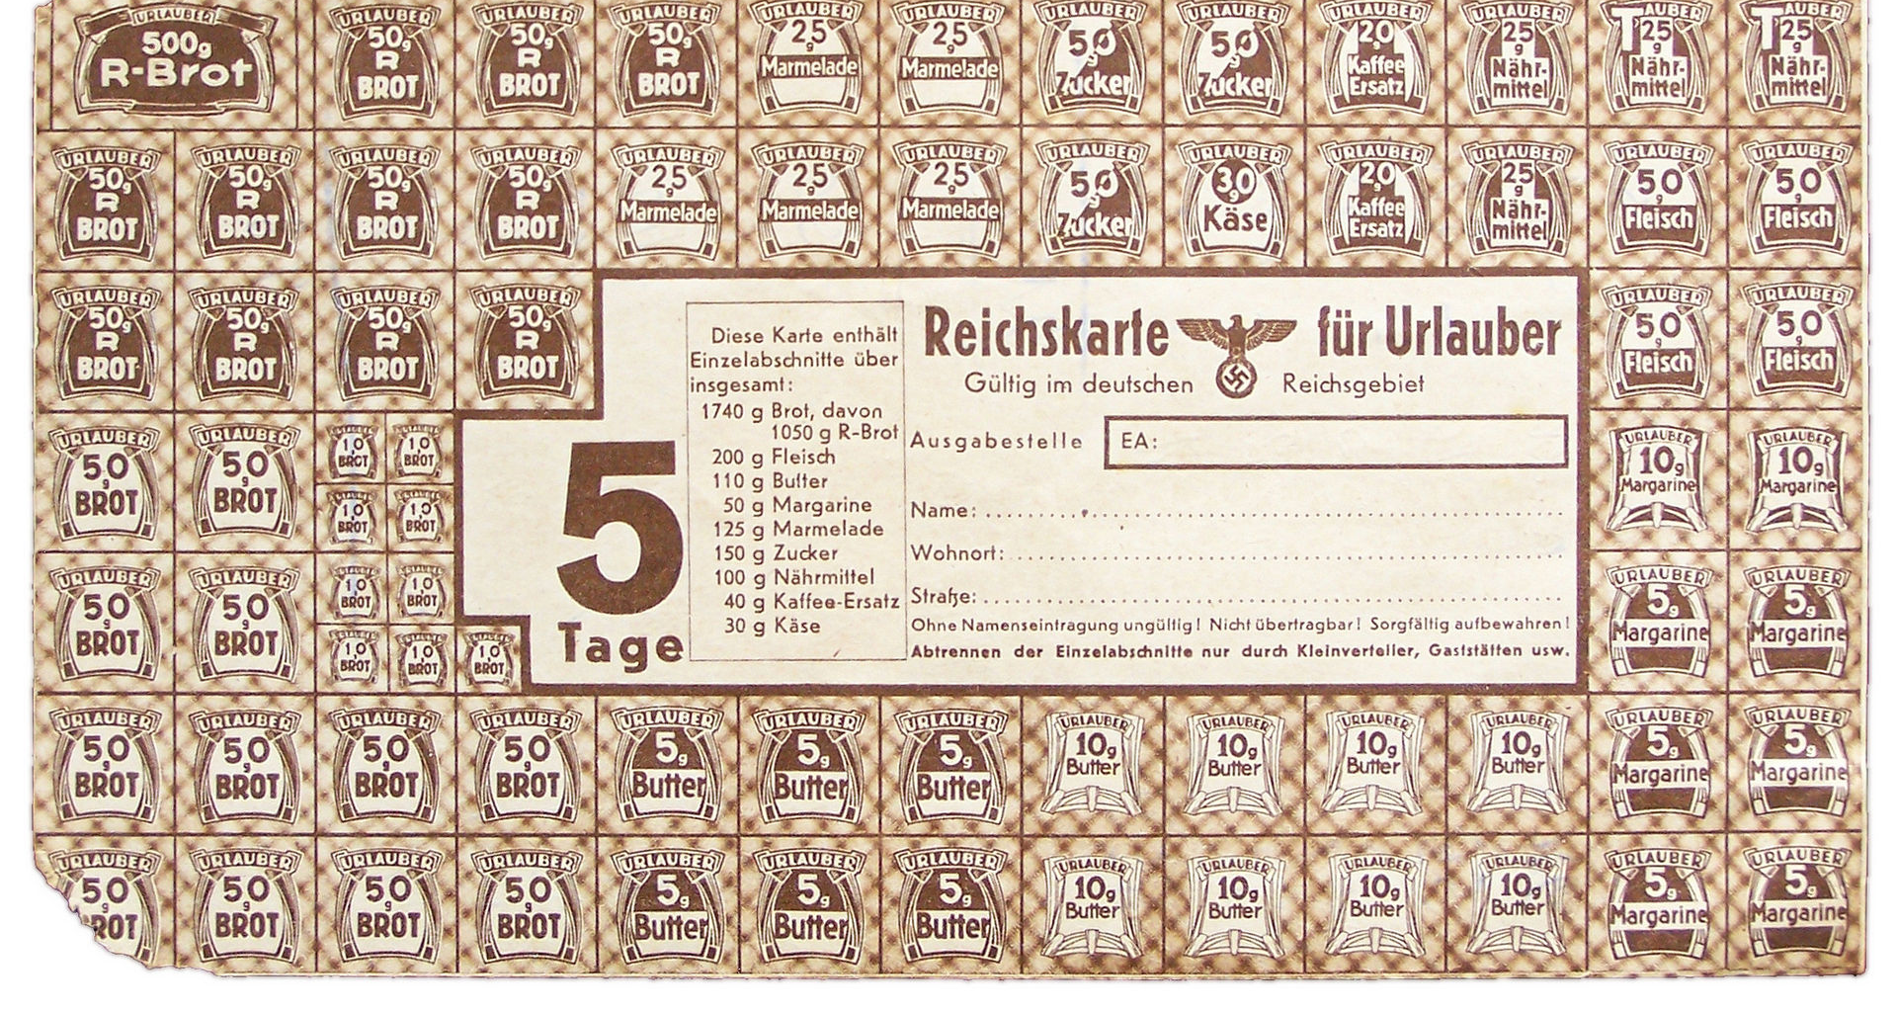
German ration stamp
German ration stamp for soldiers on leave or a person travelling within Germany and occupied territories.
(German National Archive, Photographer: Jan Mehlich (2007), CC BY-SA 3.0 DE)

Slide 5
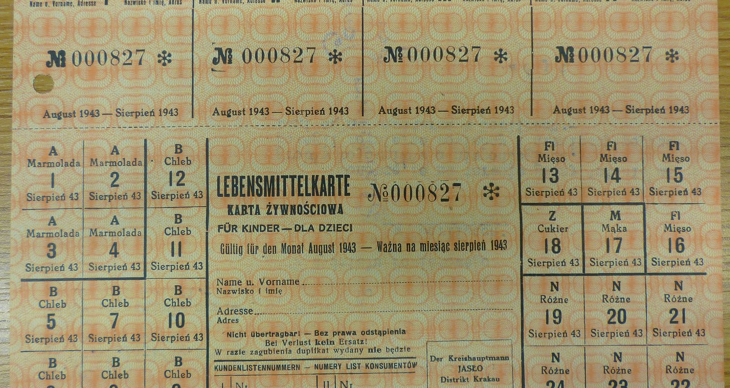
A ration-book for non-Germans in occupied Poland
A Lebensmittelkarte – a ration book for non-German adults and adolescents over the age of 14 living in German occupied Poland (otherwise known as the General Government). Issued in 1943.
(Wikimedia Commons, Photographer: Zalasem1, CC BY-SA 4.0 International)

Slide 6
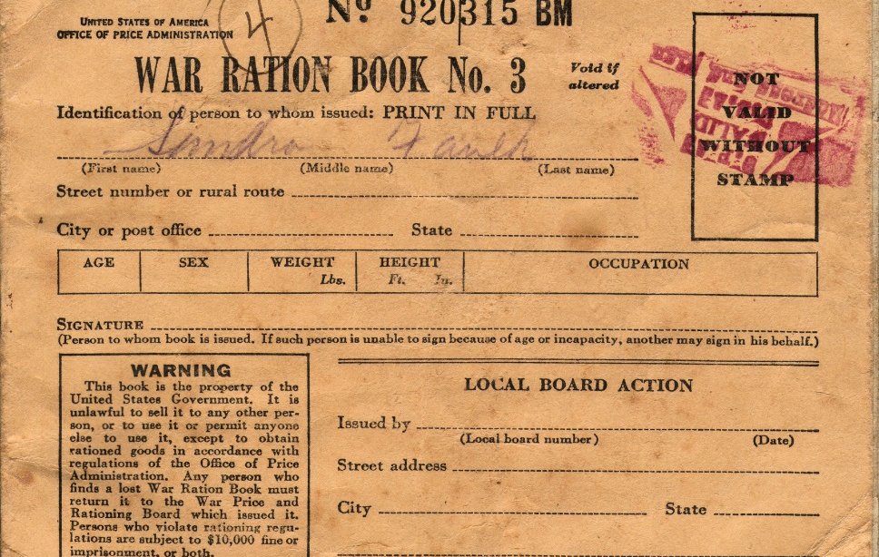
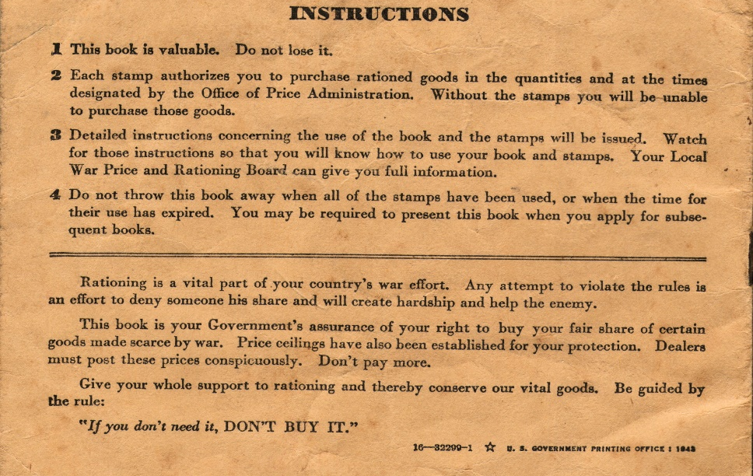
A US wartime ration book
Front and back pages of a United States Wartime Ration book issued in 1943. Inside would be a series of stamps to be exchanged for goods. At first certain goods were rationed through controlling supply. So, sale of tires and new automobiles was restricted to save rubber because the Japanese had invaded and occupied those countries in southeast Asia that had supplied the US with rubber before the war. US civilians were not provided with ration books until 4 May 1942. The first consumer product to be rationed was sugar; then gasoline (not because of a shortage but to reduce the use of automobiles), dairy products, meat, canned food, fuels, and other products.
(Wikimedia Commons, Public Domain in the US)
(Wikimedia Commons, Public Domain in the US)

Slide 7
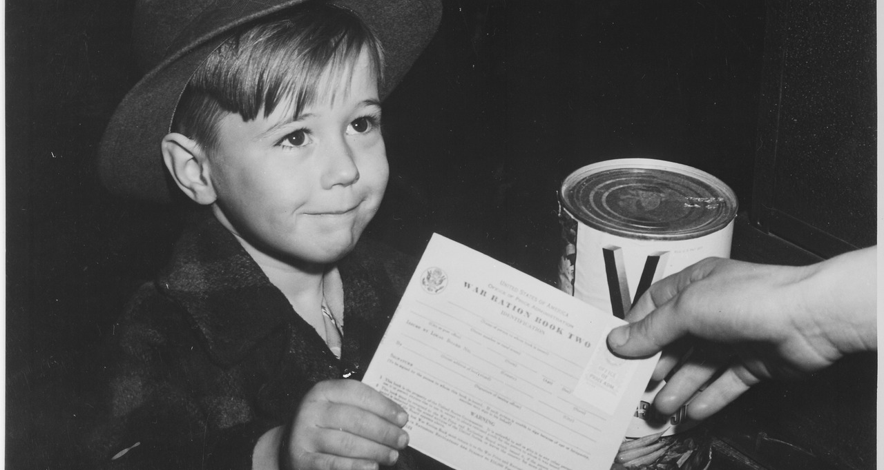
US ration books
Everyone in an American household received a ration book including children and babies. Here a young American boy is handing over his ration card to purchase a can of Vegetable Juice.
(US National Archives and Records Administration, Public Domain)

Slide 8
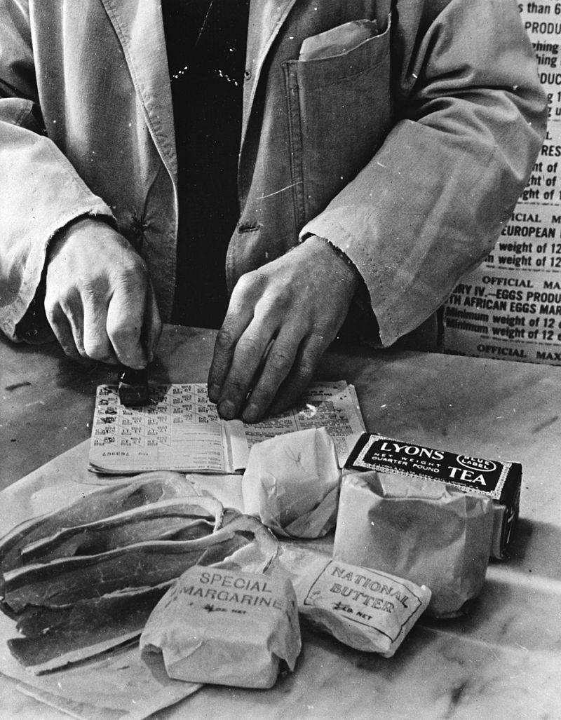
Rationing in the UK
Rationing in Britain. A shopkeeper cancels the coupons in a family ration book for the allowance of tea, sugar, cooking fats and bacon that the family was entitled to each week.
Once customers were required to present ration cards in restaurants in May 1942 a system had been introduced that ensured a fair and equal distribution of food across the whole population by providing everyone with the same number of valid coupons for the same amounts of food. However, as happened in all of the belligerent countries during the war, a black market quickly emerged, including a market in valid and forged ration coupons.
(US Office of War Information: Overseas Division, Public Domain)

Slide 9
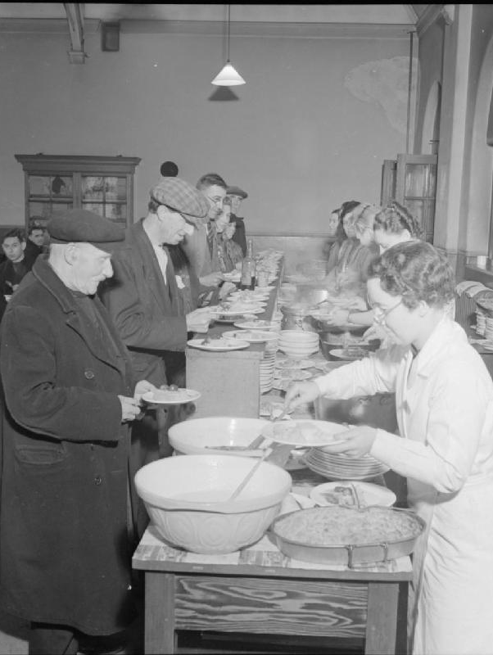
Community Food Centres
In 1940 at the height of the Blitz when some of the main cities and ports in Britain were nightly bombed by the Luftwaffe, ‘Community Food Centres’ were opened to feed those who had been bombed out of their homes or had lost all their papers including their ration cards in the bombing, or were alone and unable to cook for themselves. These began as voluntary centres but then the Prime Minister, Winston Churchill, decreed that the centres should be administered by the Ministry of Food and run by volunteers on a not-for-profit basis. He also decreed that they should be re-named British Restaurants. By 1943 there were 160 across Britain serving over half a million meals per day.
This is the Woolmore Street British Restaurant in East London in 1942.
(Imperial War Museum, © IWM (D 10680), Re-used under the IWM Non Commercial Licence)

Slide 10
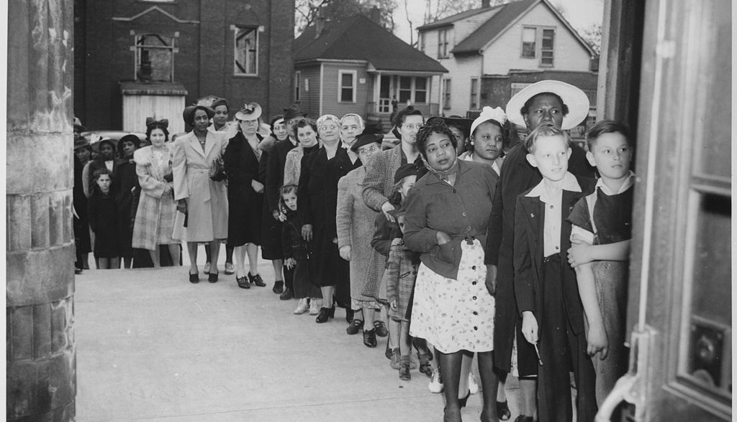
Americans queuing for their ration of sugar, 1945
(U.S. National Archives and Record Administration, Public Domain)

Slide 11
Live in rural areas during wintertime
The winter of 1941 was also the coldest in living memory and at times I used to nearly pass out from cold and hunger. I remember being constantly hungry from 1941 to 1945, although the worst year was 1944. There was a ration system, but seldom were there any goods available to fulfil it in the village.
People living in the towns and cities of the belligerent nations often assumed that those living in rural areas were better off because they could grow or buy local produce to supplement their rations. Sometimes this was true. But for, others, like Peter Ghirenghelli, living in Musadino near Lake Maggiore, the bitter winter of 1941 meant that even the rationing system could not ensure that they could get enough to eat.
(Peter Ghiringhelli, recalling life as an 11 year-old in the village of Musadino in Lombardy, Italy in 1941)

Slide 12
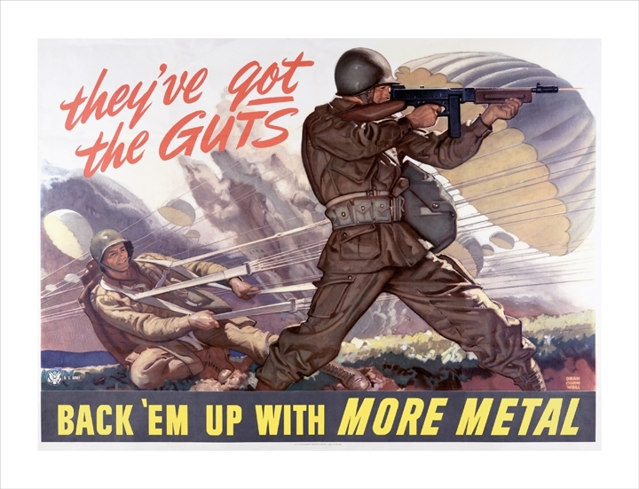
Recycling of scarce resources
(US Army Military History Institute, Public Domain)
In addition to rationing, the war-time governments also used propaganda to persuade citizens to restrict their use of scarce resources and to recycle materials needed for the war effort. Early in 1942 President Roosevelt appealed to Americans to donate their old garden hoses and rubber gloves and they collected half a million tons of rubber in a month. An American magazine told its readers that 18 empty cans would make one flame thrower.
This American poster uses the image of US Airborne Soldiers to persuade the civilian population to collect and donate scrap metal and spare pots and pans to the government so that they could be converted into weapons.

Slide 13
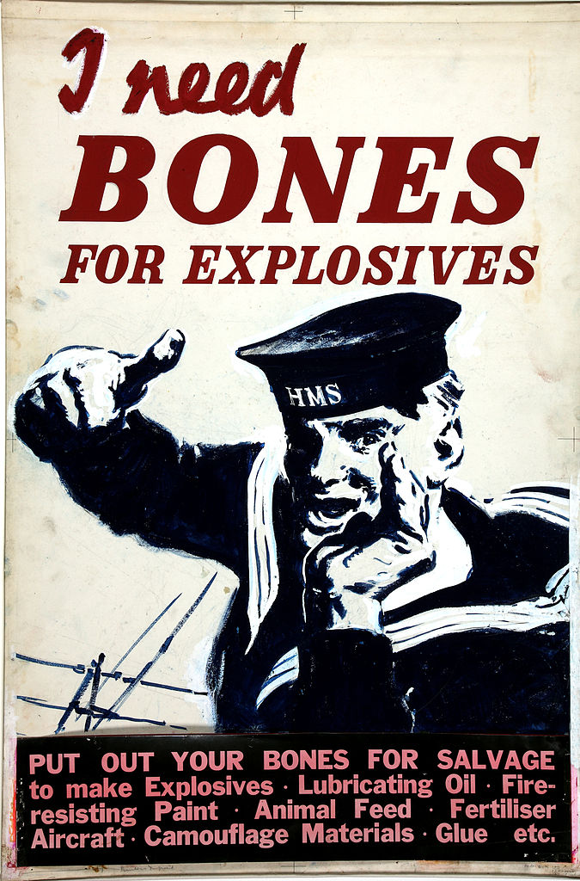
Donating animal bones to the government
It might seem surprising that the British government would be asking the British public to save and donate animal bones from the meat they had consumed. The reason was simple: the fat in animal bones was used to make glycerin which was then used in the making of explosives.
(UK National Archive, Public Domain)

Slide 14
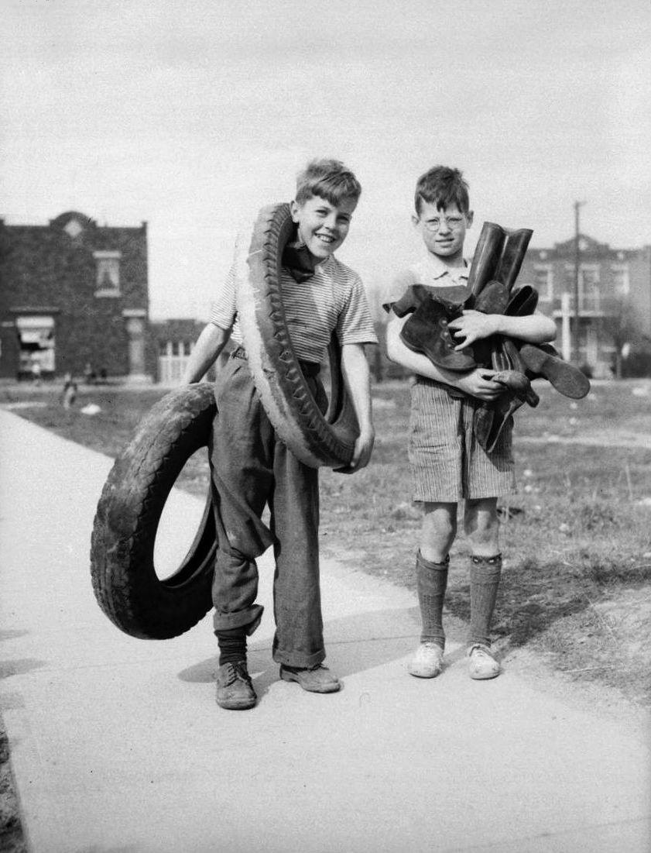
Salvaging rubber
Two boys in Canada salvaging rubber tires and boots for the war effort.
(Bibliothèque et Archives nationales du Québec, Public Domain)

Slide 15
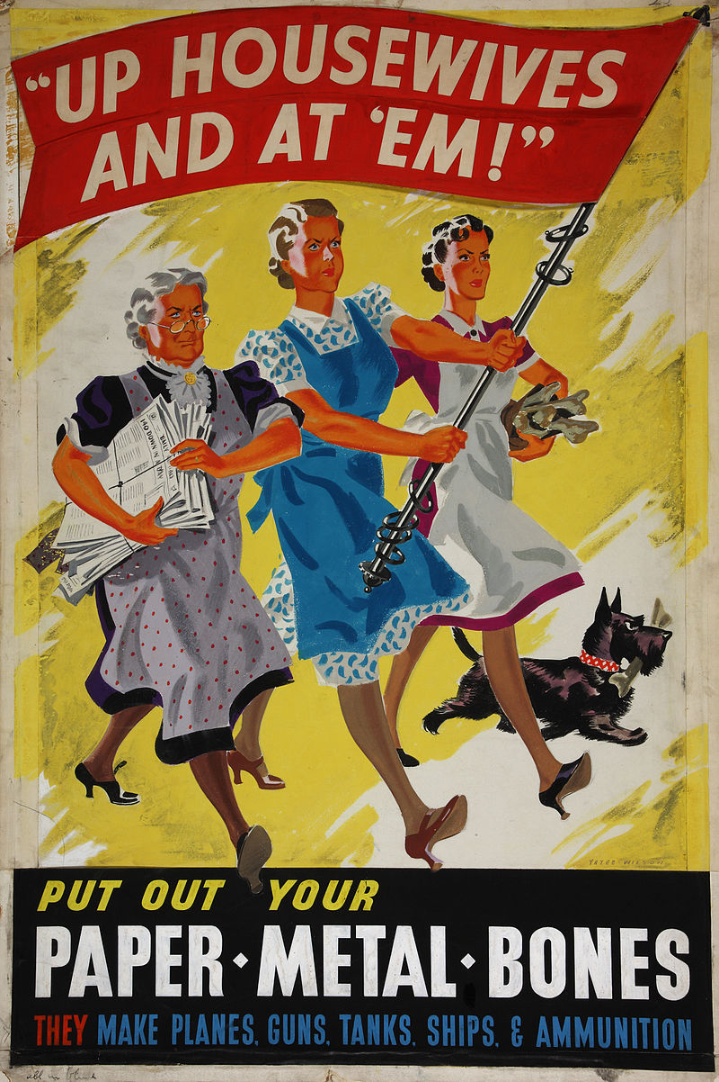
Calling on housewives
A British poster produced by the artist Yates Wilson during the war calling on British housewives to donate their scrap paper, metal and animal bones because “they make planes, guns, tanks, ships and ammunition”.
(UK National Archives, Public Domain)

Slide 16
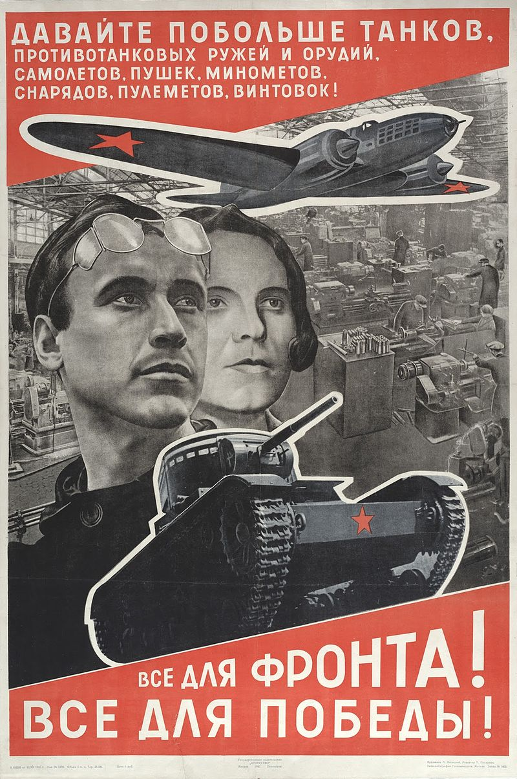
A Soviet poster
A Soviet poster created by one of the leading illustrators in the USSR in the 1930s and 1940s, El Lissitzky. It calls on the Soviet people to build more tanks and planes to win the war. The banner says “Everything for the Front! Everything for victory!”
(Wikimedia Commons, Public Domain in the US)

Slide 17
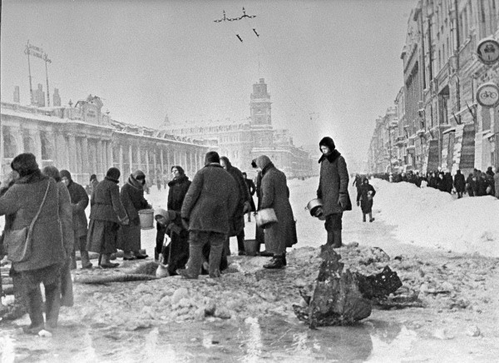
The siege of Leningrad
(Russian International News Agency, RIA Novosti archive, image #907, Boris Kudoyarov, CC-BY-SA 3.0)
During the 16-month Siege of Leningrad by German Army Group North the Russian inhabitants were short of everything including fresh water. Here we see residents gathering water from shell holes.

Slide 18
Air raids
From September 1940 to May 1941 the German Luftwaffe nightly bombed Britain’s main cities and ports. The object was twofold: to destroy Britain’s industrial capacity and to terrorise the civilian population, both aimed at forcing the British government to negotiate a peace. After Germany began Operation Barbarossa against the Soviet Union in June 1941 a similar strategy of intensive bombing was adopted against some Soviet cities such as Leningrad, Moscow and, particularly, Stalingrad. The British were also mounting air raids on German industrial centres. After the evacuation of Allied soldiers from Dunkirk between 26 May and 4 June 1940 heavy bomber raids and the naval blockade of German ports were the only means by which Britain could continue to wage war against Germany in Europe.
After Pearl Harbour and the US entry into the war the US and British air forces mounted combined air raids over Germany and occupied Europe. From February 1942 the allies introduced a policy of targetting cities and towns and not just sites of strategic importance. The objective was to undermine civilian morale. From 1943 onwards these combined bombing operations destroyed a number of major German cities, including Dresden, Hamburg and Cologne. On the Pacific Front the United States began precision air raids against Japanese industrial facilities early in 1943 but quickly switched to broader attacks on Japanese cities, including fire bombing and then, finally, in early August 1945 atom bombs were dropped on Hiroshima and Nagasaki.

Slide 19
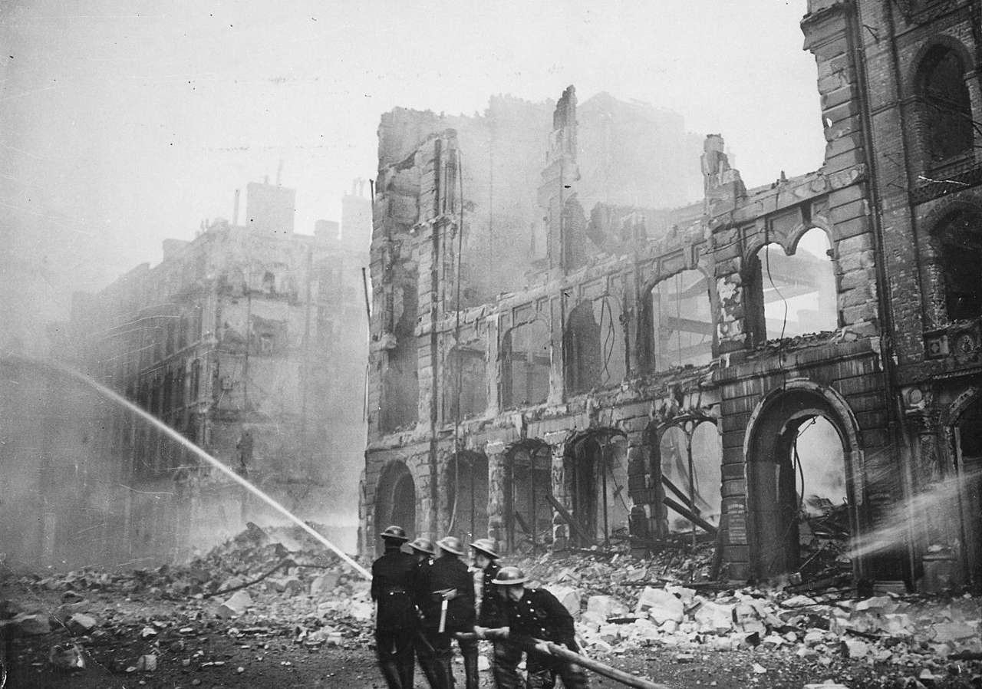
The Battle of Britain
Fireman tackling blazing buildings during the Blitz on London in the spring of 1941.
(UK National Archive, Public Domain)
After France was defeated and Allied troops had been evacuated from Belgium and northern France, the German Luftwaffe controlled the skies over most of Western Europe. They now attempted to gain air superiority over Britain prior to an invasion. The Battle of Britain between the Luftwaffe and the Royal Air Force (RAF) continued from July through to 31 October 1940. Having failed in its objective the Luftwaffe then switched to night-time bombing of Britain’s industrial facilities and main cities and ports. This came to be known in the British press as “The Blitz” – the word being taken from “blitzkrieg” or “lightning war”. By May 1941 it was clear that this strategy had also failed and Hitler turned his attention to Operation Barbarossa on the Eastern Front.

Slide 20
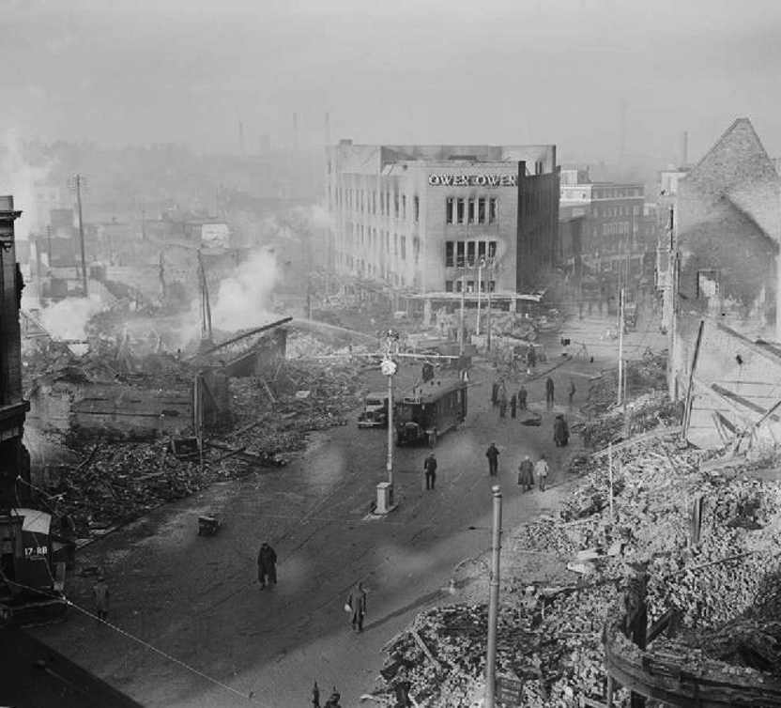
Bombing industrial cities
Bomb damage in the city centre of Coventry, England on 16 November 1940.
Coventry was an obvious target for the Luftwaffe. An industrial city in the English midlands, it had munitions factories and factories building aeroplane engines.
(Imperial War Museum Image H 5600, Public Domain)

Slide 21
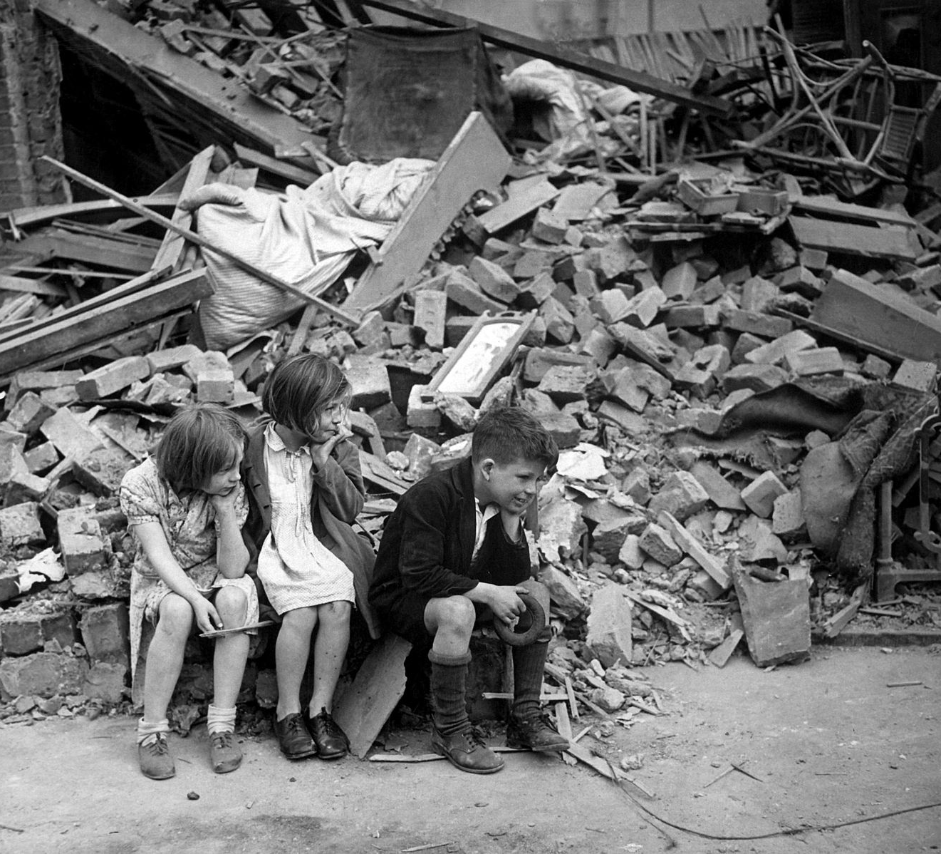
The effects on civilians
Children who had been made homeless in East London by Luftwaffe aerial bombing in 1940. According to the New York Times, when it published this photograph, the children are squatting outside the wreckage of their home.
(US National Archives and Records Administration, CC BY-SA 2.0 generic)

Slide 22
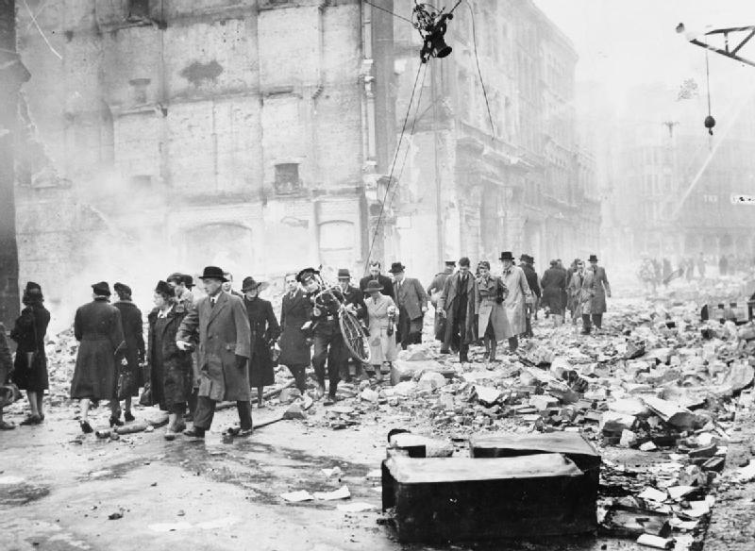
Keep calm and carry on
In 1939, after war had begun, the British government produced what has become one of the most famous propaganda posters of the war. On a red background it simply said: “Keep Calm and Carry On”. This example of British office workers going to work through the debris of the Blitz seems to capture this sentiment exactly.
(Imperial War Museum, Public Domain in the UK)

Slide 23
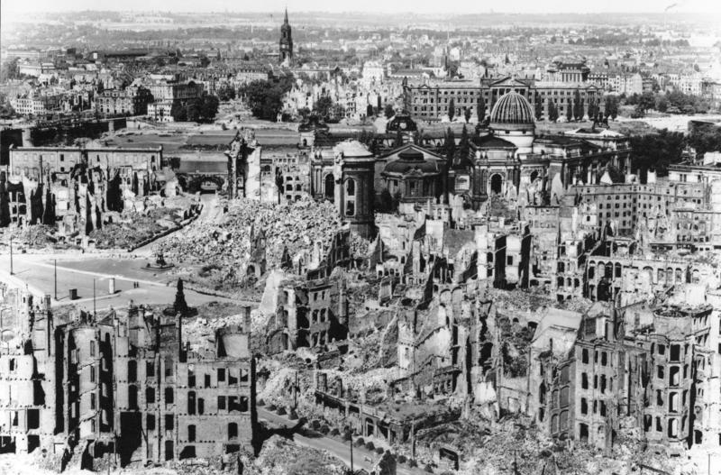
The bombing of Dresden
(German Federal Archive, Bundesarchiv, Bild 146-1994-041-07, CC-BY-SA 3.0)
Between 13th and 15th February 1945 a combined force of nearly 1500 US and British heavy bombers dropped almost 4000 tons of explosives on the German city of Dresden. The bombing resulted in a firestorm which destroyed most of the city. Around 25000 civilians died in these air raids. The strategic value of the destruction remains a matter of debate between historians. Some argue that the bombing destroyed 25% of the industrial facilities and most of the communications infrastructure which hampered the Wehrmacyt’s capacity to stop the Red Army’s advance through eastern Germany. Others question the contribution of Dresden to Germany’s war effort. Some have suggested that if the allies had lost the war the firebombing of Dresden would have been a war crime.

Slide 24
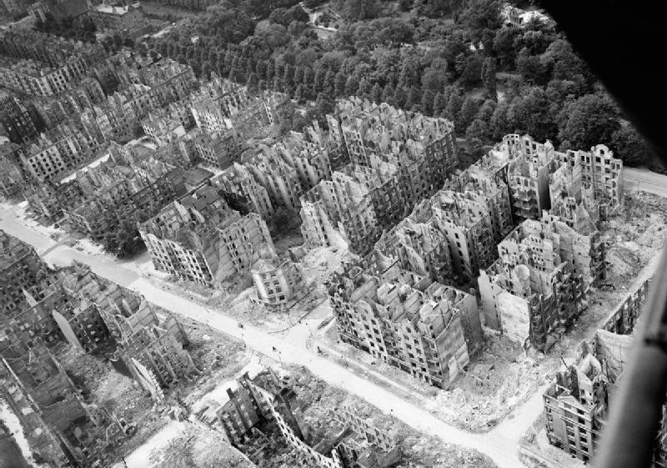
Operation Gomorrah, Hamburg
The Eilbek district of Hamburg on 28 July 1943
(Imperial War Museum, © IWM (CL 3400, Re-used under the IWM Non Commercial Licence)
The destruction of the Eilbek area of Hamburg after the aerial bombing by the Allied bombers on the night of 27/28 July 1943.
This was known as Operation Gomorrah and the targets were the port, the shipyards, the U-boat pens and the oil refineries. In reality the intense bombing created a firestorm which destroyed mostly of the city, killed 43000 civilians and injured another 37000. Most of the survivors fled the city.

Slide 25
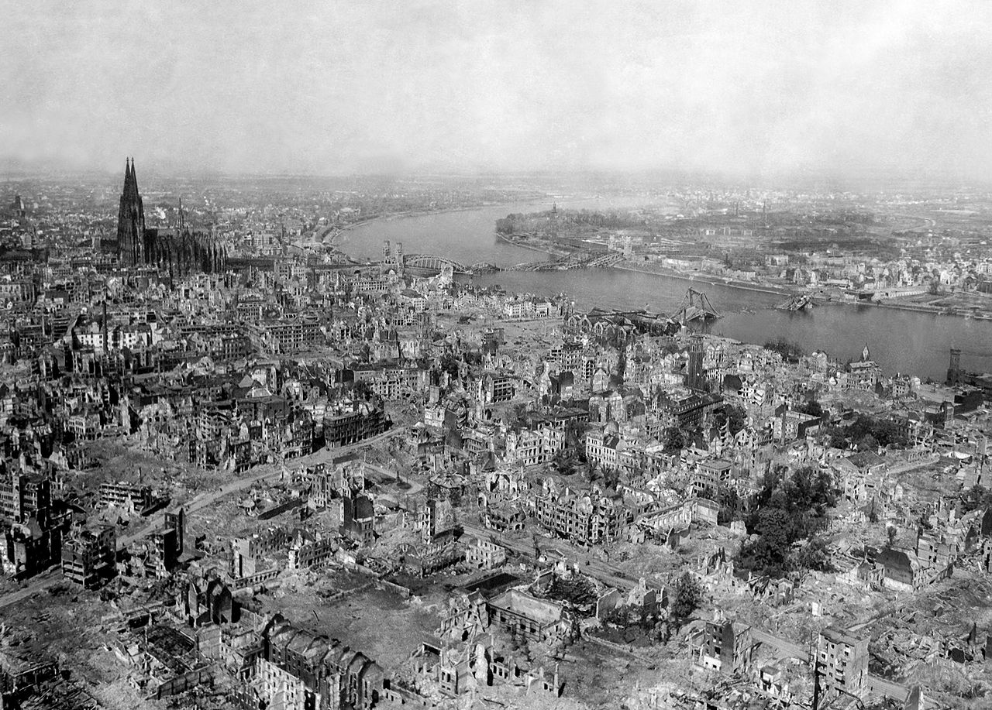
The bombing of Cologne
Cologne in April 1945.
(US National Archives and Records Administration, Public Domain)
Cologne was attacked by Allied bombers on over 250 occasions between May 1940 and April 1945. This included the first 1000 bomber raid in May 1942. A total of 35000 tons of bombs were dropped on the city during the war.
It is interesting to note that Cologne Cathedral appears relatively undamaged while the area around it is completely obliterated. After the war, rumours spread that the twin spires of the Cathedral had been used as a landmark by the pilots who had orders from Washington not to attack the Ford Motor Works further along the river. The rumours persist even now but have never been substantiated.

Slide 26
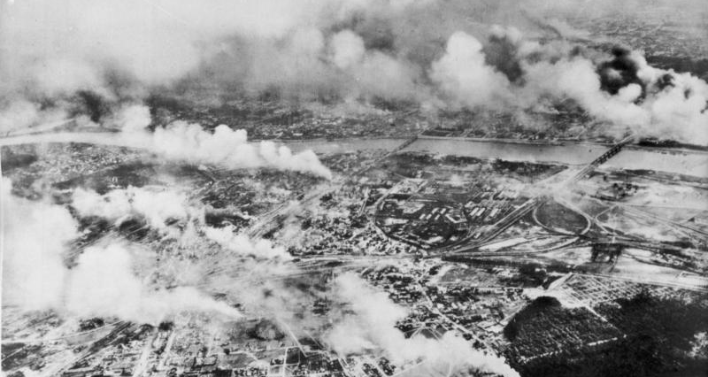
The bombing of Warsaw
The aerial bombing of Warsaw in September 1939 during the invasion of Poland by the forces of the Third Reich. Between 20000 and 25000 civilians died in the bombing.
(German Federal Archive, Bundesarchiv, Bild 141-0763, CC-BY-SA 3.0 )

Slide 27
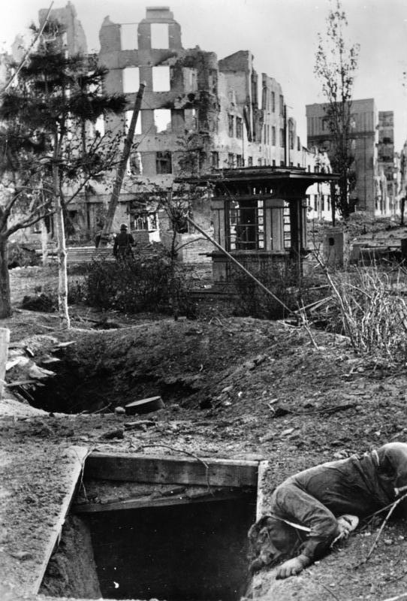
The bombing of Stalingrad
The Soviet industrial city of Stalingrad was heavily bombed by the Luftwaffe in August 1942 prior to the siege of the city by the German 6th Army. On 23 August over 1000 tons of bombs were dropped on the city turning most of it into rubble. The bombing sorties continued into the winter when the Red Army launched its successful counter-offensive.
(German Federal Archive, Bundesarchiv Bild 183-B22436, CC BY-SA 3.0)

Slide 28
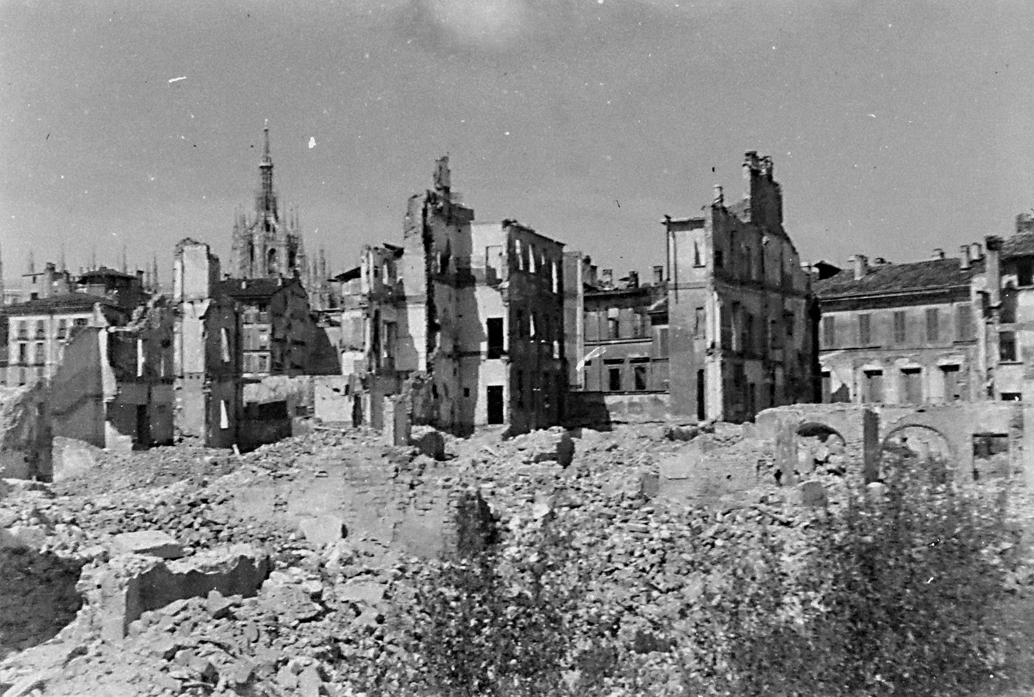
Allied bombing of Milan
(Wikimedia Commons, Public Domain)
The first Allied aerial bombing of Milan took place in October 1942 using incendiary bombs. Further air raids occurred in February 1943, targeting the factories and railway but also impacting on residential areas. The largest raid was on 12/13 August 1943 after Mussolini had been captured in an attempt to persuade the Badaglio government to surrender. This is a photograph of Milan after that August 1943 raid.

Slide 29
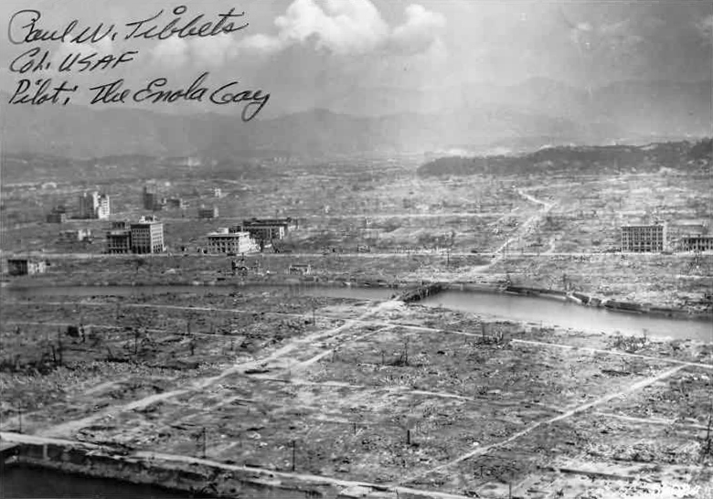
Hiroshima
(US Navy Public Affairs Resources, Public Domain)
A photograph of Hiroshima minutes after the atom bomb had been dropped on 6 August 1945. The note on the photograph is signed by Colonel Paul W. Tillets of the US Air Force who was the pilot of Enola Gay on the day that the bomb was dropped from his B-29 Superfortress bomber. Estimates of civilian deaths vary from 90000 to 150000 but many more died in the following months from radiation sickness.

Slide 30
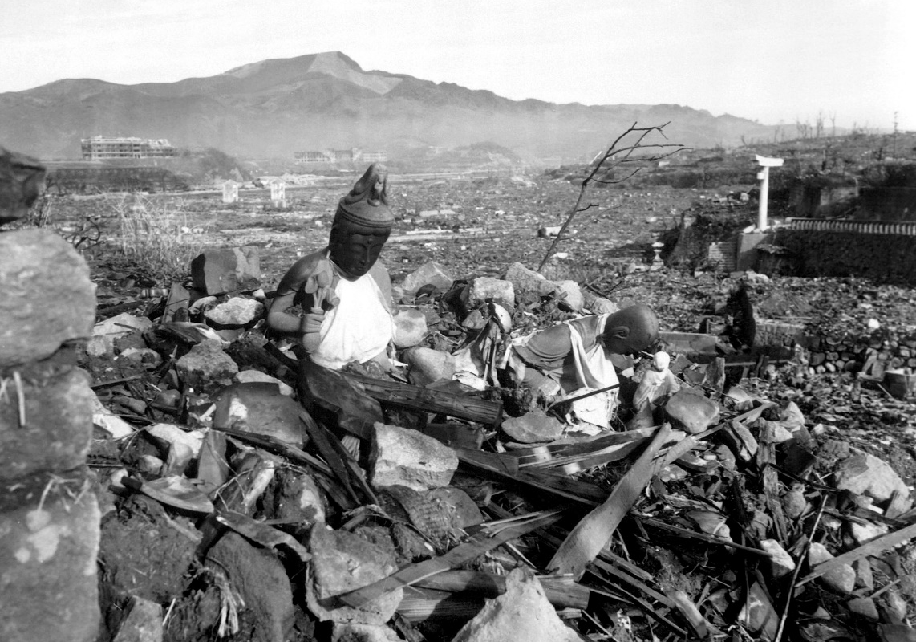
Nagasaki
(US Department of Defense ‘War and Conflict’ Image Collection (HD-SN-99-02900), Public Domain)
The second atom bomb was dropped on Nagasaki on 9 August 1945. Estimates of the numbers killed vary between 40000 and 80000 and, as with the atomic explosion over Hiroshima, many more died from radiation sickness in the months following. The picture shows battered religious figures standing watch on a hill above a tattered valley near Nagasaki, on September 24, 1945, six weeks after the city was destroyed by the world's second atomic bomb attack.
Six days after the atomic bombing of Nagasaki the Imperial Japanese government surrendered.

Slide 31
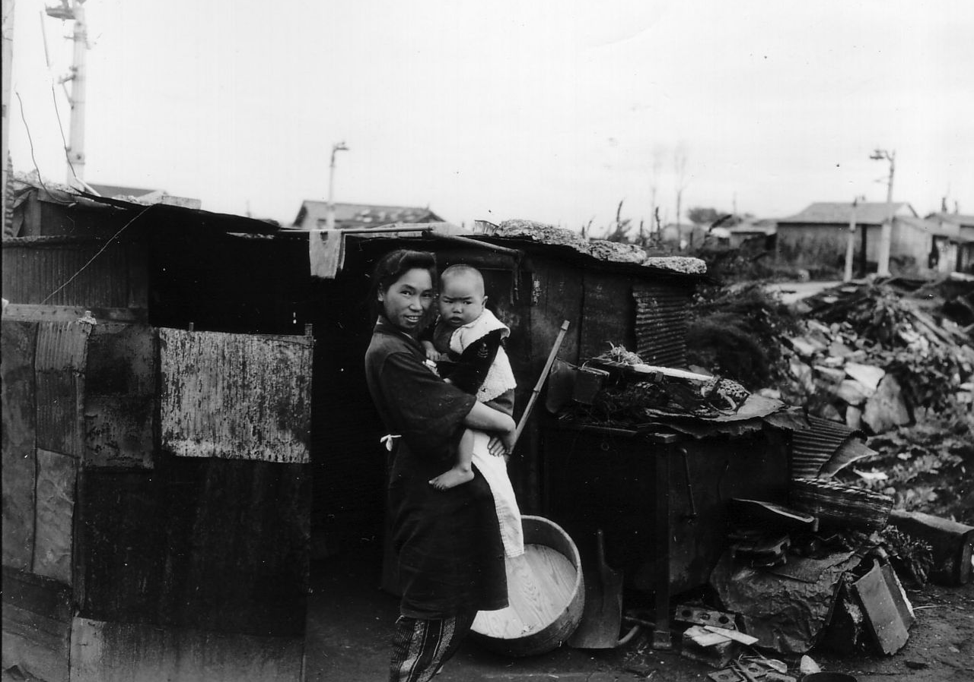
Air raid on Tokyo
(US National Archives & Records Administration, Public Domain)
The air raid by US B-29 bombers on Tokyo on 9/10 March 1945, using explosives and incendiaries, is considered to be the most destructive air raid of the war. Large areas of Tokyo were destroyed killing nearly 90000 civilians and leaving a million others homeless, including this Japanese woman and her baby.

Slide 32
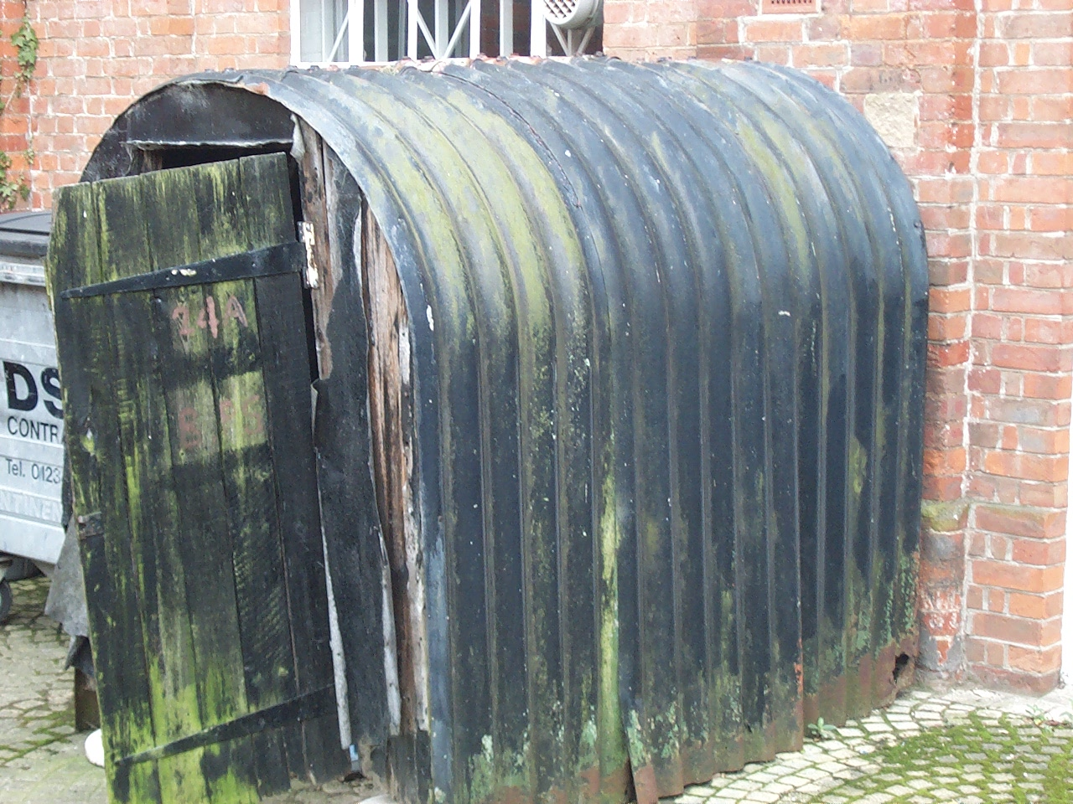
The Anderson Shelter
(Bedford Museum via Wikimedia Commons, Photographer: Simon Speed (2007), Public Domain)
This simple frame for a six-person domestic air raid shelter was named after Sir John Anderson, the British Minister responsible for implementing air raid precautions in 1939. They were buried underground outside family homes. They were made of corrugated sheet steel instead of concrete because experiments showed that sheet steel below ground absorbed blasts more effectively than concrete. Around 4 million were made and distributed to households.

Slide 33
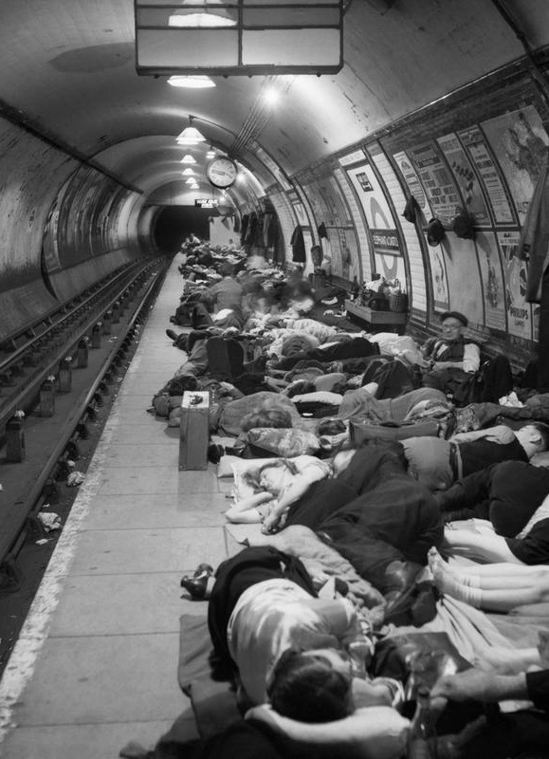
The London Underground
The London Underground (more commonly known as “The Tube”) is a rapid transit system which was opened in 1863 and then rapidly expanded across London to the outer suburbs. Most of the platforms are between 20 and 50 metres below ground so they provided good protection for civilians during the Luftwaffe air raids (“The Blitz”) and the rockets that the Third Reich used later in the war.
This photograph was taken at the Elephant & Castle station in central London in November 1940 at the height of the Blitz.
(Imperial War Museum, Photographer: Bill Brandt, © IWM (D 1568), Re-used under IWM Non Commercial Licence)

Slide 34
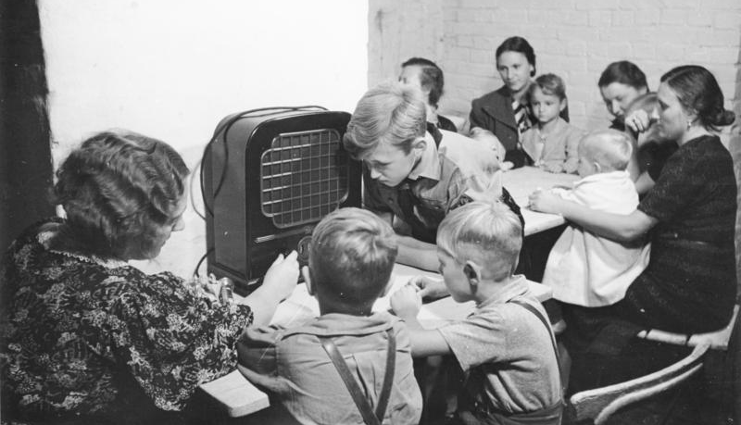
Air raid bunkers
German families sit and listen to the radio in their concrete air raid bunker during an air raid in 1942.
(German Federal Archive, Bundesarchiv, Bild 146-1981-076-29A, CC-BY-SA 3.0)

Slide 35
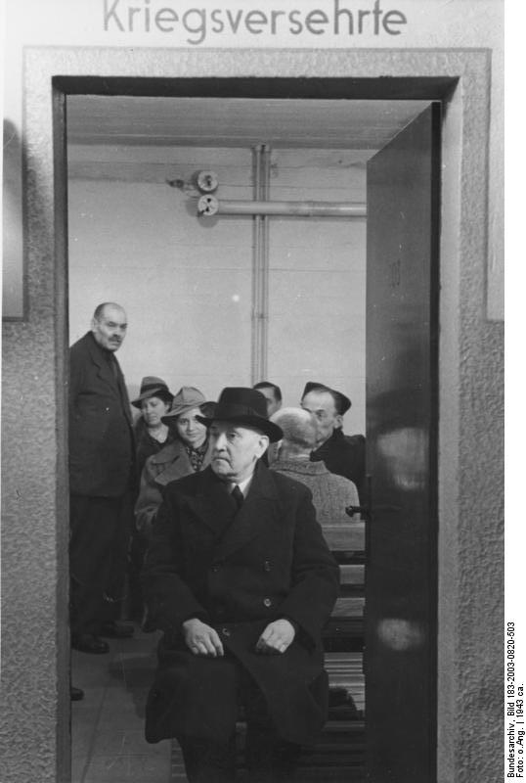
German public bunkers
German civilians sheltering in a public concrete bunker somewhere in Germany during an air raid in 1943. The largest German public underground shelter was in Alexanderplatz in Berlin, which could hold 3500 people.
(German Federal Archivem=, Bundesarchiv, Bild 183-2003-0820-503, CC-BY-SA 3.0)

Slide 36
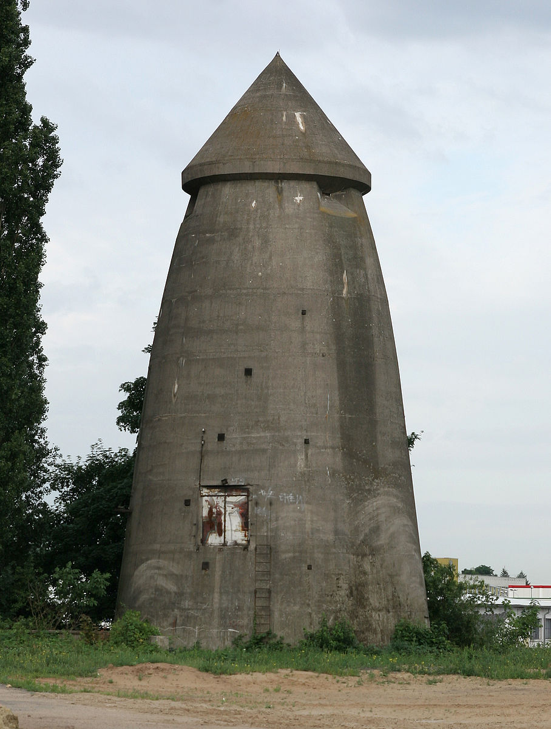
German overground shelters
However, many of the German air raid shelters were above ground like this one in Darmstadt designed by the German architect, Leo Winkel. Their walls were one metre thick and they usually had air filters to protect the people sheltering there from poison gas attack. Many, like this one, are still standing in German cities.
Wikipedia, Photographer: Armin Kübelbeck, Public Domain)

Slide 37
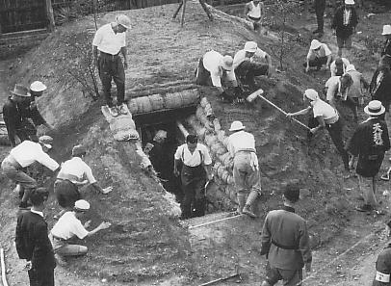
Constructing shelters in Japan
(Wikimedia Commons, Public Domain in Japan)
Construction of a large public air raid shelter in Japan in 1940.
It is worth noting that this shelter was being built before the attack on Pearl Harbour which brought the USA into the war. In 1940 Japan was more concerned about the possibility of Soviet air raids since Japan and the USSR had been fighting since May 1939 over the border between the Japanese puppet state of Manchuria and the Soviet-backed communist state of Mongolia.

Slide 38
Evacuation from danger
In addition to building air raid shelters to protect citizens from sustained aerial bombing some of the belligerent countries also evacuated their citizens, particularly children and young people and mothers with babies to areas that were less at risk. In Britain the first evacuation of children began on 1 September 1939 two days before war was declared. This was the 9-month period of the so-called Phony War in Western Europe and by January 1940 most of the children had returned home. A second evacuation, particularly from the coast happened in June 1940 when a German seaborne invasion was anticipated. The third wave of evacuations – from the main cities - took place during the Blitz. In all 3.5 million British children were evacuated. Unlike in Britain there was not a large scale evacuation of German children at the beginning of the war. But this came into operation after the Allied bombing of Hamburg and Berlin in September 1940. As Allied bombing intensified the evacuation was extended to other cities on the Ruhr and along the Rhine. In all 3 million German children were evacuated. In France, around 30000 children were evacuated from Paris by 31 August 1940 in anticipation of the German bombardment of the city. Around a million adult Parisians also left for the provinces. The German invasion of the Soviet Union in 1941 also led to large-scale evacuation of civilians further east.

Slide 39
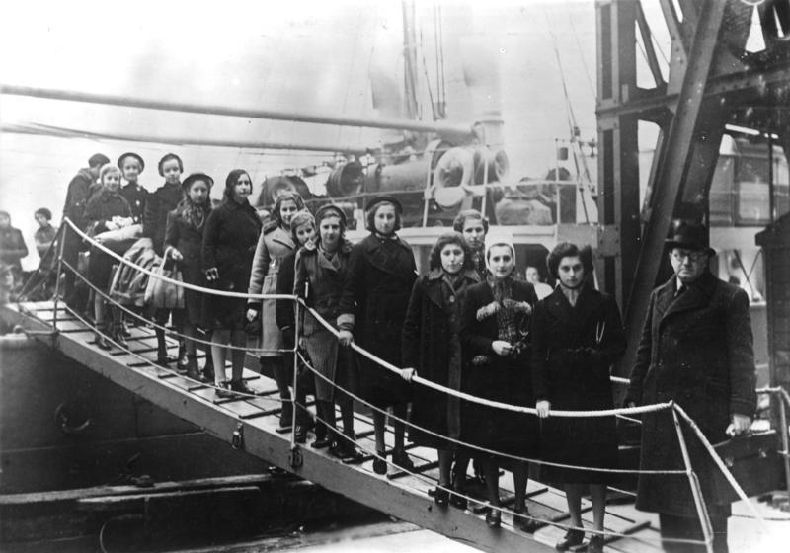
Jewish refugees
Jewish refugee children arriving at the Port of London in February 1939.
(Geman Federal Archive, Bundesarchiv, Bild 183-S69279, CC-BY-SA 3.0)
Even before the outbreak of war in September 1939, fear of war and oppression made many people into refugees. Many Jewish families sent their children away from the Third Reich to places of safety. The British Kindertransport scheme that brought Jewish children from German, Austria, Czechoslovakia and Poland to live with foster parents in Britain.

Slide 40
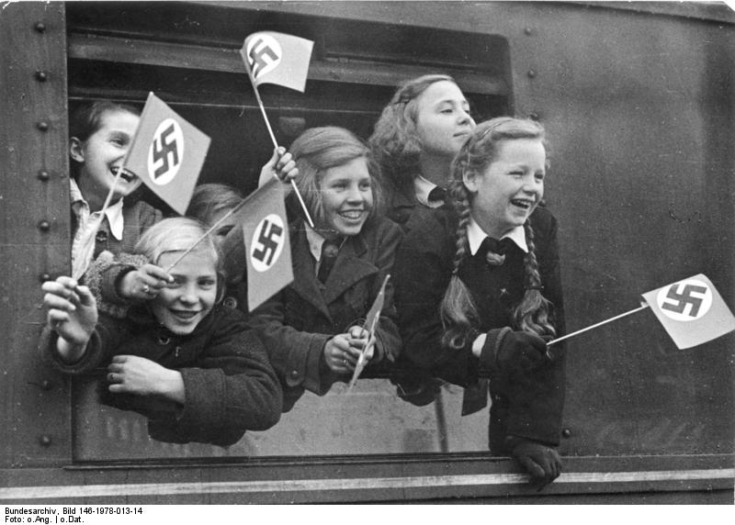
Relocating children in Germany
KLV evacuees leaving Berlin
(German Federal Archive, Bundesarchiv, Bild 146-1978-013-14, CC-BY-SA 3.0)
For almost 50 years before the start of the war Germany had temporarily relocated young children and adolecents to the countryside for foster care if they were seriously ill or malnourished. This scheme for the relocation of children to the countryside was known as Kinderlandverschickung (KLV). Once Allied bombing of major cities such as Berlin and Hamburg intensified the Third Reich decided to use the KLV scheme to relocate children and adolescents from the bombed cities to safer areas. About 3 million children were relocated, about half to homes and the other half to KLV camps. By 1943-5 there were fewer safe places to relocate to and, because the scheme was voluntary, many parents chose to bring their children back or not send them.

Slide 41
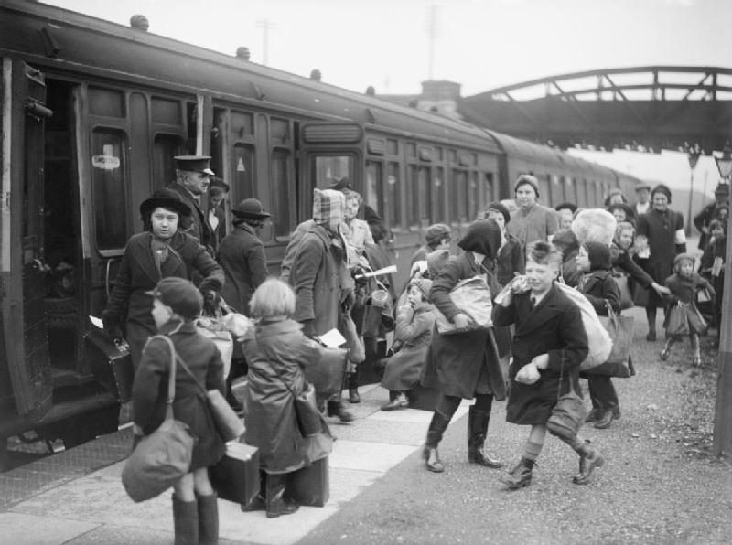
Evacuations in the UK
These children are evacuees form the port of Bristol (a target during the Blitz) arriving at the station in Kingsbridge, Devon in 1940.
(Imperial War Museum, © IWM (D 2592), Re-used under IWM Non Commerical Licence)
In 1939 the British government was concerned about the safety of children and mothers with babies if war was declared. The first evacuation was carried out to coincide with the declaration of war in September 1939. But the fighting was on the Eastern Front and many parents brought their children back home. A second evacuation, particularly from the coast, occurred in June 1940 when a seaborne invasion of Britain was expected. The next evacuation took place during the Blitz and the final one occurred from June 1944 when the Third Reich began its campaign of using rockets to attack British cities.

Slide 42
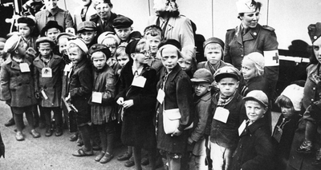
Evacuations from Finland to Sweden
Finnish children evacuated to the safety of neutral Sweden in 1939 during the Winter War with the Soviet Union when Soviet bombers were bombarding Helsinki.
(Historiana, Public Domain in Finland)

Slide 43
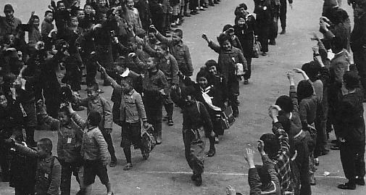
Evacuations in Japan
Japanese school children being evacuated to rural areas in August 1944. This coincided with a time when the tide of the Pacific War was turning against Japan.
(Showa History Volume 11: Road to Catastrophe, Public Domain)

Slide 44
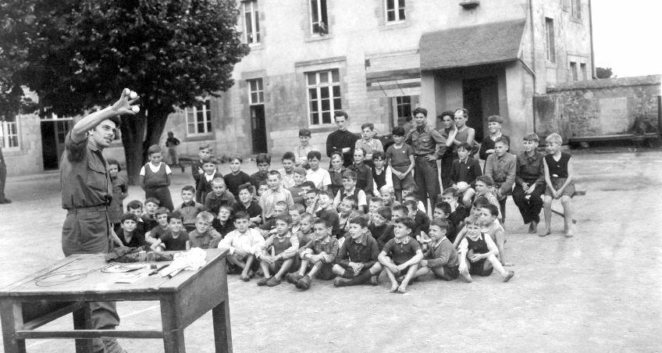
Evacuated children in France
US Corporal Paul Operer demonstrating his conjuring skills to entertain French children evacuees relocated from Paris to Plaennec near Brest. The date is 20 August 1944, just five days before the Allies liberated Paris and these children could return home.
(US Army, Public Domain in the US)

Slide 45
The siege of Leningrad
“Before the war Leningrad had a population of 3,103,000 and 3,385,000 counting the suburbs. As many as 1,743,129, including 414,148 children were evacuated between 29 June 1941 and 31 March 1943.”
The seizure of Leningrad was one of three main goals for the Third Reich’s Operation Barbarossa – the invasion of the USSR. With the German Army Group North advancing on Leningrad from the south and the Finnish Army advancing from the north the Luftwaffe began to “soften up” the city of Leningrad with a series of bombing raids. The Soviet authorities began an evacuation of civilians, especially women and children out of the city to the Volga region and then many moved on to the Urals and Siberia or south east to Kazakhstan.
(Marshal Georgy Zhukov, in his memoirs, Marshal of Victory, (1974) Volume 1 p.399)

Slide 46
The siege of Leningrad
Some 1300 factories were packed up from the northern industrial sectors and carried east by train into the Urals, Central Asia or Siberia. Moreover, these numbers only reflect large facilities. When all factories, even small ones no larger than simple workshops, are considered, as many as 50,000 industrial plants may have been transported east. As monumental as this effort proved, it still fell short of all available industry..
Mass evacuation of millions of Soviet people after the German invasion of the Soviet Union in 1941.
German victories in Russia in 1941, threatened to destroy the entire war economy of the USSR. It became urgent to evacuate Soviet industries to safer locations in Central Asia, the Urals, and Siberia. Whole factories were dismantled and 20000 trains moved machinery and equipment eastwards. This involved the mass movement of people as well as factories. Thousands of workers, women as well as men, were uprooted from their homes to experience long train journeys, being dumped in a near-empty landscape, and rebuilding factories - in winter conditions, often without gloves.
(Michael Fassbender, The Transfer of Soviet Industries during World War Two)

Slide 47
Women working for the war effort
As in the First World War, the onset of another global war in 1939 led the governments of the belligerent countries to call on women to replace the men who had been conscripted into the armed forces from vital industries and essential services. These women built aircraft, tanks, warships and military vehicles. They made weapons and ammunition. They ran public transport and other public services. Many enlisted as nurses, others enlisted in the armed forces, mostly in non-combat roles but in some countries, such as the Soviet Union they also fought on the front line.
Even before the war more than half of German women between the ages of 16 and 60 were working in industry or agriculture. In Britain about 40% of adult women were recruited to work in industry, agriculture and essential services. The figure was slightly lower in the United States at around 30%.

Slide 48
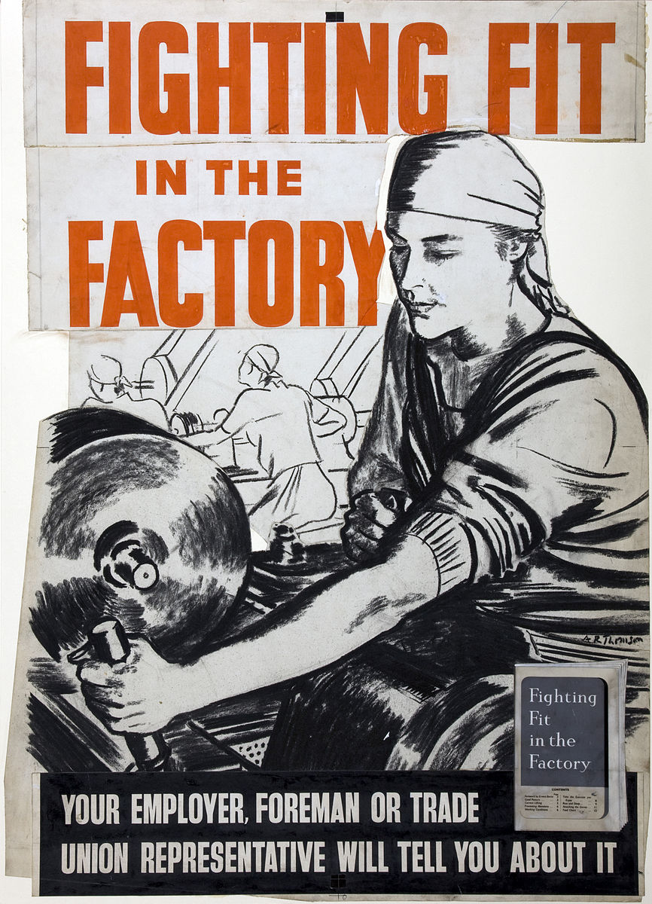
Guidance on health and safety in the workplace
This was a poster produced on behalf of the British Ministry of Work to provide women working in the factories with guidance on health and safety in the workplace.
(UK National Archives, Public Domain)

Slide 49
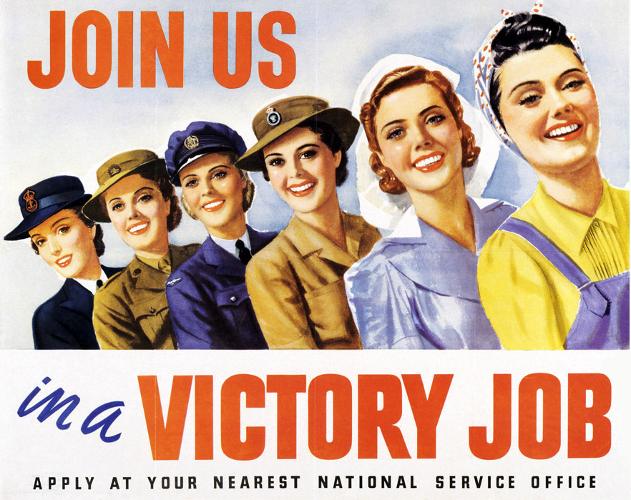
This was an Australian government recruitment poster, produced in 1943, to encourage women to join the armed forces or work in essential industries.
(Australian War Memorial, Public Domain)

Slide 50
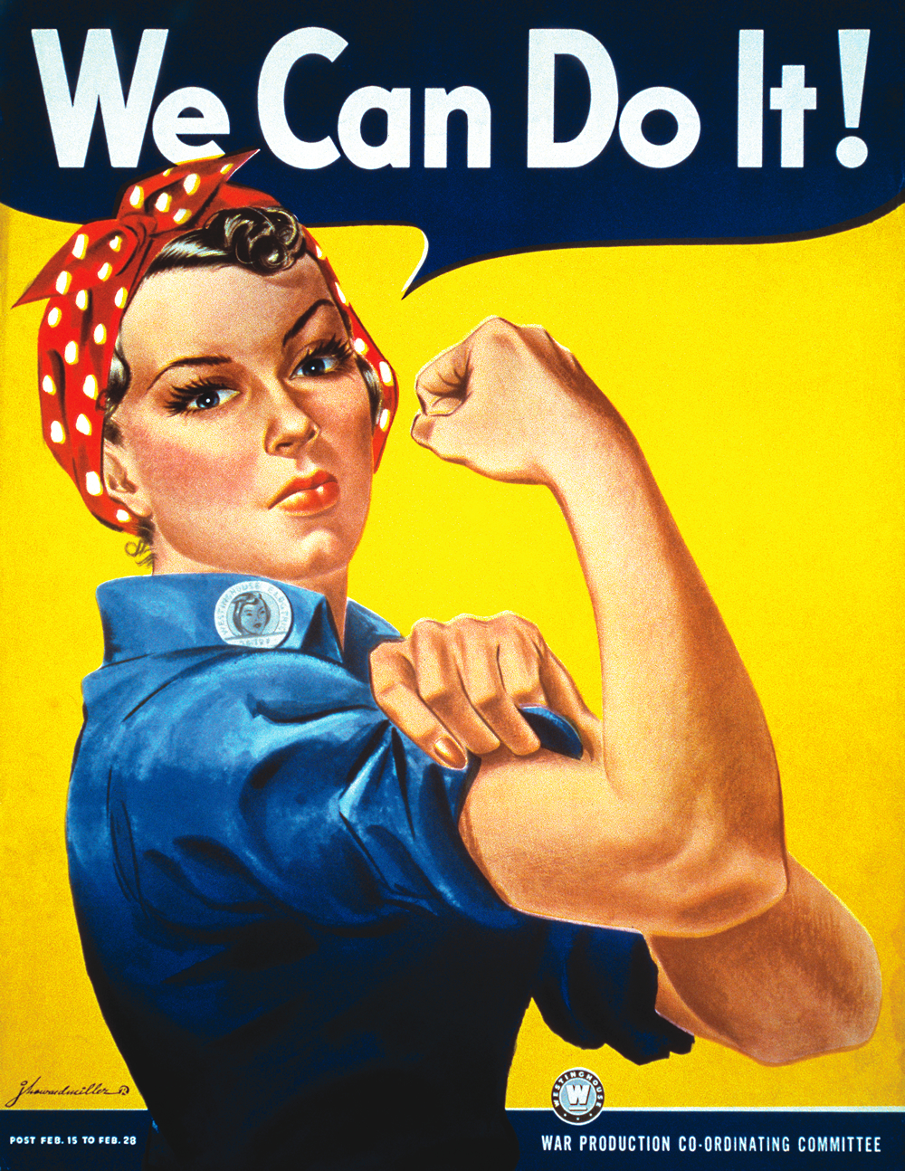
We Can Do It!
This was a poster created by J Howard Miller for Westinghouse Electric, a large US company seeking to recruit women to work for the war effort.
The young woman in the poster is often referred to as Rosie the Riveter – an iconic recruitment figure in the US during the war. She appears in a number of posters. In reality Rosie was Rose Will Monroe who worked as a riveter at the Willow Run Aircraft Factory in Ypsilanti Michigan, USA making B-24 bombers.
(National Museum of American History, Public Domain in the US)

Slide 51
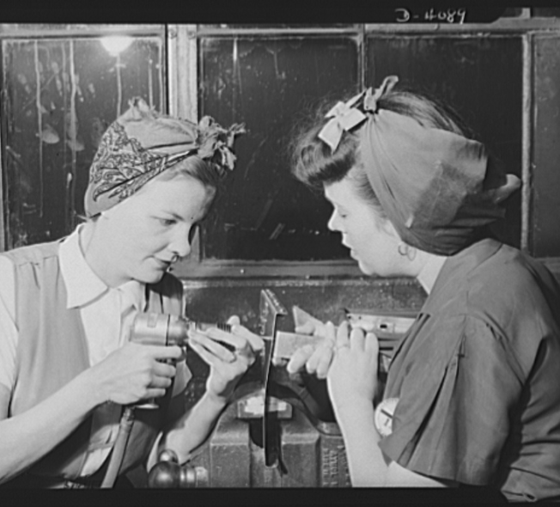
Riveting radio support assemblies
Two real-life Rosie the Riveters riveting of radio support assemblies for bomber planes. This photograph was taken in May 1942 just over four months after the United States entered the Second World War.
(US Library of Congress, Public Domain in the US)

Slide 52
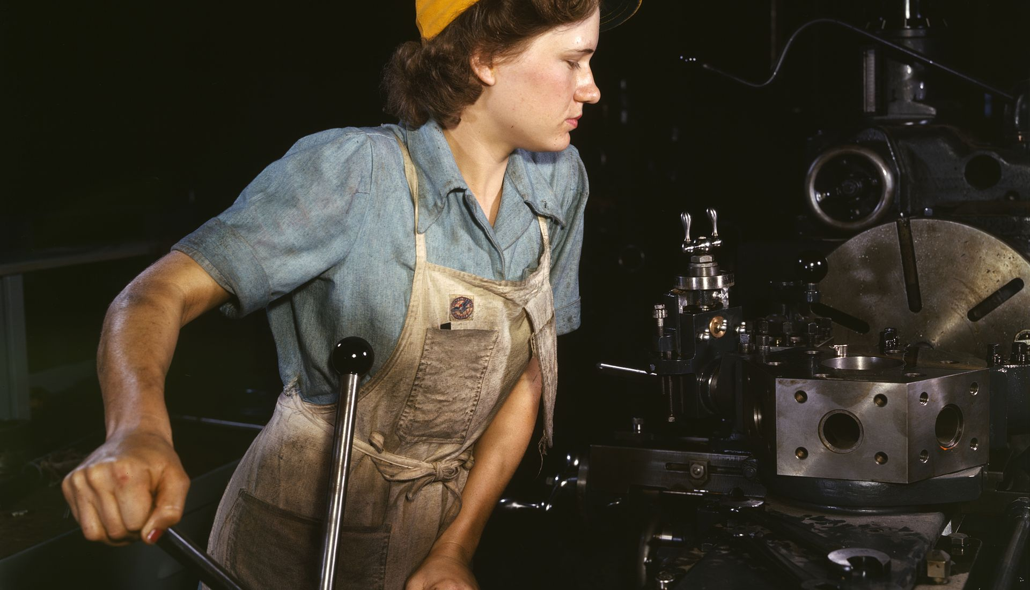
Machine tool worker
A female machine tool worker in Texas, United States, 1942.
(U.S. Library of Congress, Public Domain in the US)

Slide 53
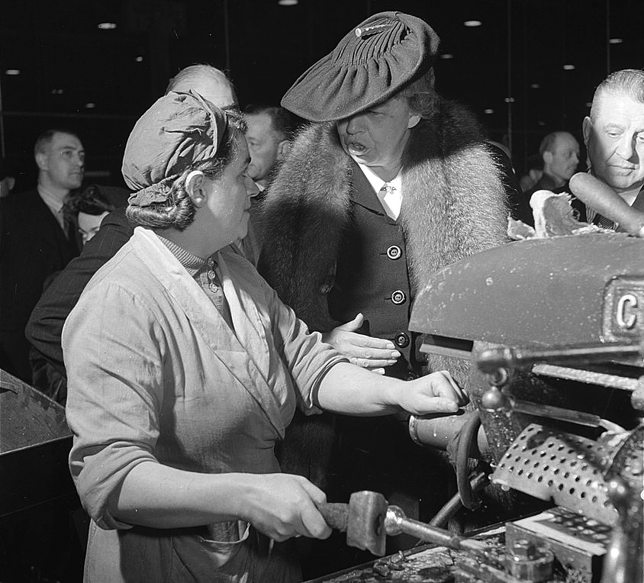
A British machinist with Eleanor Roosevelt
A British female machinist whose photograph was taken because she met the United States’ first Lady, Eleanor Roosevelt, who was making a goodwill tour of Britain in 1942.
(U.S. Library of Congress, Public Domain in the US)

Slide 54
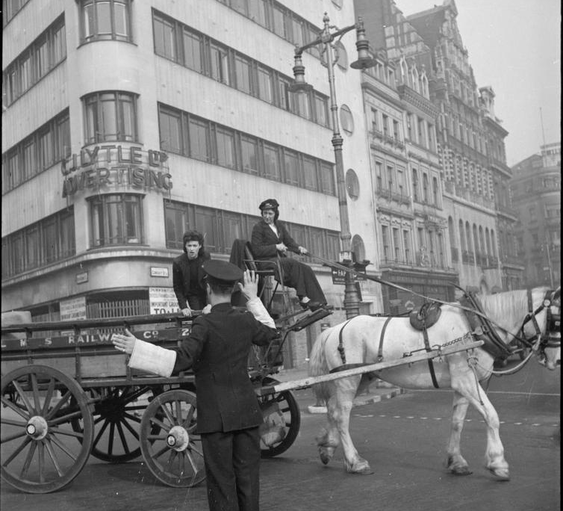
Delivering goods
Two women in London delivering goods in a horse and cart who were working for the London, Midland & Scottish railway in 1943.
(Imperial War Museum, © IWM (D 16829), Re-used under the IWM Non Commercial Licence)

Slide 55
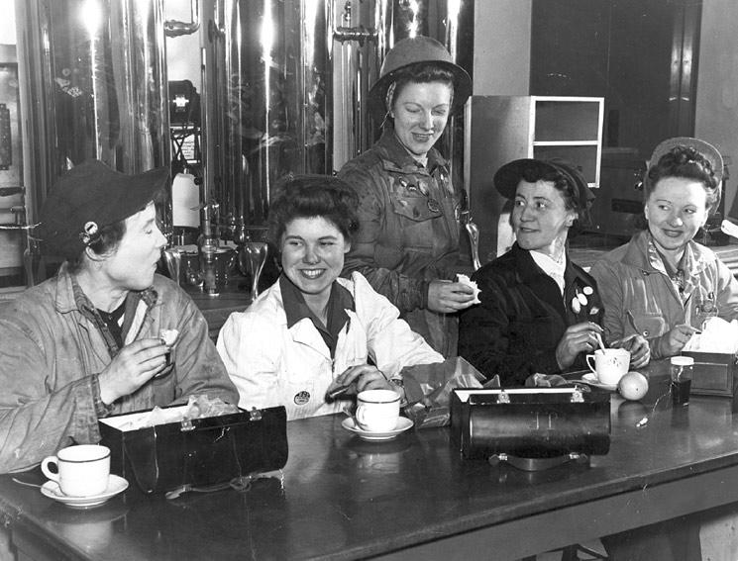
Dock workers
(North Vancouver Museum & Archives, Public Domain in Canada)
Women dock workers having a break in the canteen at Burrard Drydock in Vancouver, Canada in 1942. Over 1000 women worked at the dock and they were unionised. The women here are all shop stewards in the union. At the end of the war all the women were dismissed from their jobs so that the men returning from the war could be re-employed.

Slide 56
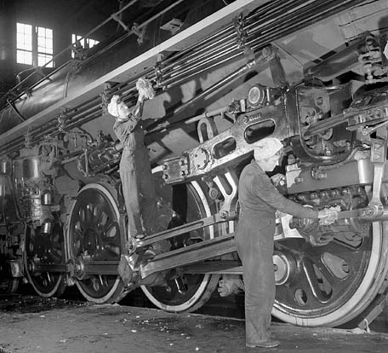
Jobs on the railway
In Canada women took over most of the jobs on the railways during the war. Here two of them are cleaning a freight train in January 1943.
(National Film Board of Canada, Public Domain in Canada)

Slide 57
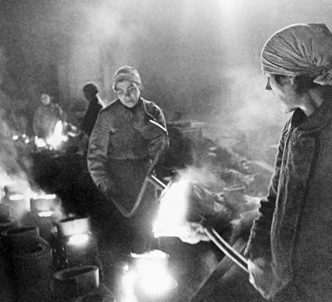
Metal workers
Russian women metal workers in a factory in Leningrad in January 1942 still working during the siege of their city by German Army Group North and the Finnish Army.
(Russian International News Agency, RIA Novosti archive, image #348, Vsevolod Tarasevich, CC-BY-SA 3.0)

Slide 58

Japanese Volunteer Fighting Corps
(Japanese book "Showa History of 100 million people: War History of Home Front" published by Mainichi Newspapers Company, Public Domain in Japan)
Many unmarried women in Japan joined either the Volunteer Fighting Corps or the Volunteer Labour Corps. This group of young women are in the Labour Corps and are marching through the factory gates to start work. The photo dates from June 1944.
In addition to Japanese female volunteers there was also a Korean Women’s Labour Force which did similar work but as forced labour with few rights.

Slide 59

Bund Deutscher Mädel
(German Federal Archive, Bundesarchiv, Bild 183-E10868, CC-BY-SA 3.0)
These teenage girls were members of the Bund Deutscher Mädel (The League of German Girls) which was the female wing of the Hitler Jugend (Hitler Youth). Membership of the BDM was compulsory.
This group are doing the work of the farm labourers who have been conscripted and, in this case, are working in what the magazine of the BDM describes as “the German territories regained in the east”

Slide 60
Internal resistance to war
In most of the countries that were drawn into the war there were peace movements in the 1930s calling on their governments not to be dragged into a second global conflict in just 20 years. There were also pacifist groups who had always been opposed to war. There were other forces at work as well who had different motives for opposing involvement in the war. In Britain the British Union of Fascists, led by a former government minister, Oswald Mosley, called for a negotiated peace with Germany. The US car manufacturer, Henry Ford, who also had factories in Germany and Britain, refused to allow his factories to make military equipment that could be supplied to the British. In the USA there were also isolationists who did not want to be dragged into what they perceived as a European war, at least until Pearl Harbour. In the colonies of the European powers there were independence movements that called on their people not to fight for Britain or France and even encouraged them to join with the Japanese in the hope of gaining independence from their Colonial “masters”.
In totalitarian states like Nazi Germany, Fascist Italy and the Communist Soviet Union it was extremely dangerous to actively oppose the regime and its war-like intentions and those who did found themselves imprisoned or executed as traitors.

Slide 61

Professor Kurt Huber
Professor Kurt Huber (24 October 1893-13 July 1943), organiser of non-violent resistance against the National Socialist regime in Gemany.
(German Federal Archive. Bundesarchiv, Bild 146II-744, CC-BY-SA 3.0)
In the summer of 1942 five students and a professor at the Ludwig Maximilian University of Munich formed the White Rose, a resistance movement against the National Socialist regime. They distributed leaflets calling on the German people to use non-violent resistance to oppose the regime. They were Hans Scholl, Sophie Scholl, Alexander Schmorell, Willi Graf, Christoph Probst and Kurt Huber, professor of music at the same University. All of them were arrested by the Gestapo in February 1943, charged with treason, and beheaded on 13 July 1943. The square outside the University in Munich is now named Professor Huber Platz.

Slide 62

The Rosenstrasse protest, 1943
This monument is dedicated to the Rosenstrasse protest, 28 February - 6 March 1943.
(Flickr, Photographer: Niki Sublime (2008), CC BY-SA 2.0 generic)
Until early 1943 the Nazis had exempted Jews married to non-Jews from the so-called “Final Solution”. But on 27 February 1943 around 1800 Jewish men married to non-Jewish women were also rounded up for deportation and taken to a temporary detention centre in Rosenstrasse, Berlin. Their wives and relatives began protesting outside the centre shouting “We want our husbands back!”. During the first week of March the protest grew. The SS called for police reinforcements to control the crowd. The Reich Main Security Office in Berlin proposed shooting all of the protesters but Goebbels intervened, worried that a public massacre on the streets of Berlin would undermine civilian morale. On 6 March Goebbels ordered the release of the prisoners in Rosenstrasse. Remarkably, most of these men and women were not deported to the extermination camps and survived the Holocaust.

Slide 63

Executions of the Edelweisspiraten in Cologne
(Wikimedia Commons, Photographer: Christoph Rückert, CC BY-SA 3.0)
This memorial in Cologne marks the site of two group executions in 1944. The first group, eleven Poles and Russians deported to Germany for forced labour, were publicly hanged on October 25, 1944. The second group were thirteen young Germans who had used various forms of resistance against the Nazis. These included members of the Edelweisspiraten from Ehrenfeld, a district of Cologne, who were also publicly hanged without trial by the SS. The Edelweisspiraten (Edelweiss Pirates) had emerged in the 1930s. They were young people who resisted the requirement to join the Hitler Youth. Mostly their leaders and some of the followers were sent to concentration camps, other were arbitrarily executed.

Slide 64

The Catholic Church
Prisoner barracks at Dachau.
(US Holocaust Memorial Museum, Public Domain in the US)
While the Catholic Church in Germany had sought to cooperate with the Nazis, even before the war, many church leaders, priests and lay people were openly anti-Nazi and some sought to help the Jews escape deportation. In Austria, Czechoslovakia, Poland and Slovenia many priests were rounded up for their support of the national resistance movements and, together with around 400 German priests, were sent to Dachau concentration camp. In all, about 2500 Catholic priests were held there.

Slide 65

Student protests
In the summer of 1939 university students in the United States, France and Britain and Western Europe held peace demonstrations calling on their governments not to go to war. By the spring of 1940 Europe was at war and the university students there did not hold peace demonstrations. But in the United States, about seven months before the Japanese attack on Pearl Harbour, over a million students did hold a one-day ‘peace strike’ in opposition to the United States getting involved in the war. It was organised by a group calling themselves “The Yanks Are not Coming Committee”.
Berkeley students against the war, 19 April 1940.
(US National Archives & Records Administration, Public Domain in the US)

Slide 66

Teru Hasegawa
Teru Hasegawa was born in Japan but married a man from Manchuria in 1936. They were living in Shanghai when the war between China and Japan began. When Shanghai fell to the Japanese in the autumn of 1937 they escaped to Hong Kong and then made their way back to mainland China. During this time she wrote articles criticising Japanese imperialism and was denounced as a traitor by the Japanese government. She began working as an announcer for the Japanese broadcasting section of China Radio, spreading anti-Japanese propaganda. After the war she and her husband returned to Manchuria but she died in 1947 at the age of 35 from an infection contracted when pregnant.
(Japanese book "Pictorial History of Modern Japan Vol.11" published by Sanseido, Public Domain in Japan)

Slide 67
Everyday life in the war
Parents in Britain and across the British Empire often used to explain to their children why they could not do something by saying “It’s because there’s a war on”. Often that was true, sometimes it was a convenient excuse. However, it was remarkable to what extent, even in the middle of enemy bombing, that people still managed to carry on doing the “normal things” in life: going to work, travelling on buses, trams and trains, getting married, having children, going to school, playing sports, going to the cinema or the theatre, listening to the radio, going dancing, going out for a beer. In fact the production of beer in Britain increased during the war and only slightly fell in Germany over the course of the war. Food, fuel and the other necessities of life might be rationed, high explosives and incendiaries might be destroying the cities and towns where they lived and even their own homes, they might be forced to leave their homes for somewhere safer but for the most part, they still tried to “keep calm and carry on”.

Slide 68

Marriage
While some couples delayed getting married or having children because of the war the majority carried on as normal. Here a young Australian couple are getting married in 1942 even though he is in uniform and about to be sent back to the Front.
(Queensland newspaper, Australia 25 October 1942, Public Domain)

Slide 69

The radio
Today we have so many means of finding out what is happening around the world. In World War Two the main source of news was the radio. Even though people knew that the news was censored it was still there only means of finding out what was happening at home and at the different theatres of war where their sons and husbands might be fighting.
(Imperial War Museum, © IWM (D 12274), Re-used under the IWM non Commercial Licence)

Slide 70

Hollywood movies
Japanese civilians queue in 1945 to watch a Hollywood film, “The Call of the Wild” – an adventure set in Alaska.
(Wikimedia Commons, Public Domain in Japan)

Slide 71

News Theatres
(Imperial War Museum, © IWM (H 23033), Re-used under the IWM Non Commercial Licence)
Leicester Square, London in the spring of 1943. People are going to the Monseigneur News Theatre. The posters outside show that they were queuing to see a newsreel about the advance of the British 8th army in Tunisia against the Mareth Line held by German and Italian forces. By the end of March the Axis forces had retreated more than 60 km.

Slide 72

Children
Children seem capable of adapting to almost any circumstances. Here we see a young boy with his home-made stuffed toy playing amongst the ruins of London during the Blitz.
(US Library of Congress, No known restrictions on publication)

Slide 73



Life on the Home Front
This collection was made by Joyce Schaftlein, Carolina Torrico and Bob Stradling.
(Imperial War Museum, Public Domain in the UK)

