Slide 1
The map of Europe in the summer of 1939 had already changed significantly from the one that had been drawn after the post-World War One peace settlements of 1919-1921.
Elsewhere in the world the United States had become a global political and economic power. While Congress and public opinion had voted for ‘isolationism’ after the war in practice the US had continued to use the twin policies of ‘gunboat diplomacy’ and ‘dollar diplomacy’ to intervene in Central and Latin America and East Asia to strengthen its regional power. Also the Neutrality Acts which prohibited the export of “arms, ammunition and implements of war”, inadvertently affected the international situation since they indirectly benefited Germany and Japan, who did not need US military exports, and disadvantaged Britain, France and the Soviet Union, who did. Also, the US economy, which had been boosted by the First World War, now ensured that the USA overtook Britain and Germany not only as an economic power but as the world’s creditor nation. The other powers were heavily in debt to US banks and after the Wall Street Crash of 1929 it became clear that when the US economy ‘sneezed’ the world’s economies ‘caught a cold’.
Meanwhile, Japan was establishing itself as a regional power in the Pacific and a global economic power. Japan had annexed Korea as early as 1910. On 18 September 1931 Japan invaded and occupied the Chinese province of Manchuria. From 1932 onwards there were border skirmishes with the Soviet Union and in July 1937 the Imperial Japanese Government launched a full-scale invasion of China leading to a war that continued until 1945.

Slide 2
World War 2: 1939-1945
The maps in this collection use following colour coding:
In blue colour are the Axis powers.
In red colour are the Allies.
In grey colour are countries not involved in the fighting.

Slide 3
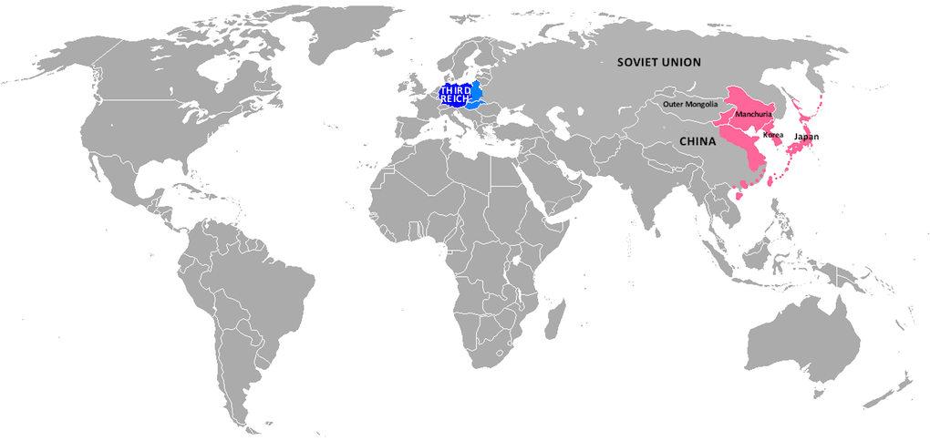
Introduction
THE WAR OUTSIDE EUROPE, 1937
KEY
 | Third Reich
 | German Occupation
 | Imperial Japan
By the time that the Third Reich invaded Poland on 1 September 1939 Japan had annexed Korea, invaded and occupied the Chinese province of Manchuria and in 1937 it had invaded China and established a stronghold along the Chinese Pacific coast. Japan, at this time, had not yet joined the Axis Pact.

Slide 4
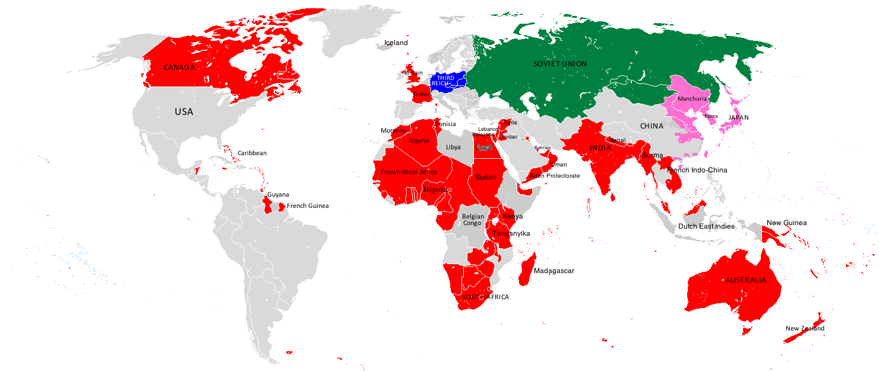
Introduction
THE WAR OUTSIDE EUROPE, end of 1939
KEY
 | Third Reich
 | Allies
 | Soviet Union
 | Imperial Japan
END OF 1939. After Germany had invaded Poland on 1 September 1939, the nations of the British Empire and France’s colonies in North and Equatorial Africa and South East Asia had entered the war on the side of the Allies. Palestine, Syria, Lebanon, Bahrain and Oman also entered the war on the side of the Allies. Meanwhile Japan was expanding the territory under its control in eastern China.

Slide 5
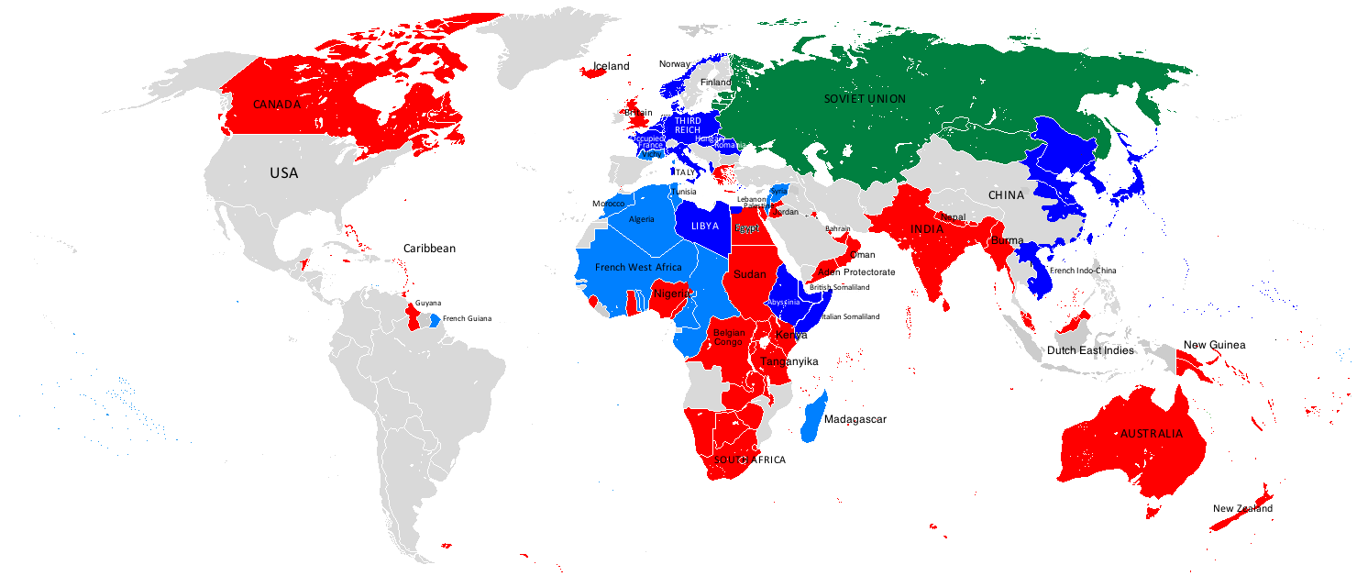
THE WAR OUTSIDE EUROPE, end of 1940
KEY
 | Axis Powers
 | Vichy France
 | Allied Powers
 | Soviet Union
END OF 1940. The Axis powers, which now included Italy, Hungary and Romania, controlled most of Western Europe while the Soviet Union had invaded the Baltic States. Germany’s client state, Vichy France, had taken control of French territories in Africa as well as Syria and Lebanon. The locus of the European war switched to North Africa when Italian troops invaded British-held Egypt and British Somaliland. Meanwhile, on 27 September Japan joined the Axis powers and by the end of the year had extended its control over much of eastern China and occupied French Indo-China.

Slide 6
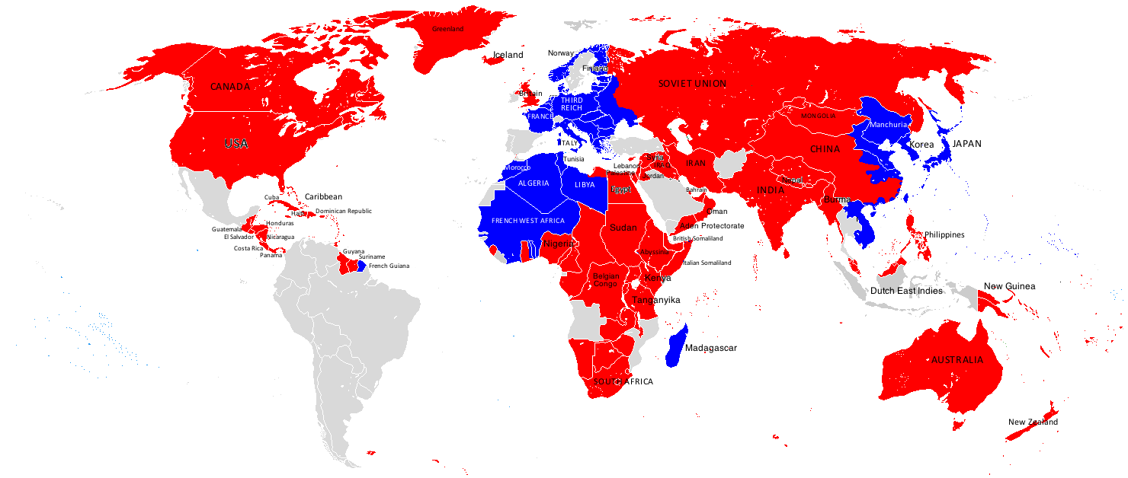
THE WAR OUTSIDE EUROPE, end of 1941
KEY
 | Axis Powers
 | Allied Powers
End of 1941. The Axis powers had invaded the Soviet Union and controlled most of western, central and eastern Europe. However, the Allies were fighting back in Africa and the Middle East. They had seized Vichy-held Lebanon and Syria and pro-Axis Iraq and Iran. In North Africa, Italian forces were in retreat and Germany had sent forces under General Rommel to Libya to stop the Allied advance. On 8 December Japan launched a surprise attack on US warships in Pearl Harbour in Hawai. The USA and most of Central America then declared war on the Axis powers. By the end of the year Japanese forces were seizing Pacific islands and other territories in South East Asia previously under the control of the Allies. China had formally joined the Allies.

Slide 7
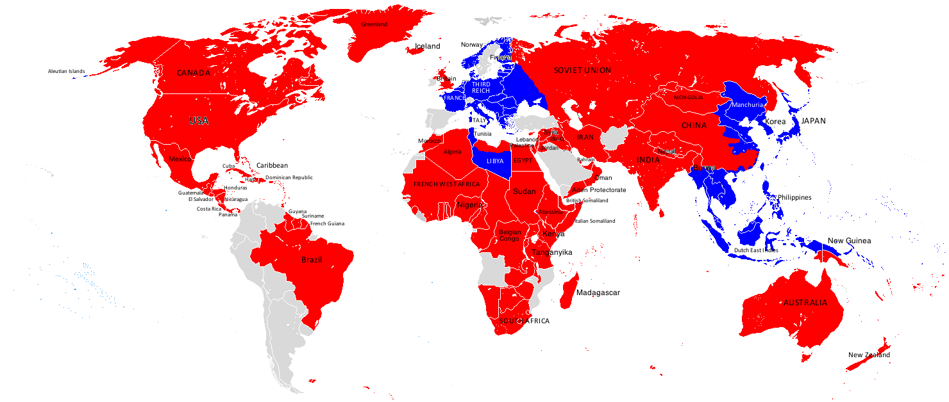
THE WAR OUTSIDE EUROPE, end of 1942
KEY
 | Axis Powers
 | Allied Powers
End of 1942. Axis forces had advanced far into Soviet territory. Allied forces had taken control of most of North Africa, and were advancing west along the Libyan coast towards Tunisia. Anticipating an invasion of southern Italy the Third Reich had taken control of Vichy France and sent forces to Italy to reinforce its defences. Mexico and Brazil also declared war on the Axis powers. Japan now occupied the whole of Indo-China, had captured most of the islands of the South Pacific and was threatening to invade Australia. At the same time she had also seized the southernmost Aleutian Islands of Alaska as part of her defences against a US naval attack on Japan.

Slide 8
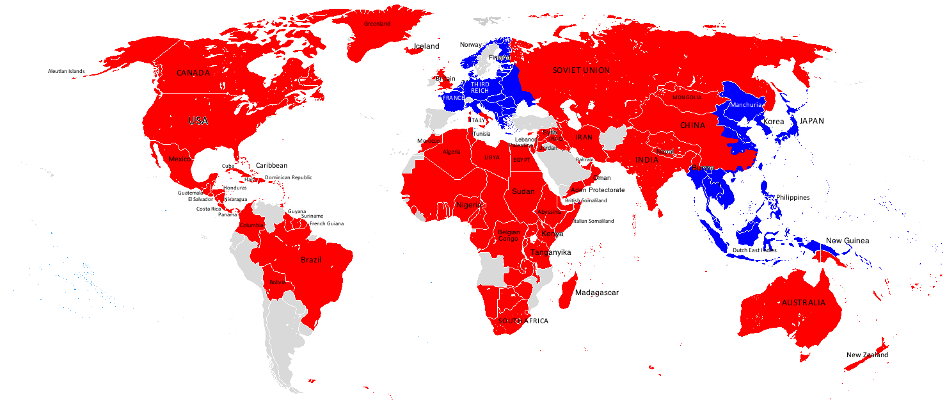
THE WAR OUTSIDE EUROPE, end of 1943
KEY
 | Axis Powers
 | Allied Powers
End of 1943. Axis forces in Libya and Tunisia had surrendered, Free French forces had seized Vichy-controlled French West Africa and the Allies now controlled North Africa. They were now able to invade southern Italy. On 7 April Bolivia declared war on the Axis powers. So did Colombia on 26 November after a German U-boat sank a Colombian ship. Allied forces began to launch a counter-offensive in the Pacific and South East Asia. Australian forces invaded Japanese-held New Guinea, an Ango-Indian force began an invasion of Burma, while US troops launched assaults on the Gilbert islands and Solomon islands and re-took the Aleutian Islands off Alaska.

Slide 9
THE WAR OUTSIDE EUROPE, end of 1944
KEY
 | Axis Powers
 | Allied Powers
End of 1944. Soviet forces had advanced along the Eastern Front into central Poland, Belarussia, the Baltic States, and into Czechoslovakia, Hungary and Yugoslavia. Allied forces had advanced through Western Europe to the German border; liberated Greece and advanced into northern Italy. Allied forces had also prevented an attempted Japanese invasion of India and launched a counter-offensive against Japanese troops in Burma to clear the way for an advance into Malaya and on to Singapore. Allied forces had also made further gains in the Marshall Islands, New Guinea, Saipan, the Mariana Islands, Guam and the Philippines.

Slide 10
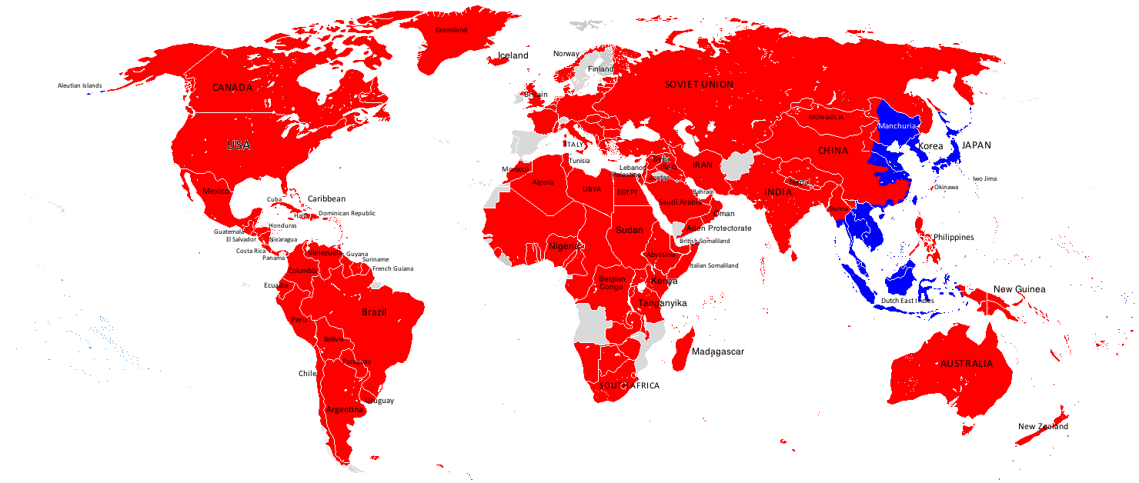
THE WAR OUTSIDE EUROPE, May 1945
KEY
 | Axis Powers
 | Allied Powers
May 1945. In February Paraguay, Ecuador, Peru, Uruguay and Venezuela all entered the war on the Allied side. In March Argentina, under international pressure, also declared war on the Axis powers, as did Chile on 11 April. On 8-9 May the Axis powers in Europe surrendered but Japan fought on. Allied forces in the Pacific now adopted a “leapfrogging strategy”. Rather than fight for every island in the Pacific they targeted strategic islands nearer Japan such as Okinawa and Iwo Jima, while by-passing French Indo-China, most of the islands of the Dutch East Indies and the island of Taiwan. It was assumed that once Japan was forced to surrender the Japanese forces in these by-passed territories would also surrender.

Slide 11
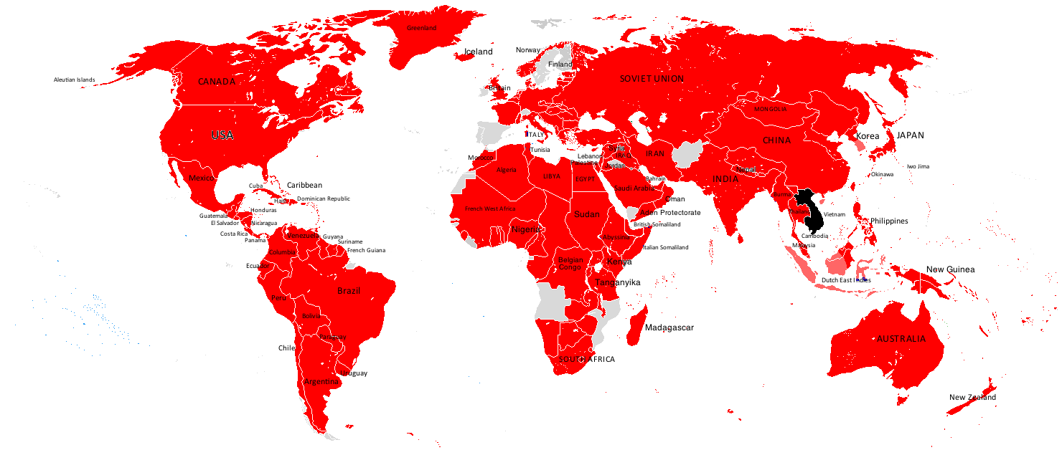
THE WAR OUTSIDE EUROPE, September 1945
KEY
 | Axis Powers
 | Lands still held by Japanese on 2.9.1945
 | Allied Powers
 | French but contested by communists
September 1945. After a US ultimatum was ignored by Japan US airforce bombers dropped atom bombs on Hiroshima on 6 August and Nagasaki on 9 August. On 8 August the Soviet Union invaded Manchuria and then north Korea, paving the way for a transfer of power to communist-led regimes. These developments left the Imperial Japanese government with little option but to surrender on 2 September. By the end of September, Japanese troops had surrendered in South East Asia and the Pacific War was over. While France once more assumed control in Indo-China it was now faced by Communist insurrections in Vietnam and Cambodia which ultimately led to the Vietnam War (1955-75).

Slide 12
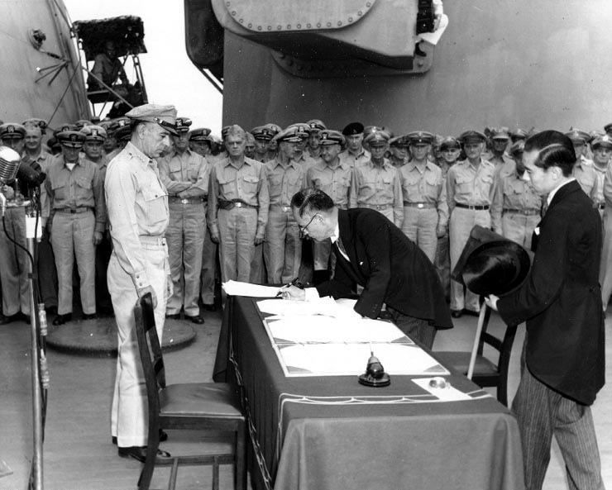
Introduction
THE WAR OUTSIDE EUROPE
2 September 1945:
Japanese Foreign Minister, Mamoru Sigemitsu, signs the Instrument of Surrender on board the USS Missouri. On the other side of the table is Lt. General Richard Sullivan, representing the US Army.
Notes:
Japanese Foreign Minister Mamoru Shigemitsu signs the Instrument of Surrender on behalf of the Japanese Government, on board USS Missouri (BB-63), 2 September 1945. Lieutenant General Richard K. Sutherland, U.S. Army, watches from the opposite side of the table.
2 September 1945
https://commons.wikimedia.org/wiki/File:Shigemitsu-signs-surrender.jpg
Source: Naval Historical Center [photo SC 213700]
Public Domain (USA)

Slide 13
How the war spread globally: From conquest to surrender
Text and graphics by Bob Stradling of the Historiana Editing Team.
(CC BY-SA 4.0)

