Slide 1
The map of Europe in the summer of 1939 had already changed significantly from the one that had been drawn after the post-World War One peace settlements of 1919-1921.
In March 1936, German troops had marched into the Rhineland which had been a de-militarized buffer zone.
In October 1935, Italian forces had invaded Abyssinia (nowadays Ethiopia).
On 12 March 1938, the Third Reich had annexed Austria and a year later German forces had invaded western Czechoslovakia.
The maps in this collection use following colour coding:
In blue colour are the Axis powers.
In red colour are the Allies.
In grey colour are countries not involved in the fighting.

Slide 2
World War Two: 1939-1941

Slide 3
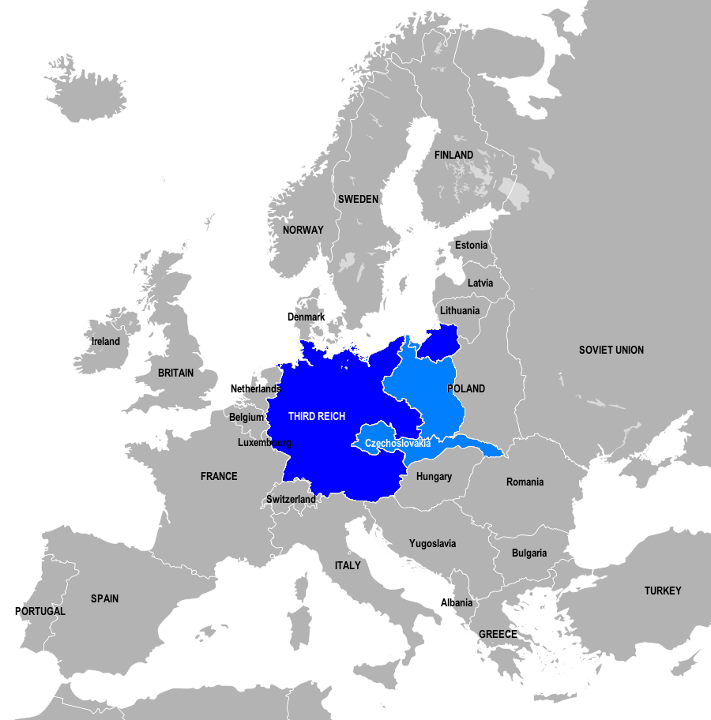
Introduction
THE WAR IN EUROPE, September 1939
1 September 1939: The forces of the Third Reich invade Poland from the west.

Slide 4
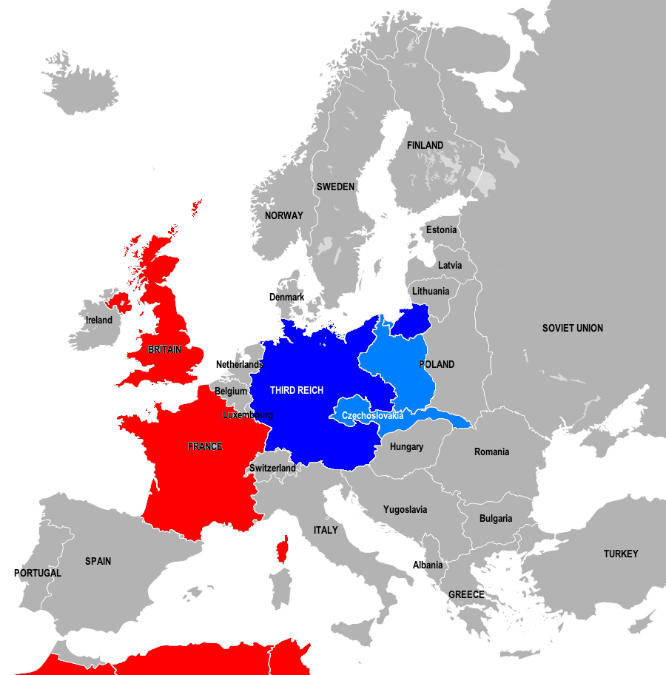
Introduction
THE WAR IN EUROPE, September 1939
3 September 1939: France and Britain declare war on Germany.

Slide 5
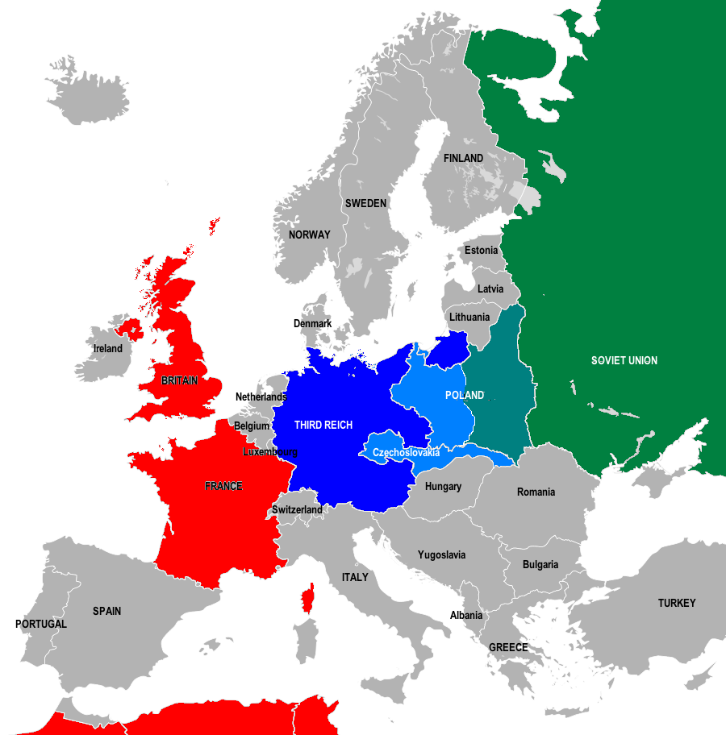
Introduction
THE WAR IN EUROPE, September 1939
17 September 1939: Under the terms of the Molotov-Ribbentrop Non-Aggression Pact of 23 August 1939 the Soviet Union, with the agreement of Germany, invades Poland from the east.

Slide 6
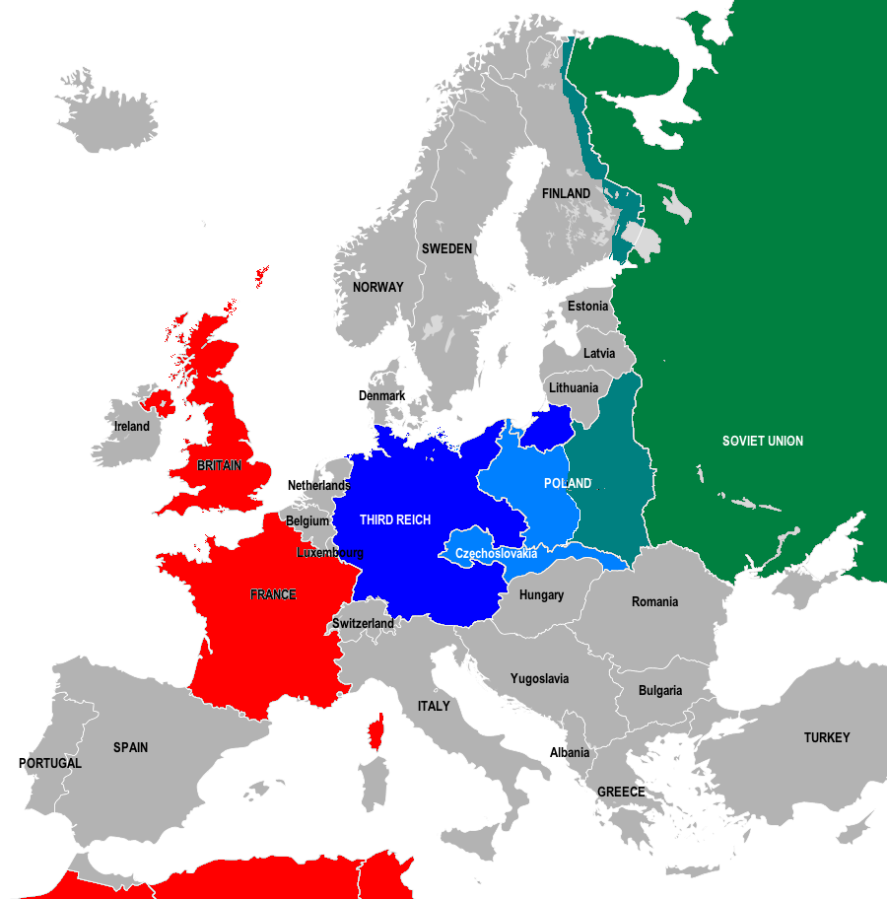
Introduction
THE WAR IN EUROPE, November 1939
30 November 1939: The Soviet Union invades Finland.

Slide 7
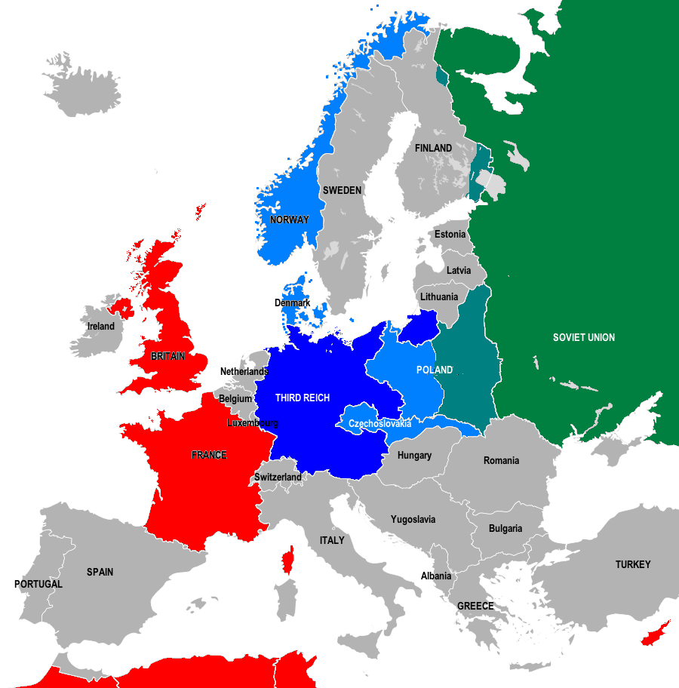
Introduction
THE WAR IN EUROPE, March 1940
13 March 1940:
The Winter War between Finland and the USSR ends after just over 100 days of fighting and on 13 March 1940 two areas of eastern Finland (Salla and Karelia) are ceded to the USSR.

Slide 8
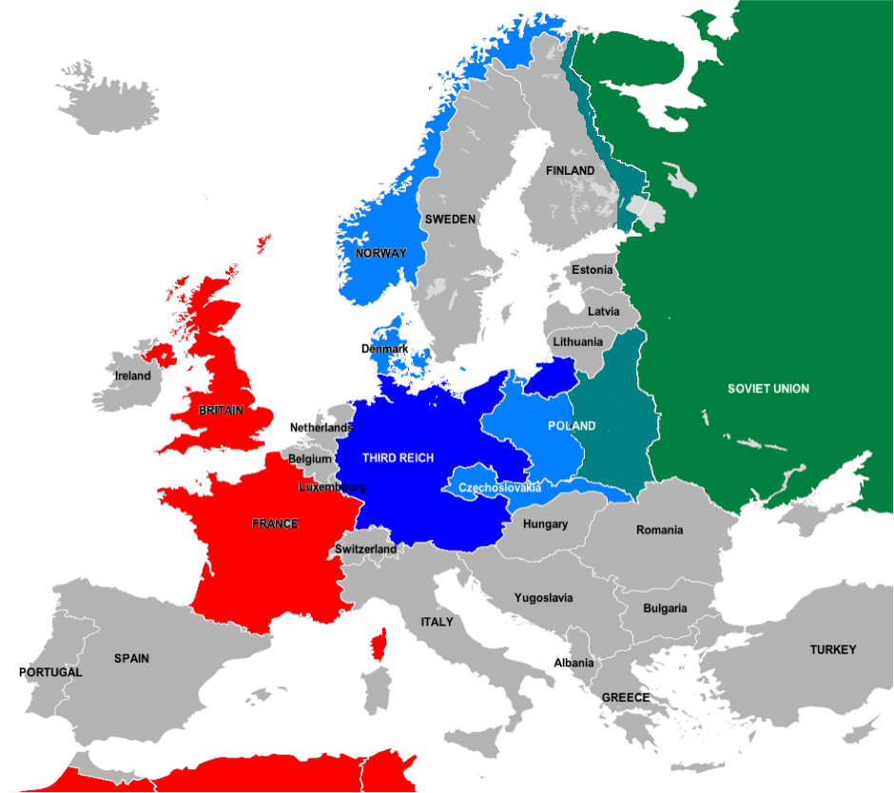
Introduction
THE WAR IN EUROPE, April 1940
9 April 1940:
German forces invade Norway and Denmark.

Slide 9
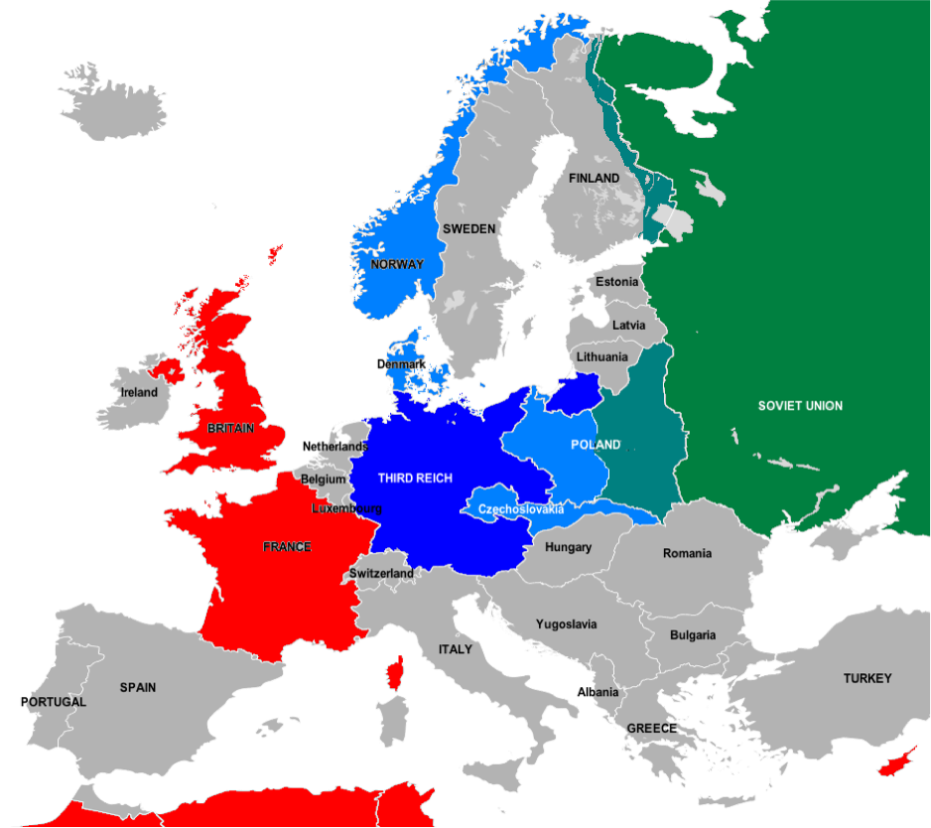
Introduction
THE WAR IN EUROPE, April 1940
12 April 1940:
Cyprus, then a British colony, joins the war on the side of the Allies.

Slide 10
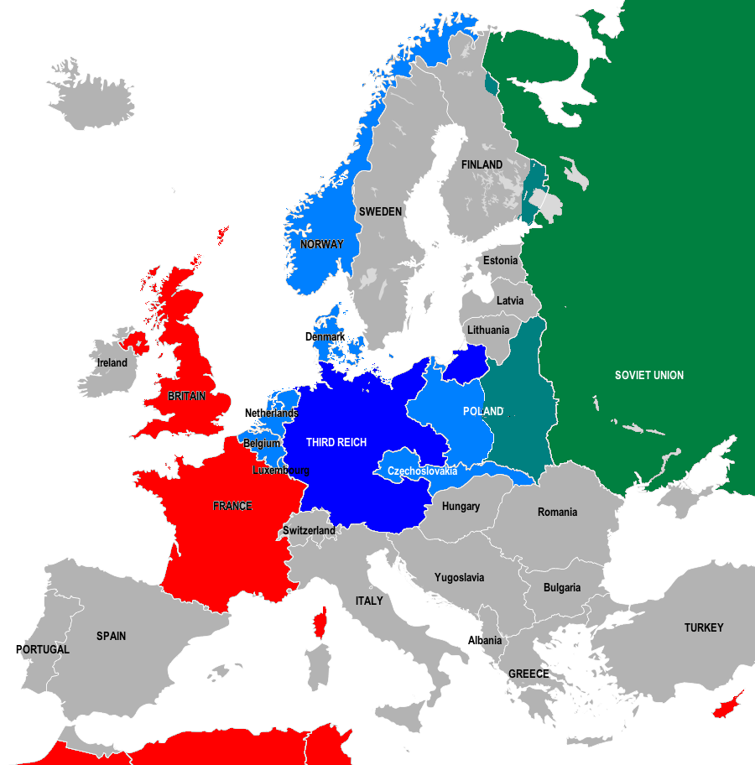
Introduction
THE WAR IN EUROPE, May 1940
10-15 May 1940: German forces invade and occupy neutral Belgium and the Netherlands.
12 May, German Army Group B invades France through Luxembourg and the Ardennes Forest.

Slide 11
Introduction
THE WAR IN EUROPE, May 1940
10 May 1940:
Britain invades neutral Iceland, which shares a King with Denmark, to prevent Germany extending its control from Denmark to Iceland, which is strategically important in the North Atlantic.

Slide 12
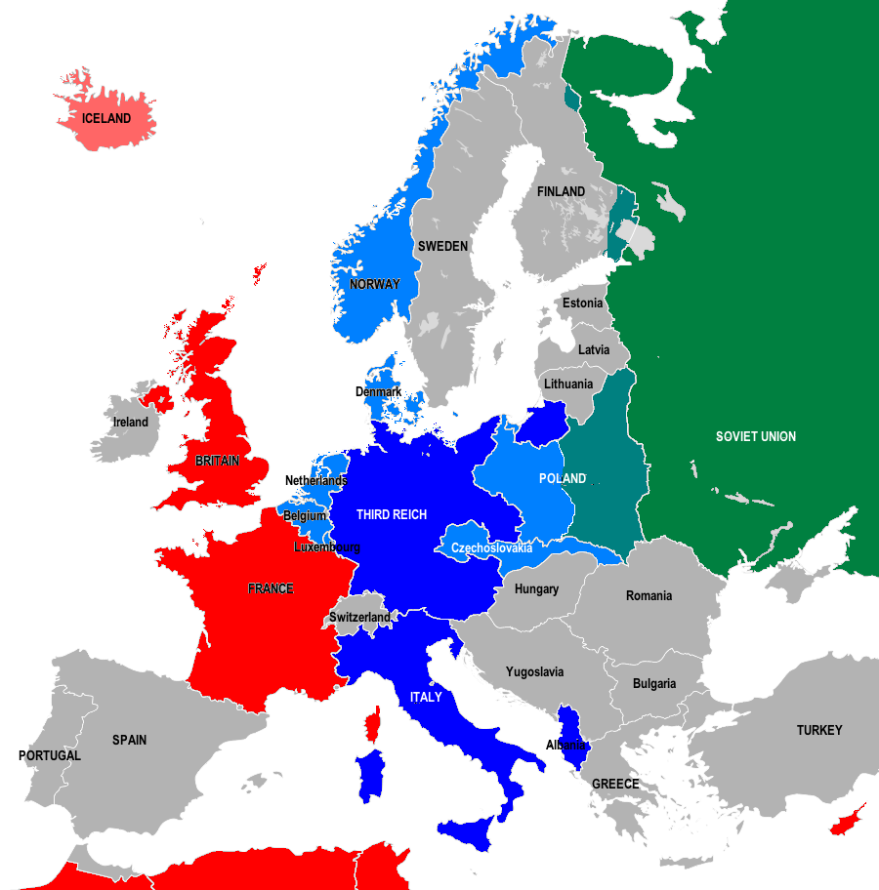
Introduction
THE WAR IN EUROPE, June 1940
10 June 1940:
Italy declares war on Britain and France and occupies French territory along the Franco-Italian border. Albania, which had been invaded by Italy on 7-12 April 1939, now also joins the Axis Powers.

Slide 13
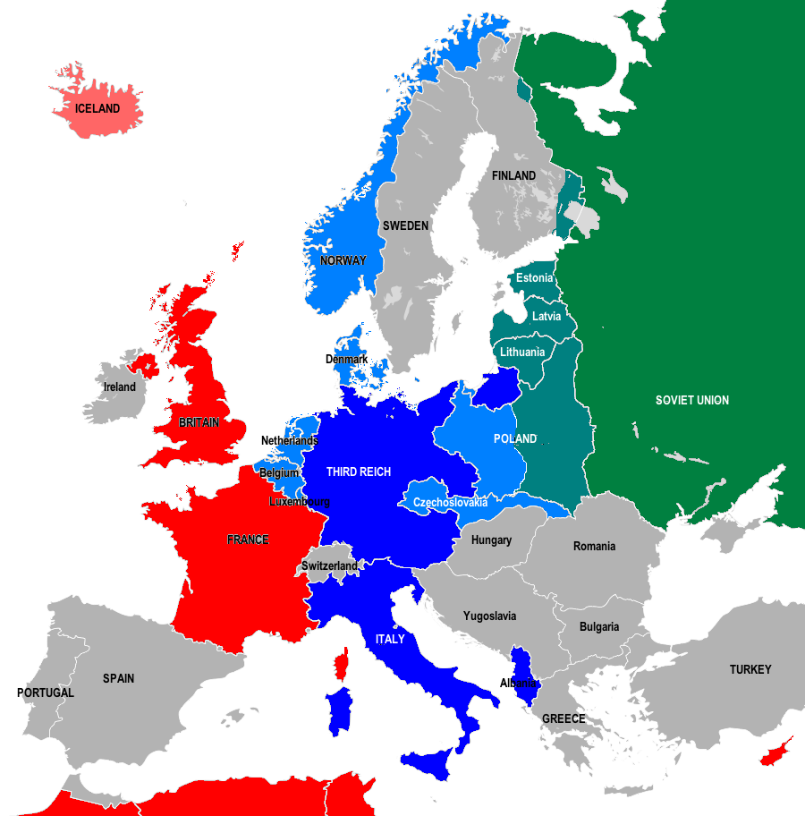
Introduction
THE WAR IN EUROPE, June 1940
16-17 June 1940:
Under the terms of the Molotov-Ribbentrop Pact between Germany and the Soviet Union, Soviet troops invade Lithuania, Estonia and Latvia.

Slide 14
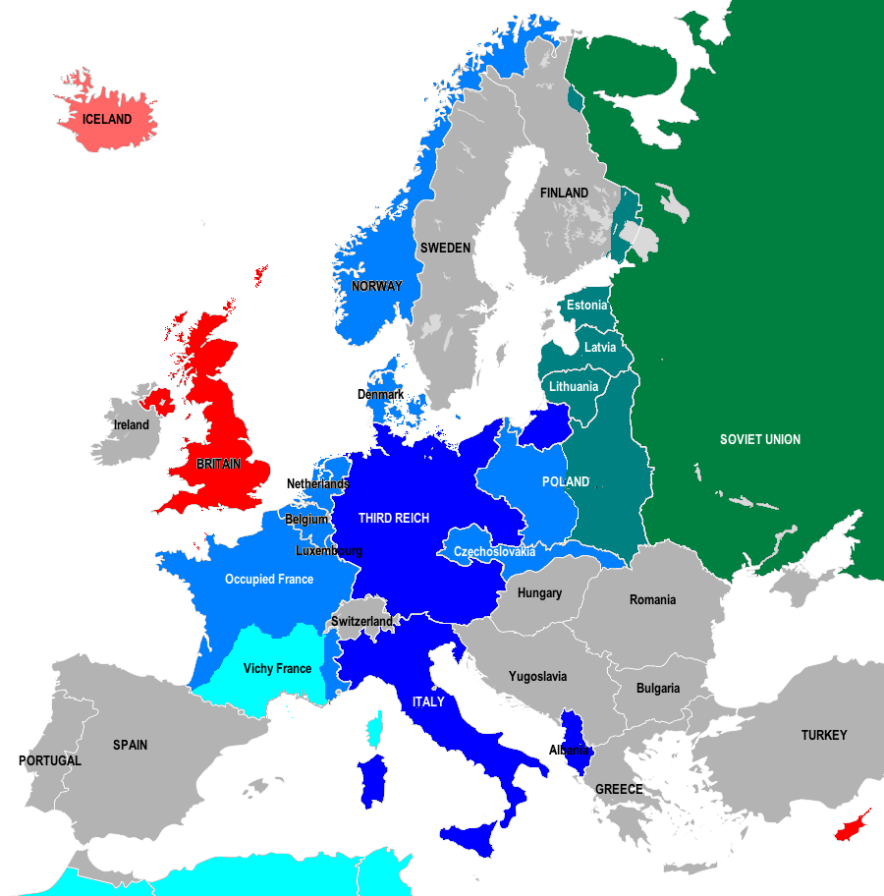
Introduction
THE WAR IN EUROPE, June 1940
22 June 1940:
France surrenders and an Armistice is signed. Two-thirds of the country is now under German occupation. The south-east is occupied by Italian forces and the remaining area, with its capital at Vichy, is officially neutral but in reality a German client state.

Slide 15
Introduction
THE WAR IN EUROPE, August 1940
3-6 August 1940:
Between 3 and 6 August 1940 the three Baltic States are integrated into the Soviet Union.

Slide 16
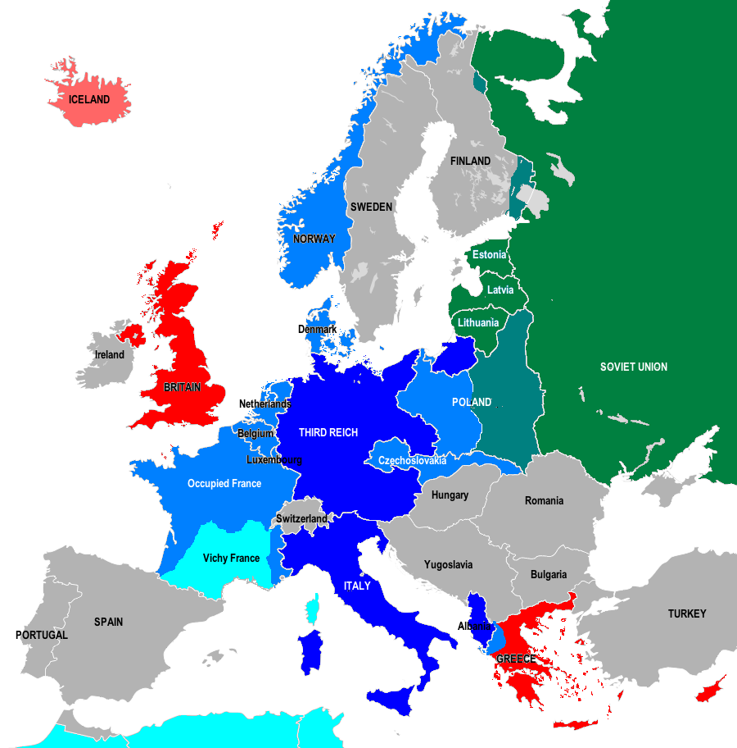
Introduction
THE WAR IN EUROPE, October 1940
28 October 1940: Italian forces invade Greece through Albania. Greece had been neutral but had signed a mutual aid agreement with Britain and France on 13 April 1939 immediately after Italy had invaded Albania.

Slide 17
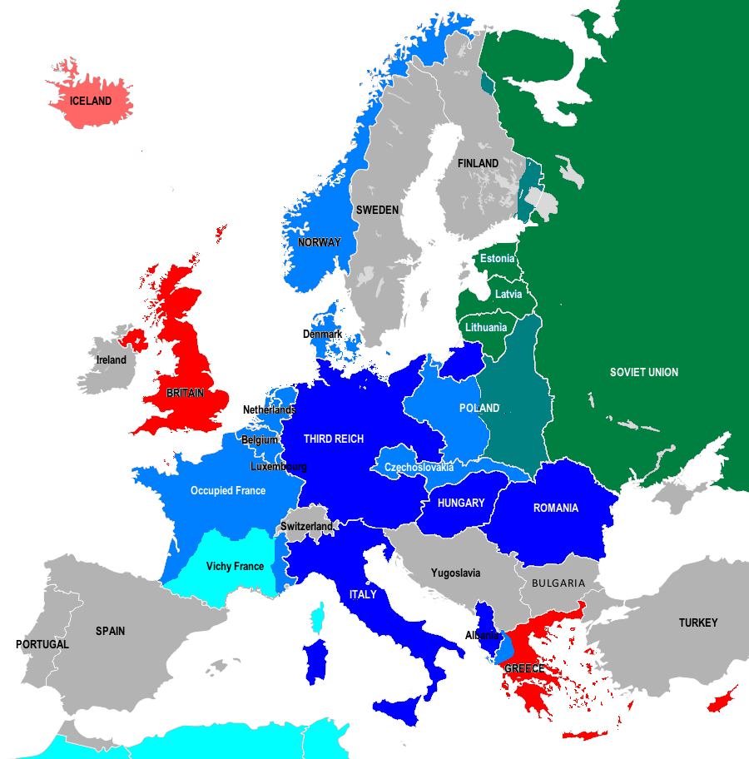
Introduction
THE WAR IN EUROPE, November 1940
20-23 November 1940:
Hungary then Romania join the Axis powers.

Slide 18
Introduction
THE WAR IN EUROPE, December 1940
December 1940:
By the end of December 1940 Greek forces, with British air support, have pushed Italian forces back over the Albanian border and now occupy southern Albania.

Slide 19
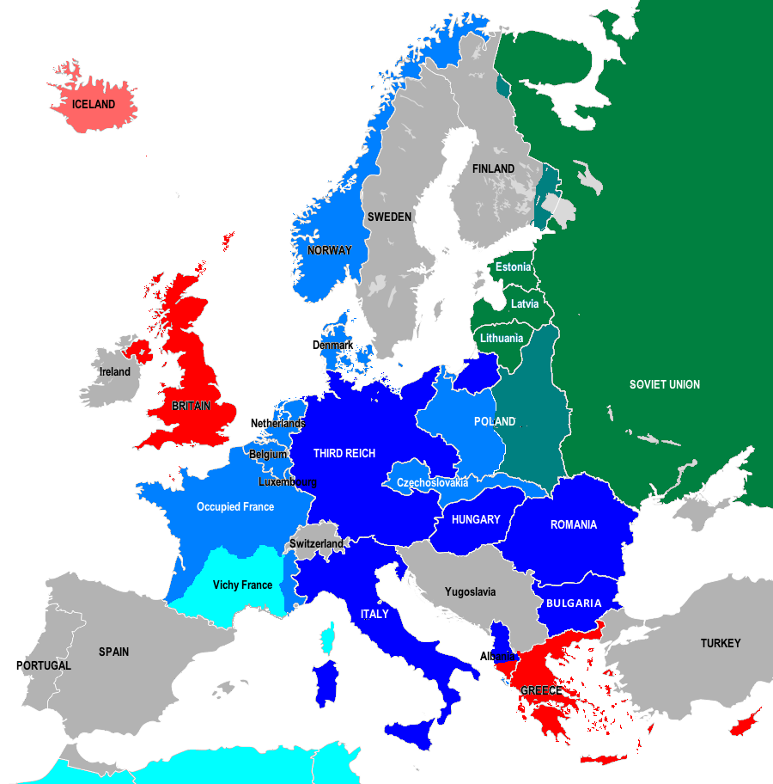
Introduction
THE WAR IN EUROPE, March 1941
1 March 1941:
Bulgaria joins the Axis powers.

Slide 20
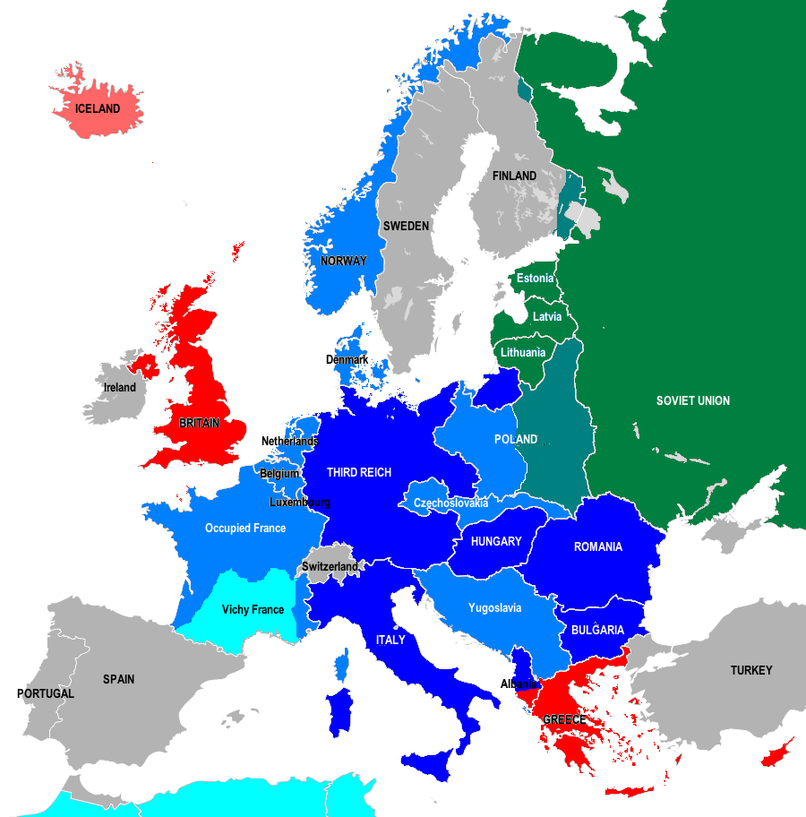
Introduction
THE WAR IN EUROPE, April 1941
6 April 1941:
The Axis powers invade Yugoslavia through Austria, Hungary and Romania leading to the unconditional surrender of the Royal Yugoslav army on 18 April.

Slide 21
Introduction
THE WAR IN EUROPE, April 1941
6 April 1941:
Axis forces invade Greece from Yugoslavia and Bulgaria to support the struggling Italian army. Greek forces retreat from Albania to engage with the invasion forces.

Slide 22
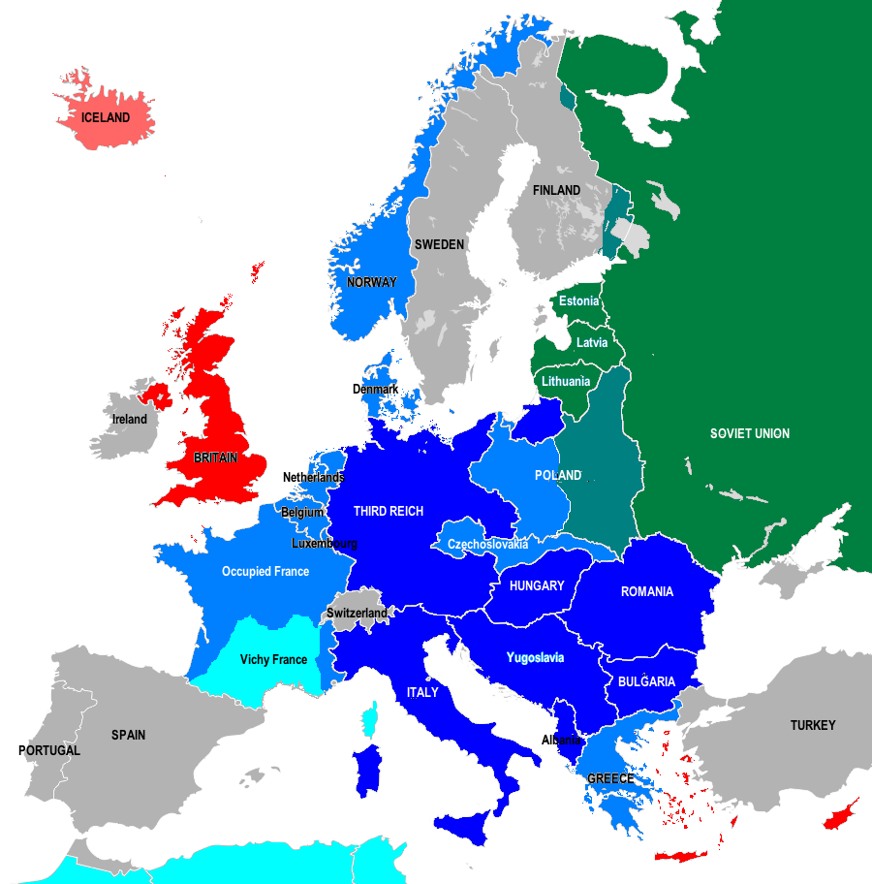
Introduction
THE WAR IN EUROPE, April 1941
April 1941:
By the end of April 1941 the Axis occupation of mainland Greece has been completed.

Slide 23
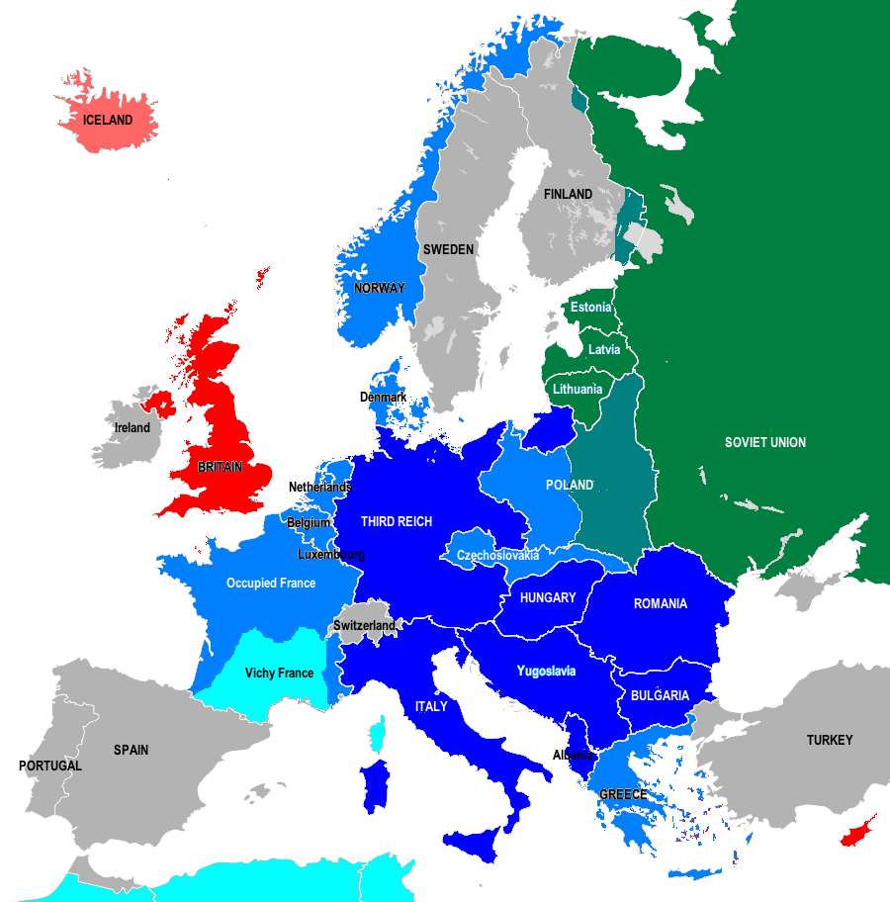
Introduction
THE WAR IN EUROPE, June 1941
1 June 1941:
By 1 June 1941, after a short battle with Allied forces, the Axis powers occupy Crete and over the summer occupy the other Greek islands.

Slide 24
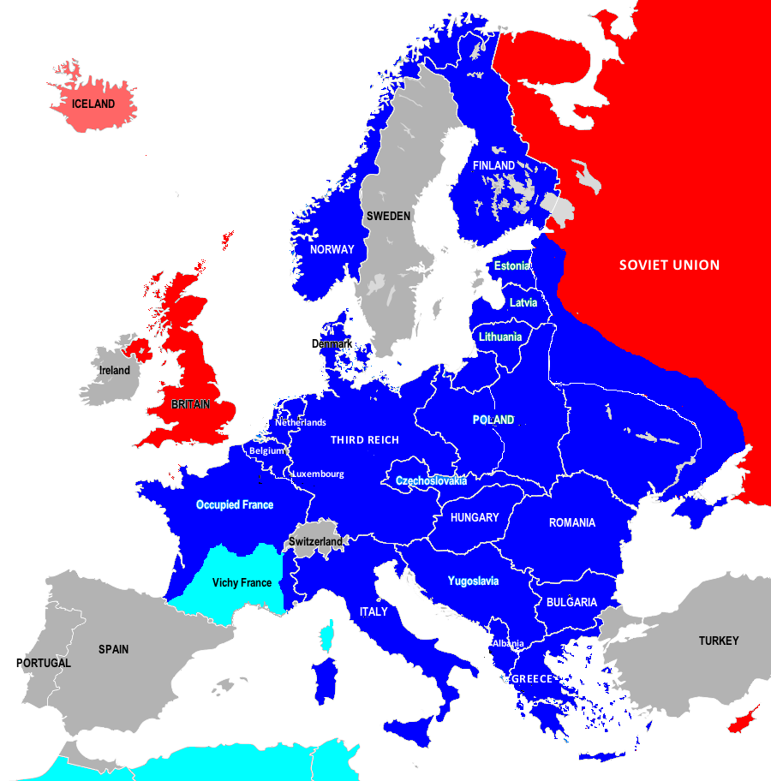
Introduction
THE WAR IN EUROPE, June 1941
22 June 1941:
The Axis powers declare war on the Soviet Union on 22 June 1941. Finland declares war on the USSR and joins Axis forces in Operation Barbarossa. Over the next two months Axis forces invade the Baltic States, Soviet-controlled Poland and Western Ukraine.

Slide 25
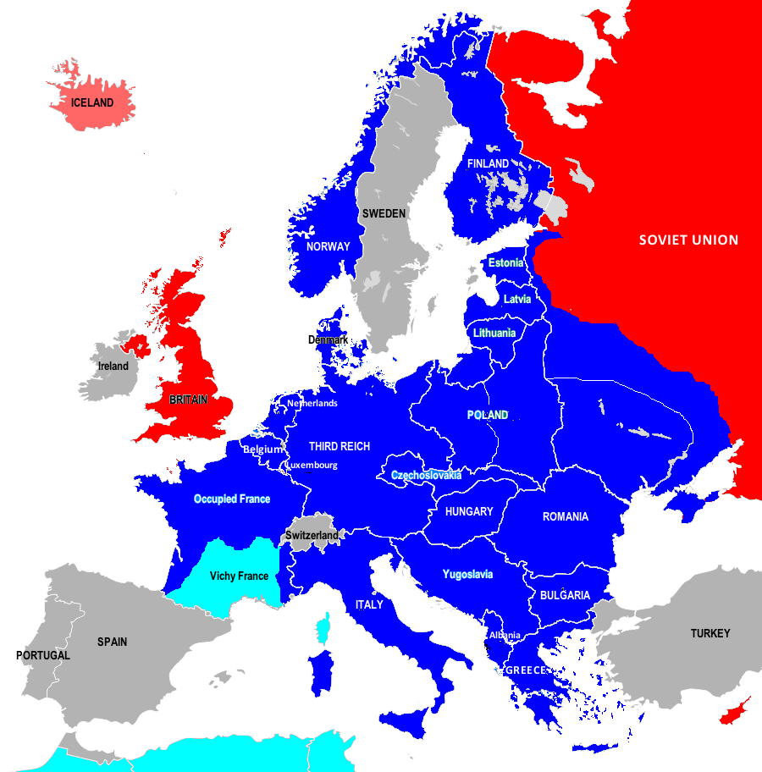
Introduction
THE WAR IN EUROPE, December 1941
December 1941:
By mid-December 1941 German forces on the Eastern Front are besieging Leningrad on the Baltic and the capital city of Moscow. However, by the end of December the Axis advance has stalled and over a million Soviet troops are re-deployed from Siberia and the Far East.

Slide 26
World War Two: 1942-1943

Slide 27
Introduction
THE WAR IN EUROPE, January 1942
January-May 1942:
From January to May 1942 the Red Army launches a counter-offensive to push German troops back from Moscow towards the Belarussian border. A counter-attack aimed at re-taking the Crimea is also launched.

Slide 28
Introduction
THE WAR IN EUROPE, Spring 1942
Spring 1942:
In the spring of 1942 the Wehrmacht launches another eastern offensive targeting Stalingrad on the River Volga and advancing south east into the Caucasus. By September there is house-to-house fighting in Stalingrad.

Slide 29
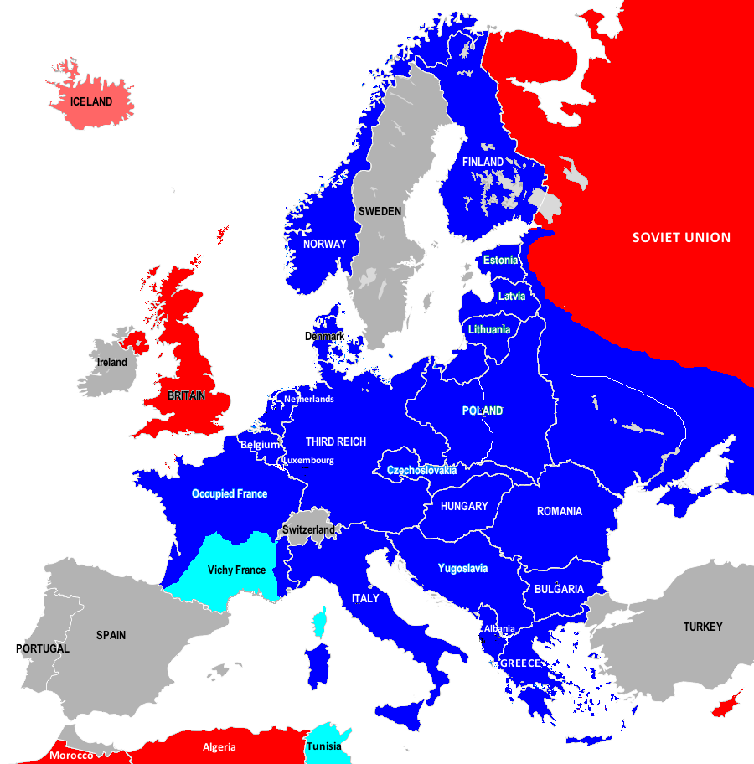
Introduction
THE WAR IN EUROPE, November 1942
8 November 1942:
On 8 November 1942, Allied forces invaded Vichy-controlled Morocco and Algeria and by 10 November are in control of both countries.

Slide 30
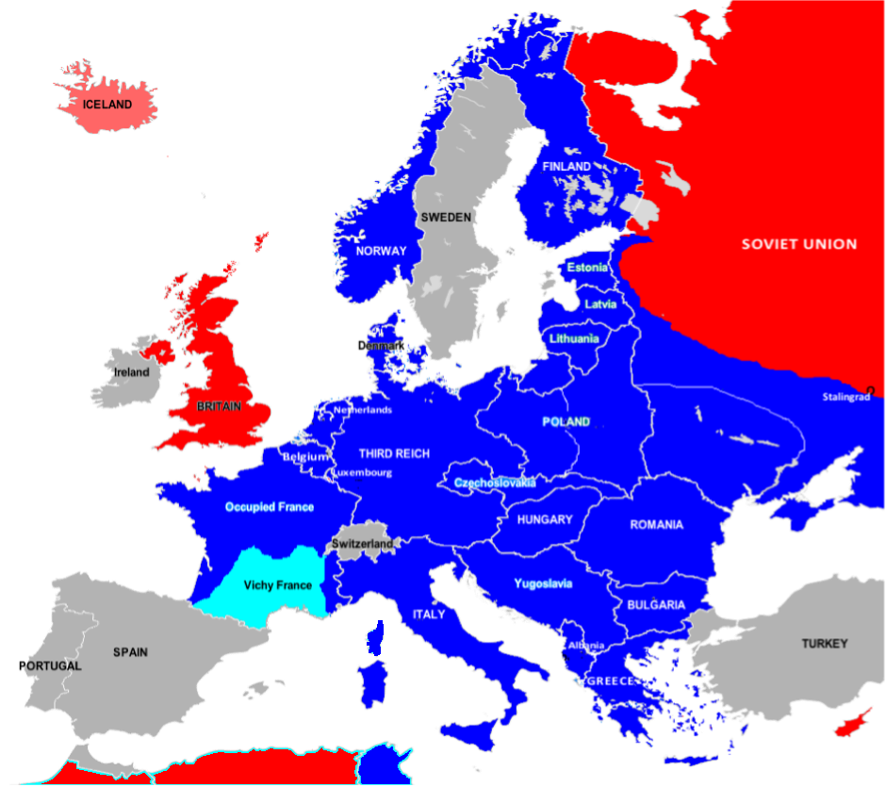
Introduction
THE WAR IN EUROPE, November 1942
9 - 11 November 1942:
After the Allied invasion of Vichy North Africa, Axis powers land in Corsica and Tunisia to counter an Allied invasion of Italy from North Africa.

Slide 31
Introduction
THE WAR IN EUROPE, November 1942
November 1942:
By mid-November 1942 Axis forces occupy most of Stalingrad and the north Caucasus.

Slide 32
Introduction
THE WAR IN EUROPE, March 1943
March 1943:
The supply lines of the Axis forces occupying the area around Stalingrad are over-extended and vulnerable to a Red Army counter-offensive. Over the winter nearly 300000 Axis forces are encircled by the Red Army. By March 1943 Soviet forces have advanced into Ukraine as far as Kharkiv.

Slide 33
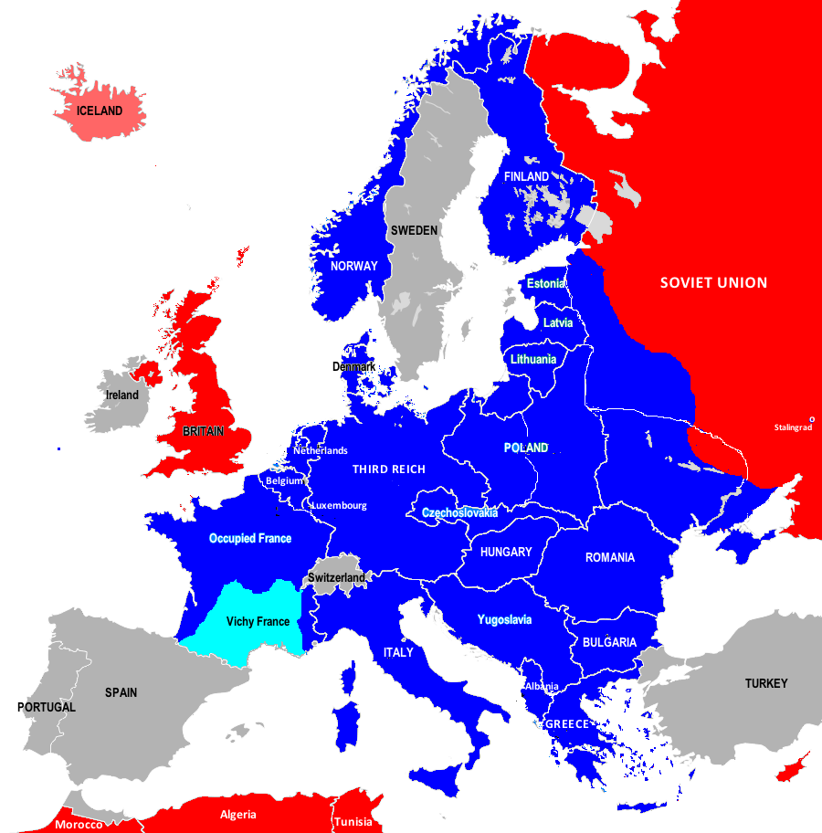
Introduction
THE WAR IN EUROPE, May 1943
13 May 1943:
German and Italian forces in Tunisia surrender to the Allies.

Slide 34
Introduction
THE WAR IN EUROPE, September 1943
3 September 1943:
The allied invasion of Italy begins through Sicily and southern Italy.

Slide 35
Introduction
THE WAR IN EUROPE, September 1943
19 September 1943: Axis forces on Sardinia withdraw to Corsica.

Slide 36
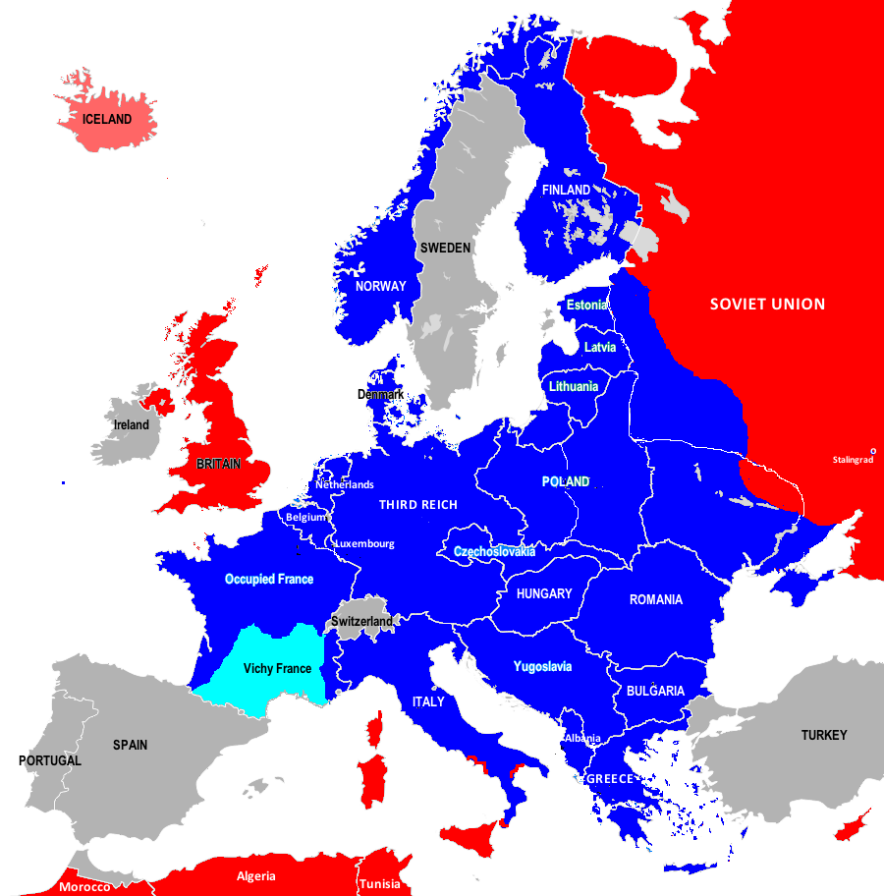
Introduction
THE WAR IN EUROPE, October 1943
4 October 1943:
Axis forces withdraw from Corsica.

Slide 37
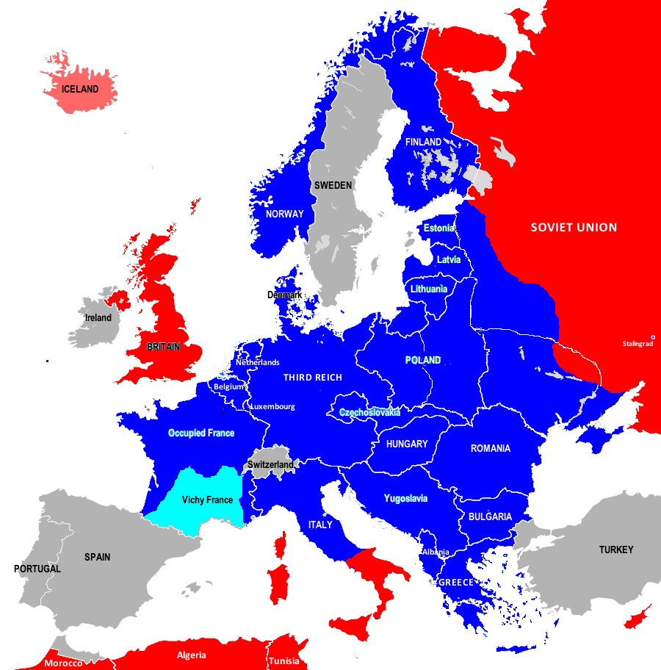
Introduction
THE WAR IN EUROPE, Autumn 1943
Autumn 1943:
Allied forces advance north through Italy but are held at Monte Cassino on the Axis-controlled Gustav Line.

Slide 38
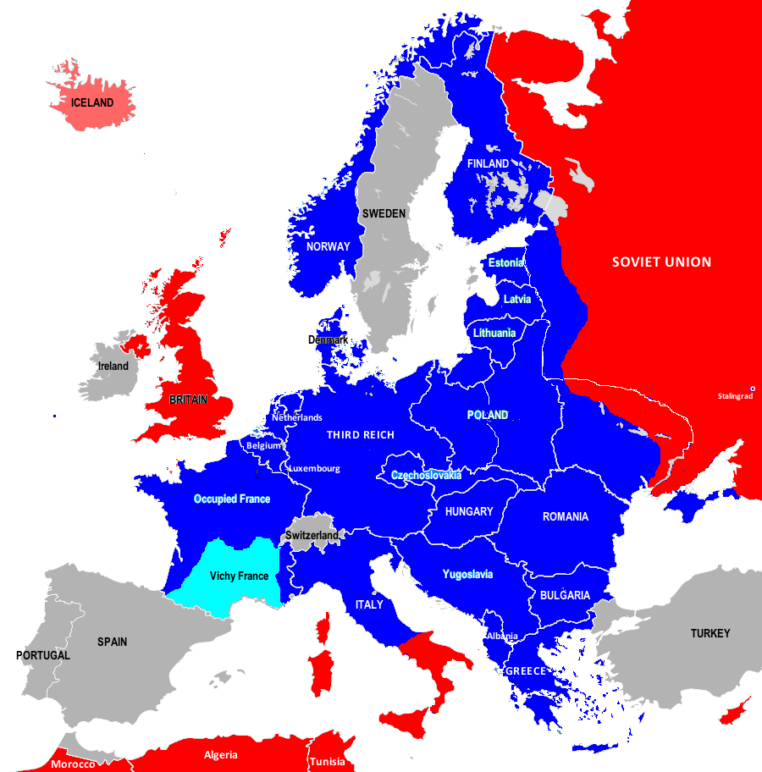
Introduction
THE WAR IN EUROPE, December 1943
December 1943:
By the end of 1943 the Red Army is advancing into Belarussia and Ukraine.

Slide 39
World War Two: 1944-1945

Slide 40
Introduction
THE WAR IN EUROPE, January 1944
January 1944:
Allied troops land at Anzio north of the Gustav Line and about 60km south of Rome to outflank the Axis forces at Monte Cassino.

Slide 41
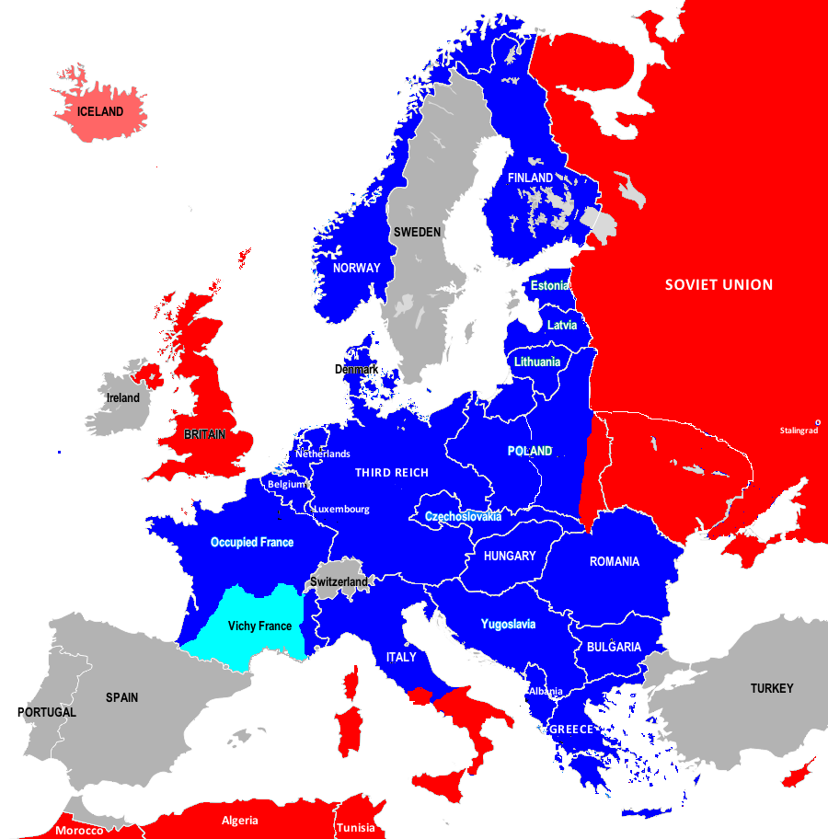
Introduction
THE WAR IN EUROPE, May 1944
May 1944:
By the end of May 1944 Soviet forces have continued their advance through Ukraine and into Poland and through Belarussia to the borders of the Baltic states. In May the Red Army also liberates Crimea.

Slide 42
Introduction
THE WAR IN EUROPE, June 1944
4 June 1944:
American forces enter Rome.

Slide 43
Introduction
THE WAR IN EUROPE, June 1944
6 June 1944:
Allied forces based in Britain land on the Normandy coast.

Slide 44
Introduction
THE WAR IN EUROPE, June 1944
9 June 1944:
A new Soviet offensive against Finland begins.

Slide 45
Introduction
THE WAR IN EUROPE, August 1944
15 August 1944:
Allied forces from Algeria and Italy land on the Mediterranean coast of Vichy-controlled France.

Slide 46
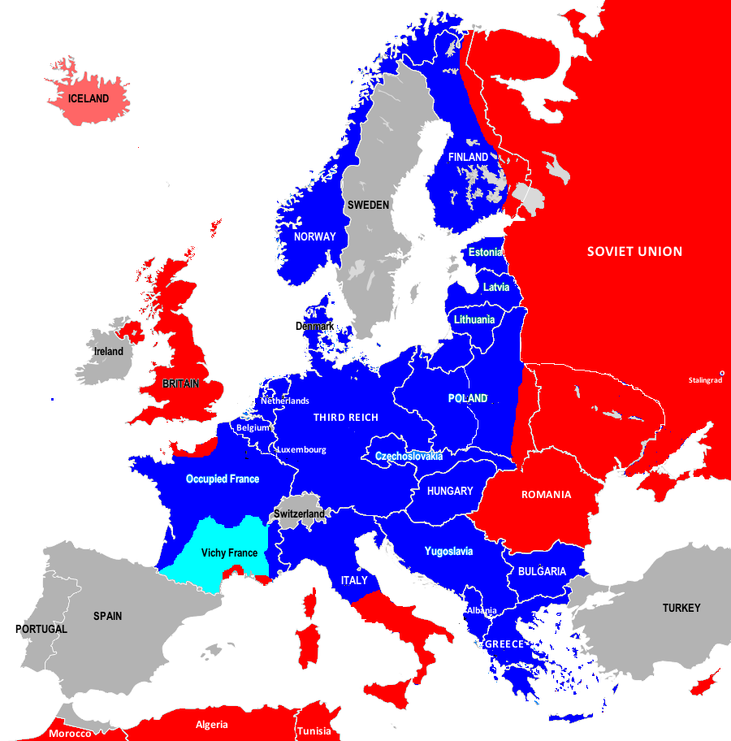
Introduction
THE WAR IN EUROPE, August 1944
19 August 1944:
Soviet forces invade Romania. On 23 August Romania joins the Allies.

Slide 47
Introduction
THE WAR IN EUROPE, August 1944
26 August 1944:
The Bulgarian government declares its neutrality after the Red Army invades Romania.

Slide 48
Introduction
THE WAR IN EUROPE, August 1944
August 1944:
By the end of August 1944 the Allies have taken control of Brittany and Normandy and have liberated Paris.

Slide 49
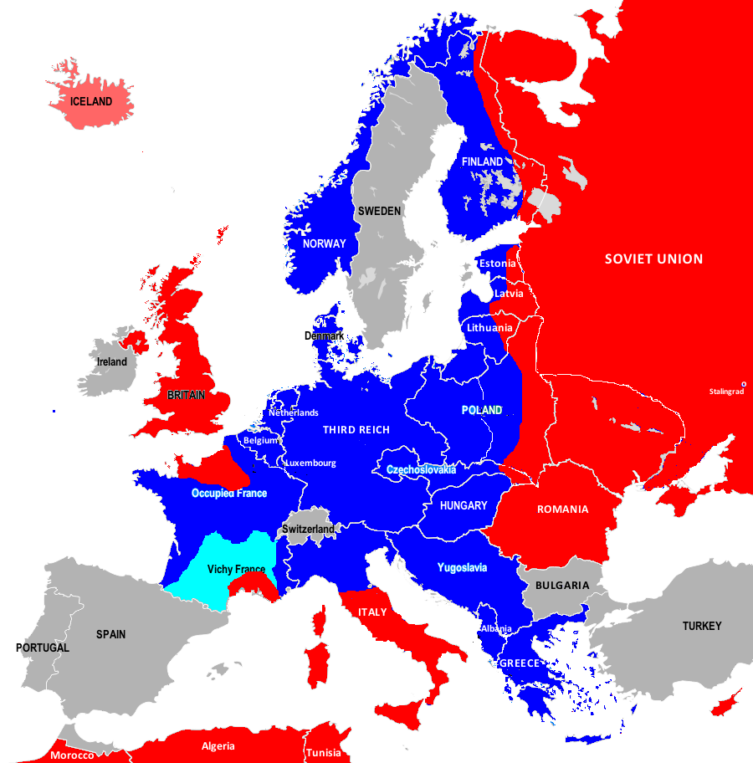
Introduction
THE WAR IN EUROPE, August 1944
End of August 1944: Soviet forces launch a Baltic offensive against occupying German forces and advance further into Poland. British and Free French forces advance further into Vichy France from the south.

Slide 50
Introduction
THE WAR IN EUROPE, August 1944
End of August 1944:
Allied forces in Italy advance further north to the Gothic Line.

Slide 51
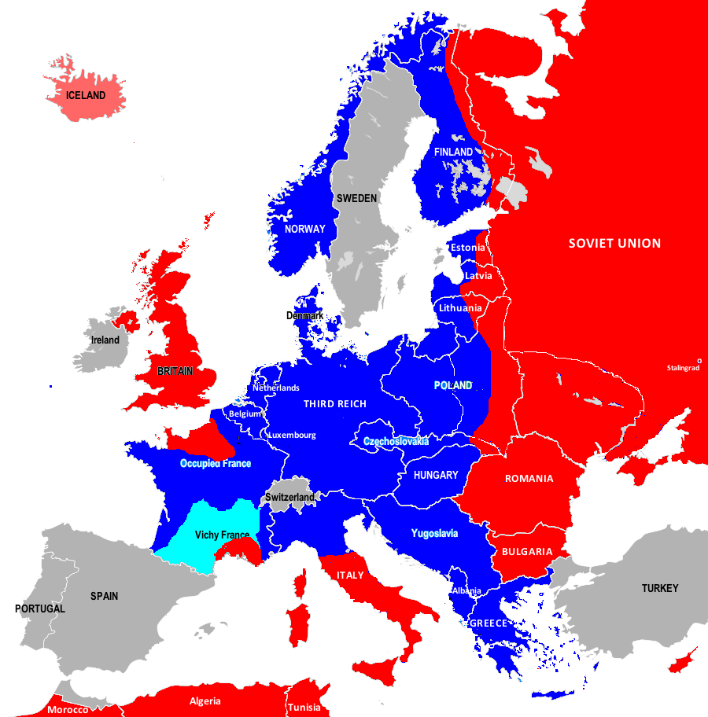
Introduction
THE WAR IN EUROPE, September 1944
9 September 1944: Bulgaria joins the Allies.

Slide 52
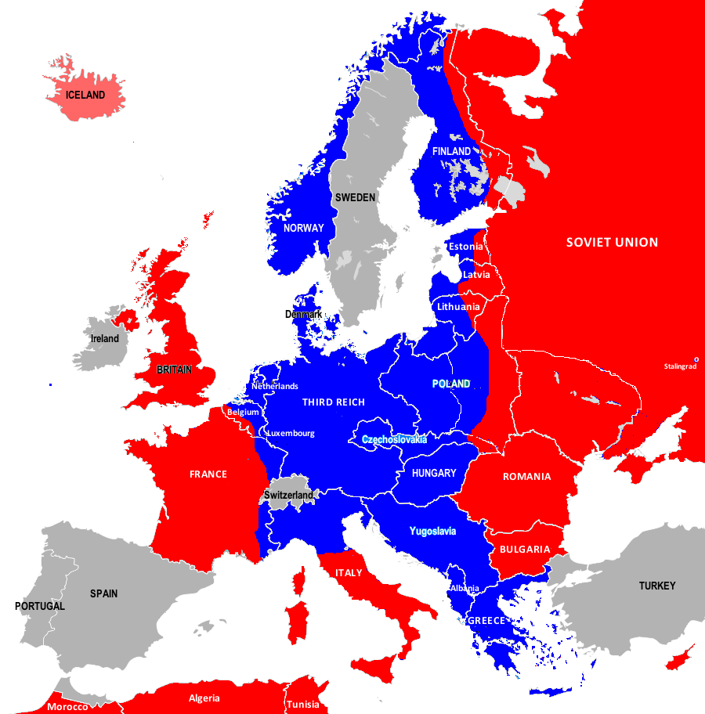
Introduction
THE WAR IN EUROPE, September 1944
14 September 1944: Allied forces advance through France and cross the Belgian border.

Slide 53
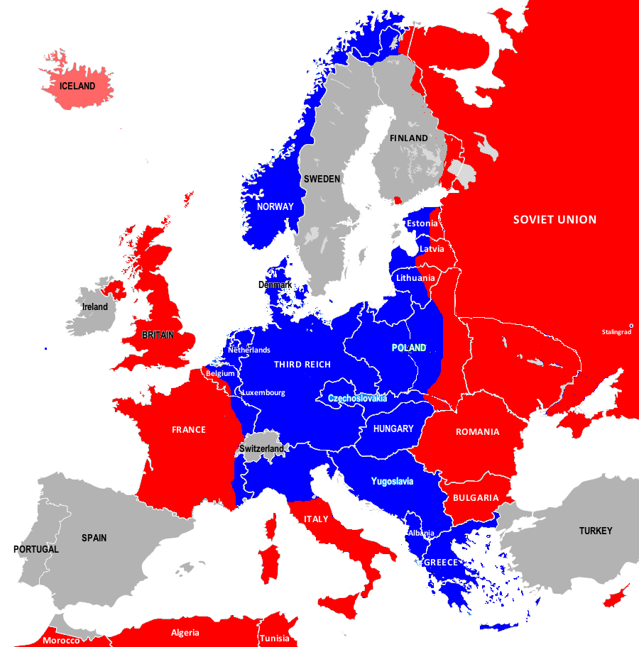
Introduction
THE WAR IN EUROPE, September 1944
5 September 1944: Ceasefire between the USSR and Finland. The Treaty of Moscow 19 September 1944, requires Finland to demobilise its armed forces, restore its border to 1940, and ensure that German forces in Lapland either withdraw from Finland or are handed over as prisoners to the Soviet Union.

Slide 54
Introduction
THE WAR IN EUROPE, September 1944
27 September 1944: Red Army invades Axis-occupied Greece from the north east.

Slide 55
Introduction
THE WAR IN EUROPE, October 1944
Mid-October 1944: British forces land in southern Greece, the Peleponese peninsula and near Athens. Greek Partisans attack German forces.

Slide 56
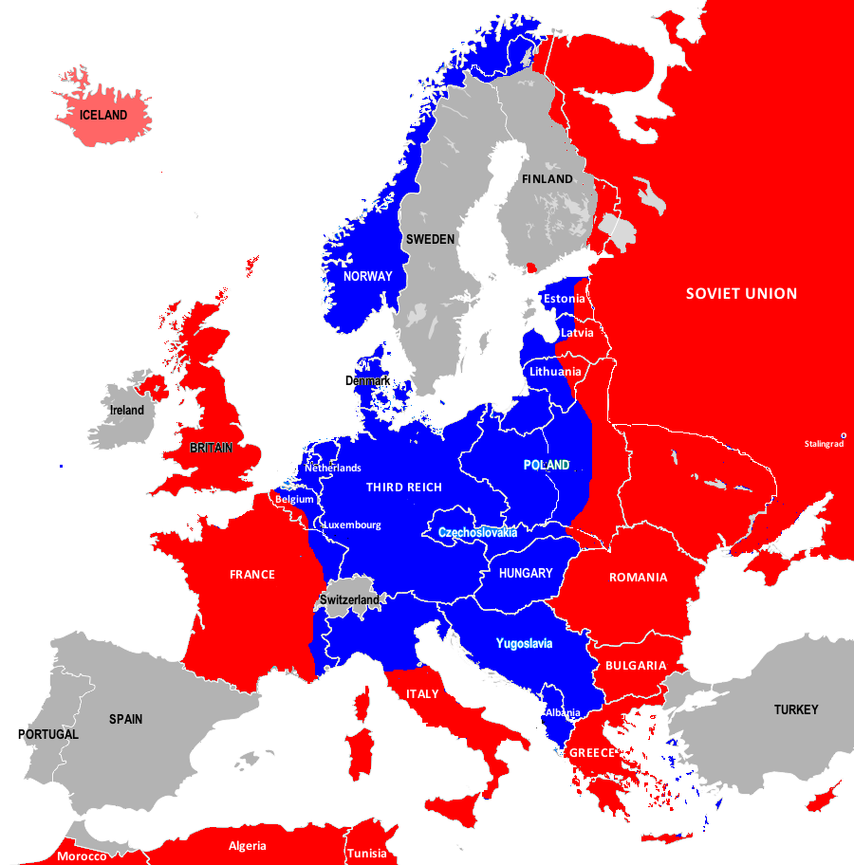
Introduction
THE WAR IN EUROPE, October 1944
End of October 1944: German forces withdraw from mainland Greece and most Aegean islands. British forces land in Crete but Germans defend an outpost in the north of the island.

Slide 57
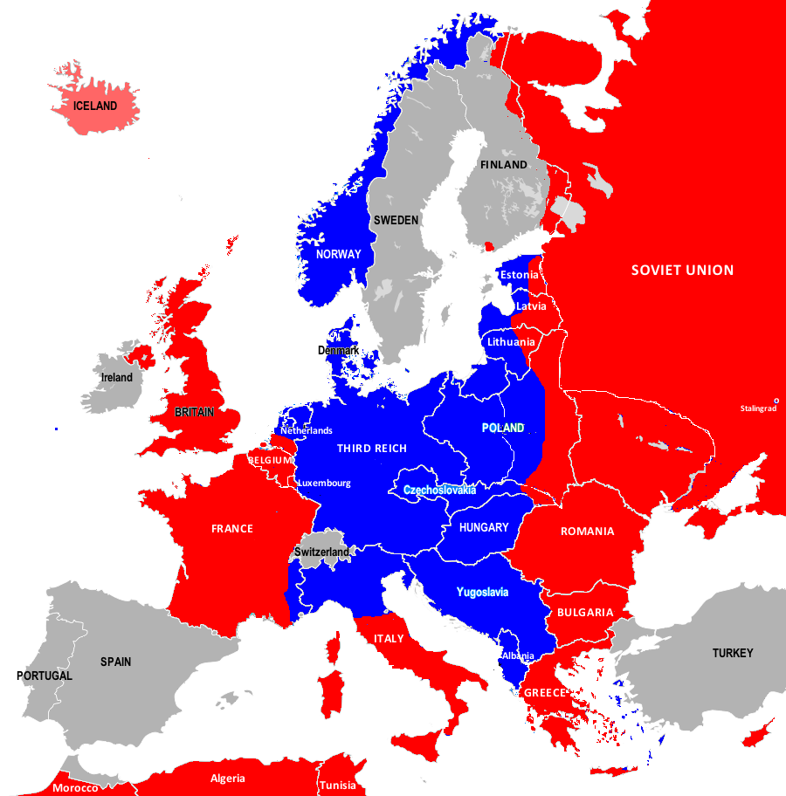
Introduction
THE WAR IN EUROPE, November 1944
November 1944:
By the end of November 1944 almost all German forces have withdrawn from Lapland into northern Norway although the evacuation will not be fully completed until April 1945.

Slide 58
Introduction
THE WAR IN EUROPE, November 1944
November 1944:
Allied forces advance through France, Belgium, Luxembourg and southern Netherlands. Soviet and Norwegian forces advance into East Finnmark, the far north of Norway.

Slide 59
Introduction
THE WAR IN EUROPE, December 1944
16 December 1944: German army begins a counter-offensive through the Ardennes.

Slide 60
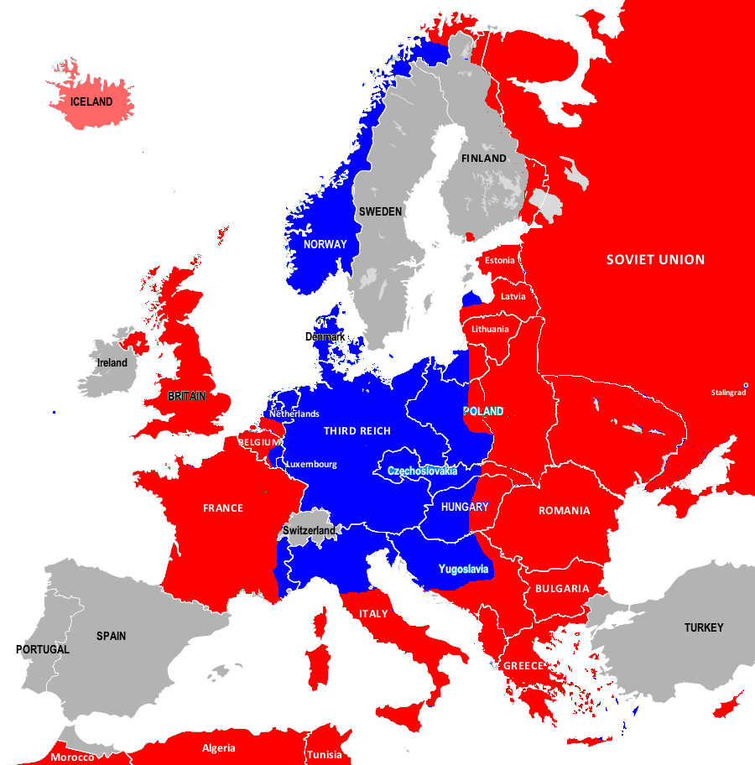
Introduction
THE WAR IN EUROPE, December 1944
December 1944:
By the end of 1944 Soviet forces have advanced along the Eastern Front into central Poland, Belorussia, the Baltic States, and into Czechoslovakia, Hungary and Yugoslavia.

Slide 61
Introduction
THE WAR IN EUROPE, January 1945
25 January 1945:
Allied forces drive the German army back through the Ardennes in what came to be known as the Battle of the Bulge.

Slide 62
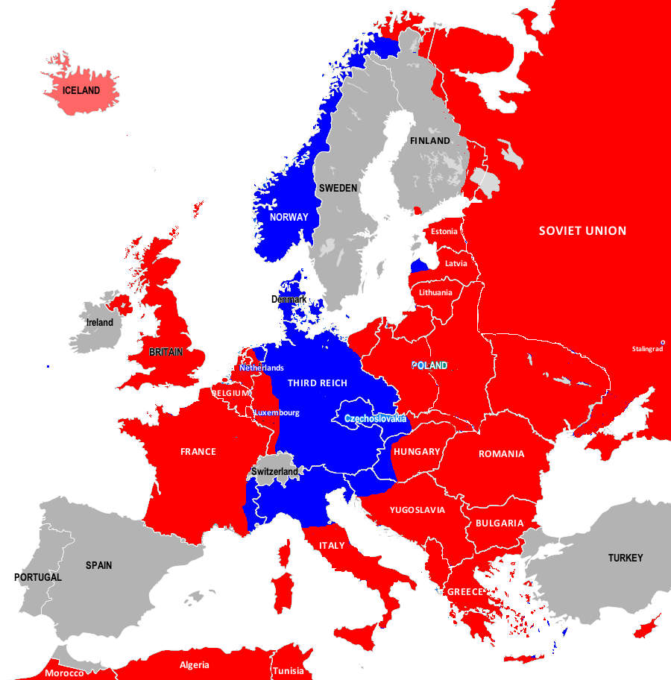
Introduction
THE WAR IN EUROPE, February 1945
February 1945:
By mid-February 1945 Allied forces have forced the German army back towards the Rhine. They are helped by the Soviet army bringing forward its winter offensive to mid-January so that the Third Reich has to reinforce its armies on the Eastern Front.

Slide 63
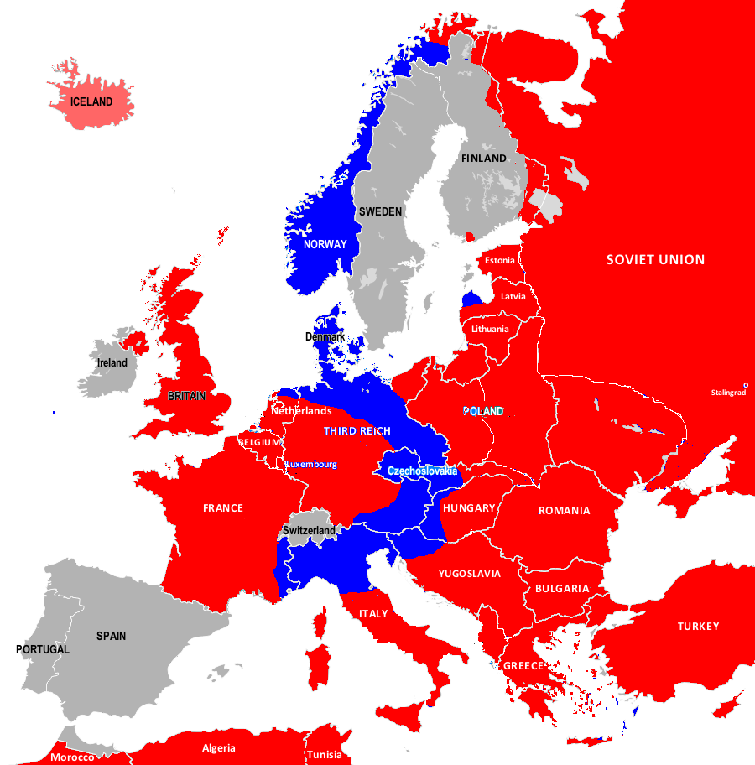
Introduction
THE WAR IN EUROPE, March 1945
March 1945:
By mid-March 1945 Allied troops have crossed the Rhine and are advancing eastwards and to the south. On 23 February, Turkey, having been neutral for most of the war, declares war on the Axis powers.

Slide 64
Introduction
THE WAR IN EUROPE, April 1945
9 April 1945:
Allied forces in Italy, having broken through the Gustav Line, are advancing on the River Po.

Slide 65
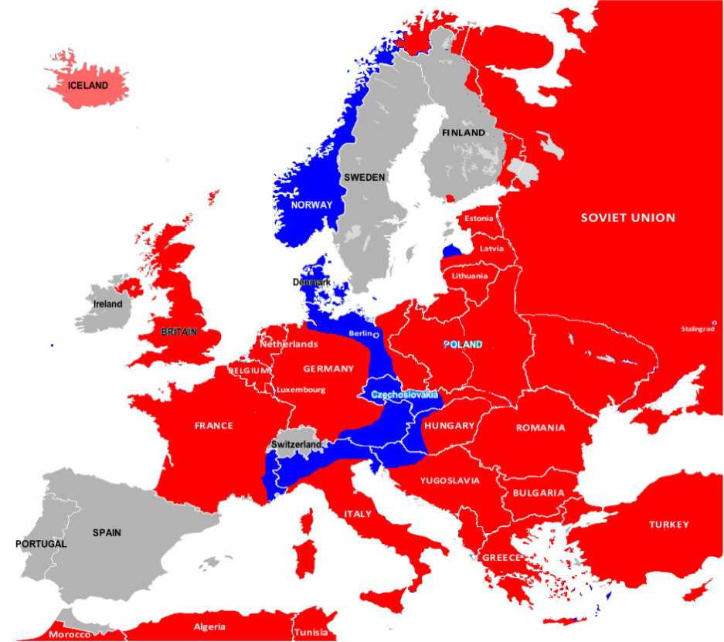
Introduction
THE WAR IN EUROPE, April 1945
Mid-April 1945:
By the middle of April 1945 the Allies in the west have reached the River Elbe in the north east of Germany and Leipzig in the east and taken Nuremberg in the south and are about to invade Austria. Soviet forces are advancing on Berlin.

Slide 66
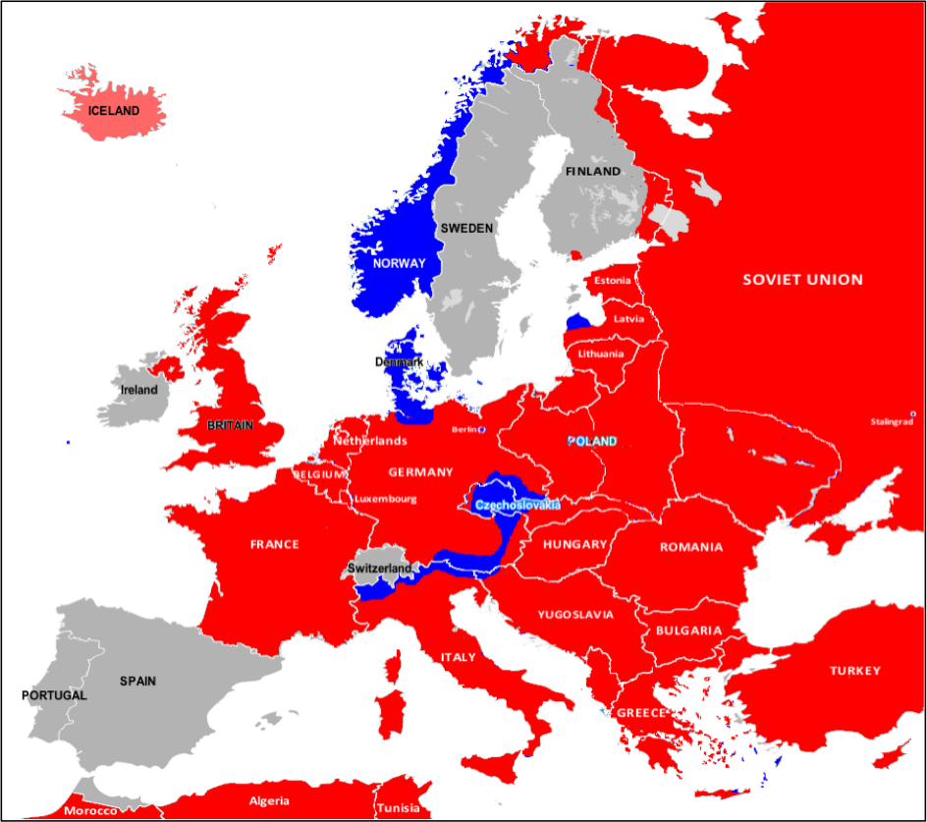
Introduction
THE WAR IN EUROPE, May 1945
May 1945:
By the beginning of May the German troops in northen Italy are on the point of surrendering; the Allies are about to take Hamburg; US forces have taken Munich and are advancing into Austria and western Czechoslovakia. Soviet and German forces are fighting hand-to-hand in Berlin.

Slide 67
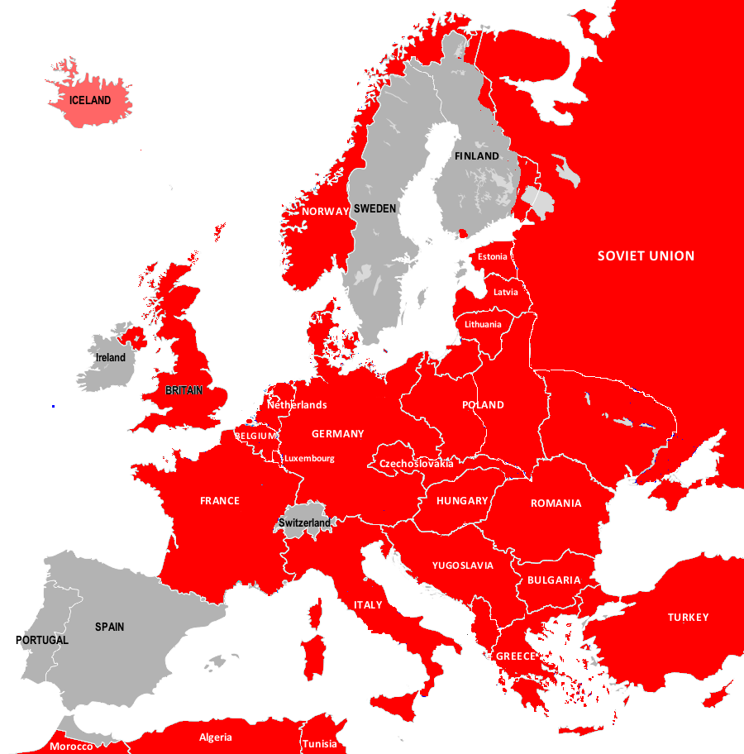
Introduction
THE WAR IN EUROPE, May 1945
7 May 1945: Unconditional surrender by Axis forces in Europe.

Slide 68
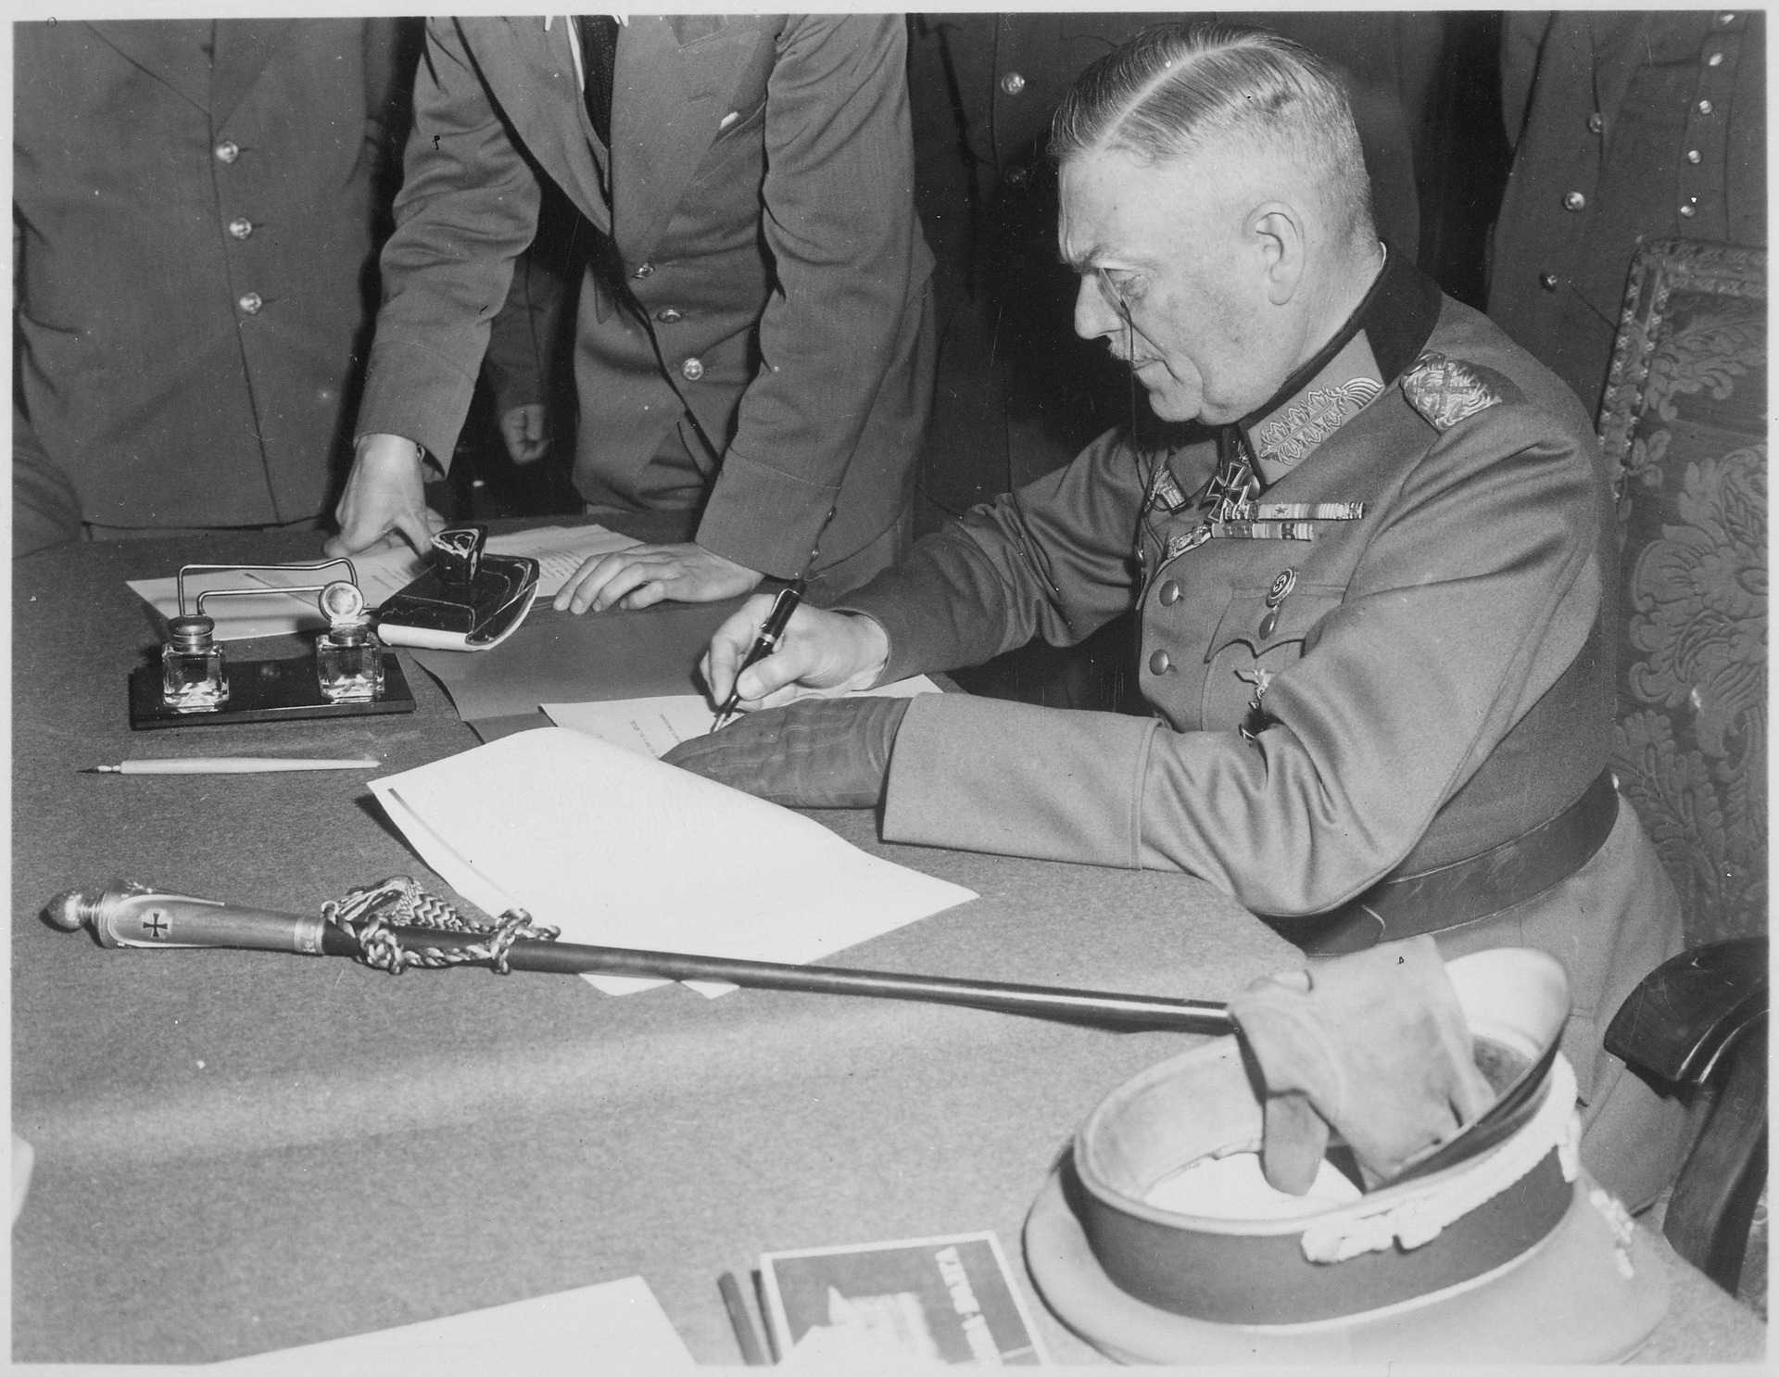
Introduction
THE WAR IN EUROPE, May 1945
8-9 May 1945:
Field Marshal Wilhelm Keitel signs the surrender terms on behalf of the German Army at the Soviet HQ in Berlin.
Source: US National Archives & Records Administration
Public Domain (USA)

Slide 69
How the war spread across Europe: From conquest to surrender
Text and graphics by Bob Stradling of the Historiana Editing Team.
(CC BY-SA 4.0)

