Slide 1
The extermination programme was the Third Reich’s answer to the so-called “Jewish question”. Within the Nazi ideology, the Aryan race was the master race and certain other “lesser races and degenerate groups” were perceived by them to threaten the “racial purity” of the Aryan race. Those so-called “lesser races and degenerate groups” included Jews, Slavs, Negroes, Roma and Sinti, as well as homosexuals, Jehova’s Witnesses, and physically and mentally disabled people. At first the Third Reich banned sexual relations and marriage between Aryans and these other races and groups. Then, between 1933 and 1939 sterilisation programmes were introduced for some of these groups. By the time war began a process of sending these “lesser races and degenerate groups” to forced labour and extermination camps was underway. This source collection shows the different aspects of these extermination programmes. The final part of the collection also looks at the mass exterminations carried out by the Soviet Union during the Second World War.

Slide 2
German anti-Semitic policies, 1933-1939
The National Socialists became the largest party in the Reichstag, with 44% of the vote, after the election of 5 March 1933. On 23 March the National Socialists, with the support of other right wing parties, had passed the Enabling Act giving Hitler dictatorial powers and within a few months the other parties had been banned. The first wave of anti-Semitic legislation was enacted just two weeks after the Enabling Act when the Law for the Restoration of the Professional Civil Service was enacted. This excluded Jews and “political unreliables” from State employment. Soon opportunities for Jews to work in other professions were being curtailed. In September 1935 at the National Socialists annual rally in Nuremberg the Nazis announced the “Nuremberg Laws”. These denied citizenship to German Jews, they were disenfranchised, and Jews were prohibited from marriage or sexual relations with “Aryans”. From 1935 to 1939 steps were taken to “Aryanise” the German economy by transferring Jewish-owned business to non-Jewish Germans. However, until the declaration of war in 1939 it was still possible for Jews to emigrate to other countries and many did, recognising where the Third Reich’s anti-Semitic policies were leading.

Slide 3
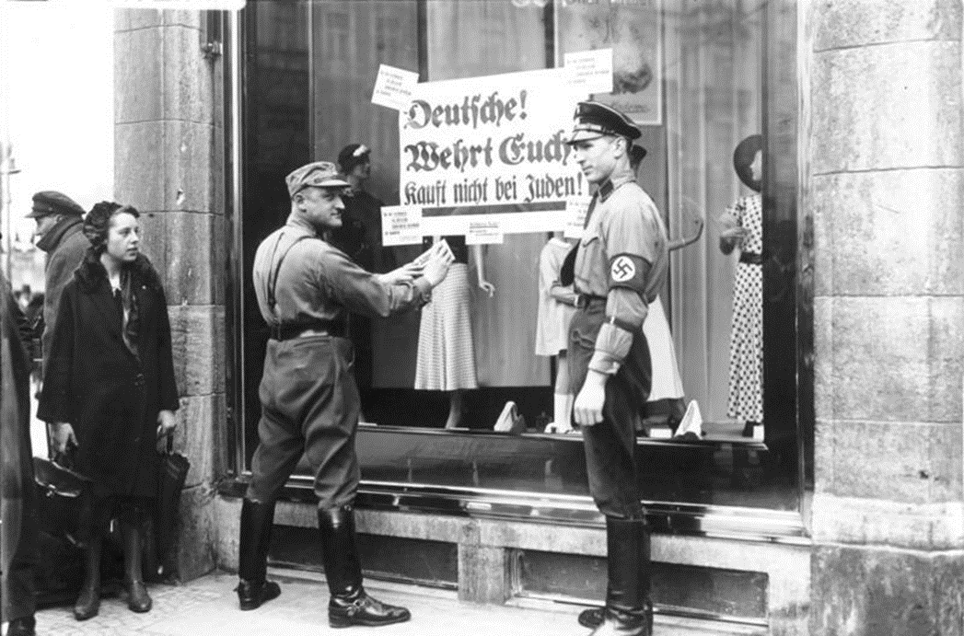
Anti-Semitism in the Third Reich, 1933-1939
In March 1933, after the Reichstag elections and the Enabling Act which gave Hitler dictatorial powers, an international group of Jewish leaders called for a boycott of German exports. The National Socialists reacted very quickly. On 1 April a boycott was announced against Jewish businesses and shops, law firms, doctors and dentists. On the 7 April 1933 the Law for the Restoration of the Professional Civil Service was enacted which barred Jews from national and local government employment.
Posters being pasted onto the window of a Jewish-owned shop in Berlin announcing the boycott.
(German Federal Archives, Bundesarchiv, Bild 102-14468, Georg Pahl , CC-BY-SA 3.0)

Slide 4
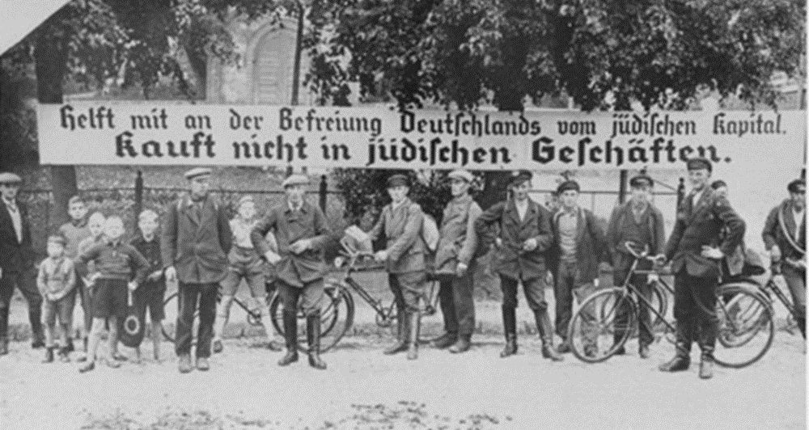
Anti-Jewish boycott in the Third Reich, 1933-1939
Another image of the anti-Jewish boycott implemented by the Third Reich in 1933. The sign says: “Help liberate Germany from Jewish capital. Don’t buy in Jewish stores.”
(US Holocaust Memorial Museum courtesy of Stadtarchiv Nürnberg, Public Domain in the US)

Slide 5
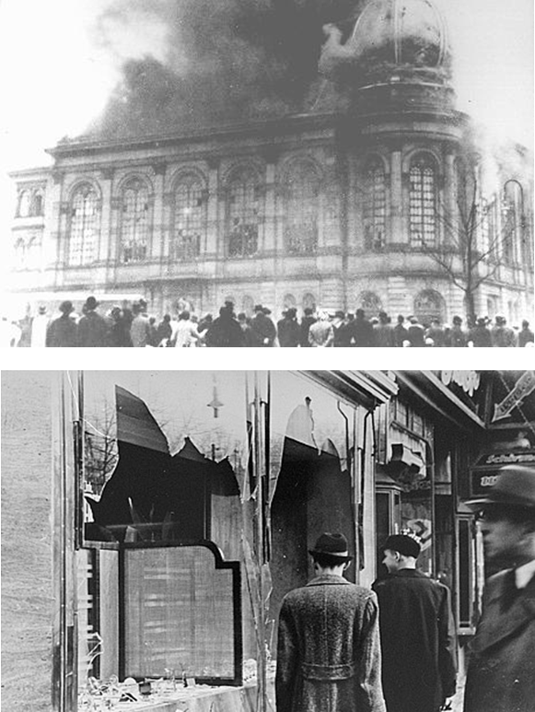
Kristallnacht in the Third Reich, 1933-1939
On the 9th and 10th November 1938 extreme violence broke out directed at Jews across Germany, annexed Austria and German-occupied Sudetenland. It was allegedly in response to the assassination of a German diplomat in Paris, Ernst vom Rath, by a 17 year-old Polish Jew, Herschel Grynszpan whose parents had just been expelled from Germany but were unable to return to Poland. The Third Reich claimed the violence was spontaneous. In reality orders had gone out from Goebbels and Heydrich to local Party offices to ensure that the violence coincided with the anniversary of the Munich Beer Hall Putsch of 1923 – an important date for the Nazis. It came to be known as Kristallnacht (literally Crystal Night but universally known as the “Night of Broken Glass”). On that night Jewish owned properties were broken into and looted and Synagogues were set on fire.
Top image: The Boerneplatz Synagogue in Frankfurt, 10.10.1938
(US Holocaust Memorial Museum)
Bottom image: Smashed windows of a Jewish-owned shop in Berlin, 10.10.1938 (US National Archives and Records Administration)

Slide 6
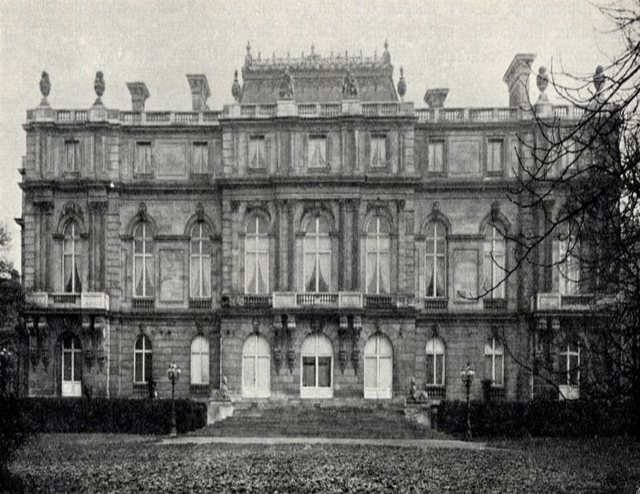
Austrian Jews, 1933-1939
Palais Albert Rothschild in Vienna. This confiscated building was used by SS Obersturmführer Adolf Eichmann in August 1938 to house the Centre for Jewish Emigration. The idea was to speed up the process of assisting Austrian Jews to emigrate but cutting out the red tape imposed by the officials of the Ostmark Reichsgau (post-Anschluss Austrian administration).
Around 45000 Austrian Jews emigrated between August and November 1939. Most were forced to give up their money and possessions in return for emigration permits. Even then many of them were sent to concentration camps once the staff and the Centre were unable to extract anything else from them. By the time Eichmann left Vienna in May 1939 the Centre had ensured that over 100000 Austrian Jews had emigrated.
(Wikimedia Commons, Public Domain in the US)

Slide 7
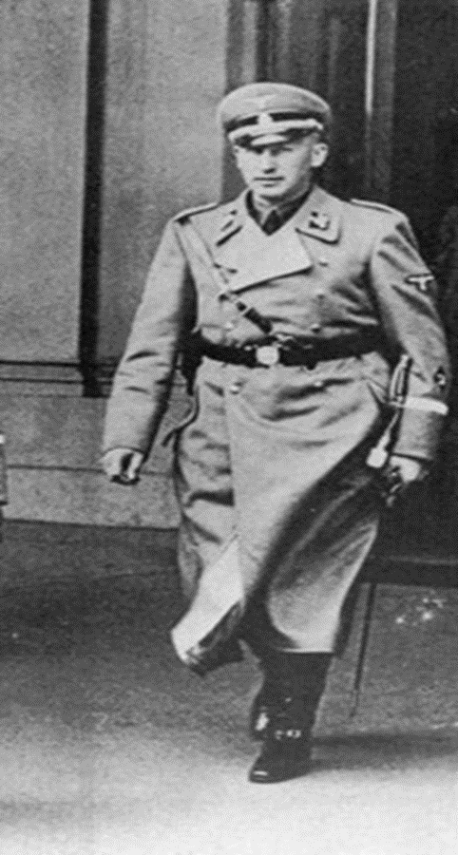
Reinhard Heydrich, 1938
Adolf Eichmann, who had set up the Centre for Jewish Emigration in Vienna and another Centre in Prague then successfully argued the case for establishing a Reich Central Office for Jewish Emigration in Berlin. This was opened on 24 January 1939 but with Reinhard Heydrich as its head; someone who was more senior than Eichmann in the ranks of the SS. Heydrich, who had organised the “spontaneous” violence against Jews on Kristallnacht and prepared the ground for the Anschluss, was already in charge of the German Security Service (SD).
The photograph shows Reinhard Heydrich in 1938 when he was head of the Reich Security Service (SD) and the Reich Central Office for Jewish emigration.
(Wikimedia Commons, Public Domain in the EU)

Slide 8
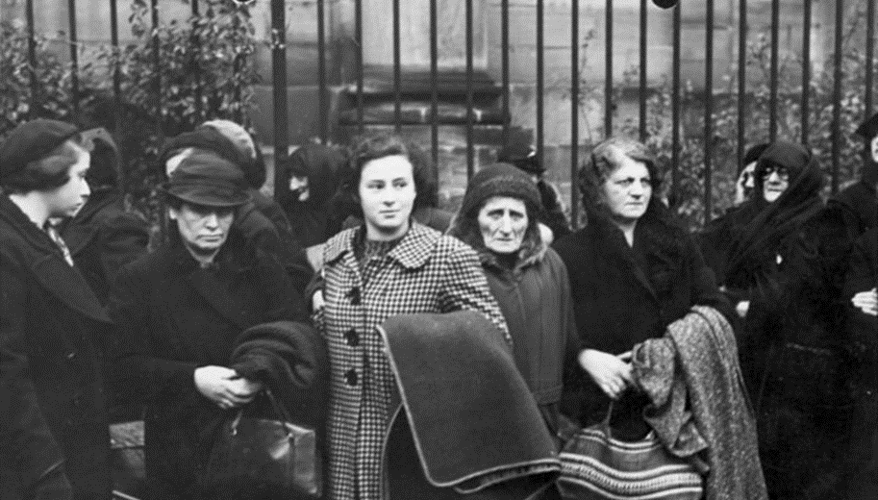
The First Mass Deportation, 1938
A group of Jewish women with Polish citizenship living in Nuremberg, Germany waiting at a meeting point to be deported to Poland on 28 October 1938.
(Geman Federal Archive, Bundesarchiv, Bild 146-1982-174-27, Großberger, H., CC-BY-SA 3.0)
The first mass deportation of Jews took place in the autumn of 1938. In March the Polish government had announced that Polish citizens living abroad would need to renew their passports by 31 October 1938 or lose their citizenship. On 28 October the Gestapo rounded up 17000 Polish Jews resident in Germany with the intention of deporting them to Poland. However, by the time the Gestapo were ready to carry out the deportation it was 31 October and the Polish government refused to accept the deportees. Instead they were stuck in makeshift facilities in a kind of no man’s land between the German and Polish borders near the town of Zbaszyn. After prolonged negotiations the Third Reich agreed that the deportees could temporarily return to Germany and settle their affairs and then return to Poland. For many it was a case of “out of the frying pan into the fire” because on 1 September 1939 German forces invaded Poland.

Slide 9
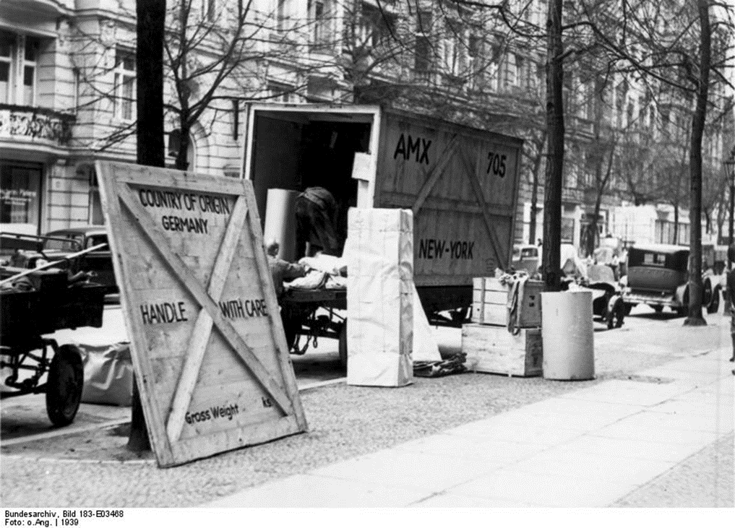
Increased Jewish Emigration, 1930s
Here we see the property of a Jewish family in Berlin being loaded on to a removals van for a move to the United States, 1 August 1939.
(German Federal Archive, Bundesarchiv, Bild 183-E03468, CC-BY-SA 3.0)
The rising tide of anti-Semitism in pre-war Germany led to a massive increase in Jewish emigration in the 1930s. Many went to Palestine. Around 300000 applied for visas to the United States but since 1924 the US Government had operated a quota system and by 1940 only 90000 Jews had been able to settle in the USA. Around 40000 emigrated to the United Kingdom. Another 100000 emigrated to other parts of Western Europe but then had to move on again after War was declared. The first wave of Jewish emigrants, in the mid-1930s, tended to be from professional and business backgrounds.

Slide 10
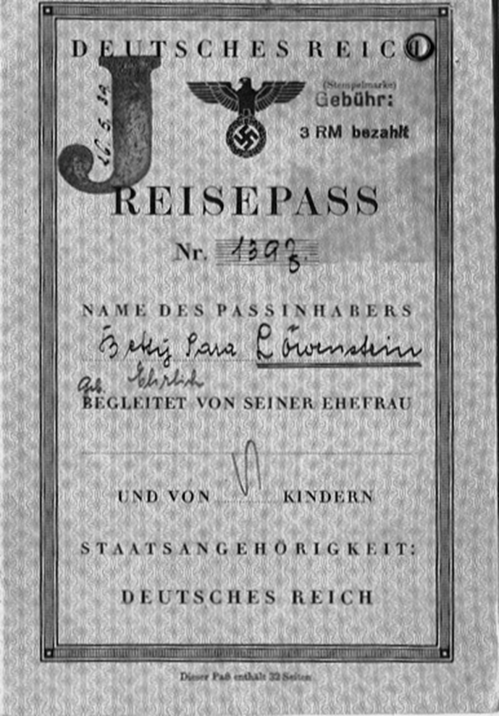
‘Reisepass’ in the 1930s
Although Jews were being allowed to leave Germany in the late 1930s they were not allowed to return. This is the Reisepass (Travel Pass) of Betty Löwenstein which permitted her to leave Germany. Betty was Jewish and therefore the State authorities had stamped the letter J on her pass. It is also interesting to note that her middle name was not Sara. It was official practice to add the name Sara to the ID and travel passes of all Jewish women and the name Israel to all the passes of Jewish men. Presumably in case the official checking the pass had not noticed the large J stamped on it!
(Wikipedia courtesy of Jonathan Lowenstein, CC BY-SA 3.0)

Slide 11
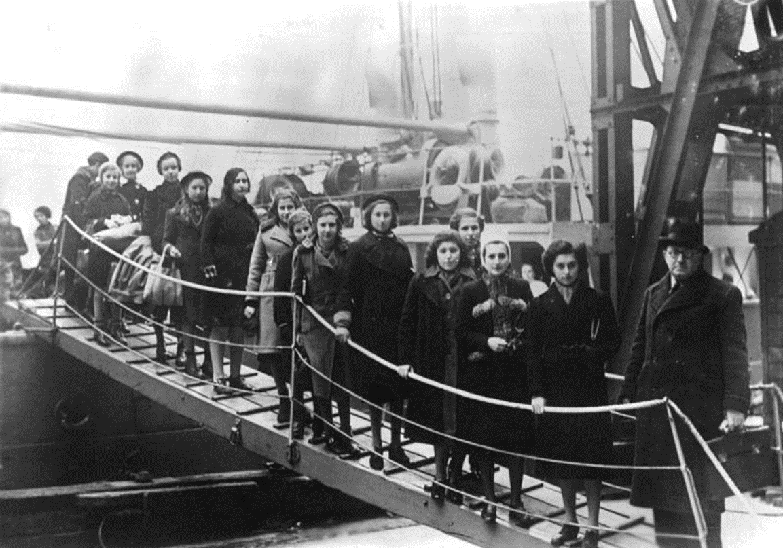
‘Kindertransport’ ,1939
A group of Jewish children and young people from Germany, Austria, Czechoslovakia and Poland brought to Britain through the Kindertransport programme in February 1939.
Nearly 10000 Jewish children came to Britain this way in the nine months before War was declared. Most lost their adult relatives in the Holocaust.
(German Federal Archive, Bundesarchiv, Bild 183-S69279, CC-BY-SA 3.0)

Slide 12
The emergence of a systematic extermination policy
As our first set of sources relating to the period 1933-1939 showed, the initial policy of the Third Reich was to encourage all Jews to emigrate from Germany and, if they were unwilling to do so, then to forcibly deport them further east. However, by January 1939 some in the Nazi hierarchy were beginning to think that emigration and deportation – the official term used at this stage was ‘evacuation’ – may not be sufficient to solve what they referred to as “the Jewish question”, particularly as the borders of Germany expanded through annexation.
Internal memos and notes began to refer to a more “final solution” to the question, although the wording is often indirect, even ambiguous, about what this meant. However, the Third Reich’s extermination policy became more systematic between January 1939 and January 1942 when SS senior officers and Nazi party officials, under the chairmanship of Reinhard Heydrich, met in Wannsee to finalise a systematic programme of extermination of the Jews, Slavs, Roma, Sinti and other groups and categories of people regarded by the Nazis as ”lesser races and degenerates”.

Slide 13
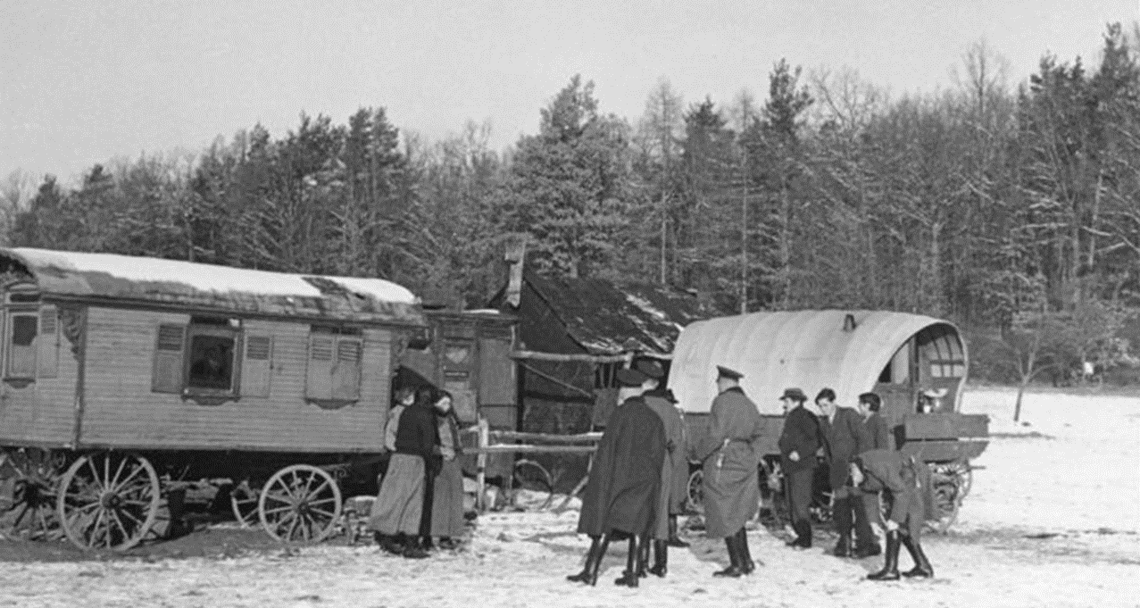
Local raid in south eastern Germany for deportation, 1937
This photograph shows a local raid on a village in south eastern Germany to round up Roma for deportation in 1937.
(German Federal Archive, Bundesarchiv, Bild 146-1989-110-29, CC-BY-SA 3.0)

Slide 14
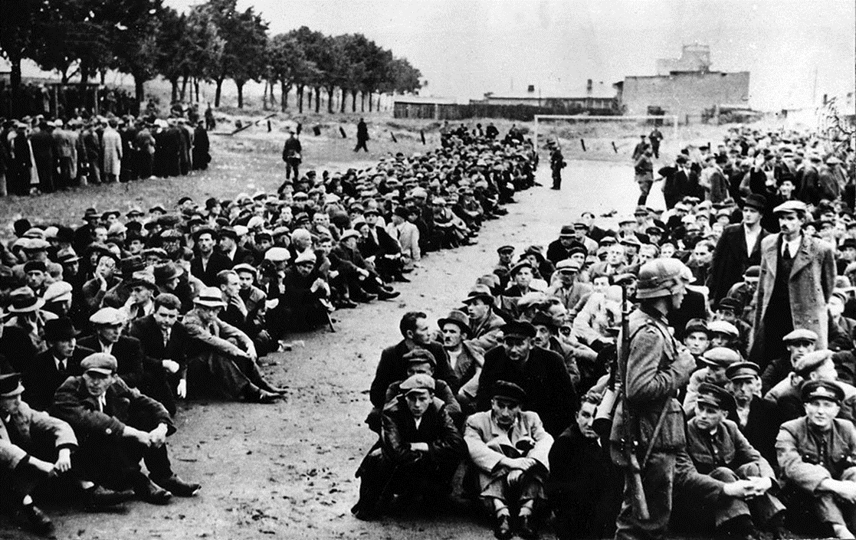
German forces invading Western Poland
(Wikimedia Commons, Public Domain in Poland & USA)
German forces invading western Poland on 1 September through the Polish Corridor advanced rapidly. The Free City of Danzig was annexed on 2 September. The whole hinterland was under German control by 14th September. Many prominent Polish citizens, professors, teachers, doctors, priests, nuns, public officials, businessmen and Polish soldiers were rounded up (Säuberungsaktion) and held at the port of Gdynia. Under the orders of Arthur Greiser, the Reich Governor of the German-occupied Wartheland, Many were deported to the newly-built Stutthof concentration camp or executed in the Piaśnica Forest.

Slide 15
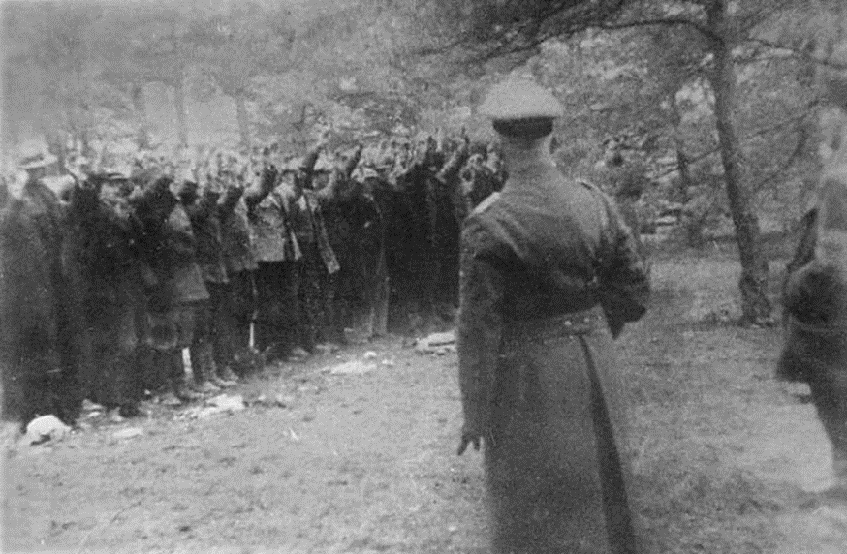
Polish Victims
Polish victims waiting to be executed in the Piaśnica Forest. The photographer was Waldemar Engler, a professional photographer in civilian life but at this time in the SS.
(Włodzimierz Jastrzębski: "Terror i zbrodnia". Interpress, Warszawa 1974, Public Domain in Poland & USA)
It is estimated that between 12000 and 14000 Poles were executed without trial in the Piaśnica Forest, 35 km outside Gdansk between October 1939 and spring 1940. The victims included men, women and children, both Jewish and Christian.
Others died in Stutthof concentration camp and Lublin Extermination Camp. Thre executions were carried out by the SS, the Einsatzkommando (SS-Gestapo killing squad) and the Volksdeutscher Selbstschutz (Ethnic German self defence unit).
Many others died in the camps.

Slide 16
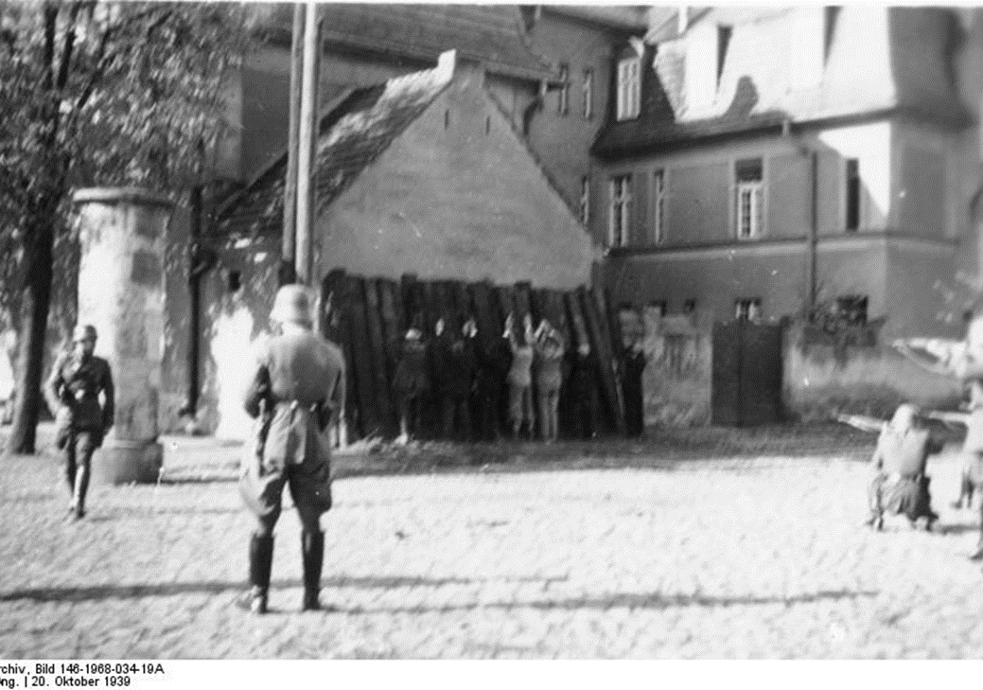
Operation Tannenberg, 1939
(German Federal Archives, Bundesarchiv, Bild 146-1968-034-19A, CC-BY-SA 3.0.)
After the occupation of Poland, the Third Reich implemented Operation Tannenberg. Within this Operation, a large number of the Polish elite was exterminated, mainly through mass shootings. The Operation took place mainly in the autumn of 1939.

Slide 17
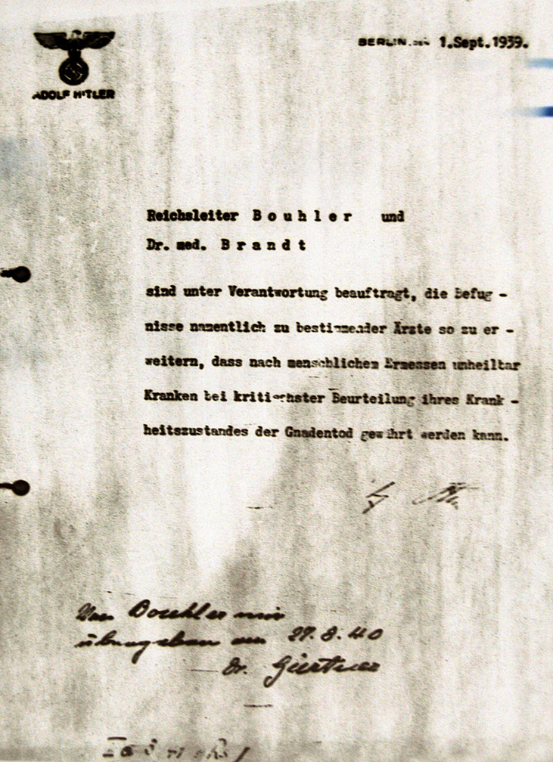
The Nazi Euthenasia Programme, 1939
This is Hitler’s order, signed on 27 August 1940 but backdated to 1939, to proceed with the Action T4 program to eliminate “life unworthy of life”. It states specifically that "Reich Leader Bouhler and Dr. Brandt are entrusted with the responsibility of extending the authority of physicians, designated by name, so that patients who, on the basis of human judgment are considered incurable, can be granted mercy death after a definitive diagnosis. -- A. Hitler”.
This euthanasia program focused at first on babies and very young children but later the programme was extended to adult disabled patients. The American historian, Christopher Browning, has estimated that over 70 000 children and adults were killed between September 1939 and March 1942.
(Wikimedia Commons, Marcel (2008), Public Domain)

Slide 18
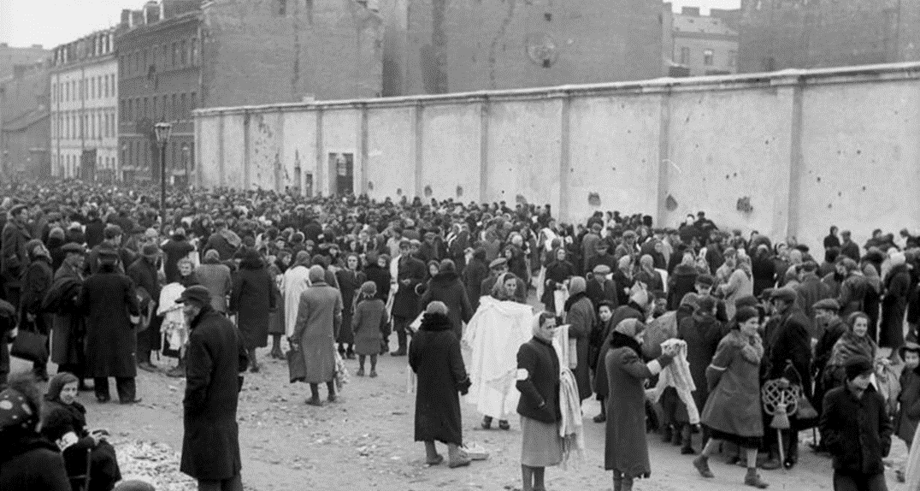
Warsaw Ghetto, 1941
People gathering in the market place at the intersection of Ksawery Lubecki Street and Gęsia Street alongside the wall of the Warsaw Ghetto on 21 June 1941. Before the “final solution” was fully implemented there were about 400000 Jews resident in the ghetto.
(German Federal Archive, Bundesarchiv, Bild 101I-134-0780-38, Cusian, Albert, CC-BY-SA 3.0.)

Slide 19
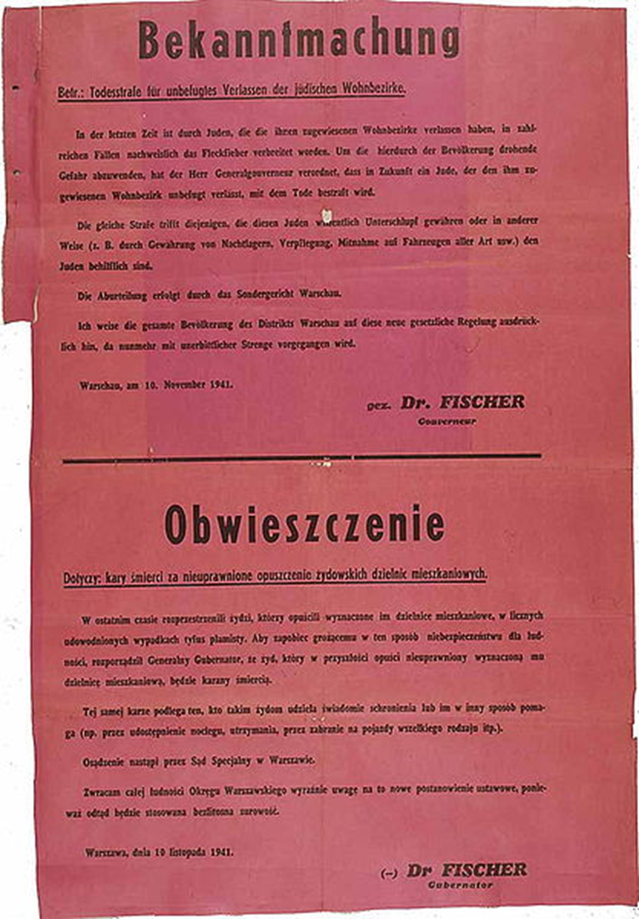
Announcement of death penalty
This announcement was issued on 10 November 1941 in Warsaw. The announcement states that Jews are forbidden to leave the ghetto, by punishment of death. The reason provided by governor Ludwig Fischer is that they would spread diseases. In addition, those who provided any kind of shelter for the Jews would be punished as well.
(Archives of the Institute of National Remembrance (Warsaw), Public Domain in Germany)

Slide 20
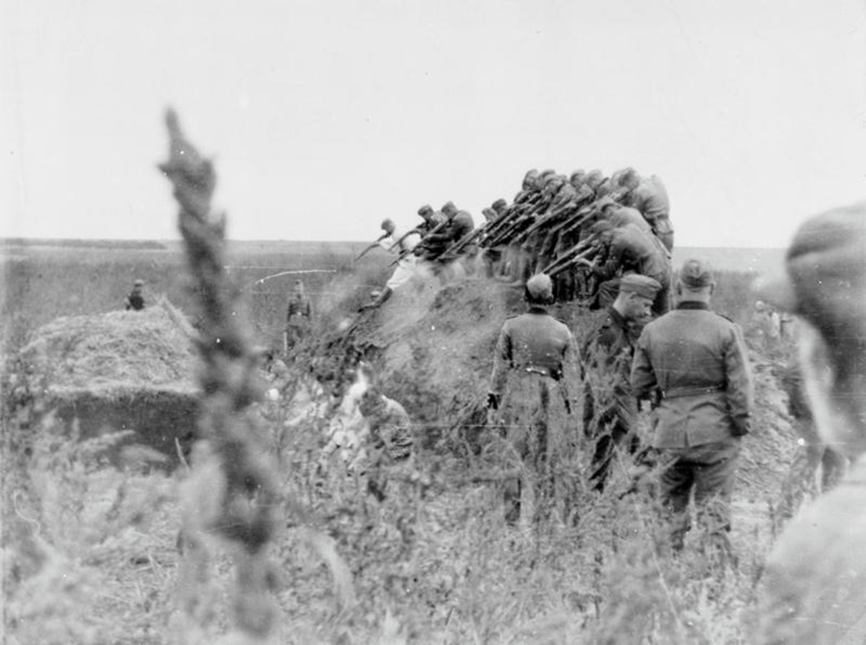
Implementation of mass shootings on the Eastern Front
(Imperial War Museum,© IWM (HU 86369)), Re-used under IWM Non Commercial Licence)
On the Eastern Front, in addition to rounding up Jewish, Romani and Slavic people and sending them to concentration and extermination camps, the extermination programme was also implemented through mass shootings especially in the early years of the war.
Here an Einsatzgruppe execution squad shoot a group of Jewish women in an open pit near Dubossary in Soviet Moldova, in 1941.

Slide 21
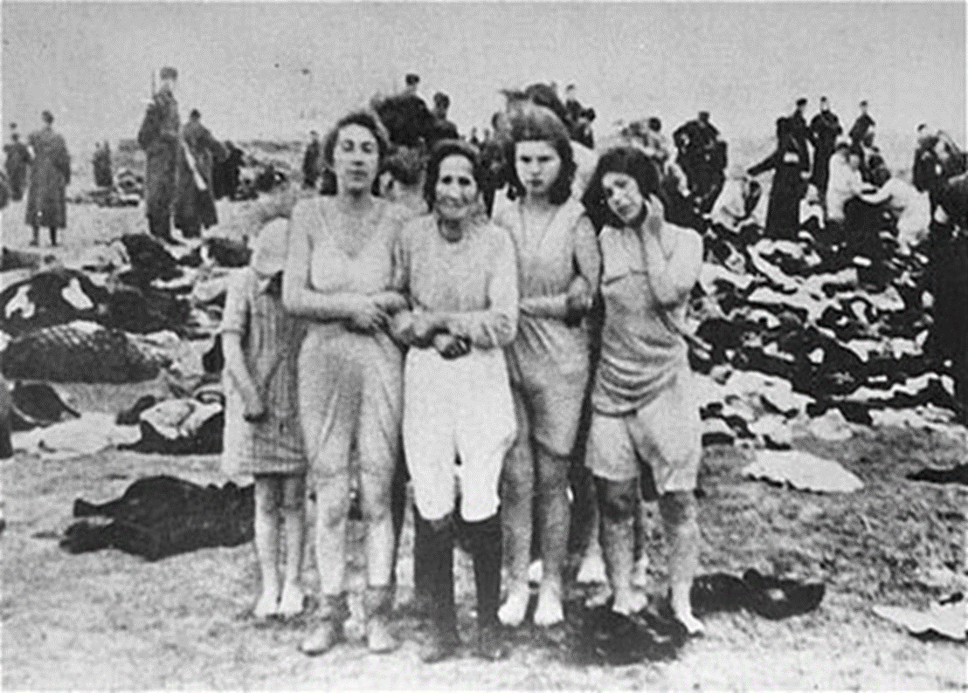
Liepāja massacres, 1941
(US Holocaust Memorial Museum image number 19121, Public Domain in USA)
The Liepāja massacres were part of the Third Reich’s large scale executions of the Jewish population in Latvia. During 3 days in late June 1941 approximately 2,700 Jews were murdered by mass shootings.
The photo was probably taken by Reinhard Wiener, a German photographer who recounted how German soldiers stood around as spectators.

Slide 22
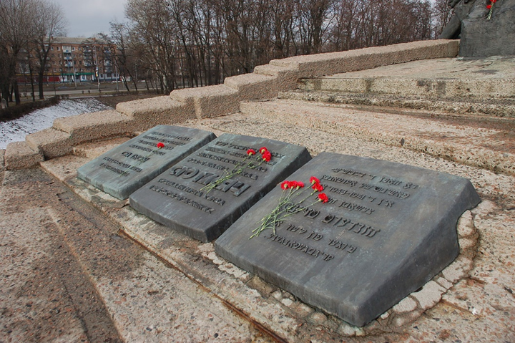
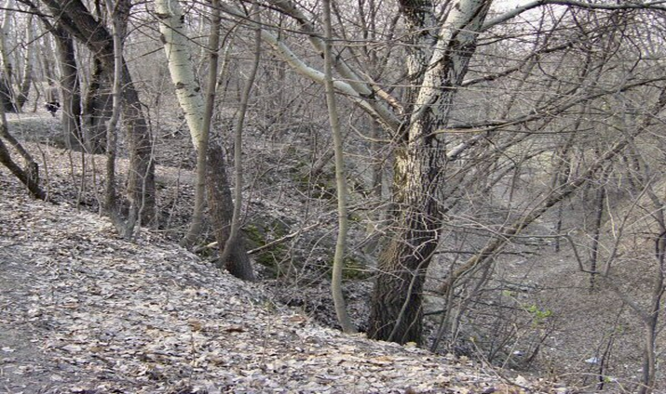
Massacre in Babi Yar, 1941
On 29-30 September 1941 German SS and SD and local police massacred 34000 Jews from Kiev in a ravine known as Babi Yar, just outside the city.
This photograph is of the ravine where the massacre happened.
(Wikimedia Commons, Mark from nl, CC BY-SA 3.0 Unported)
This photograph is of the memorial in Kiev to those who died in the massacre.
(Wikimedia Commons, Roland Geider (2008), CC BY-SA 4.0 unported)

Slide 23
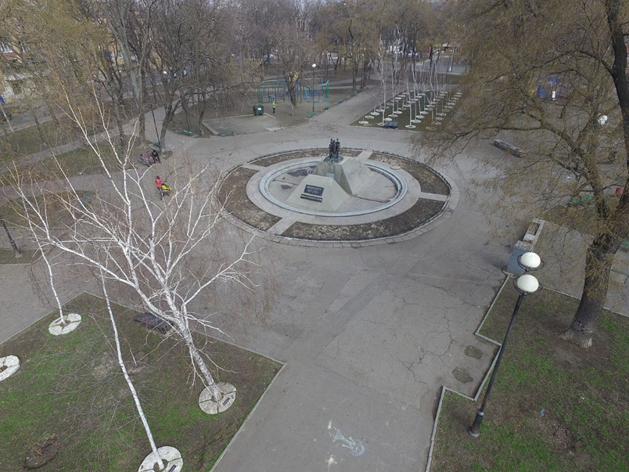
The Massacre in Odessa, 1941
The memorial in Odessa to those Jews who died in the massacre on 22-24 October 1941.
(Wikimedia Commons, Alexey M (2016), CC BY-SA 4.0 International)
On 22 June Operation Barbarossa began and Axis forces invaded the Soviet Union. The Soviet port of Odessa on the Black Sea was besieged by Axis forces from 8 August to 16 October 1941. After eventually seizing the city, with high casualty rates on both sides, Soviet forces retreated to the south east.
However, when the General commanding the Romanian troops and a number of Romanian and German officers were killed by a bomb that had been left by the Red Army in the building that they were using as their headquarters, local communists and Jews were blamed and reprisals were taken. On 22-24 October 1941, around 30000 Jews were rounded up in Odessa by Romanian and German Einsatzgruppen troops and shot or burned to death in several massacres. Those who did not die in the shootings were imprisoned in warehouses which were then set on fire.

Slide 24
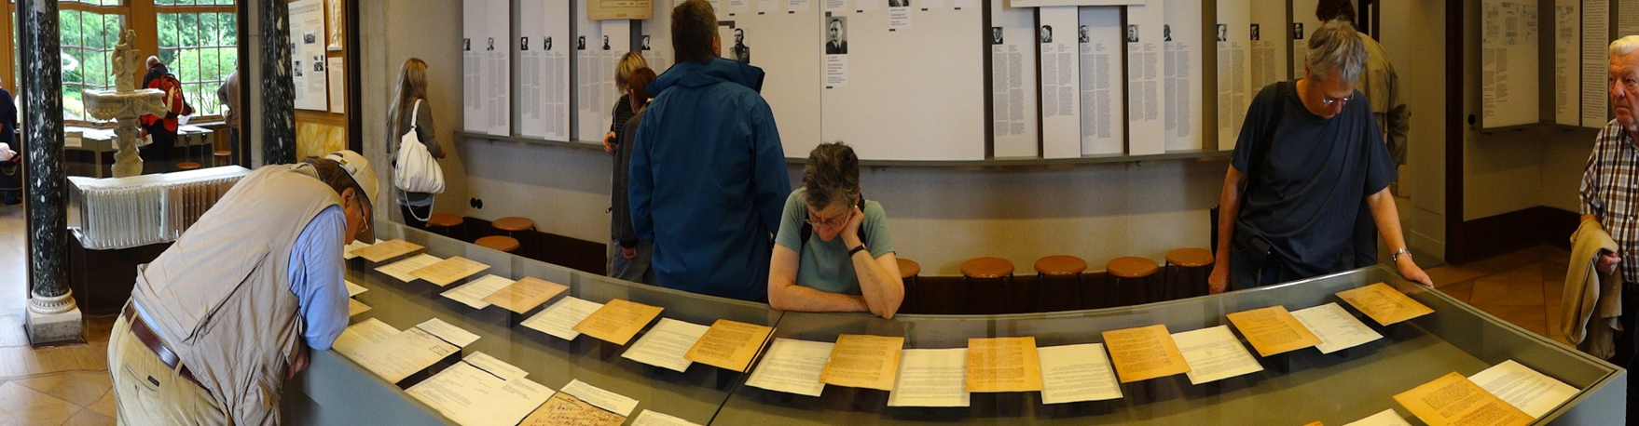
‘Wannsee Villa’ and implementation of ‘ Final Solution’
( flickr, Adam Jones, CC BY-SA 2.0 Generic)
On 20 January 1942 a meeting of senior government officials and SS leaders in the Third Reich met at the Wannsee Villa to ensure that all relevant departments in the Third Reich would cooperate in the implementation of the so-called “Final Solution” – the systematic extermination of the Jews in central and eastern Europe. The meeting was chaired by Reinhard Heydrich, then Director of the Reich Main Security Office. The villa, of which this was the Dining Room in 1942, is now a memorial and museum that is open to visitors.

Slide 25
Implementing the “Final Solution”
By the time that Reinhard Heydrich had convened a meeting of colleagues to plan the “final solution” at the Wannsee Villa in the Steglitz-Zehlendorf district of Berlin, Operation Barbarossa was well underway. The Einsatzgruppen, or SS death squads, under the overall command of Heinrich Himmler and his deputy, Reinhard Heydrich, were operating in territories in Poland and the Soviet Union now occupied by German forces. In some cases they were shooting families and small communities of Jews, Roma and Slavs, in other cases there were large-scale massacres such as at Babi Yar and Odessa and in the Rumbula forest near Riga in Latvia – where about 25000 Latvian Jews and some German Jews transported to Riga were massacred. It has been estimated by the historian Raul Hilberg that between 1941 and 1945 the Einsatzgruppen and their local auxiliaries shot about 2 million people, 1.3 million of them being Jews.

Slide 26
Implementing the “Final Solution” - Continued
By January 1942, according to another historian, Laurence Rees, Himmler and Heydrich had become convinced that the mass shootings were a slow and inefficient solution to the so-called “Jewish question” and that some of the men of the Einsatzgruppen were having mental health problems because of their participation in the constant mass killings. Consequently, the Wannsee Conference was ordered to find a more systematic and efficient means of extermination. Gas chambers were already in use to some extent, particularly as part of the Aktion T4 or euthanasia programme for the physically and mentally disabled but it was now decided that this should be the main means of disposing of the so-called “lesser races and degenerate groups”. This called for a major expansion of the extermination camps and the staffing and equipment needed to ensure they worked efficiently.
(Raul Hilberg, The destruction of the European Jews, New York (1985) p.372)
(Laurence Rees, The Nazis: A Warning from History, New York (1997) p.197 )

Slide 27
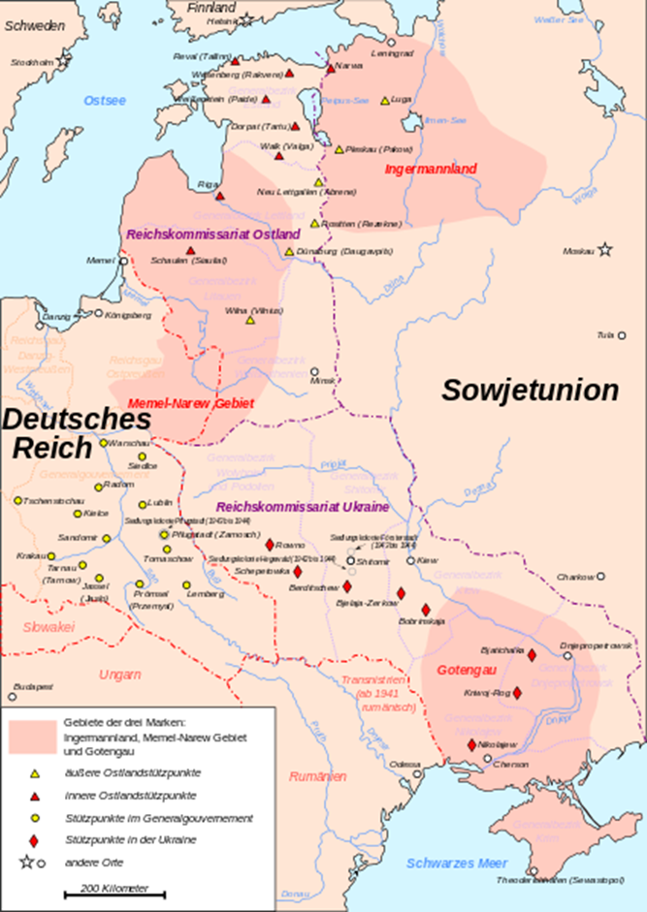
‘Greater Germany’
The goal of a Greater Germany, as set out in the Third Reich’s Generalplan Ost, involved the colonisation of central and eastern Europe. According to that plan the population was to be enslaved, deported or exterminated. This map shows the “Deutsches Reich” with the planned colonies, known as the “Reichskommissariat” areas. There were several versions of the Generalplan. The first appeared in January 1940 and the second in July 1941. This map comes from the third version of the Plan which appeared on 27 April 1942 after the Wannsee Conference. The Plan was primarily concerned with the resettlement further east of around 31 million people, including 5 to 6 million Jews once the Soviet Union had been conquered. The Reich Central Office for Jewish Emigration was critical of the Plan because, since Wannsee, a new and more “final” solution was now on the table. The Plan was dropped after the Wehrmacht was defeated at Stalingrad.
(Wikimedia Commons, Public Domain)

Slide 28
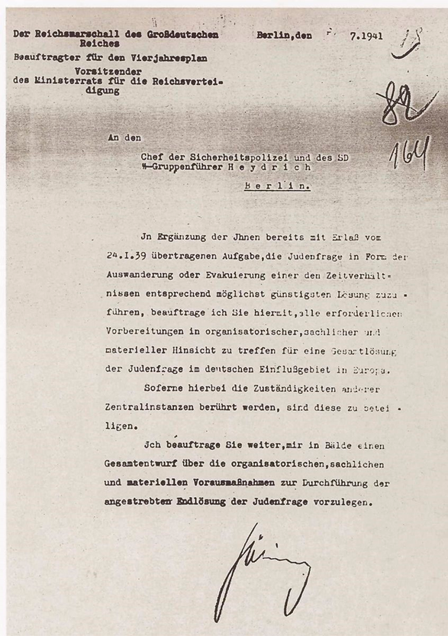
Letter to SS Gruppenführer Heydrich, Berlin, 31 July 1941
Supplementary to the task entrusted to you in the decree of 24 January 1939, to solve the Jewish question under the prevailing circumstances by emigration or evacuation in the most favourable way possible, I herewith commission you to carry out all necessary preparations in regard to organisational, practical and material matters for a total solution of the Jewish question (Gesamtlӧsung der Judenfrage) in the German sphere of influence within Europe.
Insofar as the competences of other central organizations are affected, these are to be involved.
I further commission you to submit to my office in the near future an overall plan that shows the preliminary organisational, practical and material measures requisite for the implementation of the projected final solution of the Jewish question (Endloesung der Judenfrage).
(Handwritten signature) Göring
Reichs Marshall of Greater Germany, Commissioner for the Four Year Plan, Chairman of the Ministerial Council for the Reich’s Defence To the Head of the Security Police and SD, SS Gruppenführer Heydrich
(Public Domain)

Slide 29
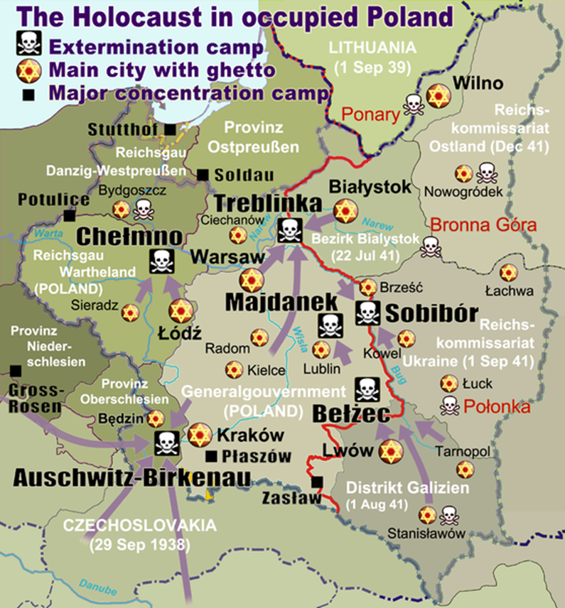
Camps and Ghettos in Poland
This map shows the large number of ghettos, concentration camps and extermination camps located across occupied Poland. The purple arrows indicate the main deportation routes. The map identifies the six main camps that were designated for purposes of extermination: Auschwitz-Birkenau, Belżec, Chelmno, Majdanek, Sobibor and Treblinka. It is estimated that around 3.5 million Jews died in these extermination camps, along with Roma, Sinti, Poles and Soviet prisoners of war. Although at least two of these camps were operational in 1940-41 the systematic mass extermination of Jews and other peoples began in 1942. Adolf Eichmann, who was later tried and executed in Israel in 1962, was responsible for the logistics that made systematic mass slaughter possible.
(Wikimedia Commons, poeticbent, CC BY-SA 3.0)

Slide 30
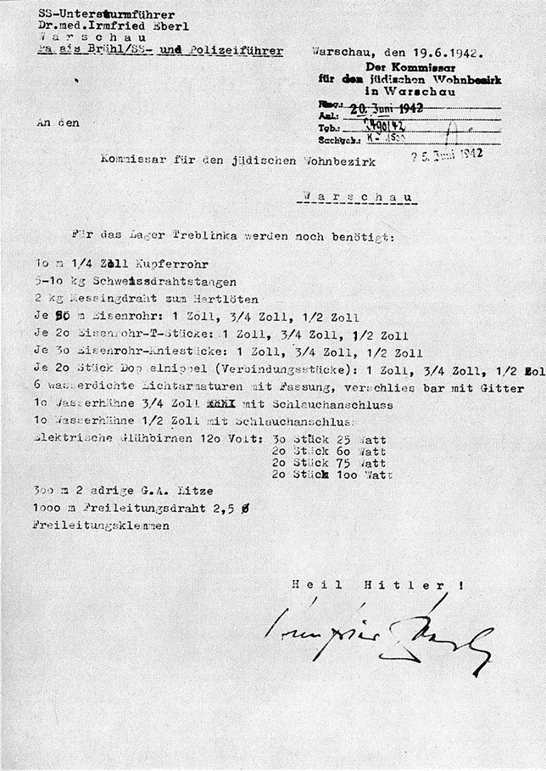
Extermination camp Treblinka II, 1942
A letter, dated 19 June in 1942, written by Irmfried Eberl, an Austrian Director of Euthanasia Institutes and the first commander of the extermination camp at Treblinka. The letter was written to the Commissioner for the Jewish quarter in Warsaw asking for additional supplies of equipment and materials for building the extermination camp, Treblinka II. Treblinka I was a forced labour camp, while Treblinka II was built specifically for the purpose of extermination. This letter was written at the final stage of the building of Treblinka II, which became fully operational in July 1942.
(Wikimedia Commons, Public Domain in Germany)

Slide 31
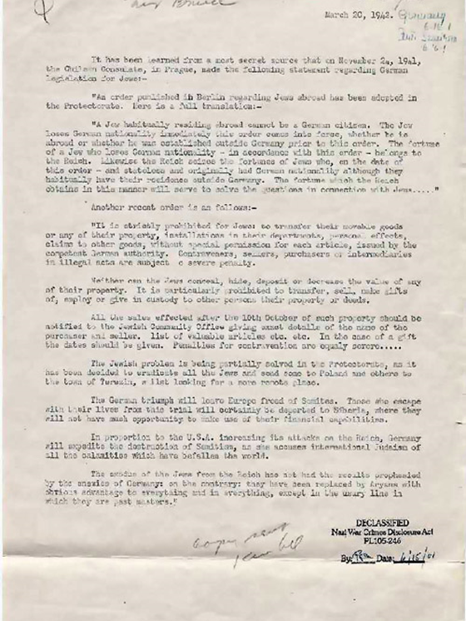
Awareness of the Allied governments of Third Reich Policy, 1942
It is clear that Allied governments were aware of the policy of the Third Reich towards Europe’s Jews by the spring of 1942, if not sooner. This diplomatic dispatch from Chile’s Consul in Prague, Gonzalo Montt Rivas, when Prague was under Nazi occupation, was intercepted by British intelligence and shared with their US counterparts. The British translated the document and copies are held in the US and UK National Archives. It is dated 20 March 1942 and marked MOST SECRET by British Intelligence officials. A key paragraph states:
“The Jewish problem is being partially solved in the Protectorate as it has been decided to reallocate all the Jews and send some to Poland and others to the town of Terezin whilst looking for a more remote place.
The German triumph will leave Europe freed of Semites. Those who escape with their lives from this trial will certainly be deported to Siberia, where they will not have much opportunity to make use of their financial capabilities”.
(US National Archives Record Group 226 Document #1356, Public Domain in USA)

Slide 32
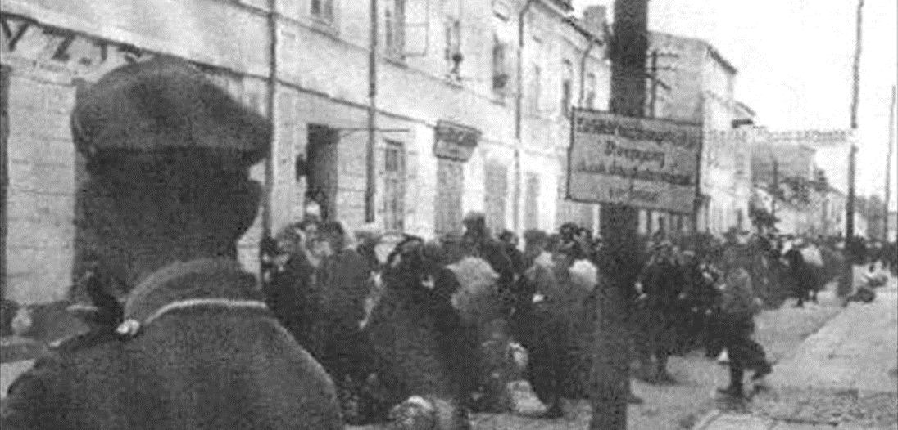
Operation Reinhard, 1942
Operation Reinhard, named after Reinhard Heydrich, was the secret plan to exterminate Polish Jews in the General Government district. For this purpose the extermination camps were built in Poland. This photo was taken in the Biała Podlaska ghetto in Poland at the beginning of Operation Reinhard in 1942. Most of the Jews in this ghetto were sent to Treblinka.
(Biala Podlaska Library, Public Domain in Poland)

Slide 33
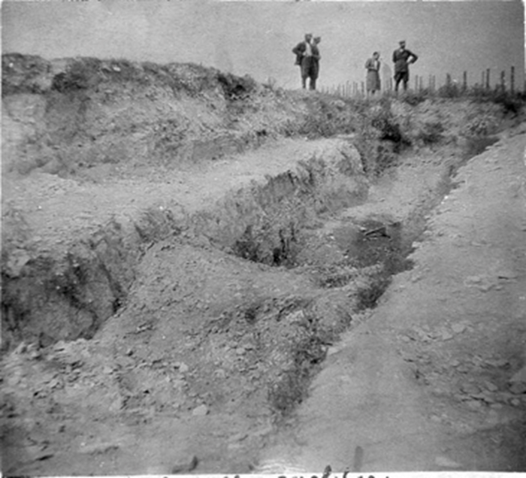
‘Operation Harvest Festival, 1943’
The mass shootings that were central to Operation Reinhard did not end with the building of the gas chambers in the six Extermination Camps. During 1942-3 some Jews, particularly the younger ones, began to actively resist the SS in the ghettos, the labour camps and in Majdanek, Sobibor and Treblinka. The response form the SS was swift and horrifically brutal. On 3 November 1943 around 43000 Jews, who had been brought to Majdanek in the previous weeks, were taken out, shot and buried in mass graves. The name for this operation, Aktion Erntefest (Operation Harvest Festival) demonstrates the extent to which the SS and its masters saw their victims as “Untermenschen” or sub-human. This was the final major action of Operation Reinhard, although the mass shootings by the Einsatzgruppen continued in the Soviet Union.
Some of the mass graves at Majdanek dug by the victims during Aktion Erntefest.
(Majdanek Museum via Wikimedia Commons, Public Domain in Poland & USA)

Slide 34
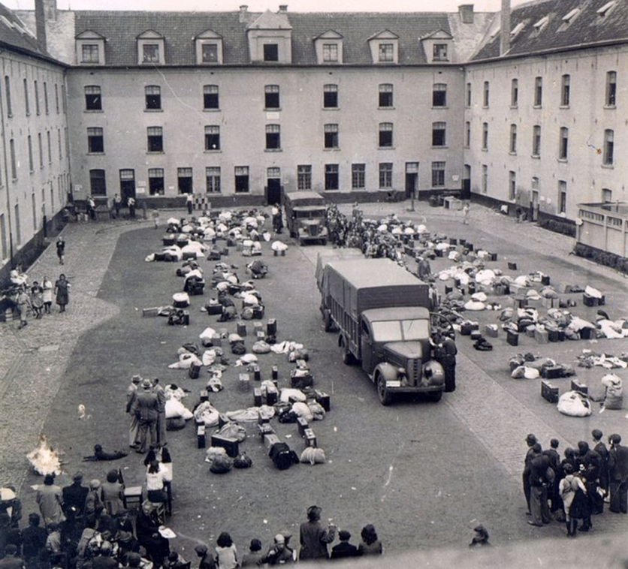
Transit Camp, SS-Samellager Mecheln
This transit camp in Belgium, officially SS-Samellager Mecheln, was established to collect and deport Jews and other groups from Belgium to concentration camps in German-occupied territories further east. Over 25.000 Jews and minorities like the Roma were deported from this camp throughout the war. Most were sent to Auschwitz-Birkenau or the forced labour camp of Heydebreck-Cosel.
This photo was taken in the summer of 1942 after the arrival of a large number of people (mainly Jews).
(JMDV Fonds Kummer, CC BY-SA 3.0 Unported)

Slide 35
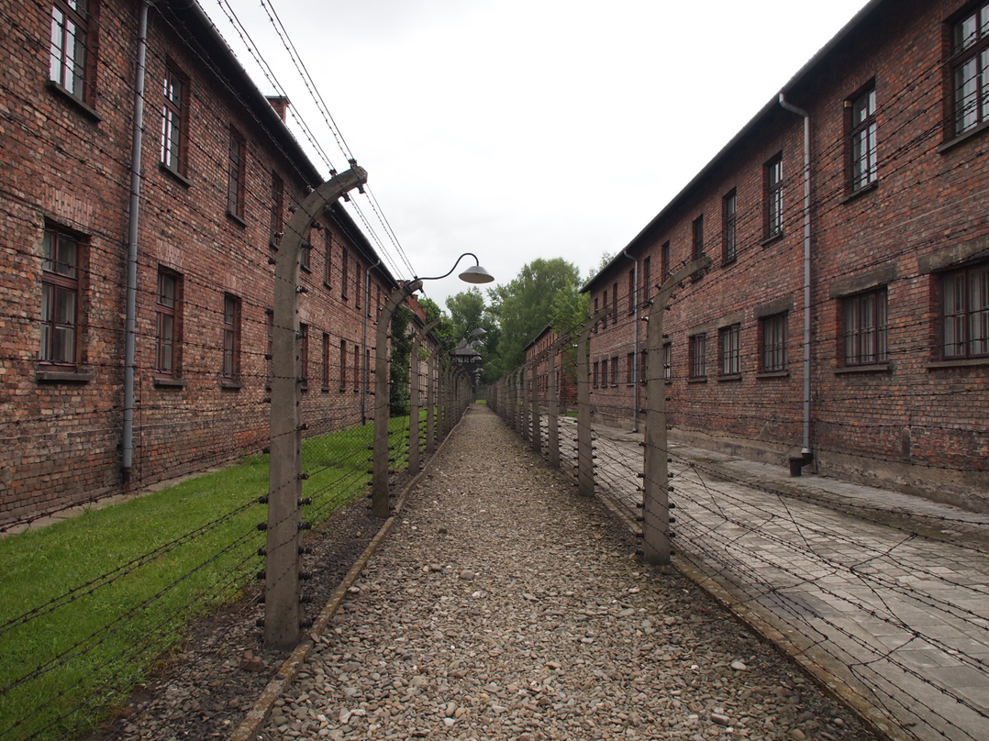
Auschwitz-Birkenau
(Flickr, Paul Arps (30.05.2014), CC BY-SA 2.0 Generic)
During the war, what is known now as Auschwitz-Birkenau became a concentration camp that consisted of three separate prisons camps called Auschwitz I, Auschwitz II and Auschwitz III. The overall complex housed an extermination camp, a labour camp, a transit camp and a concentration camp. These are just some of the buildings where the prisoners were held.

Slide 36
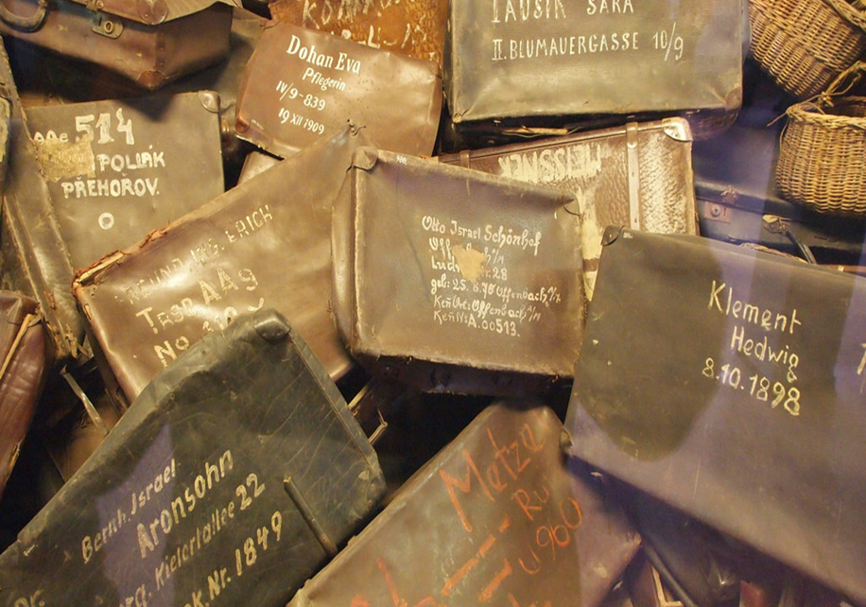
Extermination in Auschwitz II –Birkenau, 1941
(Flickr, Paul Arps in 2014, CC BY-SA 2.0 Generic)
This photograph was taken in Auschwitz. Before entering the concentration camp, the prisoners were told to mark their luggage for later identification. The owners’ names and dates of birth can be clearly seen marked on the suitcases.
Political prisoners first arrived at Auschwitz in May 1940. Extermination of inmates began in September 1941 but it was after the building of Auschwitz II – Birkenau that the systematic extermination programme was massively expanded. 1.1 million people died at Auschwitz II; 90% were Jewish. Many of those who were not gassed died of starvation, disease, medical experiments or exhaustion through forced labour.

Slide 37
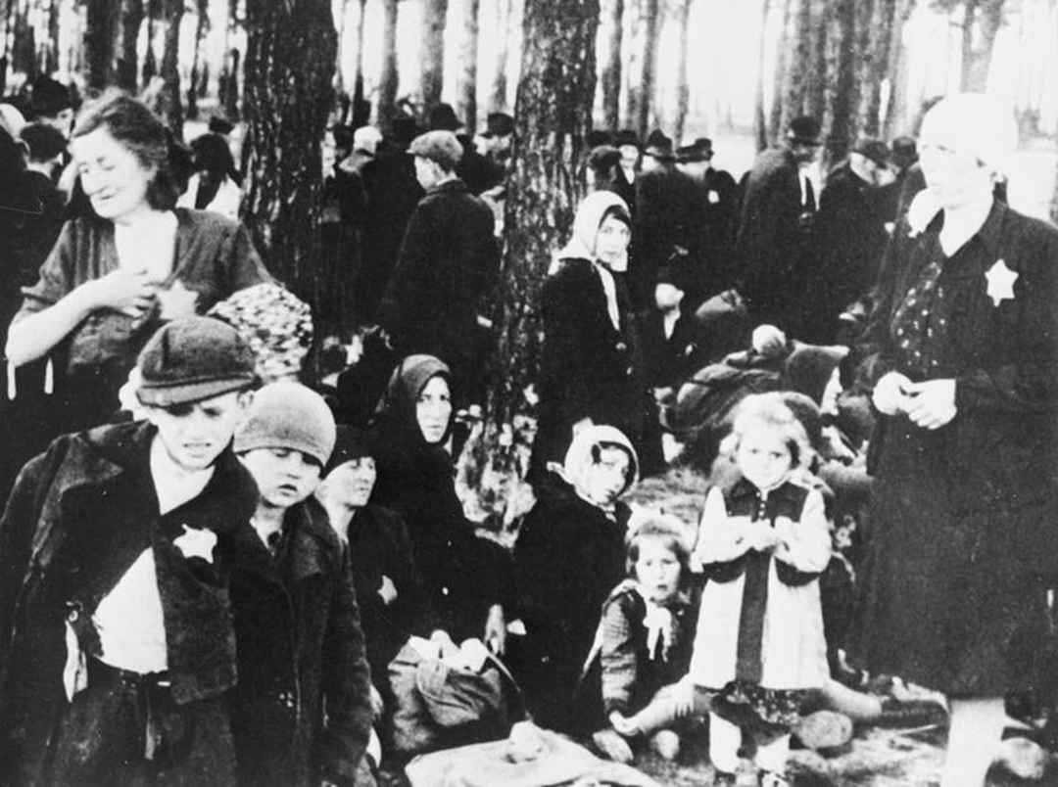
Hungarian Jews arriving at Auschwitz II-Birkenau camp, 1944
(Imperial War Museum, © IWM (HU 90295), Re-used under IWM Non Commercial Licence)
Hungarian Jews arriving at Auschwitz II-Birkenau camp, June 1944. The old and unfit men, women and children were separated from the men who were still fit to work. Then those who were unfit or unable to work had to wait in these pine woods next to Gas Chamber V before filing into the chamber to be gassed.

Slide 38
‘Remembering the atrocities’
“This false sense of security lasted 22 and half minutes. The sound of loud, distinct footsteps marching down the stairs outside broke up the murmur of congratulations and the family embrace. The wooden door was smashed down with a mighty fist. Then silence. The black silhouette of a German soldier transfixed our stares. We eyed him incredulously and each one of us was returned an individual menacing glare. One that bore a burning hole through our hearts. [...]
Every day another five thousand people slaughtered. Executed. Destroyed to nothing like the dust of the earth. People were no longer considered people; they became insignificant matter that had to be annihilated. Flames of light that had to be extinguished. Depression was ever living. No person dared become an acquaintance with another. For one day you would say hello. And the next, goodbye.”
A survivor of the Auschwitz extermination camp remembers the atrocities.
(Samantha Taylor, “WW2 People’s War: My Life Ended at Auschwitz” (2004) on the BBC website: WW2 People’s War.)

Slide 39
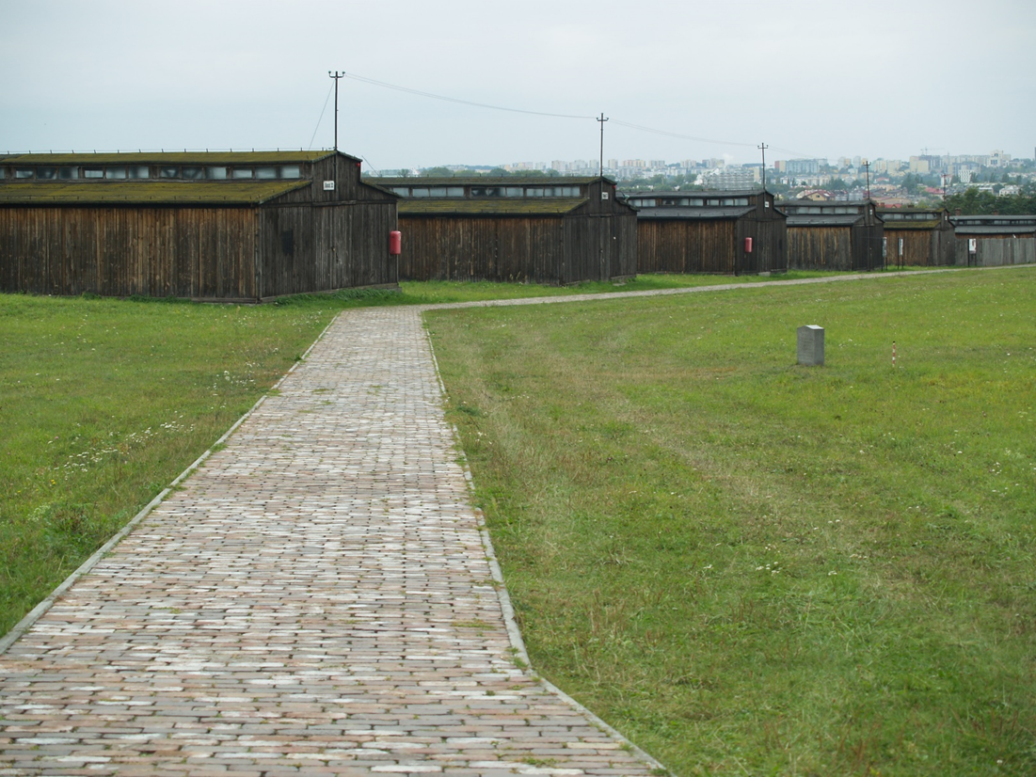
The Majdanek Concentration Camp, Poland
( Flickr, Catherine Bulinski (22.09.2012), CC BY-SA 2.0 Generic)
This is Majdanek Concentration Camp in Poland. Its was originally Konzentrationslager Lublin and was intended to house forced labour. During Operation Reinhard the camp was converted for extermination purposes. In 1943, the camp had 16206 prisoners of which 56% were Jews and 24% were non-Jewish Poles. The city of Lublin is just visible in the background to this picture. This was quite unusual. Most of the camps were located well away from urban areas.

Slide 40
Testimony by an inmate of Majdanek
“At first it was all very hard to take in, without an effort of the imagination. There were a number of very dull-looking concrete structures which, if their doors had been wider, might anywhere else have been mistaken for a row of nice little garages. But the doors - the doors! They were heavy steel doors, and each had a heavy steel bolt. And in the middle of the door was a spyhole, a circle, three inches in diameter composed of about a hundred small holes. Could the people in their death agony see the SS man's eye as he watched them? Anyway, the SS-man had nothing to fear: his eye was well protected by the steel netting over the spyhole...”
This is a description by a former prisoner of the buildings where the gas chambers were located chambers at Majdanek camp (also known as KL Lublin) in German-occupied Poland.
Extract from ("Inside a Nazi Death Camp, 1944" EyeWitness to History , www.eyewitnesstohistory.com (2004)).

Slide 41
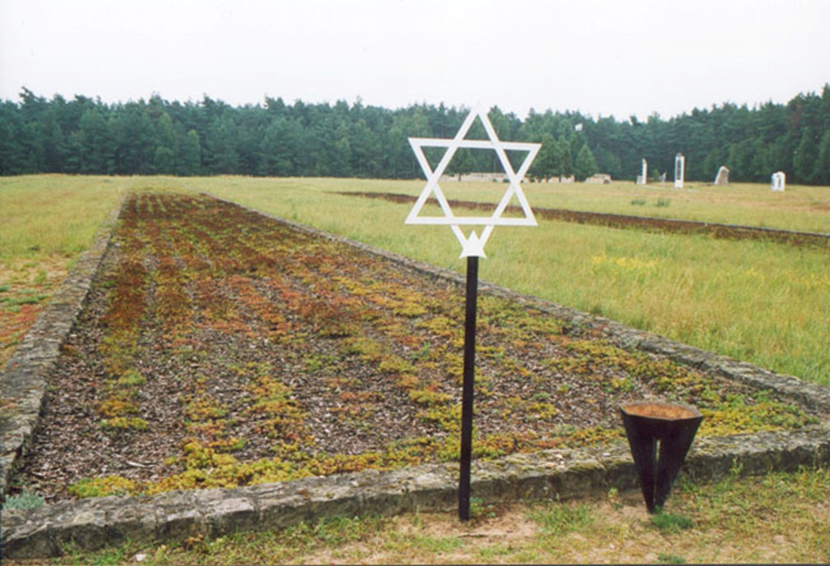
Mass grave at Chelmno extermination camp
(Wikimedia Commons, Jacques Lahitte, CC BY 3.0 Unported)
A contemporary picture taken from a mass grave at the Chelmno extermination camp. The camp was specifically set up for the purpose of extermination of Jews and other targeted groups.

Slide 42
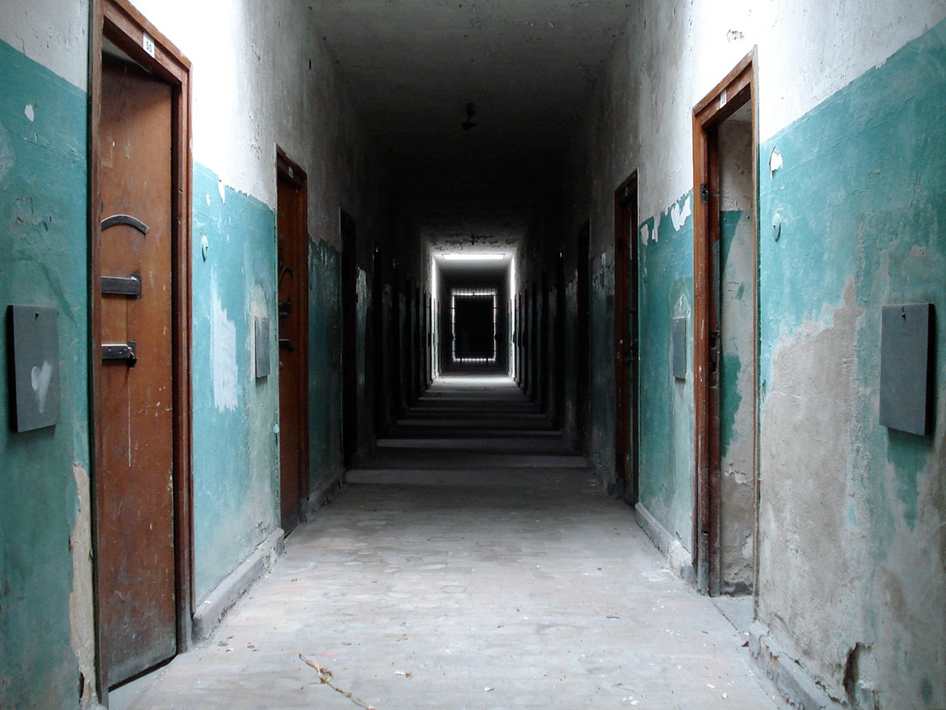
First concentration camp, Dachau, 1933
(Wikimedia Commons, Fijnlijn, Public Domain)
The process of gassing inmates was not confined to the six designated extermination camps. The necessary equipment for mass slaughter was also delivered to other concentration camps. Dachau was the first concentration camp established by the Third Reich. It was opened in 1933. At the beginning, it was intended for political prisoners (mainly communist) and to house forced labour. Some Jews were imprisoned there before the war as individuals but it was only from 1942 onwards that Jews were brought here en masse. A crematorium to speed up the extermination process was also built next to the camp in the same year.

Slide 43
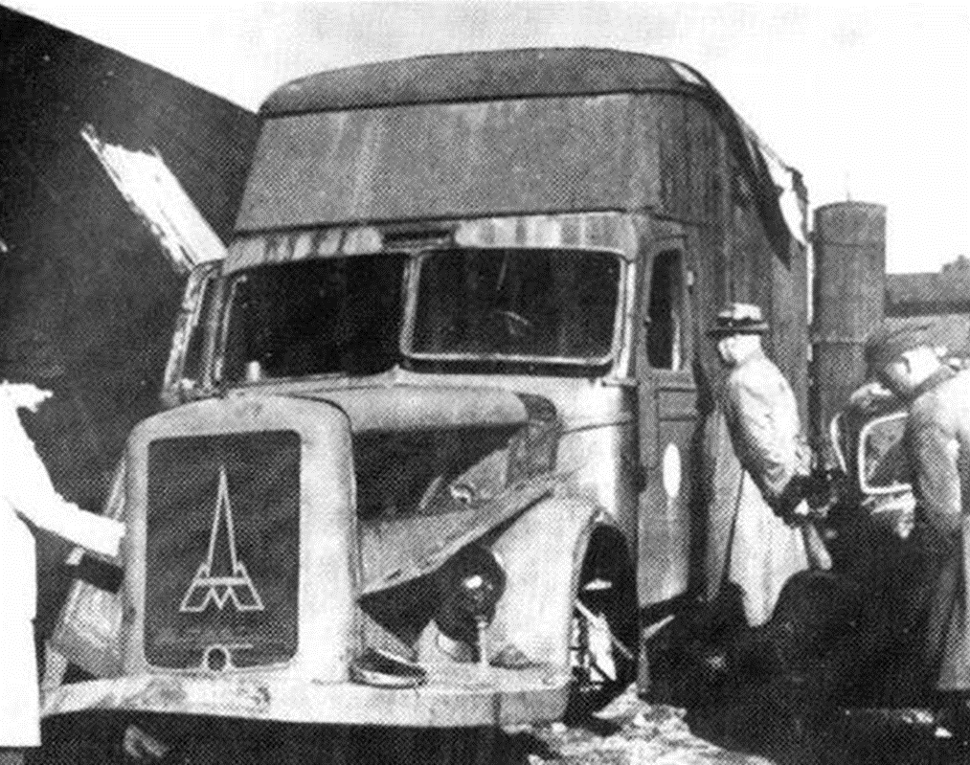
‘Mobile gas chambers’
(Wikimedia Commons, Public Domain in USA and Poland)
These gas vans were a type of mobile gas chamber where the victims were incarcerated in the van, the doors were locked and then they were gassed with carbon monoxide. These vans were used in the camps before the concrete gas chambers were installed. This one was found burnt out at the end of the war near the Chelmno extermination camp 50 km north of the Polish city of Łódź.

Slide 44
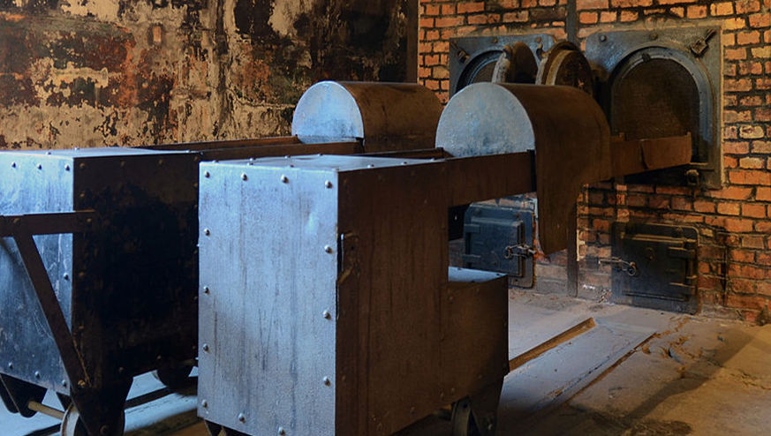
‘Crematorium’
(Wikimedia Commons, Marcin Bialek (15.09.2012), CC BY-SA 3.0 Unported)
This is a crematorium designed and constructed by J.A. Topf und Söhne that was used in Auschwitz-Birkenau. This German company were first contacted in 1939 by Nazi party officials to solve the problem of the large numbers of dead anticipated once the war began. The same company supplied other Concentration Camps as well.
Crimes against Humanity on the scale perpetrated in World War 2 cannot just be carried out by government and party officials, politicians and members of organisations like the SS and Gestapo. They are made possible because ordinary people and non-government organisations are willing not only to cooperate but to bid for contracts to facilitate those crimes. The victims were taken to the camps by the trains run by Deutsche Reichsbahn, the French SNCF, the Dutch NS, the Belgian SNCB, the Romanian CFR and the Hungarian MÁV. Firms like I.G. Farben provided the poisonous gas for the Gas Chambers. Topf Und Söhne provided the ovens to dispose of the corpses. All were complicit in the Holocaust.

Slide 45
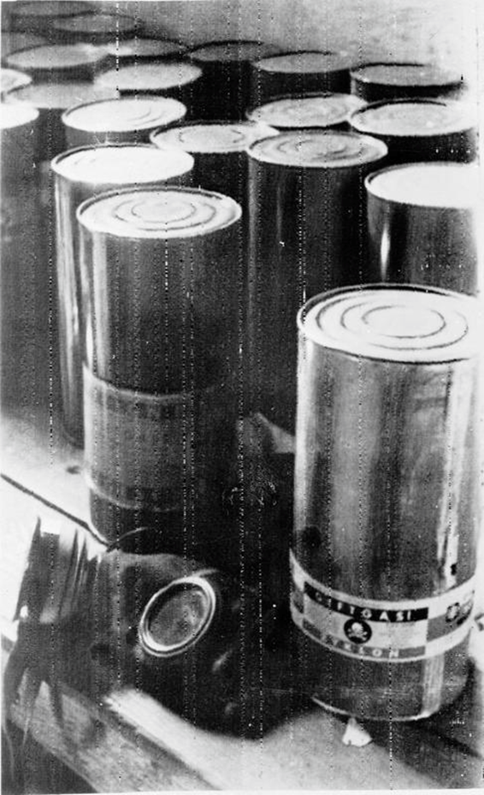
‘Gas pellets found at the Majdanek death camp, Poland’
Cans of Zyklon-B poison gas pellets found at the Majdanek death camp, Poland. The victim could neither see nor smell the gas. It had originally been developed as a pesticide by chemists Walter Heerdt and Bruno Tesch for a company called Degussa which was partially owned by one of the world’s largest chemical and pharmaceutical companies, I.G. Farben. Tesch was convicted and executed by military tribunal in 1945. But, amazingly, Zyklon B continued to be manufactured as a pesticide under the new name of Cyanosil until 1974. It was commonly used in Auschwitz-Birkenau and Majdanek.
(Imperial War museum, © IWM (RR 2206)), Re-used under IWM Non Commercial Licence)

Slide 46
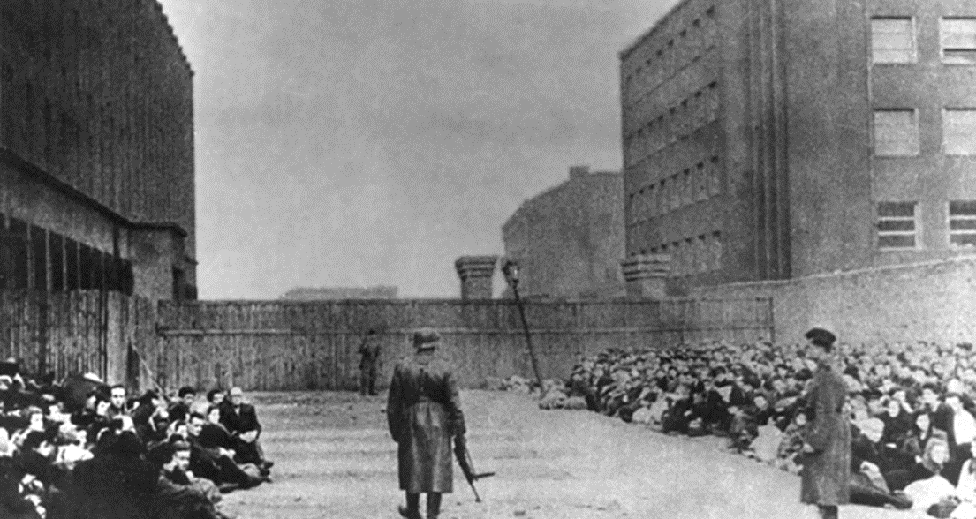
“Umschlagplatz”
Polish Jews are waiting in an “Umschlagplatz” (an area of the Warsaw ghetto where Jews were gathered for deportation) before they were transported to Treblinka extermination camp in 1943.
(Jarosław Marek Rymkiewicz, The Final Station: Umschlagplatz, Farrar, Straus, Giroux, 1994, Public Domain in Poland)

Slide 47
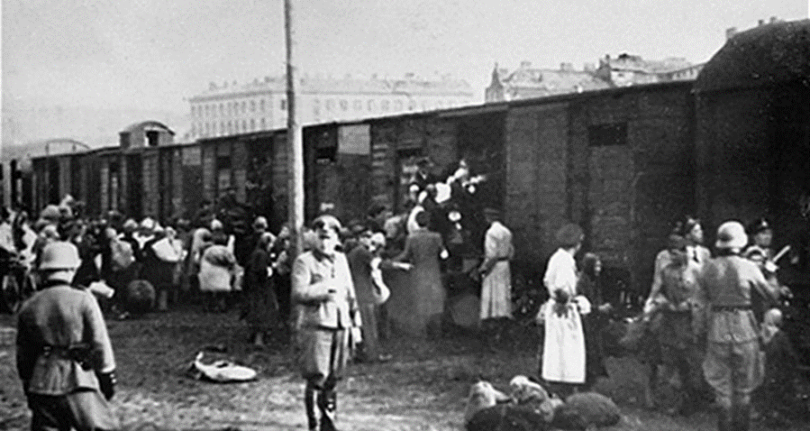
The Warsaw ghetto ‘’Umschlagplatz’’, 1942
The Umschlagplatz where ghetto inmates were gathered before being sent to the Camps were usually located near railway lines. Here we see Jewish families boarding the train at the Warsaw ghetto Umschlagplatz sometime in late 1942, early 1943.
(Wikimedia Commons, courtesy of the Jewish Historical Institute in Warsaw, Public domain in Poland & USA)

Slide 48
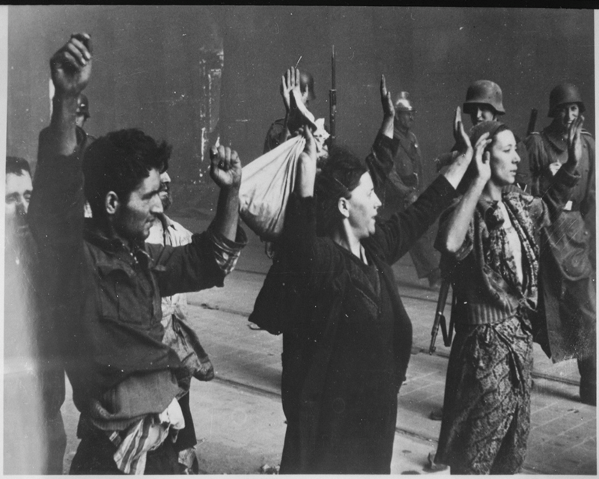
Jewish Armed Resistance in Warsaw Ghetto, 1943
Jewish resistance fighters captured during the Warsaw Ghetto Uprising.
(US National Archives & Records Administration, Public Domain in USA)
On 19 April 1943, the eve of Passover, some of the inmates of the Warsaw Ghetto began an armed resistance against SS guards and ghetto police which lasted 28 days. It was in reaction to the occupying authority’s decision to start the deportation of a large number of ghetto inmates to the camps, beginning on 19 April. As the SS guards entered the camp they were ambushed by young Jews. The resisters were armed with a variety of weapons, mostly handguns, which had been smuggled into the ghetto by Polish resistance fighters. They also used home-made weapons such as Molotov cocktails. In the end the resistance was broken but it sent a message to their captors and to an international audience which had been silent about their plight inspite of evidence of what was happening, that young Jews were not going passively to their deaths.

Slide 49
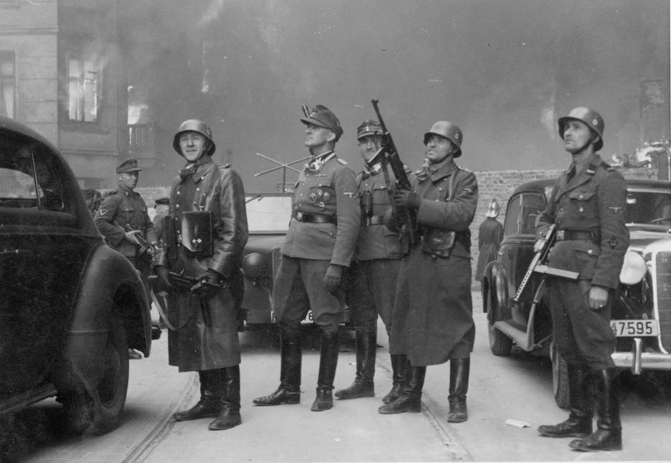
Suppression of Warsaw Uprising, 1943
SS Gruppenführer Stroop is fourth from the right. He personally pushed the button of the explosives that destroyed the Great Synagogue of Warsaw during the burning down of the ghetto.
(US National Archives and Records Administration, Public Domain in USA and Poland)
The main fighting between the SS and the Jewish resistance in the Warsaw Ghetto lasted 10 days. Polish resistance groups joined in to support Jewish resistance. But most of the leadership of the Jewish Military Union (ZZW) were killed on 29 April and after that some of the resistance fighters left the ghetto while others fought on in small groups. On 8 May the Germans attacked the dugout which served as the headquarters of the Jewish Combat Organisation (ZOB) and many of the ZOB leaders committed suicide rather than be taken. From that point on the SS, SD, Gestapo and local police, under the command of SS Gruppenführer Jurgen Stroop gradually regained control of the ghetto, systematically razing the buildings to the ground.

Slide 50
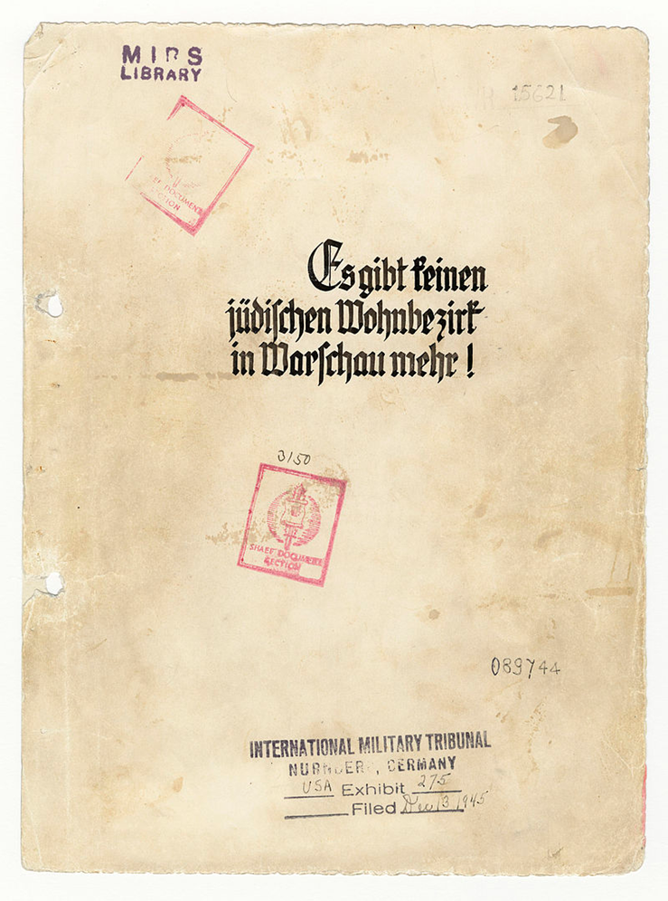
Reports by the SS, 1943
In May 1943, directly following the 28 day-long fighting and suppression of the Warsaw Ghetto Uprising, SS General Jurgen Stroop produced a report which was sent to Heinrich Himmler as a “souvenir” of the actions taken by the SS. The report contained 53 photographs, daily reports, lists of soldiers that were killed or wounded. One existing copy also contains some statistics about the possessions confiscated from the victims. The German title reads: “There is no Jewish Quarter in Warsaw anymore!”
(US National Archives and Records Administration, Public Domain in USA)

Slide 51
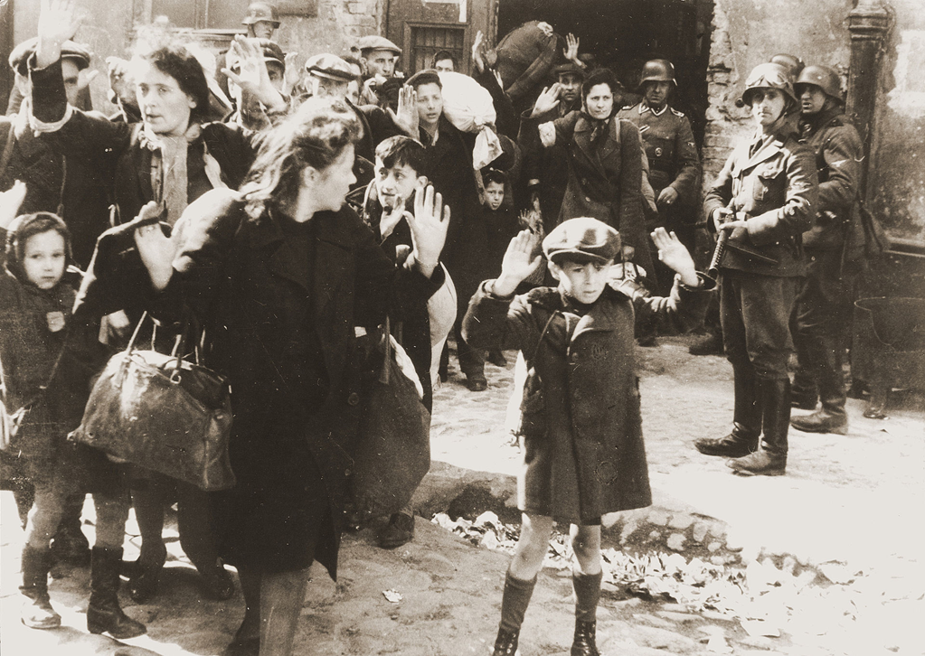
Jewish families sheltering during uprising, 1943.
(US Holocaust Memorial Museum, Public Domain in USA)
Jewish families being brought out of the cellars and dug-outs where they had been sheltering during the Warsaw Ghetto Uprising. This photograph was included in the Stroop Report sent to Heinrich Himmler.

Slide 52
Himmler’s speech, 1943
“I am talking about the "Jewish evacuation": the extermination of the Jewish people. It is one of those things that is easily said. "The Jewish people is being exterminated," every Party member will tell you, "perfectly clear, it's part of our plans, we're eliminating the Jews, exterminating them, ha!, a small matter." And then along they all come, all the 80 million upright Germans, and each one has his decent Jew. They say: all the others are swines, but here is a first-class Jew. And none of them has seen it, has endured it. Most of you will know what it means when 100 bodies lie together, when there are 500, or when there are 1000. And to have seen this through, and - with the exception of human weaknesses - to have remained decent, has made us hard and is a page of glory never mentioned and never to be mentioned. Because we know how difficult things would be, if today in every city during the bomb attacks, the burdens of war and the privations, we still had Jews as secret saboteurs, agitators and instigators. We would probably be at the same stage as 1916-17, if the Jews still resided in the body of the German people.”
Himmler discusses the on-going extermination of the Jewish people This is an extract of one of the two secret speeches he made, on 4 and 6 October 1943, and it was the first time that a leading Nazi had spoken of the ongoing extermination of Jews in the camps.
Translation of a part of the text of the speech. (Courtesy of the Bavarian State Library)

Slide 53
The victims
Although European Jews were by far the largest group of victims of the Holocaust, with almost 6 million dying in the camps and others surviving terrible deprivations, many other people also died in the camps. Nearly 2 million Poles died while others experienced years of slave labour in the camps, as did over 3 million Soviet prisoners of war, who were not protected under the Geneva Convention (although Germany as a signatory of that Convention should not have differentiated in its treatment of POWs.) Soviet POWs were usually sent to camps which were basically fenced off fields with no housing. Other Slavic groups were also sent to the camps, particularly from Yugoslavia. It is not clear just how many Romani peoples (Roma, Sinti and Lalleri) died in the camps. The lower estimate of Romani deaths is about one quarter of a million the upper estimate is 1.5 million. The death toll was formally recognised as genocide by the West German government in 1982 and the Polish government in 2011. People of African origin, colonial troops in occupied France and African-German babies born in the French occupied Rhineland, were sterilised and some were sent to the camps.

Slide 54
The victims - Continued
Political dissidents, whether they be socialists, communists or liberals opposed to National Socialism were rounded up and deported to camps, as were Spanish Republicans who had sought refuge in France after the Spanish Civil War. Religious groups were also singled out for deportation to the concentration camps. Roman Catholic and Protestant clergy unwilling to acknowledge the Nazi regime were sent to camps. Other faith groups such as the Jehova’s Witnesses and the Baha’i were banned in the 1930s and also sent to camps if they continued to practice their faith.
Finally, there were those regarded as degenerate and ‘asocial’ by the Nazis, including the physically and mentally disabled, homosexuals (allegedly because heterosexuality was essential to a high ‘Aryan’ birth rate) and Freemasons who were regarded by Hitler as part of “the Jewish Conspiracy”. The ‘asocials’ sent to the camps also included some criminals.
It is not possible in a small source collection to do justice to all of the victims of the Holocaust but we have tried to include a range of groups here.

Slide 55
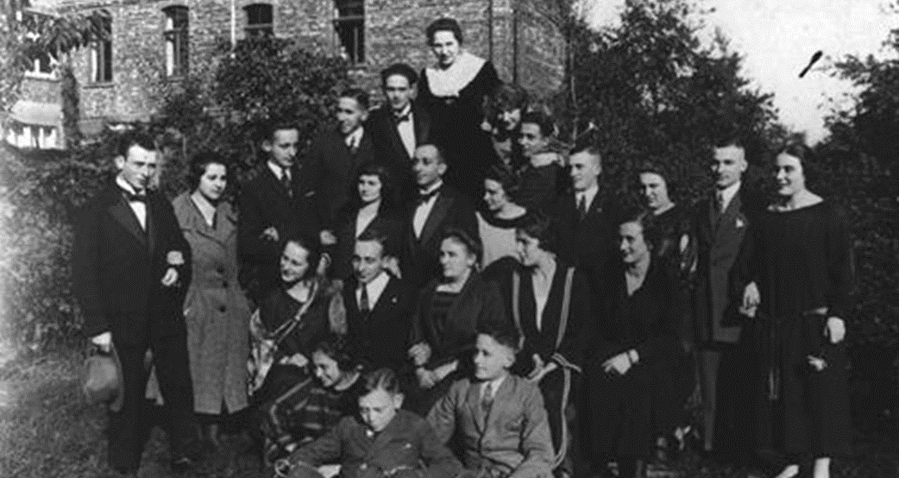
German families gathering, 1928
This is a photograph of two extended German Jewish families gathering together in 1928. Only two of them survived the Holocaust.
(United States Holocaust Memorial Museum, Washington DC, Free to use for educational purposes)

Slide 56
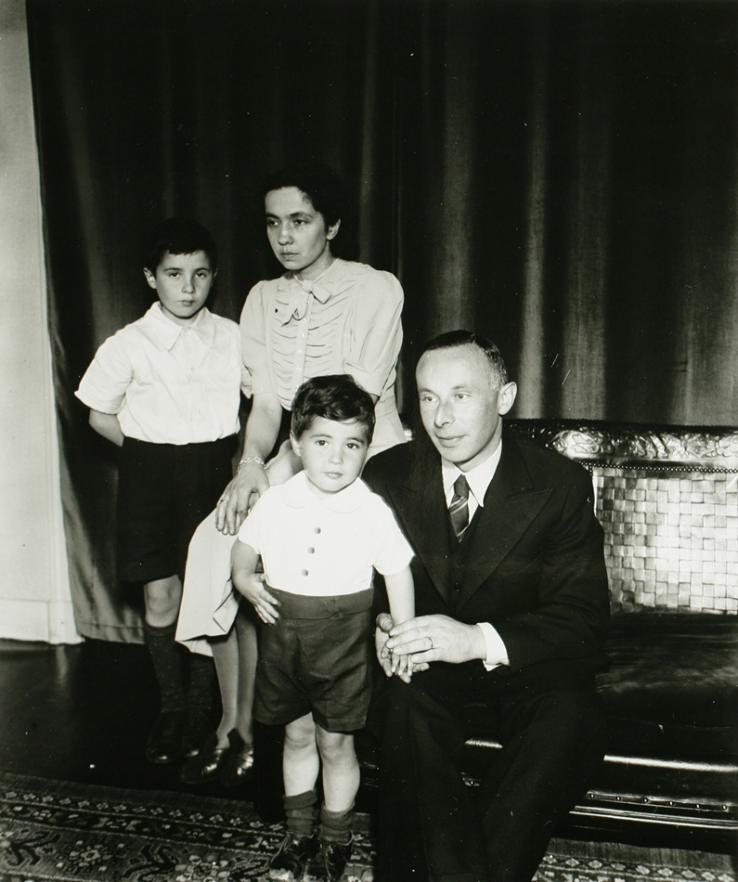
Dutch Jewish family, 1914
This picture, dated 25.07.1914, shows a Dutch Jewish family called Polak: father Felix, wife Gertrud de Jonge and two sons Johan Eric and Marcel. They all died in concentration camp Sobibor in July 1943. The surname Polak was (and is) one of the most common surnames for Jews in the Netherlands.
(Stadsarchief ‘s-Hertogenbosch Digitale Collectie via Europeana, CC BY-SA 3.0 NL)

Slide 57
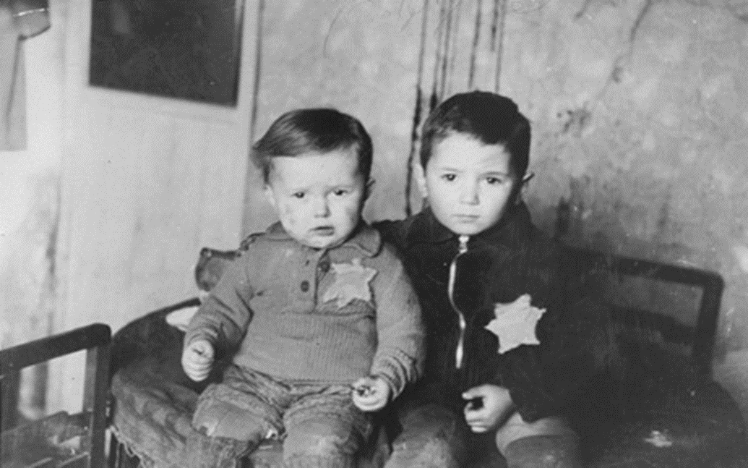
Two Jewish brothers, Kovno Ghetto in Kaunas, Lithuania, 1944
(United States Holocaust Memorial Museum, Washington DC, Free to use for educational purposes)
These two brothers are posing for a family photograph in the Kovno ghetto in Kaunas, Lithuania, in February 1944. This was only a month before they were deported to the concentration camp at Majdanek. The Kovno ghetto was used by the Germans for forced labour. Because births were forbidden in the ghetto, it is possible that they were born illegally.

Slide 58
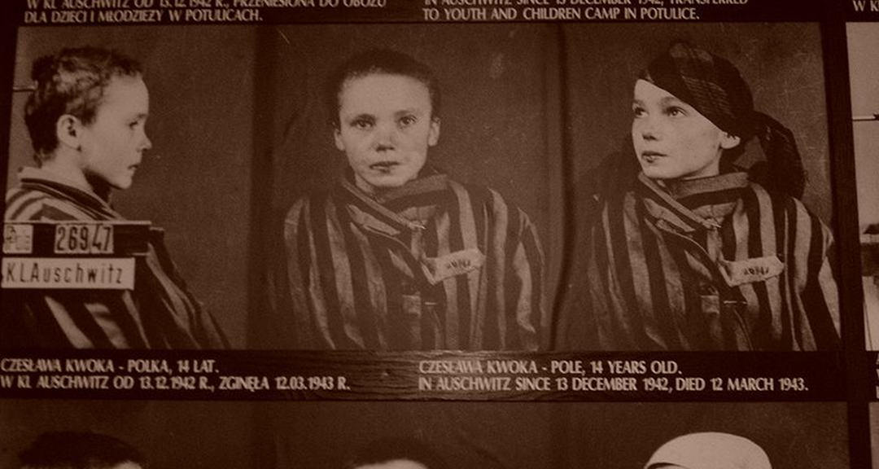
Czeslowa Kwoka
This is a triple picture taken for identity purposes of a 14-year old Polish girl in Auschwitz-Birkenau, 1943. Her name was Czeslowa Kwoka.
(Wikimedia Commons, Public Domain in Poland)

Slide 59
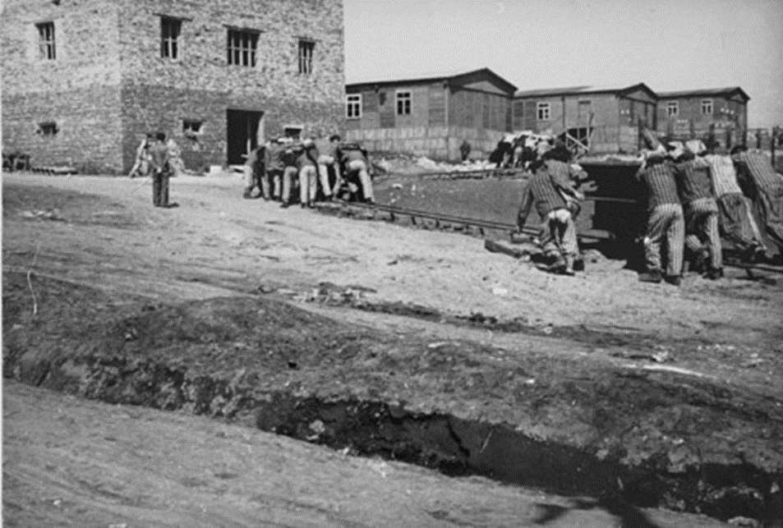
Forced labour camp, Plaszow, Poland
Forced lasblour at Plaszow concentration camp, near Krákow in Poland.
(United States Holocaust Memorial Museum, Washington DC, Free to use for educational purposes)
Not all of the Jewish people rounded up and deported went immediately to one of the six main Extermination camps. Some were sent to forced labour camps, like these inmates of the Plaszow camp in Poland. The camp was mainly populated with Polish Jews sent from the Krákow ghetto in 1943. The Austrian director of he camp, SS Hauptsturmführer Amon Göth had a reputation for being one of the most sadistic camp commandants in occupied Poland (a considerable feat given the competition). Many inmates died of exhaustion, disease, malnutrition and also arbitrary shootings.

Slide 60


Soviet prisoners of war at Mauthausen Concentration Camp, 1941
The top photograph shows a group of Soviet prisoners of war who have just arrived at Mauthausen Concentration Camp in October 1941. The second photograph shows a group of Soviet prisoners of war, also at Mauthausen, some time later in the war. The images tell their own story and need no further comment from us.
(German Federal Archives, Bundesarchiv, Bild 192-096, CC-BY-SA 3.0)
(German Federal Archive,Bundesarchiv, Bild 192-208 / Unknown, CC-BY-SA 3.0)

Slide 61

Medical experiments
(United States Holocaust Memorial Museum, Washington DC, free access for educational purposes)
Many of those identified by Nazi ideology as “lesser races and degenerate groups” were not only rounded up for mass deportation and extermination, they were also subjected to inhuman medical experiments. This photograph, taken in Dachau Concentration Camp in 1944, shows a Romani man being subjected to tests to see if salt water could be made drinkable.

Slide 62

Nazi propaganda
(United States Holocaust Memorial Museum, Washington DC, free access for educational purposes)
This image was taken from a Nazi propaganda film. The aim of the film was to show that incarcerated patients that suffer from mental or physical illnesses are people that “live without hope”. The aim was to persuade German public opinion that the Third Reich’s policy and programme towards the mentally and physically disabled was merciful. The policy was only possible with the collaboration of some of the doctors working in local communities.

Slide 63

Nazi euthanasia programma and Psychiatric hospitals
(Holocaust Education & Archive Research Project, Public Domain in Germany & USA)
Many of the adults who were victims of the Nazi Euthenasia Programme, Aktion T4, were killed in psychiatric hospitals like this one at Kaufberen in Swabia, Bavaria. According to the records of this hospital around 2000 patients were murdered between 1940 and 1945. The Director was Valentin Faltlhauser who was also a designated Aktion T4 assessor. After the war he was sentenced to 3 years imprisonment for his role in Aktion T4 but the sentence was postponed and in 1954 he was pardoned.
The sign in the hospital garden reads: "Place to heal and cure”.

Slide 64

‘Widernatürlicher Unzucht’’, 1944
This is a documented order to imprison the accused man because he had allegedly committed “unnatural sodomite acts” (Widernatürlicher Unzucht).
(Russian State Archives of Film and Photo Documents, United States Holocaust Memorial Museum, Washington DC, Free access for educational purposes)

Slide 65

Homosexual “crimes”
(Schwules Museum Berlin, United States Holocaust Memorial Museum, Washington DC, Free access for educational purposes)
These are the identification pictures of a prisoner in Auschwitz-Birkenau. He was accused of homosexual “crimes” and did not survive Auschwitz. Prisoners accused of homosexual actions, like many other prisoners, were also used by the Nazis to experiment on. They believed that it was possible to find a “cure”. Sometimes, the prisoners did not survive these experiments, or the experiments resulted in sickness or mutilation.

Slide 66

Dachau camp crematorium, 1945
This photograph was taken at Dachau concentration camp in April 1945 after the camp had been liberated. It shows the human remains left in the camp crematorium after the dead bodies had been burned.
(United States Holocaust Memorial Museum, Washington DC, Free to use for educational purposes)

Slide 67

Mittelbau-Dora camp, Germany, 1945
Another photograph taken at a concentration camp after it was liberated in April-May 1945. This camp is Mittelbau-Dora, near Nordhausen in Germany. Two inmates who have survived the Holocaust stand by the pits that are full of human ash.
(United States Holocaust Memorial Museum, Washington DC, Free to use for educational purposes)

Slide 68

Liberation and the Red Cross, 1945
(US Holocaust Memorial Museum,Public Domain in USA)
This is a picture of a former prisoner in the Hannover-Ahlem sub camp of the Neuengamme concentration camp near Hamburg, taken on 11 April 1945. Of course it was impossible for the Red Cross during the war to help people that were sent to the extermination and labour camps. However, after the liberation, they played a large role in helping the liberated prisoners in the camps, like this man in the picture taken on 11 April 1945.

Slide 69

“Die Rampe”, 1980
This Holocaust memorial in Kassel, Germany, “Die Rampe”, was created in 1980 as a tribute to the victims of the Holocaust who were deported by train to the concentration camps. The artist, Renee Nele from Germany, witnessed the deportations herself on a daily basis during the war.
Mostly the victims were transported in freight or cattle boxcars under terrible conditions and many of them were found dead on arrival at their destination camps.
(Wikimedia Commons, Dietmar Walberg (2007), CC-BY-SA-2.5 Generic)

Slide 70

Victims of Arrow Cross Militiamen
A description at the site of this memorial states: “to the memory of the victims shot in the Danube by Arrow Cross Militiamen in 1944-1945”. Towards the end of the war the extermination programmes intensified: sometimes people were not deported to the camps but, as in this case, forced to strip off their clothes, and then shot and their bodies disposed of in the river. 3500 people were killed in this way, 800 of them Hungarian Jews. These iron shoes cemented to the bank of the Danube represent the victims.
(Wikimedia Commons, Nikodem Nijaki (01.01.2012), CC BY-SA 3.0 Unported)

Slide 71

Liberating surviving inmates of the Bergen-Belsen concentration camp
After liberating the surviving inmates of the Bergen-Belsen concentration camp the camp was set on fire, probably by the allied forces in order to prevent the spread of disease and infection.
(Welcome Images via Europeana,CC BY-NC-ND 4.0)

Slide 72

Child survivors of Auschwitz , 1945
Child survivors of Auschwitz filmed by the First Ukrainian Front film unit in early 1945. The children are wearing adult-sized clothes.
(US Holocaust Memorial Museum, courtesy of Belarusian State Archive of Documentary Film and Photography, Public Domain)

Slide 73

Holocaust Denial
Immediately after the war some historians denied that the Holocaust had taken place or denied the extent of the killing. One such, American historian Harry Elmer Barnes, expressed the view that the allegations were similar to those against Germany in the 1st World War which were later shown to be propaganda. The French journalist, Paul Rassinier, made similar claims, and, for a while, his views were given credence because he had been an inmate in Buchenwald and Mittelbau-Dora. More recently, some European and Middle Eastern politicians have also denied the Holocaust. In 2001 the American historian Deborah Lipstadt was sued for libel by David Irving who had written several books which, she claimed, showed him to be a Holocaust denier. At the trial the British historian, Richard J. Evans, acted as expert witness for Lipstadt and her publisher and after she won the case he published his analysis of the evidence in the book: Lying About Hitler. It is a good starting point for anyone who wishes to critically analyse the case made by the deniers. Here we have reproduced an extract from the confession made in 1946 by SS Obersturmbannführer Rudolf Höss, commandant of Auschwitz. In it he admits: "I declare herewith under oath that in the years 1941 to 1943 during my tenure in office as commandant of Auschwitz Concentration Camp 2 million Jews were put to death by gassing and a 1/2 million by other means.”
(United States Holocaust Memorial Museum, Washington, DC)

Slide 74
Those who tried to help
It is possible that some people living in Germany, Austria and the occupied territories did not know what was happening to their neighbours when they suddenly disappeared from the neighbourhood. It is also possible that many people knew but felt powerless to do anything about it. It is certainly also likely that many were indifferent to the fate of the victims and even, on anti-Semitic or other ideological grounds, approved of the actions taken against the Jews and other peoples by the Third Reich. It is also clear that some people directly benefitted from the Holocaust by acquiring the property of those who had been deported to camps or by winning contracts that provided services to the Holocaust machine. Similarly, though it is clear that the governments of the Allied powers knew what was happening, certainly by 1942 if not earlier, it is possible that many ordinary people in unoccupied Europe and elsewhere in the world did not know what was happening or did not know the scale of the Holocaust during the war.

Slide 75
Those who tried to help – Continued
However, some people did know and, at great risk to themselves, tried to do something about it. The World Holocaust Remembrance Centre, Yad Vashem, located in Israel has identified those people who acted to save the persecuted as ‘The righteous among the Nations’. Some did so instinctively, some did so for idealistic reasons. Most of them were ordinary people. In Germany and the occupied territories the action of sheltering Jews and helping them escape from the SS meant not only arrest and execution but often meant the same fate for the rest of their family as well.
We cannot hope to do justice to these people in a source collection that seeks to cover many aspects of the Nazi Extermination Programmes but we can at least give acknowledgement to some as representatives of the many more who “stood up to be counted”.
(For more information see: http://www.yadvashem.org/righteous)

Slide 76

Irena Sendler
Irena Sendler (codename: Jolanta) was a Polish nurse living in German-occupied Warsaw during the war. She was also in the Polish resistance and within the resistance was head of the children’s section of Żegota, the Polish Council to Aid the Jews. With the assistance of her comrades she provided around 2500 Jewish children with false identity papers and then smuggled them out of the ghetto usually to be placed with foster parents or church-run orphanages. Sadly many of the children were eventually captured and sent to Treblinka.
She herself was arrested by the Gestapo, tortured and sentenced to death. Somehow she managed to avoid execution and survived the war.
(Wikimedia Commons, Public Domain in USA)

Slide 77

George Ferdinand Duckwitz
Georg Ferdinand Duckwitz was a diplomat within the Foreign Office of the Third Reich who was based in Copenhagen in German-occupied Denmark. When he learned from his boss that Danish Jews were to be deported on 1 October 1943 he tried to get the deportation stopped through official channels in Berlin. When this failed he contacted the Swedish Prime Minister, Per Hansson, who agreed to accept Jewish refugees from Denmark. He then informed a Danish contact of the intended deportation who, in turn, passed on this information to the Jewish community. With the help of Danish people over 7200 Jews escaped by sea to Sweden before they could be rounded up for deportation.
(German Federal Archive, CC BY-SA 3.0 unported de)

Slide 78

Raoull Wallenberg
Raoul Wallenberg, an architect by profession, was Sweden’s special envoy to Budapest between July and December 1944. By this time over 400000 Hungarian Jews had been deported to the extermination camp at Auschwitz-Birkenau in Poland. When Wallenberg arrived another mass deportation was being planned. He and a colleague, Per Anger, issued Swedish “protective passports" to Hungarian Jews indicating that they were Swedish citizens waiting for repatriation to Sweden. These were not legal documents but were often accepted to be so by the German and Hungarian authorities. Wallenberg also rented 32 buildings around Budapest for Jews to shelter in and he put up notices outside the buildings that they were under the protection of the Swedish Embassy and designated as Swedish territory. He, himself, slept in a different place every night to avoid capture by the Gestapo or the Arrow Cross militia. During a prolonged siege of the city by the Red Army Wallenberg was called to the Red Army HQ at Debrecen where he was accused of espionage. He was sent to Moscow where he died in the Lubyanka prison in 1947. Some reports say he died of a heart attack, others that he was executed by the NKVD.
Raoul Wallenber’g passport photograph, 1944
(US Holocaust Memorial Museum, Public Domain in USA & Sweden)

Slide 79


Oskar Schindler
Oskar Schindler, was an ethnic German born in the Sudetenland (now part of the Czech Republic). During the 1930s, while living in Czechoslavakia, he joined the National Socialists and also spied for the German Abwehr. By the beginning of the war he owned a factory in Kraków making enamelware. By 1944 he employed 1750 workers of whom about 10000 were Jews. When Jews in Kraków were deported to Belżec extermination camp he managed to get exemptions for those who were working for him. As the Red Army advanced westwards the German authorities began closing factories that were not involved in war production. Schindler was advised to stop making enamelware and start making anti-tank grenades. As the Red Army got even nearer he persuade the authorities to let him move his factory to Brünnlitz (Brnenec in the Czech Republic). His Jewish workers moved with him. He also arranged for around 3000 Jewish women to be transferred from Auschwitz to work in textile factories in the Sudetenland.
Schindler’s factory in Brünnlitz
(wikimedia Commons, Miaow Miaow (2004), CC BY-SA 2.0 generic).
Schindler’s factory in Kraków
(Wikimedia Commons, Jennifer Boyer (2011), CC BY-SA 2.0 generic)

Slide 80

Angel Sanz-Briz
Ambassador Angel Sanz-Briz, the man on the left of this photograph, was a Spanish diplomat who saved thousands of Hungarian Jews during the war. He was posted to Budapest in 1942. When, in 1944, the German army invaded the country and the infamous Adolf Eichmann arrived to supervise the extermination of Hungarian Jews, Sanz-Briz used his diplomatic status to provide Sephardic Jews (those whose ancestors originally came from Spain) with Spanish passports. The puppet Hungarian government agreed that he could issue 200 passports as long as these 200 Jews were sent to Spain at the expense of the Spanish government. He managed to send far more Sephardim to Spain this way by issuing passports where the reference number never exceeded 200. He also provided many non-Sephardic Jews with travel documents to Spain. In addition, in Budapest he rented several buildings at his own expense and designated them as annexes to the Embassy. These provided safe accommodation for Jews waiting to go to Spain because the SS and Gestapo could not enter a foreign embassy.
Ambassador Angel Sanz-Briz on 9 July 1969.
(Dutch National Archive, CC BY-SA 3.0 NL)

Slide 81

Turkish Diplomats
(Wikimedia Commons, Public Domain in Israel)
Turkey remained neutral during the Second World War. However, some Turkish diplomats posted to different countries in occupied Europe were able to save Jews from the Nazis by providing them with visas to Turkey like the one here issued 1 January 1943.

Slide 82
Soviet deportations & exterminations, 1930-1945
It was not only the Germans who carried out deportations, massacres and deaths within labour camps on a massive scale. The Soviet Union also carried out similar atrocities and abuses during the war. About six million people from Lithuania, Latvia, Estonia, Finland, Poland as well as the Chechnyans, Ingush and Crimean Tatars were deported to labour camps in Siberia or Kazakhstan. Around 1.5 million of them died from disease, malnutrition and forced labour.
This process had actually begun before the war, with the deportation to Siberia and Central Asia of around 1.8 million kulaks – the more affluent farmers who were resisting the collectivisation of the farms. In the late 1930s there had also been deportations of Poles who were living in the west of the Soviet Union. After the Soviet invasion of eastern Poland in 1939 the deportations intensified. The mass deportations within the USSR and from the territories occupied by the Red Army intensified during the war and continued beyond the end of the war. These are covered in greater depth in two more of our Source Collections: ’Deportations and Forced Labour’ and ‘The Aftermath of War: People on the Move’.

Slide 83
Soviet deportations & exterminations, 1930-1945 - Continued
This current Source Collection has focused predominantly on the extermination programmes of the Third Reich. We accept that both the Nazi and Soviet Regimes in the 1930s and ’40s were responsible for population deaths on an almost unimaginable scale. Following Professor Omer Bartov, we have taken the line that the only main difference is that the Nazis adopted a systematic programme of eradication of certain biological groups deemed to be ‘Untermenschen’ or ‘degenerate’ who, it was believed, would undermine the so-called ‘racial purity of the Aryan peoples’. This was not a part of Stalinist or communist ideology. Their mass deportations were part of a policy of population movement. In some cases, the outcome was not that different. Nearly 50 per cent of the people deported by Soviet authorities died during the process or in the labour camps. And in the case of the movement of the Chechens the European Parliament proclaimed the outcome as ‘genocide’ in 2004. However, we have opted for focusing here on the development of the extermination policies and practices of the Third Reich while looking at the deportation policies and practices of the Soviet Union elsewhere on this website.

Slide 84

Collectivisation in Soviet Union, 1927
By 1927 it was clear that Soviet agriculture was not producing enough to feed the population. Famine made the situation worse. The Kremlin decided that small landholdings should be merged into larger collective farms. Voluntary collectivisation was introduced. This didn’t work and two years later collectivisation was made compulsory. This was still resisted, particularly by those with the most productive land or livestock. Some of these more prosperous peasants, the ‘kulaks’ burnt their crops or killed their livestock rather than collectivise it. Others were accused by the Kremlin of hoarding grain to increase the price. With another famine in 1930 leading to many deaths and disease Stalin declared war on the ‘kulaks’ saying that they should be “eliminated as a class”. This resulted in around 1.8 million being sent to labour camps after their property had been confiscated and many others were executed. This is one of the posters produced at the time with a fat kulak being punched in the back by a large fist representing the state. The title is ‘Away with private peasants!’
Away with private peasants!
(Flickr from Library of the London School of Economics (2007), Public Domain in USA.)

Slide 85

‘’The Killing by Starvation’’, 1930s
Starving peasants on the streets of Kharkiv, Ukraine in 1933.
(Wikimedia Commons, Alexander Wienerberger (1933), Public Domain in Austria)
The Soviet Union was hit by a series of severe famines in the early 1930s. These were, in large part, directly due to Stalin’s forced collectivisation policy. One of the republics most badly hit in the USSR was the Ukrainian Soviet Socialist Republic. As one of the most productive agricultural regions there had been strong resistance to collectivisation. Stalin saw the famine as an opportunity to both break the resistance to his policy and crush post-revolutionary Ukrainian nationalism which he saw as anti-Soviet. The result was the Holodomor – literally ‘the killing by starvation’. Estimates of the number of deaths through the famine and famine-related diseases vary greatly due to lack of good records. But latest estimate indicate that it may have been around 10 million.

Slide 86

Massacre in the Katyn Forest, 1939
This picture of the site of the massacre in the Katyn Forest was taken by a German official photographer on 30 April 1943.
(Imperial War Museum,© IWM (HU 106211), Re-used under IWM Non Commercial Licence)
The Soviet Union invaded eastern Poland in 1939 just 16 days after the Third Reich had invaded western Poland. Like the Gestapo the Soviet security police, the NKVD, also targeted the Polish elite and took many officers, civilians and soldiers prisoner. In April and May 1940, many of them were murdered. The most infamous location where they were buried was the Katyn forest. The number of victims is estimated to be around 22000. When Berlin received reports of bodies being found in the forest Goebbels recognised the propaganda value of denouncing the USSR and even brought in neutral Red Cross observers to investigate. The Kremlin denied the claim and blamed the SS for the killings. It is not 2004 that an investigation by officials of the Russian Federation confirmed Soviet responsability for the massacre but denied that it was a war crime.

Slide 87

Katyn Massacre, 1939
This map shows that part of Poland that was occupied by the Soviet Union in 1939 and the routes along which Polish people were deported to the Soviet Union. Six places are identified as certain locations of massacres, including the Katyn forest, and two other places are marked where there is circumstantial evidence that further massacres may have taken place.
(Polish Institute of National Remembrance, Wikimedia Commons, CC BY-SA 4.0 International)

Slide 88

Operation Barbarossa, 1941
On 22 June 1941 the Third Reich launched Operation Barbarossa against the Soviet Union. The advance was rapid and by 28 June German forces were attacking Lviv in eastern Poland (now Ukraine). Many ethnic Poles had already been deported further east by the NKVD, others were in temporary prisons waiting for deportation. These were now killed by the NKVD because they no longer had time to arrange for their deportation. It is estimated that around 4000 Poles were killed.
Here we see the civilian survivors looking for family members amongst the dead.
(Wikimedia Commons, Public Domain in USA)

Slide 89

Massacre of ethnic German and Austrian minorities, 1941-43
Here we see their relatives trying to identify dead family members.
(German Federal Archive, Bundesarchiv, Bild 146-1981-150-34A, Hübner, CC-BY-SA 3.0)
The city of Ternopil (Tarnopol) in Western Ukraine had an ethnic German and Austrian minority that could be traced back to the time when the city was part of Habsburg Galicia. In addition to ethnic Poles who had been rounded up in the city for deportation to the USSR the NKVD had also rounded up members of the German minority. Now, on 10 July 1941 as German forces advanced towards the city, the NKVD massacred the ethnic Germans they were holding.
It is an indicator of the horror and brutality of the war in occupied Poland and Ukraine in 1941-43 that no sooner had German forces occupied Ternopil than the SS began rounding up Jews for deportation to the Extermination camps.

Slide 90

Soviet deportations and ‘’anti-Soviet elements’’, 1939-40
This photograph shows Latvians being taken to the Soviet Union in freight trucks in June 1941.
(Wikimedia Commons, Public Domain in Russia)
In addition to the deportation and massacres of Poles and ethnic Germans during the Soviet occupation of eastern Poland in 1939-40, so-called “anti-Soviet elements” amongst the populations in the Soviet-occupied Baltic states were also identified for deportation. The men were sent to the penal labour camps of the Gulag in Siberia. The women and children were sent to forced settlements in remote areas of the USSR where they had to fend for themselves. In June 1941, thousands of Latvians, Estonians and Lithuanians were forcibly deported in this way. The mortality rate amongst the deportees was very high.

Slide 91

Internal deportations in the USSR, 1942-1944
(Wikimedia Commons, Visem (2016), CC BY-SA 4.0 International)
Between 1942 and 1944 there were also internal deportations enforced on ethnic minorities in the USSR, such as the Kalmyks, the Crimean Tatars, the Black Sea Germans, Finns, Chechens, Ingush, Koreans and others.
This picture shows the memorial commemoration in Kiev of the Crimean Tatars. In May 1944 around 230000 Tatars were deported to Uzbekistan. According to the Kremlin at the time this was a punishment for collaboration with the Nazis when they occupied the Ukraine in 1942-43. Estimates of the number who died in exile or during the deportation vary from the NKVD figure of 30000 to an estimate of over 100000 by Tatar sources as reported by historian Mark Levene in The Crisis of Genocide, Vol 2, OUP (2013) p.333.

Slide 92




Extermination Programmes
This source collection was created by Bob Stradling of the Historiana editing team.
(United States Holocaust Memorial)

