Slide 1
The Second World War was a total war, causing devastation on a scale never before seen. Already in the early phases of the war, in 1939-1942, the technologies of modern mass warfare caused huge destruction of cities and infrastructure, such as the bombing of Rotterdam, the London ‘Blitz’ and the utter devastation caused by the siege of Leningrad and the Battle of Stalingrad. By the final phase of the war in 1943-45, the techniques of mass bombing had been so perfected that it was possible to reduce living cities to ruins in a single bombing raid: as with the firestorms that obliterated Tokyo and Dresden, and the atomic bombs that destroyed Hiroshima and Nagasaki. Had the war lasted longer, new scientific weapons, such as the V3 rockets developed in Nazi Germany might have taken devastation to even more terrible extremes.
In 1945, the starkest examples of devastation were the ruins of defeat: the impossibility of making a negotiated peace meant that the war had continued to the bitter end, with destruction piled on destruction long after the outcome was certain. But devastation was also the price of victory: the liberation of occupied Europe was only achieved at the cost of widespread death and destruction in cities like Caen and Warsaw. But devastation was also a matter of lost communities, of people removed forever from where they had always belonged, such as the Roma communities, or the Jewish shtetls of Eastern Europe, or the vibrant cultural life that had existed in pre-war Budapest and Vienna. Along with the physical ravages of war, there was devastation of culture and ideals.
Reconstruction of the post-war world after the terrible devastation of the war presented a huge challenge. Destroyed and damaged buildings could be rebuilt. But it was not only necessary to find massive resources to rebuild from the ruins of war; it was also necessary to create new political structures and multinational arrangements to rebuild shattered ideals.

Slide 2
The ruins of defeat
The Axis Powers were destroyed by the world war they had launched, and had seemed to be winning until the tide turned in 1943. Fascist Italy escaped relatively lightly by overthrowing Mussolini and changing sides in 1943 (though this led to two years of war and civil war) but Nazi Germany and Imperial Japan endured complete destruction, unconditional surrender, and military occupation.
Unconditional surrender worked both ways: the Allies insisted upon it because they refused to negotiate with evil regimes, and because they feared the Grand Alliance might split apart if they did so. Both Hitler’s Reich and the Empire of Japan insisted on fighting to the bitter end because of fanatical ideology. If Hitler had recognised the certainty of defeat in the summer of 1944 (or if the July Plot to overthrow him had been successful) millions of lives would have been saved and vast areas of Germany would have avoided destruction. If Emperor Hirohito had surrendered sooner, the age of atomic warfare would not have begun at Hiroshima and Nagasaki. In 1945 both Germany and Japan were reaping the whirlwind they had started with their wars of aggression. There was no difference of intent between the Axis attempts to destroy cities and infrastructure in Europe and in China and the mass destruction visited on them by the Allies a few short years later. The difference lay in the scale of the devastation. By 1944-45, the technical advances of aerial warfare, and the degradation of Axis military defences, made it possible to wreak devastation on a cataclysmic scale.

Slide 3
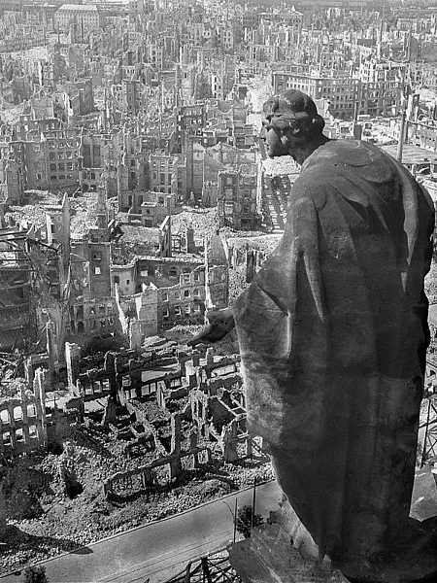
Dresden
Dresden, the historic capital of Saxony was the target of mass Allied bombing in January 1945. The city, famous for its baroque architecture and its cathedral, the Frauenkirche, was devastated by a firestorm. The loss of life was especially high because the city was full of refugees fleeing west from the advancing Soviet armies. Many commentators have described the bombing of Dresden as a ‘British war crime’, with fierce criticism of the Chief of RAF Bomber Command, Sir Arthur Harris. But other historians have suggested that the destruction of Dresden was so complete because of advances in the technologies of aerial warfare, not because the raid was different in intent from German bombing raids in Western Europe earlier in the war.
A view of the ruins of Dresden from the Town Hall tower, 1945
(Deutsche Fotothek, CC BY-SA 3.0 de)

Slide 4
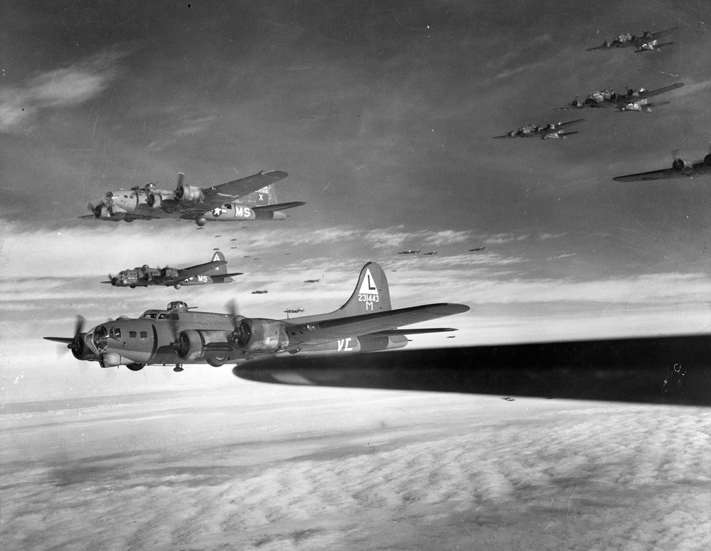
The devastation of German cities
American B-17 bombers en route to a daylight raid on Westfalen, 1944.
(Museum of the US Airforce, Public Domain)
The devastation of German cities and infrastructure was inflicted partly by land warfare, by artillery bombardment and street fighting; but it was above all the result of mass aerial bombing. From 1940, the war in the air, mostly by night bombing raids, was Britain’s main way of attacking Hitler’s Reich. From 1943 the impact of bombing Germany was increased by American daylight raids. By 1944, technical developments had improved the range of bombers and the destructive effect of the bombs they carried. After the Allied invasion of France, the bombers were taking off from airfields much nearer to their targets, and facing degraded German defences. The scale of damage caused by mass bombing increased dramatically.

Slide 5
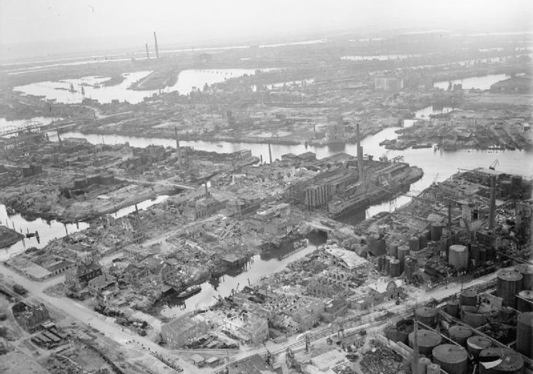
Hamburg
Aerial photograph from RAF Bomber Command showing the results of repeated bombing raids on the port of Hamburg.
(Imperial War Museum, Public Domain)
As the major port of northern Germany, and an important base for U boats, Hamburg was relentlessly attacked by the British air force from 1942 to 1945. There was major devastation of the port and the wider city, including a series of terrible firestorms in 1943.

Slide 6
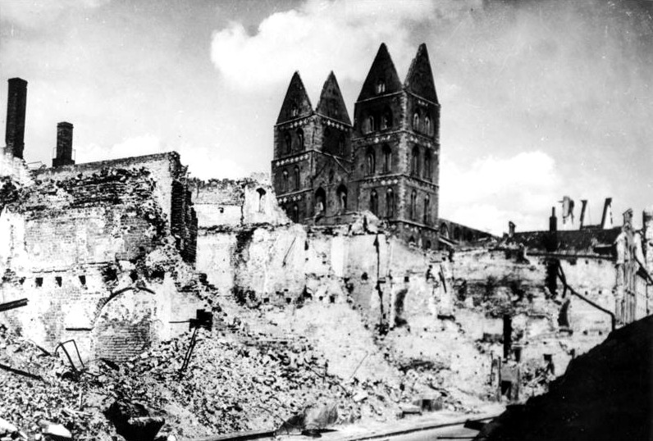
Lübeck
The ruins of Lubeck’s cathedral, the Marienkirche, and the old city, as seen in 1945.
(German Federal Archives, CC BY-SA 3.0 de)
The important seaport and beautiful historic city of Lübeck, situated on the Baltic Sea, south of Kiel and east of Hamburg, was frequently targeted by British bombing raids. A heavy raid in 1942 left the cathedral, the Marienkirche, on fire and devastated much of the city.

Slide 7
The ‘Nero Order’
“As if to dramatise what lay in store for Germany, a new order came from the Chief of Transportation, dated 29 March 1945: ‘The aim is the creation of a transportation wasteland in abandoned territory; the shortage of explosives demands resourceful utilisation of all possibilities to ensure permanent destruction’.
Included in the list of facilities slated for destruction were all types of bridges, railway tracks, technical installations in freight depots, workshop equipment, and sluices and locks in our canals. Along with this, all locomotives, passenger cars, freight cars, cargo vessels and barges were to be completely destroyed, and canals and rivers blocked by sinking ships in them. Only a technician can grasp the extent of the calamity that execution of this order would have brought upon Germany.”
Horrific though it was, the devastation of Germany at the end of the war might have been even worse. In March 1945, Hitler issued his ‘Nero Order’ for the complete destruction of Germany’s infrastructure. According to Hitler’s Munitions Minister, Albert Speer, who actually did much to thwart this decree, Hitler’s order demanded more than just ‘scorched earth’ tactics to deprive the enemy of war material. It was also a nihilistic desire to destroy everything that could be destroyed, ‘punishing’ the German people for not being capable of living up to Hitler’s ideals for a National Socialist future.
Germany was saved from total destruction because the war ended soon afterwards and because Albert Speer, criss-crossed the country to instruct officials to disobey the ‘Nero Order’.
(Albert Speer, Inside the Third Reich, London, 1970, p.453.)

Slide 8
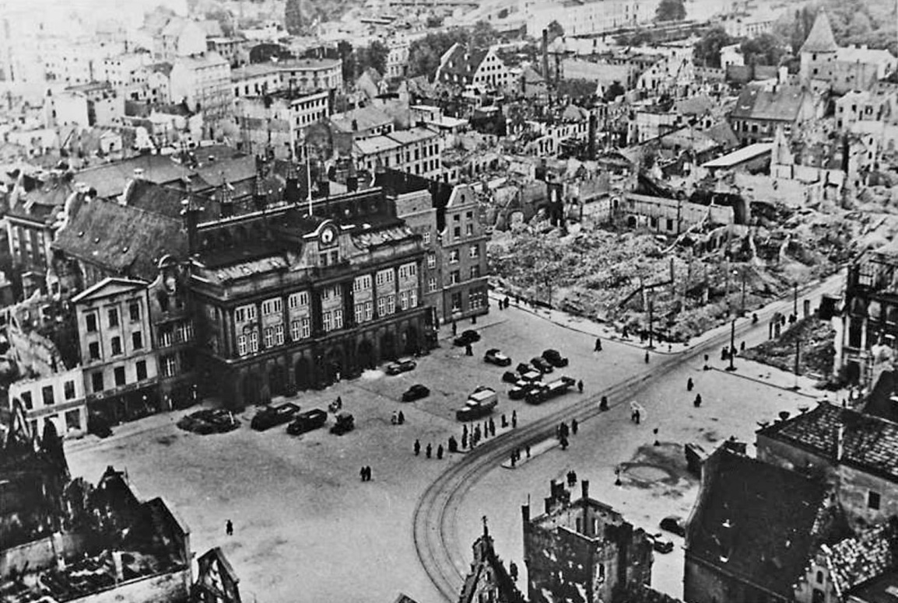
Rostock
The market square and town hall in Rostock, just after the end of the Second World War.
(German Federal Archives, CC BY-SA 3.0 de)
The port of Rostock on the Baltic Sea north of Berlin was targeted by Allied bombing and badly damaged by a heavy raid in the winter of 1942. When the Allied occupying powers took over the administration of Germany after the war they faced major problems of reconstruction.

Slide 9
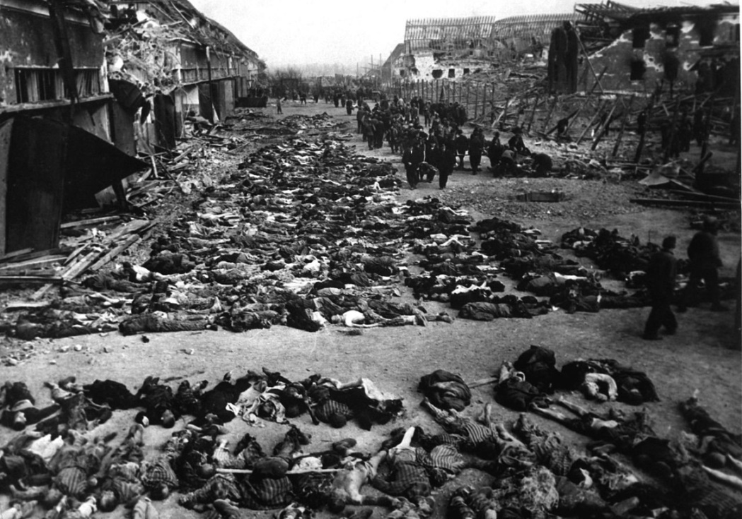
The liberation of Camp Dora
Camp Dora, at Nordhausen in the Harz mountains after it was liberated in April 1945.
(US National Archives and Records Administration, Public Domain)
Camp Dora, the Mittelbau (Central Works), was the secret installation in tunnels under the Harz mountains where V2 and V3 rockets were manufactured. The camp was run by the SS, with intensive use of forced labour under very harsh conditions. It was heavily bombed by the Allies before it was eventually overrun by American forces in April 1945. The Allies were very concerned about the massive devastation that would have been caused if the V weapons had ever gone into mass production.

Slide 10
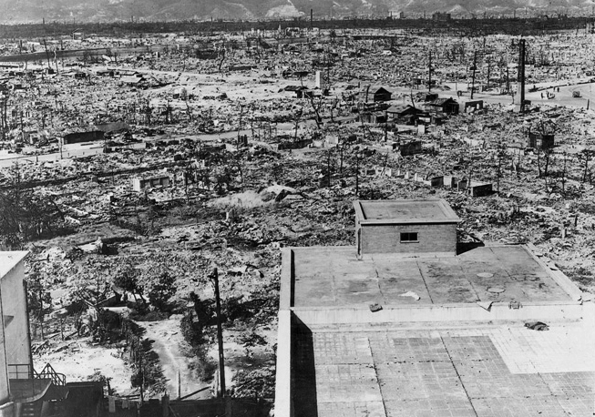
The atomic bomb
The effects of the atomic bomb on Hiroshima, August 1945.
(U.S. Government, Public Domain)
The Manhattan Project to develop an atomic bomb was carried out at vast expense amid great secrecy. The first successful test of the bomb took place at Los Alamos, New Mexico, in 1945. In August, President Truman ordered the bomb to be used against the southern Japanese city of Hiroshima. The effects were devastating: 80000 people, mostly civilians, were killed and the centre of the city was utterly destroyed. The decision to use the bomb has remained controversial ever since. It almost certainly shortened the war, possibly saving hundreds of thousands of casualties; but some historians have claimed that the main purpose behind Truman’s decision was to intimidate the Soviet Union. The memory of the devastation of Hiroshima influenced political and public opinion for decades after 1945.

Slide 11
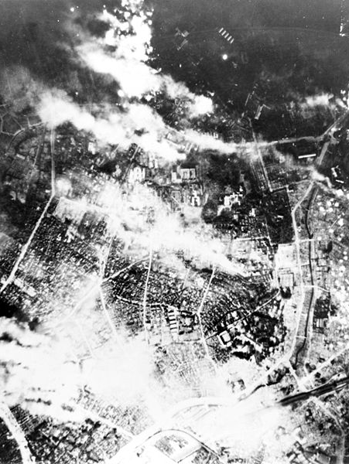
Aerial bombardment of Japan
The atomic bombs dropped on Hiroshima and Nagasaki in the last days of the Second World War caused horrific destruction, but scarcely more so than conventional bombing methods. At Hiroshima the death toll was 80000; in the firestorm caused by a mass raid on Tokyo in May 1945, 100000 people died.
In the earlier stages of the Pacific War, it was difficult for the United States to mount major bombing attacks on Japan. Distances were great and losses were high. By 1944, after the recapture of Pacific island bases, it was possible to launch massed attacks. By then, there had been significant technical advances in the range that heavy bombers could fly, the weight of bombs they could carry, and in the destructive impact of incendiary bombs. By the early months of 1945, much of Tokyo was in ruins.
Firestorm in Tokyo after the American bombing raid on 26 May 1945.
(US Army, Public Domain)

Slide 12
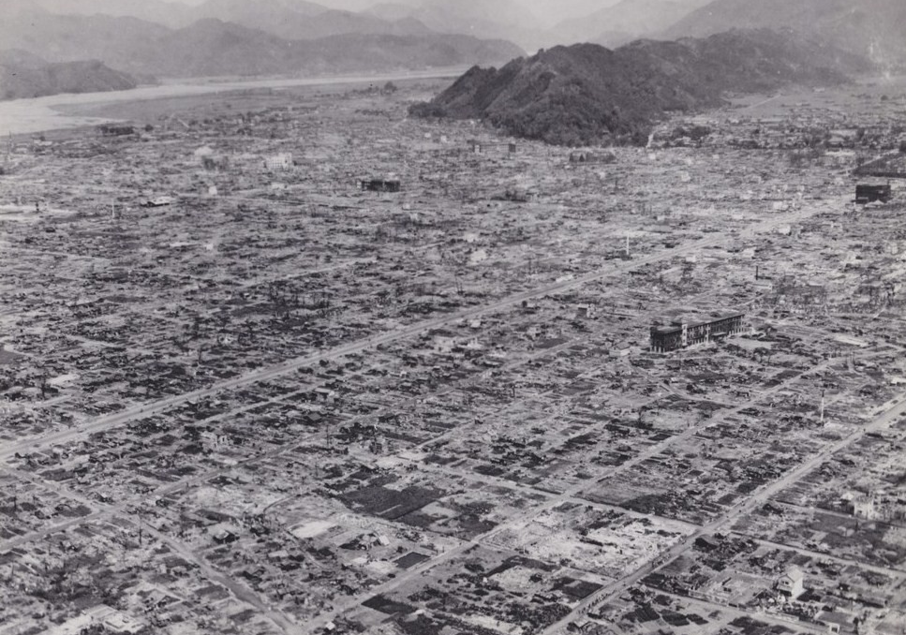
Shizuoka
Shizuoka after American bombing, 1945.
(Showa History of 100 million people: Occupation of Japan Vol.2" published by Mainichi Newspapers Company, Public Domain)
Shizuoka was not a major industrial centre, but was seen by the USAAF as an important strategic target because the Tokyo-Osaka railway line ran through it. The disruption of transportation systems was always a high priority for Allied bombing campaigns. Shizuoka was attacked on ten separate occasions. By 1945 the devastation was total.

Slide 13
The price of victory
It was not only the defeated nations that were left devastated by the Second World War. Britain endured heavy bombing raids, especially in 1940 and 1941, with major damage to cities and seaports. The Soviet Union suffered vast devastation as the war on the Eastern Front ebbed and flowed between 1941 and 1945. Hundreds of towns and cities and 70000 villages were destroyed during the conflict, and twenty million civilians killed. Even after the hard-won victory in the war, large parts of the USSR suffered from famine in 1946-47. Only in the United States was the civilian population safe, free of shortages, rationing, or the need for air raid shelters.
Across continental Europe, cities were badly damaged by invasion during the period of Nazi conquests, and then even more gravely affected by the battles fought to liberate them. The city of Caen in Normandy, was massively damaged by artillery bombardment and air raids following the D-Day landings in 1944. In Poland, the Warsaw Uprising by the nationalist Home Army lasted 63 days before it was crushed by the German occupiers, and the city was totally destroyed in mass reprisals. Liberation brought partial destruction to great European cities like Budapest and Vienna; and might have meant the total destruction of Paris but for the brave and principled decision of the German commander, General Choltitz, to disobey Hitler’s explicit order to demolish the city.

Slide 14
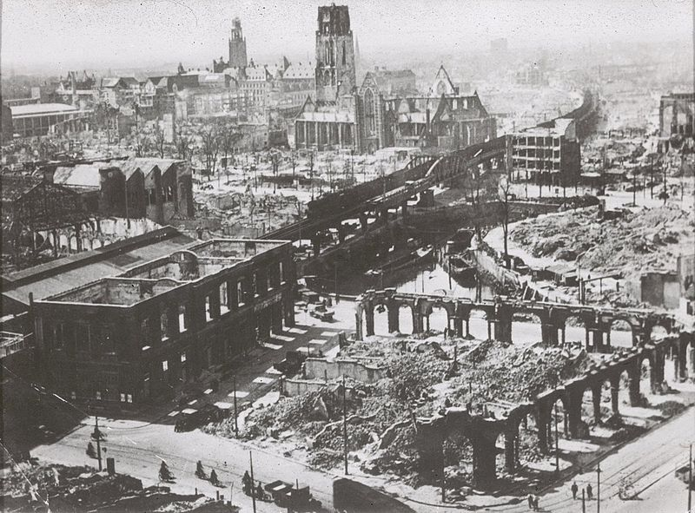
The impact of mass bombing
The results of ‘Blitzkrieg’: the Dutch seaport of Rotterdam after German air attack in May 1940.
(German Federal Archives, CC BY-SA 3.0 de)
The impact of mass bombing was already a feared aspect of modern warfare before the Second World War began. The destruction of Guernica in 1937 during the Spanish Civil War had been a sign of things to come.
The use of devastating ‘Blitzkrieg’ tactics, combining rapid armoured units on the ground with close air support from attack aircraft, was a key factor in the German invasion of Poland in 1939, and in the rapid conquest of Western Europe in 1940.

Slide 15
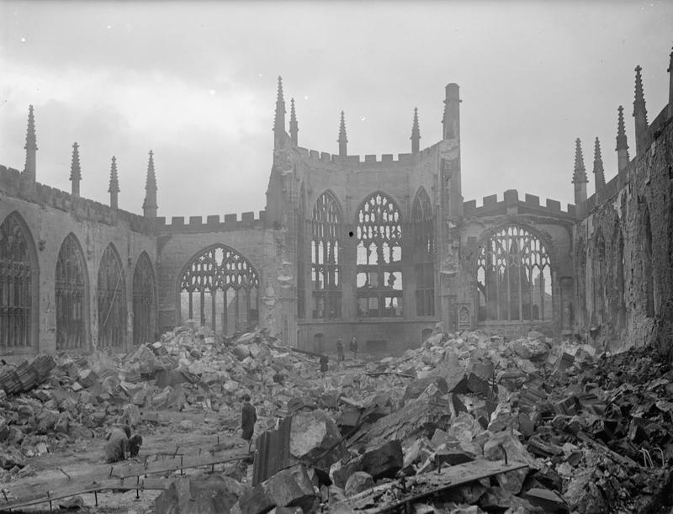
The ruins of Coventry cathedral
The ruins of Coventry cathedral after the bombing raid of November 1940.
When the cathedral was restored after the war, the medieval ruins were left as a shell alongside the new Cathedral built in a modern style.
(Imperial War Museum, Public Domain)
Britain came under attack from nightly bombing raids in 1940, following the Fall of France. This ‘Blitz’ continued through 1940 and 1941, inflicting heavy damage on cities, industrial centres and seaports such as London, Liverpool, Birmingham, Coventry, Belfast, Cardiff and Glasgow. In November 1940, a raid on Coventry led to the destruction of its historic medieval cathedral. Other historic cities such as Bath and Oxford were targeted on Hitler’s orders (the so-called Baedeker Raids, named after the British guide book used by the Luftwaffe to identify the targets) but the technologies of mass bombing were not yet fully developed. The damage of the Blitz seemed terrible at the time but was much less extensive than the destruction area bombing was capable of by 1944-45.

Slide 16
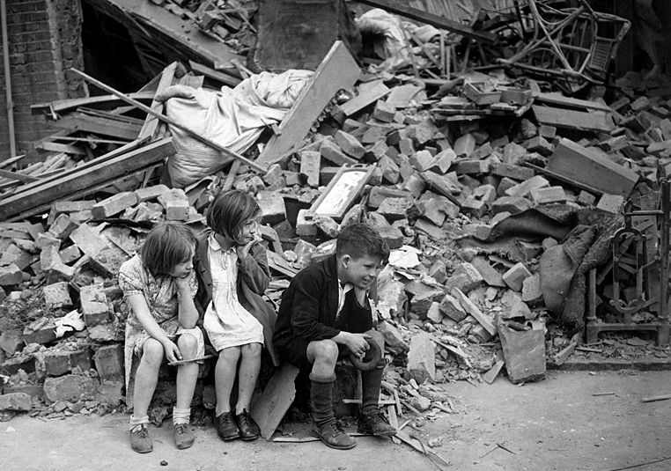
The ‘London Blitz’
Children bombed out of their homes during the London Blitz.
(Wikimedia Commons, Public Domain)
London, Britain’s capital and most populated city, was a frequent target for German bombing raids, especially in 1940 and 1941. Later in the war, London faced new terror from the air when Germany launched aerial attacks with V1 and V2 rockets. The Blitz only ended in the later months of 1944, when the advances into France and Belgium after the invasion of occupied Europe pushed the launch sites for the V weapons out of range of British targets.

Slide 17
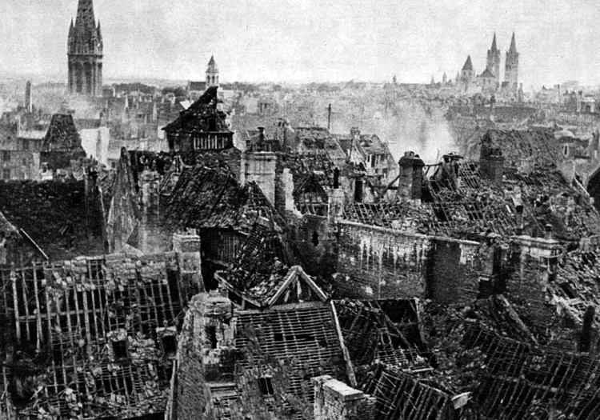
The destruction of Caen
The destruction of Caen by Allied bombing raids during the Battle for Normandy in the summer of 1944, following the D-Day landings.
(US Government Library, Public Domain)
The Allied invasion of Western Europe in June 1944 was a massive military and logistical operation that achieved great success in landing large-scale forces on the Normandy beaches. But the exploitation of that success was slow and frustrating. It took several weeks to break out into open country and advance towards Paris. During the Battle for Normandy the coastal city of Caen became a vital strategic point, and there were heavy bombing raids on the city in support of the Allied advance. Many French citizens lost their lives or their homes as the price of liberation.

Slide 18
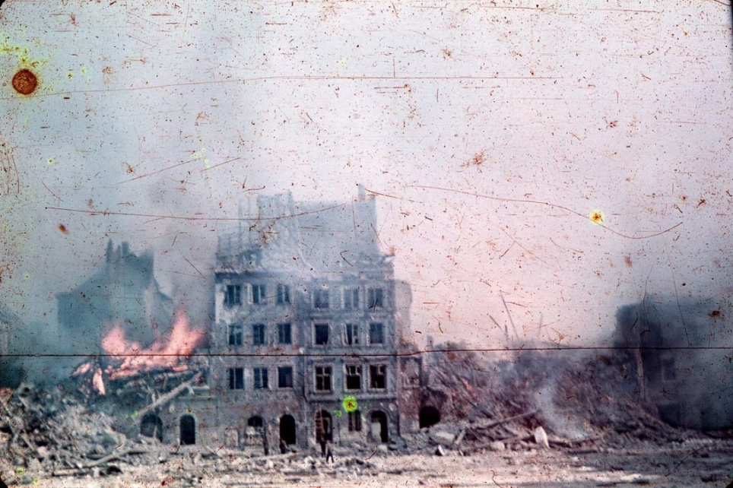
The destruction of Warsaw
Rare colour photograph by Corporal Ewa Faryaszewska of the destruction of Warsaw in 1944 as the Uprising of the Polish Home Army was crushed by the German occupiers.
(Museum of Warsaw, Public Domain)
Poland had already suffered terribly from the joint German and Soviet invasions in 1939, and from the increased savagery of German occupation after the invasion of Russia in 1941.
The liberation of Poland in 1944-45 came at a high cost. When the advancing Soviet armies were approaching Warsaw, the nationalist leadership of the AK (Home Army) launched the Warsaw Uprising hoping to drive out the German occupiers in an act of Polish self-liberation. The rising lasted 63 days before it was finally crushed; the Germans razed the city to the ground in retaliation. Soviet forces took little action to support the rising, perhaps because of operational reasons, perhaps because Stalin was happy to see Polish nationalists weakened.

Slide 19
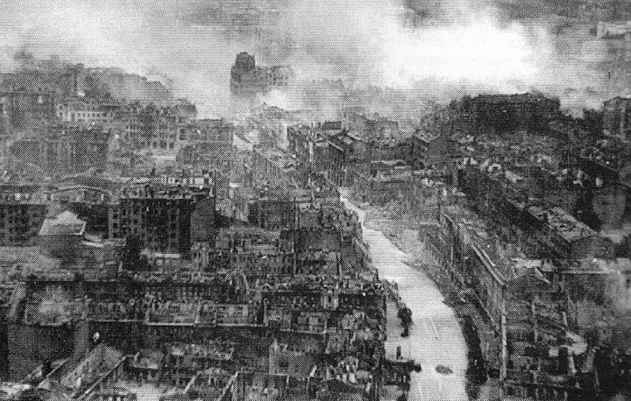
The fight over Kiev
Kiev, capital of Ukraine, during its liberation. The fight to capture the city began on 3 October 1943 and was completed on 22 December.
(Wikimedia Commons, Public Domain in the Ukraine)
Ukraine was at the centre of the destructive war on the Eastern Front. The region suffered appalling devastation during the German invasion in 1941, both from German attacks and the ‘scorched earth’ tactics employed by retreating Soviet forces. When the USSR began its great counter-attacks in 1943, the cities of Ukraine were battered again. There were four separate major battles for control of Kharkhiv. There were three great battles for control of Kiev before the city was liberated on 22 December 1943. Casualties were high, and few buildings were left undamaged.

Slide 20
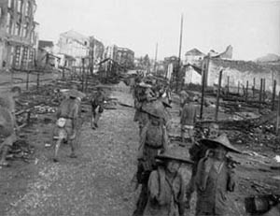
Destruction in China
Nationalist Chinese forces entering the ruined city of Liuchow, July 1945.
(US Army Military history Institute, Public Domain)
War began in China in 1937-38 with the Japanese invasion and the destruction of cities such as Nanjing and Shanghai. By 1945, the Chinese Nationalists, supported by the United States, were driving the Japanese occupying armies back towards the east.
But the years of war and occupation caused great devastation in China. Many cities had been badly damaged. There was a terrible famine in 1942. By 1945 eight million Chinese people had lost their lives in the war. And, even after the final defeat of Japan in August 1945, China faced the prospect of civil war between the Nationalists and the Communists.

Slide 21
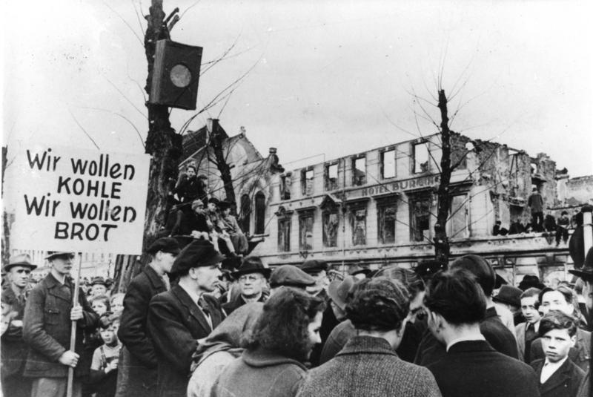
The liberation in Europe
WE WANT COAL, WE WANT BREAD. Krefeld in Westfalen during the Hunger Winter 1946-1947.
(German Federal Archives, CC BY-SA 3.0)
For many Europeans, liberation from occupation was painless and joyful. Prague was liberated by the Red Army relatively undamaged; Paris was liberated by Allied forces amid happy cheering crowds, in a city that escaped the devastation that would have followed street by street fighting. Elsewhere, liberation was slow, dangerous and full of lasting hardships. Northern Holland remained an isolated, forgotten war front in 1945 and came close to starvation in the Hunger Winter of 1946-47.
These conditions presented huge problems for the victorious Allies who were now responsible for the civilian populations in the territories under military occupation.

Slide 22
Devastated communities and cultures
Awful though it was, much of the devastation at the end of the Second World War could be rebuilt. Post-war reconstruction was costly and arduous, but it was carried through, often with remarkable success, in the years after 1945. The worst-affected country, the Soviet Union, emerged from the war as a military-industrial superpower. The huge damage to its infrastructure was gradually repaired, along with the re-housing of millions of people made homeless by the war. Western Europe overcame the dangers of economic breakdown and began a period of sustained economic growth and prosperity in the 1950s, spearheaded by the ‘economic miracle’ in West Germany. Japan made a similarly spectacular economic recovery.
But some aspects of the devastation could never be reconstructed or replaced. Many communities were destroyed and dispersed in ways that could never be put right. Sometimes this was a consequence of mass murder: Roma and Jewish communities who disappeared into the death camps. Sometimes it was a consequence of deportation and dislocation: communities displaced by the winds of war and never able to return because of new borders and new political systems. Sometimes the devastation was cultural: the destruction of art, music, literature and ideas – and of the individuals who may have produced great things if their lives had not been prematurely cut short.

Slide 23
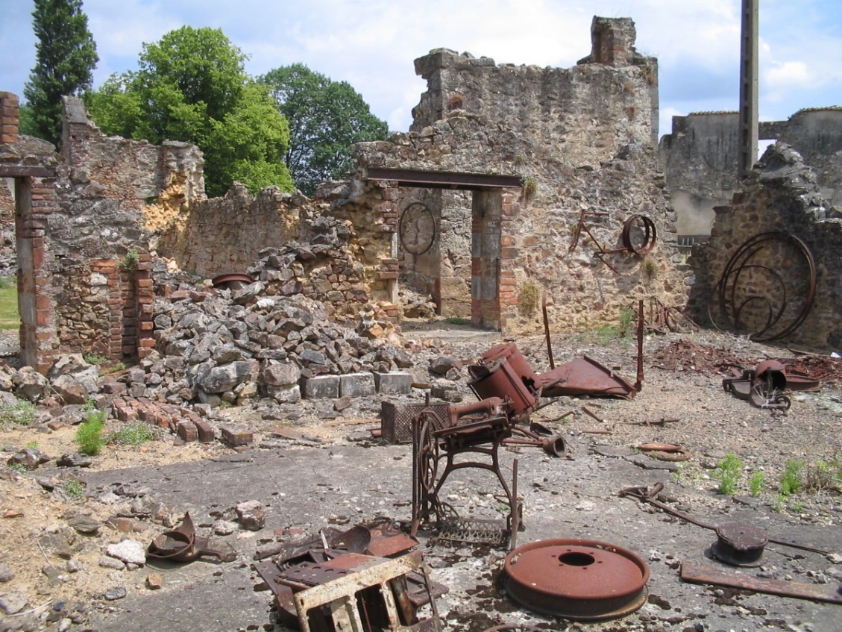
The massacre of the population of Oradour-sur-Glane
The ruins of Oradour-sur-Glane as they were left after the massacre of its civilian population by German forces in 1944.
(Wikimedia Commons, Dennis Nilsson Unrestricted use)
In 1944, the village of Oradour-sur-Glane, near Limoges in central France, was destroyed and its civilian population massacred by German SS units in mass reprisals to punish the French Resistance for obstructing the northward march of the Das Reich Division.
The French could have rebuilt Oradour, as they rebuilt so many towns and villages in France but they chose not to do so. Its ruins were left as a permanent memorial. This was both in acknowledgment of the innocent civilian victims and as a standing accusation against the perpetrators. In time the intense anti-German feelings in France were dissipated, but not the memories of devastation and loss.

Slide 24
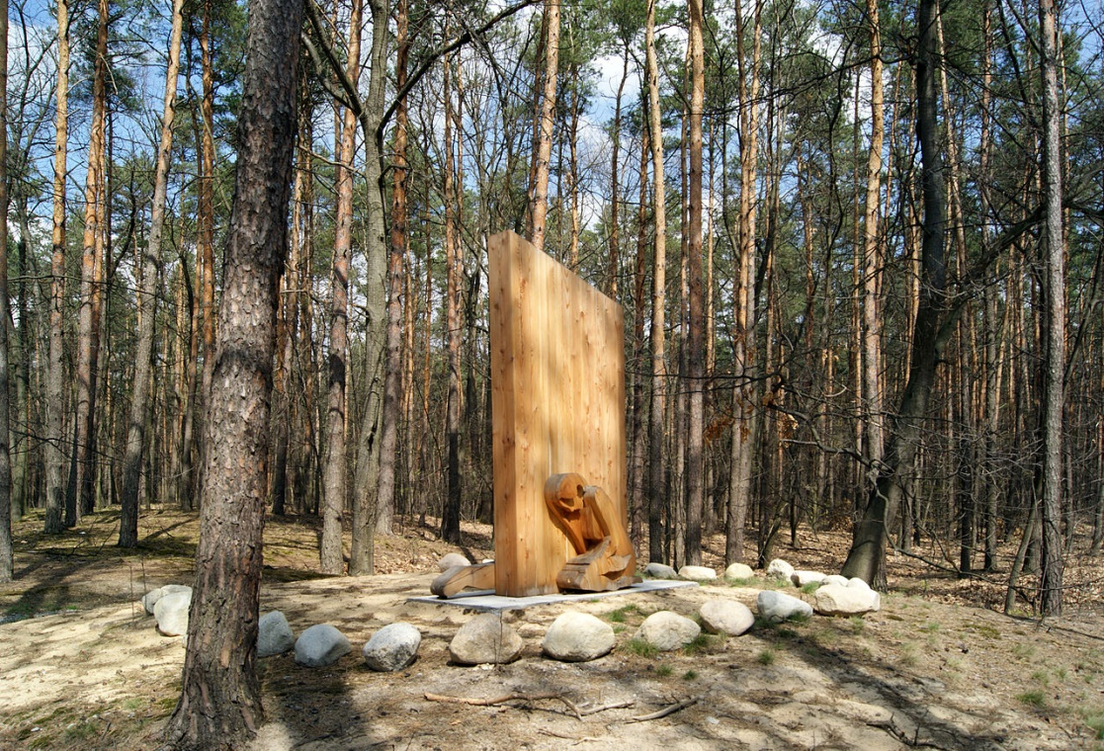
The Roma communities
Monument erected in 2012 in memory of the Roma people of the village of Borzecin, Poland.
(Wikimedia Commons, Zygmunt Put Zetpe020, CC BY-SA 4.0 International)
Before the Second World War, there were many Roma communities in Central and Eastern Europe. From 1935, the Nazi regime began the process of registering Roma people, with the intent of forcing them into ‘normal’ society. Later, these registrations became the basis for mass deportations to forced-labour camps and concentration camps where most of them died.

Slide 25
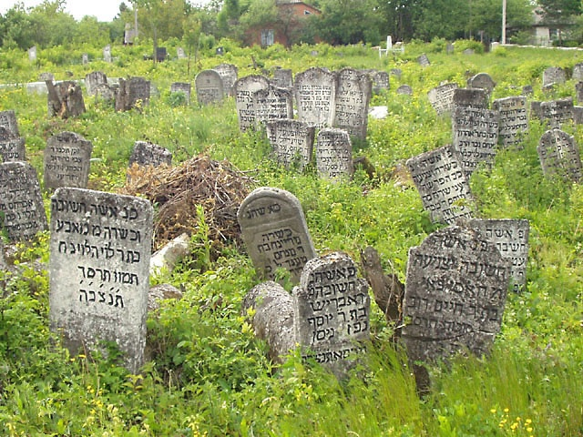
The Holocaust
Jewish cemetery in the Shtetl of Medzhybizh, Ukraine.
(Bick family via Wikimedia Commons, Public Domain)
Until the Second World War, hundreds of thousands of Jewish people lived in the Shtetls of Eastern and Central Europe. These villages and small towns were permeated with Jewish history and culture and were a distinctive element in European society.
They were destroyed in the Holocaust and remained forgotten, depopulated ruins in the decades that followed the end of the war. Often the only evidence of the life once lived there were the damaged grave stones.

Slide 26
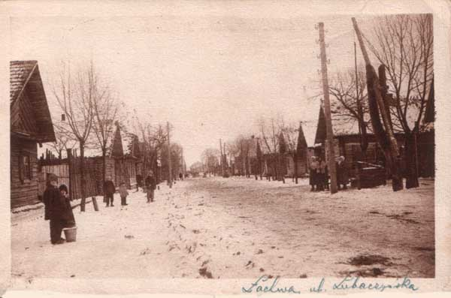
The Holocaust
The Jewish Shtetl of Lakhva, Poland in 1926. After the Second World War the town, and its inhabitants, had ceased to exist.
(Galeroa Alfabet Polski, Public Domain in Poland and the US)
After 1945, the devastation of the Jewish way of life in the Shtetls of Central and Eastern Europe was complete. Few Jews survived the Holocaust. Of those who did, few returned to their former settlements.
To get some sense of these lost communities it is necessary to go back to photographs and memoirs of earlier times - and to recognise that European Jews were not merely victims of the Holocaust but also a vibrant part of European history and culture.

Slide 27
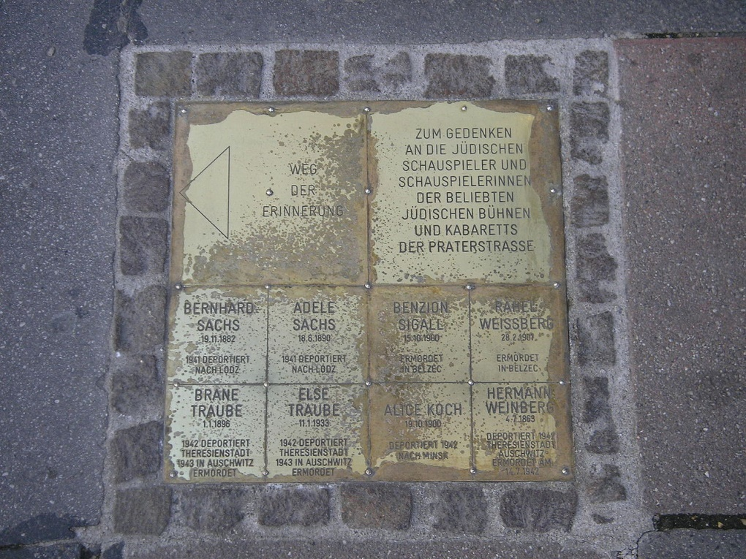
Totalitarianism and the suppression of culture
Plaques placed in the Leopoldstadt district of Vienna in memory of Jewish actors murdered in the Holocaust.
(Wikimedia Commons, Gryffindor, CC BY-SA 2.5 Generic)
During the Second World War, the imposition of totalitarian ideologies of race and culture led to the exile, or silencing, or death of many thousands of artists and intellectuals.
This was a tragedy for those who were suppressed but it was also a tragic loss for the cultural life of the places from which these artists had been forcibly removed. After the war recognition of this was often belated and grudging; but it was one example of the wide-ranging aspects of devastation and impoverishment caused by the war.

Slide 28
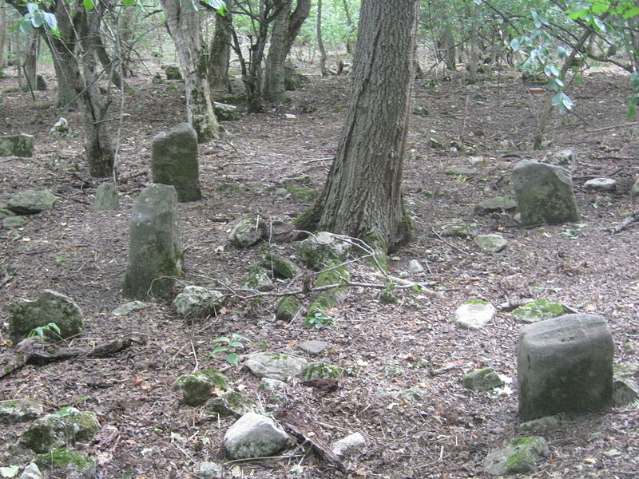
Ethnic groups in the USSR
Old Cemetery of the Crimean Tatars, Aylyanna village, Crimea.
(Wikimedia Commons, Seitmemetoff, CC BY-SA 3.0 unported)
It was not only in Nazi Germany that communities were devastated by ideology and mass deportations. In Stalin’s USSR there were many ethnic groups driven far from their homelands. These included the Volga Germans, the Kamlyks and the Crimean Tatars. The Tatars had been the majority population of the Crimean peninsula for centuries before the Russian conquest of the region in 1735, but were brutally expelled, mostly to Uzbekistan, in 1944.
It was only forty years later that some of them were allowed to return.

Slide 29
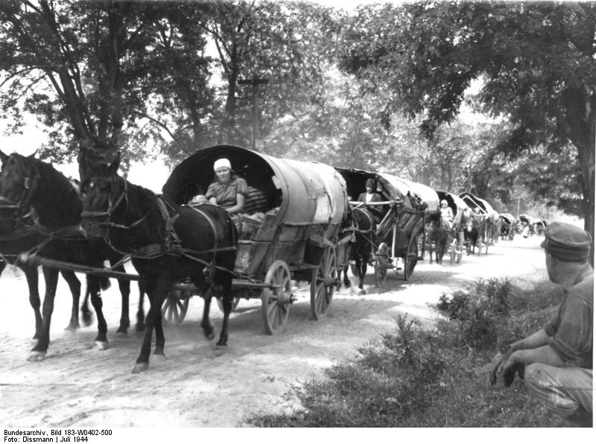
The ethnic German expellees
Expelled Black Sea Germans, passing through Hungary, July 1944.
(German Federal Archives, CC-BY-SA 3.0)
The Black Sea Germans settled between 1787 and 1805 in southern Ukraine and the Crimea, then part of the Russian Empire. They were welcomed by the Tsars as useful citizens – hard-working and productive farmers and craftsmen. After the Bolshevik Revolution they suffered hardship in the time of collectivisation and the great famine of the early 1930s. Then, after the German invasion of Russia in 1941, the Germans living in western and southern Ukraine came under Nazi rule. When German forces began to retreat westwards after defeats at Stalingrad and Kursk in 1943, the Black Sea Germans were forced to uproot; 135 000 fled to the West. They became part of the flood of 12 million ethnic German expellees in a mass migration.

Slide 30
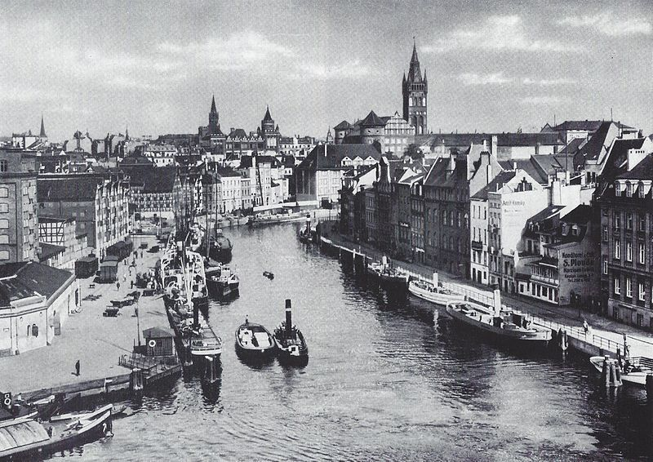
Königsberg and East Prussia
The historic port city of Königsberg in East Prussia, as it was in the 1920s.
(Adam Kraft, Rudolf Naujok: Ostpreußen. Ein Bildwerk mit 220 Fotos. Würzburg 2002, Public Domain)
By 1939, when the Third Reich Hitler invaded Poland, Königsberg had been a German city for nearly 700 years. Its fortress had been founded by the Teutonic Knights in 1255, during the ‘Germanisation’ of the Baltic region. Königsberg became an important trading city, joining the Hanseatic League in 1340. Königsberg retained its completely Prussian-German character, for centuries, even more so after East Prussia was separated from the rest of Germany by the Treaty of Versailles in 1919. But after Soviet armies conquered the city in January 1945, East Prussia was incorporated into Poland, and Königsberg was annexed by the USSR as the city of Kaliningrad, within a separate Soviet enclave. Its German history, culture and population was lost forever.

Slide 31
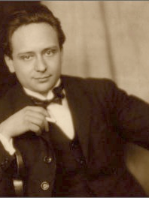
The Holocaust and cultural life in Europe
From 1919, when he came ‘home’ to the newly-formed Czechoslovakia, Viktor Ullmann (1898-1944) was a rising star of Czech music, born in Tesin in Silesia. He worked for the music department of Czechoslovak Radio, and for the Institute of Music Education, and gained a growing reputation for his strikingly original compositions. His career was then cut short by the Holocaust: in 1942 he was sent to Terezin concentration camp north of Prague because of his Jewish origins. In October 1944 Ullmann was deported to Auschwitz and sent to the gas chambers on arrival.
It is impossible to know what Ullmann might have gone on to achieve if he had not died a premature death in Auschwitz. His unfulfilled career stands as a symbol of the countless artists, known and unknown, who perished in the death camps; and of the countless works of music, art, and literature that might otherwise have been created. It was not only Jewish people who were devastated, but also the whole cultural life of Europe.
Czech composer Viktor Ullmann (1844-1944)
(Wikimedia Commons, Public Domain)

Slide 32
Devastated ideologies and ideals
The devastation caused by the Second World War was much more than physical destruction of the built environment, or the dislocation and suppression of living communities. Sometimes, the devastation was intangible and invisible. Many ideals and values - political, social and moral - were poisoned by disillusionment, or undermined by shifts in political power. On an individual level, many people remained traumatised and psychologically damaged long after the war had become a distant memory for others.

Slide 33
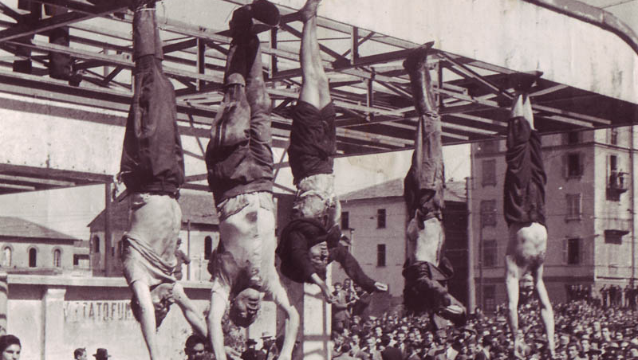
The end of Fascism in Italy
The end of Fascism in Italy: the bodies of Nicola Bombacci, Benito Mussolini, Clara Petacci, Alessandro Pavolino and Achille Starace, displayed in the Piazzale Loreto, Milan in 1945.
(Wikimedia Commons, Public Domain)
At its height in the 1920s and 1930s, Mussolini’s regime in Italy presented high-sounding Fascist ideals that many Italians eagerly believed in. For many people, Fascism was a force for patriotism, social renewal and economic modernisation. But defeat in the Second World War, and Italy’s close alliance with Nazi Germany, totally discredited Fascism. Italy was torn by civil war and the rise of anti-Fascist partisan movements. Mussolini and his mistress, Clara Petacci, were captured and executed; and their corpses put on public display in Milan. Not long after the war, Italy became a democratic republic based on explicit rejection of all that Fascism stood for.

Slide 34
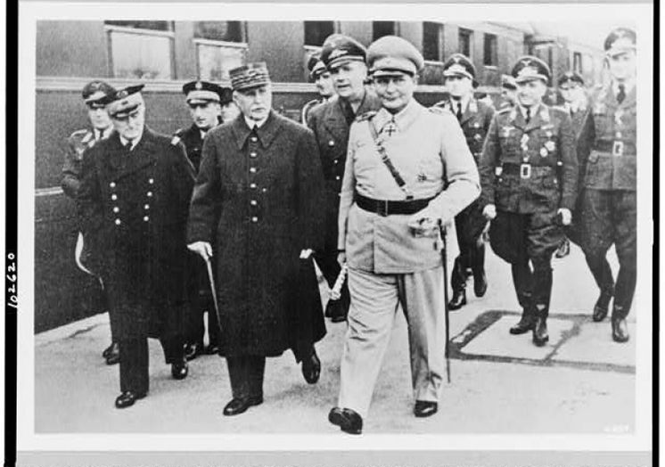
The end of the Vichy regime
Marshal Petain and Admiral Darlan from the Vichy Regime with Hermann Göring, Vice Chancellor of the Third Reich, 1941.
(US Library of Congress, Public Domain)
During the First World War, Marshal Philippe Petain became an authentic national hero, symbolising the sacrifice and national unity that carried France to victory in 1918. After the Second World War, however, Petain’s reputation had sunk to the depths of disgrace. As head of the government in the Vichy regime, Petain had presided over an authoritarian state and its ideology of ‘Work, Family, Nation’. He had collaborated with the Nazis and was deemed guilty of war crimes. In 1945, Petain was sentenced to death, though he was not actually executed; unlike his prime minister, Pierre Laval. Petain’s conservative and nationalist ideals were discredited, and the French nation remained bitterly divided.

Slide 35
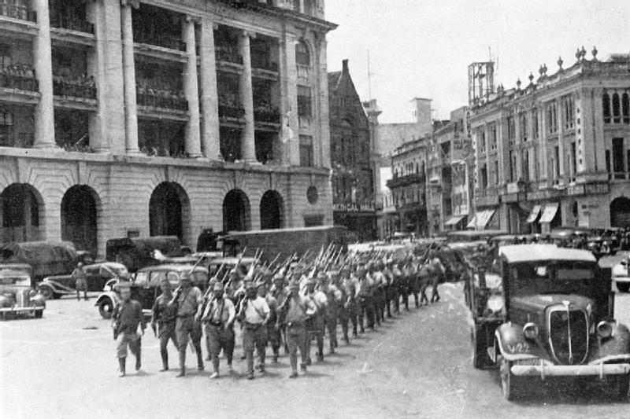
The end of the ‘imperial mystique’ of Colonial Asia
The end of the ‘imperial mystique’: Japanese troops marching through Fullerton Square in Singapore to celebrate victory, 1942
(Japanese Government, Public Domain)
Before the Second World War, much of Asia was dominated by European colonial empires. Rule by the British, French and Dutch was overthrown with stunning speed by Japanese conquests in 1942. Britain’s humiliating surrender of the naval base at Singapore was the ultimate symbol of this collapse of Western prestige. By 1945, Japan had been utterly defeated and the colonial powers seemed back in control; but this was only temporary. National independence movements emerged to challenge colonial rule, in French Indochina, Dutch Indonesia and British India and Malaysia. The imperial mystique of Colonial Asia had disappeared.

Slide 36
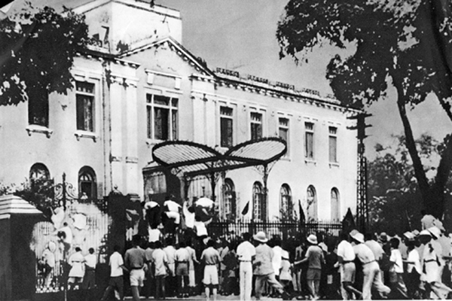
The August revolution
The ‘August Revolution’. Anti-colonial demonstrations in Hanoi 19 August 1945.
(Wikimedia Commons, Public Domain)
In French Indochina (now Vietnam) the ‘August Revolution’ began in Hanoi soon after Japan’s surrender. This became the basis for a long-running struggle for independence led by Ho Chi Minh that lasted for thirty years. French attempts to re-establish colonial control ended in 1954 at the Battle of Dien Bien Phu. This led to the Vietnam War (1955-75) as the United States attempted to ‘contain Communism in Asia’.
By 1975, Western imperialism had run its course.

Slide 37
The crimes of invading armies
“Gabriele Köpp has lived a full life in which she had everything -- everything but romantic love. It was her bad luck, she says. Women outnumbered men after the war, and none of the few men that remained happened to be right for her. ‘Besides," she adds, "I wouldn't have been able to feel anything anyway.’
During those 14 days, Köpp was raped, again and again. She was 15 years old, and she knew nothing about sex.
Köpp has now written a book about those 14 days and about the rapes, titled Warum war ich bloss ein Mädchen? ("Why Did I Have to Be a Girl?").
The book is an unprecedented document, because it is the first work of its kind written voluntarily by a woman who was raped in the final months of World War II, and who, years later, described the experiences and made them into the central theme of a book.”
National Socialism, Italian Fascism and Soviet ideology all promoted fundamental – if contrasting – ideals of womanhood. But these only applied to those German, Italian and Soviet women whose lifestyles and behaviour epitomised those ideals. These ideals certainly did not apply to the enemy. In the closing months of the war hundreds of thousands of women and girls were raped by soldiers in invading armies. For example, it is estimated that 90000 German women had abortions after such rapes; and the total number of victims of sexual assaults by the Red Army was about 300000. News of these rapes was suppressed by the military authorities and most women remained traumatised and silent. In recent years, the topic has been more openly discussed, including claims that US soldiers were also guilty of many thousands of sexual assaults.
(German Woman Writes Ground-Breaking Account of WW2 Rape. An article by Susanne Beyer in Spiegel Online, 26 February 2010)

Slide 38
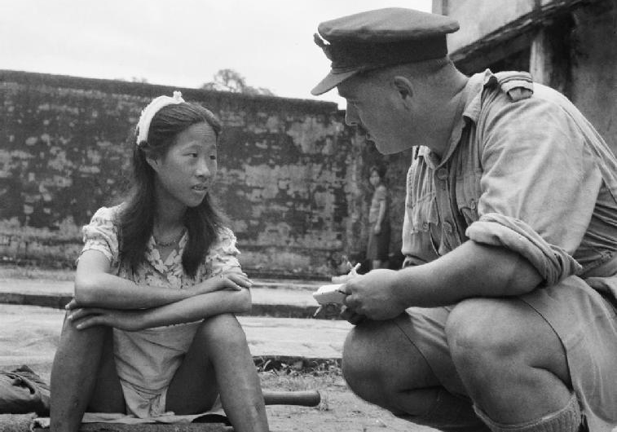
‘Comfort women’ enslaved by the Japanese Army
A young Chinese girl recently freed from a Japanese ‘comfort battalion is counselled by a an officer in the British RAF on 8 August 1945, the day the war ended.
(Imperial War Museum, Public Domain)
In Asia many thousands of so-called ‘comfort women’ were enslaved by the Japanese Army during the Second World War. These women and girls came from China, Malaya, the Philippines and, particularly, from Korea. After the war, this painful experience gained little public acknowledgment. It is only in recent times that books have been published, memorials erected, and some efforts made by Japan to offer an apology.

Slide 39
Rebuilding from the ruins
A few of the countries fighting the Second World War (such as Australia, Canada and the United States) emerged from the conflict relatively undamaged; but the war had left a trail of ruins and devastation across the world. Re-housing the millions of homeless, rebuilding cities, and repairing the destroyed economic infrastructure was a matter of great urgency but would take long years to accomplish. In many parts of Europe and the world there were dangers of political instability and social breakdown.
In the event, the reconstruction of the post-war world was achieved more successfully, and much more quickly, than might have been feared. From the early 1950s, there was a sustained economic recovery, underpinning greater political stability. The built environment was restored and modernised. Living standards rose. In many countries there was talk of a post-war ‘economic miracle’. This economic transformation was particularly evident in Japan and West Germany, the defeated and disgraced countries worst damaged by the war – both placed under military occupation. Elsewhere, post-war Britain slowly recovered from the war and applied government planning to rebuilding towns and cities. The recovery in Britain and Western Europe was significantly helped by aid from the United States under the Marshall Plan of 1947. In Eastern and Central Europe, the Soviet Union shaped economic renewal along collectivist socialist ideals; recovery was much slower but eventually enabled reconstruction through vast housing projects and urban regeneration.

Slide 40
Disillusion after the War
I firmly believed that after victory everything would suddenly change. When I recall conversations at the front and at the rear, when I re-read letters, it reminds me how everybody expected that once victory had been won, people would know real happiness.
We realized, of course, that the country had been devastated, impoverished, that we would have to work hard, and we did not have fantasies about mountains of gold. But we believed that victory would bring justice, that human dignity would triumph.
As the war ended, millions of ordinary Soviet people celebrated victory with wild enthusiasm. They hoped that the immense sacrifices they had made for the war effort would be rewarded by better economic times, and by a relaxation of the harsh political regimes that had pushed people to the limits in the 1930s and during the war. These hopes were not fulfilled. In the immediate post-war years, Stalin plunged the USSR into an era of repression and fear and renewed calls for sacrifices in the face of a national emergency.
Recollections of the Soviet writer and propagandist, Il’ia Ehrenburg.

Slide 41
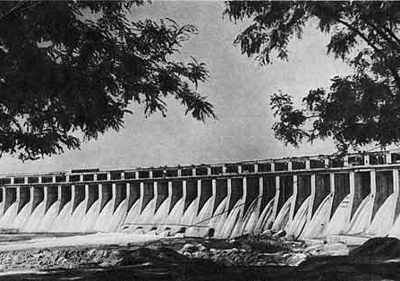
The reconstruction of the Dniepr River Dam
The Dniepr River Dam in 1947.
(Public Domain)
The Dnieper River Dam, at Zaporzhia in Ukraine was vital for hydroelectric power generation in the USSR. The dam was deliberately destroyed by Soviet engineers in 1941 as the invading German armies overran Ukraine. Its repair and reopening in 1947 was one of the great achievements of post-war reconstruction in the region.

Slide 42
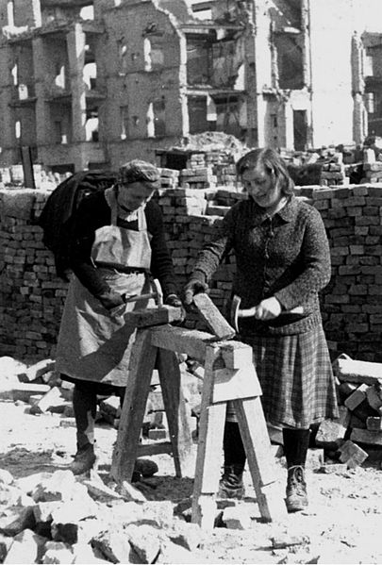
Trümmerfrauen in Germany
By the time the war ended in May 1945, German cities had been reduced to heaps of rubble and clouds of choking dust. Transport and industry had completely broken down; and the peacetime industrial workforce was virtually non-existent. Clearing the rubble and preparing for reconstruction was a task supervised by the occupying military powers and carried out by civilian workers, mostly women. These ‘Trümmerfrauen’ (Rubble Women) became a symbol of the beginnings of urban renewal in defeated Germany.
‘Rubble Women’ preparing bricks for re-use, Berlin circa 1947.
(Wikimedia Commons, Janczikowsky, CC BY-SA 3.0)

Slide 43
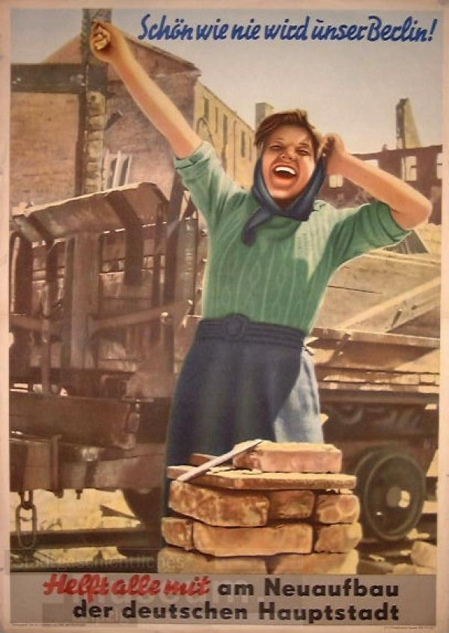
Rebuilding Our Berlin Together
This 1952 propaganda poster dramatises the collective effort to rebuild East Germany from the ruins of war. The joyous commitment of the woman illustrates the ‘Socialist Realism’ style frequently used in the propaganda of the Soviet Union and the new East German regime.
Translation:
Our Berlin Will Be Beautiful As Never Before!
Everyone Must Help Rebuild Our German Capital
(Stadtgeschichtliches Museum Leipzig PL 52/144, CC BY-NC-SA -4.0)

Slide 44
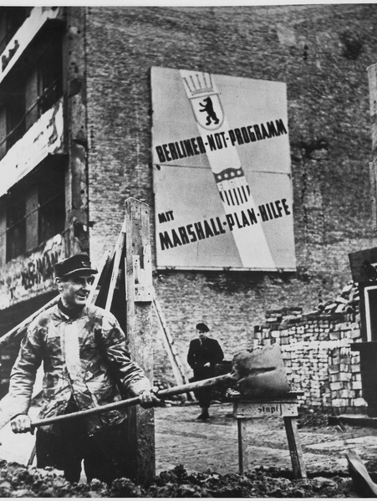
The Marshall Plan
One of the factors stimulating rapid economic recovery in Germany and Western Europe was economic aid under the Marshall Plan. Like many other countries in western Europe, Marshall aid boosted economic activity at a vital time. In theory, countries in Eastern Europe could also have received Marshall aid, but this was rejected by Stalin as a ‘trick’ to enable American dominance.
Another important stimulus to the West German economy was the sudden increase in demand for industrial production caused by the Korean War from 1950.
A construction worker in West Berlin, pictured next to a poster praising Marshall Plan aid, 1952.
(Public Domain)

Slide 45
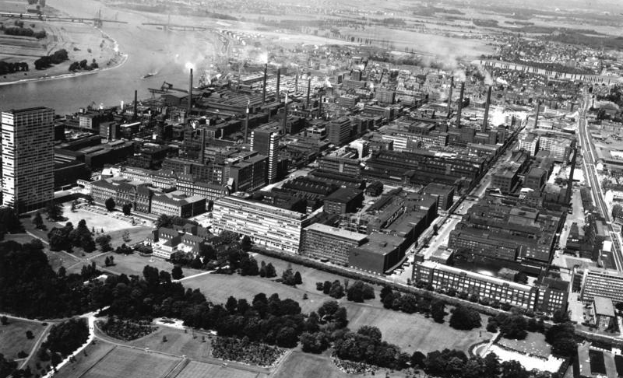
The take-off of the German economic miracle
Bayer AG chemical factory complex, at Leverkusen, 1964.
(German Federal Archives, Bild-P090383, CC BY-SA 3.0 DE)

Slide 46
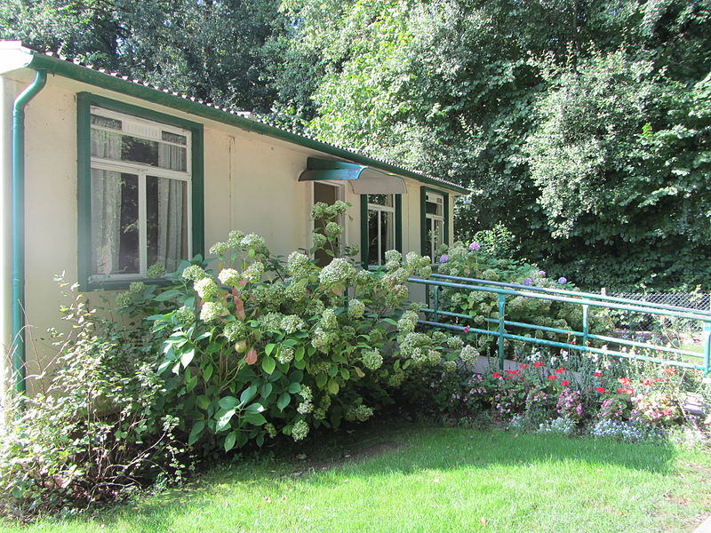
The British post-war housing crisis
A prefabricated house as it would have been in 1950. On display at the St Fagans National History Museum, Cardiff.
(Wikimedia Commons, Deb, CC BY-SA 3.0)
Extensive bomb damage led to a major housing crisis in post-war Britain. In 1944, the wartime coalition government prepared plans to meet the pressing demand for housing by constructing 500 000 temporary prefabricated homes. They were expected to last for ten years before being replaced by permanent housing. 1.2 million new homes were built in Britain between 1945 and 1950. About 160 000 of these new homes were ‘prefabs’. Most of the ‘temporary’ homes lasted far longer than ten years – several hundred still existed in 2009.

Slide 47
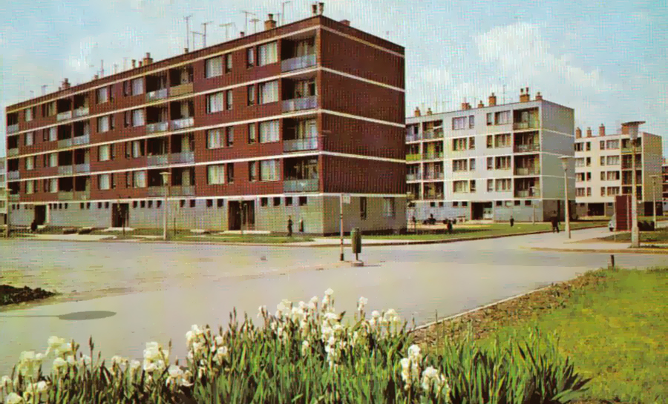
Housing in post-war Hungary
Pre-cast concrete housing blocks in post-war Hungary.
(Wikimedia Commons, Public Domain)

Slide 48
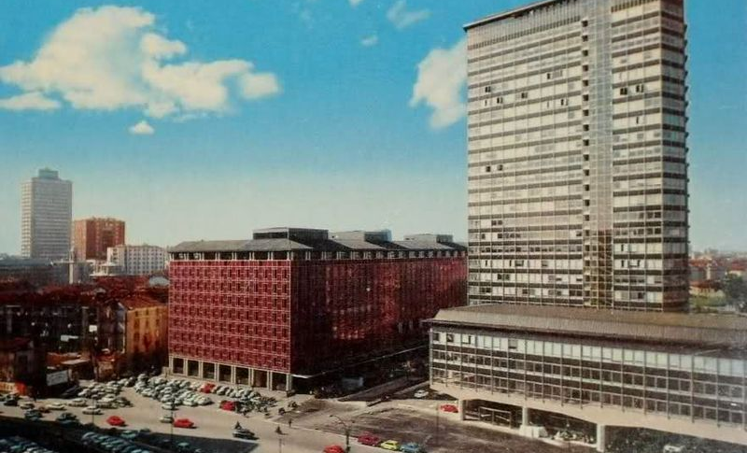
Reconstruction of central Milan, circa 1965
(Wikimedia Commons, Public Domain in Italy)

Slide 49
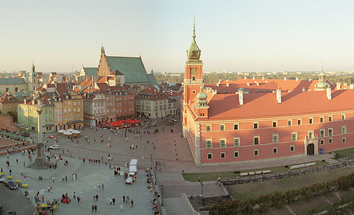
The reconstruction of Warsaw
Warsaw Castle Square with view on the Castle and the restored Old Town.
(Wikimedia Commons, Olaf1541, CC BY-SA 3.0)

Slide 50
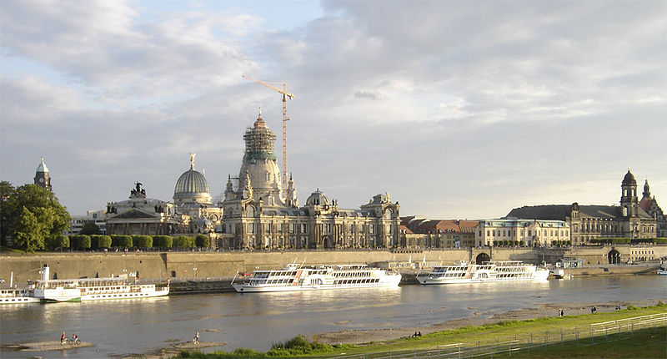
The reconstruction of Dresden
Reconstruction of the Frauenkirche and historic centre of Dresden nearing completion in 2004. The rebuilding of Dresden was delayed by the policies of the DDR, and only began as a serious project after the end of the Cold War.
(Wikimedia Commons, Cepheiden, CC BY-SA 3.0)

Slide 51
New structures: political and moral reconstruction
It was not only homes, cities and infrastructure that had to be rebuilt after the Second World War. The war, and the fascist regimes defeated at such terrible cost by 1945, had threatened to destroy all civilised values. Even more so than in 1919, the victorious powers were confronted with the task of political and moral reconstruction; of reasserting the concepts of freedom, democracy and international justice. This drive for reconstruction and renewal led to war crimes tribunals and demands to identify and purge those guilty of atrocities. It led to the establishment of the United Nations, with its UN Charter of Human Rights, and its many supranational organisations such as the High Council of Refugees. But the universality dreamed of in 1945 did not last: the emerging Cold War led to different, often surprising, models of reconstruction.
In the West, led by the military and economic dominance of the United States, reconstruction was shaped by the Marshall Plan and the formation of the ‘Atlantic Alliance’ – by 1951 France and West Germany had drawn together in the European Coal and Steel Community, and were already engaged in the plans for economic and political integration of Western Europe that would lead to the Treaty of Rome in 1957. In Eastern and Central Europe, led by the military and economic dominance of Soviet Communism, reconstruction was shaped by rather different aims and methods, but with the same appeal to high ideals and the need to ‘build a better world’.

Slide 52
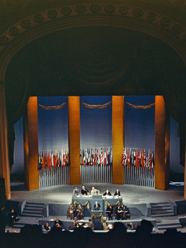
The formation of the United Nations
The awareness of the extent of the moral and physical devastation caused by the Second World War was the driving force behind attempts to reassert human rights and offer moral reparation for the terrible war crimes that were revealed by 1945. Such efforts included the Nuremberg War Crimes Tribunal, held to identify and punish those guilty of war crimes and crimes against humanity. They also included moves towards the economic and political integration of western Europe to prevent further wars between European nation states. For the United States, there was a determination to avoid the errors that had undermined the League of Nations after 1919 and to secure a new and better supranational organisation to uphold human rights and maintain the peace. The Declaration of the United Nations in 1942 provided the basis for the formation of the UN at the San Francisco Conference in April 1945; and for the promulgation of the United Nations Charter in 1948.
The formation of the United Nations at the San Francisco Conference, April 1945.
(United Nations Information Centre, re-usable for non-commercial purpose)

Slide 53
A United States of Europe?
“And what is the plight to which Europe has been reduced? Over wide areas a vast quivering mass of tormented, hungry, care-worn and bewildered human beings gape at the ruins of their cities and homes, and scan the dark horizons for the approach of some new peril, tyranny or terror. Among the victors there is a Babel of jarring voices; among the vanquished the sullen silence of despair. That is all that Europeans have got by tearing each other to pieces and spreading havoc far and wide. Indeed, but for the fact that the great Republic across the Atlantic Ocean at length realised that the ruin or enslavement of Europe would involve their own fate as well, and has stretched out hands of succour and guidance, the Dark Ages would have returned in all their cruelty and squalor.”
That such physical destruction and moral barbarity had taken place in the heart of modern, civilised Europe led to anguished considerations about how democracy and civilised values could be protected in the future. One example of this was the speech made by Winston Churchill at Zurich in September 1946, calling for a United States of Europe to rebuild the continent and provide more secure foundations for the future of democracy. The formation of the Council of Europe in 1949 reflected this kind of reaction to the devastation caused by the war.
A speech in Zurich, Switzerland by Winston Churchill in September 1946
(The Churchill Society, London)

Slide 54
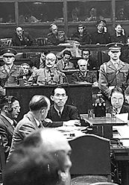
The Allied War Crimes Tribunal in Nuremberg and Tokyo
Political and moral reconstruction was a key aim of the victorious Allies after the Second World War. War Crimes Tribunals were established in Nuremberg, Germany and in Tokyo, Japan, to prosecute war criminals responsible for atrocities, among them military and government officials.
The picture shows Hideki Tojo, former Japanese General, Premier and War Minister, facing the War Crimes Tribunal in occupied Japan after the Second World War.
This judicial process was based on high ideals but was neither complete nor even-handed. Many Japanese or Nazi war criminals escaped retribution; and many war crimes committed by the victors were sidelined or forgotten.
(National Archives and Records Administration, Public Domain)

Slide 55
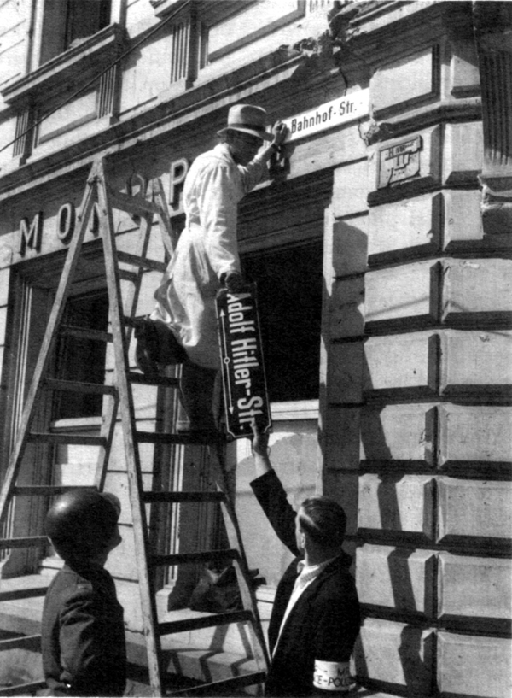
‘De-Nazification’
One of the aims of political and moral reconstruction was the ‘De-Nazification’ of Germany. The total collapse of Hitler’s Reich led to a complete rejection of everything associated with Nazism. There were demands for ‘the guilty ones’ to be punished, removed from public life. In one sense this was convenient: the Nazi leaders were almost all dead and they could carry the responsibility for what was done by Nazis, as opposed to ‘other Germans’. But, in another sense, Germans faced a nightmare problem in dealing with the legacies of the Nazi regime while in the midst of social breakdown and political vacuum.
Removing public traces of Hitler’s Reich in the city of Trier in Germany’s Rhineland, 1945.
(Public Domain)

Slide 56
The immediate aftermath of the war
In 1918, the entire bureaucracy, the fabric of authority in the country, had been left intact by the victors. In 1945, policy decreed that Nazis must be banished from all positions in the bureaucracy and in government. At a stroke, the controlling forces of the nation were almost eliminated. A long-prepared yet at once overstretched structure of Allied military government replaced it. Germany entered the sordid, gloomy post-war era of hunger, and the black market; of families picking over mountains of rubble for salvage; of Allied officers and men making a twilight living selling petrol, tyres and cigarettes; widespread prostitution; men and women of all nationalities urgently seeking papers or any identification documents that would enable them to cross a frontier, purchase food, or lose a past.
There could be no quick recovery in Germany from the devastation of defeat. The unconditional surrender of Germany left the American, British, French and Soviet armies of occupation with deep and complex problems of administration. The immediate aftermath of the war was a time of continuing hardships, confusion and corruption.
(Max Hastings, Victory In Europe: D Day to Berlin, London p.183)

Slide 57
The Japanese economic miracle
Despite the efforts of Japanese politicians and US occupation authorities to put the country back on its feet, it was only after the outbreak of the Korean War that the Japanese economy really got going again. Politically, the Korean War paved the way for a peace treaty with the United States in 1951, officially ending the US occupation of Japan. Economically, the Korean War greatly stimulated the Japanese economy, which benefited substantially from a big jump in its total export earnings, and also from Japan’s geographical proximity to the Korean peninsula. Between 1950 and 1953, Japan’s combined export earnings reached $4.6 billion (compared with $0.5 billion in 1949) and US war procurement orders boosted Japan’s economy by a further $2.4 billion. This huge amount of foreign exchange earnings greatly improved Japan’s balance of payments, and enabled the country to import $2 billion per year of equipment and raw materials to expand its industrial production. US war procurement and technological transfer and assistance also brought new techniques and procedures into Japan that eventually found application in non-military production.
The Cold War had a significant influence on post-war reconstruction in defeated Japan. Changing world relationships, especially after the 1949 Chinese Revolution, transformed Japan from the status of a hated enemy to a potentially valuable ally.
Japan experienced an ‘economic miracle’.
In the late 1940s and early 1950s there was a similar political and economic transformation in Western Europe, paving the way for political and economic reconstruction in West Germany.
(Kevin Cai, The political Economy of East Asia, Basingstoke: Palgrave Macmillan, 2008, p.50)

Slide 58
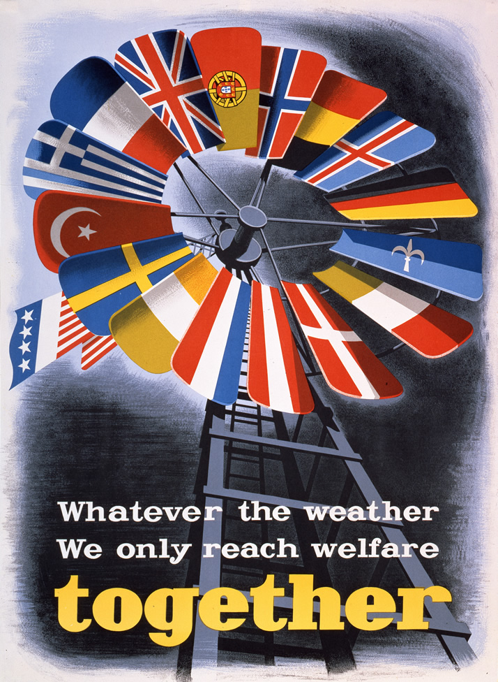
The European Recovery Programme
The Marshall Plan, the programme for American aid to war-torn Europe that was set up in 1947, was part of a huge economic and political effort by the United States to secure economic recovery and political stability at a time when there were grave fears of Europe being overtaken by civil war or revolution. Originally proclaimed as being available to all European nations, East or West, the Marshall Plan was rejected by the USSR and its satellite states and became closely associated with the economic and political integration of Western Europe under American leadership.
(The George C. Marshall Foundation, E. Spreckmeester, 906, re-usable for educational purposes)

Slide 59
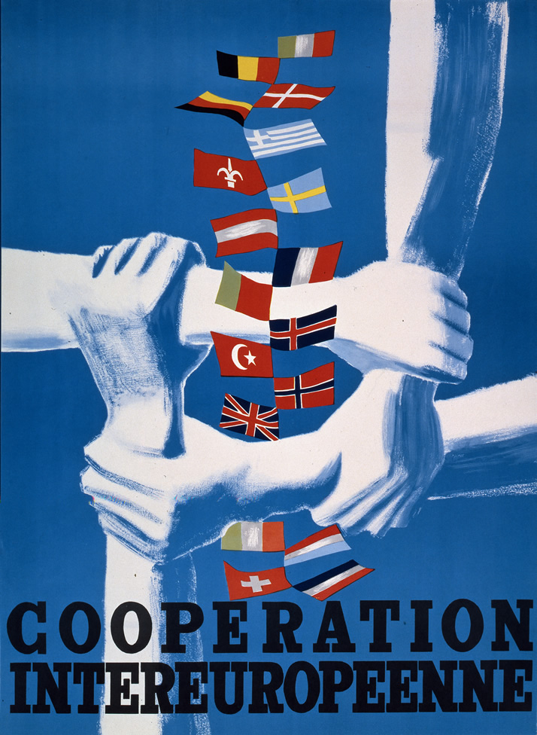
European economic recovery and international cooperation
The economic recovery of Western Europe was underpinned by moves towards international cooperation and political integration. In 1949, the Council of Europe was formed, bringing together former enemies in an inter-governmental organisation committed to the protection of human rights, and to the enhancement of education and youth programmes. Also in 1949, the formation of NATO (North Atlantic Treaty Alliance) cemented cooperation between Europe and North America. In 1951, the European Coal and Steel Community integrated the economies of former enemies, particularly France and West Germany, and paved the way for the establishment of the EEC (European Economic Community) through the Treaties of Rome in 1957. These organisations were not only military or economic; they represented a conscious desire for political integration to protect and extend democratic values.
(The George C. Marshall Foundation, F. Vienne, 900, re-usable for educational purposes)

Slide 60
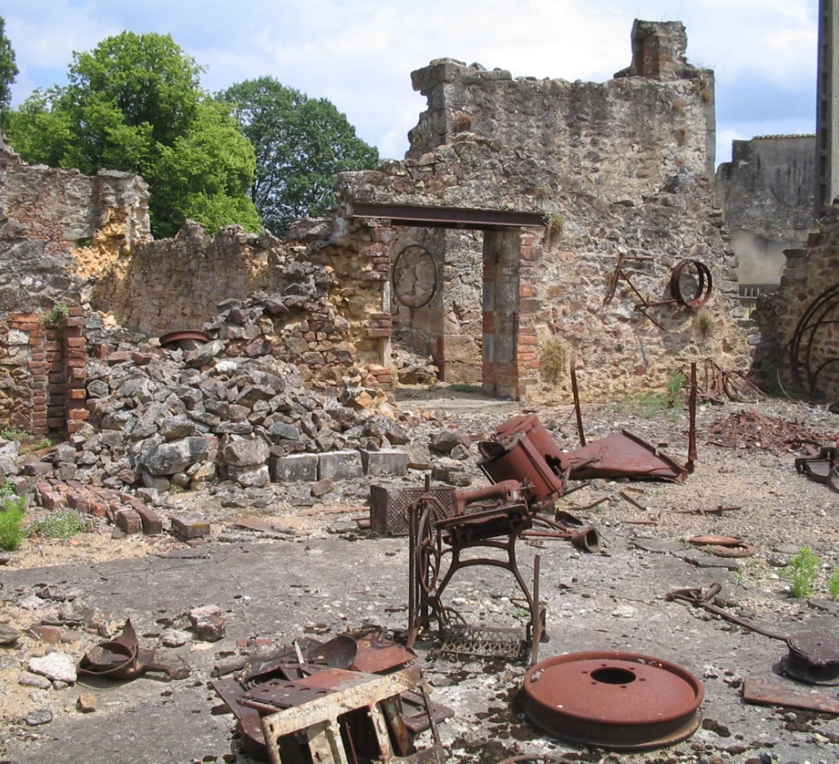



Devastion & Reconstruction
This source collection was compiled by Francesco Scatigna, Henrik Hartmann and Chris Rowe on behalf of the Historiana team.
(Wikimedia Commons, Dennis Nilsson, unrestricted use)

