Slide 1
By the time that the Axis powers had surrendered in the summer of 1945, countless millions of soldiers, and even more millions of civilians had lost their lives. As with the end of the First World War a generation before, there was a great emotional need to commemorate the enormous loss of life that had been the price of victory, and to acknowledge the courage and sacrifice of those who fought to achieve it.
Commemoration took many forms. At first, there was great emphasis on celebrating victory. Such official commemorations often included accusations against the defeated enemies, as well as glorification of victory. On a different level, there were many smaller, more private and personal memorials, often created by people who were unhappy with the tone, or the omissions, of the official celebrations. Many memorials consciously diverged from the militaristic rejoicing in victory, seeking to promote the message of ‘Never Again’. And, in those countries with nothing to celebrate but the ashes of defeat, there was silent anger and resentment, with hardly any public commemoration at all.
Attitudes towards commemoration have inevitably changed over time. Political changes made former enemies into partners, even friends. The end of the Cold War after 1989 led to many shifts in opinion. Many suppressed memories belatedly came out into the open. Distance from the war also changed perceptions and priorities. Bitter memories faded. Old certainties about guilt and glory were undermined. In the 21st century, commemoration of the war has become more reflective, more shaped by the deep desire for peace and reconciliation; though powerful currents still work against this.

Slide 2
Heroism and sacrifice: celebrating victory

Slide 3
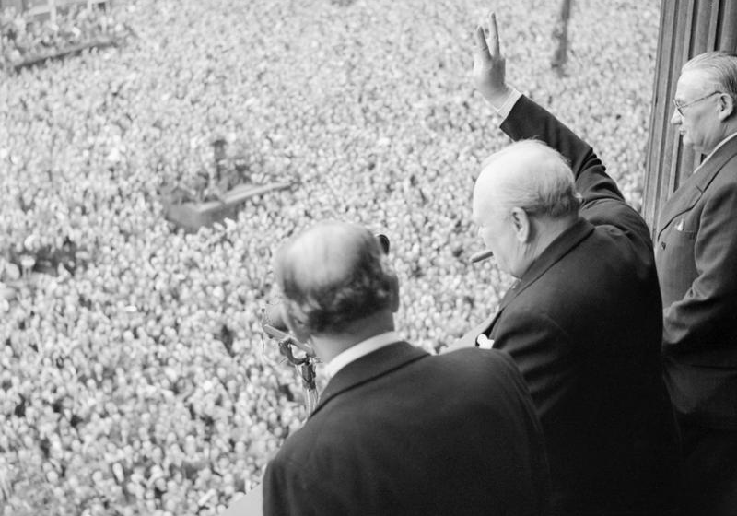
Victory Day in Europe in Great Britain
Winston Churchill waving to the crowds in London, 8 May 1945.
(IWM, H41849, re-used under IWM Non-Commercial Licence)
At the VE Day celebration in London, Winston Churchill was the central figure, widely seen as the man who led Britain through its ‘Finest Hour’. The events of VE Day were witnessed ‘live’ by huge crowds, but were also brought to millions through radio and cinema newsreels. Links were immediately made between 1945 and 1918. The Cenotaph War memorial in Whitehall was re-modelled in 1946 to combine the commemoration of the two world wars.

Slide 4
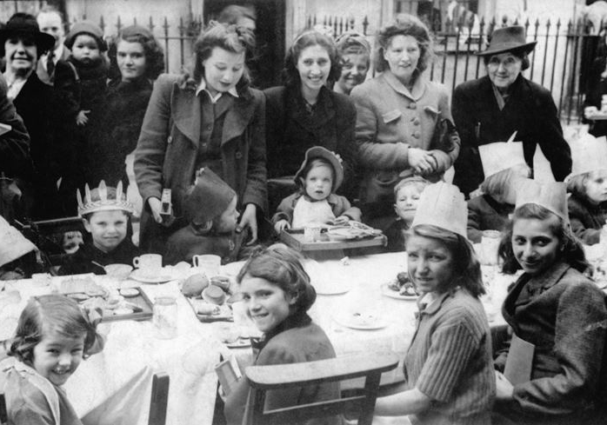
The end of rationing
VE-Day street party in Stanhope Street.
(IWM, HU92607, re-used under IWM Non-Commercial Licence)
Civilians as well as soldiers had an intense, often communal experience of the Second World War. When the war ended, there were many organised expressions of relief and joy. All over Britain there were street parties to celebrate victory and the hoped-for end of wartime sacrifices like rationing.

Slide 5
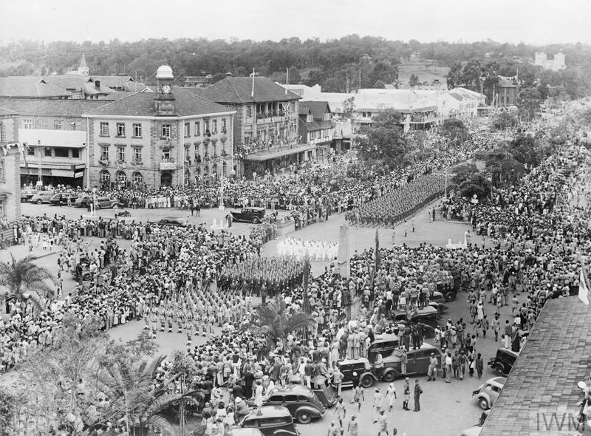
Victory in Japan Day in Kenya
Victory in Japan parade in Nairobi, Kenya.
(IWM, K9879, , re-used under IWM Non-Commercial Licence)
Many countries in the British Empire and Commonwealth had contributed to the war effort, and the Pacific War was fought in the islands of the Pacific Ocean, the South West Pacific, South-East Asia, and China. Therefore, celebrations of victory after the final surrender of Japan were worldwide. The war had also sparked nationalistic movements and paved the way for independence in, for example, Dutch East Indies and India.

Slide 6
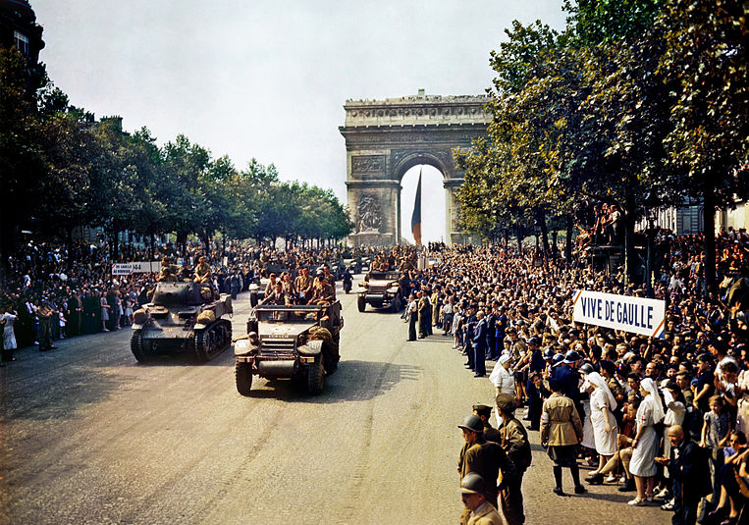
The Liberation of Paris
‘VIVE DE GAULLE!’: The Liberation of Paris, 26 August 1944.
Library of Congress via Wikimedia Commons, no known restrictions on use)
In many countries the moment of victory and national liberation came before the end of the war. The liberation of France was symbolised by the entry into Paris of Charles De Gaulle, leader of the Free French forces since 1940, accompanied by his American and British allies. Huge crowds witnessed the event on the day; and millions saw it through cinema newsreels. As with other great national celebrations of victory, the Liberation of Paris was instantly fixed in the collective memory of the nation. It was used over and over again to reinforce a national narrative in which ‘France was liberated by the French’.

Slide 7
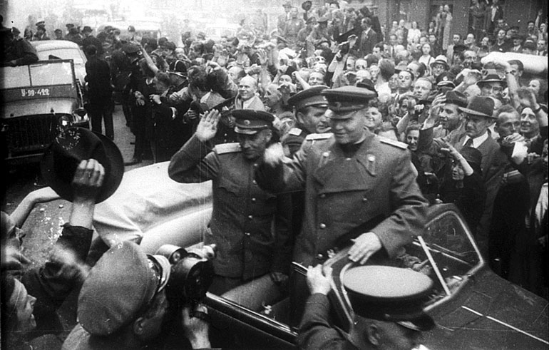
The liberation of Prague
General Konev leading the liberation of Prague by the Red Army in 1945.
(Wikimedia Commons, Karel Hasek (1945), CC BY-SA 3.0 unported)
The liberation of Nazi-occupied Europe in 1944-45 brought a succession of celebrations as cities greeted their liberators. The advance of the Red Army through Eastern and Central Europe created complex political problems for the future of Europe, but such concerns were overlooked in the joyful celebrations at the time.

Slide 8
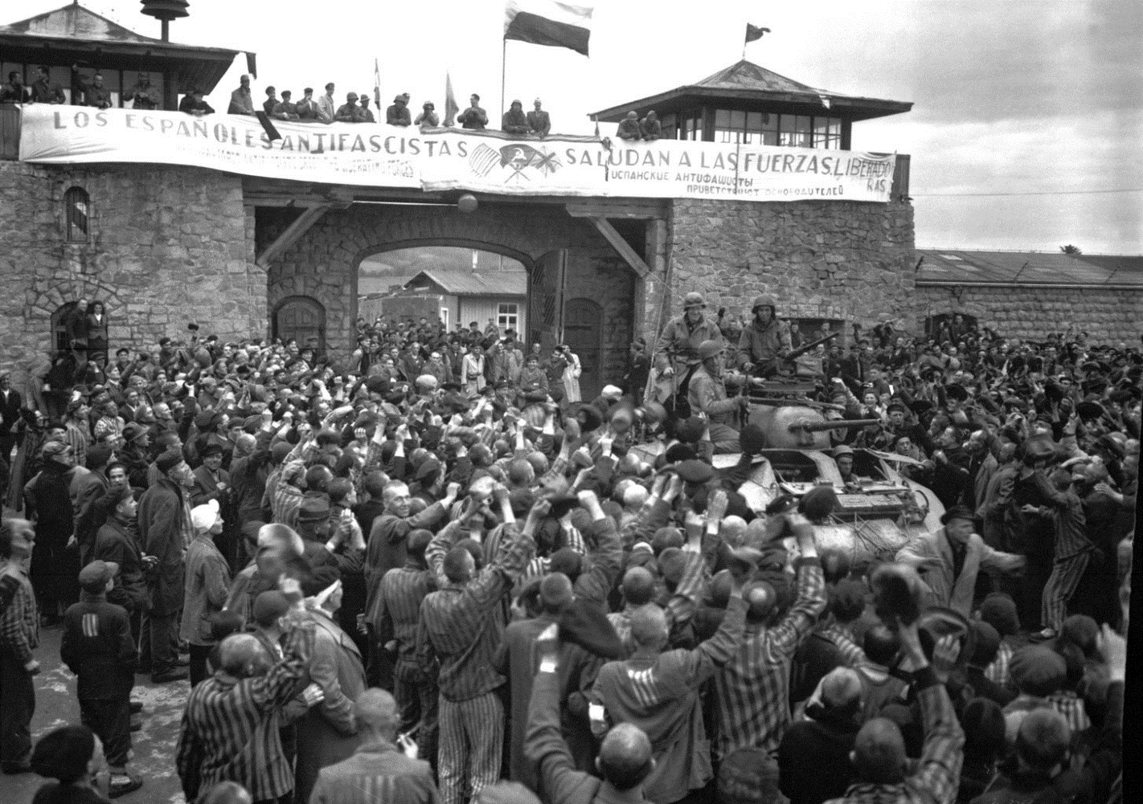
The liberation of camps
Liberation of KZ Mauthausen, near Linz, 6 May 1945.
(National Archives, No restrictions on re-use)
As Allied armies closed in on final victory in 1945, many prisoner of war camps and concentration camps were liberated. This brought brief joy and celebration for the surviving inmates of the camps, but it also caused shock and horror as the brutal truth about conditions in the camps came out into the open.

Slide 9
Commemorating victory
Celebrations of victory were often momentary and ephemeral. But there was a deep desire to perpetuate the mood of victory by acts of commemoration that would mark the heroism that had brought victory, and the sacrifice of those who had suffered and died to achieve it. Sometimes, this meant putting in place permanent memorials. Sometimes it meant organising elaborate ceremonies to mark the anniversaries of great moments of victory.

Slide 10
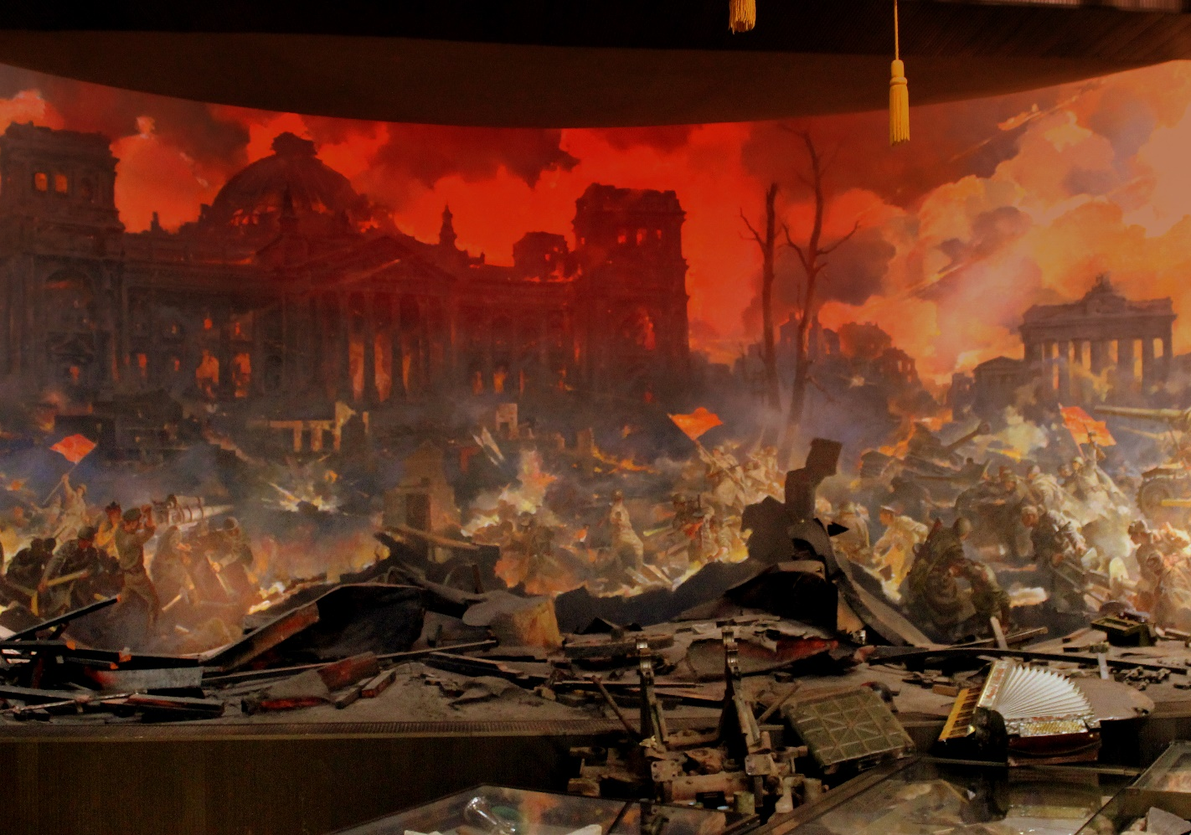
The belief in the righteousness of victory
A ‘Diorama’ mural painting commemorating the burning of the Reichstag by the Red Army in 1945.
(Flickr, CC BY-SA 2.0)
The scale and sacrifice of Soviet Russia’s war against Nazi Germany was reflected in many memorials that portrayed the final victory in the Battle of Berlin in 1945 as a glorious achievement – as heroism defeating evil. Many paintings and photographs, and this Diorama in the post-war years showed the same unquestioning belief in the righteousness of military victory.

Slide 11
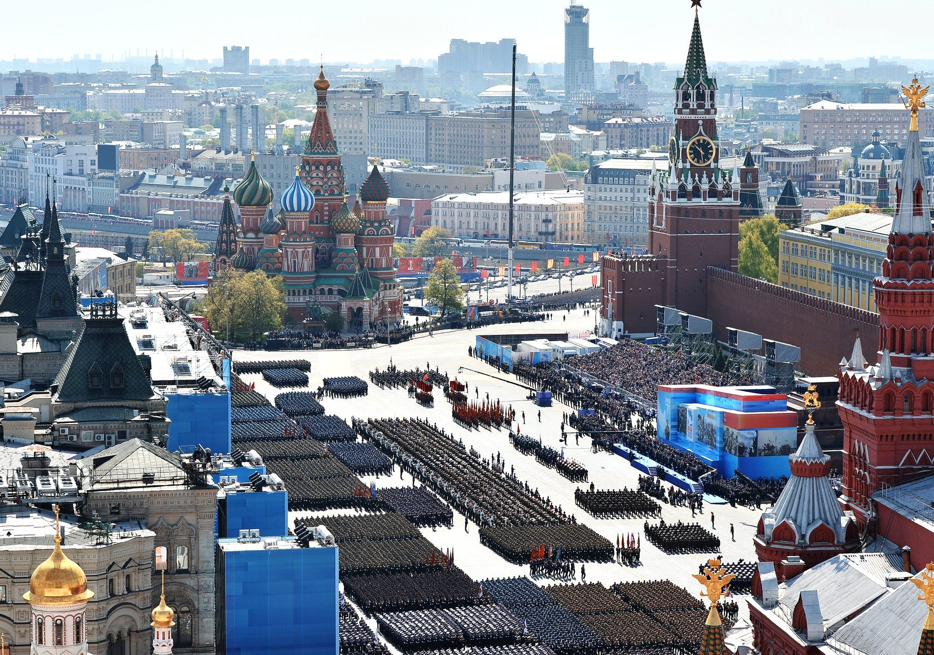
Annual commemorations, Russia
Celebrating the 70th anniversary of Soviet Russia’s victory in the Great Patriotic War, Moscow 9 May 2015.
(kremlin.ru via Wikimedia Commons, CC BY-SA 4.0 International)
The moment of victory in 1945 was often commemorated annually in following years. Even after the collapse of the Soviet Union in 1991, the Russian Federation has continued to celebrate 9 May as a public holiday. However, some of the former Soviet Republics, like Lithuania and Poland, have instead started to celebrate Victory in Europe Day on 8 May, like Western European countries. There is both continuity and change in the way the victory of 1945 is commemorated.

Slide 12
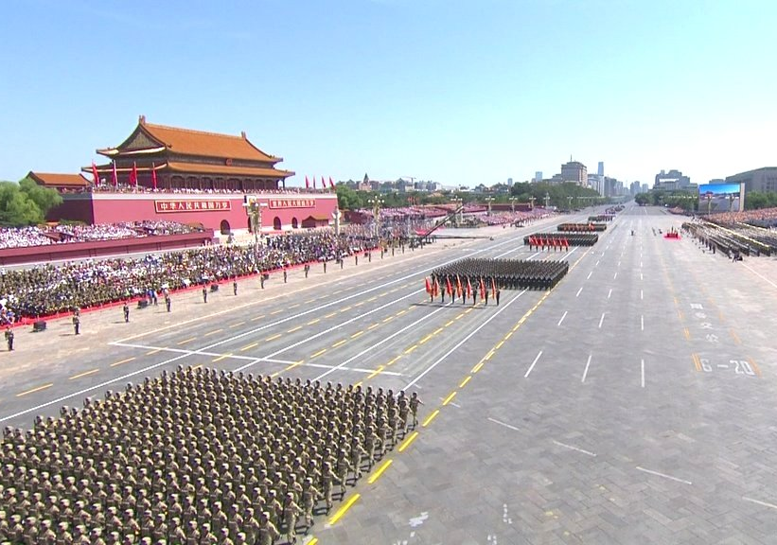
Annual commemorations, China
Military parade during China’s 70th anniversary celebrations of the end of the Second World War, Tiananmen Square in Beijing, 3 September 2015.
(kremlin.ru via Wikimedia Commons, CC BY-SA 4.0 International)
The Chinese Communist Revolution of 1949 meant that China was almost completely cut off from the historical traditions of the rest of the world. The rapid modernisation of China since the 1990s has re-connected China with world affairs, as was demonstrated by the celebrations of the 70th anniversary of the end of the war in 2015.

Slide 13
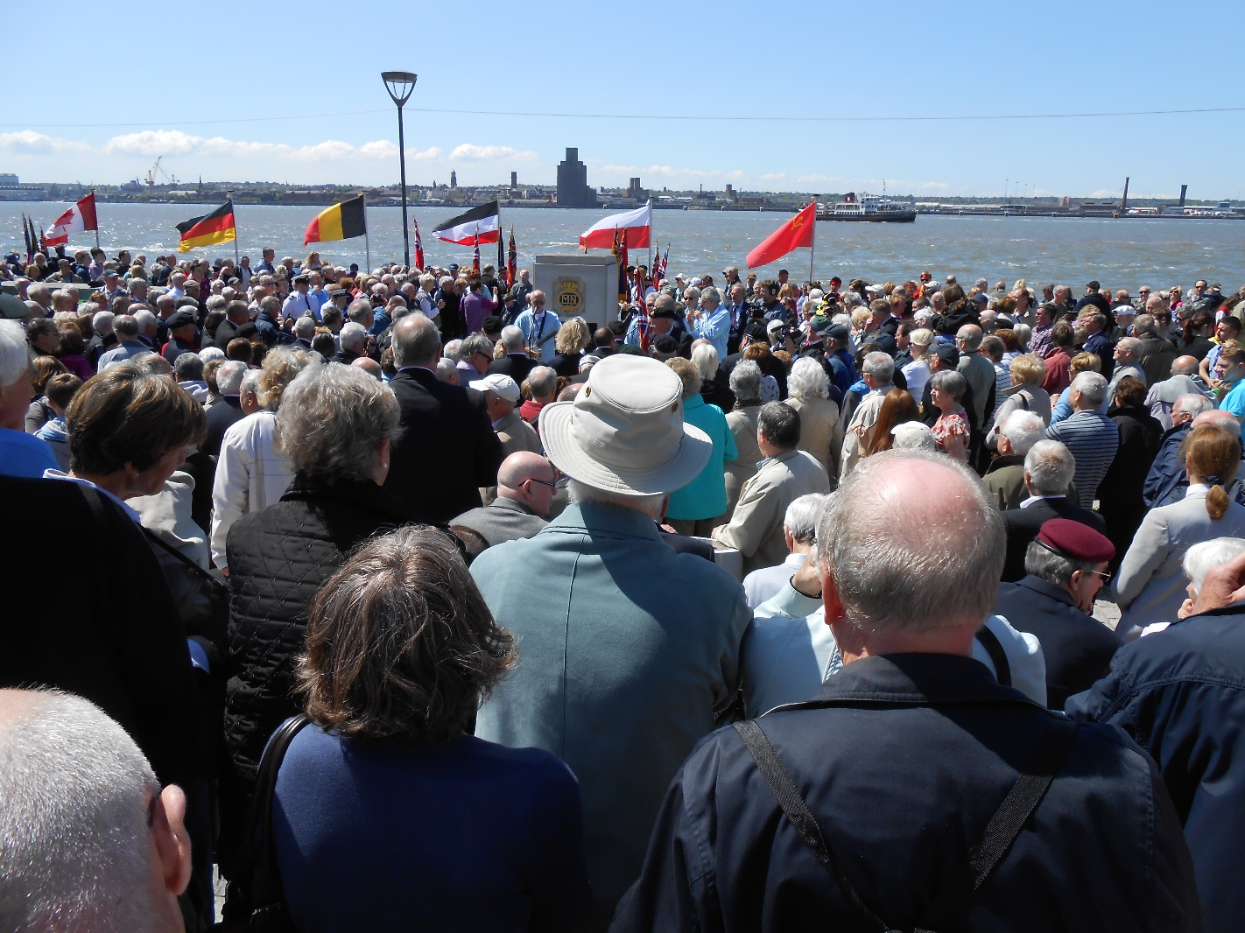
Annual commemoration, Great Britain
Battle of the Atlantic on the 70th anniversary celebrations in Liverpool on 25 May 2013.
(Wikimedia Commons, CC BY-SA 3.0 Unported)
The Battle of the Atlantic was fought between Allied convoys bringing vital supplies for Britain’s war effort against the German U Boats attempting to break Britain’s maritime lifeline to America. This battle, fought by merchant seamen as much as by fighting navies, was essentially won by May 1943. Particular emphasis on the commemoration of that victory has been given to annual ceremonies in Liverpool, headquarters of the defence of the Western Approaches to Britain, and in Canada, from where so many convoys set off on the perilous Atlantic crossing.

Slide 14
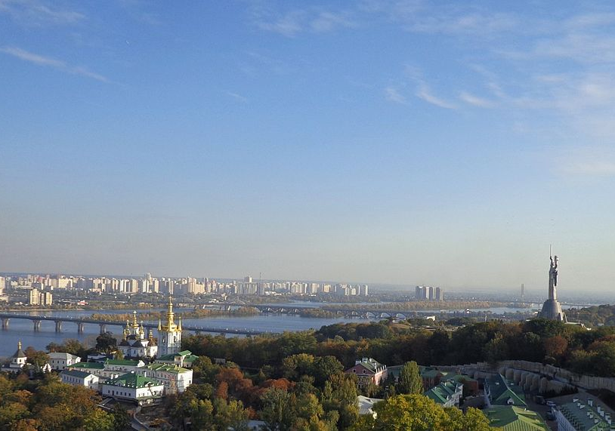
Rodina Mat, Kiev
Rodina Mat (Mother of the Motherland) dominates the skyline of Kiev.
(Wikimedia Commons, CC BY-SA 4.0 International)
From its place on a grassy cliff high above the Dnieper river, the huge statue of Rodina Mat (Mother of the Motherland) has dominated the city of Kiev since it was built in 1981 – when Kiev was in the Soviet Union, not as it is now the capital of independent Ukraine. Beneath the statue is a proudly patriotic museum glorifying the Red Army. Despite the political changes since 1991, Rodina Mat remains in place, still symbolising unquestioning pride in the victory over Fascism achieved in 1945.

Slide 15
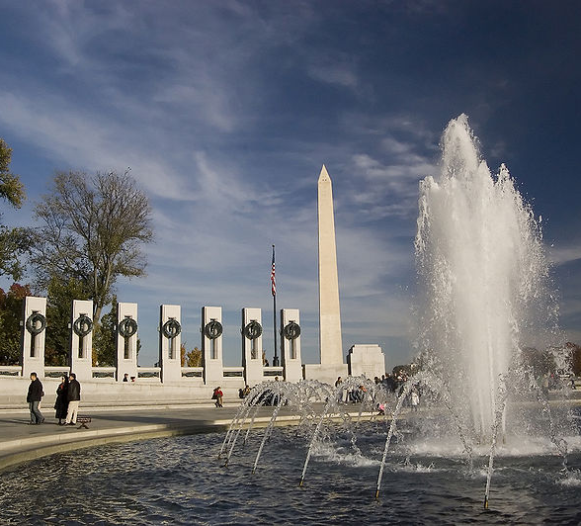
National memorial in Washington DC
Initiated by a World War Two veteran, the process of building a national memorial in Washington DC began in 1987. It was opened by President George W. Bush 2004. The memorial is dedicated to American soldiers and civilians of the Second World War.
National memorial to World War Two in Washington DC.
(Wikimedia Commons, CC BY-SA 3.0 Unported)

Slide 16
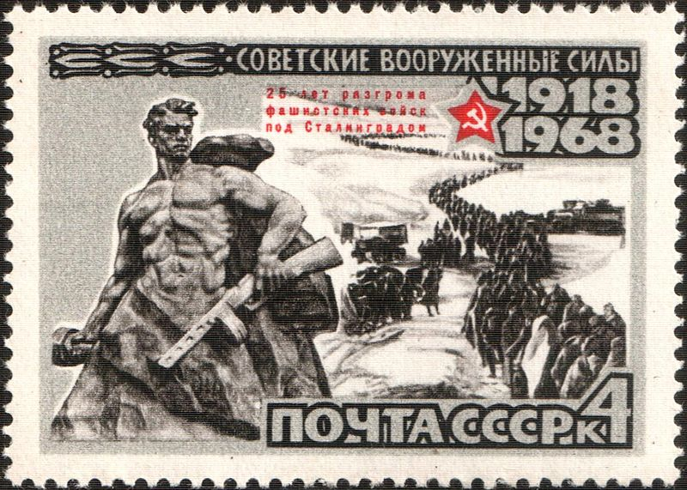
Commemorate the 25th anniversary of victory in the Battle of Stalingrad
USSR Postage stamp (CPA 3611) issued in 1968 to commemorate the 25th anniversary of victory in the Battle of Stalingrad
The combined images show the Stalingrad Monument by Yevgeni Vuchetich and the columns of defeated German
Troops being led away into captivity.
(Wikimedia Commons, Public Domain)

Slide 17
Loss: remembering the victims
The Second World War brought catastrophic loss of life to all the combatants, victors as well as losers. Public commemorations understandably laid great weight on remembrance of the fallen. In Britain and France, such remembrance was closely aligned with the memory of the First World War. Many war memorials, such as the Cenotaph in Whitehall in London, seamlessly connected the two great conflicts as part of the same narrative.
Reverent commemoration of the victims of war were often heavily influenced by denunciation against those deemed guilty of warmongering and aggression. All over Eastern and Central Europe the sites of the Nazi concentration camps became frozen in time as places of remembrance and reminders of ‘German guilt’. The memory of places which had witnessed particularly horrific wartime atrocities, such as Babi Yar near Kiev, or Oradour-sur-Glane, or the Katyn Forest near Smolensk, or the Burma Railway where POWs suffered at the hands of the Japanese, were kept alive not only as memorials to the innocent victims but also as angry accusations against the perpetrators. As a result, many bitter memories and grievances remained strong, making it difficult to win acceptance for more reflective forms of commemoration leading to peace and reconciliation.

Slide 18
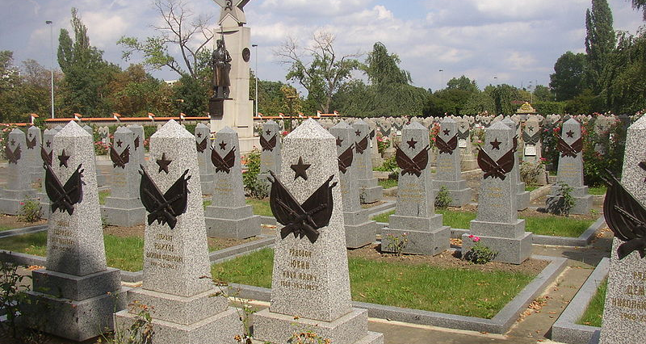
Mass graves
Victory in the Second World War was gained at a terrible cost. In every theatre of war, mass graves commemorated the fallen. These are graves of Red Army soldiers who died during the liberation of Czechoslovakia Olsany Cemetery, Prague.
(Wikimedia Commons, Public Domain)

Slide 19
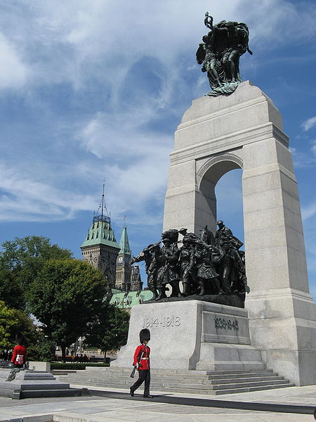
The ‘unknown soldier’
Many acts of commemoration focused on the idea of the ‘unknown soldier’ because so many of those who fell in the First and Second World Wars died in circumstances where it was impossible for them to be identified or returned to their families. Here, soldiers are guarding the Tomb of the Unknown Soldier, which part of the National War Memorial of Canada, Ottawa.
(Wikimedia Commons, CC BY-SA 3.0 Unported)

Slide 20
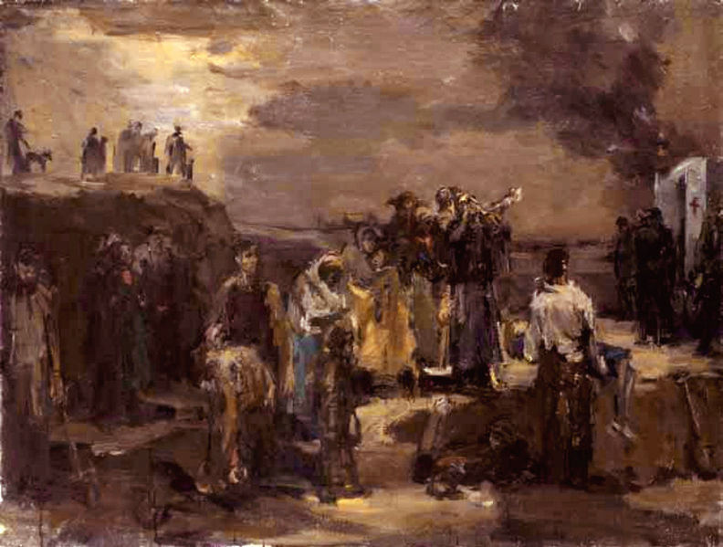
Remembering Babi Yar
Execution at Babi Yar. Painting by Felix Lembersky ca. 1944-52.
(Wikimedia Commons, CC BY-SA 3.0 Unported)
The massacre of 34 000 Jews at the ravine known as Babi Yar near Kiev in September 1941 was one of the most notorious atrocities of the Second World War. There were other massacres at the same site in the following months. After Kiev was recaptured in 1943, great publicity was given to the Babi Yar massacres by Soviet propaganda. In 1962, there was the first performance in Moscow of the Thirteenth Symphony by Dmitri Shostakovich, a choral symphony set to poems by Yevgeni Yevtuschenko dedicated to the memory of Babi Yar.

Slide 21
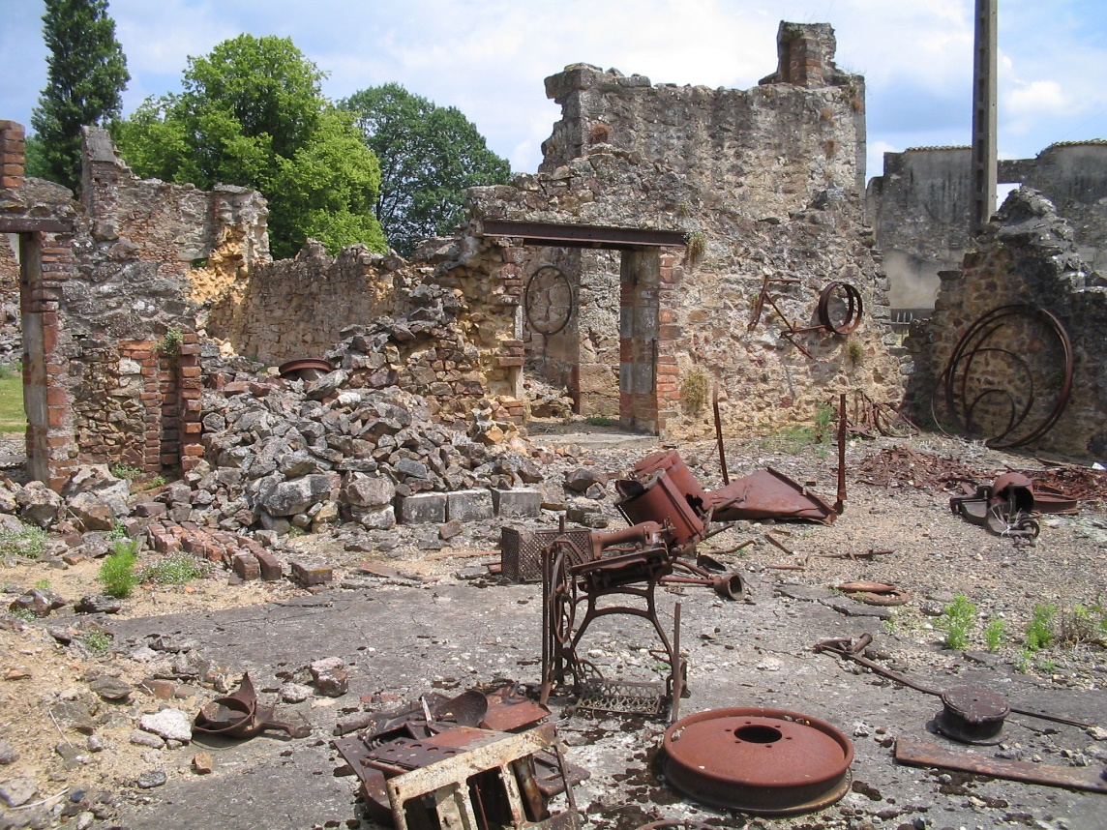
Oradour-sur-Glane
(Wikimedia Commons, Dennis Nilsson (2014), Public Domain)
In 1944, the village of Oradour-sur-Glane , near Limoges in France, was destroyed and its civilian population massacred by German SS units 1944, in mass reprisals to punish the French Resistance for obstructing the northward march of the Das Reich Division. They never rebuilt Oradour. Its ruins were left as a permanent memorial. This was both in acknowledgment of the innocent civilian victims and as a standing accusation against the perpetrators. These are the ruins of Oradour-sur-Glane as they were left after the massacre of its civilian population by German forces in 1944.

Slide 22
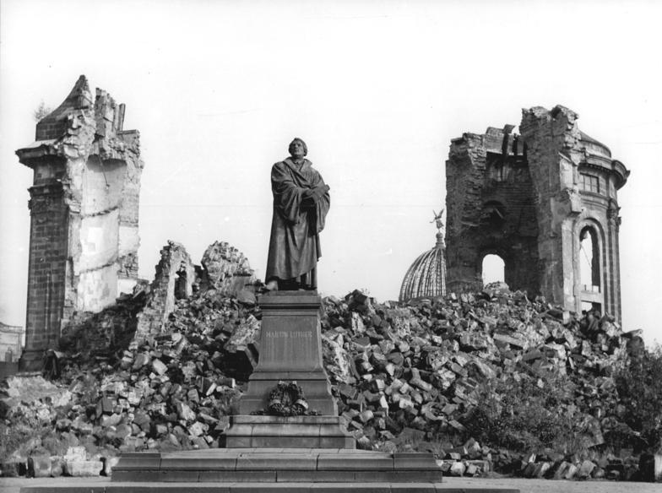
The ruins of Dresden
(Bundesarchiv, Bild 183-60015-0002, Giso Löwe, CC-BY-SA 3.0)
Unlike most European cities badly damaged by war, the historic city of Dresden was not rebuilt after 1945 but remained in ruins. This fitted in with post-war Communist ideology; Dresden had been destroyed by ‘Fascism’. In the post-war era, many East Germans (supported by some liberal voices in the West) regarded the destruction of Dresden as a war crime – as an unnecessary exercise of the power of mass bombing. The picture showsw the Ruins of Dresden in 1958: the great Frauenkirche as it was left after the devastation of Dresden by Allied bombing raids in 1945.
After the end of the Cold War and the reunification of Germany, Dresden was rebuilt by a joint international effort dedicated to peace and reconciliation.

Slide 23
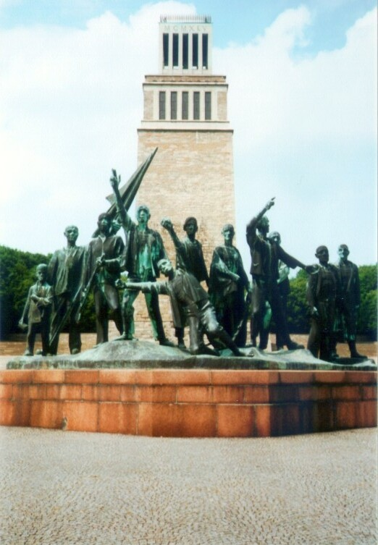
The Buchenwald Memorial
The Buchenwald memorial at the Nazi concentration camp near the historic city of Weimar was designed by Professor Fritz Cremer. The memorial originally reflected the perspective of Soviet Communism and the German Democratic Republic, by the way it emphasised the resistance of the communist inmates. The way in which the memorial is presented now takes into account the wider perspectives that have been recognised since the end of the Cold War. It also recognises other inmates of the camp, including Jews, Sinti and Roma people as well as so-called work-shy, asocials, habitual offenders and homosexuals.
Buchenwald memorial commemorating the self-liberation of the prisoners at KZ Buchenwald 11 April 1945.
(Wikimedia Commons, CC BY-SA 3.0 Unported)

Slide 24
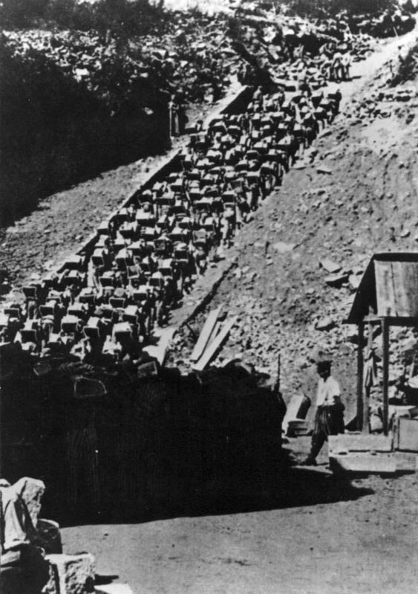
KZ Mauthausen
Since its liberation in 1945, concentration camp KZ Mauthausen has remained as a site of silent memory; an empty shell left as a warning to future generations. One of the most striking memorials at Mauthausen is the ‘Todes Stiege’ (‘Staircase of Death’) that leads up from the huge quarry that was the main economic enterprise at the camp. Prisoners were brutally exploited as forced labour, climbing up the steps four abreast, carrying heavy blocks of granite stone. Many died on the steps; others resorted to suicide to avoid the crushing workload.
Prisoners climbing the Staircase of Death at Mauthausen.
(German Federal Archive, CC BY-SA 3.0 De)

Slide 25
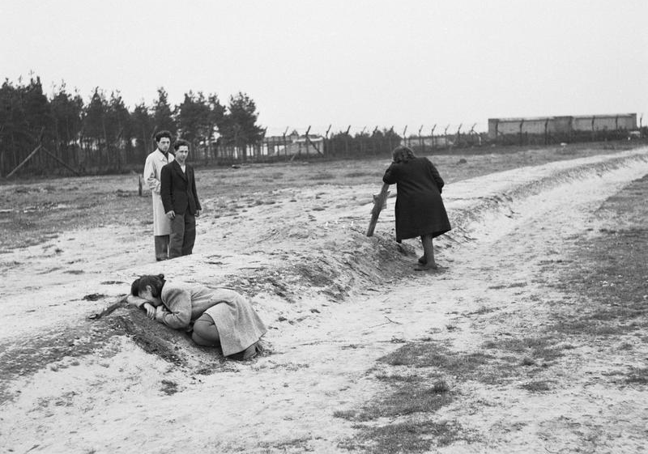
KZ Bergen-Belsen
(Imperial War Museum, © IWM (BU 12578), re-used under the IWM Non Commercial Licence)
Bergen-Belsen concentration camp buildings were burned to the ground after the liberation in April 1945. However, since 1945, survivors of the camp have erected memorials on the site and for a long time it has been the survivors themselves who also organised memorial events. Here, two former inmates weep over one of the mass graves on the first anniversary of liberation of Bergen-Belsen concentration camp.

Slide 26
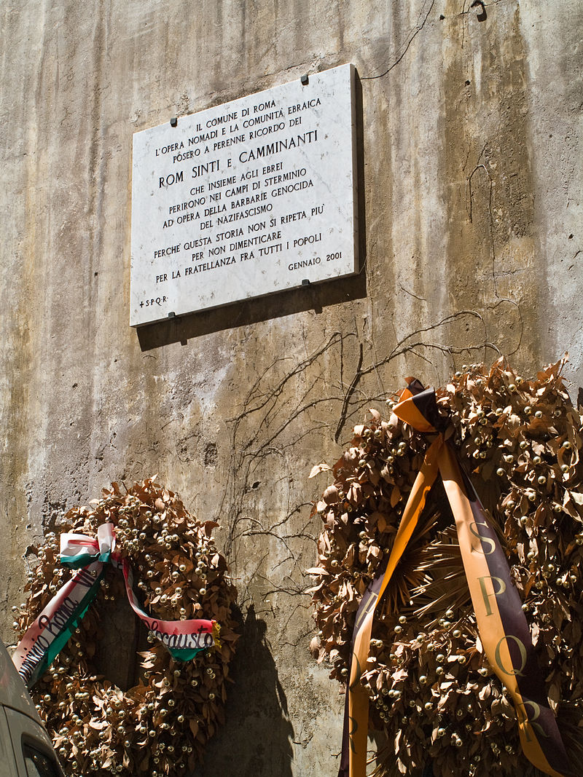
Memorial in Rome in memory of Romani people who died in the Holocaust
Many small and modest memorials commemorated victims perceived as being forgotten or ‘written out of history. Romani people across Central and Eastern Europe suffered appallingly during the Holocaust, but their fate was often overshadowed by the understandable focus on the mass extermination of millions of European Jews.
(Wikimedia Commons, Photographer: Myrabella (2009), CC BY SA 3.0 Unported)

Slide 27
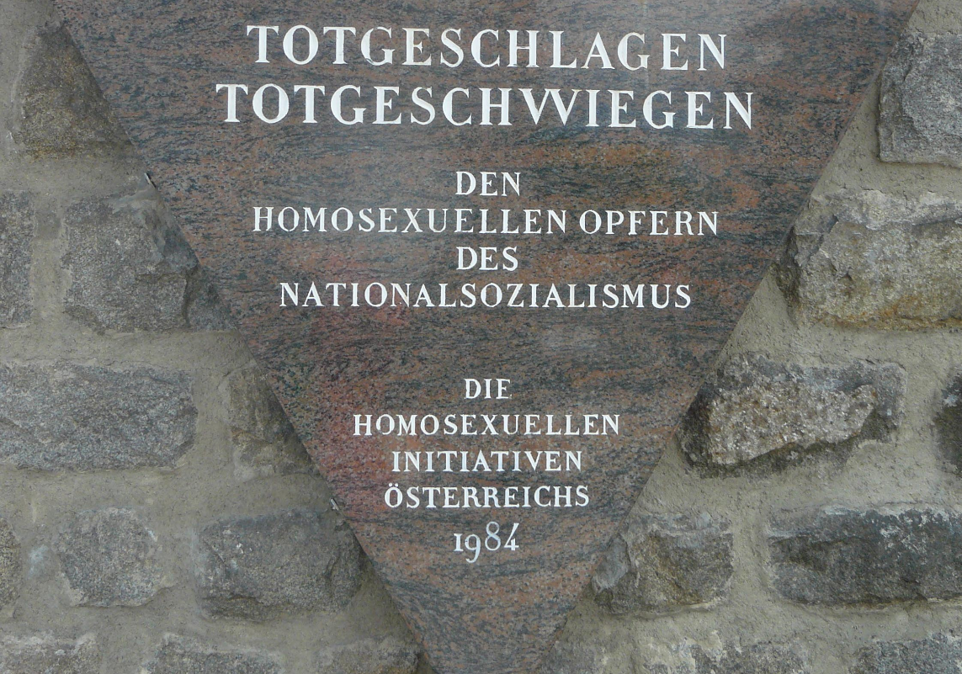
Homosexual victims of Nazism
(Wikimedia Commons, Public Domain)
Understandably, because of the enormous numbers of European Jews who perished in the Holocaust, commemorations of Nazi crimes against humanity were dominated by the themes of anti-Semitism and the mass extermination of Jewish people. But the Nazi regime sent other groups deemed to be ‘racial enemies and degenerates’ into the death camps, too. As time passed after 1945, memorials to these groups, such as Roma people and those who were persecuted for homosexuality, were erected. This is a memorial plaque at KZ Mauthausen, erected in 1984 In memory of the homosexual victims of Nazism.

Slide 28
Local remembrance
Alongside the large-scale public commemorations of the war, there was a huge range of unofficial commemorations. These included many small, local war memorials. For example, thousands of monuments appeared all across France in memory of heroic actions by Resistance fighters, or victims of Nazi reprisals. Throughout the post-war years, monuments and plaques continued to be erected in remembrance of individuals and groups who had been ‘forgotten’ or overlooked in the first wave of official commemorations.

Slide 29
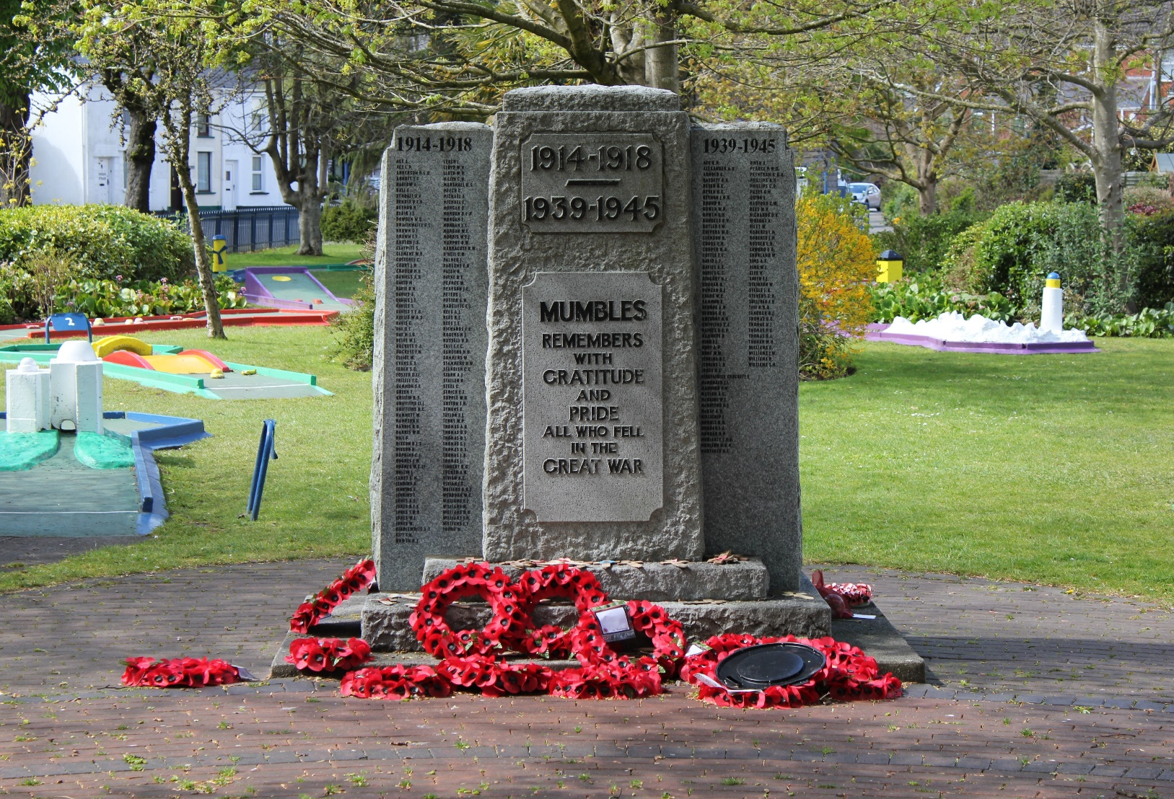
Mumbles war memorial, South Wales
After the Second World War, many local war memorials to those who fell in the First World War were adapted to include also names from 1939 to 1945.
(Wikimedia Commons, CC BY-SA 3.0 unported)

Slide 30
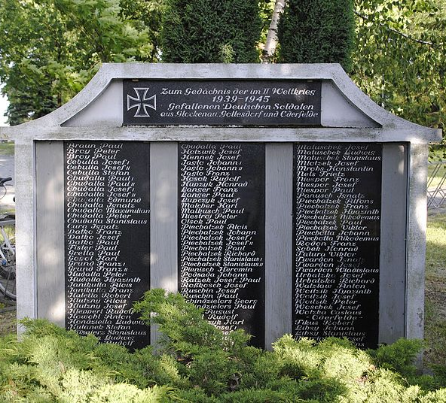
War memorial in Silesia
Soldiers died fighting for defeated armies as well as victorious ones. Though neglected in official commemorations, they were often remembered in small local monuments. This is a war memorial to German soldiers who died in the Second World War at Boguszyce in Silesia. The region was part of Germany until 1945 but then incorporated into Poland.
(Wikimedia Commons, CC BY-SA 4.0 International)

Slide 31
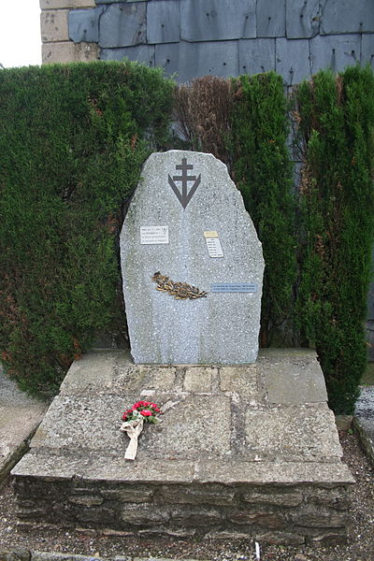
French monuments to the Resistance
Thousands of small local monuments were erected in France to honour groups and individuals who fought in the Resistance. This is a memorial to the resistance fighters in the Benjamin Group, at Labastide-Rouairoux, Departement Tarn, southern France.
(Wikimedida Commons, CC BY-SA 4.0 International)

Slide 32
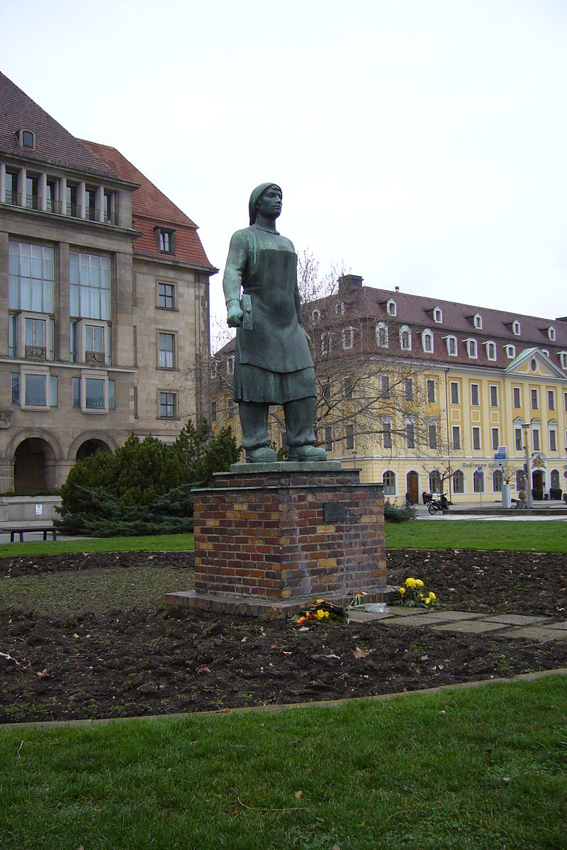
Trümmerfrauen
At the end of the Second World War, Germany was ‘a land without men’. The arduous work of clearing the rubble from Germany’s bombed-out cities was done mostly by ‘Trümmerfrauen’ (Rubble Women). Their contribution was commemorated by a few monuments such as a statue in Dresden.
This memorial is dedicated to the “Rubble Women” of Dresden who, in a difficult period, laid the groundwork for the reconstruction of the destroyed city with their own hands.
(Wikimedia Commons, Photographer: Torsten (2007), CC BY-SA 3.0 unported)

Slide 33
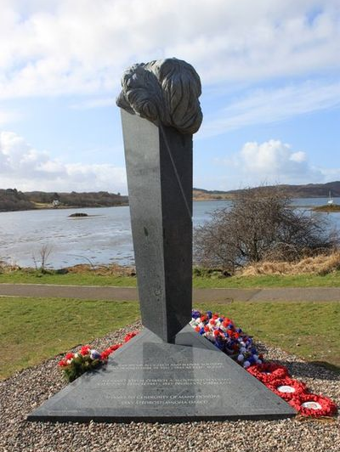
The Arisaig memorial
In 1942, Czech and Slovak volunteers were parachuted into Nazi-occupied Czechoslovakia to carry out an attack against Reinhard Heydrich, the Nazi ‘Protector of Bohemia and Moravia’. The operation succeeded in killing Heydrich, but almost all of the British-trained fighters were killed after the manhunt that followed Heydrich’s death. There were also vicious reprisals against Czech civilians. The Arisaig memorial in the Scottish Highlands was erected in 2010 to commemorate Czech and Slovak agents who trained nearby at a secret base run by SOE the (Special Operations Executive).
(Wikimedia Commons, CC BY-SA 2.0)

Slide 34
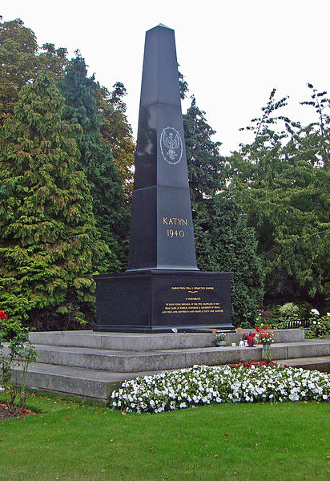
Remembering Katyn
After the Soviet occupation of eastern Poland in 1940, under the terms of the 1939 Nazi-Soviet Pact, 7000 Polish army officers were murdered on the orders of Stalin and Beria. Their bodies were buried in unmarked mass graves in the forest at Katyn, near Smolensk. From 1943, Soviet propaganda claimed that the murders had been committed by the Nazis, after the invasion of Russia in 1941. The Polish community in the United Kingdom raised money for a permanent memorial to the victims of Katyn; but their plan was fiercely opposed by the governments in Moscow and Warsaw because they said the date of the massacre was given as 1940 (i.e. before the Nazi invasion of Poland) and that this was unproven.
The monument was finally erected in 1976. A plaque saying “Murdered by the Soviet secret police on Stalin’s orders” was added in 1990. Memorial in Gunnersbury Cemetery in Middlesex, West London to the Polish army officers murdered in the Katyn Forest Massacre and the other Polish prisoners of war intelligentsia who were also murdered at that time.
(Wikimedia Commons, CC BY-SA 4.0 International)

Slide 35
Personal remembrance
Alongside the large-scale public commemorations of the war, there was a huge range of more personal acts of remembrance. Many people recorded their experiences and perceptions in diaries, or poems and novels, or works of art. Such forms of remembrance often had a very different tone and emphasis from the public mood that prevailed immediately after the war. Many people also sought to rehabilitate the memory of those they thought had been unfairly categorised as the ‘guilty ones’. Over time, many of these personal and private commemorations passed into the mainstream and became part of the public sphere – as with the Diary of Anne Frank, or the many feature films that popularised stories that had previously been little-known.

Slide 36
Immortal Regiment Parades
What I intend to share here is a sense of the mood and composition of the crowd, as well as of the efforts of the city to provide the safety infrastructure that made it what it was: a family event.
As it turned out, the crowd was uniformly good humoured and focused on its private obligations to be met: the celebration of parents, grandparents, even great grandparents’ role in the war and reconfirmation of their status as family heroes whatever their military or civil defence rank, whether they survived or were among the countless fatalities.
Among the marchers, there were a great many family groups consisting of two and three generations. The latest demographic trends were on full display – young families with two or three children in tow. There were also young courting couples. Very few single elderly, or lone wolves in general.
An Eyewitness Account of the Immortal Regiment Parade in St Petersburg, 9 May 2016 by Gilbert Doctorow.
‘Immortal Regiment Parades’ commemorating family members who died during the Word War Two have been celebrated in Russia since 2007. Russian communities in other countries have also organised their own parades.
(Une parole franche blog, 10.5.2016)

Slide 37
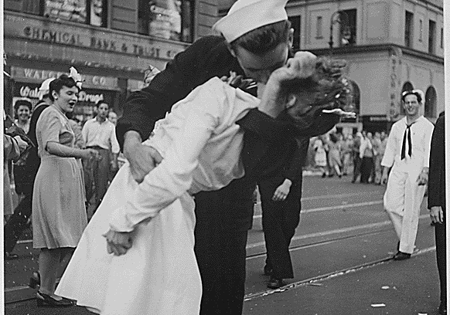
VJ celebration in New York
VJ celebration at the Times Square, New York.
(US National Archives (520697), Unrestricted use)
This image seemingly shows a carefree private moment during VJ celebrations in New York. It was reproduced so often in newspapers and newsreels that it has become an iconic part of the public memory. The clear ‘message’ of the photograph is of the joy and relief that accompanied the moment of victory; that this one kiss represented a symbol of a whole nation coming together. In reality, there is no certainty that the kiss was a happy symbol of joy given with consent. In the crowd many intoxicated sailors were kissing women who were passing by, and several sailors and nurses have since claimed to be in this iconic picture. Many women recalling the experience of the day have said they did not know who the man kissing them was, and some also said they found it unpleasant.

Slide 38
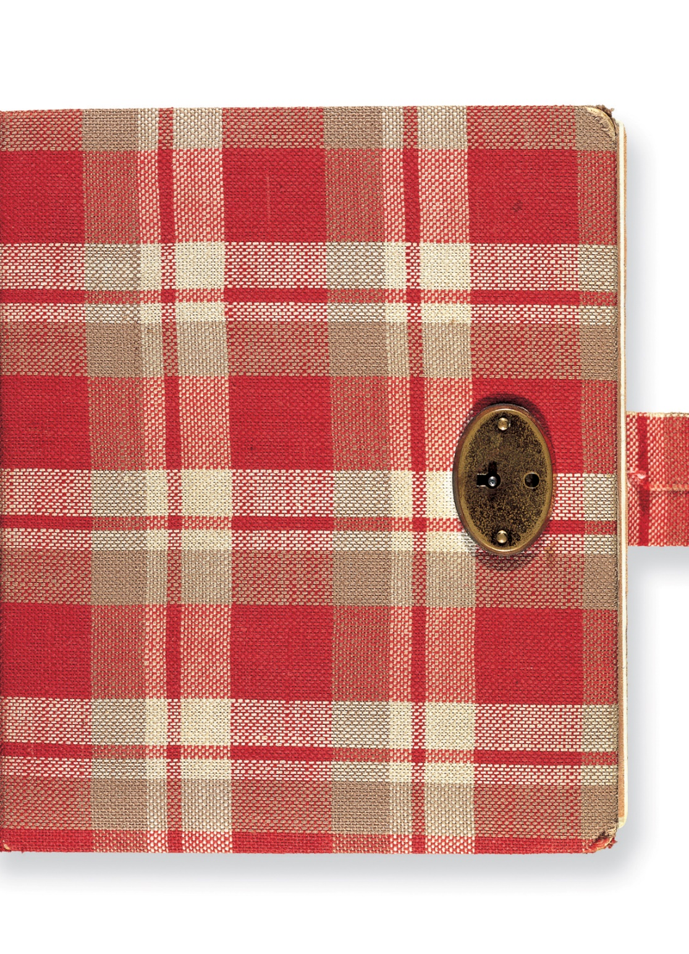
Anne Frank
Anne Frank was a young girl in a Jewish family that lived in hiding in Amsterdam during the Nazi occupation. The family was eventually arrested and deported to concentration camps. Anne and her sister Margot died in Bergen-Belsen Concentration Camp in 1945. Her mother died a year earlier. During her time in hiding, Anne wrote a vivid personal diary, which she hoped to publish after the war. Her father Otto Frank, who survived the camps, eventually got the diary published, and the story of Anne Frank has since become a strong symbol of the Holocaust.
The original diary of Anne Frank.
(Anne Frank House via Flickr, Cris Toala Olivares, CC BY SA-NC-ND 2.0 generic)

Slide 39
Christabel Bielenberg
Before the generals left, when their two huge motorcars were already drawn up outside the Adler Inn, a young adjutant slipped in to say goodbye. He knew I was English. ‘Goodbye, Gnadige Frau,’ he said. ‘Good luck. It won’t be long before you are home again. That’ll be the day for you!’ ‘I hope you’ll be home soon too, back to your studies perhaps,’ I answered. He had wanted to be a biologist, but had had to go into the army straight from school. The boy shrugged, and gave me a very old smile from such a young face. ‘Not very likely after this assignment’, he said.
Later, I climbed up the hill behind the house to find Peter. ‘Thank God it’s over Chris’, he said. ‘ But I just can’t help thinking about those poor devils who left today’. No, I thought, they won’t come back; nor will the hopes, the plans, the friendships. Here was this longed-for moment of liberation and I could not rejoice, but just stood there silently, watching the bonfires as they dimmed, glowed red, and went out, one by one, across the valley.
Christabel Bielenberg was an aristocratic Englishwoman who married Peter Bielenberg, a German lawyer in 1934. Christabel lived through the Third Reich as a wife and mother, and a German citizen: first in Hamburg and then, for two years at the end of the war, in a village in the Black Forest. In her first volume of memoirs, The Past Is Myself (Bielenberg, Chatto & Windus 1968), Bielenberg describes how German forces pulled out of her village as the Allied armies advanced, and how the moment of liberation brought complicated and ambivalent thoughts into her mind
(Christabel Bielenberg: The Past is myself (Corgi edn. 1988) pp. 281-282)

Slide 40
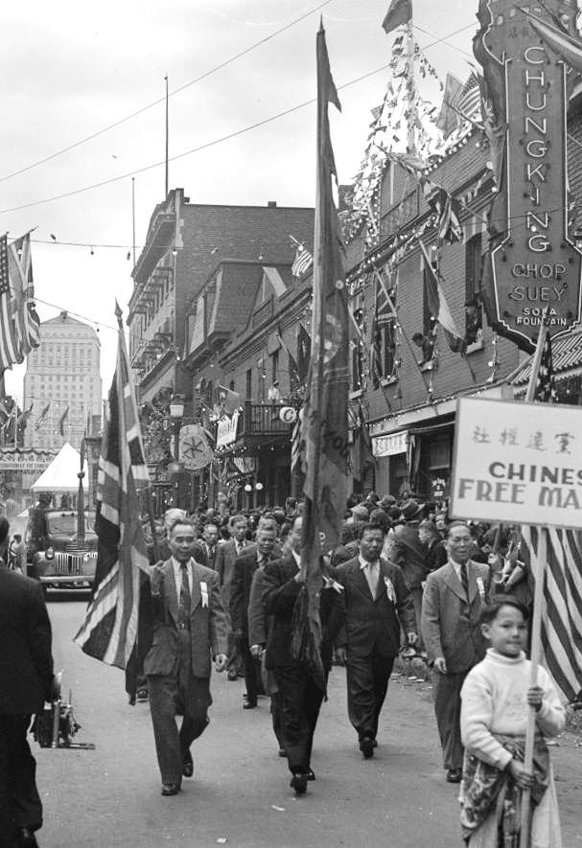
VJ Day among Chinese communities
‘V-J Day! Victory! Against Japan! The enemy had finally surrendered, and not only to the Allies, but to China as well! What a time to rejoice! Ah Dang, then working as a waiter at the Lotus Garden Café on Clark Street in Chinatown, joined the crowds on the streets – to celebrate, to grieve, and to breathe a concerted sight of relief. A few day later he lined up with the five-deep crowd of Chinese and whites to watch a parade. The streets were decorated with British and Chinese flags as well as silk banners and garlands of flowers. A temporary gate was constructed across Lagauchetiére Street, hung with banner proclaiming “V-J Day Celebration by the Chinese Community of Montreal” in both Chinese and English and festooned with flags, ribbons, and lanterns. --- When he heard that postal and telegraph services to China were open once more, his first action was to send a telegram to Ah Thloo.’
(May Q. Wong: A Cowherd in Paradise: From China to Canada (Brindle & Glass Publishing 2012) p. 97)
Montreal’s Chinese community out celebrating VJ Day.
(Wikimedia Commons, Public Domain)

Slide 41
Silence: resentment and rejection
For many countries, and for many people, the end of the war was not met with commemorations of heroic, glorious victory but with resentment, silence and rejection. For Germany, Italy and Japan the war represented bitter defeat, bringing the shame and humiliation of foreign military occupation amid economic and political collapse. There was a deep sense of grievance against what many perceived as the unfair actions of the victors. Even in countries where the war had resulted in national liberation, many people felt defeated or excluded because they were opposed to the political consequences of liberation. For millions of individual people, the war meant above all tragic personal loss, through the deaths of family members, or by the destruction of their homes, or the displacement of their communities. Many of those who had fought in the war were damaged by the experience and pushed the memory of it out of their minds – many refused to talk about it for decades afterwards. Even in victorious countries, there were many people who reacted against what they thought was the triumphalism and bombastic nationalism that accompanied victory celebrations.

Slide 42
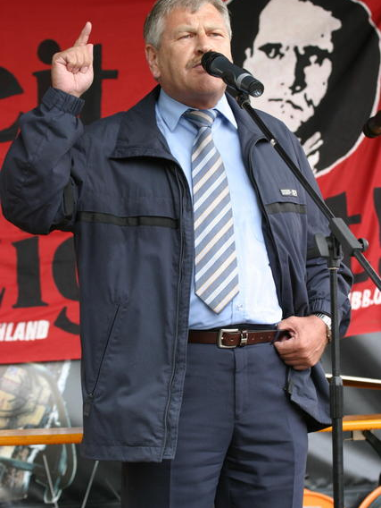
German Right-wing parties
Post-war governments in West Germany, and in reunified Germany since 1990 made strenuous attempts to apologise and to atone for the crimes of the Nazi regime. But a persistent right-wing fringe kept alive loyalties to extreme nationalism and the Nazi past. Many were ex-soldiers. Many were expellees – ethnic Germans expelled from Czechoslovakia and Poland in 1945.
In 1946 a small German Right Party was formed in Lower Saxony which merged into the DRP (German Empire Party) in 1950. In 1964 the NPD (National Democratic Party of Germany) was founded. The NPD managed to win some seats in local elections, but was never able to break through the ‘5 per cent rule’ that excluded fringe parties from federal politics unless they achieved 5 per cent or more of the vote. In 2003 there was an attempts to outlaw the party, but this was blocked by the courts. Here we see Udo Voigt, leader of the far-right NPD Party, speaking in praise of Rudolf Hess on the tenth anniversary of Hess’s death in 2007.
(Wikimedia Commons, Photographer: Marek Peters (21.8.2004), www.marek.peters.com, GNU Free Documentation Licence)

Slide 43
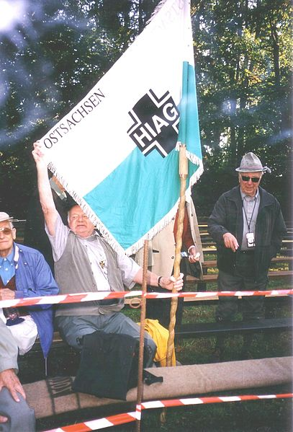
Mutual Aid Society for Former Members of the Waffen SS
The HIAG (Mutual Aid Society for Former Members of the Waffen SS) was founded in Bonn in 1951 as a pressure group with the aim of gaining rehabilitation for soldiers who had served in the Waffen SS. Its first leader was Paul Hausser, a former general in the Waffen SS. HIAG owned a publishing house, producing many books and a monthly magazine, ‘Der Freiwillige’ (Free Will). It was finally banned in 1992, following the reunification of Germany. Here is a meeting of HIAG supporters at Ulrichsberg Mountain, eastern Saxony, 2003.
(Wikimedia Commons, Josef Kriegl, Free to use if attributed)

Slide 44
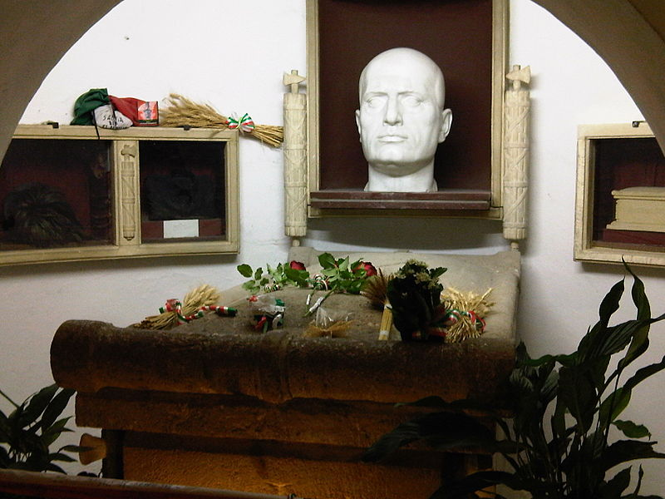
Commemoration of Benito Mussolini in the house of his birth at Predappio
(Wikimedia Commons, Lovio at It.Wikipedia, GNU Free Documentation Licence)
Not everyone rejoiced at the overthrow of the Fascist dictators. Many Italians remained loyal to the memory of Mussolini, whose birthplace at Predappio became a shrine. In Austria, the town authorities at Hitler’s birthplace, Braunau-on-the-Inn, took strenuous measures to prevent it becoming a shrine to the Fuhrer.

Slide 45
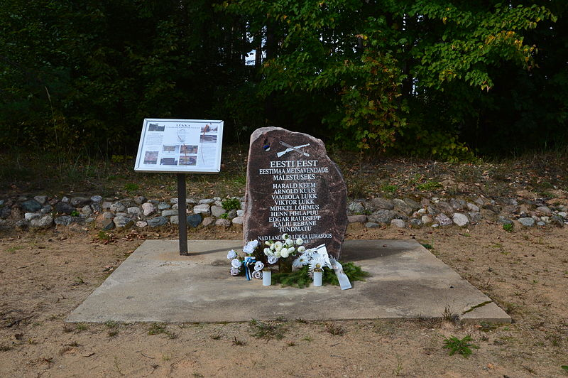
Memorial at Rouge, Estonia in memory of the Forest Brothers partisans
(Wikimedia Commons, CC BY-SA 4.0 International)
From 1918 to 1940, Estonia, Latvia and Lithuania were independent states. They were then annexed by the USSR in 1940 and occupied by Nazi Germany from 1941. After the ‘liberation’ of the Baltic States in 1945, when they were forced back into the USSR, many nationalists rejected the Soviet view of the Great Patriotic War.
Several partisan groups such as the Forest Brothers in Estonia had fought on against Soviet control. During the later history of the USSR these partisans were denounced as traitors and ‘fascists’ – but after 1991 their memory was reclaimed as patriotic freedom fighters.

Slide 46
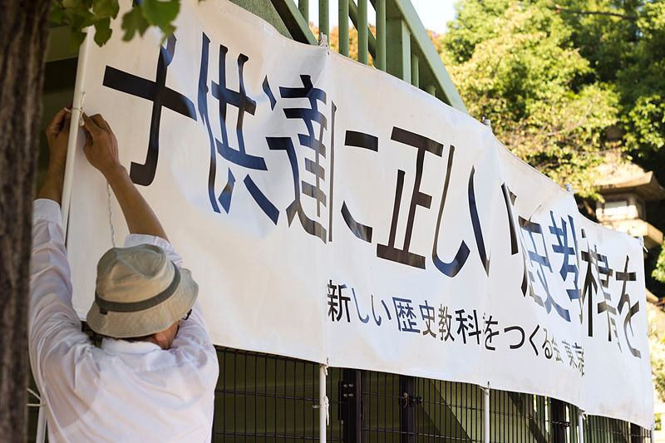
Right-wing groups in Japan
A poster for the right-wing nationalist group Japanese Society for Textbook Reform, 2014.
(Wikimedia Commons, © Japanexperterna.se., CC BY-SA 3.0 Unported)
After 1945, Japan responded to defeat and occupation in a different way to West Germany. There was little attempt to confront the evils of the past, partly because the Emperor was still in place, and partly because there was not a close relationship with Japan’s neighbours (as was the case with West Germany and France and the Benelux countries.
Right-wing groups continued to take a revisionist view of Japan’s role in the Second World War, and to demand that school textbooks should ‘properly recognise’ the ‘positive aspects’ of the Empire of Japan.

Slide 47
Belated recognition: changing perceptions of the defeated
The public commemorations of the Second World War were dominated by the victors. It was the values and self image of the victorious powers that set the tone for how the war should be remembered and what moral lessons should be learned from it. War crimes by the enemy were highlighted, but war crimes by the victors were not acknowledged. Soviet propaganda, for example, concealed or distorted many dark memories, including massacres, deportations, and the mass rape of German women in 1945. In West Germany, from the 1960s, there was public acknowledgment of Nazi war crimes, though many Germans wanted simply to forget the war. In Japan, large sections of society remained in denial about Japanese war crimes against China, or Japan’s dreadful mistreatment of the so-called ‘comfort women’. Many people living with defeat after the war eagerly adopted the ideals of the victors and renounced the evils of previous regimes; many others simply opted for silence and forgetting.
Over time, attitudes changed, both from the defeated and from the victors. Within the defeated nations, there was more readiness to admit unwelcome truths about the past, or to rehabilitate the memory of people who had previously been condemned. From the standpoint of the victors, it became possible to admit past evils and mistakes. In the United States, for example, the internment of many blameless Japanese Americans in internment camps was brought into the open. In Britain, there was recognition of the scale of the destruction caused by mass bombing. The end of the Cold War also affected historical memory. In countries that emerged out of the former Soviet Empire, such as Poland, Ukraine and the Baltic States, the end of the Cold War released many nationalisms that had been suppressed since 1945. There was a reversion to triumphant celebrations of national heroes, and to accusations against their enemies.

Slide 48
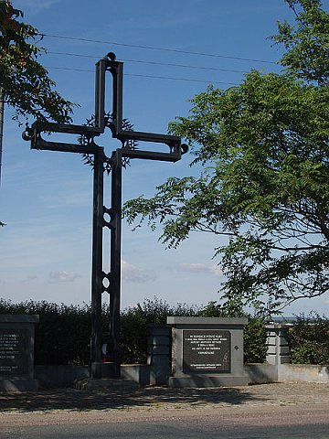
Remembering the expelled ethnic Germans
After the liberation of Czechoslovakia from German occupation in 1945, there was a wave of violent revenge attacks against the ethnic German population. Three million people from what had previously been the Sudetenland were driven out by ‘wild expulsions’ and government decrees.
During the Cold War, the suffering of the expellees was not recognised by the Communist regime. It was only after 1990 that the expulsions were acknowledged and efforts made to secure apologies and reconciliation. Several memorials were erected to commemorate these ‘forgotten victims’.
This memorial was set up at Pohorelice in southern Moravia in 2002, in memory of ethnic Germans who died during the ‘Death March’ from Brno after being expelled from Czechoslovakia in 1945.
(Historiana, © http://www.radio.cz/)

Slide 49
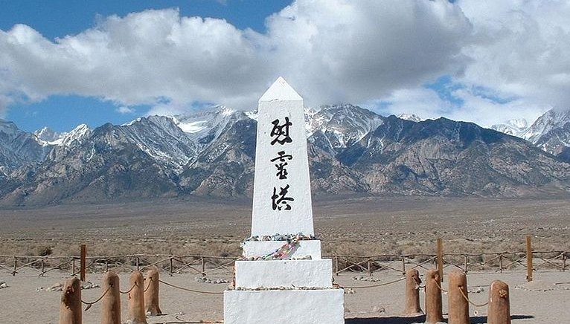
Remembering Japanese Americans
(Wikimedia Commons, Daniel Mayer (2002), CC BY-SA 3.0)
After Japan attacked Pearl Harbour in December 1941, there was a backlash against Japanese Americans in the United States. More than 100000 Japanese Americans were forced into internment camps, even though there was no evidence to indicate they might be disloyal. After the war what happened to the Japanese Americans received little attention, though it was highlighted to some extent by a Hollywood film Bad Day At Black Rock, released in 1955.
The first Day of Remembrance for Japanese American internees was 1978. In 1988 President Ronald Reagan signed a Civil Liberties Act that provided for financial compensation to the internees and their descendants.
This shrine is to Japanese Americans interned in the camp at Manzanar in California. The Japanese inscription reads: ‘Monument to Console the Souls of the Dead’.

Slide 50
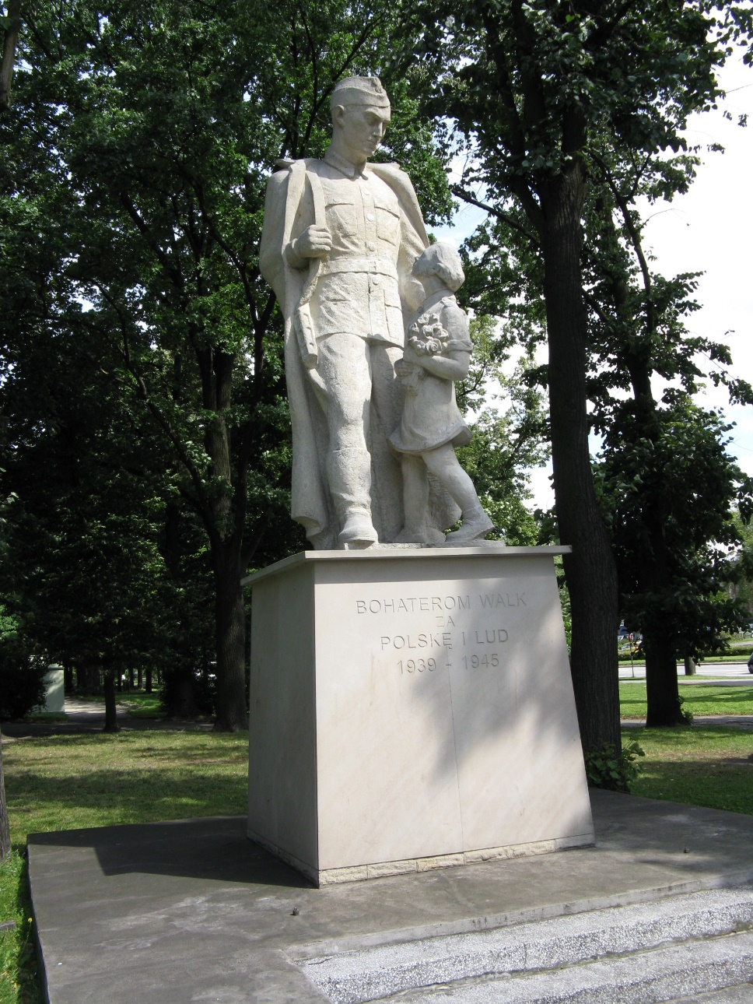
Memorial to the Polish Communist Army in Piotrkowie Trybunalskim
Between 1945 and 1900, Poland was governed by a pro-Soviet Communist regime. Monuments commemorating the war were put in place all over Poland, glorifying the contribution of Polish Communist forces alongside the Red Army. After the fall of Communism, many of these monuments came to be regarded as inappropriate. In April 2016, the Polish Institute of Remembrance announced plans to remove more than 500 of them and place them in museums as examples of Communist propaganda. A Russian spokesman claimed that: “the Poles are hitting out not only at our countries’ shared historical memory but at their own history as well.”
(Wikimedia Commons, CC BY-SA 3.0)

Slide 51
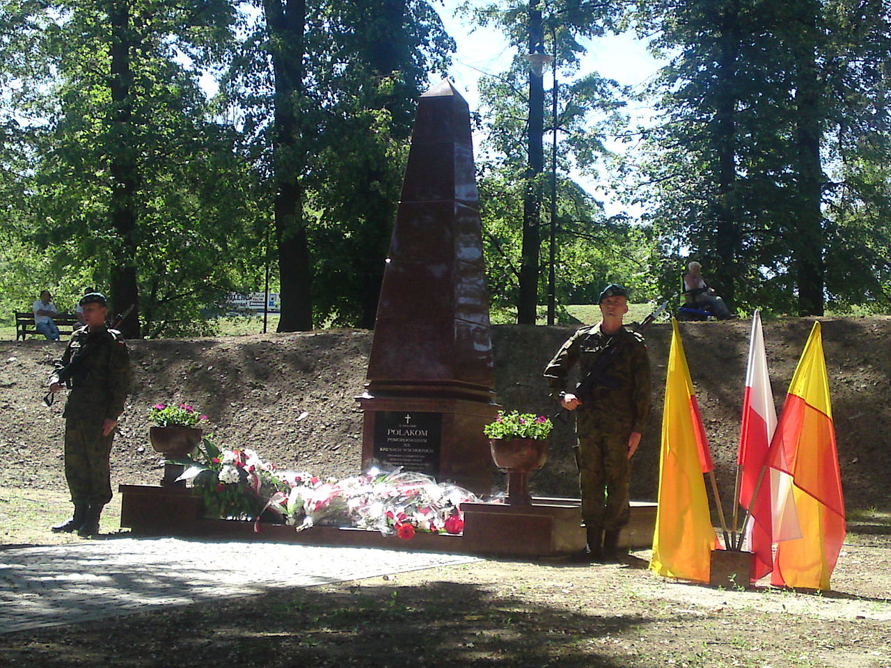
Monument at Klodzko
(Wikimedia Commons, Glaube (2011), CC BY-SA 3.0 Unported)
Wolyn (Volhynia) province has been part of Western Ukraine since the end of the Second World War. Before the war it was part of Poland; in 1943 and 1944 many of the Poles living in Wolyn were driven out or killed by the Ukrainian Insurgent Army (UPA). After 1945, the whole region was under Soviet domination; the USSR enforced a large-scale population exchange that moved the borders of Ukraine far to the west. After the collapse of the USSR in 1991, what happened in Wolyn became once again an issue of controversy and conflicting nationalisms. This is a monument at Klodzko in memory of Polish people killed by the Ukrainian Insurgent Army in 1943.

Slide 52
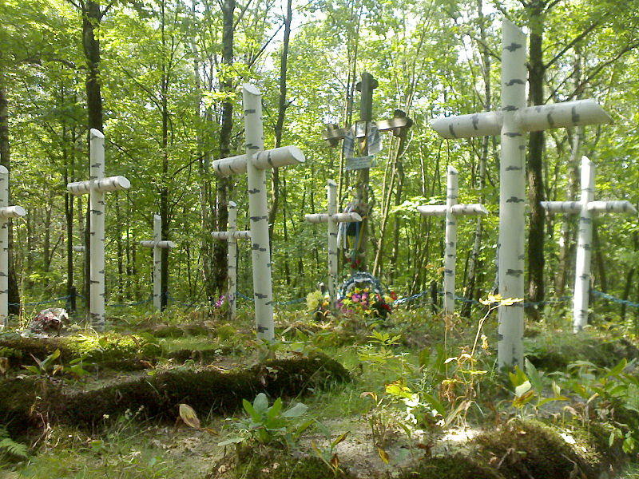
UPA (Ukrainian Insurgent Army) cemetery at Tarnopol, Western Ukraine
(Wikimedia Commons, Onekca (2007), CC BY-SA 3.0 Unported)
After the collapse of the USSR in 1991, Ukraine became once again an independent country, as had briefly been the case in 1918. The Soviet perspective of the actions of the Ukrainian Insurgent Army (UPA) during the Second World War had been that they were war crimes by ‘fascist’ militias. But in the new mood in Ukraine after independence, especially after the Orange Revolution of 2004, many Ukrainian nationalists claimed the UPA as true patriots; their wartime graves were turned into a site of remembrance.

Slide 53
The rape of Berlin
In 2015 a German war-time rape victim, Ingeborg Bullert, was interviewed by the BBC. She had been 20 in 1945 and living in the Charlottenburg district of Berlin. During an air raid she left the cellar where the family was sheltering to fetch something and ran upstairs. “Suddenly there were two Russians pointing their pistols at me. One of them forced me to expose myself and raped me and then they changed places and the other one raped me as well. I thought I would die, that they would kill me.” Ingeborg goes on to recall that women between the ages of 15 and 55 were ordered to get tested for sexually transmitted diseases. “You needed the medical certificate to get the food stamps and I remember that all the doctors doing these certificates had waiting rooms full of women”.
Evidence of the widescale rape of German women by Allied soldiers in the final year of the war was largely suppressed until recently. The historian, Antony Beevor, estimated that around 2 million Geman women were raped at this time. Since the end of Communism evidence has emerged of the scale of rape by Red Army soldiers. There has been less public attention given rapes committed by American, British and French soldiers at this time. In 2003 a book was published titled Woman in Berlin about the experiences at that time of an anonymous female author, later revealed to be journalist Marta Hillers. This led to a film, Anonyma, in 2008 which was based on the book. This seemed to be cathartic and encouraged several women to come forward and talk or write about their experiences. This included Gabriele Köpp who, at 80, wrote about her experiences of multiple rape at the age of 15 in April 1945 under the title Warum war ich bloss ein Mädchen (Why did I have to be a girl?).
(Lucy Ash, The rape of Berlin, 1 May 2015, www.bbc.co.uk/news/magazine-32529679)

Slide 54
Hidden memory: changing perceptions of the forgotten and neglected
In the aftermath of the war, many memories were officially repressed, especially by the winners. But many memories were also ‘spontaneously’ suppressed or avoided by people who found it too difficult to confront the painful past. In Germany, most ordinary people wanted simply to forget the war. In France, the painful issue of widespread collaboration with the Nazis under the Vichy regime was pushed aside – covered up by the convenient myth that almost all Frenchmen had been active in the Resistance. Many individuals found it impossible to discuss openly what they had gone through during the war, even within their own families. For many, it was only decades after 1945 that these silences gave way to confronting the past openly.
Over time, attitudes changed. Buried memories came out into the open. Changing social attitudes, towards women, or homosexuals, or pacifists, for example, also altered ways in which the war was remembered. The end of the Cold War also prompted the recovery of forgotten and neglected memories. The Cold War had perpetuated many myths and suppressed many truths. When it ended, many older nationalisms were released and reinvigorated as national states regained full independence.

Slide 55
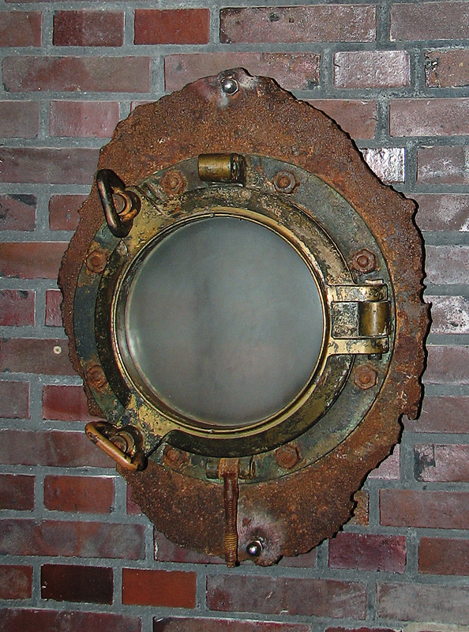
MV Wilhelm Gustloff
In January 1945, the transport ship Wilhelm Gustloff was sunk by torpedoes fired from a Soviet submarine near Gdynia (Gotenhafen) on the Baltic coast. The ship was overcrowded, with approximately 9000 German refugees hoping to escape to neutral Sweden. It was the greatest loss of life ever caused by the sinking of a single ship.
The tragedy drew little public attention at the time, partly because the victims were German, partly because there were so many other tragedies occurring. The memory of the Wilhelm Gustloff was kept alive by survivors and local historians. Parts of the wreck were salvaged in 1988 and an online Wilhelm Gustloff Museum was set up in 2010.
Porthole salvaged in 1988 from the wreck of MV Wilhelm Gustloff and placed in the Maritime Museum at Damp.
(Wikimedia Commons, CC BY-SA 2.5 generic)

Slide 56
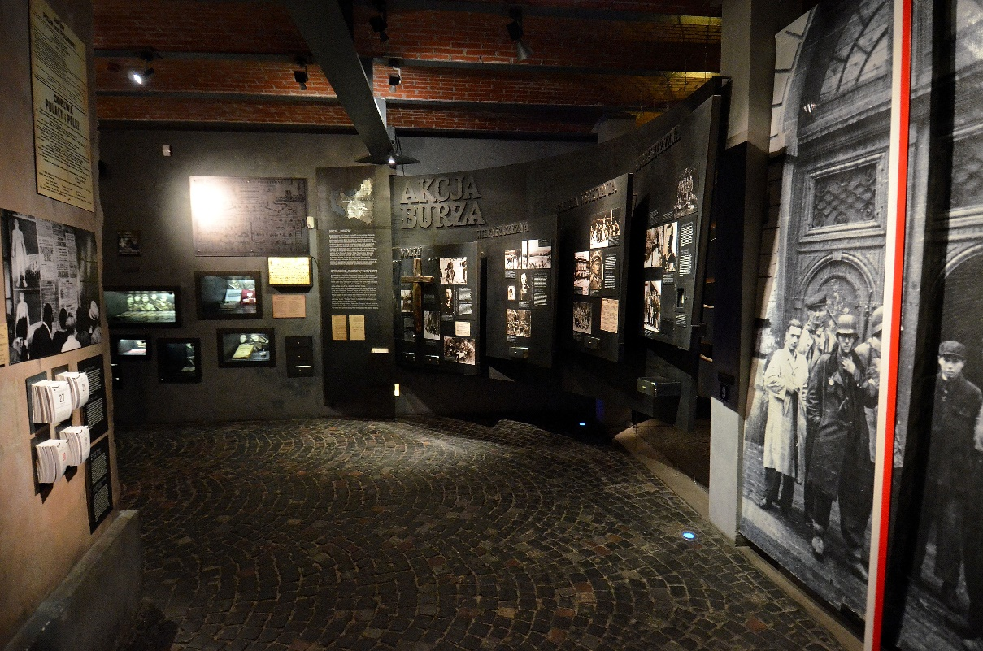
The Warsaw Uprising
The Warsaw Rising Museum was opened in 2004.
(Wikimedia Commons, CC BY-SA 2.5 generic)
The Warsaw Uprising was launched by the nationalist volunteers of the AK (Home Army) in August 1944. They fought bravely against massive German forces to liberate Warsaw but, after 63 days, the rising was crushed. 22000 fighters were killed or wounded. Afterwards Warsaw was razed to the ground. Poland was liberated by the Red Army and remained a pro-Soviet Communist state until 1989. During the years of Communism, the memory of the Uprising was largely neglected in Poland, seen as the work of ‘rightists’. After the collapse of the USSR and the re-emergence of Polish independence, the Uprising was once again seen as a courageous struggle by national heroes. The Red Army was seen, not as fraternal liberators, but as guilty of deliberately allowing the AK to be slaughtered by the Germans.

Slide 57
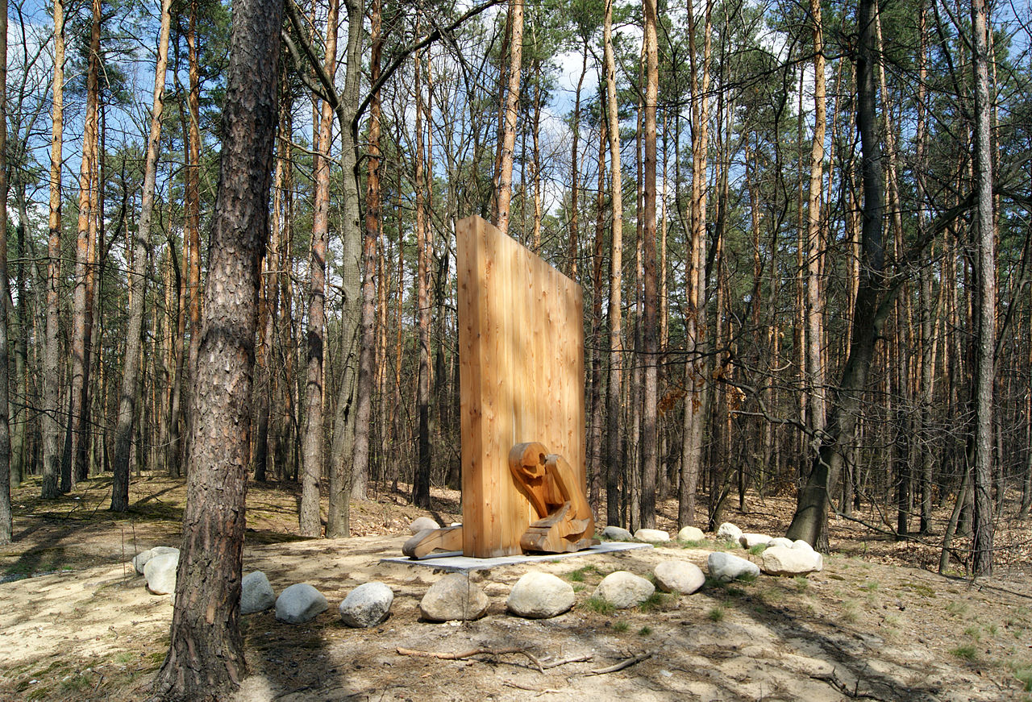
Recovery of lost memories
Monument to Romani victims murdered in the village of Borzecin in Poland.
(Wikimedia Commons, Zygmunt Put Zetpe0202 (2012), GNU Free Documentation Licence)
The end of the Cold War, and the re-establishment of independent states in Eastern and Central Europe, led to changed perceptions and allowed for the recovery of ‘lost memories’ of the Second World War. One example was the erection of monuments to victims of repression whose suffering had been neglected or suppressed by official state propaganda.

Slide 58
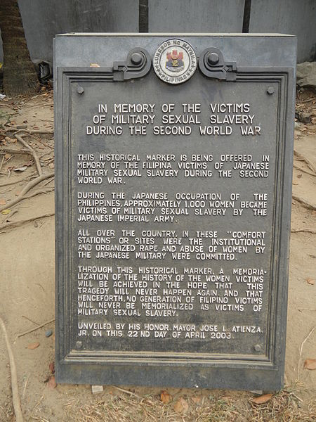
Remembering ‘comfort women’ in Asia
The suffering of hundreds of thousands of ‘comfort women’ as sexual slaves of the Imperial Army of Japan was rarely acknowledged after the war, and is still denied by apologists in Japan. Many of these women were seized from Korea, but thousands of others were abducted from Malaya, Thailand, and the Dutch East Indies.
Daughters Of The Dragon: A Comfort Woman’s Story by William Andrews brought this story to an English-language audience when it was published in 2016.
A memorial set up in 2003 at Liwasung Bonifacio, Manila to commemorate the 300000 women who were exploited by Japanese troops between 1941 and 1945.
(Wikimedia Commons, Ramon F. Velasquez (2014), CC BY-SA 3.0 Unported)

Slide 59
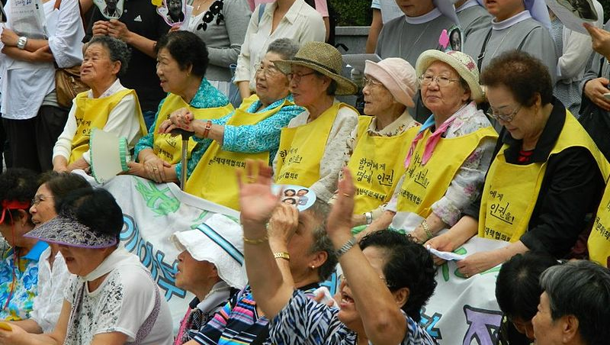
Protest demonstrations at the Japanese Embassy in South Korea
(Wikimedia Commons, Claire Solery (2012), CC BY-SA 3.0 Unported)
Since 1992 surviving comfort women and other protestors have held weekly Wednesday demonstrations in front of the Japan Embassy in Seoul demanding that Japan redress the Comfort Women problems. A statue of a young girl dressed in a traditional Korean dress was placed in front of the embassy in 2011, and similar statues have been built in American cities with sizable Korean communities. On December 2015 Japan and Korea reached an agreement in the dispute, with Japan committing to pay 1 billion yen to a fund for the surviving comfort women, and South Korea refraining from criticizing Japan over the issue and working to remove the statue in front of the embassy.
Protest demonstration at the Japanese Embassy in Seoul in August 2011 by Korean ‘Comfort Women’ exploited by Japan during the Second World War.

Slide 60
Never mind the facts — logic alone demolishes ‘comfort women’ deniers’ case
Some of the arguments made by deniers of Japanese military involvement in wartime sexual slavery are ridiculous but they are relevant to how things still work in Japan today. Comfort women were rounded up from Korea and elsewhere and put to work as sex slaves for the Japanese military. To deniers, describing the women as having been coerced is to them a terrible calumny upon Japan’s honour, as is referring to them as “sex slaves.” In their version of events, comfort women responded to advertisements and worked as prostitutes at a time when the practice was perfectly legal. They did the job willingly and were paid for their efforts. Let us ignore the numerous first-person accounts of women, as well as the findings of a number of historical researchers. Nor need we mention war-crime tribunals arising from the sexual enslavement of female Dutch civilians interned when Japan conquered Indonesia; or past admissions of culpability by Japan’s own post-war government, including a compensation fund and apologies by past Japanese prime ministers. According to the Deniers, these are all the result of a terrible misunderstanding caused by the shoddy yet inexplicably influential journalism of one reporter at the Asahi Shimbun.
You don’t need anything more than the central Denier argument — that comfort women were just willing prostitutes exchanging services for payment — to appreciate how ridiculous it is.
(Colin Jones, Japan Times, 7 January 2015)

Slide 61
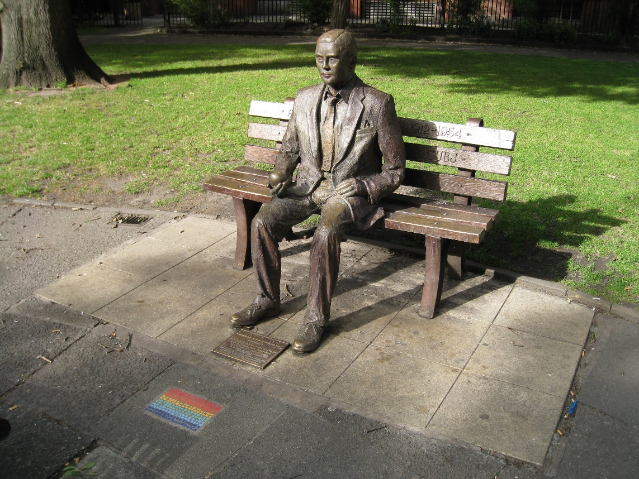
The Alan Turing Memorial Sackville Park, Manchester
(Wikimedia Commons, Hamish MacPherson (2008), CC BY-SA 2.0 generic)
Alan Turing was a brilliant mathematician whose work at Britain’s secret codebreaking centre at Bletchley Park helped to win the war by cracking the Nazi Enigma coding machine, and by developing one of the first computers. But Turing gained little recognition until long after the war. The first reason for this was secrecy – the work of the codebreakers at Bletchley Park did not become public knowledge until the 1970s. The second reason was that he was a homosexual, arrested by the police in humiliating circumstances in 1952. Turing committed suicide in 1960. Changing social attitudes have since led to reassessment. There are now several public memorials to him, including a major building at Manchester University. In 2014 a major feature film The Imitation Game celebrated Turing’s great wartime achievements at Bletchley Park.

Slide 62
Popular culture
Since 1945, the Second World War has been prominent in popular culture, above all in film, both documentaries and movies. In the immediate post-war years, such films reflected a triumphalist tone. One American example was The Sands Of Iwo Jima (1949), celebrating heroic victory in the pacific. In Britain, The Cruel Sea (1953) celebrated the Battle of the Atlantic. In France, Act Of Love (1953) was a romantic drama about an American soldier falling for a French woman in Paris after the liberation. Few war films addressed complex or painful issues. Few war films were made at all in the countries that had experienced defeat. It was only from the late 1960s that film-makers took a more balanced and nuanced approach. In 1969, British television launched World At War, a huge multiperspective history of the war in 26 episodes. In France The Sorrow And The Pity by Marcel Ophuls confronted the complex truths of collaboration in Vichy France, shattering the cosy myth that almost all Frenchmen had been supporters of the Resistance. Since the 1970s, a flood of films has awoken many painful memories that had been ignored or suppressed. In 1981 a TV series made in Germany, Das Boot, presented a sympathetic view of U boat crews in the Battle of the Atlantic. In 1988 Grave Of The Fireflies portrayed two Japanese children caught up in the horrors that faced civilians after Japan’s surrender. In 2001 an international co-production Enemy At The Gates attempted an authentic and balanced portrayal of two snipers, one German one Russian, in the Battle of Stalingrad. In 2006, LETTERS FROM IWO JIMA, made in the US, showed the Pacific War from a Japanese perspective.

Slide 63
Never again: reflection and reconciliation
Even in the immediate aftermath of the war, many voices called for ‘peace in our time’. Pacifists saw the huge losses of the war as yet more proof of the need for disarmament and international peace. The formation of the United Nations in 1945, and the UN Charter of Human Rights, reflected this view. European integration, with its strong new partnership between France and West Germany, was based on the desire to prevent future wars, as well as the need to avoid economic collapse. Fear of the destructiveness of atomic weapons, as seen at Hiroshima and Nagasaki, reinforced this message of ‘never again’. So did many expressions of elite and popular culture, through art, literature, theatre and cinema. But such ideas ran counter to the prevailing public mood in the early post-war years and were slow to win general acceptance.
As wartime hatreds softened, the desire for peace and reconciliation grew stronger. Anniversary celebrations were often the occasion for reassessment. Historians brought forward new evidence and new interpretations challenging the national myths which were so embedded in 1945. New generations grew up without the historical ‘baggage’ of wartime memory. International youth travel and the global media made old conflicts seem distant, even irrelevant. Peace and reconciliation became the new orthodoxy. Karlshorst in East Berlin was an example of this. In 1945 Karlshorst was the scene of Germany’s formal surrender to the USSR. From 1949, the building was a museum presenting a one-sided triumphalist view of Soviet victory over Fascism. Then, in 2003, it was transformed into the German-Russian Museum, presenting a message of reconciliation jointly agreed by Russian and German historians.

Slide 64
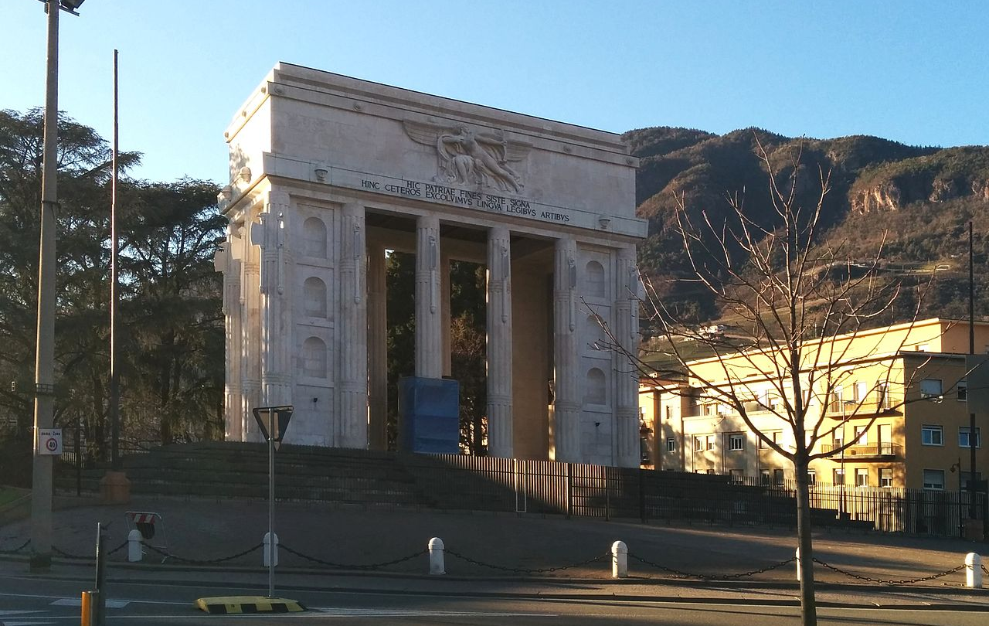
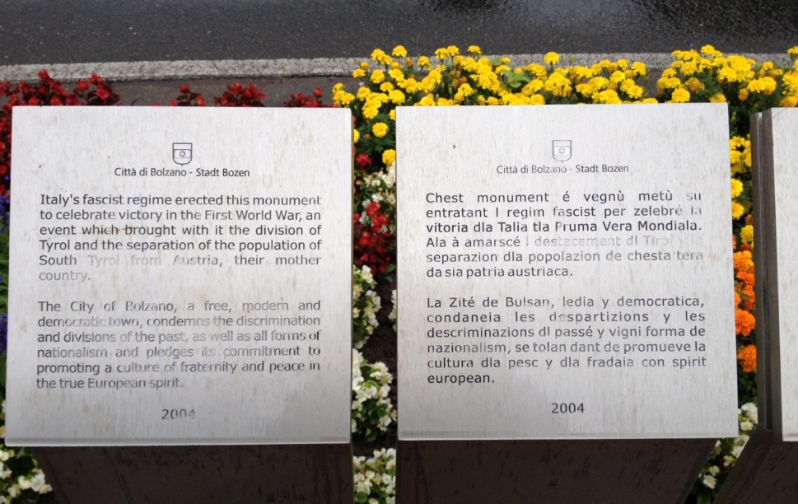
BZ ‘18-45’ Memorial at Bolzano, South Tirol
The Inscription reads:
Italy’s fascist regime erected this monument in 1929 to celebrate victory in the First World War, an event that brought with it the division of Tyrol, and the separation of the population of South Tirol from Austria, their mother country. The city of Bolzano, a free, modern and democratic town, condemns the discrimination and divisions of the past, as well as all forms of nationalism, and pledges its commitment to promoting a culture of fraternity and peace in the true European spirit.
(Wikiimedia Commons, Walber (2014), CC BY-SA 3.0 Unported)
(Wikimedia Commons, CC BY-SA 3.0 Unported)

Slide 65

The Anne Frank House
Queues outside the Anne Frank House museum on Prinsengracht in Amsterdam in June 2015, 70 years after Anne Frank died at Buchenwald.
(Wikimedia Commons, Dietmar Rabich (2015), CC BY-SA 4.0)
Anne Frank’s Diary of a Young Girl was first and foremost a private and personal document telling the thoughts, hopes and fears of one teenager facing terrible circumstances. The popularity of the book and its vast worldwide fame in the decades since it was published made Anne Frank part of the public memory of the war and the Holocaust. The house where her family was in hiding is now a famous landmark and the home of a foundation that works for international peace and reconciliation.

Slide 66

The Cemetery at Lamsdorf / Lambinowce, near Opole in Upper Silesia
(Wikimedia Commons, Jacques Lahitte (2008), CC BY-SA 3.0 Unported)
From 1946, the prisoner of war camp at Lambinowice, Poland fell into disuse. In 1968 it was made into a Monument of National Remembrance. In 2002, after the end of the Cold War it became the Site of National Remembrance at Lambinowice, part of the Central Museum of Prisoners of War in Lambinowice-Opole. The nearby cemetery is home to the graves of POWs from many countries captured during the many wars between 1870 and 1945: from France, Britain, Serbia, Romania, and the Soviet Union. This quiet resting place is now a place of peace and reconciliation.

Slide 67

The cemetery at Bitburg
The cemetery at Bitburg in West Germany, visited by President Ronald Reagan 5 May 1985 as part of the commemoration of the 40th anniversary of the end of the Second World War.
(Wikimedia Commons, Elke Wetzig (1985), CC BY-SA 4.0 International)
In May 1985 U.S. President Ronald Reagan visited a German military cemetery in Bitburg, attending the 40th anniversary celebrations of the end of the war. It was intended to be a gesture of reconciliation between former enemies. It was hoped that the NATO alliance would be strengthened. In reality, the occasion caused intense controversy. The fact that a section of the Bitburg military ceremony contained war graves of soldiers of the SS led to a storm of protest. One placard held up at a demonstration claimed: ‘America is ashamed, Mr President’. There was a mood not of reconciliation but of divisiveness and recrimination.
The cemetery at Bitburg in West Germany, visited by President Ronald Reagan 5 May 1985 as part of the commemoration of the 40th anniversary of the end of the Second World War.

Slide 68
Special anniversary in Domme
Special anniversaries, such as the 40th and 50th, were often seen as opportunities to bury past hatreds and to bring peace and reconciliation between former enemies.
In 1984, near the historic town of Domme in the valley of the Dordogne, a small monument was installed to commemorate the victims of German reprisals in the summer of 1944, when the feared Das Reich Division was retreating northwards. In pink and granite stone, with an eternal flame burning, it bears the inscription:
IN MEMORY OF ALL THOSE WHO SO TRAGICALLY DIED HERE, 16 JUNE 1944
Not everyone was ready to accept this message of reconciliation and European harmony. Nailed to the adjacent stone wall, a cheap white enamel plaque was embossed with a fiery and defiant message from a local woman:
IN MEMORY OF MY BELOVED DADDY, MURDERED BY THE GERMANS, 16 JUNE 1944

Slide 69
The Evening Read
When Eric Lomax travelled half way across the world to confront the man who had been his wartime torturer it was with dreams of revenge. And yet, when the former Japanese prisoner of war, brutalised by his captors and forced to work on the infamous Burma Railway, came face to face with ex-guard Takashi Nagase, something quite different happened – Nagase asked for his forgiveness and the two erstwhile enemies became friends. It was the tale Lomax told in his 1995 book The Railway Man, one that is now coming to the big screen with the help of Liverpool author and screenwriter Frank Cottrell Boyce.
“It’s just such an extraordinary story,” says the 54-year-old writer. “It’s such an amazing thing that somebody sets out to get revenge and finds friendship instead”. Still, he doesn’t believe the man himself would have wanted to watch the finished film. “He was passionate about it being made, because he thought it was a good story for everybody. Eric wanted people to know that water boarding was wrong, and was useless and pointless. And he felt very strongly about men coming back from war and not being understood. All those different things he felt very strongly about and wanted the story to be told. He just didn’t want it to be told to him!”
Liverpool author Frank Cottrell Boyce on bringing his story of hope and forgiveness to the big screen
(LIVERPOOL ECHO, 17 December 2013, Reproduced with the permission of the Liverpool Echo)

Slide 70

The Frauenkirche, Dresden
(Wikimedia Commons, Gryffindor (2008), CC BY-SA 3.0 Unported)
After its destruction in the devastating bombing of Dresden in 1945, the Frauenkirche and other great buildings in the historic city centre remained in ruins. The Communist leaders of the USSR and the GDR (East Germany) wanted the ruins to be a memorial to the crimes of Fascism. After the reunification of Germany in 1990, moves were made to restore the church to symbolise the rebirth of the city. The committee that supervised the restoration included British bomber pilots who flew in the 1945 raid.
The decoration above the high altar includes the nose cone of a Lancaster bomber. The interior of Dresden’s Frauenkirche, destroyed by Allied bombing raids in 1945 and restored between 1995 and 2006 as a symbol of international peace and reconciliation.

Slide 71

Making the Past Whole Again?
Aerial view of the restored historic centre of Dresden, 2014.
(Wikimedia Commons, Carsten Pietzsch (2014), CCO 1.0 Universal Public Domain Dedication)

Slide 72
Lessons of Second World War Must Continue to Guide United Nations Work
The lessons of World War II — on whose ashes the United Nations was founded — must continue to guide the Organization’s work, even as it adapted to meet the evolving challenges of the modern world, delegates commemorating the seventieth anniversary of the end of the war told the General Assembly today.
“We must never forget the international community’s responsibility to stand up to tyrants, despots and all those that attempt to suppress the enduring nature of the human spirit,” said Sam Kutesa (Uganda), Assembly President. Having survived the catastrophe of the Second World War, humankind sought to embrace new means to prevent the recurrence of such tragic events.
To that end, he said, the Organization was established to ensure unity and harmony among nations. As envisaged in the United Nations Charter, it was founded to “save succeeding generations from the scourge of war”. Over the last seven decades, the war had not only shaped the Organization’s mission, but its lessons continued to guide its work around the world.
The General Assembly told this during Meeting marking the UN’s seventieth anniversary. Several Speakers call for Security Council Reform to address present challenges.
(United Nations Press Release, 5 May 2015)

Slide 73




Commemoration: World War Two in history and memory
This collection has been developed by Piia Lempiäinen and Chris Rowe of the Historiana editing team.
(Wikimedia Commons, CC BY-SA 2.0)

