Slide 1
Community Day 2 Tallis Citizens
Period 6 Activity Instructions

Slide 2
The main tasks
There are three main tasks
Brief discussion of the different lessons that students experienced and things they learnt during the day. 10mins Years 12 and 13 might like to consider the debate topic This house believes that quotas for women in upper tiers of organisations will advance the cause of gender equality
All students will consider and amend and/or add to the Tallis Accepts document. 10-15mins
Creative Challenge (see following slides) – each tutor group will create a range of wearables with a gender equality message displayed. The best of these will be displayed in reception over the coming term. 35-45mins

Slide 3
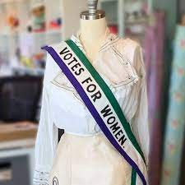
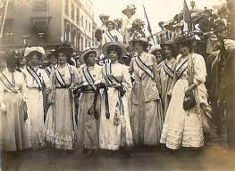
The suffragettes had a kind of uniform
Notes:
These all feed into the decisions that we make

Slide 4
The challenge for each tutor group
Aim
To make at least one 'suffragette sash' and as many other wearables as you can
To adorn the garments with gender equality messages starting "We will break the bias by..."
Resources
You will have;
Green, Purple and White sugar paper
Black markers
Green, purple and white wrist bands (enough for one of each colour per student)
Scissors and glue (provided by your tutor)

Slide 5
The challenge for each tutor group
Students will have to work out how to make a sash of the type used by the suffragettes. How they make it is up to them, however,
it must be made using only the resources stated,
it must use all of the three colours, and
it must have a gender equality message
As well as the sash, students can make whatever else they feel could be worn.
Each student will also have a wrist band in each of the colors that they should write gender equality messages on. They can keep and wear these.

Slide 6
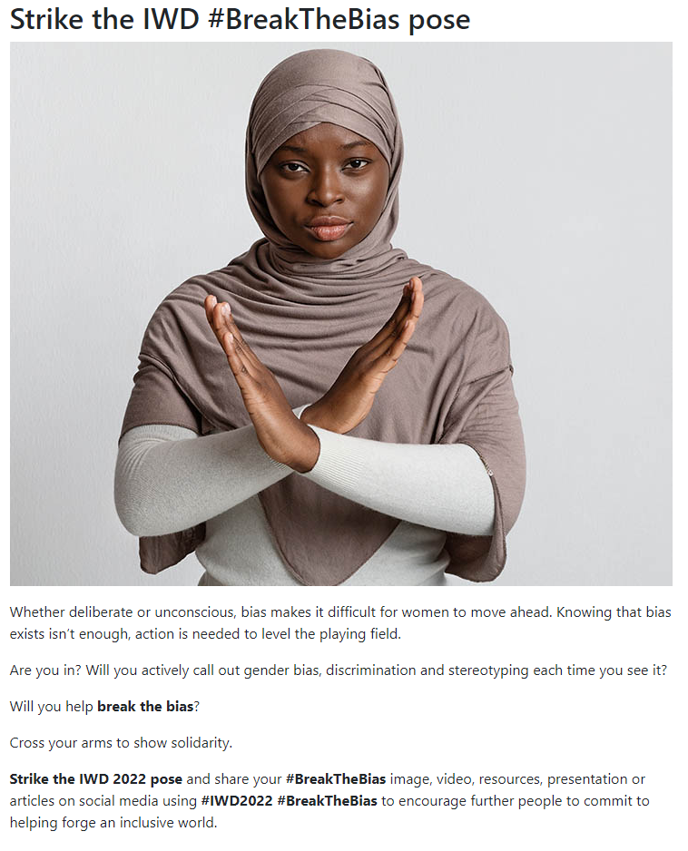
Take photos in your tutor group to send to Ms Springer or HoY. The media team will also be taking some of these photos throughout the day

Slide 7
At the end of the session
It would be great if each tutor could take a photo of their tutor group wearing their creations. Send photos to your Head of Year and Michelle Springer or Abi Cook
All wearables that are well-made and with a positive gender equality message (apart from wrist bands) should be brought to the Sports' Hall at the end of the day. Please make sure the tutor group is written on each piece that you submit
Also bring any Tallis Accepts amended documents to the Sports' Hall at the same time

