Slide 1
The Painted Hall at ORNC Greenwich
A presentation by volunteer Tony Hier April 2024

Slide 2
Introduction
1 Greeting
2 My name is Tony
3 Some basics
4 Four phases
5 A challenge - Imagine
6 Overview of the Hall

Slide 3
Vestibule
Drum and Dome – compass, winds and the Order of the Garter
Large painted tablets
The benefactors and the sixpence levy on the wages of sailors
Role of John Evelyn – balance the books
Master Mason – Strong, Master Bricklayer Billinghurst, Master Carver Jones

Slide 4
The Lower Hall - Overview
The center piece – Thornhills monumental allegorical mural painting placed in a grand architectural setting
Two classical Triumphal Arches
An illusionary ceiling with a plentiful cast of characters each playing their part in the compositions title “The triumph of peace and liberty over tyranny and arbitrary power”
Justifies the succession of William and Mary after the invasion o0f 1688 and the Glorious Revolution

Slide 5
The Lower Hall – Triumphal Arch 1
Triumphal Arch
Neptune and Cybele
The Spanish Galleon – 1704
Humber, Avon and Seven
Tyco Brau, Newton, Copernicus, James Flamstead
Diana the Goddess of the Moon

Slide 6
The Lower Hall – Trimmings
Fictitious architectural setting – blur the boundaries between reality and fiction
16 guilded columns and capitals supporting the entablature align the hall – painted rather than carved
A painted motif painted in shades of grey to resemble sculpture with all the tools and instruments of the mariners trade
Queen Mary is celebrated in the Latin Inscription

Slide 7
The Lower Hall – The Centre piece
Apollo
William and Mary – Glorious revolution 1688
Significance – Parliamentary accountability and Protestant succession
William’s posture
Allegorical characters of good governance
Louis XIV
The perimeter – Zodiac and seasons
A word on John Worley

Slide 8
The Lower Hall – Triumphal Arch 2
A second triumphal arch flaked by Juno (Air) and Jupiter (Fire)
The Blenheim
City of London and the rivers Isis, Thames and Tyne – the arteries of trade for Britain’s voracious colonial appetite
Archimedes, Galileo, Navigation and astronomy
The Proscenium Arch with the crest of William and Mary flanked by Mars and Menira the God and goddess of war.

Slide 9
The Upper Hall – Overview
A second commission 1717-26
Originally for Anne, but now dedicated to the Hanoverian's
Continuation of fictitious architectural setting, elaborate cast of Monarchical characters along with allegorical and mythological representations
4 further compositions

Slide 10
The Upper Hall – Ceiling
Queen Anne and Prince George of Denmark
A more modest gathering of allegorical character proves visual continuity Hercules, Concord, Wing figures of Victory
Prince George as Lord High Admiral is presented a trident by Neptune
Eight muscular male representations support the illusionary ceiling
Flora and fauna of the four continents Europe, Africa, Americas and Asia

Slide 11
The Upper Hall – The West Wall
The Hanoverian's 52nd in line to the Throne
Succession the result of the Bill of Rights 1689 and the Act of Settlement 1701
Triumphal Arches and guilded columns and capitals
George I, George II, Frederick, Caroline, Sophia and Sophia
Allegorical figures of stability, Time, Justice and Providence , Peace and Plenty at the feet of the grandchildren – a golden Age of plenty
Victory holds a trident and a scroll
Thornhill representation

Slide 12
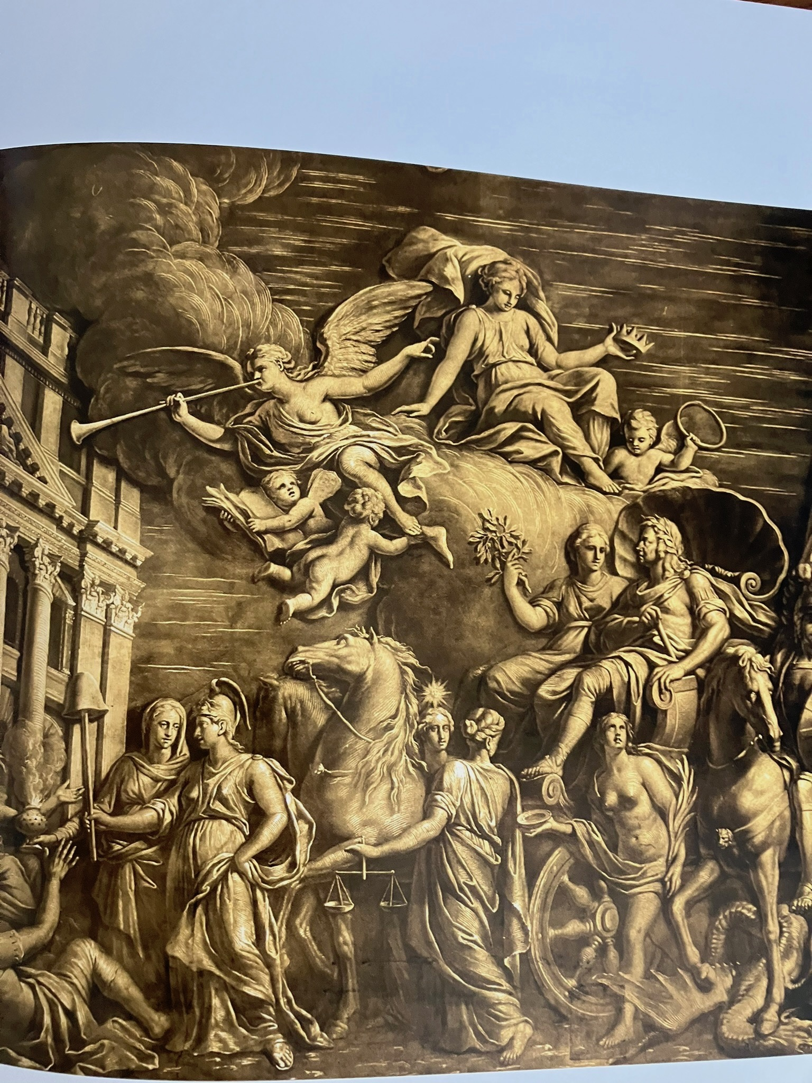
The Upper Hall – The Side walls
The two succession
William lands at Torbay in 1688 welcomed by Britannia, Reason and Love whilst Jupiter observes that England expects great things
The landing of King George at Greenwich in a chariot escorted by St George – Religion, Liberty, Truth and Justice
King Charles building, Thames and failed Jacobite uprising 1715
Visual continuity
Nelson lying in state before his funeral after the Battle of Trafalgar

Slide 13
Painted Hall ORNC Greenwich A significant footnote
Propaganda of Monarchy, Militarism and Mercantilism –Dominant narrative
Whose narratives are neglected
1 Opponents of the two successions
2 Victims of the wars of successions
3 Those who opposed monarchical, aristocratic and mercantile elites
4 Indigenous and First Nation people of the Empire
5 The victims of the Transatlantic slave trade

