Slide 1
Teacher Notes The following is as reminder of the results that came as a result of the last Community Day last year, Choose to Challenge. There is a full explanation of the day on the first slide, after which are the results of the survey carried out. You can share this with your students to highlight the need for a change in behaviours and to discuss solutions they may come up with. Ideas generated should be sent to Michelle Springer or Abi Cook. We will then work through these ideas with the relevant Ambassador Groups.

Slide 2
IWD 2022 campaign theme: #BreakTheBias
Imagine a gender equal world.
A world free of bias, stereotypes, and discrimination.
A world that is diverse, equitable, and inclusive.
A world where difference is valued and celebrated.
Together we can forge women's equality.
Collectively we can all #BreakTheBias.

Slide 3
Break the Bias
Learning Objectives:
to understand one of the areas in which gender bias occurs at Tallis
to consider ways that we can work together to Break the Bias

Slide 4
Choose to Challenge 2021
In summer 2021, we had a whole school community day with the theme ‘Choose to Challenge.’
The aim of the day was to start important conversations about gender inequality at Tallis and misogyny in British culture.
Students spent the day discussing misogyny, harassment and what changes we need to see in separate groups.
At the end of the day, each tutor group made a pledge to ‘Choose to Challenge’ an aspect of gender inequality.
We have been continuing this conversation throughout Community Day today.
Before Community Day 2021, we asked students some questions and the results of these were discussed on the day.

Slide 5
Examine the following slides
You could consider the following;
What are the differences between the responses of boys and girls?
What are the similarities?
Why are there differences in the responses depending on whether you are male or female?
Do you think that anything has changed since the last Community Day? If so, what?
What still needs to be done?
The slides show the responses to some of the questions asked prior to the Choose to Challenge Community Day last year

Slide 6
How often does sexual harassment happen at Tallis?

Slide 7
Do you feel that sexual harassment is challenged at Tallis?

Slide 8
Does Tallis offer adequate support for reporting sexual harassment?
Notes:
Please spend some time making it clear what the expectations are and why we have them.

Slide 9
Do you feel there are adequate consequences for sexual harassment?

Slide 10
Commitment to Change
If we are going to make a commitment to change, we need to really listen to each other.
Some things to remember:
We all have something to learn from each other’s experience. Don’t judge the experiences of others.
We are making a commitment to change
We all have work to do
We MUST show Tallis Character when we’re listening to each other.

Slide 11
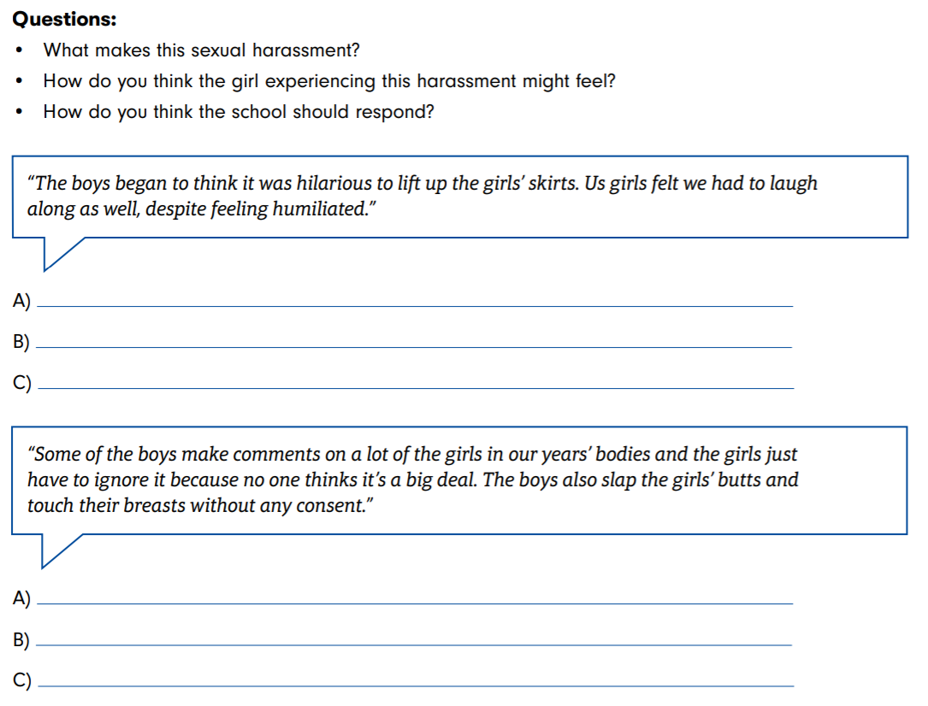
Optional Task 1 – Sexual Harassment Scenarios

Slide 12
Optional Task 2 – What to do about sexist language?
What is sexist language?
Why is sexist language harmful?
Allocate one side of the classroom as Very Harmful and the other side as Not At All Harmful.
Look at the phrases on the next slide
For each phrase, students will decide where on a scale they think the phrase is, and stand in a space on that continuum.
Students need to be able to justify their decisions.
They can move positions at any point if they change their mind
Notes:
Questions to facilitate the discussion • Have you ever heard this phrase being used? • When is the phrase used? • What is the phrase implying or communicating? • How might the phrase make someone feel? • What stereotypes does the phrase draw on?

Slide 14
Break the Bias
Write a commitment statment as a class starting “We will break the bias by…”

