Slide 1
Post revisionist view of the origins of the Cold War
BY BASMA, ARETHA, WILL

Slide 2
. Argued that the foundations of the Cold War were neither the fault of the U.S. nor the Soviet Union.
. They viewed the Cold War as something inevitable.
. The Cold War emerged from the power vacuum after World War II, when the European countries were severely weakened by the war.
. The multipolar situation that had existed before the war had given way to a bipolar world.

Slide 3
The Yalta Conference, February 1945
Differences arose over the future of Poland and Germany. The US and Britain accepted that Poland was in the Soviet sphere of influence.
Some historians claim that this laid the foundations for a divided Europe.
The Potsdam Conference, July 1945
Divided Germany into 4 zones temporarily and established new borders for a Germany and Poland that suited Stalin. Key issues of the future of Germany weren’t solved.

Slide 4
The Kennan Telegram
Suggested policy of containment toward the communist Soviet, due to fears of the expansion of communism.
The Novikov Telegram
Argued that the US was beginning to act like an imperial power.

Slide 5
The Truman Doctrine 1947
. President Truman warned the American Congress that it was America's job to contain Communism - this became known as the Truman Doctrine -
. The Post-revisionist school of thought says that the speech itself was a somewhat accurate representation of the situation in Europe- particularly in regards to Greece and Turkey. The Truman Doctrine itself was highly incendiary, thus justifying Stalin's reaction to it (Cominform).
. Both sides can be said to have been concerned primarily with their own security, and thus both sides can be said to have overreacted or mischaracterized the positions of themselves and the other side (largely as an effort to rally the public support behind them).
. In the post-revisionist viewpoint the natural conflict between the ideologies of communism and capitalism is also seen as a source of misunderstanding and misinterpretation which led to the start of the Cold War.

Slide 6
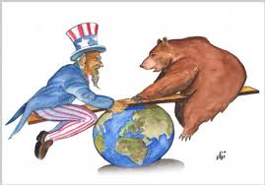
The Marshall Plan 1947
. General George Marshall came up with a plan to help Europe recover from the war using American money - this became known as the Marshall Plan
. For both the United States and the Soviet Union it was unacceptable to let the other superpower dominate Europe, as this would seriously disrupt the balance of power.
. Conflict over spheres of influence was therefore an inevitable result of considerations of national security.

Slide 7
The establishment of Cominform Sept 1947
. Stalin established Cominform as a tool of strengthening the communist bloc and to strengthening Soviet political control of that bloc.
. It introduced Soviet style economic policies including the state control of industry
. John Lewis Gaddis focuses on some shared culpability and that "neither side can bear sole responsibility for the onset of the Cold War." He did, however, emphasize the constraints imposed on U.S. policy makers due to the complications of domestic politics and later that it took men, responding unpredictably to circumstances, to forge the chain of causation; and it took [Stalin] in particular, responding predictably to his own authoritarian, paranoid, and narcissistic predisposition, to lock it into place.

Slide 8
BERLIN
BLOCKADE

Slide 9
John lewis Gaddis
believed that both America and Russia wanted to keep the peace after the war but that conflict was caused by mutual misunderstanding, reactivity, and above all the American inability to understand Stalin's fears and need to defend himself after the war.

Slide 10
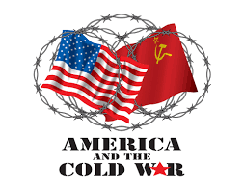

Slide 11
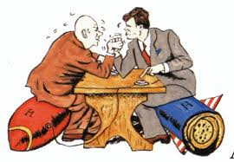
Other post revisionists
Martin P. Leffler, in his book: A Preponderance of Power: National Security, the Truman Administration and the Cold War (1992) saw the Cold War as a clash of two military establishments both seeking world domination.
Marc Trachtenberg, A Contested Peace: The Making of the European Settlement, 1945-1963 (1999) claimed that the Cold War was really about settling the German question in the aftermath of World War II.

Slide 12
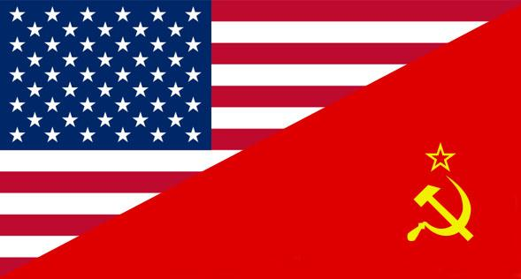
The Cold War was caused by the conflicting interests of the United States and the U.S.S.R., compounded by miscommunication and poor diplomacy. The differences in the cultures of the American political leaders and their moral and righteous justifications for diplomacy from Soviet leaders' communist expansionist policies led to the unraveling of the new international order nealy established in Roosevelt's wartime conferences with Churchill and Stalin.

