Slide 1
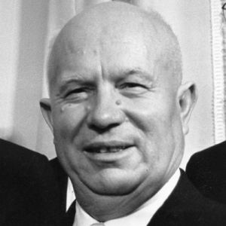
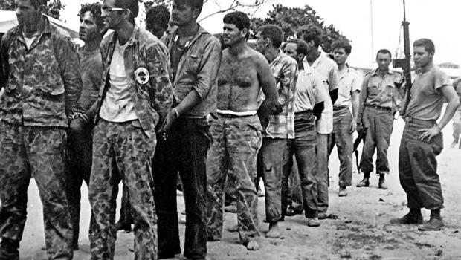
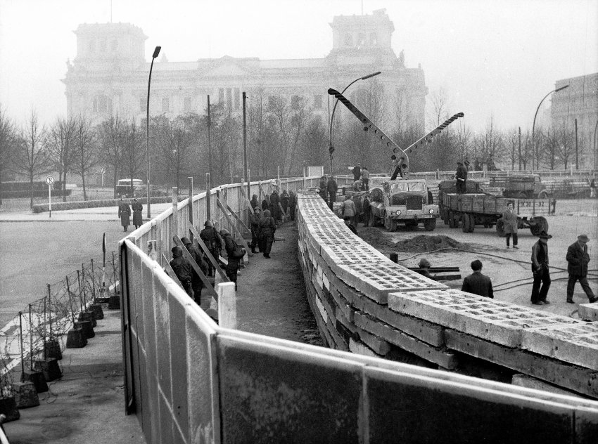
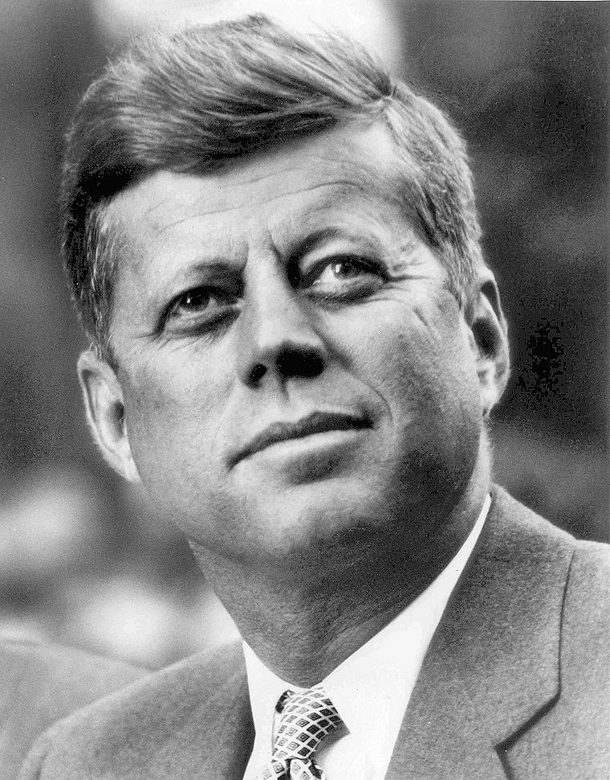
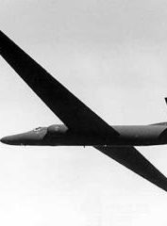
To what extent was peaceful coexistence achieved?
Coexistence or conflict 1960-1962?

Slide 2
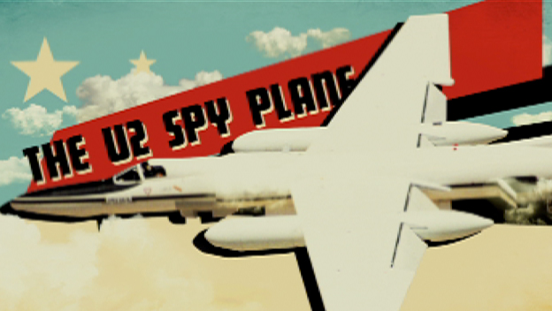
1960
Conflict
USSR Military alliance with Cuba
Castro and Khrushchev alliance in the Western Hemisphere was immediately challenged by the United States
it suggested a great leap of expansionism westwards.
This alliance later on led to the Bay of Pigs incident and the Cuban missile crisis
U2 plane shot down in Russian airspace
As the policy of open skies was rejected back in 1955 by the USSR it led to rapid increased conflict
US rejected responsibility which enraged the USSR
Peaceful coexistence
The Paris Summit
Was an example of diplomacy
However- it did not succeed

Slide 3
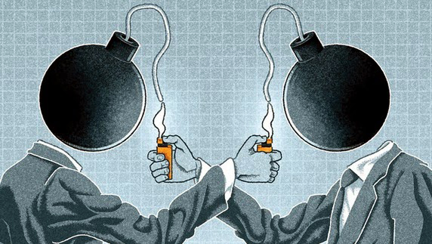
1961
Conflict
Bay of Pigs
CIA planned to train Cuban exiles in order to take Cuba back
Demonstrated US opposition to Soviet military alliance with Castro
Vienna Summit
Khrushchev threatened the US with military
It was a failure for Kennedy as it only increased hostility between spheres
Berlin Wall
Constructed to save East Germany from economic collapse
Suggests peaceful coexistence failed due to Germany being visibly divided
MAD (Mutually Assured Destruction)
Unlimited budget of US overwhelmed Soviets
Soviets had enough nuclear arms to destroy the US once
Suggests they both were capable to wipe one another out
Peaceful coexistence
The Vienna Summit
Was an example of attempted diplomacy and conciliation after the Bay of Pigs
But it didn’t succeed

Slide 4
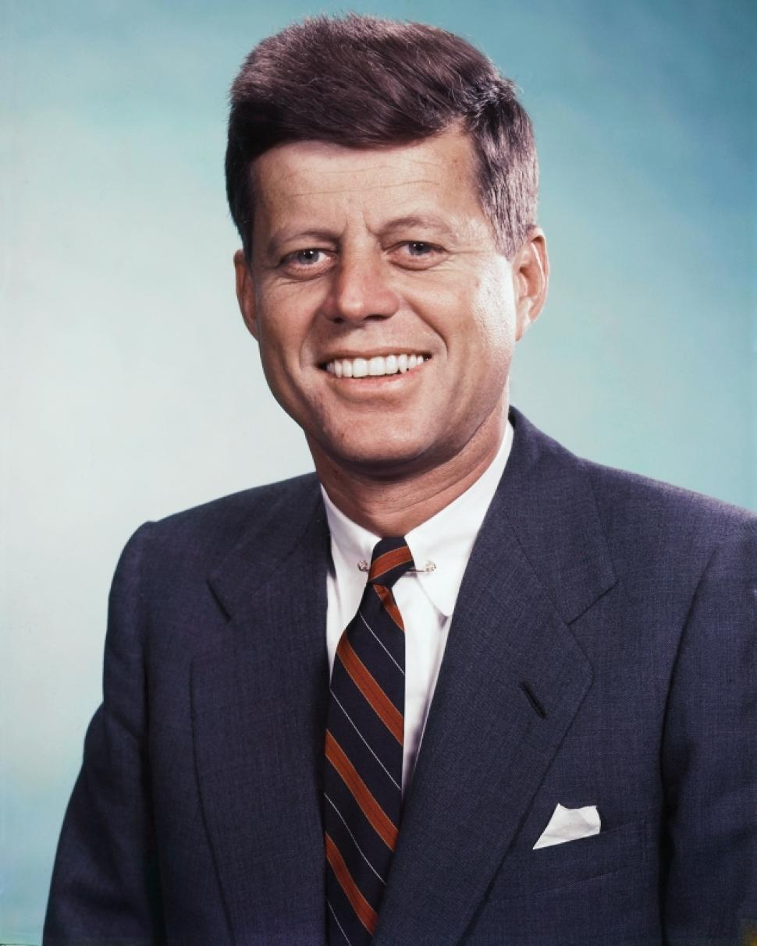
1962
Conflict
Cuba
U2 surveillance
Kennedy concerned over Cuba
24 missile pods located in Cuba
Treated as a threat to the US
Kennedy’s options
General Taylor (Chairman of the joint chief of staff) recommended a surgical airstrike on Cuba.
Kennedy's plan was to quarantine Cuba and prevent delivery of missiles
Cuban missile crisis as a whole
The most extreme point of conflict between spheres
Threatened US national security
Showed power and influence of communism
Displayed signs of a potential nuclear war
Peaceful coexistence
The end of the Cuban Missile Crisis
Krushchev insisted missiles were for defense
Krushchev indicated by letter 26th October that the missiles would be withdrawn
Results in the Presidential Hotline
Results in the Nuclear Test ban treaty

Slide 5
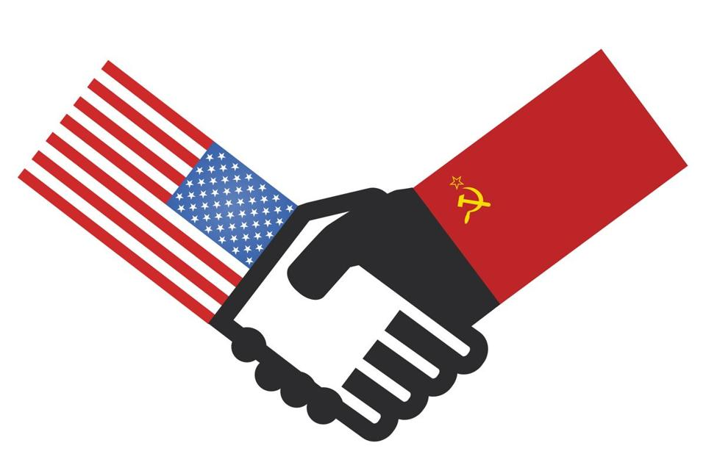
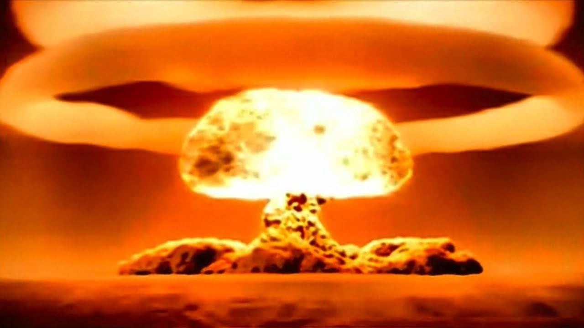
Overall
?
?
?
?
Overall, we feel that by 1961 Khrushchev had consolidated his position as a leader of the Soviet regime and once this stability in his role had been established, he was able to pressurise America, especially in 1962 with the Cuban Missile crisis. The U2 spy planes made peaceful coexistence difficult between the superpowers as this was a breach of Soviet National security. We feel that within the period as a whole, peaceful coexistence was undermined by growing tensions in areas such as Germany and Cuba. There are some continued attempts at peaceful coexistence which exists due to the presidential hotline and by the period 1962 were not at war with one another but as a whole there was increased tensions within the period.

