Slide 1
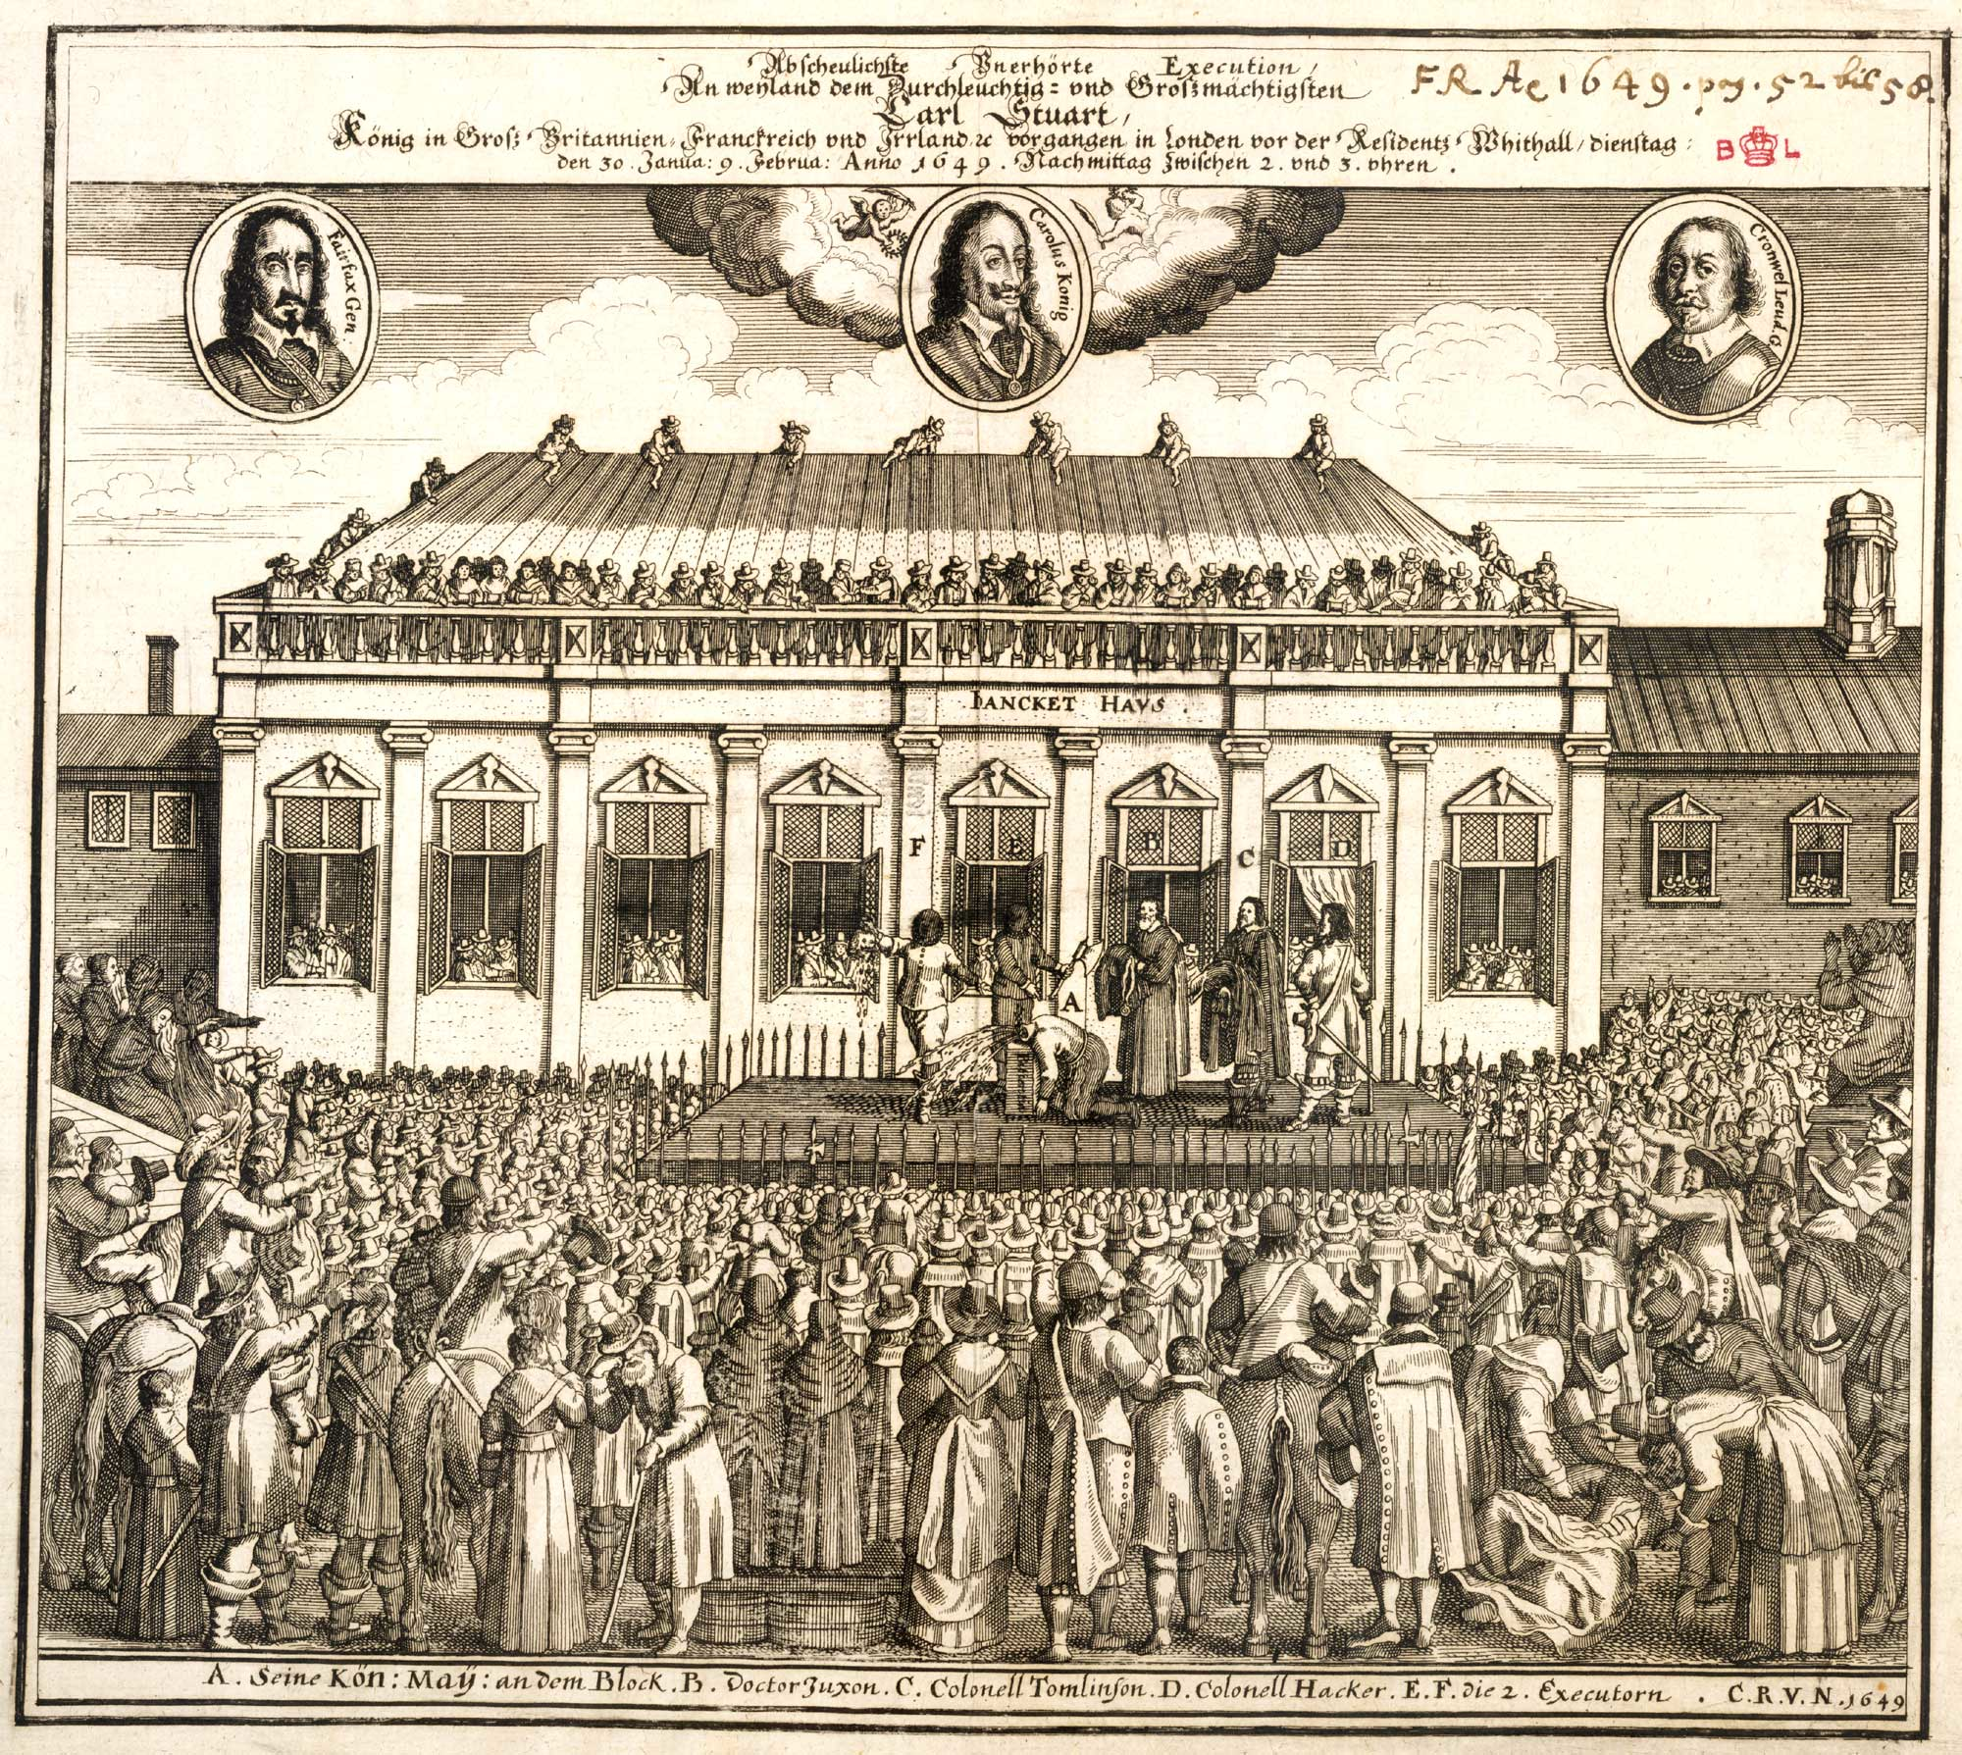
What is happening in this picture?
Who is involved?
Why is there such a big crowd?
Challenge: What does this image signify?
Notes:
Give each group a copy of the image to analyse and discuss. Shows the execution of Charles I. The images at the top are Charles, Oliver Cromwell and Thomas Fairfax (both army/parliamentary opposition to Charles in the Civil War). Big crowd to watch the execution of the King – first trial and execution of a monarch. Signifies the loss of monarchical power and the enhancing the power of the people. 10 minutes including class discussion.

Slide 2
How far did the monarchy lose control, 1509-1745?
Learning Objective:
To gain an understanding of how the power of the monarchy changed 1509-1745 in an overview of a broad time period.

Slide 3
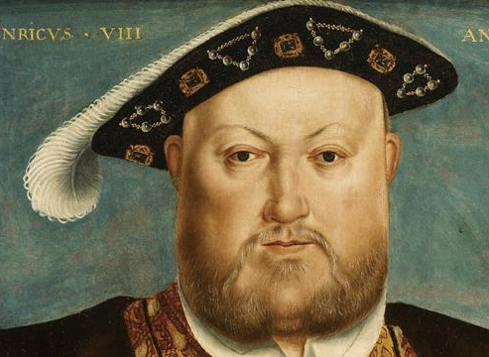
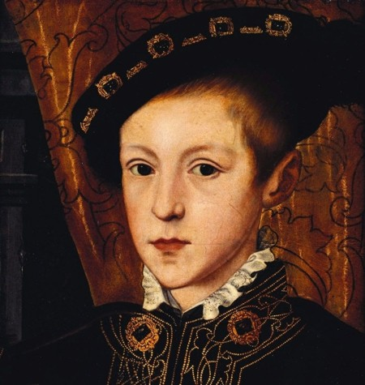
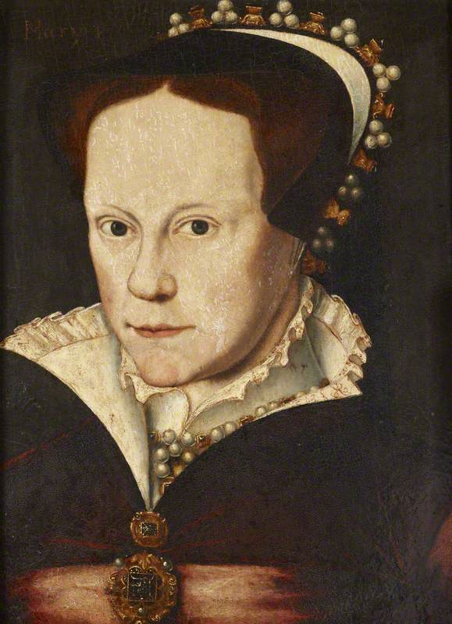
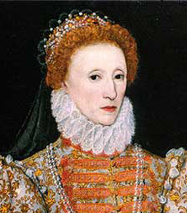
1509-1603
Henry VIII became king in 1509.
He took away power from the Pope.
From 1509-1603, the Tudors had more power than previous kings and queens had.
Elizabeth shared power well with her Parliament.
Notes:
Talk through the information in the notes, and read the slide together to summarise. Get them to draw a cross on their graphs. Show the next slide to demonstrate how it should look. Repeat for each section. 20 minutes.
Henry VIII succeeded his father Henry VII in 1509. He significantly increased the power of the monarchy by removing the control of the Pope over England, which had previously limited the amount of power that the monarch had.
King John, for example, was excommunicated for a while when he fell out with the Pope. This meant that he was not allowed to attend Church – and this could lead to exclusion from Heaven! At the time, this was a severe punishment.
From 1509-1603, the Tudors had more power than previous kings and queens had.
Elizabeth shared power well with her Parliament.

Slide 4
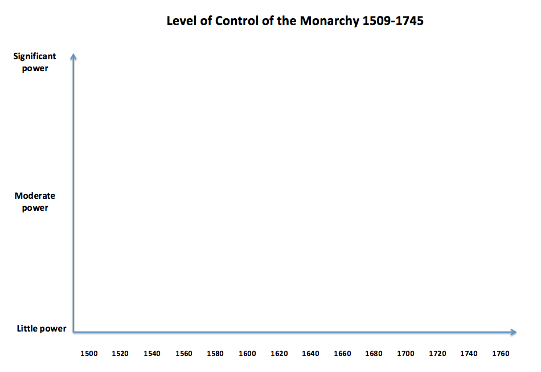
X
X
X

Slide 5
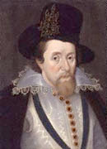
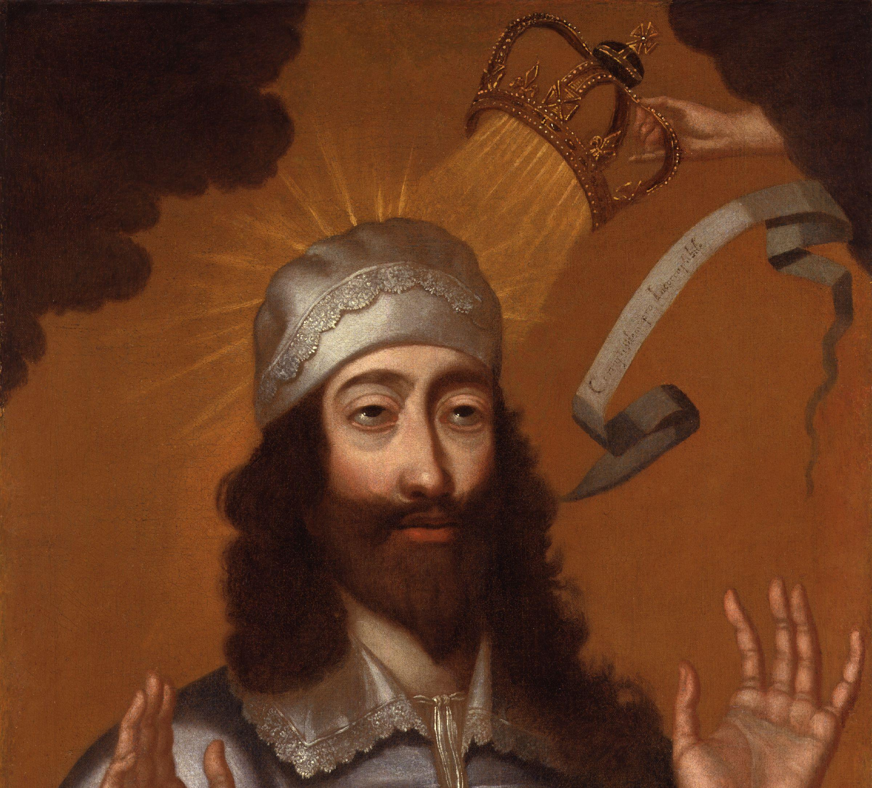
1603-1625
James I of England became King in 1603.
The Divine Right of Kings said that kings were selected by God, and were higher beings than normal people.
James felt he had total control over the way the country was run.
Notes:
James I of England (also James VI of Scotland) became King in 1603. He wrote a theory called the Divine Right of Kings. He believed that kings were selected by God, and were therefore higher beings than normal people.
He believed that kings should have the right to impose royal laws, and they were the makers of the laws, rather than the law the maker of the king.
He therefore felt that he had total control over the way the country was run.

Slide 6
X
X
X
X

Slide 7
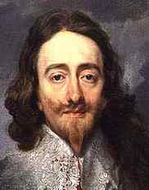
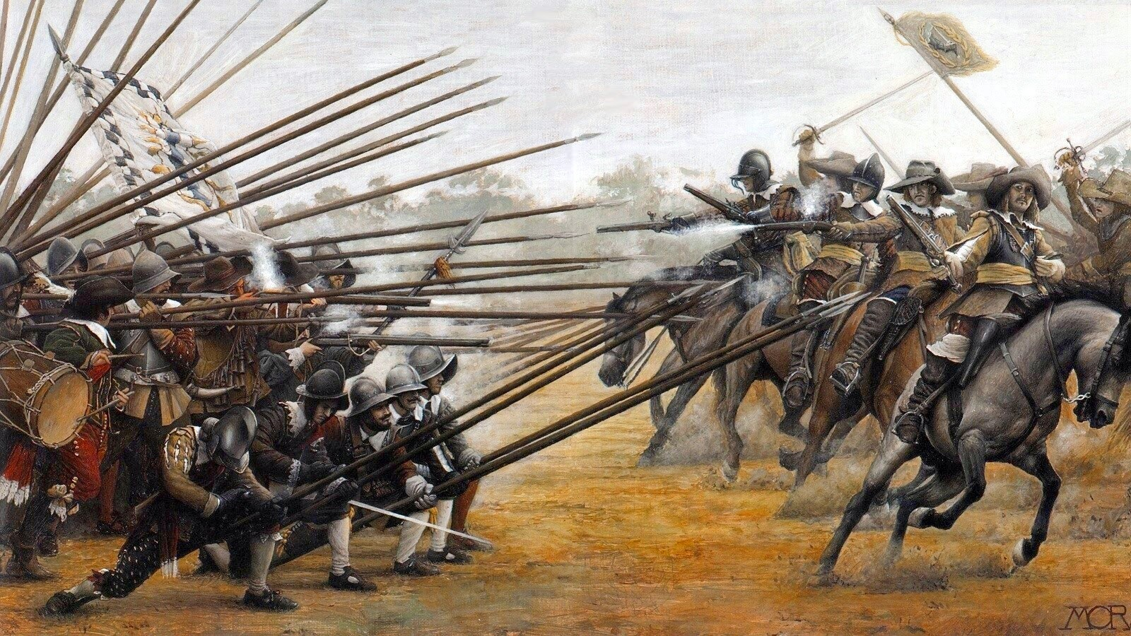
1625-1649
In 1625 Charles I became King.
1625-1646 – Charles argued with Parliament, and then decided to rule completely on his own without Parliament
1642-1646 – the Civil War broke out between Charles and Parliament. Charles initially lost and was imprisoned
1646-1649 – a second Civil War broke out but didn’t last long. Charles was put on trial and executed for treason
Charles initially had an enormous amount of power, but quickly lost it all.
X
Notes:
In 1625 James I died, leaving his son Charles I in power. Charles was King until 1649.
1625-1646 – Charles argued with Parliament when they refused to give him the money he asked for. He then ruled completely on his own without Parliament – he was very powerful
1642-1646 – the Civil War broke out between Charles and Parliament. Charles initially did well but soon started losing. He eventually surrendered and was captured and imprisoned
1646-1649 – a second Civil War broke out but didn’t last long. Charles was put on trial and executed for treason
Charles initially had an enormous amount of power, but quickly lost it all.

Slide 8
X
X
X
X
X
X
X

Slide 9
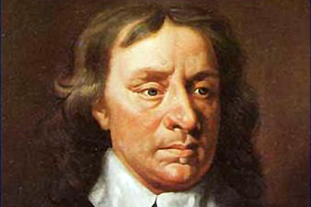
1649-1660
After Charles was executed, Oliver Cromwell the ‘Lord Protector’ ruled over England. There was no King or Queen, so the monarchy lost all power for 11 years.
This time is known as the Interregnum (which means ‘between kings’).
Notes:
After Charles was executed, Oliver Cromwell the ‘Lord Protector’ ruled over England. There was no King or Queen, so the monarchy lost all power for 11 years.
Charles I’s son, Charles II was hiding in France while this went on.
This time is known as the Interregnum (which means ‘between kings’).

Slide 10
X
X
X
X
X
X
X

Slide 11
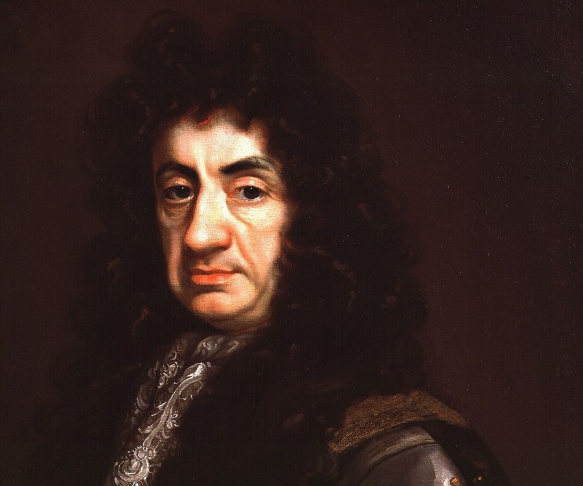
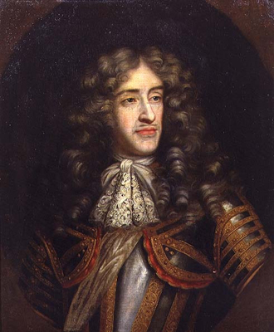
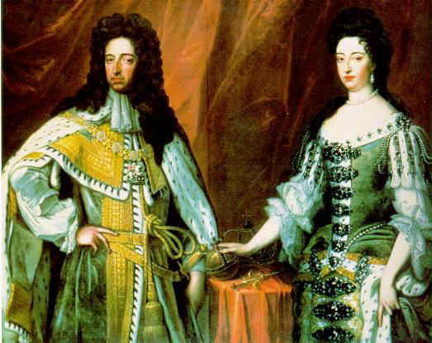
1660-1688
In 1660, the monarchy was put back in place – this is known as the Restoration.
Charles II became king. He was quite sensible with his power.
When he died in 1685, his brother James II became King. James was less sensible and became powerful.
In 1688 the people decided to remove him from power, inviting his Protestant daughter Mary and her husband William to be King and Queen.
Notes:
In 1660, the monarchy was put back in place – this is known as the Restoration.
Charles II became king. He knew that if he upset people he would be executed. He was a fairly moderate ruler but he did face opposition.
When he died in 1685, his brother James II became King. James was less sensible. He believed in the Divine Right of Kings and was a Catholic which made people angry.
His power increased for a while, but in 1688 the people decided to remove him from power, inviting his Protestant daughter Mary and her husband William of Orange to be King and Queen. This decreased the power of the monarchy significantly.

Slide 12
X
X
X
X
X
X
X
X
X
X

Slide 13
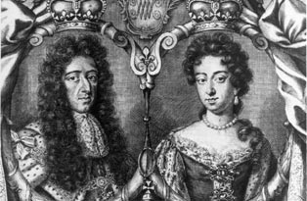
1689-1745
William and Mary knew they must act sensibly or they would be removed from power.
They signed the Bill of Rights, which limited the power of the monarch and set out the rights of parliament.
The monarchy faced opposition from the ‘Jacobites’ who wanted to restore the Stuart kings to the throne. Their final attempt failed in 1745.
Notes:
After this ‘Glorious Revolution’ the monarchy remained fairly stable, with moderate control over England.
William and Mary knew they must act sensibly, and with the support of the people, or they would be removed from power like James II. They signed the Bill of Rights, which limited the power of the monarch and set out the rights of parliament to rule with the monarch.
The monarchy faced opposition in the form of ‘Jacobite Rebellions’. The Jacobites wanted to restore the Stuart kings to the throne (led by James II’s son Charles Edward Stuart).
Their final attempt in 1745 led to their ultimate defeat.

Slide 14
X
X
X
X
X
X
X
X
X
X
X
X

Slide 15
How far did the monarchy lose control, 1509-1745?
The monarchy gained power steadily, before losing total control following the Civil War. After the Restoration, they gained more power again, before losing some control at the Glorious Revolution of 1688.
By 1745 the monarchy had less control than it had done in 1500, due to the restrictions on its power and legal rights of parliament now enforced through the Bill of Rights in 1689.
Challenge:
Do you think this loss of power was a good thing? Why?
Notes:
Ask the students to describe the trend of their graphs, using this one to help them if necessary. Challenge for most able to write.15 minutes.

Slide 16
What was the most significant event in the time period? Why?
Henry VIII becomes king
Henry reforms the Church
Edward enforces Protestant laws
Lady Jane Grey is murdered
Mary burns Protestants
Elizabeth becomes Queen
James introduces the idea of the Divine Right of Kings
Charles I rules without parliament
The Civil War begins between Charles and Parliament
Charles I is executed
Oliver Cromwell rules instead of a King
Charles II is restored to the throne
James II is overthrown in the Glorious Revolution
William and Mary sign the Bill of Rights to ensure the rights of Parliament and limit the role of the monarch
Notes:
Write a paragraph to explain which event they think was the most significant and why.

Slide 17
Things to think about…
Do you think this loss of power was a good thing? Why?
What was the most significant event in the time period? Why?
Notes:
Questions to discuss to end the lesson.

