Slide 1
💥 💥 💥 💥 💥 💥 💥 💥 💥 💥 💥 💥 💥 💥 💥
💣 💣 💣 💣 💣 💣 COLD WAR HISTORY 💣 💣 💣 💣 💣 💣
💥 💥 💥 💥 💥 💥 💥 💥 💥 💥 💥 💥 💥 💥 💥

Slide 2
Orthodox Cold war interpretation
The first school of interpretation to emerge in the U.S. was "orthodox." For more than a decade after the end of the Second World War, few U.S. historians challenged the official U.S. interpretation of the beginnings of the Cold War. The "orthodox" school places the responsibility for the Cold War on the Soviet Union and its expansion into Eastern Europe.

Slide 3
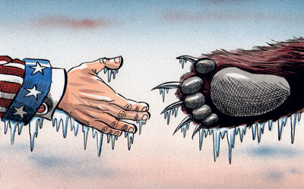
1945
The POTSDAM conference
The YALTA conference
These conferences were not successful due to soviet demands and expansionismdemanding parts of eastern poland and attempting to start a communist government in poland, which would undermine much of the allied effort in the war
Russian expansion in Europe
The Soviet Union annexed much of Eastern Europe in the mid 1940’s. Their treatment of Europe’s governments was ruthless, expelling 5 million German’s from Poland.

Slide 4
kENNANS LONG TELEGRAM
Reported on stalins secret speech in which he made aggressive claims regarding soviet expansion and the demise of the capitalist west
The Baruch Plan
The Soviet refusal to control nuclear weapons development further made the US suspicious of Soviet intentions.
1946
1946 IS SEEN BY MANY AS THE START OF THE COLD WAR. sTALINS AGGRESSIVE REGIME RECIEVES ATTENTION FROM WESTERN LEADERS TRUMAN AND CHURCHILL
Churchill puts attention on to soviet oppression of the eastern bloc in his iron curtin speech
Stalin refuses to remove troops from iran. Churchill openly condemns this as imperialist expansionist policy in the soviet union. This is seen as the first sign of aggressions shown by the ussr in the middle east.

Slide 5
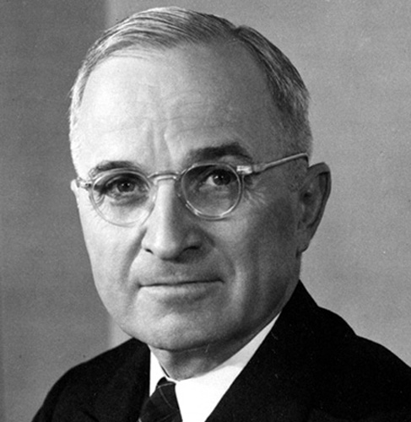
This was a clear response to Kennan’s Long Telegram.
Britain and the US shared the common aim to rebuild Germany’s industry= Natural to unite_____
Soviets had shown they didn’t want to coopoerate____
‘Conainment’ would save the demoratic, Capitalist world from communist expansion
The US was not being aggressive
The Truman Doctrine, March 1947
A necessary measure so as to prevent Communist expansion
The creation of Bizonia, Spring 1947
1947
The establishment of Cominform, September 1947
The Marshall Plan, June 1947
This was an example of the USSR expanding into Eastern Europe
Key part of ‘containment’,
Proof that communist expansion was happening and needed to be stopped
given in order to protect countries from Soviet expansionism.

Slide 6
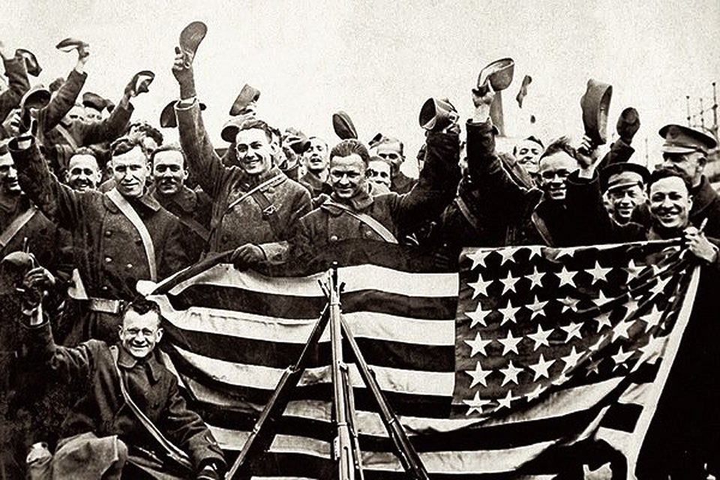
1948
1949
THE BERLIN BLOCKADE 1948
Stalin forcefully blocks of all trade routes into Berlin. West Berliners are threatened by starvation, and their electricity cut off.
Berlin Crisis:
THE BERLIN AIRLIFT 1948 and 1949
Truman and Churchill prevent Soviet expansion with the Berlin airlift. They ship over 2.3 million tonnes of supplies into the city. Eventually, Stalin is led to repeal the blockade, further tensions are defused.

Slide 7
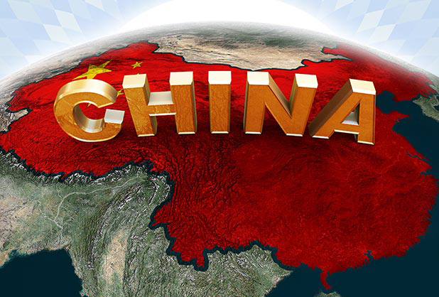
1949
CHINA TURNS RED!
China became communist in 1949, turning with it ½ of the world’s population communist in doing so.
Communism appears as a serious threat now to the world. Imperialism is clearly a motive for communist nations. A Chinese alliance with the Soviet Union threatens the western world with Mao and Stalin share common hatred for American capitalism

Slide 8
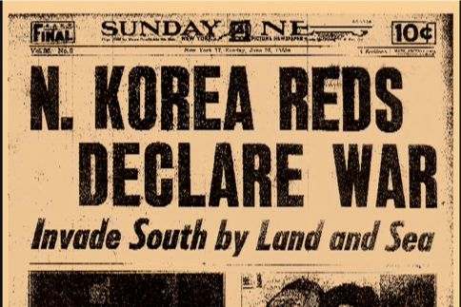
Evidence of communist expansion
North Korea= backed by russia
South korea= backed by USA
North korea invaded south korea
South korea was backed by the USSR so was evidence of russian aggression
THE KOREAN WAR 1950-1953
US involvement was backed by the UN (which russia had boycotted) showing it was retalitaion not aggression on the american side.

Slide 9
TO CONCLUDE...
Between 1945 and 1953, Stalin had exhibited key signs of aggressive foreign policy.
His rhetoric in post-war conferences established his expansionist desires.
Truman’s responses to the actions of the Soviet Union came from a desire to protect a capitalist ideals of freedom and liberty within Europe. Stalin’s aggression threatened the safekeeping of the free world. World War Two had illustrated the dangers of appeasement to the world, so communist expansionism was a threat that had to be responded to.
He had keenly spoke of the fall of capitalism, and seeked for communism to expand in Europe and Asia
Stalin had confronted the capitalist world in Germany. His militaristic approach was nothing less than imperialist.

