Slide 1
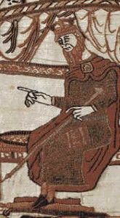
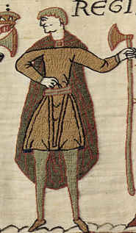
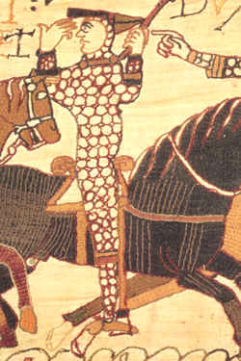
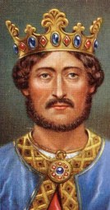
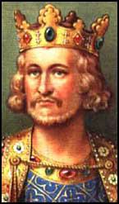
How much control did medieval monarchs have?

Slide 2
Lesson 1: What made a good medieval monarch?
Learning Objectives:
To learn what features were required of a good medieval monarch.
To consider which medieval monarch was the ‘best’ according to the criteria.
Notes:
Resources for the lesson: starter sheet (optional, not required), John card sort (laminated – collect from Cammie)

Slide 3
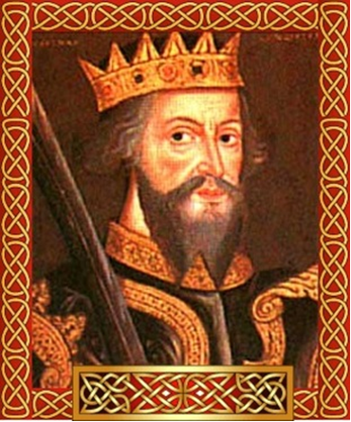
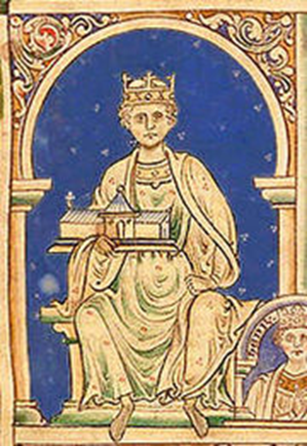
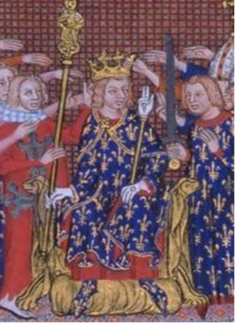
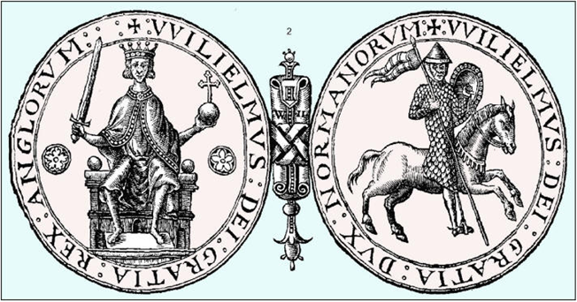
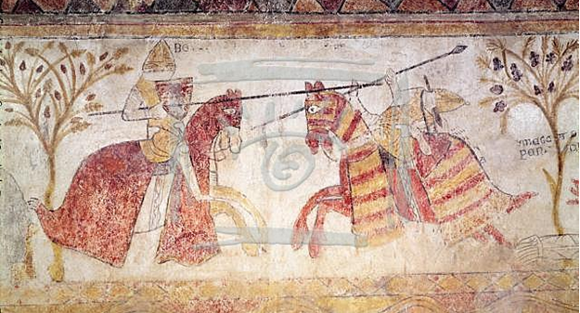
Write a list of things a medieval king might have to do. Use the photos to help you!
Notes:
Use the starter sheet if you like, or just put this on the board and write in books. Sheet can be one per table, pair or one each.

Slide 4
what made a good medieval monarch?
As a table:
Come up with 3 or more criteria for a good medieval monarch.
What skills or talents do they need to have?
What should they be like as a person?
What should they do with their time?
Notes:
Give discussion time, then share ideas as a class.

Slide 5
What made a good medieval monarch?
Look at the criteria on the cards. Match the cartoon pictures to the different criteria to show the requirements of a good medieval monarch.
Write these criteria in your books, and illustrate them with pictures.
Challenge:
Look at the Top Trumps monarch cards in the blue textbook and decide which monarch sounds like the best one!
Notes:
Introduce the 7 criteria on the cards before OR after card sort depending on ability and language: 1) Look rich and powerful to impress your people. 2) Win the support and trust of the barons and listen to their advice. 3) Lead the army, win wars and keep your land. 4) Raise taxes fairly, in the same ways as kings before you. 5) Stamp out crime and keep order in the country. 6) Support the church. 7) Have sons so there are no disputes over who is the next king. Recap answers together. Get them to copy down the 7 criteria in their books and illustrate with the copies of the cards if they have time.

Slide 6
Homework
Imagine you are a medieval monarch. What kind of things might worry you? Write a letter talking about your daily life and also expressing your concerns.
Complete this homework on paper. You can tea-stain the paper if you like!

Slide 7
Lessons 2 and 3: Was King John a good king?
Learning objectives:
To revise what made a good medieval monarch.
To assess whether or not King John was a good monarch, using the specified criteria.
Notes:
Resources for the lesson: Magna Carta sheet (one each for more able students, or all as preferred). A3 tables and cards to stick on.

Slide 8
Was John a good King?
Cut up the cards and place them on your A3 table. Decide which of the 7 criteria each card matches, and then whether it suggests John was good or bad at it.
Challenge:
In your book write a paragraph summarising whether you think John was a good or a bad king, and why.
Complete the Magna Carta sheet.
Notes:
You might prefer to give them only the positives, then the negatives, depending on the class pace. Place and then check before sticking!

Slide 9
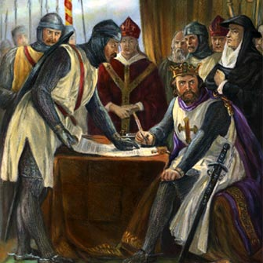
What was the magna carta?
Use this picture to help you work it out:
What is happening?
Who is present?
Which person is John?
How does he look? Happy or unhappy? Powerful or weak?
Notes:
Can be done on sheets as an extension for more able before general class discussion.

Slide 10
What was the Magna Carta?
The Magna Carta (or Great Charter) was a set of rules that the barons demanded that John sign. It was very important, as it made John accept that he didn’t have total control, and that he had to follow the laws of the land. It protected the rights of the people, and laid the foundations for modern-day legal systems in many democratic countries around the world. If John hadn’t signed, there would probably have been a civil war!
Notes:
Read aloud together, then make notes from the yellow in books.

Slide 11
What was the magna carta?
John believed that he was the king, and had the right to do as he pleased. One part of the Magna Carta made him very angry – Clause 61, which said:
The barons shall choose 25 barons to make certain the King keeps this charter. If he breaks the charter, the 25 barons can take action to make him keep it. They can take his castles and lands but must not attack the King, his Queen, or his children.
Who do you think was right – the barons, or King John?
Write a paragraph in your book to explain what you think and why.
Challenge: Use information from Clause 61 to explain your answer.
Notes:
Encourage students to try and quote the Clause in their paragraph.

