Slide 1
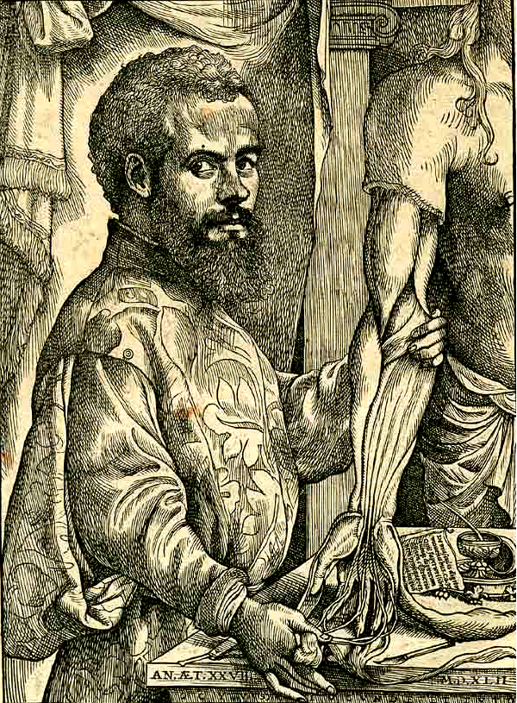
Medicine Revision – what do I need to know?
Learning Objective: Revise the key time periods, people and contextual knowledge required for the Medicine exam.
Starter:
Write a quiz question about Medicine on your post-it note.
When you have finished, stick it aside on your desk, to use at the end of the lesson.

Slide 2
The 4 Strands
To kick us off… name the 4 strands (or themes) of the medicine course that you need to know:
C______
T______ / Prevention
T_______ / Practitioners
P_______ H_______
Causes
Treatments
Training
Public Health

Slide 3
When, what, who?
In your table groups, make a timeline using the time period cards.
Add the contextual knowledge that tells you about each time period.
Add any key people, who fit into that time period.
Challenge:
Write down any key developments that you know about from that time period.

Slide 4
Key people
Fill in the table naming the key people of the Medicine course, in chronological order, or in some cases write what they achieved.
Check your answers with the person next to you.
Once you have finished, if there are any that you still can’t answer, and no one on your table can help you, look it up in a textbook.
Challenge:
Start memorising the key people in order, and their achievements. Test each other on them until you can remember. Colour-code the people so they are in time period groups (e.g. 20th century people = green, Romans = red, etc.)
“Who did came up with the Theory of the Four Humours?” “Hippocrates!” “Who was Hippocrates?” “An ancient Greek doctor!” “Who was?” “Hippocrates!” “What did he do?” “Came up with the Theory of the Four Humours!” “Who came up with the Theory of the Four Humours?” “Hippocrates!” “Who’s he?”

Slide 5
Plenary
Read the question on the post-it note you have been given.
Answer the question in a full sentence on your paper.

Slide 6
Homework
Take home the key people sheet, and learn them. We will have a knowledge test next lesson to check what you can remember.

