Slide 1
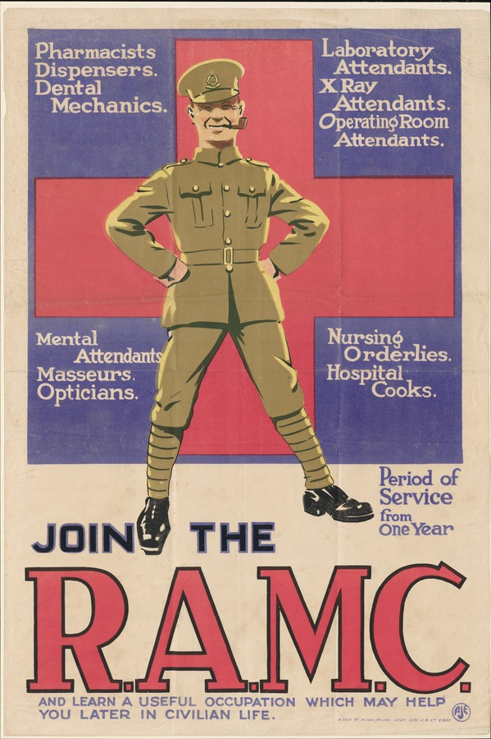
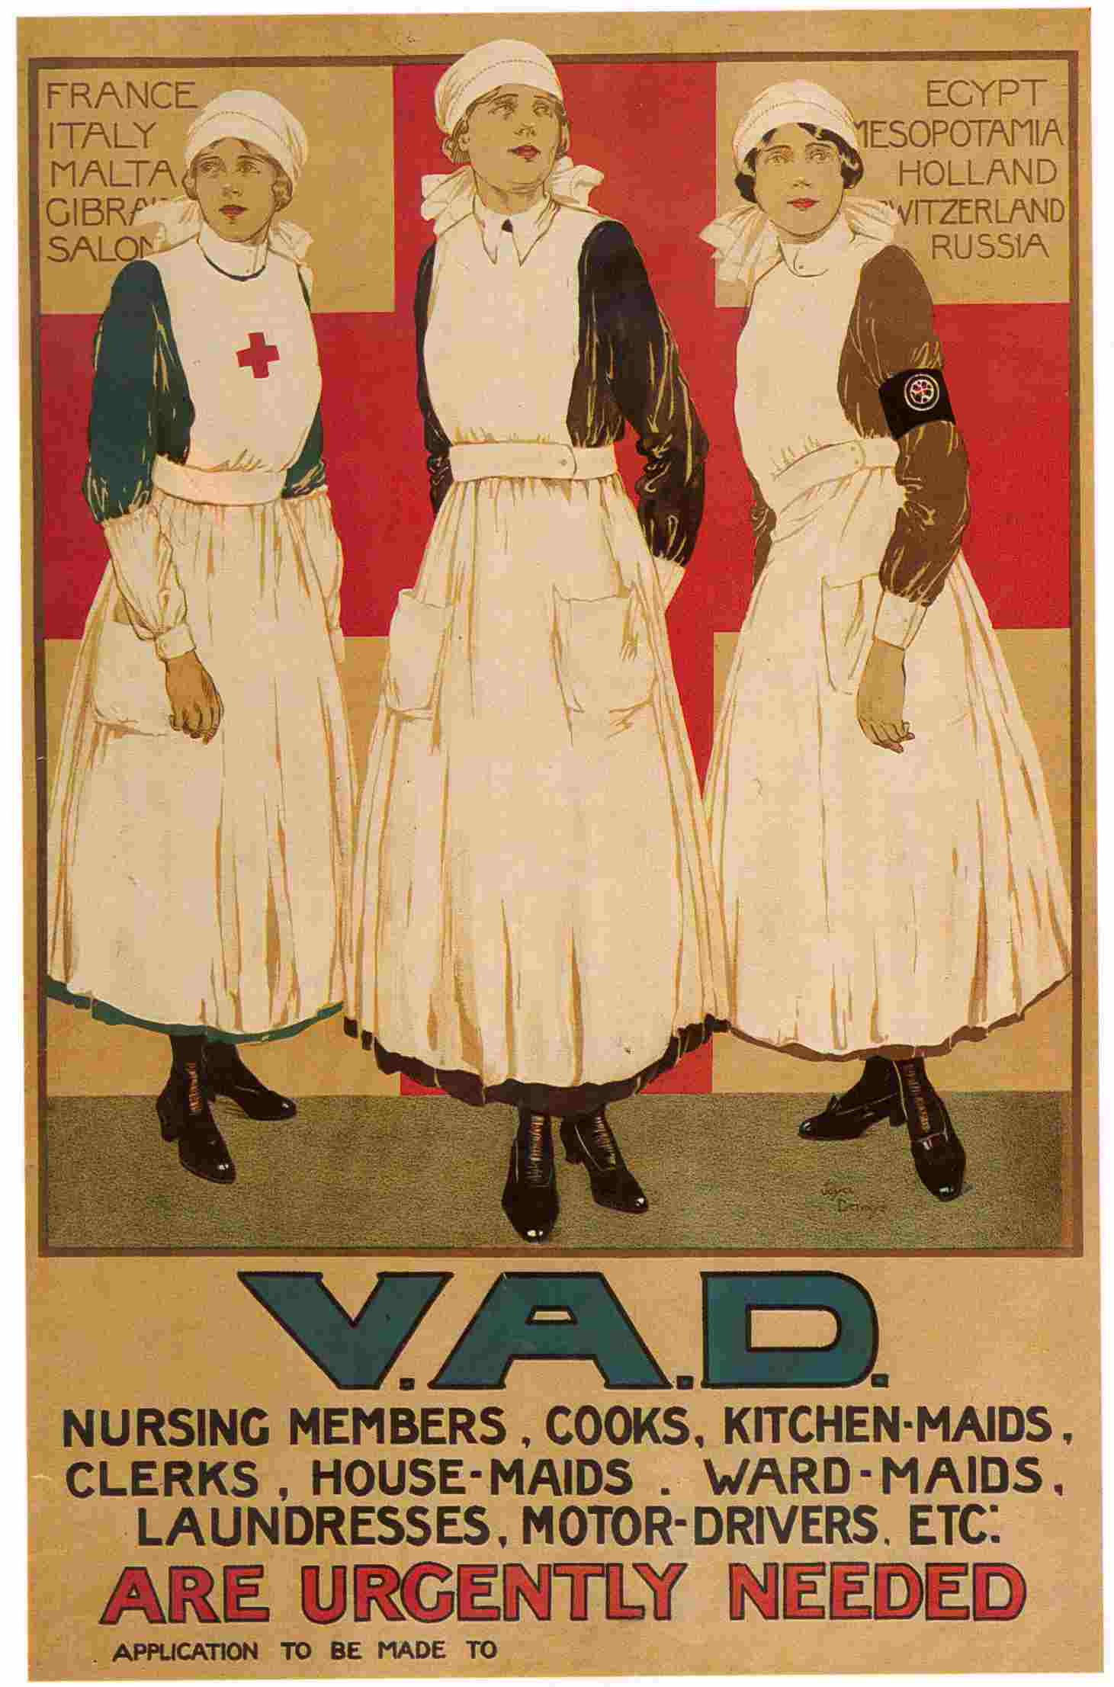

Slide 2
i) What do these posters suggest about the medical services in the First World War?
ii) What does the VAD poster suggest about the role of women in the First World War?

Slide 3
The personnel of a Casualty Clearing Station normally comprised of eight medical officers and 77 other ranks. One of the medical officers had dental qualifications. Nursing sisters were added in 1915, at first five and then seven. A CCS had two surgical teams during quiet spells, consisting of a surgeon, anaesthetist, theatre sister and an operating theatre orderly.
From T Scotland in The First World War and it influence on the development of orthopaedic surgery, Journal of the Royal College of Physicians of Edinburgh, 2014
The RAMC numbered under 20,000 at the start of the war, by the end it numbered about 150,000 administering well over half a million beds… they dealt with nine millions cases and administered 1,088 million doses of drugs, over one and half million splints, 108 million bandages, 7,250 tons of cotton wool and 22,386 artificial eyes.
In Death’s Men by Denis Winter, p.197, published in 1978

Slide 4
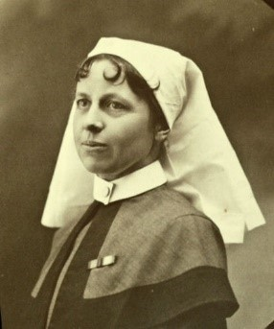
Queen Alexandra's Imperial Military Nursing Service (QAIMNS) or the ‘Regular' military nursing service was formed in March 1902. At the outbreak of war in 1914, there were 297 members of QAIMNS - matrons, sisters and staff nurses - employed in military hospitals at home, and overseas in Malta, Gibraltar, Egypt, South Africa and China. There was also a QAIMNS Reserve. By the end of 1914 more than 2,200 women had enrolled in this service, and in total more than 12,000 served with the Reserve at some time during the Great War in all theatres.
Extract from British Military Nurses and the Great War: a Guide to the Services - http://www.westernfrontassociation.com

Slide 5
County branches of the Red Cross had their own groups of volunteers called Voluntary Aid Detachments (often abbreviated to VAD). Voluntary Aid Detachment members themselves came to be known simply as ‘VADs’. Made up of men and women, the VADs carried out a range of voluntary positions including nursing, transport duties, and the organisation of rest stations, working parties and auxiliary hospitals. At the outbreak of the war, many people were inspired to train to help the sick and wounded. Women needed to be taught first aid, home nursing and hygiene by approved medical practitioners. They also took classes in cookery. Men were trained in first aid in-the-field and stretcher bearing… VADs had to pass exams to receive their first aid and home nursing certificates… Over 90,000 people volunteered for the British Red Cross at home and overseas during the war.
http://www.redcross.org.uk/
I can honestly say I love nursing, even after only two days. It is surprising how things that would be horrid or dull if one had to do them at home quite cease to be so when one is in hospital. Even dusting a ward is an inspiration… I have various other jobs in the morning, such as going round with the doctor to see patients, bandaging limbs, helping semi-helpless people to get up & put their clothes on… preparing dinner and in general being at the beck and call of the nurse who is over me…
Vera Brittain, a VAD Nurse in Letters From a Lost Generation: First World War Letters of Vera Brittain and Four Friends, 2008

Slide 6
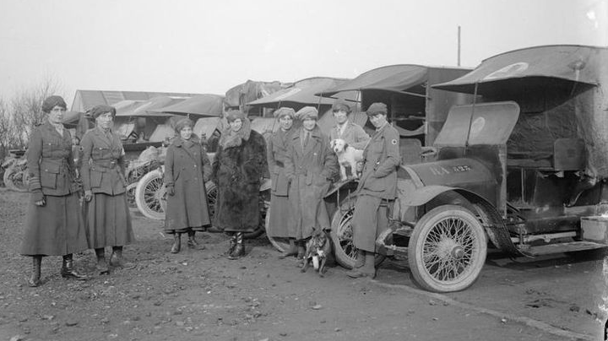
The FANY with the ambulances in Calais, January 1917.

Slide 7
The First Aid Nursing Yeomanry (FANY) was an independent voluntary organisation set up in 1907 and modelled on military lines, taking the title 'Yeomanry' from the fact that it was a mounted unit. It was originally created to provide emergency medical care in the critical period between soldiers being wounded and their evacuation from the battlefield. The FANYs were trained in first aid and, being very mobile, could take care to soldiers at the point of injury. They practised riding out to a casualty, providing immediate first aid and either evacuating casualties by horse, carrying them on stretchers, or stabilising them until the slow horse-drawn ambulances could arrive. From October 1914 the FANY provided nurses and ambulances for the Belgian Army, and soon afterwards for the French, and from 1916 for the British Army.
Remembering the First Aid Nursing Yeomanry in the First World War from the National Army Museum website – www.nam.ac.uk

