Slide 1
The Islamic World: 7th-18th century
Learning Objectives:
To gain some understanding of the culture and history of Islam in the Middle East.
To be able to compare life in the UK to life in Islamic World during the same time period.

Slide 2
Lesson 1: How did Islam originate?
Through the story of Muhammad, we will learn about the origins of the religion of Islam, and consider what life was like Arabia in the 6th century.

Slide 3
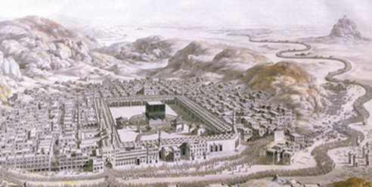
Makkah, 570 AD
Makkah was a bustling city, with around 20,000 inhabitants. On the edge of the city were camel stables, from where traders took caravans, carrying goods to sell.
Makkah was not only a stopping point for traders, a marketplace, and a home, but it was the sacred city of Arabia. Pilgrims came from miles around to visit the Kaaba, around which were 300 holy objects – Jewish, Christian and Pagan.
Key Words:
Caravan: group of travellers on camels
Kaaba: shrine (black, square building)
Pagan: someone who believes in many Gods
Notes:
Read aloud and check key words.

Slide 4
Where is Makkah?
Mark Makkah on your map!
Makkah is here, in modern-day Saudi Arabia. You might have seen it spelled ‘Mecca’.
Notes:
Get students to mark on their maps where Makkah is.

Slide 5
Arabia, 570 AD
Task 1: Write down 5 facts about Arabia/Makkah in 570 AD.
Different Religions
The caravan trade brought pagan Arabs, Christians and Jews into contact, and they shared stories.
Some Arabs were not happy with the pagan practice of worshipping special stones and lots of gods, and wanted to focus on one God only – Allah. They were known as Hanifs.
Clans and Tribes
There were no kings or emperors in Arabia, just different tribes. Within each tribe were smaller clans, or around 100 families. They were incredibly loyal to each other, and saw it as a duty to protect each other at all costs.
A small number of people thought this was wrong, and sometimes people who had done wrong should not be protected. They called themselves ‘lovers of justice’.
Culture
Arabia had a rich history of grand cities. Poetry was very popular, and was often used to celebrate family history.
Notes:
Get the students to write down 5 key facts about Arabia/Makkah in 570. 10 minutes.

Slide 6
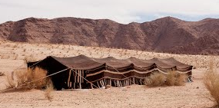
Muhammad, 570
Task 2: Make a list of things from his childhood that you think would influence Muhammad later in life.
In 570 AD, a baby called Muhammad was born. Some women from the Bedouin tribe came looking for children to foster and feed when Muhammad was only a few days old. They would not be paid, but when they returned the children they would expect a gift.
Muhammad’s mother, Aminah, gave her son to a Bedouin woman called Halimah, who took him back to her tribe in the desert. She raised Muhammad until he was six, living a simple nomadic life, with barely any possessions. He grew up learning about looking after the poor and sick, war and history of the Bedouin tribe, and the ancient religion of Arabia, sacred places, kind spirits and scary jinn.
Key Words:
Bedouin: tribe that lives in the deserts of Arabia
Nomadic: without a permanent home
Jinn: supernatural spirits or beings
Notes:
5 minutes to make their list. Short class discussion, ideas could include: kindness towards the needy, religion and beliefs, simple life – no desire for possessions, link with the Bedouin people?

Slide 7
Muhammad, 610
Task 3: Read the next part of the story and answer the questions on your worksheet. We will check answers in 10 minutes!
Caring, and living a simple life. He experienced both of these in his early life, living with the Bedouin tribe.
Only worshipping one God. They felt that Muhammad was cursing and insulting their ancient religious beliefs.
They would protect him, at all costs! This is what clans believed in at the time, in Arabia.
Notes:
15 minutes to complete worksheet and check answers.

Slide 8
Islam is born!
Islam had begun!
Muhammad had begun to spread the word of Allah to his local tribe, but not everyone was happy.
Task 4: Summarise how and when Islam began. Try to be concise – use fewer than 30 words!
Task 5: Predict what difficulties you think/know Muhammad might face.

