Slide 1
Islam Today: How far has Islam spread in 1400 years?
Learning Objectives:
To learn about how Islam has spread further afield, and the influences it has had on the modern world

Slide 2
Carefully and lightly, shade in all the countries coloured on the map. Just use one colour. You don’t need to label the countries.
Notes:
Explain that Islam has also gone much further, e.g the USA, but this selection covers the countries on their maps.

Slide 3
British Muslims
Today, Britain is a multicultural society with a diverse mix of cultures.
Play the celebrity quiz game to see if you can identify the different areas in which these British Muslims have helped to shape British culture!

Slide 4
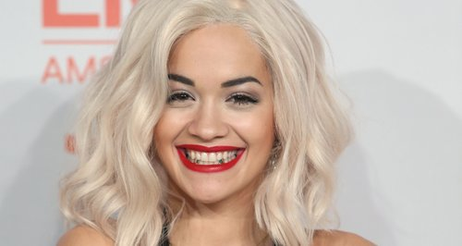
1

Slide 5
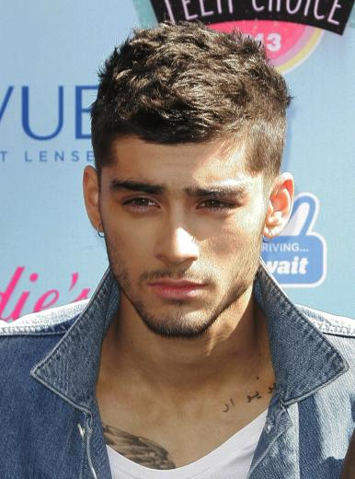
2

Slide 6
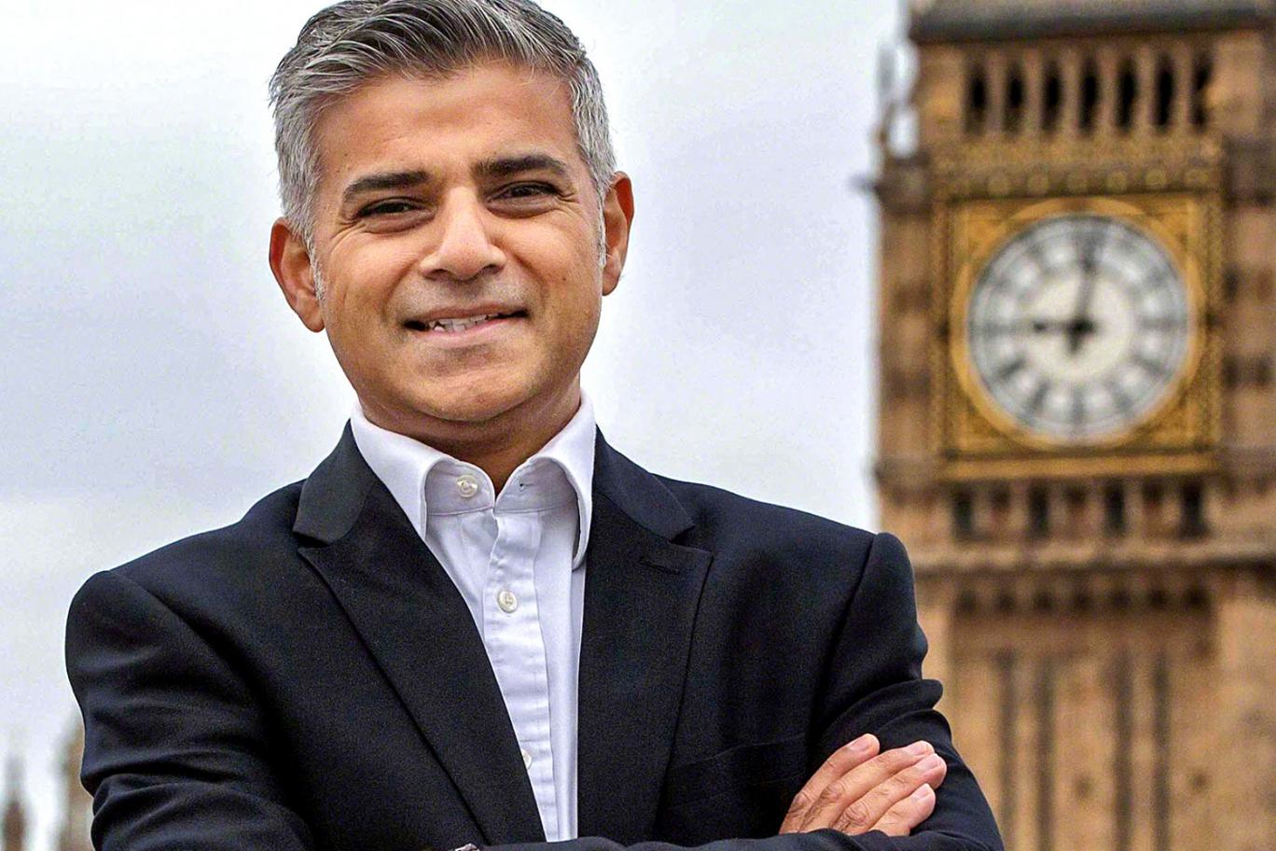
3

Slide 7
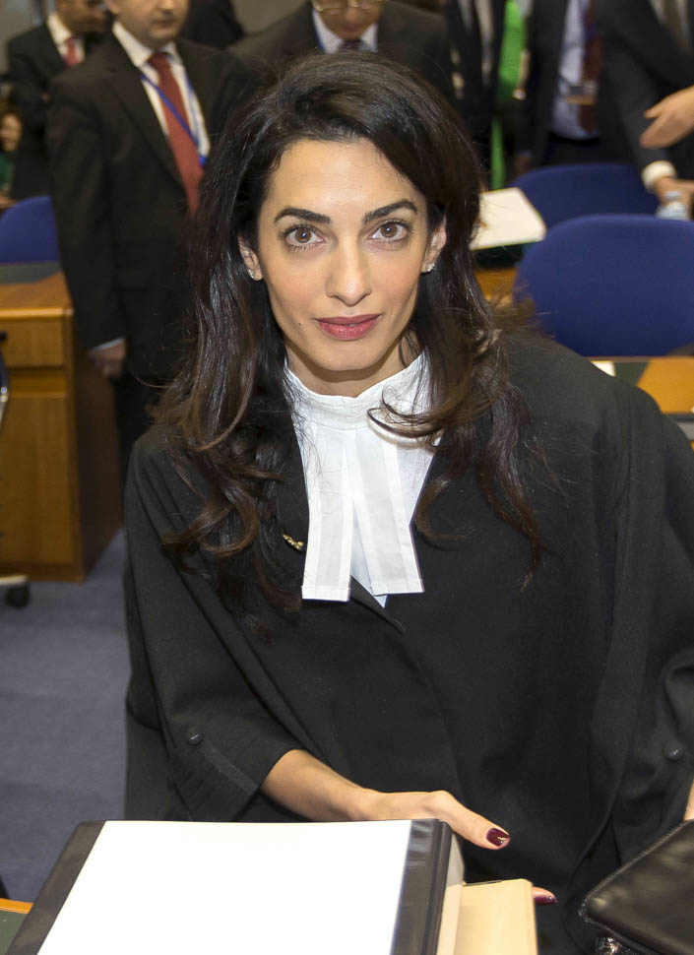
4

Slide 8
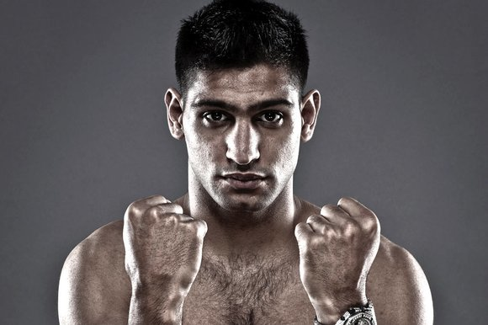
5

Slide 9
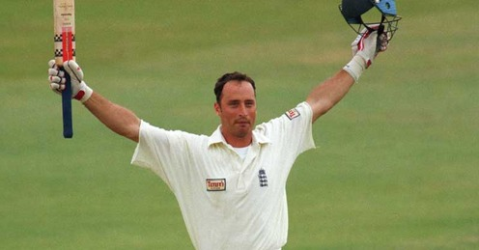
6

Slide 10
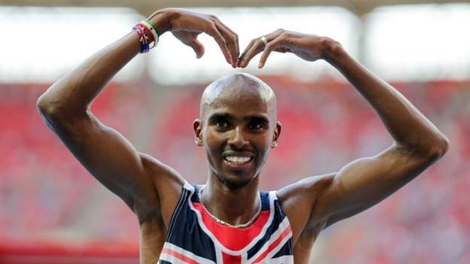
7

Slide 11
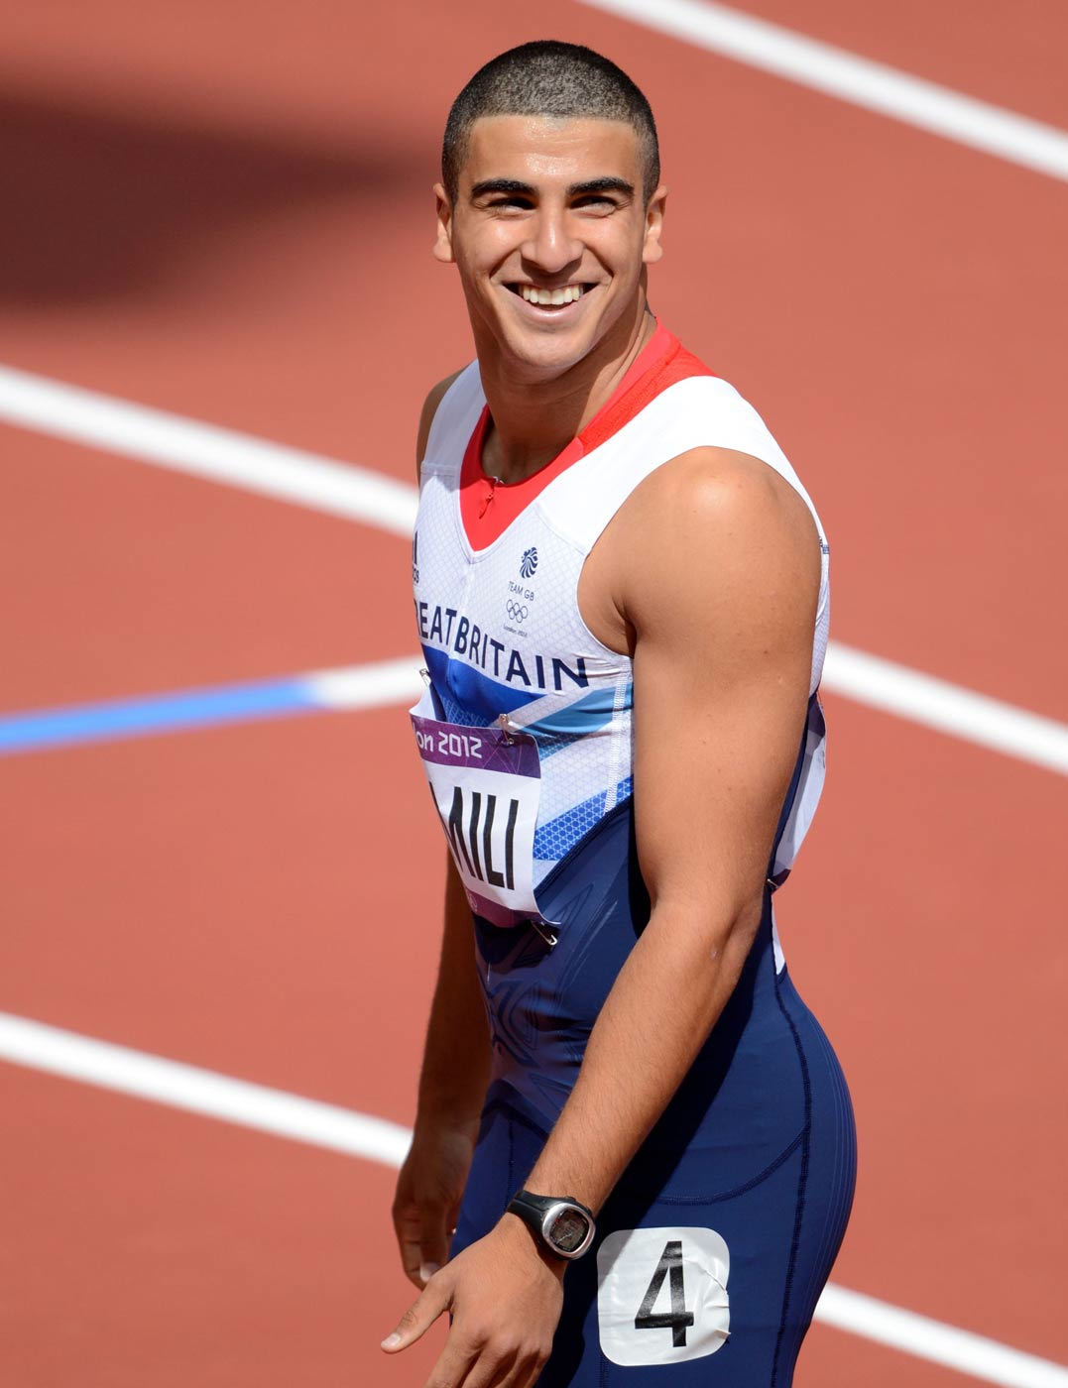
8

Slide 12
Rita Ora – singer and actress
From Kosovo
Born to Albanian parents

Slide 13
Zayn Malik – singer
From Bradford
Born to English and Pakistani parents

Slide 14
Sadiq Khan – Mayor of London
From Tooting
Born to Pakistani parents

Slide 15
Amal Clooney – Human Rights Lawyer
From Beirut
Born to Lebanese parents

Slide 16
Amir Khan – Boxer
From Bolton
Born to Pakistani parents

Slide 17
Nasser Hussein – former England Cricket Captain
From Madras
Born to Indian and Anglo-Indian parents

Slide 18
Mo Farah – distance runner
From Mogadishu
Born to Somali parents

Slide 19
Adam Gemili – Sprinter
From Dartford
Born to Iranian and Moroccan parents

Slide 20
Islam Today
That was only a selection!
Of course, these celebrities are not known for their religion, but their talents. 100 years ago, most people in England were Christians. Now, people of all religions live side by side. Religious harmony is only disturbed by the ignorant, and extremists who misuse their religion.

Slide 21
Islam Today
Look back to your Baghdad poster. Which aspects of Islamic culture from the middle ages have influenced England to be as it is today? Fill in the middle box of your sheet.
Challenge!
Try to work out the English words from their Arabic roots!

Slide 22
Answers
amir-ar-ahl | Chief of the transport | Admiral
sikkah | Dye used for coin-making | Sequin
jarrah | Large vase | Jar
jubba | Outer garment (of clothing) | Jumper
kaithara | Stringed instrument | Guitar
naranj | Citrus fruit | Orange
qand | Cane sugar | Candy / sweets
safar | Journey | Safari

Slide 23
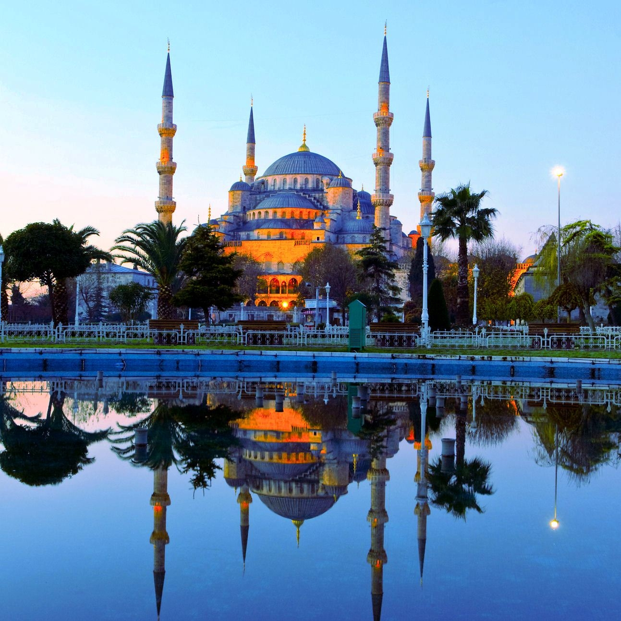
Things to think about… and maybe share!
Does anyone speak Arabic? Can you teach us?
Is anyone Muslim? Would you like to share your knowledge and experience of Islam in England and/or different countries?
Has anyone visited a mosque in
England or elsewhere?

