Slide 1
Did Medieval Baghdad have ‘all the treasures of the world’?
Learning Objectives:
To understand what Medieval Baghdad was like and how advanced it was.
To consider whether it is true to say it had ‘all the treasures of the world’.

Slide 2
Where is Baghdad?
Mark Baghdad on your map!
Cordoba
Baghdad is here, in Iraq.
Jerusalem
Medina
Makkah
Notes:
Get students to mark on their maps where Medina is.

Slide 3
Baghdad
By the middle of the 8th century, Islam had spread from Arabia to as far west as Spain, and as far east as India. It took 2 years to travel from one end to the other.
At first the empire was ruled by the Umayyads from Damascus, but in 750 they were defeated by the Abbasids who moved the capital to Iraq.
In 762, the caliph, al-Mansur, decided to build a new capital on the site of a small village called Baghdad.
Baghdad was situated between 2 rivers and on flat, fertile soil: it was perfect for growing crops.
It was well-connected to the whole of the Islamic world, to Africa, Byzantium (South-East Europe), India and China.
Notes:
Read together.

Slide 4
‘All the treasures of the world!’
This is how, an historian in the 9th century described Baghdad.
You will be creating a poster that shows all of these treasures. This poster needs to be carefully researched, planned, and drafted before you create your final piece.
It must be of a high quality, very informative, and neatly presented.
Notes:
Explain task.

Slide 5
Research
In order to decide if Baghdad had ‘all the treasures of the world’ you must first find out about the medieval city.
Complete your research table using the information posters.
Notes:
Spend most of lesson 1 on this, but try to start drafting a poster if possible. The draft can be done completely for homework if necessary.
You will need the research tables and the information cards (hard copy only – see Cammie for these).
Atmospheric music!
https://www.youtube.com/watch?v=cF2YcA3fBEI

Slide 6
Planning
Using your research, draft a poster that shows ALL the different types of ‘treasures’ (e.g. science, architecture, geography…) with examples.
For homework, finish this design and print some pictures off if you like, to stick onto your final poster.
Notes:
Emphasise that it should be predominantly informative, like an academic poster, but also include pictures.

Slide 7
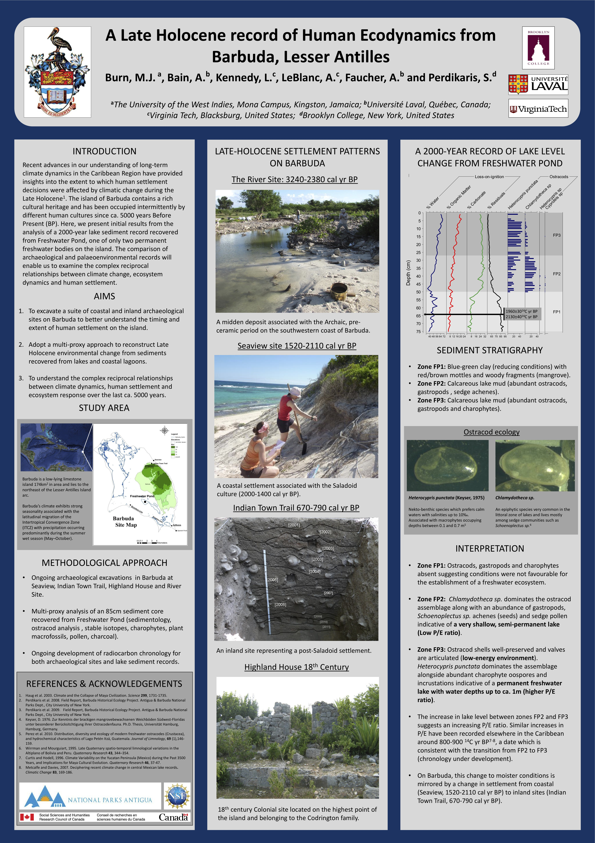
Notes:
Examples of academic posters to show the students.

Slide 8
Treasure Posters
Complete your poster showing all the treasures of Baghdad.
Use your draft, and all of your research.
Add pictures to illustrate your poster.
Complete for homework if you don’t manage to do so in class.
Notes:
The second lesson can be spent making these, and they can be completed for homework if necessary. If you have time, tidy up and put out the posters to allow the students to look at each other’s.
Atmospheric music!
https://www.youtube.com/watch?v=AQVLf2HFjz4

