Slide 1
Be the Light in the Darkness
Holocaust Memorial Day
27th January 2021

Slide 2
What was the Holocaust?
The mass murder of up to 17 million people deemed by Hitler’s Nazis to be inferior people:
6 million Jewish people, around 2/3 of the European Jewish population.
Millions of black and mixed-race people, the disabled, the mentally ill, homosexuals, Romany Gypsies, Jehovah’s Witnesses, Poles and Slavs, political prisoners, vagrants and criminals.

Slide 3
What is Holocaust Memorial Day and why is it important?
Wednesday 27th January: 76 years since the liberation of Auschwitz-Birkenau death camp.
To remember:
The victims of Holocaust and other genocides since.
The path to genocide.
Those who stood up against hatred and intolerance.

Slide 4
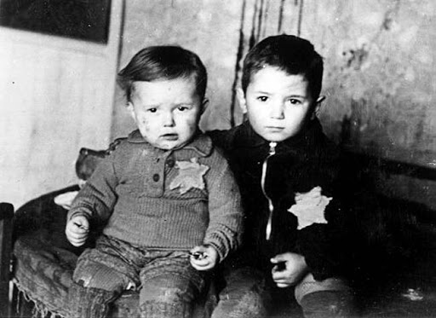
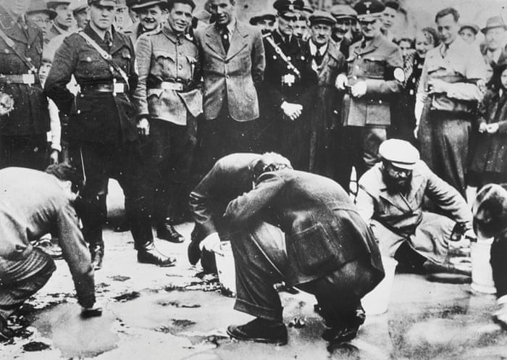
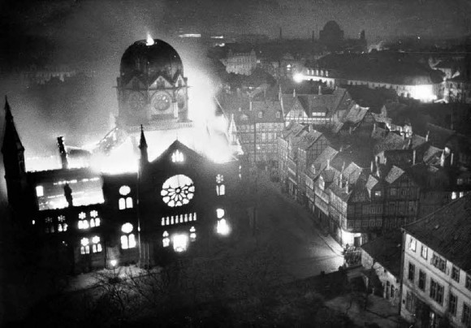
Darkness draws in
Distortion and hate
Emotional darkness
Stages 2, 3 and 8 of the Genocide Watchlist:
Symbolisation, discrimination, persecution

Slide 5
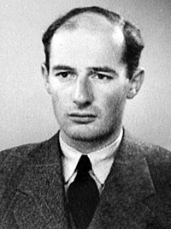
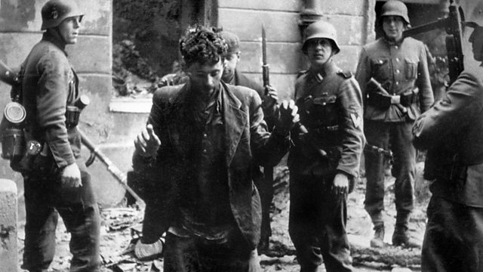
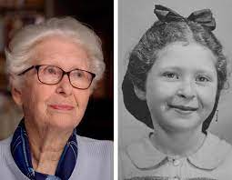
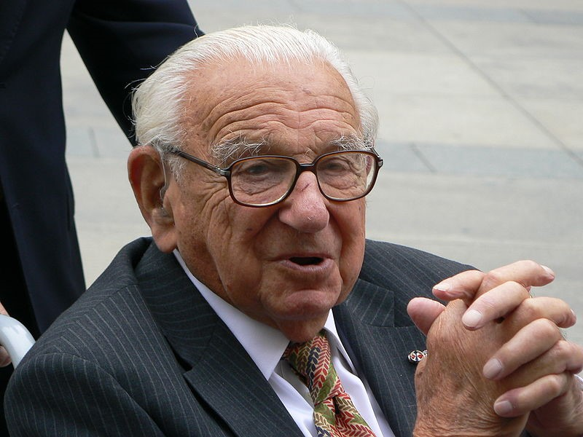
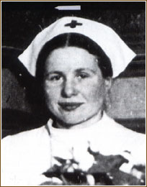
Light during the darkness
Resistance
Rescue
Kindness
Shining light into the dark
Raoul Wallenberg
Warsaw Ghetto Uprising, 1943
Holocaust survivor Francine Christophe: #HUMAN interview
Sir Nicholas Winton
Irena Sendlerowa
Notes:
Raoul Wallenberg – thousands of Jews Nicholas Winton – 669 Czech children on the Kindertransport
Warsaw Uprising – 6 weeks, first armed resistance Irena Sendlerowa – 2500 Polish children

Slide 6
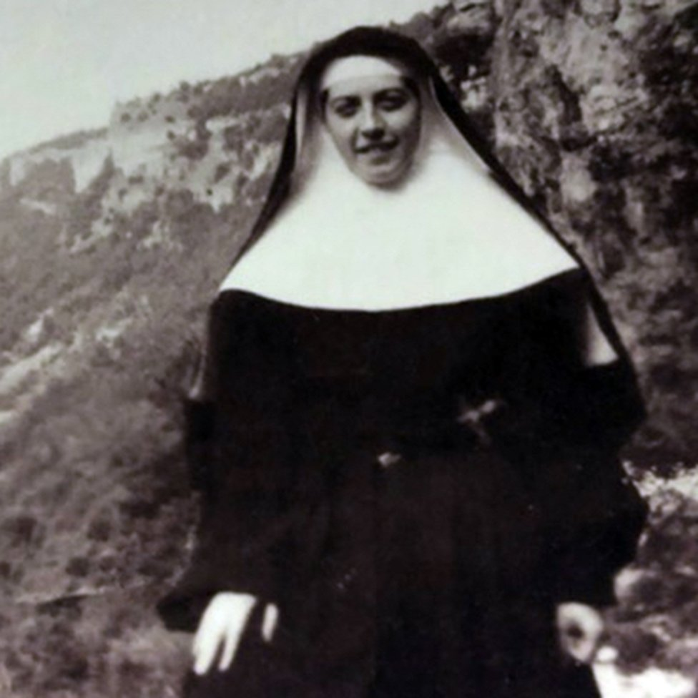
Light during the darkness
Sister Denise: ‘Notre dame de la guerre’
Denise Bergon, a French nun, saved 83 Jewish children by hiding them amongst the Catholic children at her convent’s boarding school.
In response to her concerns about endangering her colleagues and being dishonest, her Archbishop replied:
"Let's lie, let's lie, my daughter, as long as we are saving human lives."

Slide 7
Darkness today
‘The truth has never been more fragile.’
David Baddiel
Denial
2018 poll: more than 2.6 million British adults believe the Holocaust is a myth.
Prejudice
Hate crimes have been steadily rising since 2015.
Religious Hate Crimes recorded by the Home Office
Anti-Semitic Incidents recorded by the CST

Slide 8
Darkness draws in
Genocide Watch:
The red stages are both the earliest stages and easiest to spot and stop.
They are also usually the stages ignored by people who believe:
It will pass.
It’s not my problem.
It’s not that bad.
It’s not true.

Slide 9
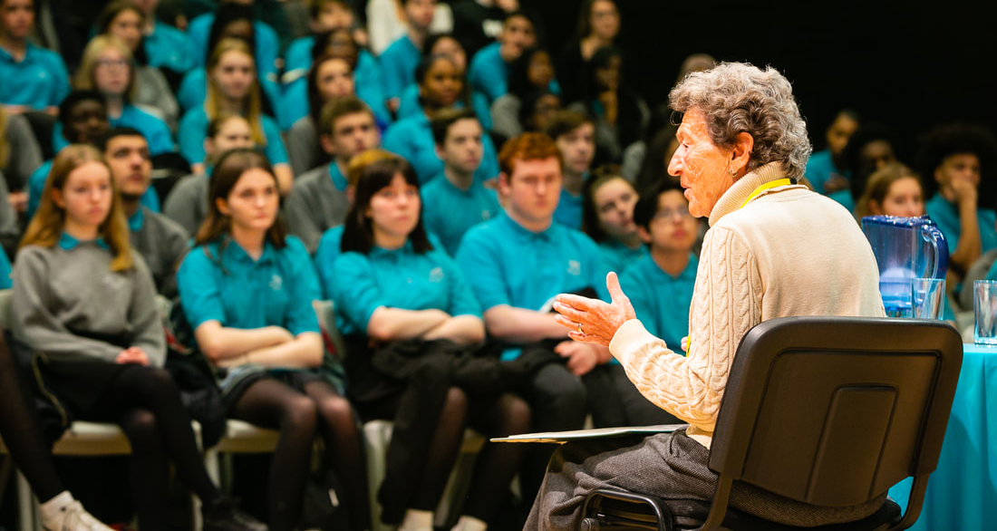
Be the light in the darkness today
Shining light through testimony
Confronting denial, distortion and misinformation
Our responsibility to be the light
Hedi Argent visits Thomas Tallis, 2020
Josef Perl, 1930-2018

Slide 10
Be the light in the darkness
‘Every day of inaction means that more people are being killed.’
Former Gambian Justice Minister Abubacarr Tambadou brought Myanmar’s leader Aung San Suu Kyi to The Hague on charges of failing to prevent genocide by her country’s military.
Judges voted unanimously to order Myanmar to ‘take all measures within its power’ to prevent genocide.

Slide 11
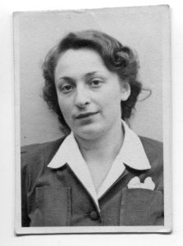
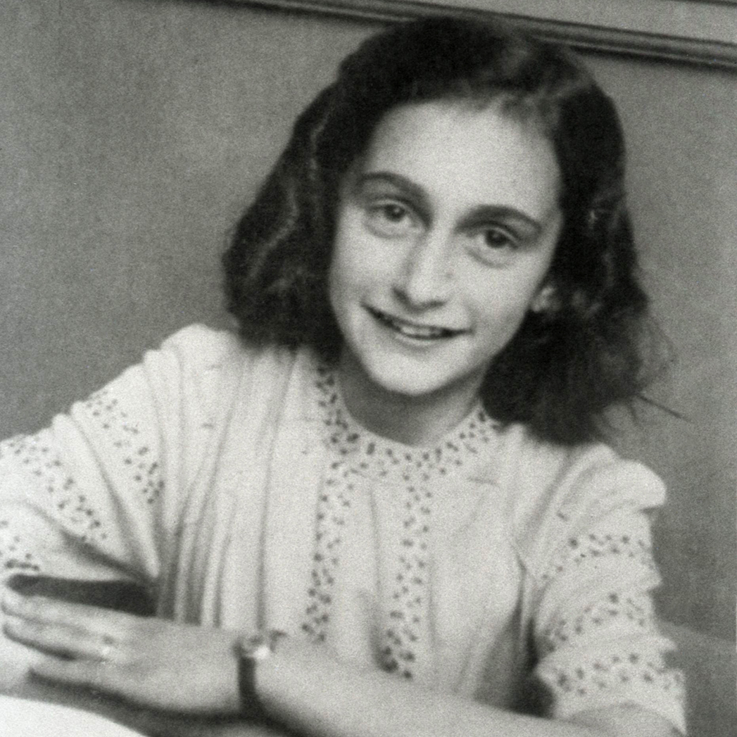
Be the Light
‘I made a promise to a girl in Auschwitz – to make young people aware of the dangers that the dehumanisation, denigration and differentiation of people can lead to.’
Iby Knill, Holocaust Survivor
‘My experiences have not destroyed my belief in humanity’s goodness.’
Josef Perl, Holocaust Survivor
‘In spite of everything, I still believe people are good at heart.’
‘How wonderful it is that nobody need wait a single moment before starting to improve the world.’
Anne Frank, Holocaust Victim

Slide 12
Be the Light in the Darkness
Holocaust Memorial Day
27th January 2021

