Slide 1
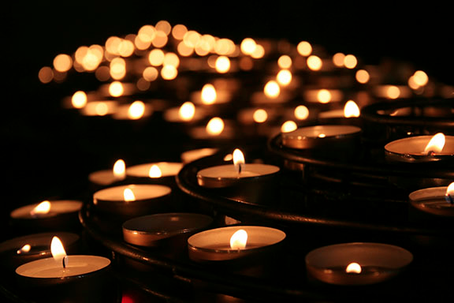

Slide 2
One Day
Think of a day that your life changed…

Slide 3
What is Holocaust memorial day?
On the 27th January 1945, the Auschwitz-Birkenau Nazi death camp was liberated.
By this time, around 6 million Jewish people had been murdered, along with millions others considered to be ‘unworthy’ by the Nazis, including homosexuals, Jehovah’s Witnesses, the disabled, and ethnic minorities.
Every year on this date, people remember those who were killed in the Nazi genocide (the deliberate killing of an entire group of people).

Slide 4
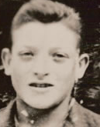
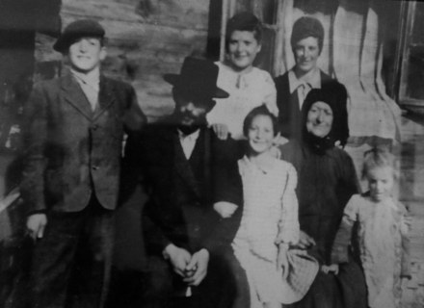
Josef Perl

Slide 5
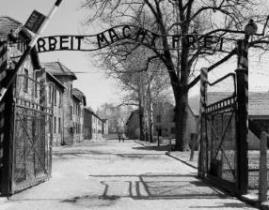
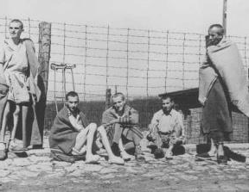
One Day
27th April 1930: Josef was born in Czechoslovakia.
30th January 1933: Hitler became Chancellor of Germany.
1938: Czechoslovakia invaded, new teachers.
1939: Outbreak of WWII.
Spring 1940: Josef and other Jews in his town were taken away.
1941: Josef saw his mother, sisters, nephews and nieces killed.
1941-44: Josef spent time working in 6 different concentration camps, including Auschwitz.
Late 1944: Josef was shot in the leg and then sent on a Death March.
Despite his injury he reached Buchenwald.
April 1945: American troops arrived in Buchenwald and liberated the camp. Of the 21,000 people freed, only 700 were still alive a few weeks later.

Slide 6
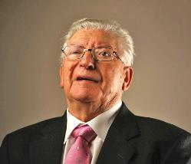
One Day
1945: Josef spent months searching for his family, going from one UN refugee camp to another. He made his way to his childhood home, and was threatened by a neighbour who now lived there. Of the 1,700 Jews who lived in his town, only 50 survived.
1945-46: Josef received medical treatment for his injured leg and TB.
11th June 1946: Josef came to England, where he was soon taken in by a Jewish couple living in Brighton. He soon discovered that three of his sisters had survived and were living in Israel.
1954: Josef married Sylvia, and had two children.
1959: Josef received a letter from his father, who managed to meet with in 1966.

Slide 7
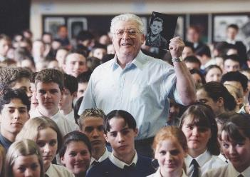
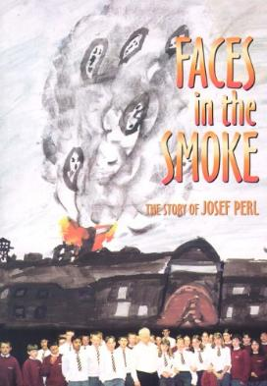
One Day – 10th May 2006

Slide 8
Why is today important?
In 1945, people swore that humanity would never again be allowed to sink so low.
But it has happened again.
And again.
And again.
And again.
The Holocaust, 1933-1945 Cambodian Genocide, 1975-1979 Rwandan Genocide, 1994

Slide 9
A 2018 poll showed that:
5% of British adults do not believe the Holocaust happened.
8% say that the scale of the genocide has been exaggerated.
33% said they knew little or nothing about the Holocaust.
5% said they had never heard of it.
The Holocaust is evidenced, and documented. There are survivor testimonies, photographs, film footage, confessions, buildings, and so many more sources of evidence.
The Holocaust happened.
Until we take note of the causes of hatred and evil, and act to prevent them, genocides will continue to happen.

Slide 10
The number of hate crimes has more than doubled since 2013. Increases: Race: 11% Disability: 14% Anti-Semitic: 18% Sexual Orientation: 25% Transgender: 37%
Year: 20
https://www.theguardian.com/society/2019/oct/15/hate-crimes-double-england-wales

Slide 11
Will it end? Hopefully one day.

Slide 12
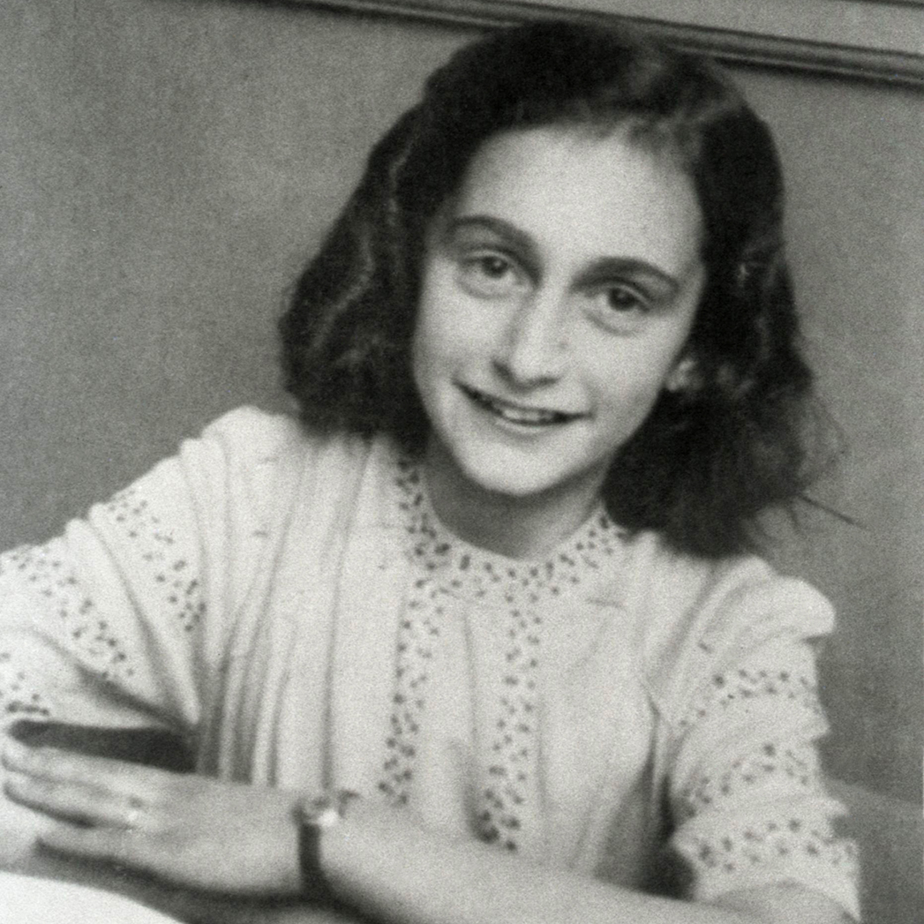
“How wonderful it is that nobody need wait a single moment before starting to improve the world.”
Anne Frank

