Slide 1
Holocaust Memorial Day 2024
The Fragility of Freedom

Slide 2
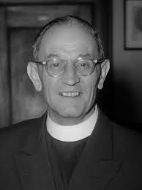
First they came for the Socialists, and I did not speak out— Because I was not a Socialist.
Then they came for the Trade Unionists, and I did not speak out— Because I was not a Trade Unionist.
Then they came for Jewish people, and I did not speak out— Because I was not Jewish
Then they came for me—and there was no one left to speak for me.
Martin Neimoller

Slide 3
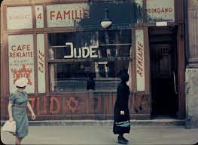
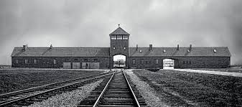
What was the Holocaust?
Derived from the Greek meaning ‘burnt sacrifice to God.’
Sho’ah and Ḥurban also used by Jewish communities to describe this event.
Describes the systemic murder of Jewish people by the Nazi Regime in Germany up to 1945. However definitions do vary.
The majority of killings took place in Extermination Camps in Poland, in places such as Auschwitz-Birkenau.

Slide 4
Holocaust Memorial Day
This day has been recognised since 2001 and sits on the 27th of January each year, the date that Auschwitz was liberated
Each year a theme is introduced to encourage the nation to reflect on the Holocaust in a slightly different way.
This year’s theme is ‘the Fragility of Freedom”

Slide 5
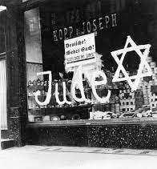
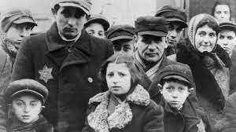
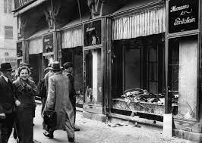
Slow beginnings
Nazi attacks on Jewish people began in 1933, years before death camps were created, with the restriction of Jewish liberties in terms of work.
Into 1935 Hitler re-energised Nazi Antisemitism by attacked Jewish identity and love with the Nuremberg Laws.
By 1938 Nazi Anti-Semitism became more blunt with the destruction of Jewish spaces and forced migration.

Slide 6
Awareness

Slide 7
The Aftershocks of Genocide
The story of how to recover from such a loss of freedom is also a very complicated one which reminds us of how precious it really is.
“We lived in Southampton for a while where I was intoxicated with the freedom in England. I could walk freely wherever I wanted, I could ride a bicycle and everyone was so extremely kind and helpful to me.” Alec Ward, Survivor
“The first few days after liberation were joyous and yet sad, confusing and bewildering. I did not know how to cope with freedom after years of painful imprisonment.” Esther Brunstein, Survivor
“They say: ‘’you have your freedom now, be happy’’. There was no way I could be all joyful, because I missed my brothers and sisters, always, to this very day. When the holidays came and people celebrated, or the families sat together, that was when this inner thing, this nervous strain came. That was very hard.” Otto Rosenberg, Survivor

Slide 8
What might we think about?
The Holocaust has a terrible and special place in the history of our planet
But sadly these moments of exceptional evil have become expected.

Slide 9
What might we think about?
Handle with care
Education to understand the world and change it for the better

