Slide 1
Has the world become safer since 1945?

Slide 2
Has the world become safer since 1945?
Write a sentence explaining answer, with a number on a scale of 1 (yes, much safer) to 5 (no, much more dangerous).
1 – the world has become much safer because…
2 – the world has become a bit safer because…
3 – the world is the same as it was in 1945 because…
4 – the world has got a bit more dangerous because…
5 – the world has become much more dangerous because…

Slide 3
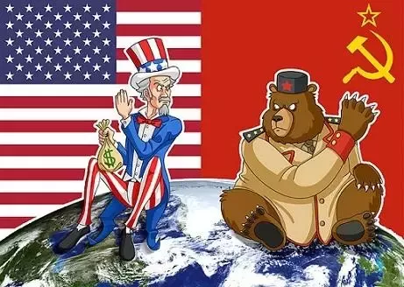
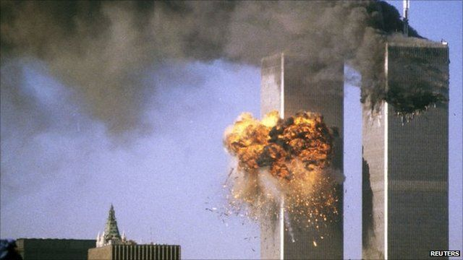
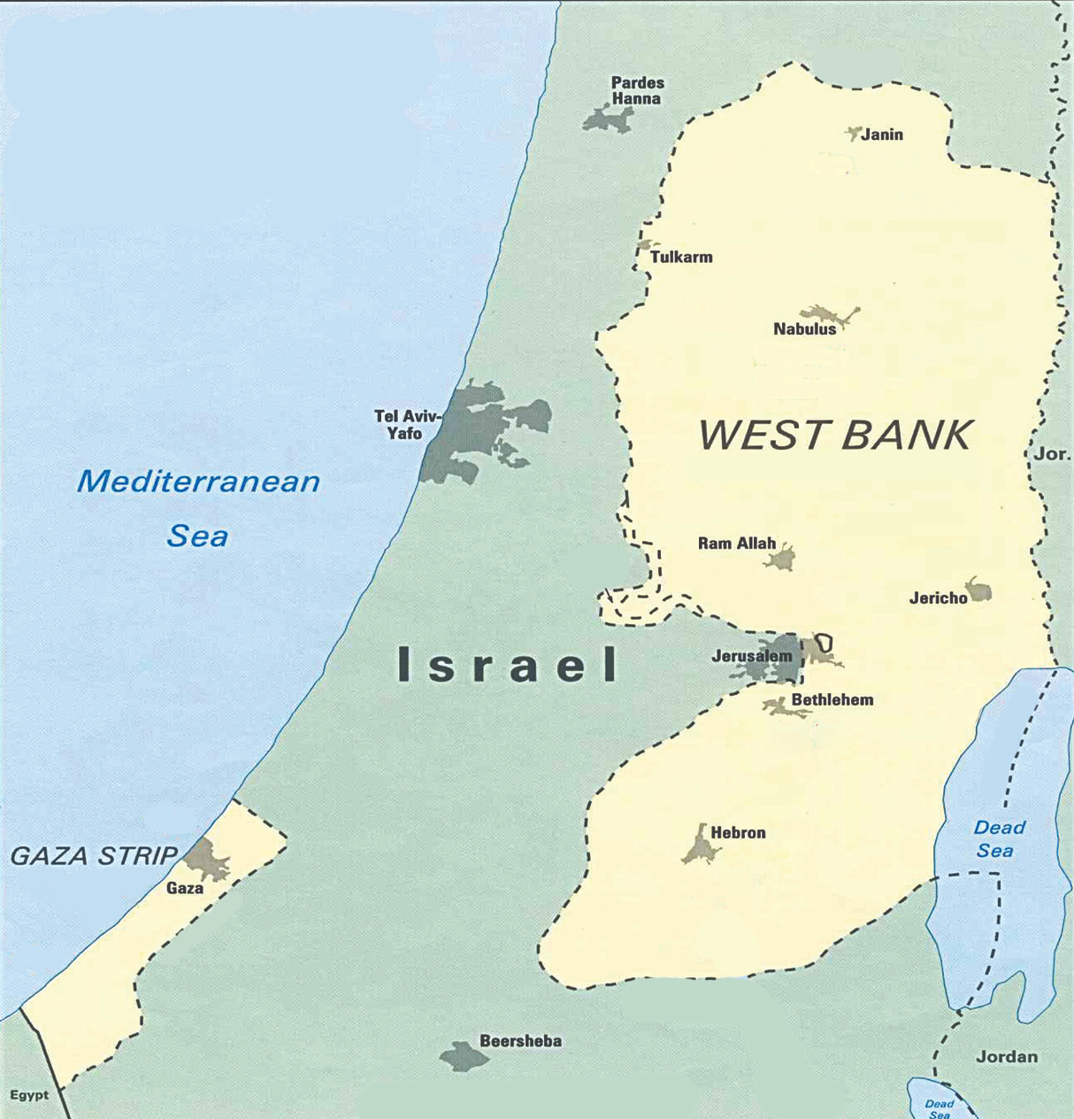
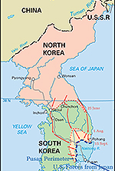
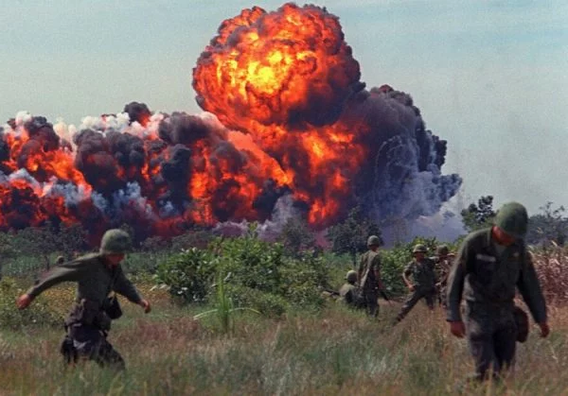
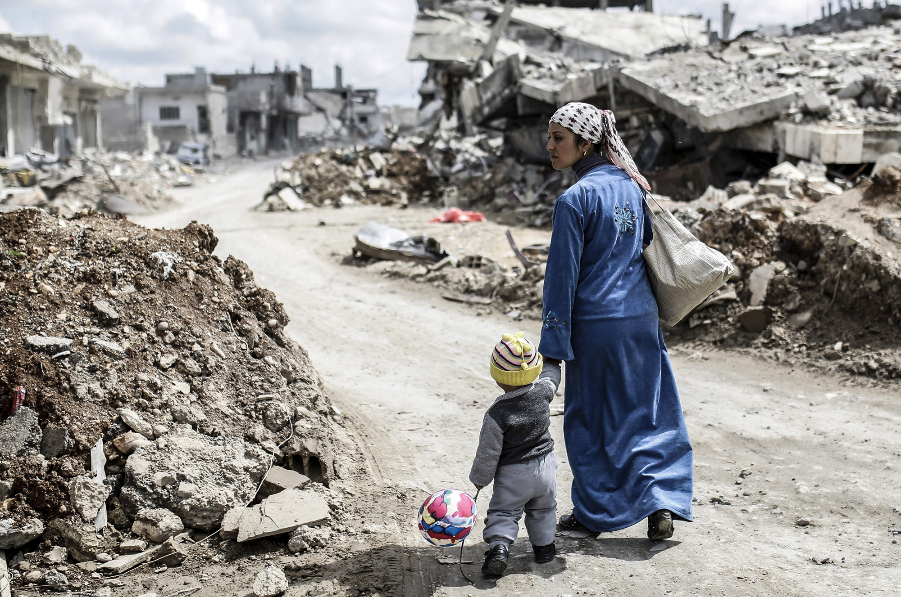
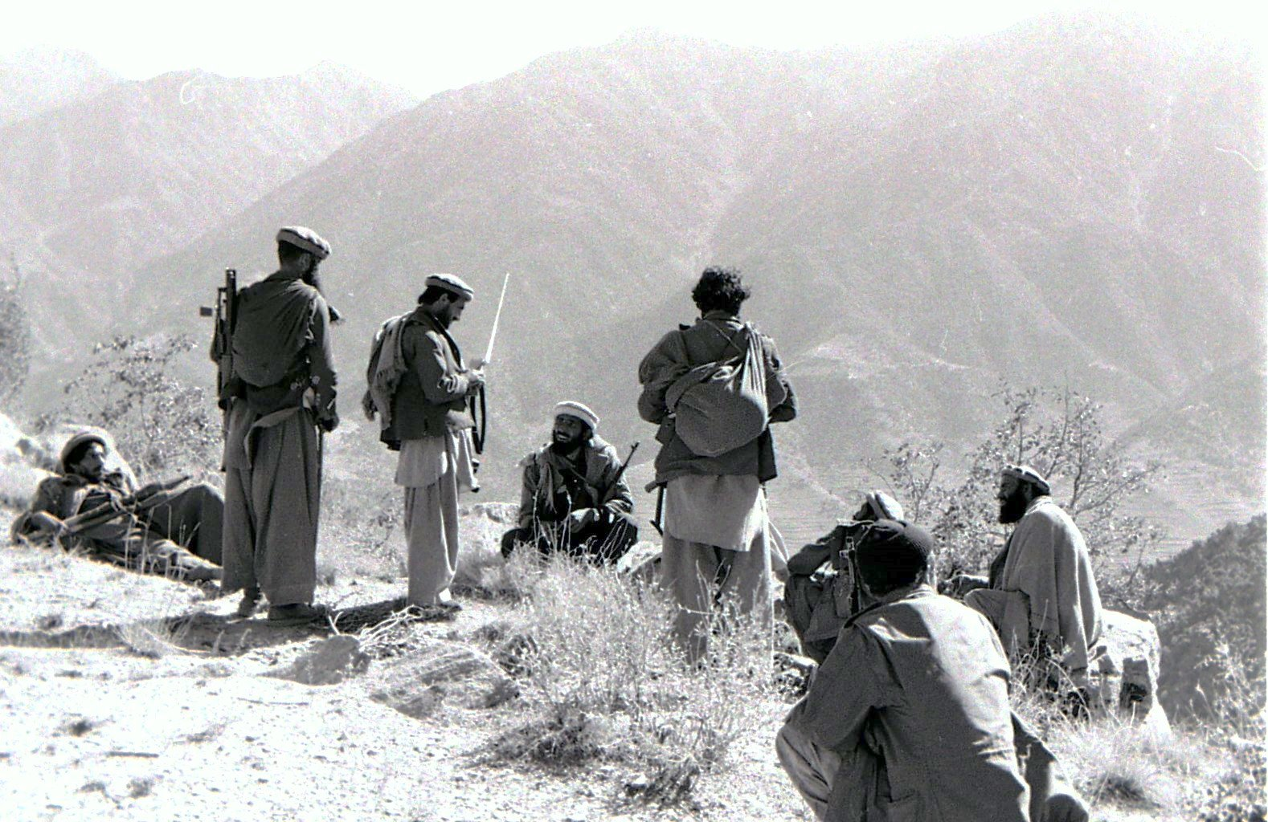
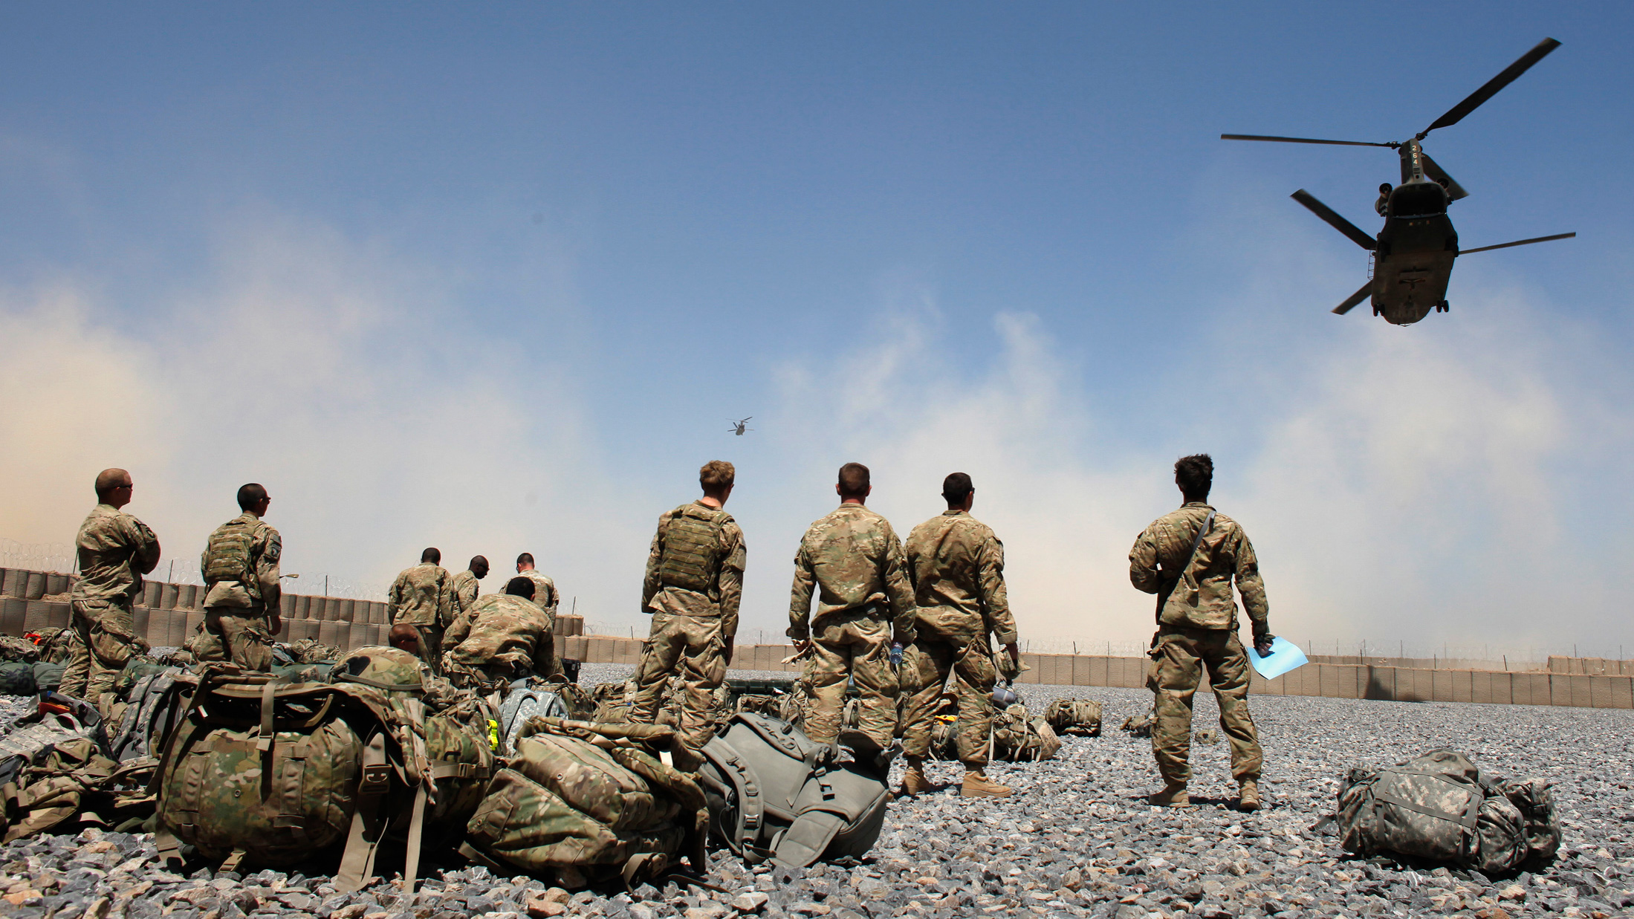
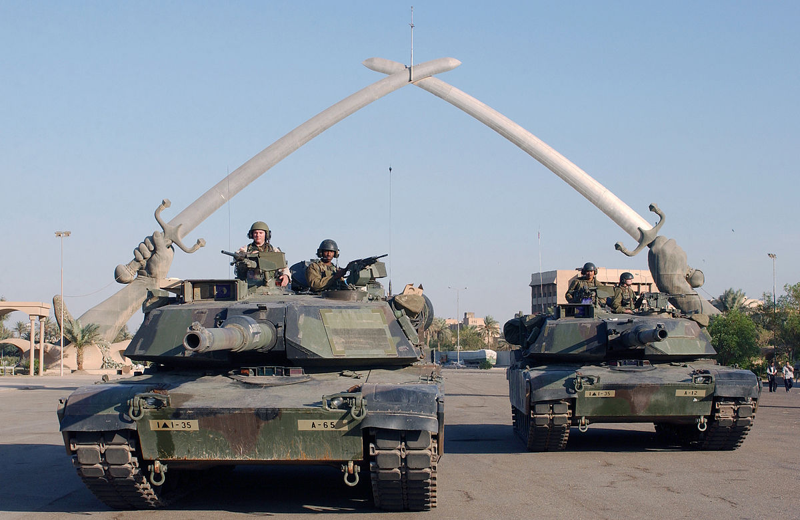
What do these pictures show?
Notes:
Cold War, 9/11
Arab-Israeli Conflict, Korean War, Vietnam War, Syrian Conflict
Soviet-Afghan War and 2001 Afghan War, 2003 Iraq War

Slide 4
Has the world become safer since 1945?
Have you changed your mind?
Explain why/why not.

Slide 5
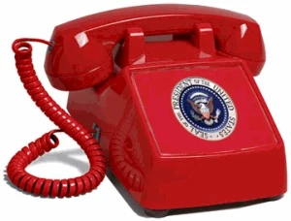
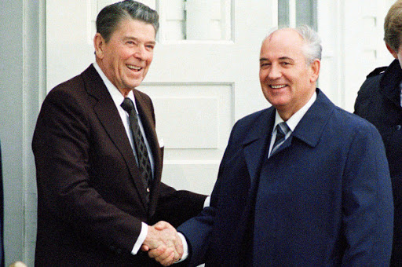
What do these pictures show?
Notes:
Left column: UN, Arab-Israeli Conflit, Hotline
Middle column: Soviet-Afghan War, 2001 Afghan War, 2003 Iraq War
Right column: Cold War, Reagan-Gorbachev handshake, 9/11 attacks.

Slide 6
Has the world become safer since 1945?
Have you changed your mind?
Explain why/why not.

Slide 7
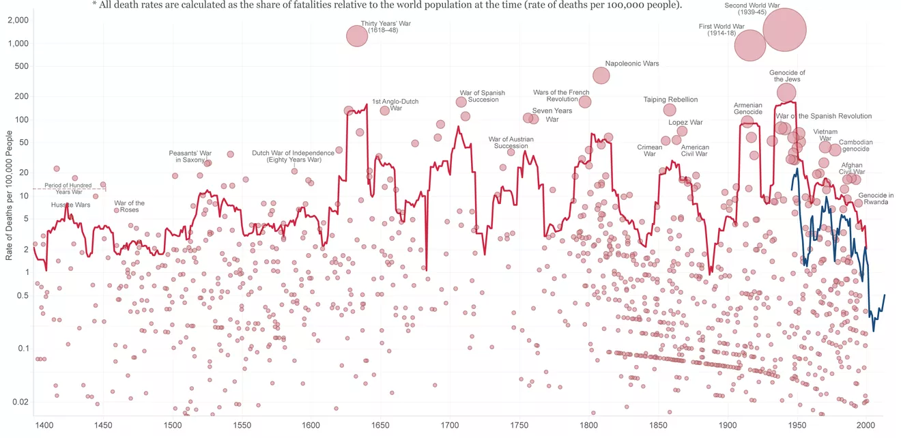
This graph made by Oxford University economist Max Roser shows the number of global deaths in conflicts since 1400. Each circle represents a conflict. The red line shows military and civilian deaths, 1400-2000. The blue line shows military deaths, 1946-2013. What can you infer from the graph about how safe the world is now?

Slide 8
Has the world become safer since 1945?
Read your source pack, and watch this clip: https://www.youtube.com/watch?v=yCm9Ng0bbEQ
Answer the question in your book, using evidence from the lesson in your writing:
There is evidence that the world has continued to be a very dangerous place in the years since the end of the Second World War in 1945. For example…
However there is also evidence of international cooperation and conflict resolution, making the world a much safer place since 1945. For example..
Overall, I think that…
Notes:
Watch the clip from 4:39, to 6:23.

Slide 9
Has the world become safer since 1945?
Stand up!
If you think that the world IS SAFER, go to the left of the room.
If you think that the world is NOT SAFER, go to the right of the room.
Can you justify your decision?

