Slide 1
Describe and Draw
Partner A – turn to the back of the room.
Partner B – describe the image on the board to A.
Partner A – draw what is described to you without looking.

Slide 2
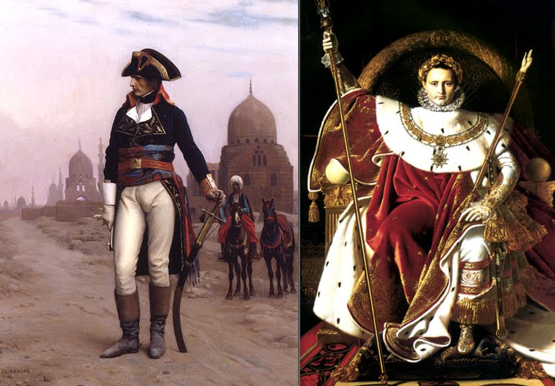
Who is this man?
What job does he do?
Notes:
Do the drawing activity in 3 minutes, then guess who they think it is/what he does.

Slide 3
Describe and Draw
Partner B – turn to the back of the room.
Partner A – describe the image on the board to A.
Partner B – draw what is described to you without looking.

Slide 4
Who is this man?
What job does he do?
Notes:
Do the drawing activity in 3 minutes, then guess who they think it is/what he does.

Slide 5
Notes:
Show both pictures together – General Napoleon in the Revolutionary Wars 1790s, and then later as Emperor Napoleon in 1804.

Slide 6
What was Napoleon’s most significant achievement?
Learning Objective:
To understand how Napoleon became the Emperor of France
To learn about the different achievements and impacts he had, and consider which of them was the most significant

Slide 7
Who was Napoleon?
Napoleon Bonaparte started out as a soldier, and became something of a military superstar as a General of the French Army during the French Revolution and the Revolutionary Wars (c. 1792-1802).
He later became the Emperor of France in 1804-1814, and then again in 1815. He is considered a very important historical figure, and is unusually known by his first name only.
Notes:
Read together.

Slide 8
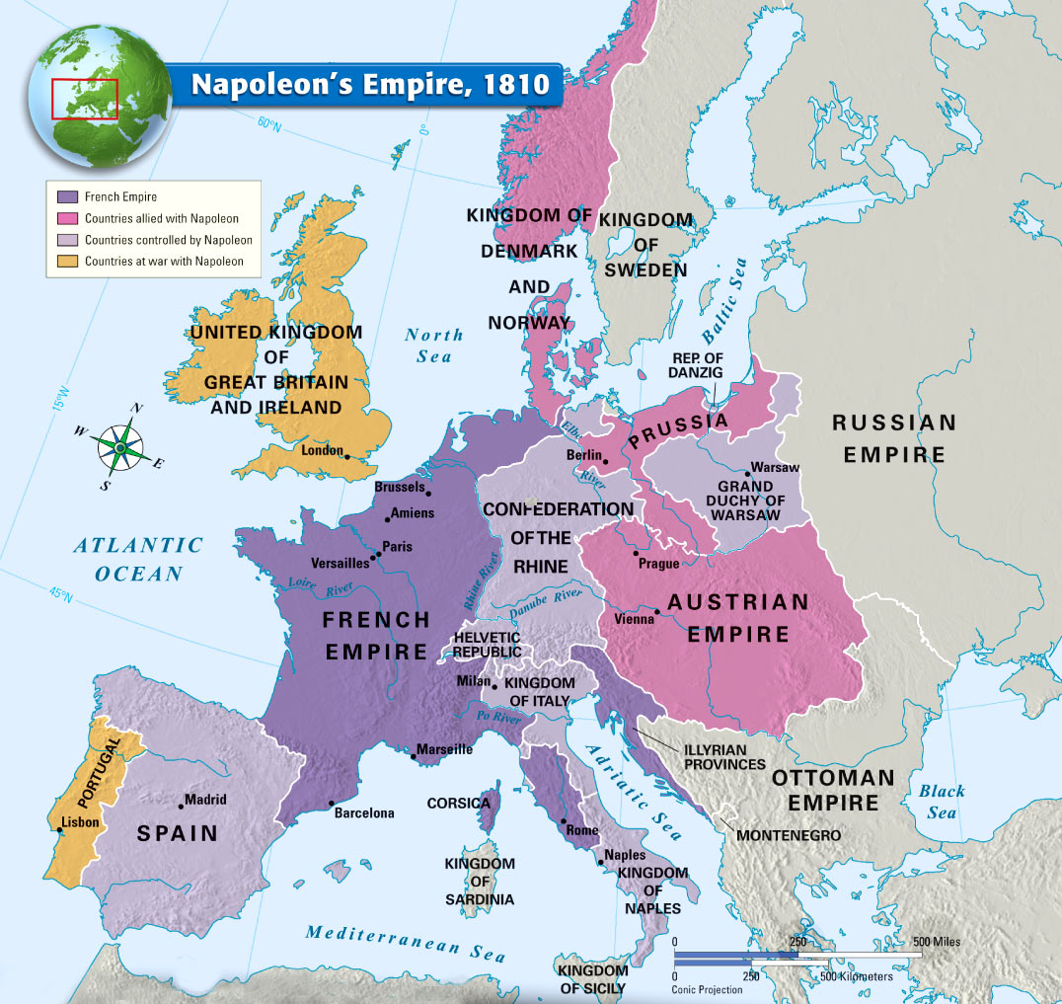
Napoleon won so many wars in Europe that the French Empire was very large at its strongest point, 1810-1811.
He was finally defeated at Waterloo 1815.
Notes:
Explain the map showing the First French Empire at its strongest, using the key.

Slide 9
Card Sort
Colour-code your cards to show 3 categories – military achievements, political achievements (as a ruler), and any other achievements.
Challenge: try to categorise the other achievements – what categories will you choose?
Once you have coloured them, cut them up and organise them into a ‘diamond 9’ – the most significant achievement at the top, and the least significant at the bottom.
Look at the person next to you. Do they agree with you? Debate. Move yours around if you want to.
Once you are happy, glue your diamond into your book.
Challenge: Explain why you put your top and bottom cards where you did.
Notes:
25 minutes in total.

Slide 10
Most significant achievement
Fairly significant achievement
Fairly significant achievement
Average achievement
Average achievement
Average achievement
Less significant achievement
Less significant achievement
Least significant achievement
Notes:
Show to explain how to do the ‘diamond 9’.

Slide 11
Homework
Complete up to 2nd December 1804 (p. 6) of your French Revolution Diary.
Use Show My Homework to help you.
Remember to write in character.
Notes:
Upload the help sheet to SMH and copy and paste the following into the instruction box:
Complete up to 28th June 1815 (p. 6) of your French Revolution Diary.
The Directory was popular everyone but the Jacobins at first, but didn’t achieve much.
Third Estate generally liked Napoleon as he was a believer in the Revolution and he made France powerful.
Second Estate generally liked Napoleon though some might have felt that when he became Emperor he was destroying traditions. He was still popular as he made France strong.
First Estate might have been upset that Napoleon was destroying traditions by becoming Emperor. He was still popular as he had made France so strong and powerful with the Empire.

