Slide 1
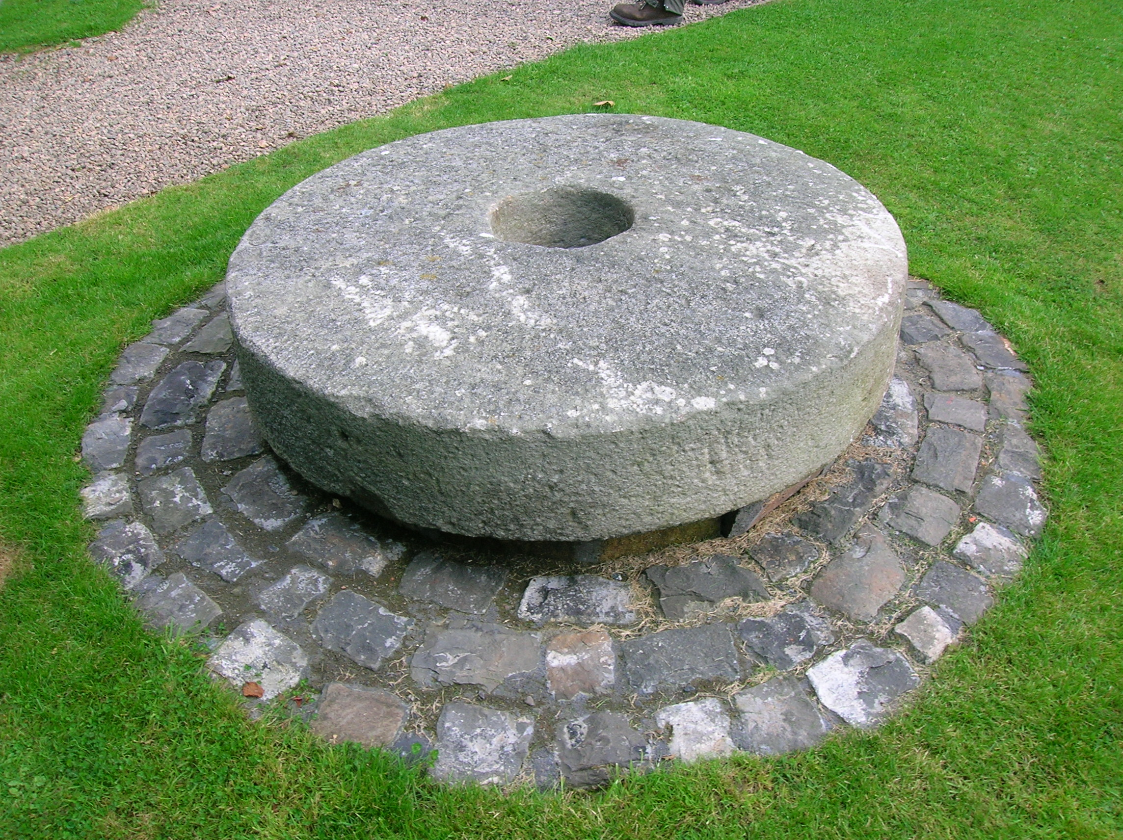
What are these 2 things?
Grindstone – used for sharpening weapons
Guillotine – used for chopping off people’s heads
Notes:
Starter: Discuss what the 2 images show, then reveal. 3 minutes.

Slide 2
Were people better off under Louis or Robespierre?
Learning Objective:
To learn about the Reign of Terror under Robespierre.
To consider whether people were better off before the Revolution than during the Terror.

Slide 3
Grindstone and Guillotine
In 1859, 60 years after the French Revolution began, Charles Dickens wrote the book A Tale of Two Cities about the revolution.
The grindstone and the guillotine are 2 key features of the story, and highlight the horror of the months between September 1793 and July 1794.
During this time a group called the Committee of Public Safety and its leader, Maximilien Robespierre, had many thousands of people (supposedly sympathetic towards the monarchy) murdered. It was known as the Reign of Terror.
Notes:
Read together as a class. Further details: Committee of Public Safety formed 6th April 1793, Robespierre joined 27th July 1793, 5th September the sansculottes declare terror the order of the day, 16th October Marie-Antoinette executed, 31st October Girondins executed, further executions until July 1794, when Robespierre was executed. Many priests were executed as the Committee led a ‘dechristianising campaign’.

Slide 4
Grindstone and Guillotine
While you listen to the 2 extracts…
EITHER:
Close your eyes and try to imagine the scene.
OR:
Draw what is being described to you as you listen, on a blank piece of paper.
Notes:
Give instructions, then read the 2 extracts aloud to the class. 10-15 minutes. Have a summary discussion of what they understood from each extract at the end of each one.
Grindstone: Jacobins, in the middle of the Reign of Terror, are sharpening their weapons in a mad frenzy before going back to kill more ‘enemies of the Revolution’ (the rich and powerful) through the night.
Footsteps die out forever: ‘enemies of the Revolution’ are being taken in carts to the guillotine to be executed. Among them is a man called ‘Evremonde’, an aristocrat (First Estate), but also a seamstress (Third Estate) – she like many who were killed might have been accused of sympathising with enemies, as she would not have been considered an enemy herself. These 2 characters meet in the cart and console each other on the way to their death. The knitting women sit there all day for entertainment, counting the dead in their stitches.

Slide 5
Activities
Read the sources to find out what life was like during the Reign of Terror, under the rule of the Jacobin leader Maximilien Robespierre.
Complete your table showing whether they were better off before the Revolution, under the rule of Louis XVI, or afterwards, under Robespierre.
Challenge:
Complete the questions on the 2 extracts that were read aloud to you at the start.
Notes:
15-20 minutes to complete the activities.

Slide 6
Were people better off under Louis or Robespierre?
Louis XVI
Robespierre
Mark where you think things would be best for most people.
Mark where you think would be best for your character.
Notes:
Plenary: Get the students to draw this line and mark the 2 points. 5 minutes.

Slide 7
Homework
Complete from 27th July 1793 – 28th July 1794 (p.4-5) of your French Revolution diary.
Use Show My Homework to help you.
Remember to write in character.
Notes:
Upload the News sheet to SMH, and copy and paste the following into the instructions box:
Complete up until 28th July 1794 (p.5) of your French Revolution diary.
If you are a Jacobin you would probably be very pleased with the events. You might have joined the Committee of Public Safety, or be a supporter of it. You want to kill anyone who threatens the Revolution. Now, your Estate doesn’t matter so much. You might be upset when Robespierre dies, or you might think he has gone too far and it was right to kill him.
If you are not a Jacobin, the changes are quite frightening. You would probably think that the Terror is a step too far, and might even be living in fear for your life, especially if you are First or Second Estate, or even if you are the Third Estate. You don’t want to be associated with anyone who could be seen as a traitor. You would be relieved with the end of the terror and Robespierre’s death.

