Slide 1
A New France
Read about the different impacts of the French Revolution.
Decide whether each impact of the revolution was good or bad for the monarch, First Estate (nobility), Second Estate (clergy), and Third Estate.
Notes:
Complete worksheet. 15 minutes including checking answers.

Slide 2
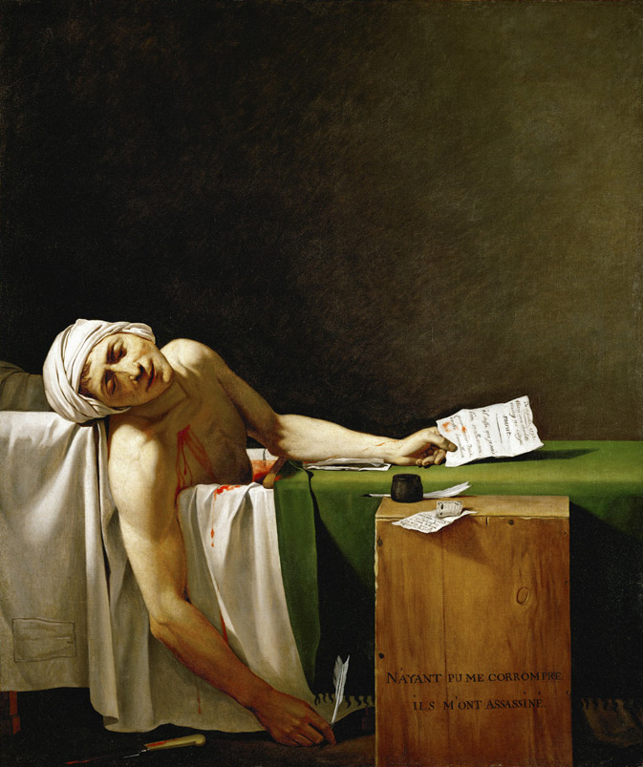
There has been a murder!
Use your set of clues to find out what happened, who did it, and why.
Notes:
15-20 minutes to investigate the murder using the clues, and complete the worksheet as they go.

Slide 3
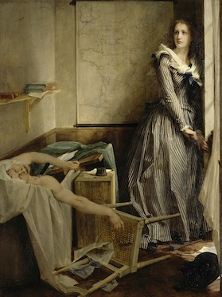
It was Charlotte Corday, in the bathroom, with a knife!
She killed Jean-Paul Marat, a Jacobin journalist, in revenge for the purge of the Girondins, many of whom were murdered in May-June 1793.
Notes:
5 minutes to discuss findings and reveal the answer.

Slide 4
During her trial, Charlotte said that she had worked entirely alone, and that the effective stab was due to luck, not practice.
Charlotte was a Girondist sympathiser, and at her trial she said ‘I kill one man to save 100,000’, referring to the mass-killings in Paris that Marat had called for.
She described him as a ‘monster’ who was only respected in Paris.
Notes:
5 minutes to discuss findings and reveal the answer.

Slide 5
Did the Revolution help Charlotte Corday?
Learning Objectives:
To learn who Charlotte Corday was, and why she assassinated Jean-Paul Marat.
To consider the extent to which the new France was better than the old one.

Slide 6
Did the Revolution help Charlotte Corday?
What estate was Charlotte from?
How was her life before the Revolution?
Write a short newspaper report explaining why the murder happened.
Challenge:
Explain why life was still difficult for many people, such as Charlotte, after the Revolution.
Notes:
15-20 minutes to complete, including the challenge by some students. The challenge can be used for a plenary discussion.

