Slide 1
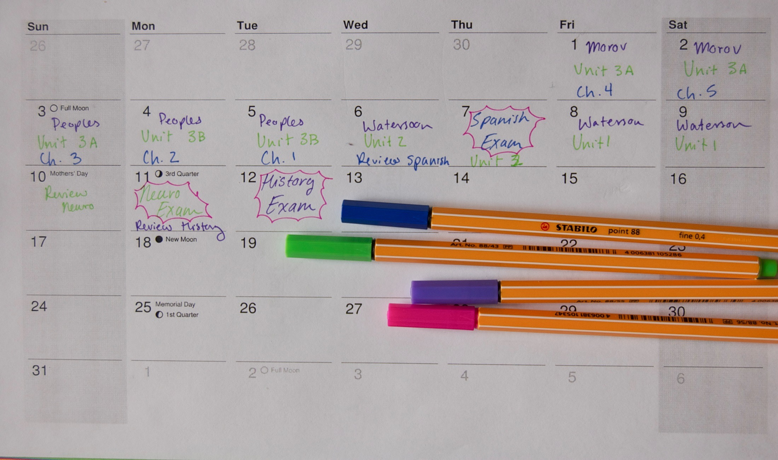
How to promote self study

Slide 2
Five strategies for encouraging more effective independent study
1
2
3
4
5
QUIZZING
SPACING
ELABORATION
CHUNKING
METACOGNITION

Slide 3
#1 Quizzing

Slide 4
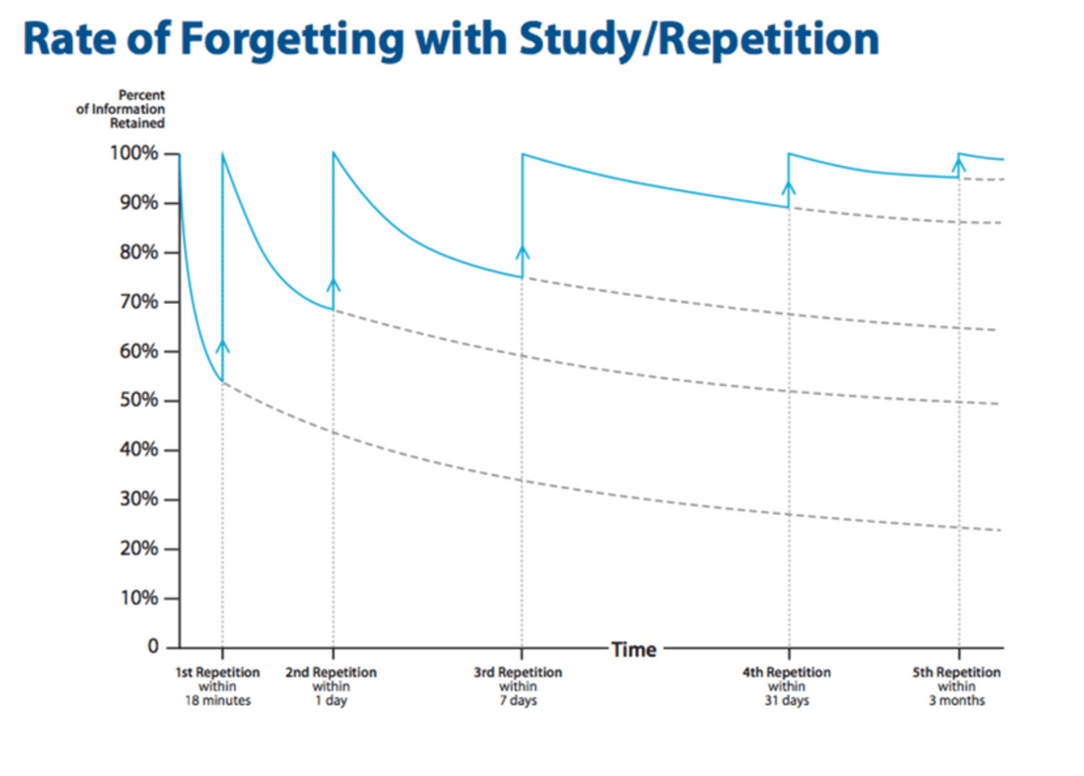
What is quizzing and why does it work?

Slide 5
What does quizzing look like?
1. Comprehension:
Why was A Doll’s House considered radical when it was first performed?
2. Cued recall:
Complete the following: ‘He is too full…’ and explain three key ideas in Lady Macbeth’s soliloquy that follows.
3. Cued elaboration:
Use the following to explain changes to the theatre in the 19th century.
naturalism, romanticism, ‘well –made play’, royal personages, heroic tragedies, rhyme verse, psychological, elaborate plots, stock types
4. Multiple Choice:
Chlorophyll is a naturally occurring chelate compound in which the central metal is
a) Copper; b) Magnesium; c) Iron; d) Calcium.

Slide 6
#2 Spacing

Slide 7
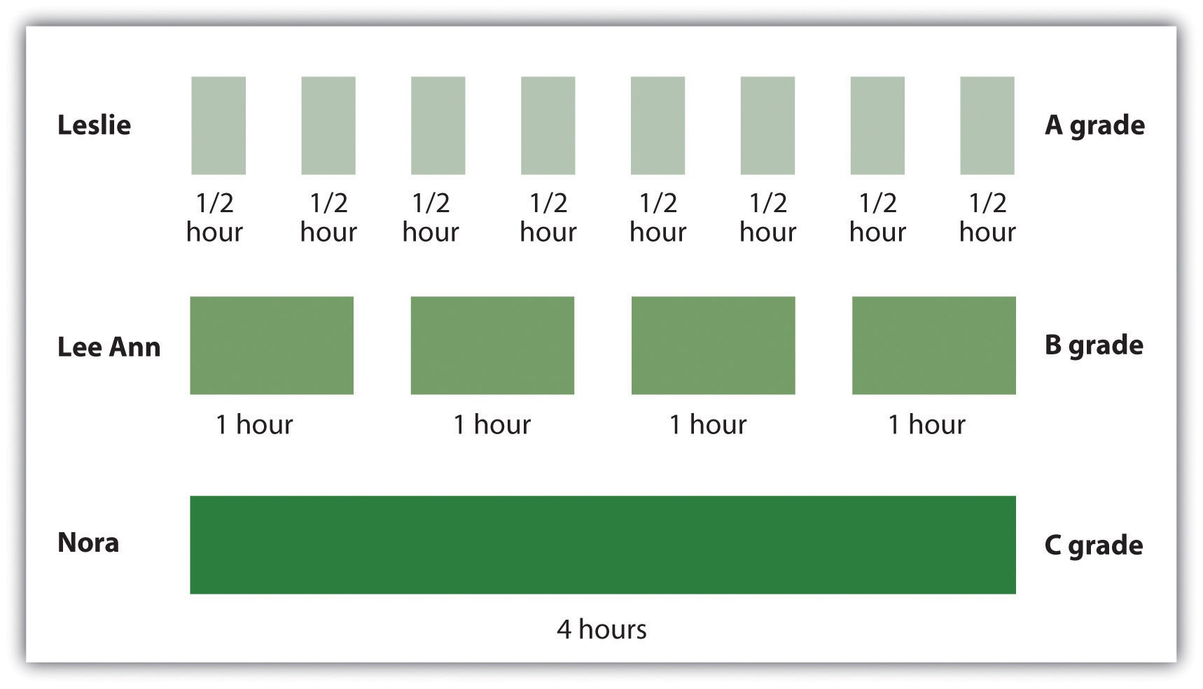
What is spacing?

Slide 8
Why does spacing work?
1 day
6 days
24 days
60 days

Slide 9
Example spaced timetable
English
Maths
Science
RS
Monday
Tuesday
Wednesday
Thursday
Friday
Saturday
Sunday
Reactions of carbonyl compounds
Biblical examples of experiences
Otto's concept of numinous
Jacobean theatre
Esters, triglyceridesand fats
William James - experiences
Properties carboxylic acids
The late romance plays
General Binomial Expansion
Features of carbonyl compounds
Partial Fractions
Otto's concept of numinous
Partial Fractions
Jacobean theatre
BREAK
Parametric Equations
Act One character and plot
Algorithms
Properties carboxylic acids
features of carbonyl compounds
Theme of Power and control
William James - experiences
Properties carboxylic acids
Swinburne credulity & testimony
Theme of Power and control
Act One character and plot
Algorithms
Parametric Equations
General Binomial Expansion
BREAK
Swinburne credulity & testimony
Esters, triglyceridesand fats
Parametric Equations
William James - experiences
Biblical examples of experiences
The late romance plays
Esters, triglyceridesand fats

Slide 10
#3 Elaboration

Slide 11
What is elaboration?
Clarify
What does this mean?
Analyse
Why does this matter?
Speculate What would happen if?
Contextualize How does this relate to?
Elaboration = structured questioning or self-elaboration that makes linking of concepts occur

Slide 12
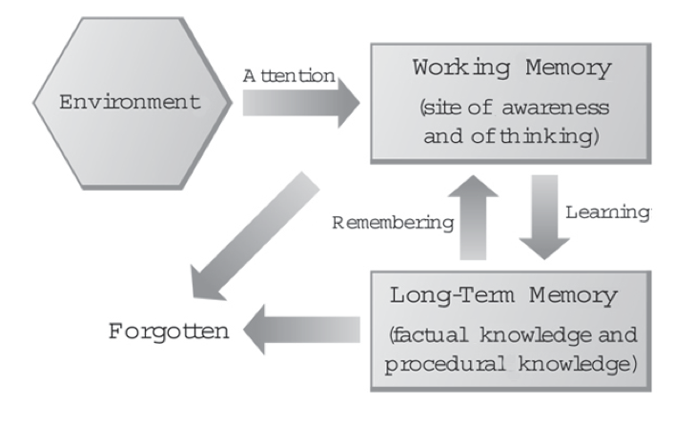
Why does elaboration work?

Slide 13
What does self-explanation and elaboration look like?
Geography
Explain the circumstances when coastal erosion occurs
Explain how destructive ways erode the coast line.
Compare erosion to other geographical processes.
Physical education
What does term cardiovascular mean?
Why does alcohol increase blood pressure?
How does this relate to sport?

Slide 14
#4 Chunking

Slide 15
What is chunking?

Slide 16
How does chunking work?
Focus – chunking required attention on the learning.
Understanding – full understanding before chunking material.
Context – going beyond understanding the initial problem or concept and seeing when, where and how to apply it.

Slide 17
From units to flash cards

Slide 18
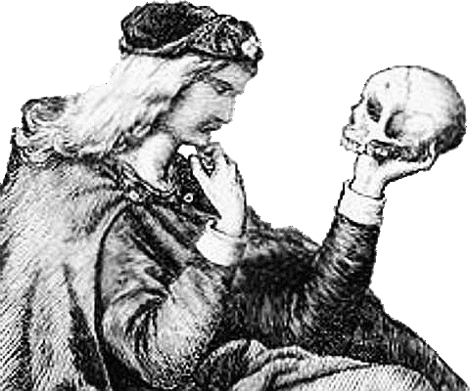
1/20
‘Hamlet’
Act One, Scene One
The plot:
Bernardo and Francisco on battlements
Bernardo tells Horatio about the ghost
The ghost resembles the late King Hamlet
Horatio talks to ghost , whose wearing Hamlet’s armour
We learn how Denmark acquired Norway’s lands
Links to context:
Elizabethan anxieties around the next monarch
Elizabeth had no children
Only legitimate royal claim, James of Scotland
Problem of Mary, Queen of Scots

Slide 19
FRONT
BACK
The three unities are:
The unity of action: a play should have one main action that it follows with few subplots.
The unity of place: a play should cover a single physical space and should not attempt to compress geography.
The unity of time: the action in a play should take place over no more than 24 hours.
The three unities
Naturalism
an extreme or heightened form of realism
Rebellion against formula of morality of Romantic movement
Action simplified and lifelike, characters psychologically motivated and physiologically correct in way look and act
explores concept of scientific determinism
Naturalism

Slide 20
Concept cards
Elaboration cues
Describe concept without using words on the card
The three unities
Draw this concept
Give a real life example of this concept
What is the opposite of this concept?
Realism
How would you explain this idea to a novice?
How does this concept relate to another concept?
Naturalism

Slide 21
#5 Metacognitive strategies

Slide 22
What is metacognition?
Knowing steps and timings involved in assessments e.g. WTM
Drawing on coping strategies e.g. acronyms, checklists
Using aids to recall key information e.g. memory palaces and mnemonics
Evaluating work against objectives or targets set by yourself or a teacher e.g. a PLC

Slide 23
What does metacognition look like?

Slide 24
Tip: stay focused despite nerves and remember you don’t need to understand everything

Slide 25
A useful website
getrevising.co.uk

Slide 26
Six steps to improve independent study
1
When / where do I focus best?
2
What order should I study?
3
What do I already know about this?
right place and time to work
plan study timetable
link to prior knowledge
4
5
How am I getting on?
6
What else do I need to know?
How do I study best?
read, chunk, diagrams, quiz
review progress
focus on weaknesses

Slide 27
Revisiting
Ask teachers to write example quizzes for their subjects. Use these to show students how to write their own. Encourage frequent quizzing.
Teach students the value of spacing out their revisiting and support them in deisnging their own study plans e.g. mocking up exam timetables.
Ensure that revisiting lessons make frequent use of elaborative questioning. Encourage students to self-explain as part of their studies.
Make sure that all sudents have notecards and that they know how to chunk informastion and use them effectively as part of their studying.
Share metacognitive strategies with staff, and agree upon one or two approaches to be used consistently with students across the school.
Implementation
Notes:
Introductions

