Slide 1
What do we know, and how could we find out more?

Slide 2
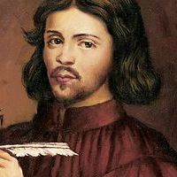
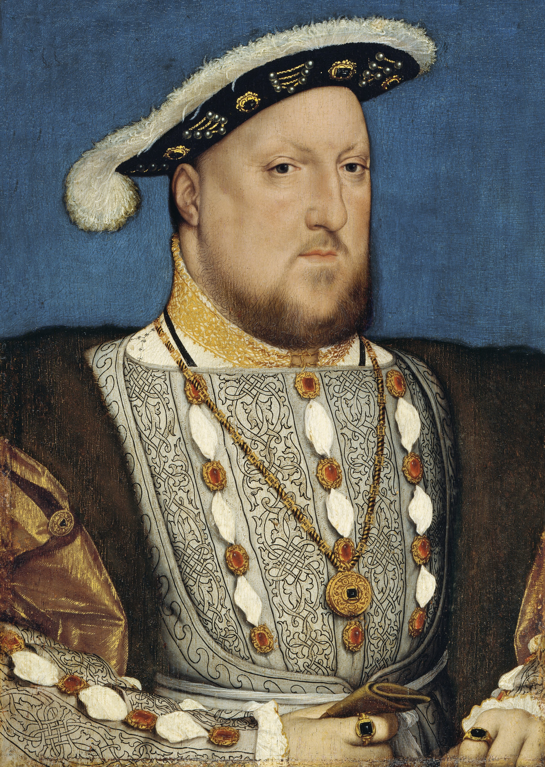
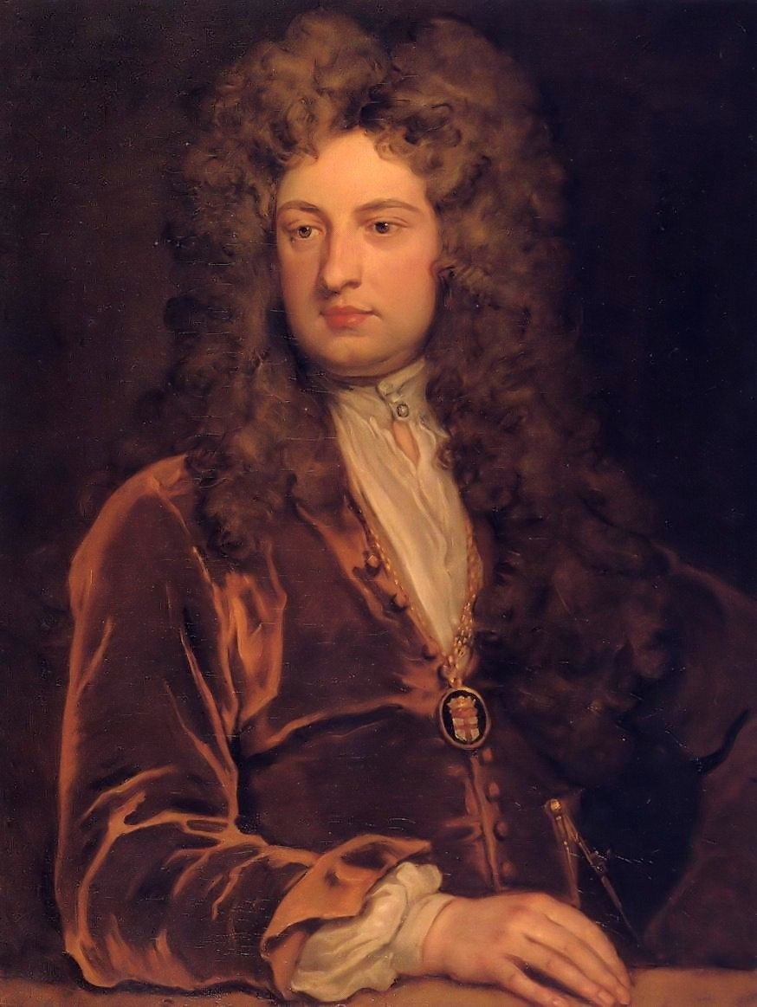
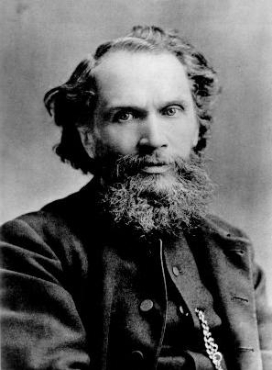
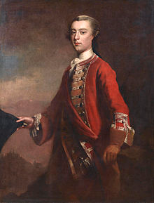
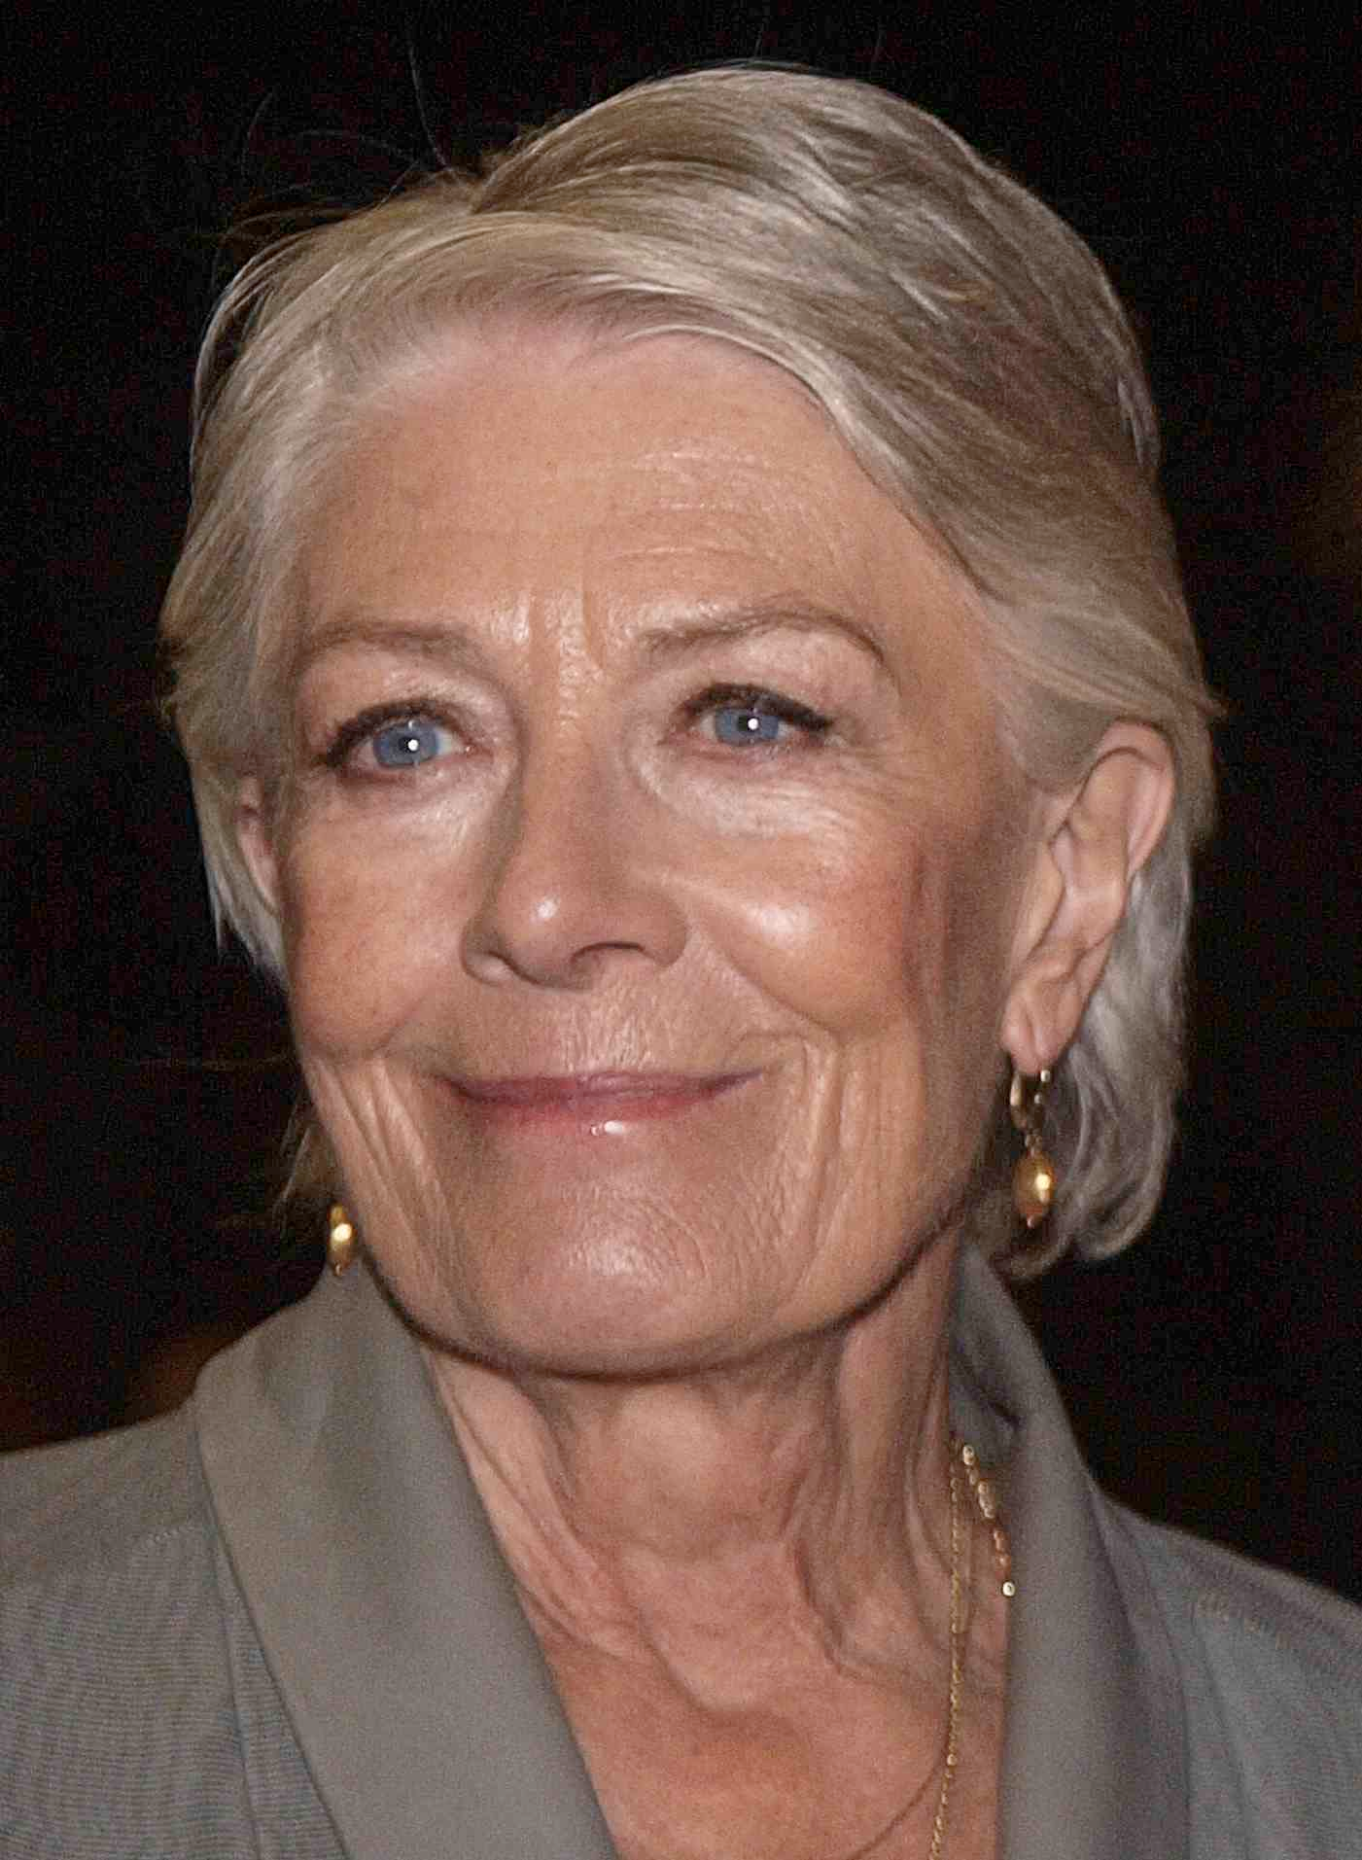
Most people should study their own family history. If you prefer not to, you can research the school or your local area, or select one of the following:
Dominic Cooper
Jools Holland
Glen Johnson
Daniel Day-Lewis
Laurence Llewelyn-Bowen
Vanessa Redgrave
Thomas Tallis
Henry VIII
John Vanbrugh
Benjamin Waugh
James Wolfe

Slide 3
What do I know?
What do you already know about your family?
Where are your parents from?
Have you ever lived anywhere else?
Do you know anything about your grandparents?
For alternative projects:
What do you already know about your person?
Miss Evans will be completing this project too, to provide examples. Here’s what she knows already:
Her dad grew up in Zimbabwe but his mum was from Scotland and his dad was from England.
Her surname is Welsh, so her dad’s family must have been Welsh at some point.
Her mum grew up in England, but lots of her family live in Ireland. She goes to visit family there every year.
Her mum’s dad fought in WWII in D-Day, and then fought in Malaya after the war. He won some medals.
Notes:
Teachers: feel free to use my family as an example, or change the red boxes to show information about yourself if you prefer.

Slide 4
What would you like to know?
Think of between 5 and 10 questions that you would like to find out during this project.
Miss Evans would like to know:
Why did her dad grow up in Zimbabwe if his parents were from Britain?
Why did they come back to live in England?
Who was the last Welsh person in her dad’s family?
Have her mum’s family always lived in Ireland?
How did her grandparents meet?
When and why did her grandad join the army?
What medals did he win? What were they for?
Was he injured during the war?
Why did my mum’s family leave Ireland?
Does she have any other connections from outside of the UK and Ireland?
Notes:
Teachers: feel free to use my family as an example, or change the red boxes to show information about yourself if you prefer.

Slide 5
How could I find out more?
First stop:
Asking parents and uncles/aunts what they know
Asking grandparents (unfortunately I only have 1 living grandparent)
Looking at photographs
Using websites like Ancestry, My Heritage or Find My Past to look for family members and make a family tree – ask parents for permission if you use this
Asking for letters or diaries that people might have inherited in the family
First stop:
Do some online research
Look for photos or interviews with the person
Visit the library
Look for an episode of Who do you think you are?
Ideas for all research:
Use military records such as the Commonwealth War Graves Commission, Forces War Records and the National Archives for any military records
Use census records to find out about birth, marriage and death dates, as well as family members and jobs.

Slide 6
Why does it matter?
Sometimes our family history is interesting and exciting. However, be prepared that there might be things that make you feel emotions you aren’t expecting. The past can sometimes be sad, or even surprising.
https://www.youtube.com/watch?v=g5o9DmUYCJA
https://www.youtube.com/watch?v=7mqWYuKvbXY

Slide 7
Homework: How to start
Begin by having conversations with family members
Write down full names of family members to research and how they are related to you.
Start doing to basic online research
Start doing to basic online research
Try to find out some of your initial questions: when were they born? Who were their parents and family members? What are they famous for?
https://www.freecen.org.uk/
Let’s try this out together!

