Slide 1
Memory test starter!
Without looking back at your notes, try to write down 3 things that Charles and Parliament disagreed on!
Challenge: which disagreement was the most significant? Why?

Slide 2
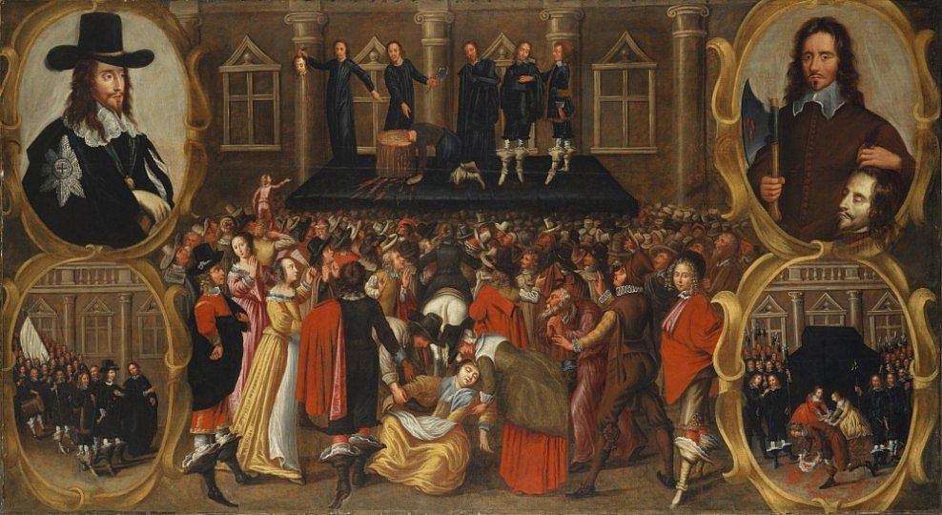
What caused the English Civil War?
Learning Objective:
To identify and understand the different causes of the Civil War.
To assess which cause was the most significant in leading to the Civil War and why.

Slide 3
What were the different factors that led to the Civil War?
Look back to your decision-making sheet from last time.
As a table try to identify different factors that led to the Civil War.
Factors shouldn’t be specific decisions, such as ‘Charles decided to raise a tax called Ship Money which made people angry’ – this is an EXAMPLE of a factor. What might a more general title for something to do with taxes be called?
Money / Economic
Try to identify other factors.
Economic Religious Political Personal
Notes:
Prompt them to understand what a factor is, then show ‘economic’. Give discussion time, before revealing the 4 factors.

Slide 4
Causes table
Complete the table to show the causes of the Civil War.
The factors are already in the table for you.
Under each factor are 3 points.
Each point then has 1, 2 or 3 examples.
Cut up your cards and put them in the correct box in the table.

Slide 5
Links
How do the different factors link to each other?
Discuss with a partner and try to find connections between different factors.
For example:
Many of Charles’ political decisions were influenced by his need for money (economic). Can you find an example of this?
Write the different connections you find in the ‘links’ column of your table.

Slide 6
Debate!
You will be given a factor to argue. In groups, you must come up with a strong argument for why your factor was the most significant (important) in leading to the Civil War.
You have 20 minutes to prepare your argument, and designate 2 strong speakers to debate for your group.

Slide 7
Rules!
For each group, Speaker 1 will give an outline of their argument, in 2 minutes, in turn.
Once each group has had a turn, Speaker 2 will have a chance to argue back against points that other groups made.
You MUST NOT speak over anyone else – each group has their turn.
At the end there will be time for questions.

Slide 8
Which cause was the most significant? Why?
Having heard arguments for each of the 4 factors, decide which one you agree with.
Once you have decided on your view, write a detailed paragraph in your book to explain how this factor led to the Civil War and why it was important.
Challenge:
Also explain why it is more significant than other factors. Give reasons why the other factors were less important.

