Slide 1
How did the Benin Bronzes end up in England?

Slide 2
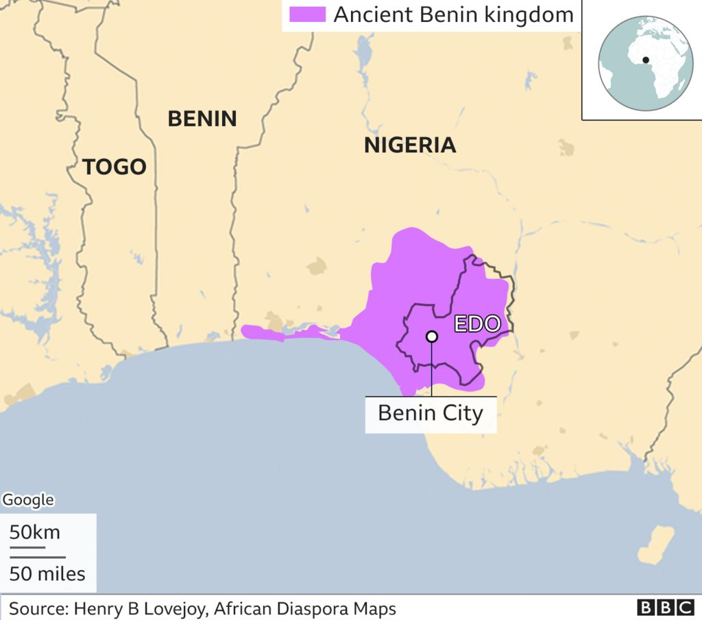

Slide 3
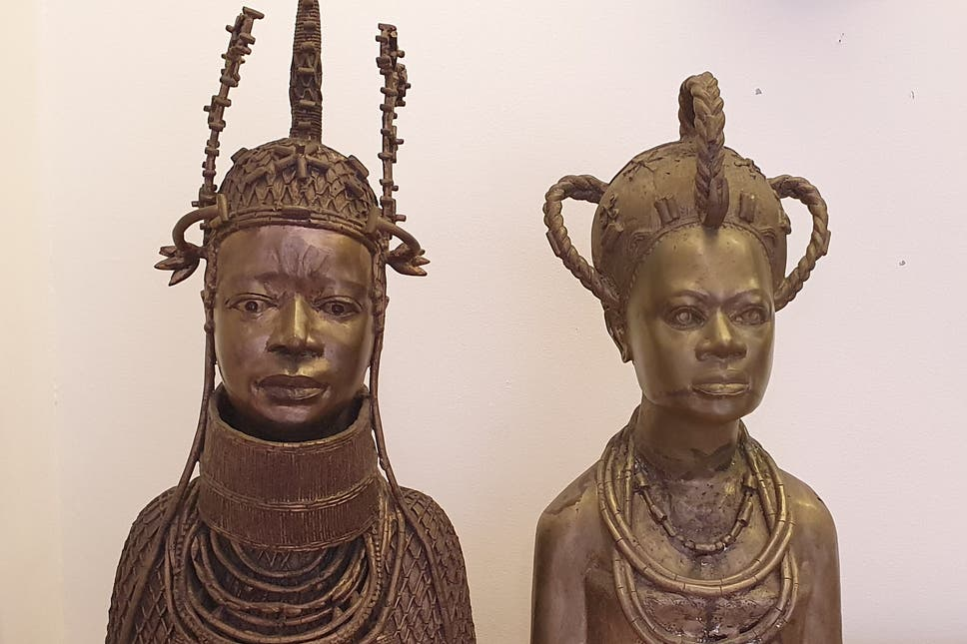
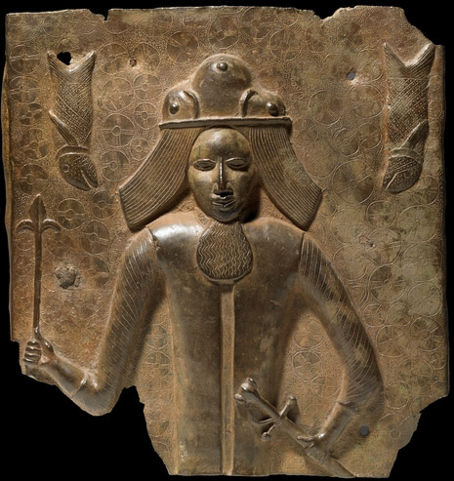
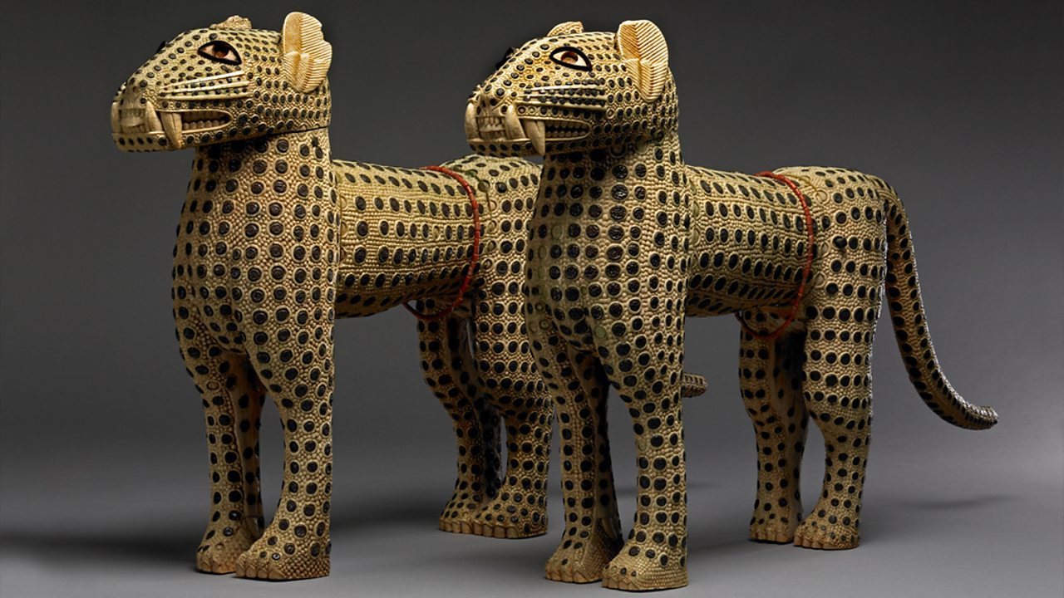
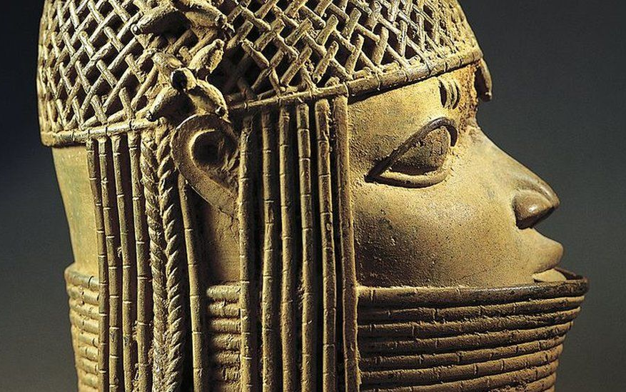
What are the Benin Bronzes?
The Benin Bronzes are cultural artefacts that have been created for thousands of years in the Kingdom of Benin, in modern-day Nigeria.
They depict Obas, Queens, European traders and soldiers, and animals: they were commissioned by the Oba to record anything deemed significant, and are therefore historical records in their own right.
They reflect highly skilled artistic techniques by African craftsmen and artists.
They are made from Bronze, but other similar items were also made from ivory (from elephant tusks).
Bronzes are still made today, on a much larger scale, and by the Guild of Master Bronzecasters, who can make and sell them to whoever they choose, not just royalty!

Slide 4
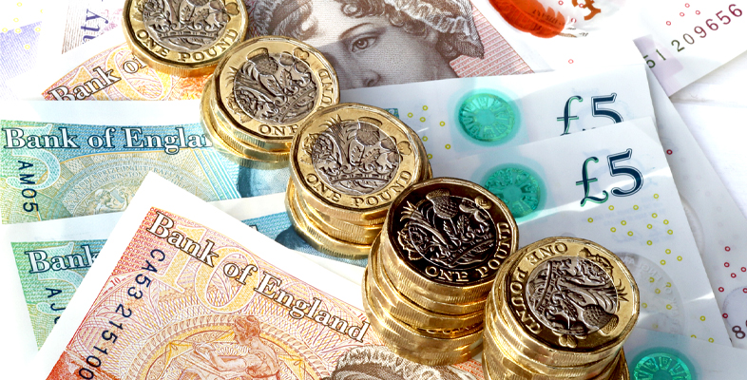
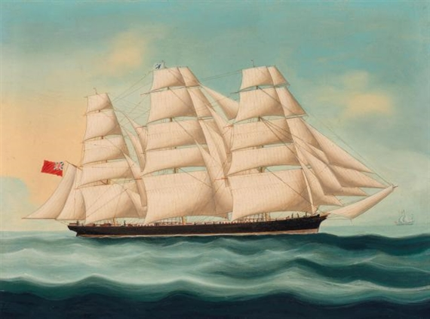
Why were the British involved in Benin?
Previous scholars have argued that the British wanted to challenge the Oba on humanitarian grounds, in opposition to the human sacrifices and ‘uncivilised’ culture.
However, this has been reassessed by scholars such as Nigerian historian Professor Philip Igbafe, who argues that it was in fact economic interests that drove British actions in Benin.
In the 1890s, the British wanted to expand their economic interests in Benin and ensure their ability to trade inland in the country. They were supported by some other coastal indigenous traders, whose rights to trade were limited by the Oba Ovonramwen’s power to suspend trade and demand gifts. The Oba maintained monopolistic economic policies, whilst the British sought freer trade.
The British most likely also wanted to gain greater political control as they had achieved in many of their other colonies, which had started as trading posts, such as India.

Slide 5
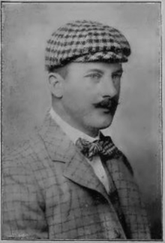
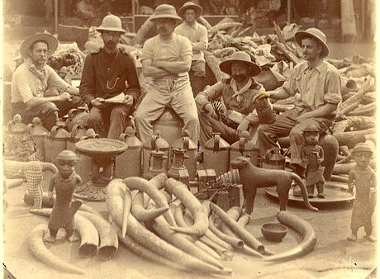
How did the Benin Bronzes come to be in British hands?
In January 1897, James Philips brought a group of British and African soldiers and traders, armed with hidden weapons on a mission to supposedly discuss trade with the Oba. However, some of the Itsekiri trading chiefs sent a message to the Oba that ‘the white man is bringing war’. The Oba sent soldiers to ambush the group, and all but two were killed in what became known as the Benin Massacre.
In response, in February 1897, the British sent an invasion force of over 1000 soldiers and sailors on warships. The people of Benin City were massacred, with women and children attacked and killed, and the city burned. The Oba was deposed and exiled, and six other chiefs were hanged in the city centre.
Widespread looting then began, and religious artefacts, visual history and cultural artefacts, Bronzes and plaques were removed to Britain. Around 40% was displayed in the British Museum, and the rest was given to members of the armed forces as spoils of war or sold at auction to pay for the expedition.

Slide 6
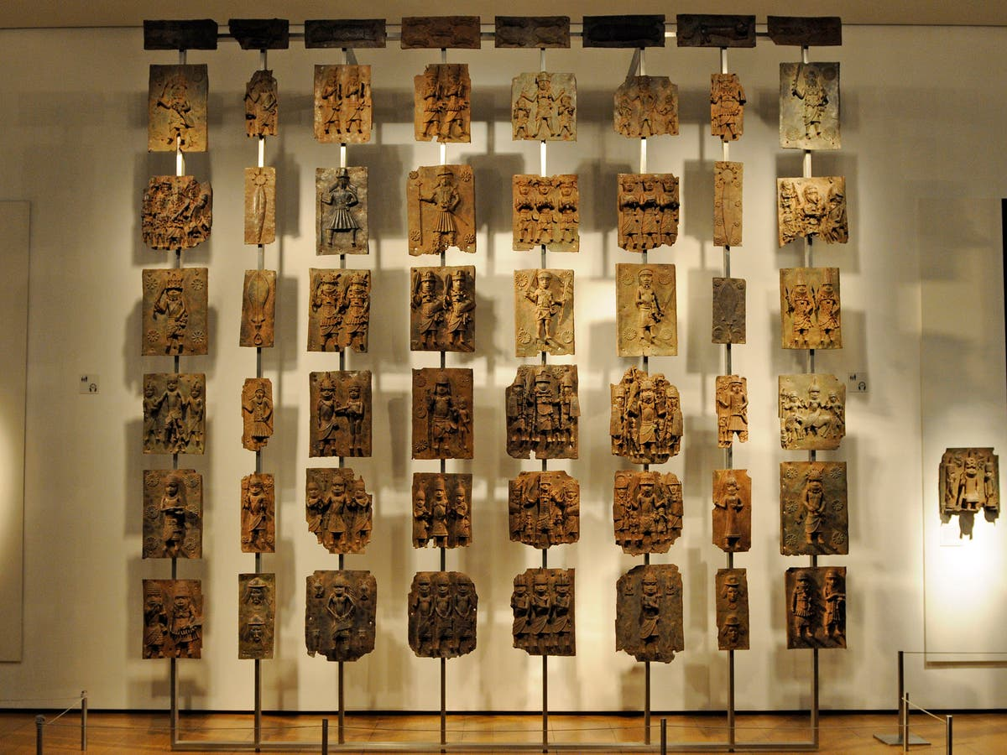
What should happen to the Benin Bronzes now?
In recent years the conversation about repatriation of the Bronzes has become widespread. Nigeria have been campaigning for decades for the Bronzes to be returned to their rightful owners, having been stolen by the British in the previous century. However, the British Museum, claiming never to have received a formal request, still displays many of them.
France and Germany have recently promised to return many of their artefacts, and there is a conversation ongoing in Nigeria regarding where they should be kept once returned.
The Universities of Cambridge and Aberdeen have made private decisions to return items in their possession, but in order to return the ones in the British Museum laws would need to be changed. So far, the government has said this will not be happening.
https://www.channel4.com/news/benin-bronzes-properly-reside-in-british-museum-says-culture-secretary
https://www.channel4.com/news/benin-bronzes-properly-reside-in-british-museum-says-culture-secretary
https://www.bbc.co.uk/news/av/business-50466986

Slide 7
What should happen to the Benin Bronzes now?
Discuss in pairs or small groups what you think should happen to the Benin Bronzes now.
Justify your argument with at least 2 reasons.

Slide 8
Q&A What would you like to ask Mr Nzerem about this topic?

