Slide 1
Why study History at GCSE?

Slide 2
Why study History?
History is a window to the past
It teaches us why we are here, and the journey our ancestors took to get us here.
It helps us understand the world we live in.
It allows us to develop useful, transferable skills, valuable to a wide variety of pathways.

Slide 3
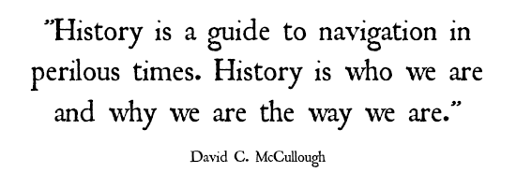
Why study History?

Slide 4
What will I learn?
Medicine through time, 1250 – Present Day
How have understanding of causes and treatments changed?
Injuries, Treatment and Trenches on the Western Front 1914-1918
How gruesome was surgery on the bloody WWI battlefields?
Superpower relations and the Cold War
How close did we come to World War III?
Early Elizabethan England 1558-88
Who was the first Queen Elizabeth, and how did she rule England and beyond?
Germany c. 1919-1945
Why did the German people give Hitler power, and how did he use it for evil?
All the topics will be assessed in exams at the end of year 11.

Slide 5
How will I learn?
Independent study
Pair, group and class discussion
Source-based investigations
Exam-style practice questions
Role play
Video clips
Presentations

Slide 6
What will I gain?
A rich and varied understanding of past events.
A variety of skills: explanation, analysis, debating, research, deduction, questioning, using evidence, critical thinking, verbal and written communication, and much more.
A good GCSE to add to your CV.

Slide 7
What can I use it for?

Slide 8
What can I use it for?
Understanding the world you live in.
A levels
Universities like History as they know you will have a wide range of skills.
A very wide range of jobs!
Law, journalism, media, the civil service, TV, politics, advertising, education, publishing, banking, PR, business, heritage, curatorship, marketing, property, retail and much more!

Slide 9
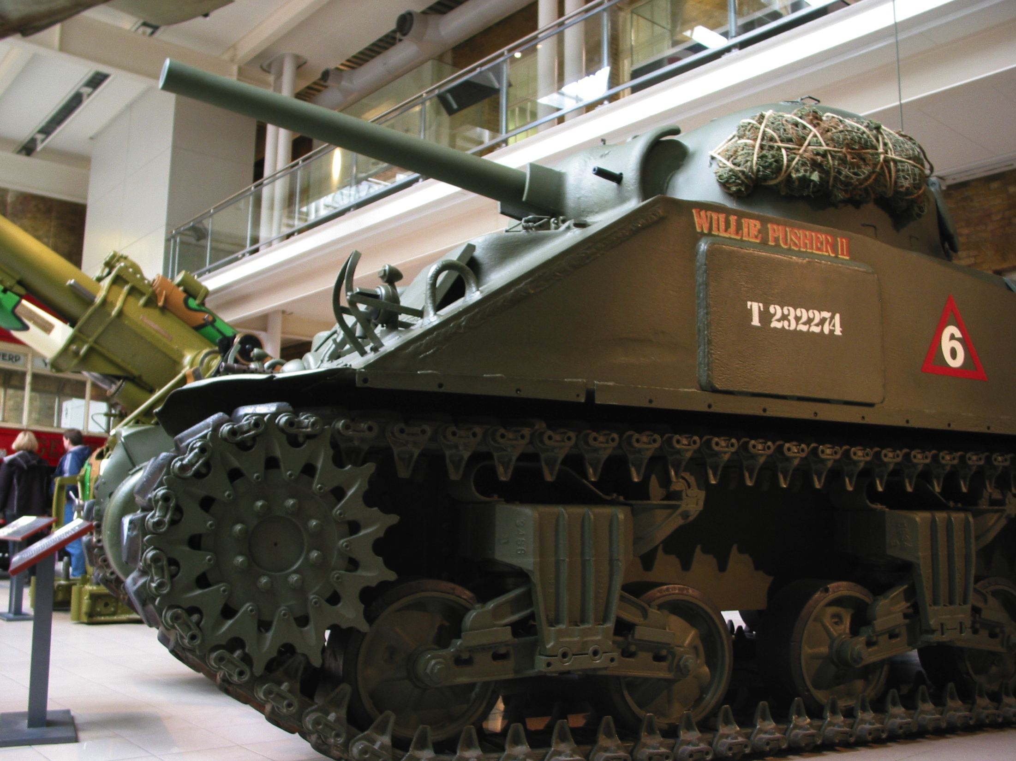
What opportunities will I be offered?
We offer a number of trip opportunities to our GCSE and A level Historians, including the Science Museum, Imperial War Museum, Belgium and Berlin.

Slide 10
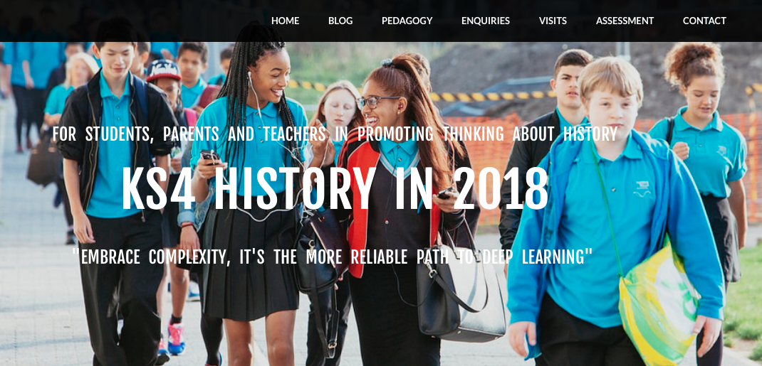
Where can I find out more?
Ask your teacher or look at our GCSE History Weebly page!
http://historyattallis.weebly.com/ks4-exam-2018.html

