Slide 1
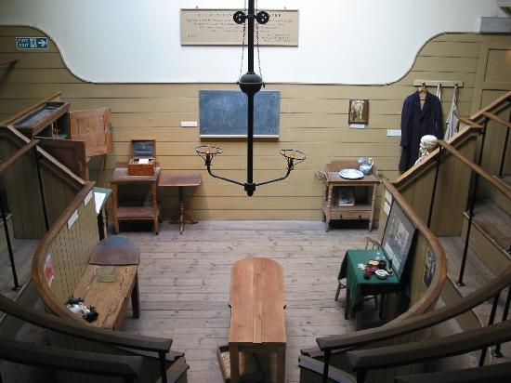
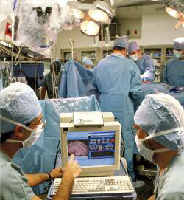
How did we get from this … ... to this?
L/O To identify the main problems involved in surgery in 1845
Make a list of the differences between the two operating theatres in these pictures. a Start by identifying differences you can see. b Then add to your list any differences you can infer from the pictures or changes which you think took place between 1793 and the present.
Now add to your list as you watch the clip: ‘Playing God’ from ‘what the Victorians have done for us’.

Slide 2
Inferences
An inference is a judgement made from the sources, which is not directly stated by it.
A supported inference is one that uses detail from the source to prove the inference.
Consider this example:
Source A: ‘Sue pushed Liz off the swing’ (this is directly stated in the source so is not an inference).
An inference could be: Source A tells me that Sue is in serious trouble and is likely to be punished. The sources does not directly tell us this, but we can infer that it is likely).
A supported inference could be: Source A tells me that Sue is in serious trouble and likely to be punished. I can infer this because she pushed Liz off the swing and so her parents will probably be cross. (An inference , with supporting details quoted from the source).

Slide 3
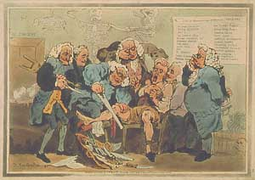
Look at source 1. What can you infer about the main problems involved in surgery in 1793
Class discussion…

Slide 4
Here is a source and a question for you to study. Source 1: Surgeons amputating a man's leg, 1793.
Were you able to transfer the skills learned in year 9?
What can you learn from Source 1 about the risks of surgery in the 18th Century?
Write the inference you can make from the supporting detail provided.
Write the supporting detail that goes with the inference provided.
Inference | Supporting Detail
One thing I can infer from Source 1 is that...(i) | I can infer this because the source shows that there are many people in the room whilst the operation is happening, and that they have not changed into clean clothes nor cleaned the room.
I can also infer that patients often died during amputations. | I can infer this because... (ii)
An answer like this, with two inferences, both supported by detail in the source would gain full marks.

Slide 5
Here is a source and a question for you to study. Source 1: Surgeons amputating a man's leg, 1793.
Were you able to transfer the skills learned in year 9?
What can you learn from Source 1 about the risks of surgery in the 18th Century?
Write the inference you can make from the supporting detail provided.
Write the supporting detail that goes with the inference provided.
Inference | Supporting Detail
One thing I can infer from Source 1 is that...(i) There is no knowledge of germs, the patient may die of an infection. | I can infer this because the source shows that there are many people in the room whilst the operation is happening, and that they have not changed into clean clothes nor cleaned the room.
I can also infer that patients often died during amputations. | I can infer this because... (ii) the image of ghosts suggest the grim reaper is present, also the patients face shows excruciating pain. He may die of shock.
An answer like this, with two inferences, both supported by detail in the source would gain full marks.

Slide 6
Before 1847 the 3 problems with surgery were;
1. PAIN or SHOCK
2. INFECTION
3. BLOOD LOSS
Activity: Copy the above and then decide how these problems solved were eventually solved?
However, that is not to say operations did not take place…
The most common surgical procedures included amputation, caesarean section, removing stones from the bladder can you explain why this was the case?
Surgery could not be too complex, time consuming or go deep into the body due to the problems listed above.

Slide 7
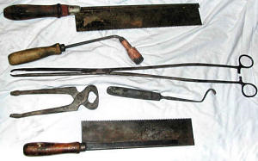
Why was surgery so dangerous in the nineteenth century?
19th century surgical tools.
Would you want your doctor to use these?
We are now going to have a go at a 16 mark JUDGEMENT question. You are allowed 20 minutes for this task.
Infection was the biggest problem faced by patients during and after operations at the beginning of the nineteenth century?
Using the sources A, B and C and your knowledge Explain your answer.
You may use the writing frame to help you structure your answer
Oracy: Be prepared to read your answer out and/or suggest ‘what went well’, or ‘even better if’ to another student for next time.

Slide 8
Infection was the biggest problem faced by patients during and after operations at the beginning of the nineteenth century. Do you agree? Using the sources A, B and C and your knowledge Explain your answer. 16 marks
Level
Level 1 (1 – 4 marks) | Generalised answer Answer offers valid undeveloped comment without direct support from sources or own knowledge. OR Selects details from the sources, but without direct linkage to the question.
Level 2 (5 – 8 Marks) | Supported answer Answer offers a judgment on the hypothesis and links to relevant details from sources and/or own knowledge.
Level 3 (9 12 marks) | Response focuses on the issue of whether problem of infection was the most dangerous or whether it was bleeding or pain, or all three and reaches a judgement based on evidence.
Level 4 (13 – 16 marks) | Sustained argument, exploring the evidence for and against the hypothesis.

Slide 9
How do you feel about your learning today?
L/O To identify the main problems involved in surgery in 1845
Task List
Starter – listing exercise
Video clip task
Source 1 inference question
3 Problems surgery 1850s copied
Common procedures 1850s
Judgement Question practice and mark scheme
Plenary
Homework
Create fact file on the discovery of anaesthetic by Humphrey Davey – Laughing Gas

Slide 10
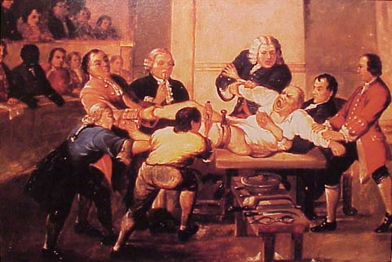
Source A: An operation around 1800

Slide 11
Source B The novelist Fanny Burney’s account of her mastectomy operation in 1811. She survived and lived for many years after
“…when the dreadful steel was plunged into the breast – cutting through veins – arteries – flesh – nerves – I needed no injunctions not to restrain my cries. I began a scream that lasted intermittently during the whole time of the incision – I almost marvel that it does not ring in my ears still! So excruciating was the agony, when the wound was made, and the instrument was withdrawn, the pain seemed undiminished, for the air that suddenly rushed into those delicate parts felt like a mass of minute but sharp and forked daggers, that were tearing at the edges of the wound, but when I felt again the instrument… I thought I must have expired, I attempted no more to open my eyes - they felt so firmly closed, that the eyelids seemed indented to the cheeks…”
Mastectomy: The operation of removing all or part of the breast

Slide 12
Source C: An account by Professor James Syme of his amputation of a leg at the hip joint in the nineteenth century
“I introduced a narrow knife about a foot long … I cut along the bone, which started, with a loud report, from its socket. Finally I passed the knife around the head of the bone, cutting the remaining portion of the ligament, and this completed the operation, which certainly did not occupy at most more than one minute.
My assistant relaxed the tourniquet so that we might estimate the size and number of the bleeding vessels. It seemed at fist sight as if the vessels which supplied so many jets of arterial blood could never all be closed… a single instrument was sufficient to convince us that the patient’s safety required all our speed and in the course of a few minutes haemorrhage was effectually restrained by the application of ten or twelve ligatures.
Tourniquet: any device for arresting bleeding by forcibly compressing a blood vessel, as a bandage tightened by twisting.
Ligature: Tying up an artery to stop the flow of blood from a vessel
Haemorrhage: The flow of blood from a vessel which can lead to death

Slide 13
Infection was the biggest problem faced by patients during and after operations at the beginning of the nineteenth century. Do you agree? Using the sources A, B and C and your knowledge Explain your answer. 16 marks
Introduction: Operations in the nineteenth century were dangerous due to three main problems which the surgeons of the time could not deal with such as…
Source A tells me that surgery was dangerous because...
Source B discusses surgery and it agrees / disagrees that operations were risky because...
Source C discusses operations and it agrees / disagrees that ‘surgery was dangerous because...
Other factors which dangers of surgery are …
Conclude making a judgement decide the most important reason for the dangers of surgery according to the sources and your own knowledge and say why.
By following this plan you are forced to ANALYSE the sources. Compare and contrast! Make links between them. This gives you the best mark.

Slide 14
Infection was the biggest problem faced by patients during and after operations at the beginning of the nineteenth century. Do you agree? Using the sources A, B and C and your knowledge Explain your answer. 16 marks
Introduction – explanation of surgery dangers
Source A explanation
Source B comparison with Source A
Source C comparison with Source A and B
Other factors which explain why surgery was dangerous in the nineteenth century are …
Conclude making a judgement decide the most important reason for surgery being dangerous in the nineteenth century.
By following this plan you are forced to ANALYSE the sources. Compare and contrast! Make links between them. This gives you the best mark.

Slide 15
Infection was the biggest problem faced by patients during and after operations at the beginning of the nineteenth century. Do you agree? Using the sources A, B and C and your knowledge Explain your answer. 16 marks
Introduction
Source A explanation
Source B comparison with Source A
Source C comparison with Source A and B
Other factors ...
Conclusion...
By following this plan you are forced to ANALYSE the sources. Compare and contrast! Make links between them. This gives you the best mark.

Slide 16
Infection was the biggest problem faced by patients during and after operations at the beginning of the nineteenth century. Do you agree? Using the sources A, B and C and your knowledge Explain your answer. 16 marks
Create your own plan.
Try to use ...
Point
Explanation
Evidence
Refer back to Q (Analysis)
There are many factors involved in the fact that surgery was dangerous in the nineteenth century...
I believe the most important is…
Because…
Also…
ANALYSE the sources. Compare and contrast! Make links between them. This gives you the best mark. Use ALL sources.

