Slide 1
Exploration, exploitation, and resistance: how did Europeans make connections in Africa and the America’s 1500-1900?
Lesson 12:
How did European powers start carving up the world by 1900?

Slide 2
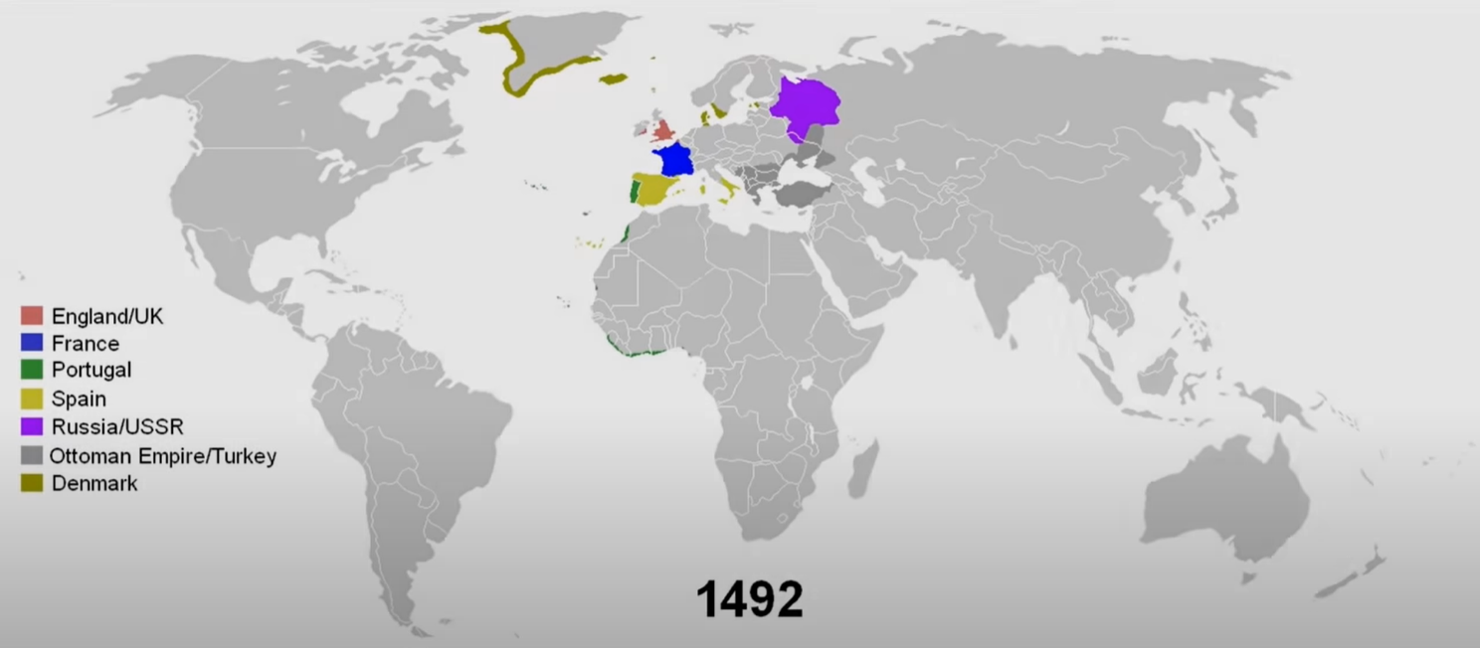
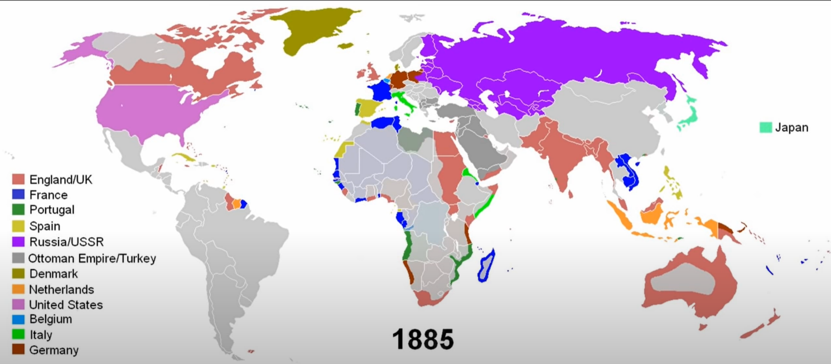
Activity: Watch the video and answer the questions https://www.youtube.com/watch?v=ihD3__Nm8qA
Give one similarity between global empires 1492-1885.
Give one difference between global empires 1492-1885

Slide 3
Optional videos
https://www.bbc.co.uk/bitesize/guides/zf7fr82/revision/1
https://www.youtube.com/watch?v=cAMTB-DRRfE

Slide 4
Final thoughts…

