Slide 1
Exploration, exploitation, and resistance: how did Europeans make connections in Africa and the America’s 1500-1900?
How accurate is it to say that European exploration to Africa and the America’s in 1500-1900 always ended in exploitation?

Slide 2
How accurate is it to say that European exploration to Africa and the America’s in 1500-1900 always ended in exploitation?
Activity 1a: Sort the examples into factors: *social *political *economic
Activity 1b: Label the examples: Exploitation (Ex) or Resistance (Re)

Slide 3
Exploitation Resistance
Factor 1: Political | Factor 2: Social | Factor 3: Economic
Enslaved people had no rights and were defined as property until 1863 in America. | Enslaved people regularly ran away or disobeyed plantation owners, despite the risks. | West Africa was left poor by its relationship with Europe in the slave trade. At the same time the economic development and wealth of Europe and the European colonies in the New World grew.
The Indian Act 1876 set out to control and forcefully assimilate Indigenous people into Canadian society. [If you are trying to fit in, you are trying to assimilate.] | Current estimates are that about 12 million to 12.8 million Africans were shipped across the Atlantic over a span of 400 years. Separating families and destroying cultures and identities. | Most damaging for Indigenous communities was a dependency on European goods. Use of these goods meant the indigenous people had to trade or work for wages.
On January 1, 1804, Haiti was a free republic. The only successful rebellion of enslaved people in world history. | By 1900, Canadian authorities forcibly removed Indigenous children to place them in ‘residential schools’, to try to re-educate them in European ways. Many families resisted, keeping their children at home as long as possible. | In the USA after slavery was officially ended in 1863 many previously enslaved people just stayed right where they were, working on the same plantations for the same white overseers.
As the demand for slaves grew, in some areas the impact ended existing kingdoms. Existing systems of governance based on kinship and consent were destroyed. | When the Europeans arrived, the indigenous people of the Americas were effectively doomed. Viruses tore through the continent, killing an estimated 90% of Native Americans. Sometimes Europeans spread disease intentionally. | At first the fur trade worked had many benefits for the Indigenous, who were able to gain resources from the Europeans.
Paramount Chief Koro Liman IV in the Sisala West District of Ghana, build defences to protect the people against the slave raiders. | In the USA after 1863, black and white teachers in the North and South worked hard to give the emancipated (which means free) African American population the opportunity to learn and go to school. | After 1530 the Oba banned slavery in Benin, despite the money that could be made, this ban lasted at least a century.
Treaties were signed between 1725 and 1779 with the Mi’kmaq (pronounced 'meeg mah’) Indigenous in Nova Scotia to improve relations with the Europeans. | There are many examples of enslaved people on slave ships overthrowing their captures e.g. on the Amistad in 1839. Eventually all enslaved people on this ship were given freedom and returned to West Africa. | Many enslaved individuals such as Olaudah Equiano managed to become free from slavery In 1789 he published his autobiography. He travelled widely, Equiano a wealthy man.

Slide 4
Activity 1c: Explain one consequence of connections made with Europeans
Write a paragraph in your book to explain one of the consequences.
Choose a factor (e.g. economic).
Give an example of the consequence (e.g. West African countries were left poor)
Explain if it was an example of exploitation or resistance.
Challenge: Add extra detail from our previous lessons, and explain if it was long- or short-term.
Challenge: Can you add a second example for the same point, and explain it in detail?

Slide 5
Activity 1d: Mark your answer Use the checklist below to give yourself a mark out of 6.
Use the checklist below to give yourself a mark out of 4.
Factor – 1 mark
Example – 1 mark
Exploitation/resistance? – 1 mark
Bonus points:
Very detailed explanation – 1 mark
What went well?
What could you improve next time?

Slide 6
How accurate is it to say that European exploration to Africa and the America’s in 1500-1900 always ended in exploitation? Activity 2: Tick the phrase you think best answers the question. Write a PEE paragraph to explain your choice Always accurate Sometimes accurate Never accurate

Slide 7
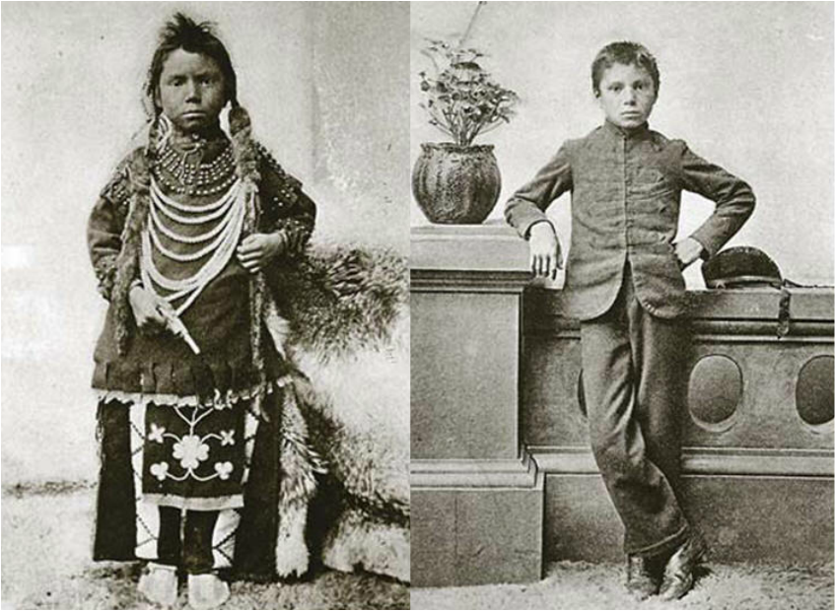
Final thoughts… Read the sources: What can we learn about European attitudes towards the Indigenous in the 1800s?
Source C: Before and after photos of young Thomas Moore at the Regina Indian Industrial School. Four years after enrolling, Moore was sent home ill with tuberculosis and soon died.
Source A: A 1879 Report on Industrial Schools for Indians and ‘Half-Breeds’ (Half-Breeds was a racist way to refer to someone with mixed heritage):
‘…if anything is to be done with the Indian, we must catch him very young. The children must be kept constantly within the circle of civilized conditions. (Davin 1879, 12)’

Slide 8
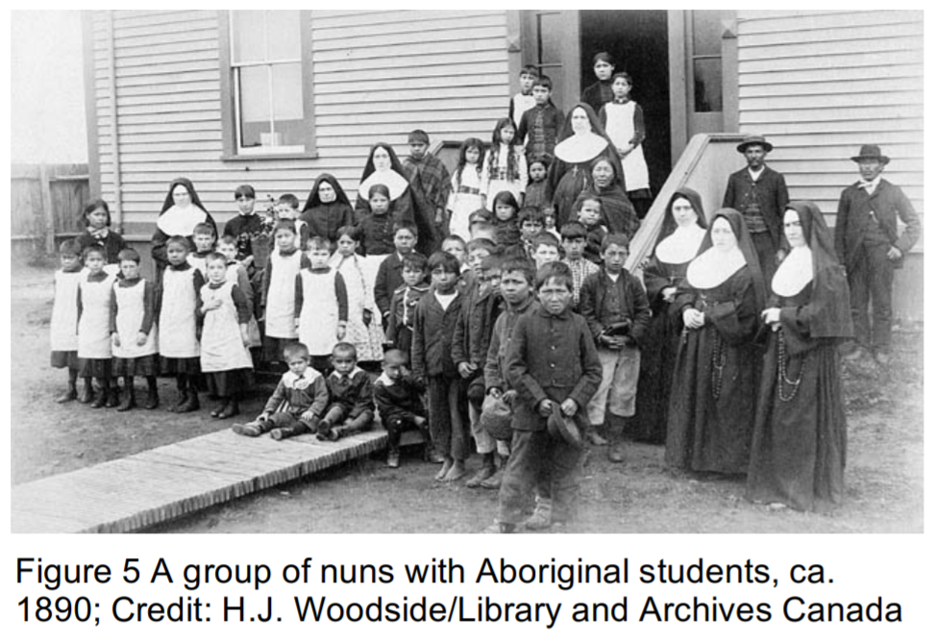
What was it like to be an indigenous person in 1900 America?

Slide 9
