Slide 1
Exploration, exploitation, and resistance: how did Europeans make connections in Africa and the America’s 1500-1900?
Title: How successfully did enslaved people create their own nations?

Slide 2
Activity 1: Watch the videos and make a mind map about the Haitian Revolution https://www.bbc.co.uk/bitesize/clips/zjgg9j6 https://www.youtube.com/watch?v=Uw7Ie_vNO7g

Slide 3
Activity 2- read the information and fill in the blanks
Challenge: complete the challenge questions

Slide 4
Activity 3: Create a newspaper article about long term success of the Haitian Revolution
Include:
Key individuals
Key dates
How successful was it in the long term?

Slide 5
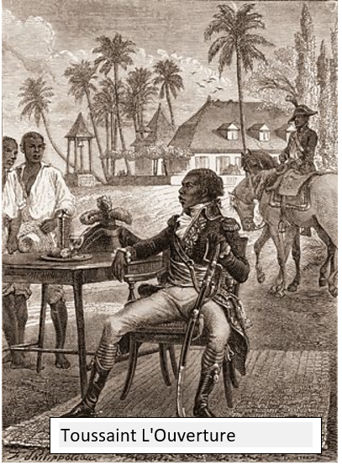
The Haitian Revolution
This was the most successful enslaved people rebellion in history. The Haitian Revolution began as a enslaved people revolt and ended with the founding of an independent state. It started in 1791 in the valuable French colony of Saint-Domingue, in the Caribbean. It was inspired by the French Revolution in 1789. The enslaved people on this island had been treated very badly by French owners and eventually black enslaved people launched an organized rebellion, killing thousands of whites and burning sugar plantations and gaining control of the region. This challenged the idea that enslaved peoples were inferior to white people and completely changed peoples mindsets.

Slide 6
How did the Haitian beat the British?
In 1793 Britain took the chance to take St Domingue from the Haitian leader L’Ouverture. However, Britain suffered humiliation and was beaten by disease and the ex-slave army. Despite this failed invasion, the British continually attempted to defeat the slave army and capture the island’s resource The government hoped this would stop rebellion spreading to neighbouring British colonies. 45,000 British soldiers died in battle and from disease in the West Indies between 1793 and 1801. In Britain there was fear that rebellion would spread to other islands.

Slide 7
How did Haiti become a new country?
The unrest continued until February 1794, when the French government officially abolished slavery in all its land. Then the people who had been enslaved declared their independence and established the island as the new republic of Haiti. News of the first successful rebellion—the only enslaved people uprising in history to end with the foundation of a new country went on to inspire countless other revolts throughout the United States and the Caribbean.

Slide 8
What were the consequences of the Haitian Revolution?
On January 1, 1804, Haiti was a free republic. The only successful rebellion of enslaved people in world history. However, the country had been crippled by years of war, the country devastated. Haiti was forced to make payments to French slaveholders in 1825 in the amount of 90 million gold francs (a value of $21 billion USD today), Haiti was forced to pay France for the next one hundred years for its independence. A great many historians believe that this has contributed significantly to making Haiti the poorest nation in the Western Hemisphere.

Slide 9
Final thoughts…

