Slide 1
Exploration, exploitation, and resistance: how did Europeans make connections in Africa and the America’s 1500-1900?
Title: How did enslaved people resist and rebel?

Slide 2
Resistance and rebellion
We have looked at how Europeans started to explore new waters in what would become modern-day America. How when they came into contact with indigenous people there were both examples of co-operation and trade, and awful repression and ill-treatment.
We have looked at how Europeans came into contact with African nations, and how at first areas such as Benin traded and worked with the Europeans on their own terms. When the slave trade began, many African nations resisted or banned it entirely. However, eventually many countries in West Africa would be devasted by the effects of the slave trade.
Now we will look at the destination of many of those enslaved Africans, and how at every stage in their journeys there are examples of resistance and rebellion. These could be small acts of individual rebellion, or large organised revolution.

Slide 3
Life on the plantation
On the plantation enslaved people had a harsh existence. Gangs of enslaved people worked from dawn until dusk under the orders of a white overseer. Enslaved people were whipped if they did not work hard enough. During harvest time, enslaved people worked in shifts of up to 18 hours a day.
Housing on the plantation
On the plantations, enslaved people lived in small cottages with thatched roofs, earth floors, a bed table and bench.
Mistreatment and punishment of enslaved people White masters had complete control over the lives of their enslaved people, as they had no rights. Enslaved people who disobeyed or resisted were violently punished - in Antigua it was not a crime to kill an enslaved person until 1723.
The punishments given to enslaved:
Captured runaways could be hanged or maimed.
Slaves were often flogged with a whip.
The number of lashes that they received depended upon their ‘crime’.

Slide 4
Activity 1: Read the information and answer this question: Describe two features of life on a plantation for enslaved people.
One feature of life on a plantation for enslaved people was… for example…
Another feature of life on a plantation for enslaved people was… for example…

Slide 5
What happened when enslaved people arrived at plantations?
From 3 minutes : https://www.youtube.com/watch?v=U32Zp4u_pNs
Activity 2- watch the clip and answer the questions.
Why were enslaved Africans more affordable than indentured servants?
What crops did the enslaved people work on?
Why did the crop have to be rushed?
Enslaved people had to work through the night. True/ False
What was the life expectancy of enslaved Africans arriving at the plantation?
indentured servants: typically worked four to seven years in exchange for the journey by ship, room, and food.

Slide 6
What happened when enslaved people arrived at plantations?
From 3 minutes : https://www.youtube.com/watch?v=U32Zp4u_pNs
Why were enslaved Africans more affordable than indentured servants? Plantation owners owned any children the enslaved people had
What crops did the enslaved people work on? Sugar cane.
Why did the crop have to be rushed? The juice would spoil.
Enslaved people had to work through the night. True/ False
What was the life expectancy of enslaved Africans arriving at the plantation? Seven years
indentured servants: typically worked four to seven years in exchange for the journey by ship, room, and food.

Slide 7
Individual acts of rebellion Activity 3- Watch the clip and make a mind map of all the way enslaved people could rebel https://www.bbc.co.uk/bitesize/guides/z732pv4/revision/5
Acts of resistance

Slide 8
Individual acts of rebellion Activity- Watch the clip and make a mind map of all the way enslaved people could rebel https://www.bbc.co.uk/bitesize/guides/z732pv4/revision/5
Runaway to be with family on another plantation
Runaway to escape punishment
Some stayed away for a night
Some stayed away for many years
Some never returned
In Jamaica, how groups runaway to villages- they were called maroons. They could not be captured, as they were more used to the terrain.
Ambushing soldiers

Slide 9
Activity 4: Read the table and label the acts of resistance passive (P) or active (A)
How could enslaved people resist the overseas and plantation owners? | Label the acts of resistance passive (P) or active (A)
Work slowly
Steal from owner
Deliberately damage machinery
Speak to other enslaved people using an African dialect
Kill a plantation owner
Pretend not to understand orders
Plan and carry out an armed revolt
Refuse to do any work
Practise your own religion and cultural beliefs
Working slowly when not being observed

Slide 10
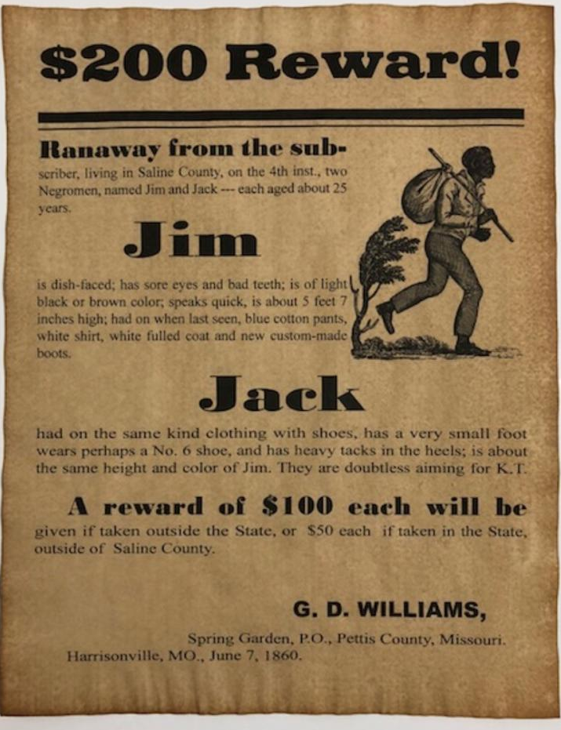
Final thoughts… Why do you think plantation owners were so determined to find enslaved people who ran away?
Notes:
Also in workbook if students can’t read from the board.

