Slide 1
Exploration, exploitation, and resistance: how did Europeans make connections in Africa and the America’s 1500-1900?
Title: Why did Europeans get involved in the business of enslaving people?

Slide 2
What were the causes of the Slave trade?
Activity 1:
Label the boxes: *Religious *Economic *Other
Slavery was accepted in the Bible, the Roman Empire and Anglo-Saxon England, but abolished by the Normans. | The first enslaved African people were brough and sold in England by Sir John Hawkins between 1562 and 1567.
The indigenous people in the West Indies were wiped out by European diseases and were seen as ‘unsuitable’ for plantation work. | Enslaved African people were seen as better at working in hot climates.
There was a labour shortage in the colonies. This making products like sugarcane expensive to harvest as workers were demanding better pay. | There was growing demand in Europe for sugar, tobacco and cotton. This led to the creation of large plantations.
Ship owners in Britain could sell an African slave for five times the price it cost to buy and transport the, | Slavery was an important part of the African way of life. Chiefs would sell criminals, debtors or prisoners of war
Enslaved African people were sold in exchange for guns and manufactured goods, which gave the chiefs great wealth and power. | Enslaved African people were immune to the diseases that were killing the Indigenous people of the Caribbean and America.
The slave traders argued that slavery was good for Africans as they would become Christians and go to heaven | Within 18 months a plantation owner could make enough profit from an enslaved people to pay for the cost of the purchase,
Challenge: chose a new label for the boxes entitled ‘other’

Slide 3
The Causes of the Slave Trade
Activity 2- watch the video and write down the three main CAUSES for slave trade:
https://www.bbc.co.uk/bitesize/clips/znjjmp3
1.
2.
3.
Challenge: explain how this threshold concept links to what we are learning about in todays lesson

Slide 4
The Causes of the Slave Trade
Activity- watch the video and write down the three main CAUSES for slave trade:
https://www.bbc.co.uk/bitesize/clips/zdvvr82
1. Money
2.Land
3.Power

Slide 5
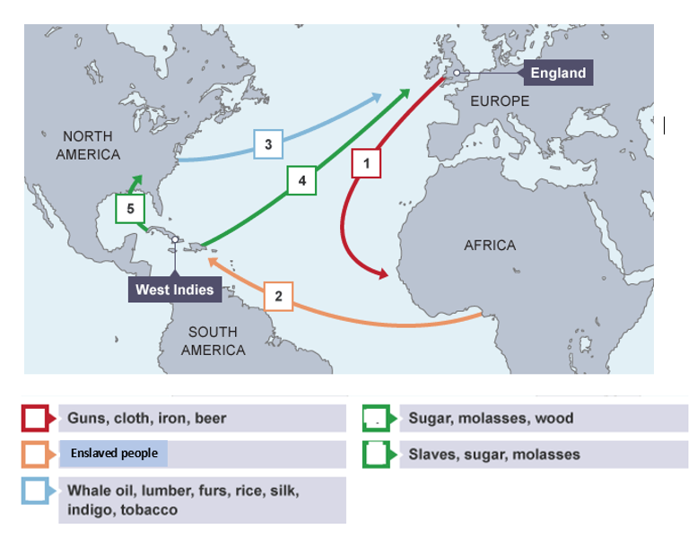
The Triangle Trade
Watch video and match the items with the numbers
https://www.bbc.co.uk/bitesize/clips/zm44d2p
Notes:
Molasses are like sugar cane

Slide 6
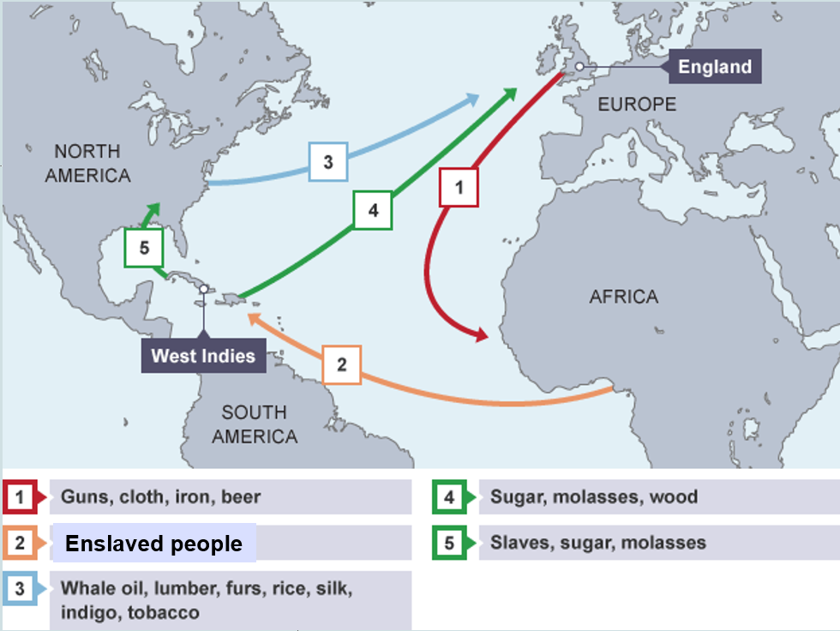
Answers

Slide 7
Legacy and consequences of the slave trade
Activity 3: Watch the clip and answer the questions https://www.youtube.com/watch?v=3NXC4Q_4JVg&t=136s
How many Africans were brought to the America’s during the slave trade?
When did the Atlantic slave trade begin?
The European settlers tried to force indigenous people to work as slaves true/ false
Slavery had existed in Africa before the Slave trade True/ False
What percentage of enslaved people died at sea?
Most of the enslaved people taken from Africa were men True/ false
What happened to African Kingdoms that relied on the slave trade, when slavery was abolished?
European religious ideas always challenged the slave trade. True/ false

Slide 8
Answers
Watch the clip and answer the questions https://www.youtube.com/watch?v=3NXC4Q_4JVg&t=136s
How many Africans were brought to the America’s during the slave trade? 10 million
When did the Atlantic slave trade begin? Late 1400s
The European settlers tried to force indigenous people to work as slaves true/ false
Slavery had existed in Africa before the Slave trade True/ False
What percentage of enslaved people died at sea? 20%
Most of the enslaved people taken from Africa were men True/ false
What happened to African Kingdoms that relied on the slave trade, when slavery was abolished? They collapsed
European religious ideas always challenged the slave trade. True/ false In fact in helped justify the slave trade and create racist ideas that still exist to this day

Slide 9
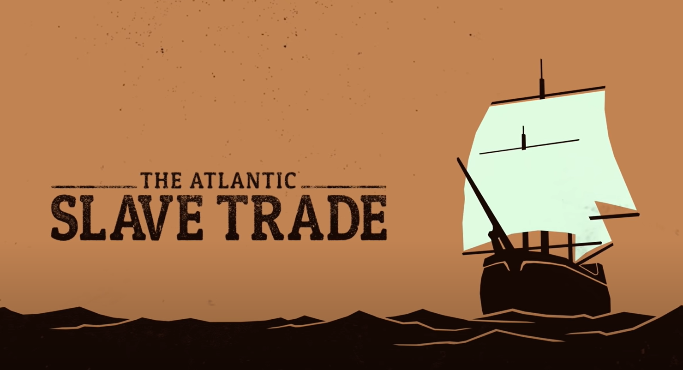
Final thoughts… Discussion: What was the most important factor in causing the start of the Atlantic slave trade?

