Slide 1
Exploration, exploitation, and resistance: how did Europeans make connections in Africa and the America’s 1500-1900?
Title: What was Benin like before the arrival of the Europeans?

Slide 2
Africa Before Transatlantic Slavery
Activity 1: read the text and fill in the blanks Slavery gold men kingdoms civilized crime years traded
Discussion: Why is it important to learn about Africa before the arrival of Europeans?
Challenge: In your books: Describe two African kingdoms that existed before the arrival of Europeans. (use specific examples)

Slide 3
Answers
Many Europeans thought that Africa's history was not important. They argued that Africans were inferior to Europeans and they used this to help justify slavery. . However, the reality was very different. A study of African history shows that Africa was by no means inferior to Europe. The people who suffered the most from the Transatlantic Slave Trade were civilised, organised and technologically advanced peoples, long before the arrival of European slavers, trying to suggest they were backward peoples.
Egypt was the first of many great African civilisations. It lasted thousands of years and achieved many magnificent and incredible things in the fields of science, mathematics, medicine, technology and the arts. Egyptian civilisation was already over 2000 years old by the time the city of Rome was built.
In the west of Africa, the kingdom of Ghana was a vast Empire that spread across an area the size of Western Europe. Between the ninth and thirteenth centuries, it traded in gold, salt and copper. It was like a medieval European empire, with a collection of powerful local rulers, controlled by one king or emperor. Ghana was highly advanced and prosperous. It is said that the Ghanaian ruler had an army of 200,000 men.

Slide 4
Answers
The kingdoms of Benin and Ife were led by the Yoruba people and sprang up between the 11th and 12th centuries. The Ife civilisation goes back as far as 500BC and its people made objects from bronze, brass, copper, wood and ivory. Studies of the Benin show that they were highly skilled in ivory carving, pottery, rope and gum production.
From the thirteenth to the fifteenth century, the kingdom of Mali spread across much of West and North-East Africa. At its largest, the kingdom was 2000 kilometres wide and there was an organised trading system, with gold dust and agricultural produce being exported north. Mali reached its height in the 14th century. Cowrie shells were used as a form of currency and gold, salt and copper were traded.
Between 1450-1550, the Songhay kingdom grew very powerful. It had a well organised system of government, a developed currency and it imported fabrics from Europe. Timbuktu became one of the most important places in the world. Libraries and universities were built and it became the meeting place for poets, scholars and artists from other parts of Africa and the Middle East.
Forms of slavery existed in Africa before Europeans arrived. Some countries in the African continent had their own systems of slavery. People were enslaved as punishment for a crime, payment for a debt or as a prisoner of war. However, African slavery was different from what was to come later.

Slide 5
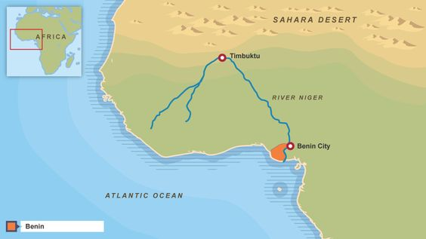
Activity 2a- Watch the clip and answer the questions
https://www.bbc.co.uk/programmes/p02m8908
The Benin Civilization existed before Queen Victoria True/ False
Where was the Benin Civilization?
Who was the leader of the Benin?
Give two examples of metals the Benin used.
Some of the goods came from as far away as which country?
Who were the first Europeans to meet the Benin?
What spelled the end for the Benin empire?

Slide 6
Answers
The Benin Civilization existed before Queen Victoria True/ False
Where was the Benin Civilization? Modern day Nigeria
Who was the leader of the Benin? The Oba
Give two examples of metals the Benin used. Tin and copper.
Some of the goods came from as far away as which country? India
Who were the first Europeans to meet the Benin? The Portuguese.
What spelled the end for the Benin empire? The British invaded

Slide 7
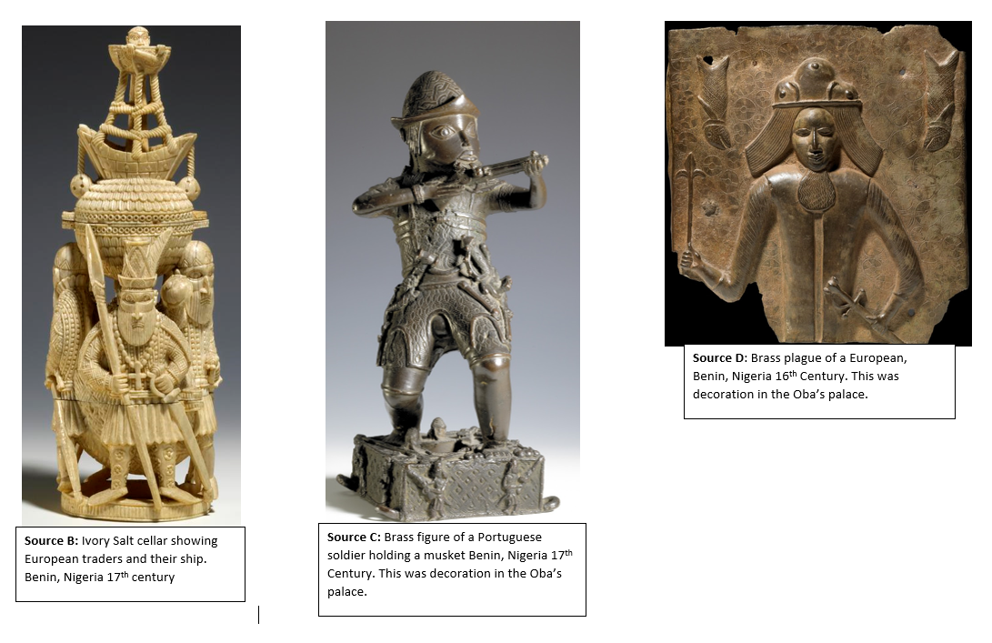
Activity 3: Read/ look at Sources A-D. Fill in the table
Challenge: What can you learn from the source about the relationship with Europeans in the 16th and 17th centuries?
Extension: Which source is the most useful for learning about the relationship with the Europeans 16th- 17th century. Explain your answer in your books

Slide 8
Answers to the first row
Source | Nature and Origin- what is the source? When was it made? | What can you infer from the source about the Kingdom of Benin? | What can you infer from the source about the relationship with Europeans in the 16th and 17th centuries?
Source A | In the year 1668 a Dutch writer called Olfert Dapper put together some merchants’ descriptions of their travels. | I can infer that the Benin Kingdom was very sophisticated. It had an advanced culture and large and organized cities. I can infer the Oba was very powerful and respected by the people. Benin had an organized political system | The Europeans sound very impressed by what they see.

Slide 9
Answers
Source | Origin- what is the source? | What can you infer from the source about the Kingdom of Benin? | What can you infer from the source about the relationship with Europeans in the 16th and 17th centuries?
Source A | In the year 1668 a Dutch writer called Olfert Dapper put together some merchants’ descriptions of their travels. | I can infer that the Benin Kingdom was very sophisticated. It had an advanced culture and large and organized cities. I can infer the Oba was very powerful and respected by the people. Benin had an organized political system | The Europeans sound very impressed by what they see.
Source B | Ivory Salt cellar showing European traders and their ship. Benin, Nigeria 17th century | I can infer that the Benin were extremely skilled and able to create incredible sculpture. I can infer that Benin knew how to create sculpture from ivory. I can infer that the Benin were very interested in the Portuguese who arrived. | I can infer that the Portuguese brought their ideas about Christianity. I can infer that the Portuguese brought their ship design.
Source C | Brass figure of a Portuguese soldier holding a musket Benin, Nigeria 17th Century | I can infer that the Benin were skilled in making sculptures from Brass. I can infer that the Benin were interested in the Portuguese use of guns. | I can infer that the Portuguese brought guns with them to Benin. Perhaps this means they traded with the Benin
Source D | Brass plague of a European, Benin, Nigeria 16th Century. This was decoration in the Oba’s palace. | Their presence on the decorations of the king’s palace shows how the Portuguese were regarded as symbols of the king’s wealth and power, to which their trade contributed so much. | The plaques show how the people of Benin saw the Portuguese traders and their soldiers, with their pointed noses, thin faces and beards and strange clothes.

Slide 10
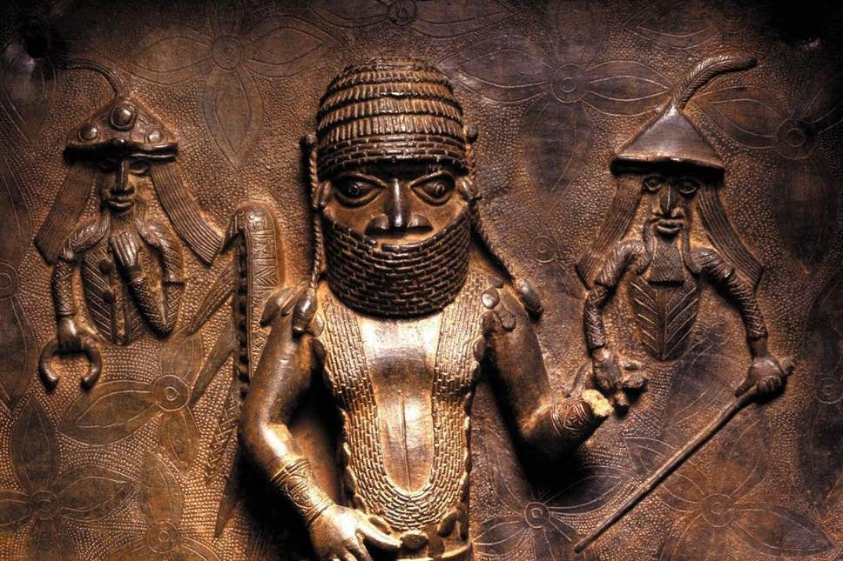
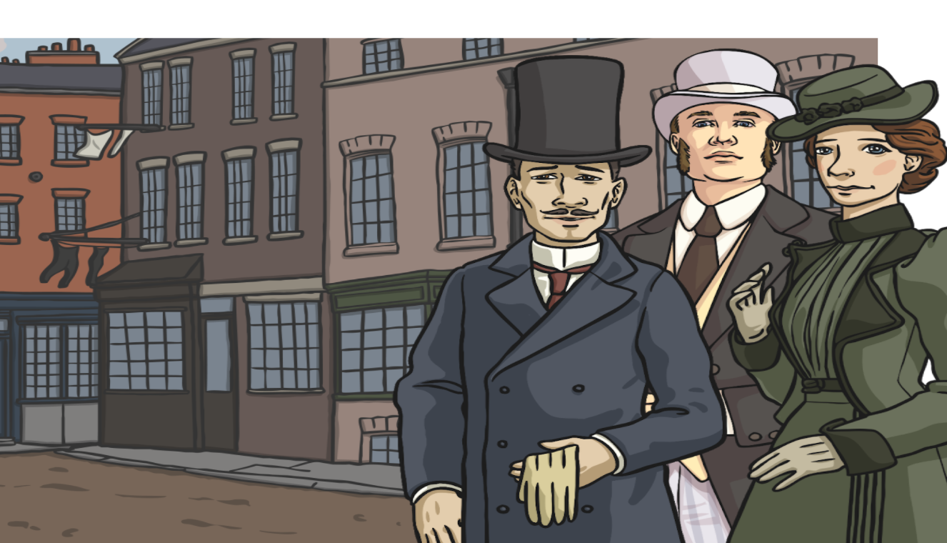
Final thoughts… When the Victorians first “found” the Benin Bronzes they were surprised by the quality. Many did not believe they were genuine. Read the quotes from Victorian people: what can we learn about Victorian attitudes towards the Benin Kingdom? Challenge: explain the threshold concept.
“These crafts must have been brought to the Kingdom of Benin by the Portuguese when they arrived here in the 15th and 16th centuries.” “These African craftspeople must have learnt their craft from European people.” “These crafts are not African. They are from another civilisation, a European one, like Atlantis.”
“It need scarcely be said that at the first sight of these remarkable works of art we were at once astounded at such an unexpected find, and puzzled to account for so highly developed an art among a race so entirely barbarous.” - Read and Dalton 1898
Notes:
Also in workbook if students can’t read from the board.

