Slide 1
Exploration, exploitation, and resistance: how did Europeans make connections in Africa and the America’s 1500-1900?
Title: How did European relations with Indigenous people in North America change over time?
Starter: In many places in America today there is a celebration on ‘Columbus Day’, to mark the day the Christopher Columbus supposedly arrived in the Americas. Many people don’t think this should be a celebration. Why might this be?

Slide 2
Activity 1a: watch the video and write a definition for the word ‘indigenous’.
What does the word indigenous mean?
https://www.youtube.com/watch?v=CISeEFTsgDA

Slide 3
What does the word indigenous mean?
Indigenous people are the first people to live in a place.

Slide 4
The interpretations of Christopher Columbus
Activity 1a: Watch the video and answer the questions https://www.youtube.com/watch?v=GD3dgiDreGc&t=287s
Who were the first Europeans to visit the Americas?
Italians
Spanish
Norse
2. How were the European practices of slavery and warfare from those that Native Americans had engaged in among themselves?
3. Why might Native Americans living today be uncomfortable with Columbus Day as it has been celebrated through most of the 20th century?
4. What do some Latin American countries celebrate on holidays like Día de la Raza?
Challenge: Do humanity’s moral standards change with time, or are there certain things that would shock people in any era?

Slide 5
The interpretation of Christopher Columbus
Answers
Who were the first Europeans to visit the Americas?
Italians
Spanish
Norse
2. How were the European practices of slavery and warfare from those that Native Americans had engaged in among themselves? It was sporadic and limited
3. Why might Native Americans living today be uncomfortable with Columbus Day as it has been celebrated through most of the 20th century? It wiped out large numbers of the population, descendants were forced onto reservations
4. What do some Latin American countries celebrate on holidays like Día de la Raza? A celebration of native or mixed cultures that survived colonisation
Challenge: Do humanity’s moral standards change with time, or are there certain things that would shock people in any era?

Slide 6
Activity 1b - look at the image of the threshold concept.
What can you see?
How do you think this links with the video you have just watched?

Slide 7
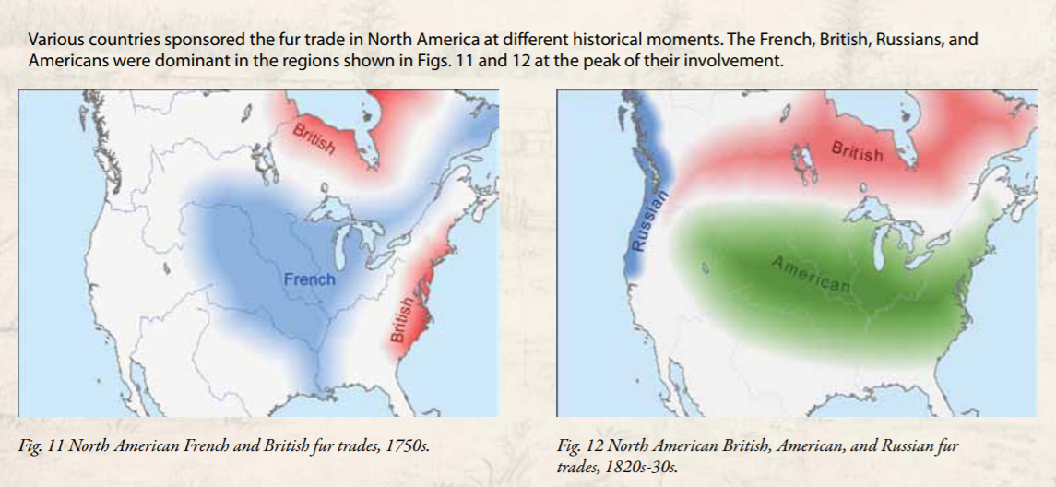
Case study: What was the Fur Trade?

Slide 8
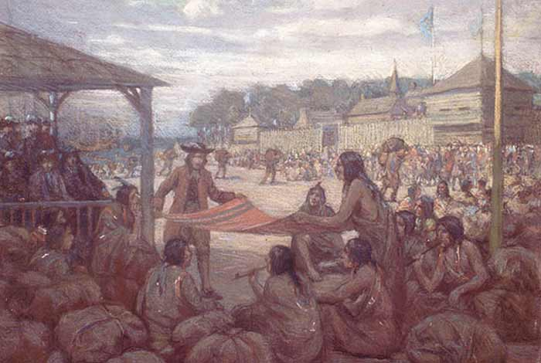
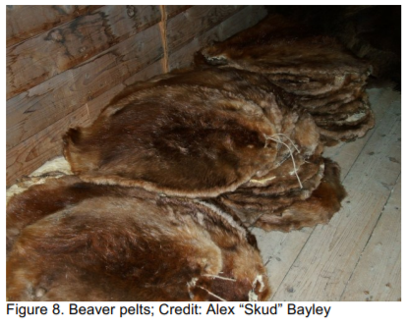
What was the fur trade?
Indigenous peoples had been trading amongst each other across far distances for thousands of years. Trade relationships were a large part of the connections between Indigenous nations across North America. The fur trade covered a period of about 250 years, and this module only scratches the surface of that history. The fur trade does not only describe exchanges between First Nations and Europeans. Trading also took place between Indigenous groups, as European goods would travel in one direction and furs in the other. Many Indigenous peoples came into contact with European trade goods before they met Europeans themselves
Notes:
Information reference: University of Alberta: Faculty of Native Affairs

Slide 9
What did some indigenous first think of the Europeans?
Activity 2a: Answer the following questions in your exercise book using the sentence starters to help you:
1. What can you infer (work out) from Source 1 about how some indigenous people first saw the English?
a. From Source 1 I can infer that the indigenous…
Source One Alex “Skud” Bayley The Montagnais (Innu) trading captain who mentioned that the beaver:
“does everything” also went on to say, “The English have no sense; they give us twenty knives like this for one beaver skin”
Challenge:
If you had to follow up one of the sources to find out more, which one would you pick and why? Explain your answer in your exercise book using the sentence starters below.
I would follow up Source ___.
I would like to follow up the detail ‘…’ because… (choose a detail you want to know more about and explain why!)

Slide 10
What did some indigenous first think of the Europeans?
Answer
1. What can you infer (work out) from Source 1 about how some indigenous people first saw the English?
From Source 1 I can infer that the indigenous Montagnais trading captain was amazed at the value placed upon the beaver pelt by Europeans. Trade in beaver pelts in the seventeenth and eighteenth centuries would have been impossible without the cooperation and enthusiasm of Indigenous peoples to consume European merchandise and products.

Slide 11
Activity 2b: Highlight the positive and negative impacts of the fur trade on Indigenous people.
Challenge:
Explain two consequences of European connections with Indigenous people during the dur trade.
One consequence of European connections with Indigenous people during the fur trade was…
Another consequence of European connections with Indigenous people during the fur trade was…

Slide 12
Answers
The fur trade offered Indigenous peoples new access to various useful material technologies of Europeans, particularly metal. | Trading old clothing (used furs) gave them access to metal objects such as knives, pots and axes, as well as needles, kettles, ice chisels, hatchets, and projectile points. Other goods were traded were guns, bullets, beads, linens for fishing nets, and mirrors. | Indigenous women began to marry and have long term relationships with the newcomers.
Indigenous peoples contributed not only their skills in hunting, but also their extensive knowledge of the land and ecosystems to the development of the hybrid economy known as fur trade | Most damaging for Indigenous communities was a dependency on European goods. Use of these goods meant the indigenous people had to trade or work for wages. | The children of the relationships between Europeans and indigenous became known as “halfbreeds” or “mixed-bloods”, while the French called their children “boisbrûlés” or Métis.
Little could have anyone predicted that, these relationships between the Europeans and indigenous would create a new Nation, the Métis people. | This dependency on Europeans weakened many aspects of traditional Indigenous life, and eventually European interests won. They gained the upper hand both economically and politically. | By the 1800s beavers were almost hunted to extinction in many parts of Canada, and by the late 1800s, the fur trade crashed.
Notes:
Information reference: University of Alberta: Faculty of Native Affairs

Slide 13
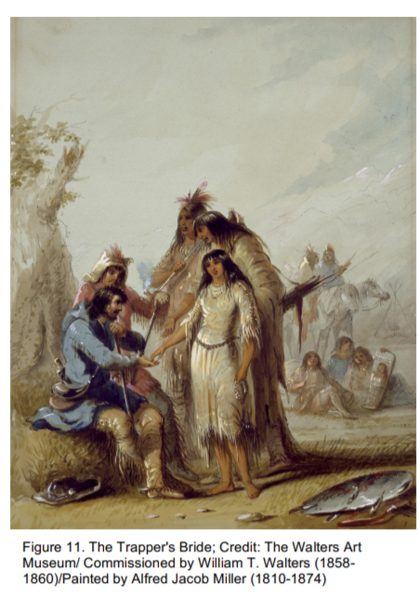
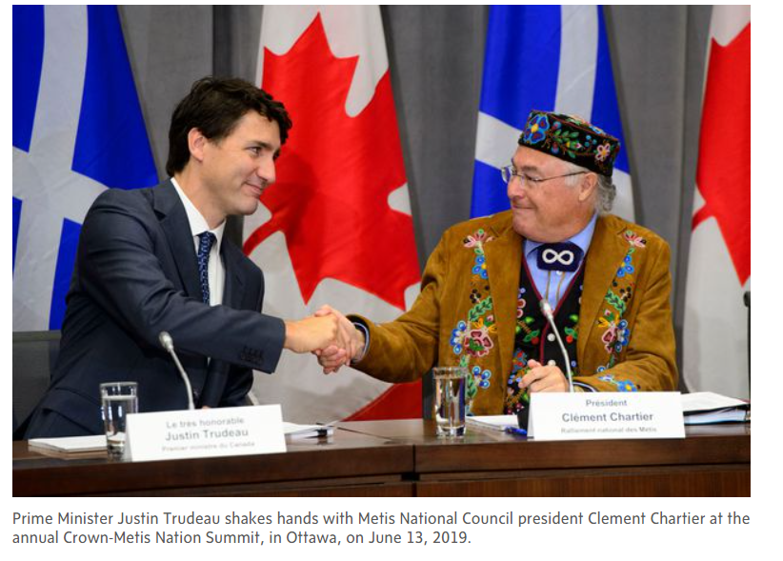
Further information: The Métis
As the trading networks grew, some French men adopted the trading practices of the Indigenous population. Securing the economic bonds and loyalty that came with kinship ties, Indigenous women and their kin would secure trading privileges through marriages and long term relationships with the newcomers.
These bonds were often called “marriage à la façon du pays”, and, while mutually beneficial, were not always permanent. The children of these relationships became known to some as “halfbreeds” or “mixed-bloods”, while the French called their children “boisbrûlés” or Métis. Little could have anyone predicted that through a series of unforeseen circumstances, time, and human nature, these relationships would create a new Nation, the Métis people.

Slide 14
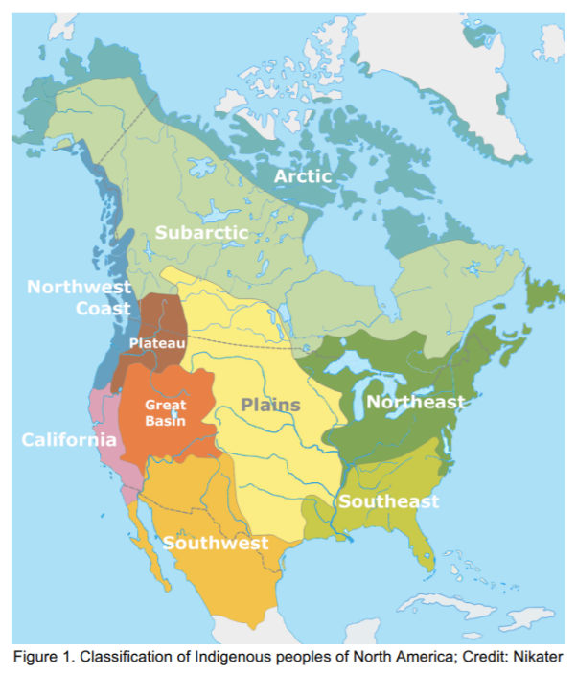
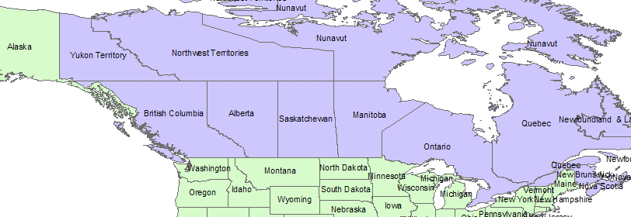
Final thoughts…
Indigenous peoples before the arrival of the Europeans
Look at the maps:
What do you notice about the differences?
Modern day Canada/ American state borders
Notes:
Indigenous people lived across modern day country/ state boarders.

Slide 15
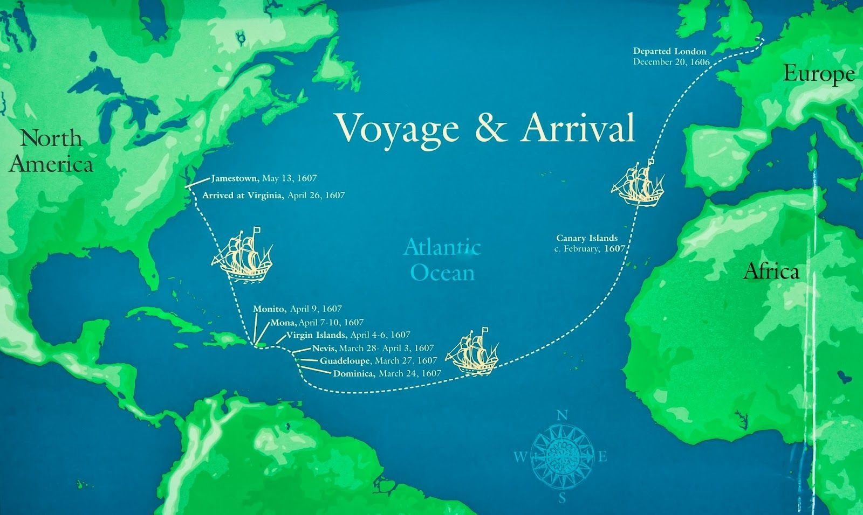
Final, final thoughts…
Why do you think so many Europeans wanted to join the Indigenous?
In 1612 in Jamestown, so many European men were leaving the European settlements to live with the Indigenous that the governor brought in strict punishments:
‘hanged, some burned. Some to be broken on wheels, others to be shot to death’
In 1785, a French/American writer, Hector de Crevecoeur noticed that when Europeans tried to collect their children who had been kidnapped in times of war with the Indigenous, the children ‘resolutely refused to go with them, and ran to their adopted [indigenous] parents for protection… I have heard of thousands of examples of this but we have no examples of kidnapped Indigenous choosing to stay living as Europeans’
Notes:
Important to remember that some may have defected because early settlements often died of disease and starvation. However perhaps more importantly the indigenous offered an alternative lifestyle, and knowledge that Europeans had forgotten or neglected.
Sources as quoted in ‘Feral’ George Monibiot.

