Slide 1
Ideas: How far did big ideas change people’s understanding and experiences of the world, 1500-1800?
Lesson 2:
What was the Renaissance?

Slide 2
Activity 1a: Quick starter drawing activity
Person 1 – turn around to face the back.
Person 2 – describe the images on the board.
Person 1 – draw what is being described to you in the back of your book.

Slide 3
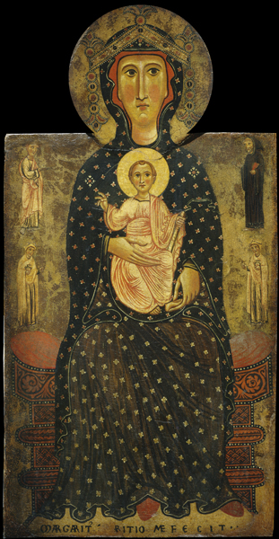

Slide 4
Now swap!
Person 2 – turn around to face the back.
Person 1 – describe the images on the board.
Person 2 – draw what is being described to you in the back of your book.

Slide 5
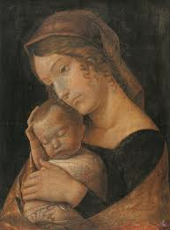

Slide 6
Activity 1b: What can you learn from the two images about how art changed at this time?

Slide 7
Activity 2: What was the Renaissance?
Fill in the gaps with the missing words:
Istanbul scholars Rome rediscovery Leonardo Italy Florence anatomy quickly science
The word Renaissance comes from French, meaning ‘re-birth’. It was the term used to describe a period of ______________ and ‘rebirth’ of culture inspired by that of Ancient ________ and Greece.
The term is used both as the name of a time period, and also a movement of thinkers with new ideas. As a time period, historians date it roughly from 1300-1600. As a movement of ideas, historians suggest it really started in 1453, when Constantinople (____________) was captured by the Ottomans, because after this many _________ fled towards Western Europe with their understanding of Ancient Greek and Latin learning, and ideas that had been lost came back to Europe.
_________ is considered to be the home of the Renaissance, as many of the greatest thinkers of the time such as ________________ da Vinci, Andreas Vesalius, Michelangelo and many others came from centres of learning such as Padua and _______________. Following the Reformation, the Catholic Church had less power and new discoveries in _____________ were made.
Art and literature flourished. Statues like Michelangelo’s David were created at this time. They reflected new understanding of human ____________ (how the body was put together). Perhaps most importantly, the printing press was invented in 1439. This allowed ideas to spread __________ and easily across Europe through printed books.

Slide 8
Activity 2: Answers!
The word Renaissance comes from French, meaning ‘re-birth’. It was the term used to describe a period of rediscovery and ‘rebirth’ of culture inspired by that of Ancient Rome and Greece.
The term is used both as the name of a time period, and also a movement of thinkers with new ideas. As a time period, historians date it roughly from 1300-1600. As a movement of ideas, historians suggest it really started in 1453, when Constantinople (Istanbul) was captured by the Ottomans, because after this many scholars fled towards Western Europe with their understanding of Ancient Greek and Latin learning, and ideas that had been lost came back to Europe.
Italy is considered to be the home of the Renaissance, as many of the greatest thinkers of the time such as Leonardo da Vinci, Andreas Vesalius, Michelangelo and many others came from centres of learning such as Padua and Florence. Following the Reformation, the Catholic Church had less power and new discoveries in science were made.
Art and literature flourished. Statues like Michelangelo’s David were created at this time. They reflected new understanding of human anatomy (how the body was put together). Perhaps most importantly, the printing press was invented in 1439. This allowed ideas to spread quickly and easily across Europe through printed books.

Slide 9
Activity 3: What were some of the major events, people, and features of the Renaissance?
1) Read through some of the developments on the next page categorise them into the following factors: science, travel, art and architecture, politics, religion, literature
Answer the following questions in your book:
2) What was the most significant discovery/person of the Renaissance? Explain two consequences of it/them, to explain why you think it was important.
The most significant ______________ of the Renaissance was… This was because it/they had important consequences. Firstly… For example… Secondly… For example… These were important because…
3) Write a narrative explaining how ideas changed from 1300-1600, using the following structure:
In 1300, people were heavily influenced by the Church, and believed… However, this changed in 1517, when… Further changes occurred throughout… due to the… By 1600, people’s understanding and experiences of the world had significantly changed. They were now less… and more rational and logical.

Slide 10
Activity 3: Example narrative
In 1300, people were heavily influenced by the Church, and believed everything that the Pope and the Catholic Church taught them. However, this changed in 1517, when Martin Luther reformed the Church. This meant that the Church had less power, and people felt encouraged to challenge old ideas. Further changes occurred throughout the Renaissance due to developments in science and understanding of the world. By 1600, people’s understanding and experiences of the world had significantly changed. They were now less religious and more rational and logical.

Slide 11
Final thoughts… How significant would these Big Ideas have been to people? Why?
Discuss and share ideas!
Notes:
Covid-19 Guidance: Ensure students tag in booklets, put plastic covers on their books and wipe them down before leaving!

