Slide 1
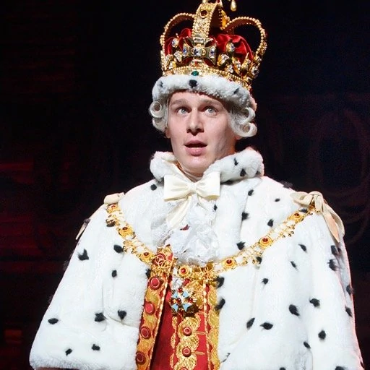
What is King George III singing about in the song ‘You’ll be back’, from the musical Hamilton?
https://www.youtube.com/watch?v=pFx-rCBe6sI

Slide 2
Decolonisation: How and why did the empire dismantle?

Slide 3
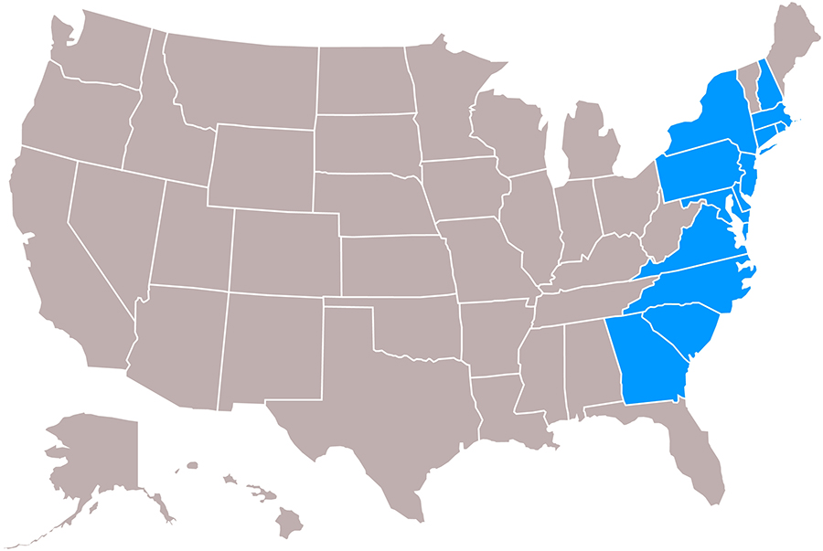
American Independence
The Thirteen Colonies formed the United States of America and won independence from the British Empire in 1783 following the American War of Independence, or American Revolutionary War, 1775-1783.
This was the first breakaway colony, and Britain fought to keep it.

Slide 4
But is this song a useful source to tell us about decolonisation?
When we think about how useful a source is, we need to consider its:
Nature: a funny song from a musical
Origin: released in 2015, written by musician and composer Lin-Manuel Miranda
Purpose: entertainment, popular history (based on truth, but exaggerated for humour)
Then we ask if it’s:
Comprehensive? Not very – it doesn’t tell us a lot of details.
Accurate? Yes – let’s read the original speech that King George III made to parliament, on which the song is based…

Slide 5
But is this song a useful source to tell us about decolonisation?
Complete the activities on the sheet about decolonisation!
Challenge: read the abridged version of the original speech that George gave to parliament in 1775, before fighting to keep the American colonies!

Slide 6
Why did the empire end?
Think of 2 ways that the colonies might have gained independence.
British economic weakness
Nationalist independence movements and wars
Activism by individuals
Changing attitudes in Britain.
2. Look at the sources on your sheet. What can you infer (work out) was the main reason that each country gained independence?
Notes:
Queen’s message: https://www.cbc.ca/archives/entry/queen-elizabeths-1959-dominion-day-message

Slide 7
Optional Homework
Choose a country on the decolonisation timeline and research its journey to independence.

