Slide 1
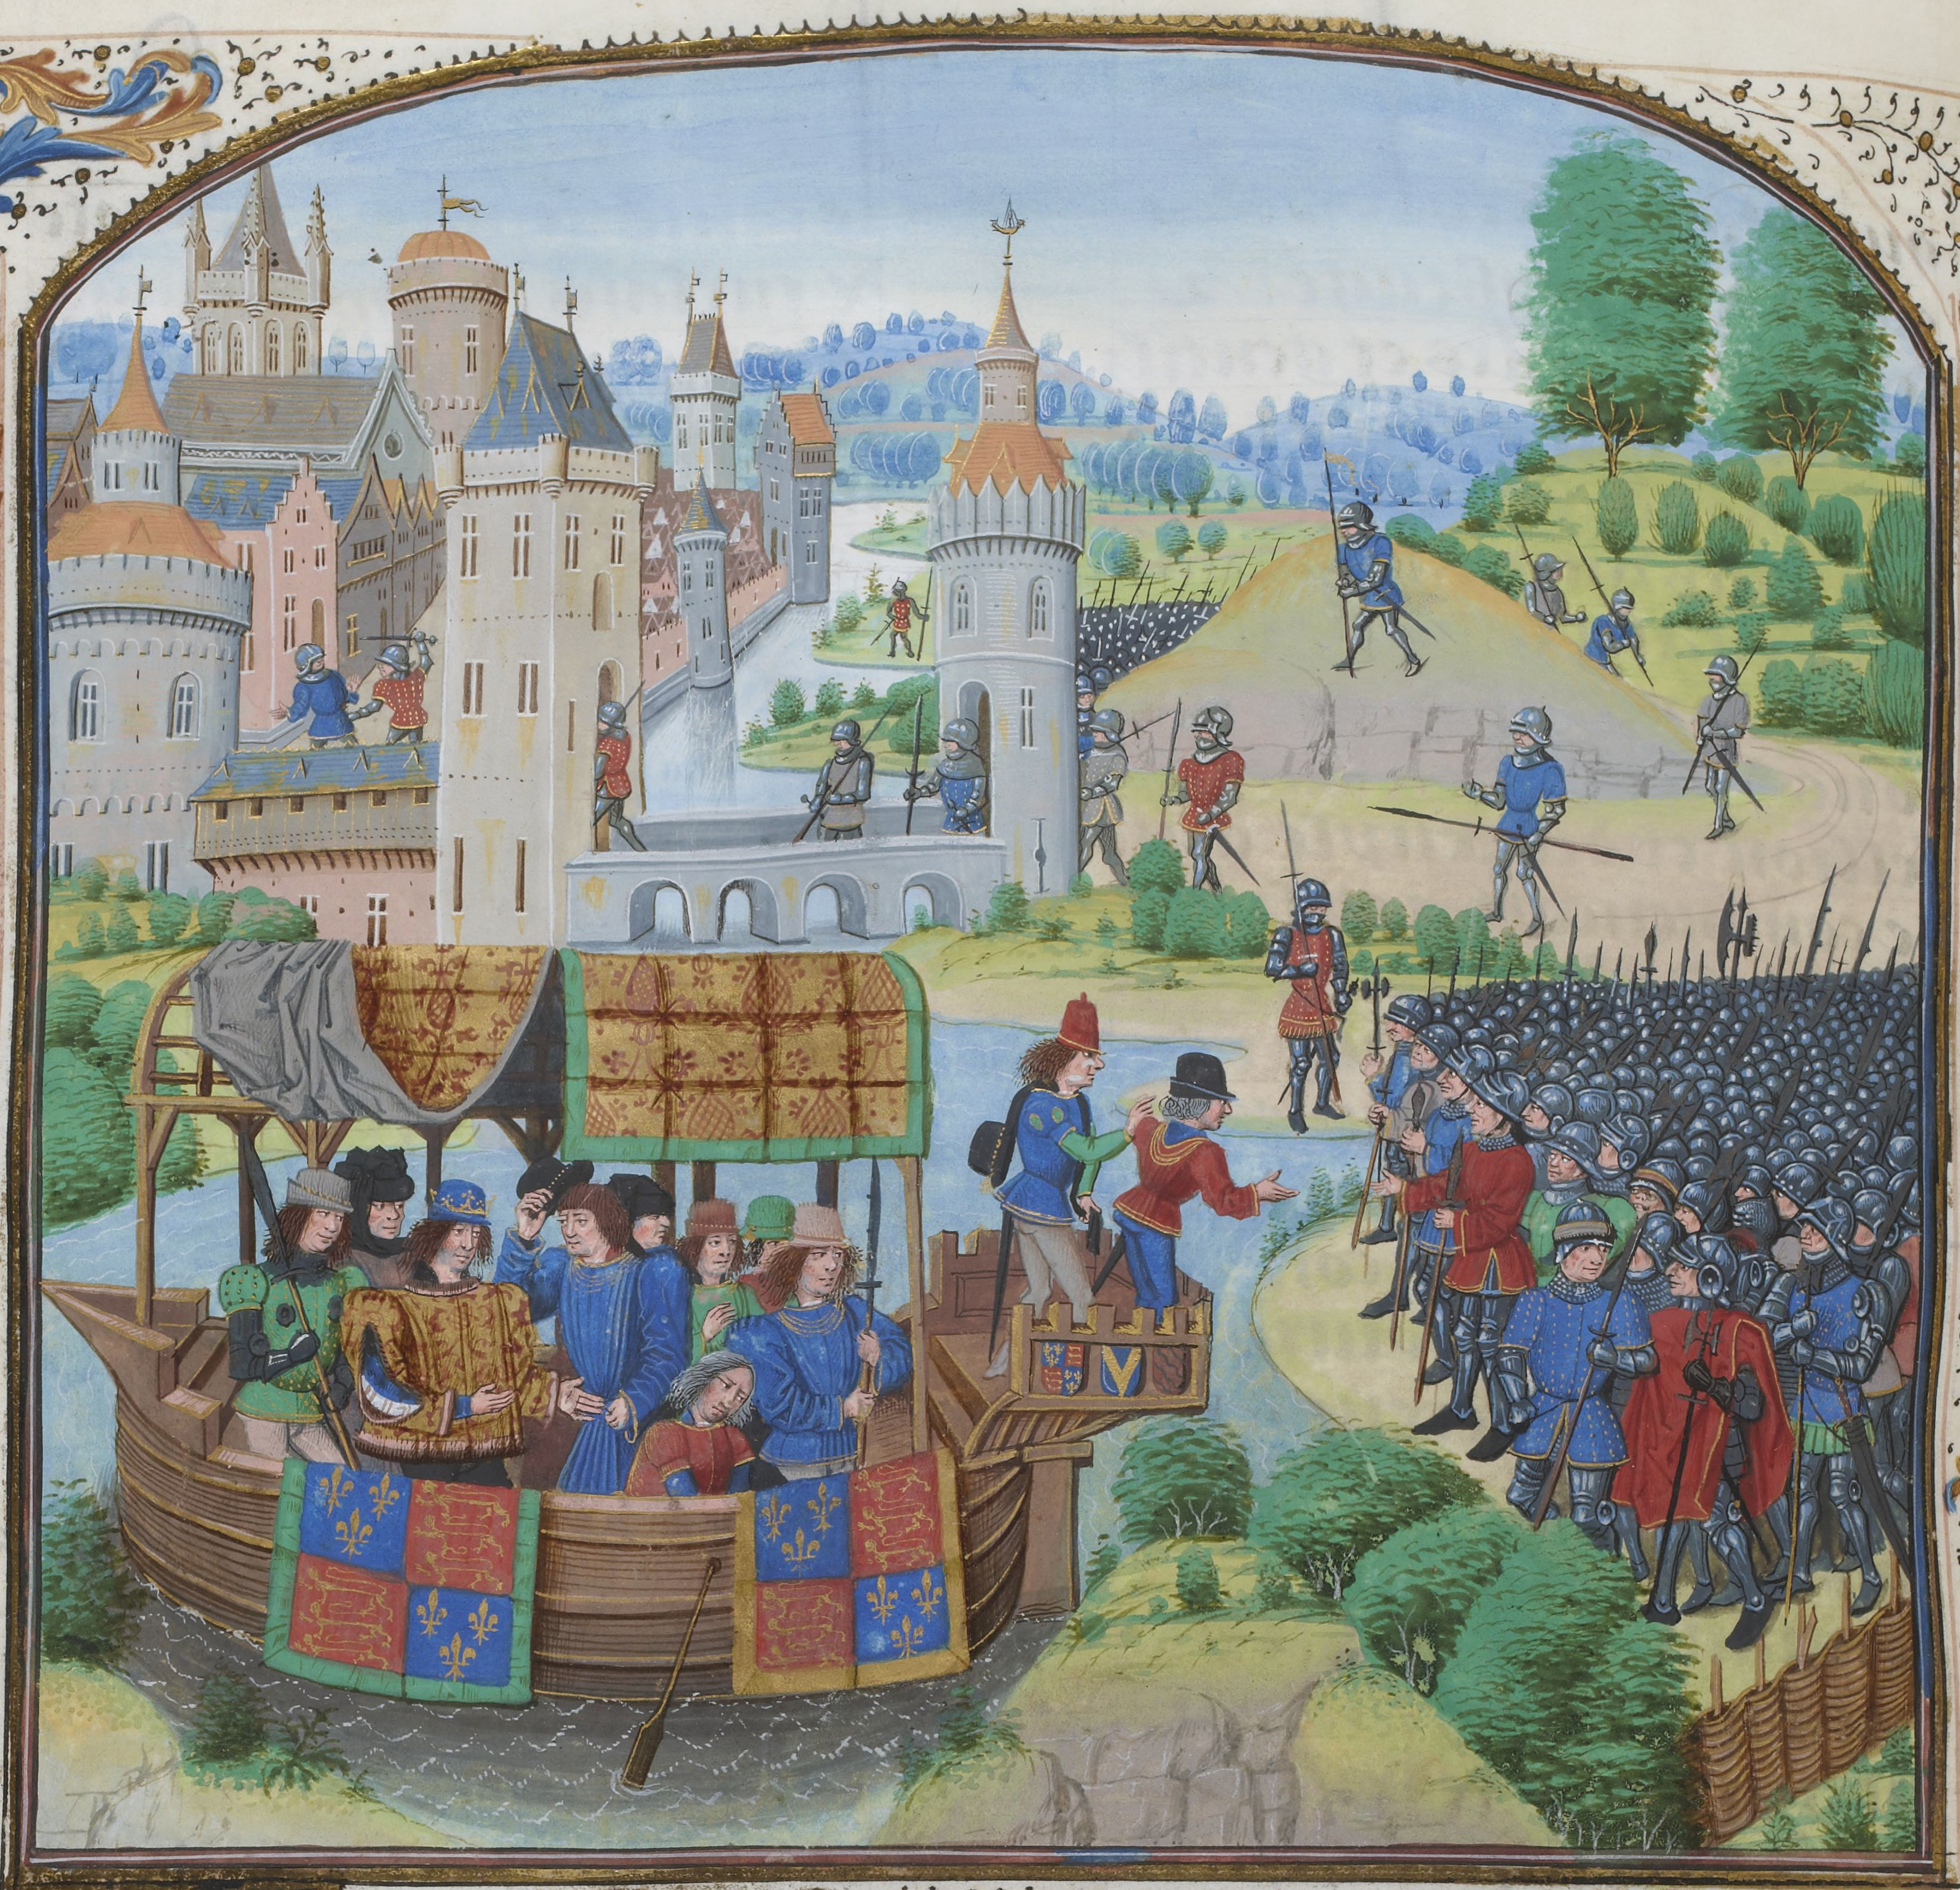
What is going on in this picture?
Who might the people be?
Notes:
5 minutes to discuss.

Slide 2
King Richard II meeting with an angry mob in 1381, trying to come to an agreement about their rights.
But why?

Slide 3
Everyday Life: Was life always terrible in Medieval England?
Lesson 9:
Why did the peasants revolt in 1381?

Slide 4
Activity 1a: Why were the peasants angry?
Reason | What was the problem? | Why were the peasants angry about it? | Challenge: Who else might have been angry and why?
Statute of Labourers, 1351 | After the Black Death, there were more jobs for the peasants that survived to choose from. They could ask for more money, because people needed them to do work. However, a law called the Statute of Labourers was passed in 1351 to stop this. | The peasants were angry because they now had to do more work, but got paid the same, which was unfair. The landowners stayed rich. | N/A
Rising prices | Because so many people, including farmers, died from the Black Death, not enough food was made. This meant that farmers had to sell the food they had at higher prices to make enough money. | This made the peasants angry because food prices were high, but they weren’t being paid more. Many peasants starved. | Everyone who needed to buy food.
The young king | Until 1377, a strong warrior king called Edward III ruled England. In 1377 his grandson Richard II became king at just 10 years old. As he was so young, he asked advisors for help. These barons controlled England by advising Richard to do what suited them. | This made the peasants angry because the barons were already rich and powerful, and now they also had control over the king. | Other people in society who also had to pay the tax. Barons who more honest and not controlling the king.
Poll taxes, 1377 and 1380 | In 1377 the barons introduced the ‘Poll Tax’ to raise money for a war they were fighting against France. Unlike normal taxes this tax was to be paid by poor as well as rich landowners. It was supposed to only happen once but was so successful that it was repeated three times. The peasants had to pay the tax in cash, but were often only paid for their work in food, not money, so they couldn’t pay. | This made the peasants angry because they had to pay the same as the rich, even though they were paid much less. This was unfair. Many didn’t have the money. | Other people in society who also had to pay the tax. Barons who more honest and not controlling the king.
The Church | Many priests who had prayed with the sick also died during the Black Death. Many of the replacement priests were not very good, and some even took the side of the rich barons instead of helping the poor. Some rebellious priests such as John Ball supported the peasants, saying that all people were born equal. John Ball was arrested and put in prison. | This made the peasants angry because the Church was supposed to support the poor, but they were helping the rich and being selfish. | Priests

Slide 5
Activity 2: Watch the video and answer the questions.
Peasants Revolt – Timelines.tv History of Britain B05
https://www.youtube.com/watch?v=3dA-t7694uw

Slide 6
Activity 2: Answers!
Over 100 peasants stormed Cressing Temple, sacked the manor, drank the wine, and torched the building.
Two weeks’ pay
The lord of Cressing Temple and the king’s Royal Treasurer.
They helped John Ball, a rebellious priest, escape from prison.
Why should the poor obey the law when they had no say in making them?
Democracy
Everyone is equal in the face of death.
They joined an army 50,000 strong, marched to London, and camped south of the River Thames and waited for the king to respond.
14.
The barons.
They were furious. They crossed London Bridge, opened prisons, burned legal records, killed Sir Robert Hales, and the Archbishop of Canterbury
8.
London Bridge, the traditional fate of traitors.
He set out to face the rebels at Smithfield.
The leader of the rebels. He demanded a new Magna Carta.
He agreed.
One of the king’s men insulted Wat Tyler and there was a scuffle. Tyler was killed
‘You shall have no other captain but me.’
Broke up and went home.
He broke his promise and had the leaders of the rebellion caught and hanged.
It was the first fight for democracy and freedom.

Slide 7
Final thoughts… How would you have handled the situation if you were the king or queen? What would happen if Richard hadn’t been decisive?
Discuss and share ideas!
Notes:
Covid-19 Guidance: Ensure students tag in booklets, put plastic covers on their books and wipe them down before leaving!

