Slide 1
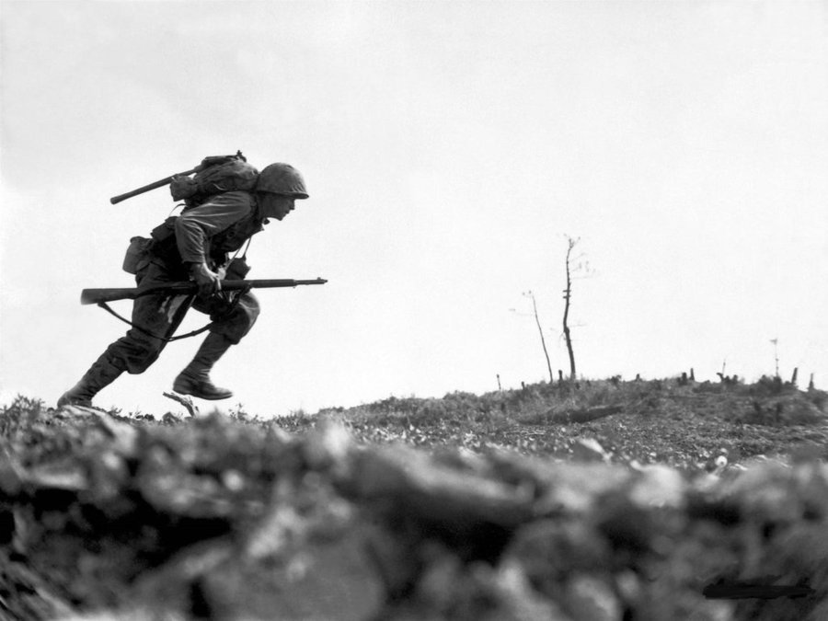
What do you consider to be the ‘traditional narrative’ of World War 2?
Hint: Try to think of any specific battles/ events that you would associated with World War 2?

Slide 2
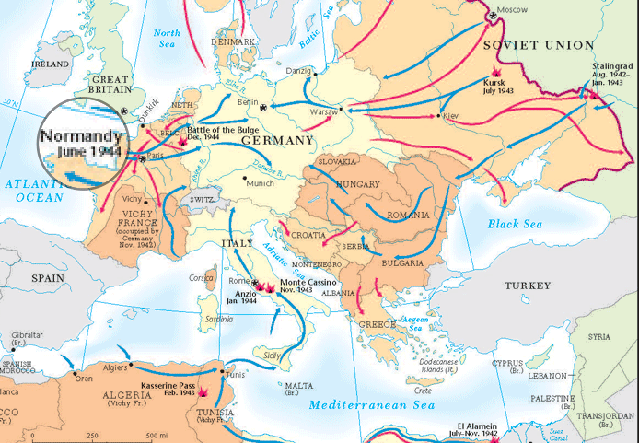
Was it all about Dunkirk, the Blitz, the Battle of Britain and D Day?
Background information
The Western Front in the Second World War 1939-45.
This shows the location of the western Front and particularly Dunkirk and Normandy beaches for D Day.
Look over your maps from lesson 1- can you add Normandy and Dunkirk?

Slide 3
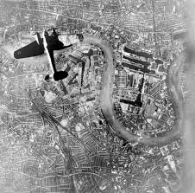
Was it all about Dunkirk, the Blitz, the Battle of Britain and D Day?
As we watch each of the four clips, everyone needs to record 3 pieces of factual information about each of the key events.
As a challenge- try to add a fourth piece of information!
Notes:
https://www.youtube.com/watch?v=MCih6Oow4Mg Dunkirk 4.57
https://www.youtube.com/watch?v=1VwY_UxXkYU Blitz 3.40
https://www.youtube.com/watch?v=6JB3bgzLCA0 Battle of Britain 10.28
https://www.youtube.com/watch?v=4cGuB-OWR0g D Day 3.13
35 to this point

Slide 4
How does this compare to the alternative narrative?
Read through the information sheet in pairs and answer the following questions:
1) What kinds of jobs did women undetake in World War Two? Think about their jobs at home as well as empoloyment.
2) Which significant yet surprising individual was trained to have a role in war? Why might this be surprising?
3) How many children were evacuated and where did they come from? 4)What kinds of experiences did evacuees have?
Challenge: Do you think evacuation was successful?
5) How many soldiers fought for the British Indian Army during World War 2? 6) How has the contribution of the British Indian Army been recognised by the British government?
Challenge: If the contribution of the British Indian Army is not being taught as part of the dominant narrative, has their contribution truly been acknowledged?
Notes:
50 minutes – to make this resources

